Slide 1
Traditional Methods for Determining Requirements
Interviewing individuals
Interviewing groups
Observing workers
Studying business documents

Slide 2
Interviewing and Listening
One of the primary ways analysts gather information about an information systems project.
Interview Guide is a document for developing, planning and conducting an interview.

Slide 3
Guidelines for Effective Interviewing
Plan the interview.
Prepare interviewee: appointment, priming questions.
Prepare agenda, checklist, questions.
Listen carefully and take notes (tape record if permitted).
Review notes within 48 hours.
Be neutral.
Seek diverse views.

Slide 4
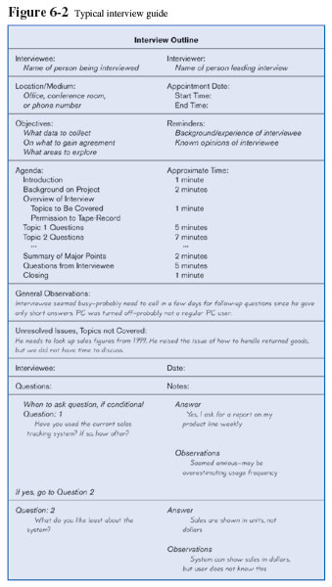
Interviewing and Listening (Cont.)

Slide 5
Choosing Interview Questions
Each question in an interview guide can include both verbal and non-verbal information.
Open-ended questions: questions that have no prespecified answers.
Closed-ended questions: questions that ask those responding to choose from among a set of specified responses.

Slide 6
Interviewing Groups
Drawbacks to individual interviews
Contradictions and inconsistencies between interviewees.
Follow-up discussions are time consuming.
New interviews may reveal new questions that require additional interviews with those interviewed earlier.

Slide 7
Interviewing Groups (Cont.)
Interview several key people together
Advantages
More effective use of time.
Can hear agreements and disagreements at once.
Opportunity for synergies.
Disadvantages
More difficult to schedule than individual interviews.

Slide 8
Nominal Group Technique (NGT)
A facilitated process that supports idea generation by groups.
Process
Members come together as a group, but initially work separately.
Each person writes ideas.
Facilitator reads ideas out loud, and they are written on a blackboard or flipchart.

Slide 9
Nominal Group Technique (NGT)
Group openly discusses the ideas for clarification.
Ideas are prioritized, combined, selected, reduced.
NGT exercise used to complement group meetings or as part of JAD effort.

Slide 10
Directly Observing Users
Direct Observation
Watching users do their jobs
Obtaining more firsthand and objective measures of employee interaction with information systems.
Can cause people to change their normal operating behavior.
Time-consuming and limited time to observe.

Slide 11
Analyzing Procedures and Other Documents
Document Analysis
Review of existing business documents
Can give a historical and “formal” view of system requirements
Types of information to be discovered:
Problems with existing system
Opportunity to meet new need
Organizational direction

Slide 12
Analyzing Procedures and Other Documents (Cont.)
Names of key individuals
Values of organization
Special information processing circumstances
Reasons for current system design
Rules for processing data
7.12

Slide 13
Analyzing Procedures and Other Documents (Cont.)
Useful document: Written work procedure
For an individual or work group.
Describes how a particular job or task is performed.
Includes data and information used and created in the process.
7.13

Slide 14
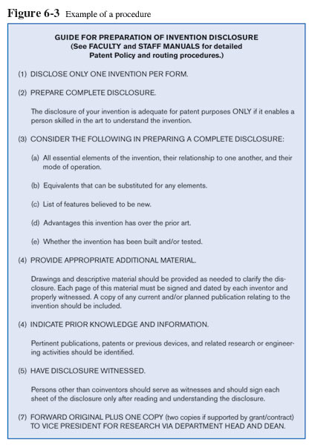
Analyzing Procedures and Other Documents (Cont.)

Slide 15
Analyzing Procedures and Other Documents (Cont.)
Potential Problems with Procedure Documents:
May involve duplication of effort.
May have missing procedures.
May be out of date.
May contradict information obtained through interviews.

Slide 16
Analyzing Procedures and Other Documents (Cont.)
Formal Systems: the official way a system works as described in organizational documentation (i.e. work procedure).
Informal Systems: the way a system actually works (i.e. interviews, observations).

Slide 17
Analyzing Procedures and Other Documents (Cont.)
Useful document: Business form
Used for all types of business functions.
Explicitly indicate what data flow in and out of a system and data necessary for the system to function.
Gives crucial information about the nature of the organization.

Slide 18
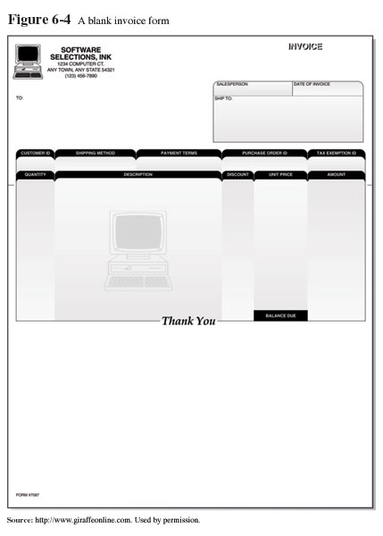
Analyzing Procedures and Other Documents (Cont.)

Slide 19
Analyzing Procedures and Other Documents (Cont.)
Useful document: Report
Primary output of current system.
Enables you to work backwards from the report to the data needed to generate it.
Useful document: Description of current information system

Slide 20
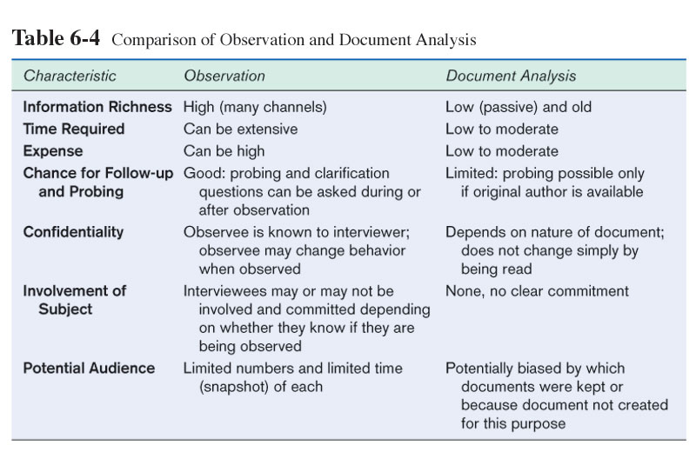
Analyzing Procedures and Other Documents (Cont.)

