Slide 1
Final Analysis of the University of Missouri- St. Louis Calendar System
Mehdie Ataei
Michael Bruns
Douglas Hughey
Atchara Sunthornrangsan
IS 6840
Dr. Vicki Sauter
The Agile Group – Fall 2009

Slide 2
Overview
Definition of the Problem
Current System Description
System Requirements
Exploring Solutions
Options to Consider
Recommended Solution
Question and Answer
Notes:
Introduce team members.
Start with an overview of presentation!

Slide 3
Definition of the Problem
UMSL website design, five years old
Missing new technologies
Web 2.0
Social Networking
Podcast
Blogs
Improperly allocated resources
Incoherent theme
Insufficient emphasis on the UMSL web site

Slide 4
A Narrowed Focus-Campus Calendar
Good example of the range of problems with UMSL’s web presence
A lot of process issues
Old technology
Improved Campus Calendar as a building block
An investment to improve
Student recruitment
Student retention
Alumni and community involvement on campus
Brand awareness
Notes:
Building block to improve the overall UMSL web site.
Brand awareness as the community becomes more involved with campus events.

Slide 5
Current System Description
Launched 7 years ago
Dusted off and refreshed approximately 4 years ago
Written using Adobe ColdFusion
Original programmer no longer with UMSL
Originally ahead of its time
University fielded requests from other schools for source code

Slide 6
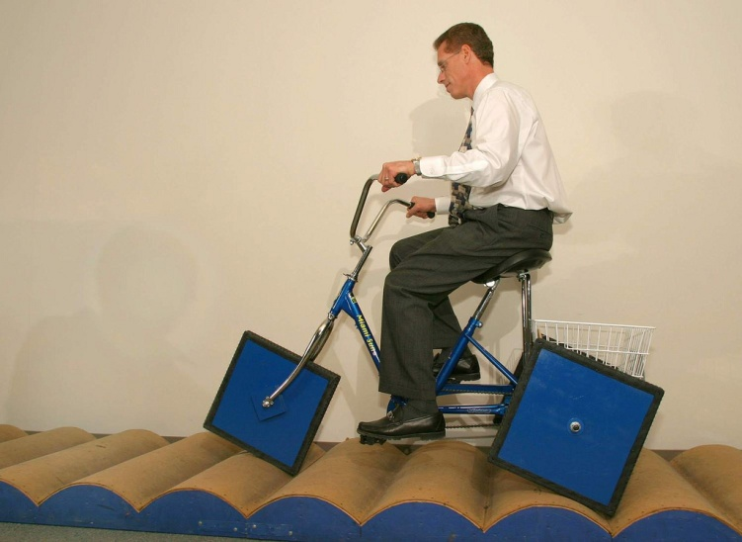
Current System Description – cont.
Problems
7 year old calendar no longer satisfies University’s needs
Departments want their own calendar
Users want a more comprehensive solution
ITS can code new categories for departments but
Too many departments
Unintuitive interface
Notes:
Student Life is an exception- they have their own calendar.
Interface is solely text-based; does not lend itself to more categorization, or features

Slide 7
Current System Description – cont.
Looking for solutions
2008- ITS looked into new calendar solutions
EMS Master Calendar selected
Planned pilot in January 2009
Funding cut

Slide 8
System Requirements
Determined by
Interviews
ITS
Media, Creative Services and Printing Services
Stakeholders:
Dinesh Mirchandani, Gina Ganahl, John Matthews, Bonnie Unal and Vicky Hawkins
Student survey results (Sample size: 131).

Slide 9
System Requirements – cont.
Finalized New System Specifications
Process Improvements
Education
Support
Enforced use
Low-Cost solution
Improved organizational structure and search functionality
Module-based approach to Calendaring
Subscription Services
Integration with Third Party Calendars
Notes:
Module-based approach: ; make the calendar system comprehensive, rather than separate calendars
Subscription services – Email and RSS
3rd party Calendar integration – Outlook and Google

Slide 10
System Requirements – cont.
Finalized New System Specifications – continued
Better integration with UMSL web site
Monthly calendar view
Workflow automation
User Statistics tracking
Not feasible
Privacy concerns
Notes:
Improved Appearance - Calendar view, with drill-down from year/month view to week/day view. Also, unified appearance with the rest of UMSL web site. Also, more attractive appearance
Workflow automation - Basic event editing (day/time, location) after submission without going through approval process

Slide 11
Exploring Solutions
Maintain the current system
Not acceptable to stakeholders

Slide 12
Exploring Solutions – Option 1
“Do Nothing”, but Enforce Usage
Short on functionality
Processes must be improved
Ex. usage could be enforced
Advantages
Cost
Time (could be implement by Spring 2010)
Drawbacks:
Unintuitive interface
No subscription services
Not module-based
Not comprehensive
Total Acquisition cost | Total Recurring Costs (Annual) | Total cost (over 5 years) | Annual Cost per constituent | Cost per Constituent over 5 years
$0.00 | $1,495.00 | $7,475.00 | $0.08 | $0.41
Notes:
Not module-based – No separate dept. calendar

Slide 13
Exploring Solutions – Option 2
Hire a New Employee to code a New Calendar
Advantages
Most customized E-Calendar solution
Control
Disadvantages
Longer timeframe (spring semester of 2011)
Higher cost
Hiring costs, training, benefits
Budget cuts- currently in a hiring freeze
Total Acquisition cost | Total Recurring Costs (Annual) | Total cost (over 5 years) | Annual Cost per constituent | Cost per Constituent over 5 years
$0.00 | $55,000.00 | $275,000.00 | $3.03 | $15.16

Slide 14
Exploring Solutions – Option 3
Outsource the Production of a Calendar to Contractors
Advantages
Outside organization’s expertise
Comparative shorter amount of time
Disadvantages
EXPENSIVE
Total Acquisition cost | Total Recurring Costs – 2nd Year On | Total cost (over 5 years) | Annual Cost per constituent | Cost per Constituent over 5 years
$63,500.00 | $95,000.00 | $443,500.00 | $4.89 | $24.45
Notes:
Expensive- Support costs are outrageous!

Slide 15
Exploring Solutions – Option 4
Application Service Provisioning (Google Apps)
Advantages
Free
Great list of functionality
Gmail
Google Talk
Google Docs
Google Video
Google Sites (Personalized Sites)
Google Calendar
Mitigate the university of hosting all functions
Disadvantages
Calendar does not meet our requirements
Requires the institution move productivity functions to Google

Slide 16
Exploring Solutions – Option 5
Application Service Provisioning (Trumba)
Popular among higher education institutions
Advantages
Tech Support
Early Roll-out
Disadvantages
High price
Service level agreements
Total Acquisition cost | Total Recurring Costs – 2nd Year On | Total cost (over 5 years) | Annual Cost per constituent | Cost per Constituent over 5 years
$6,000.00 | $97,080.80 | $394,323.20 | $4.34 | $21.74

Slide 17
Exploring Solutions – Option 6
Implement an Open Source Solution – Bedework Enterprise
Advantages
Free and meets all key requirements
The lowest cost solution to acquire
Disadvantages
Hosting cost
Setup and integration
No official tech support channels
Support personnel training
Total Acquisition cost | Total Recurring Costs (Annual) | Total cost (over 5 years) | Annual Cost per constituent | Cost per Constituent over 5 years
$10,000.00 | $1,495.00 (est.) | $17,475.00 | $0.19 | $0.96
Notes:
No official tech support channels- open source community tends to be willing to help, but no guarantees
Support personnel training- talk about how someone at umsl would need to learn the coding language (Java).

Slide 18
Exploring Solutions – Option 7
License a Proprietary Calendar Solution – EMS Master Calendar
Selected by ITS in 2008
Advantages
Vendor provides technical support
Upgrades, updates included in licensing fee
Minimal administration costs
Disadvantages
Up-front costs
Total Acquisition cost | Total Recurring Costs (Annual) | Total cost (over 5 years) | Annual Cost per constituent | Cost per Constituent over 5 years
$12,000.00 | $1,100.00 (est.) | $17,500.00 | $0.19 | $0.96

Slide 19
Options to Consider
“Do Nothing”, but Enforce Usage
A solution that could be implemented quickly and inexpensively
Bedework Enterprise
A better solution, especially if up-front acquisition costs are an issue
EMS Master Calendar
The ideal solution in the long run
Notes:
Ems- if the University is concerned with administration costs and support

Slide 20
Recommended Solution
EMS Master Calendar Software Solution
Meets all key requirements
Low-cost
Fully functional
Strong vendor support

Slide 21
Enforced Usage Content Solution
Real problem- lack of engagement within the user and support community
Until the UM – St. Louis leadership makes the calendar a priority, it will continue to languish, regardless of whether or not new features are added.
Notes:
While Master Calendar provides the university with many features that are not available with the current system, the real problem seems to be the lack of engagement within the user community.

Slide 22
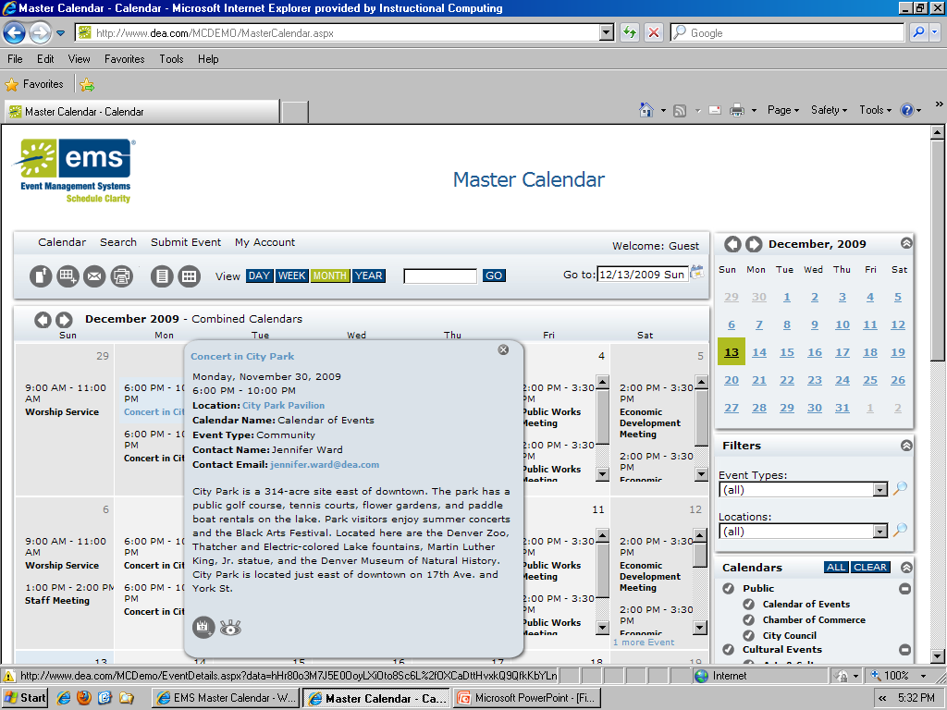
Prototypes
Live Demo!
Notes:
http://calendar.tamu.edu

Slide 23
Question and Answer

