Slide 1
Project Estimation
Describe project scope, alternatives, feasibility.
Divide project into tasks.
Estimate resource requirements and create resource plan.

Slide 2
Project Estimation (Cont.)
Determine standards and procedures.
Identify and assess risk.
Create budget.

Slide 3
Deliverables and Outcomes
Business Case
Justification for an information system.
Presented in terms of the tangible and intangible economic benefits and costs.
The technical and organizational feasibility of the proposed system.

Slide 4
Assessing Project Feasibility
Economic
Technical
Operational
Scheduling
Legal and contractual
Political

Slide 5
Assessing Costs and Benefits
Economic feasibility: a process of identifying the financial benefits and costs associated with a development project.
Often referred to as cost-benefit analysis.
Project is reviewed after each SDLC phase in order to decide whether to continue, redirect, or kill a project.

Slide 6
Determining Project Benefits
Tangible benefits refer to items that can be measured in dollars and with certainty.
Examples include:
reduced personnel expenses,
lower transaction costs, or
higher profit margins.

Slide 7
Determining Project Benefits (Cont.)
Most tangible benefits will fit within the following categories:
Cost reduction and avoidance
Error reduction
Increased flexibility
Increased speed of activity
Improvement of management planning and control
Opening new markets and increasing sales opportunities

Slide 8
Determining Project Benefits (Cont.)
Intangible benefits are benefits derived from the creation of an information system that cannot be easily measured in dollars or with certainty.
May have direct organizational benefits, such as the improvement of employee morale.
May have broader societal implications, such as the reduction of waste creation or resource consumption.

Slide 9
Determining Project Costs
Tangible costs: a cost associated with an information system that can be measured in dollars and with certainty.
IS development tangible costs include:
Hardware costs,
Labor costs, or
Operational costs including employee training and building renovations.

Slide 10
Determining Project Costs (Cont.)
Intangible costs: a cost associated with an information system that cannot be easily measured in terms of dollars or with certainty.
Intangible costs can include:
Loss of customer goodwill,
Employee morale, or
Operational inefficiency.

Slide 11
Determining Project Costs (Cont.)
One-time cost: a cost associated with project start-up and development or system start-up.
These costs encompass activities such as:
Systems development,
New hardware and software purchases,
User training,
Site preparation, and
Data or system conversion.

Slide 12
Determining Project Costs (Cont.)
Recurring cost: a cost resulting from the ongoing evolution and use of a system.
Examples of these costs include:
Application software maintenance,
Incremental data storage expenses,
Incremental communications,
New software and hardware leases, and
Supplies and other expenses (i.e. paper, forms, data center personnel).

Slide 13
Determining Project Costs (Cont.)
Both one-time and recurring costs can consist of items that are fixed or variable in nature.
Fixed costs are billed or incurred at a regular interval and usually at a fixed rate.
Variable costs are items that vary in relation to usage.

Slide 14
Determining Project Costs (Cont.)
Procurement
Consulting, equipment, site preparation, capital, management time
Start-up
Operating systems, communications installation, personnel hiring, organizational disruption
Project-related
Application software, software modification, personnel overhead, training, data analysis, documentation
Operating
System maintenance, rental, asset depreciation, operation and planning

Slide 15
The Time Value of Money
Net Present Value (NPV)
Use discount rate to determine present value of cash outlays and receipts
Return on Investment (ROI)
Ratio of cash receipts to cash outlays
Break-Even Analysis (BEA)
Amount of time required for cumulative cash flow to equal initial and ongoing investment

Slide 16
The Time Value of Money
Net Present Value (NPV)
Use discount rate to determine present value of cash outlays and receipts
Return on Investment (ROI)
Ratio of cash receipts to cash outlays
Break-Even Analysis (BEA)
Amount of time required for cumulative cash flow to equal initial and ongoing investment

Slide 17
The Time Value of Money
Time value of money (TVM): the concept that money available today is worth more than the same amount tomorrow.
Discount rate: the rate of return used to compute the present value of future cash flows (the cost of capital).
Present value: the current value of a future cash flow

Slide 18
The Time Value of Money (Cont.)
Net Present Value
PVn = present value of Y dollars n years from now based on a discount rate of i.
NPV = sum of PVs across years.
Calculates time value of money.

Slide 19
The Time Value of Money (Cont.)
Break-even analysis: a type of cost-benefit analysis to identify at what point (if ever) benefits equal costs.

Slide 20
Assessing Technical Feasibility
Technical feasibility: a process of assessing the development organization’s ability to construct a proposed system.

Slide 21
Assessing Technical Feasibility
The potential consequences of not assessing and managing risks can include the following:
Failure to attain expected benefits from the project,
Inaccurate project cost estimates,
Inaccurate project duration estimates,
Failure to achieve adequate system performance levels, and
Failure to adequately integrate the new system with existing hardware, software, or organizational procedures.

Slide 22
Project Risk Factors
Project size
Team size, organizational departments, project duration, programming effort
Project structure
New vs. renovated system, resulting organizational changes, management commitment, user perceptions
Development group
Familiarity with platform, software, development method, application area, development of similar systems
User group
Familiarity with IS development process, application area, use of similar systems

Slide 23
Assessing Technical Feasibility (Cont.)
Risk can be managed on a project by:
Changing the project plan to avoid risky factors,
Assigning project team members to carefully manage the risky aspects,
Setting up monitoring methods to determine whether or not potential risk is, in fact, materializing.

Slide 24
Assessing Technical Feasibility (Cont.)
The four primary factors associated with the amount of technical risk on a given project are:
Project size,
Project structure,
The development group’s experience with the application and technology area, and
The user group’s experience with systems development projects and the application area (see also Kirsch, 2000).

Slide 25
Assessing Technical Feasibility (Cont.)
Four general rules emerged as technical risk assessments:
Larger projects are riskier than smaller projects.
A system in which the requirements are easily obtained and highly structured will be less risky than one in which requirements are messy, ill structured, ill defined, or subject to the judgment of an individual.

Slide 26
Assessing Technical Feasibility (Cont.)
The development of a system employing commonly used or standard technology will be less risky than one employing novel or nonstandard technology.
A project is less risky when the user group is familiar with the familiar with the systems development process and application area than if unfamiliar.

Slide 27
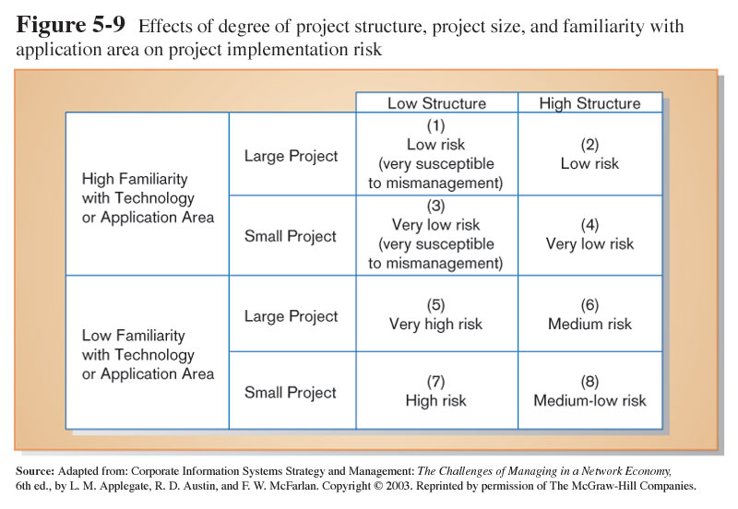
Assessing Technical Feasibility (Cont.)

Slide 28
Assessing Other Feasibility Concerns
Operational
Does the proposed system solve problems or take advantage of opportunities?
Scheduling
Can the project time frame and completion dates meet organizational deadlines?
Legal and Contractual
What are legal and contractual ramifications of the proposed system development project?
Political
How do key stakeholders view the proposed system?

Slide 29
Building the Baseline Project Plan
Baseline Project Plan (BPP) is a document intended primarily to guide the development team.
Sections:
Introduction
System description
Feasibility assessment
Management issues

Slide 30
Building the Baseline Project Plan (Cont.)
Project Scope statement is part of the BPP introduction.
Sections:
Problem statement
Project objectives
Project description
Business benefits
Deliverables
Expected duration

Slide 31
Factors in Determining Scope
Organizational units affected by new system
Current systems that will interact with or change because of new system
People who are affected by new system
Range of potential system capabilities

