Slide 1
Chapter 9 IMPLEMENTATION AND EVALUATION
Decision Support Systems
For Business Intelligence

Slide 2
Table 9.1: Factors Influencing Success
Issues
User
Involvement
Management
Commitment
Value basis
Success Factors
User involvement and interest
Much user involvement and user-level application documentation
Lack of end-user involvement
User and data processing department cooperation
Full-management attention
Top-management support
Good public reaction to DSS
Value of application
“Second system” based on established value of first system
Failure Factors
Lack of user commitment to application
Local user involvement only
Insufficient management interest
Lack of top-management involvement in key area
Lack of support for required project organization
High risk
continued

Slide 3
Table 9.1: Factors Influencing Success Continued
Issues
Mutual understanding
Design quality
Performance level
Project management
Success Factors
Designers’ understanding of user needs
Good design
Flexible design
Strong project and budget control
Frequent creative project meetings
Use of prototypes
Careful planning and testing
Good planning
Failure Factors
More attention to technical than to user issues
Lack of user acceptance of information value
Failure to understand the choice process
Nonspecific functional design specifications
Inflexible design
Poor performance
No performance objectives
Clumsy implementation of key function
Lack of training package
Excessively complex implementation approach
Implementation too rushed
Poor timing in terms of deadlines
continued

Slide 4
Table 9.1: Factors Influencing Success Continued
Issues
Resource adequacy
Situational
stability
Success Factors
Stability of user requirements
Failure Factors
Excessive use of computing resources
Inadequate or poorly used resources
Project leader’s time not fully committed
Lack of resources to make system “friendly”
Insufficient technical skills
Lack of designer’s commitment
Bad input data
Departure of designer during implementation
Collapse of cost justification
Change of rules during implementation
Increasing expenses

Slide 5
Table 9.2: Problems Emanating from Unbalanced Influence Gross Design
IT Dominance
• Too much emphasis on database hygiene.
• No recent new supplier or new distinct services.
• New systems always must fit data structure of existing system.
• All requests for service require system study with benefit identification.
• Standardization dominates -- few exceptions.
• Benefits of user control over development discussed but never implemented.
• IT specializing in technical frontiers, not user-oriented markets.
• IT thinks it is in control of all.
• Users express unhappiness.
• Portfolio of development opportunities firmly under IT control.
• General management not involved, but concerned.
continued

Slide 6
Table 9.2: Problems Emanating from unbalanced Influence gross design Continued
User Dominance
• Too much emphasis on problem focus
• Explosive growth in number of new systems and supporting staff.
• Multiple suppliers delivering services. Frequent change in supplier of specific service.
• Lack of standardization and control over data hygiene and system.
• Hard evidence of benefits nonexistent.
• Soft evidence of benefits not organized.
• Technical advice of IT not sought or, if received, considered irrelevant.
• User building networks to own unique needs (not corporate need)
• While some users are growing rapidly in experience and use, other users feel nothing is relevant because they do not understand.
• No coordinated effort for technology transfer or learning from experience between users.
• Growth and duplication of technical staffs.
• Communications costs are rising dramatically through redundancy.

Slide 7
Table 9.3: Factors Influencing Acceptance of a DSS
Organizational Climate
• Degree of open communication
• Level of technical sophistication of users
• Previous experiences with using DSS and other computer-based systems
• General attitude about computer-based systems and IT
• Other disruptive influences which might parallel the DSS development and implementation
Role of Senior Management
• Attitudes of senior management toward computer-based products and the IT department, both in terms of their actions and their statements
• Adequacy of the resources devoted to the IT function in general, and the DSS development in particular
• Amount of time spent on IT-related issues by senior management
• Expectancies of senior management
• Integration of IT personnel in strategic decision making
Design Process
• Recognition of IT impacts in the organizational planning process
• Participation of IT management in the organizational planning process
• Perceived need for IT in the strategic goals

Slide 8
Figure 9.1: Relationships Among Measures of Effectiveness

Slide 9
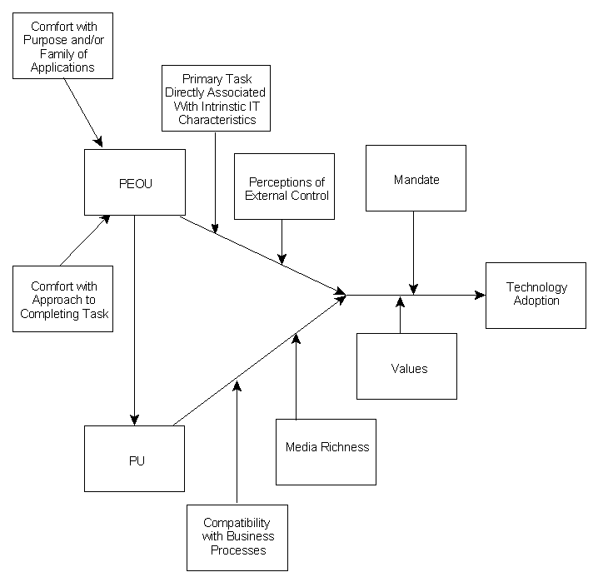
Figure 9.2: Factors Impacting System Acceptance; “Information Technology Adoption by Groups Across Time”

