Slide 1
Chapter 5 USER INTERFACE
Decision Support Systems
For Business Intelligence

Slide 2
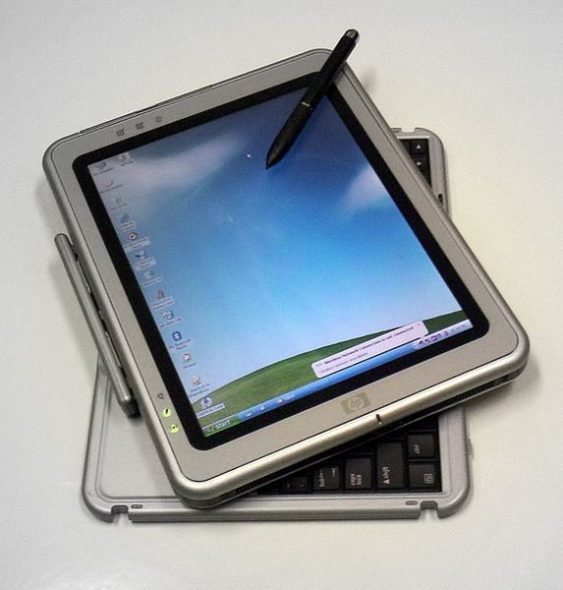
Figure 5.1: Pen-Based System

Slide 3
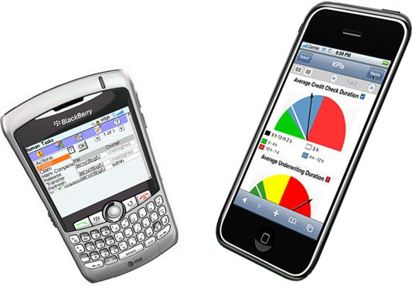
Figure 5.2: Mobile Phones as Input and Output Devices

Slide 4
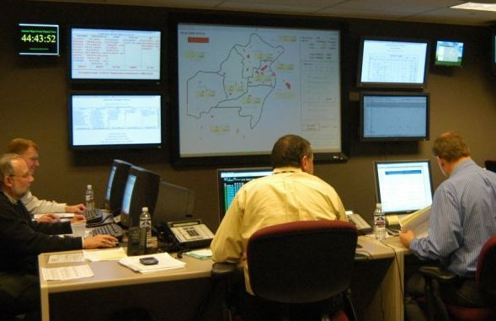
Figure 5.3: Wall Screens as Displays

Slide 5
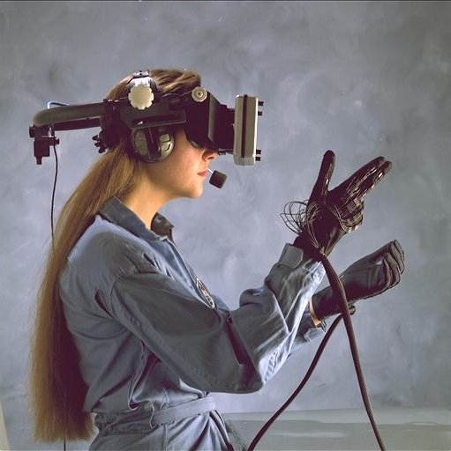
Figure 5.4: Virtual Reality Devices

Slide 6
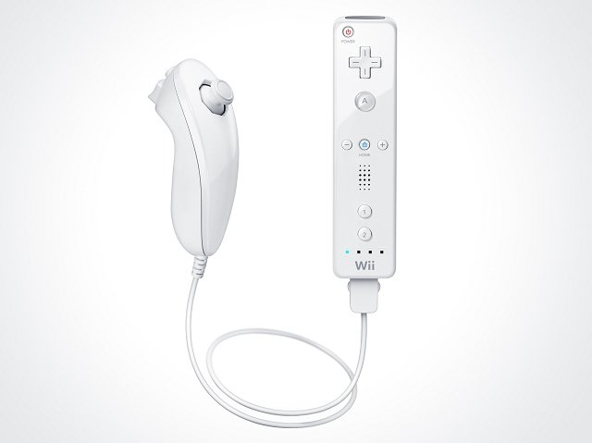
Figure 5.5: A Wii Device

Slide 7
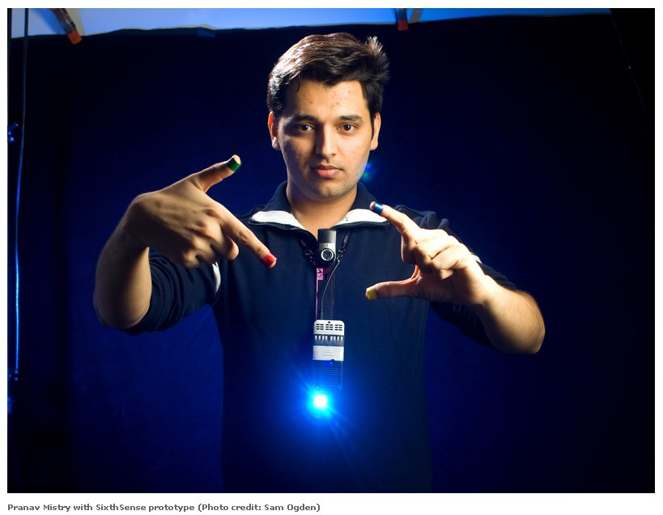
Figure 5.6: MIT Media Lab’s View of User Interface Device

Slide 8
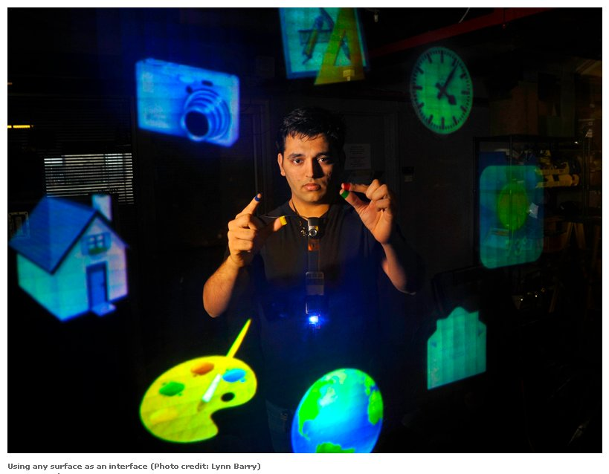
Figure 5.7: MIT Media Lab’s View of User Interface Device

Slide 9
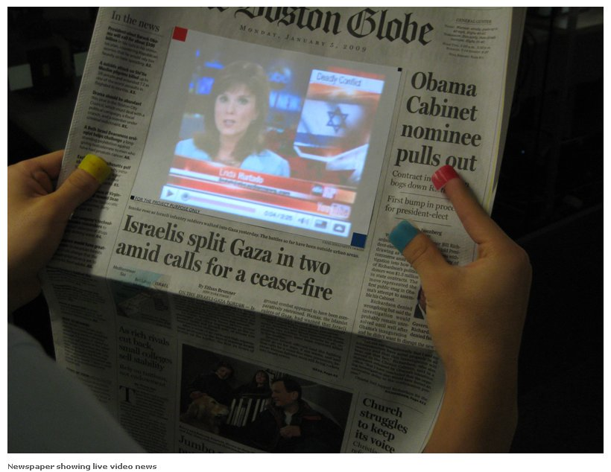
Figure 5.8: MIT Media Lab’s View of User Interface Device

Slide 10
Figure 5.9: MIT Media Lab’s View of User Interface Device

Slide 11
Table 5.1: User Interfaces
User Interface Components
• Action language
• Display or presentation language
• Knowledge base
Modes of Communication
• Mental Model
• Metaphors and Idioms
• Navigation of the model
• Look

Slide 12
Table 5.2: Basic Action Language Types
Menu format
Question-answer format
Command language format
Input/output structured format
Free form natural language format

Slide 13
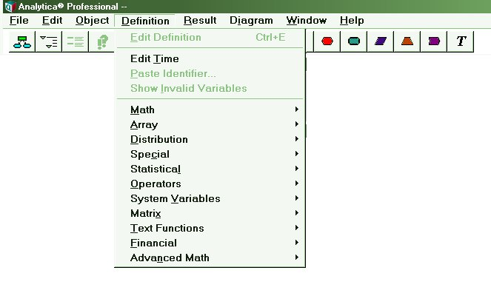
Figure 5.10: One Form of a Menu

Slide 14
Figure 5.11: A “Ribbon Bar” as a Menu

Slide 15
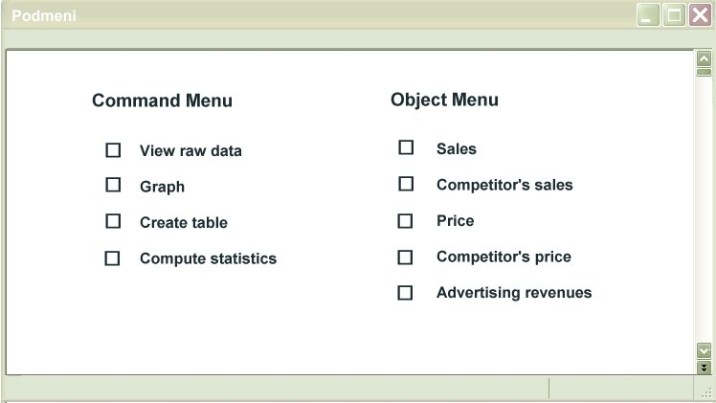
Figure 5.12: Independent Command and Object Menus

Slide 16
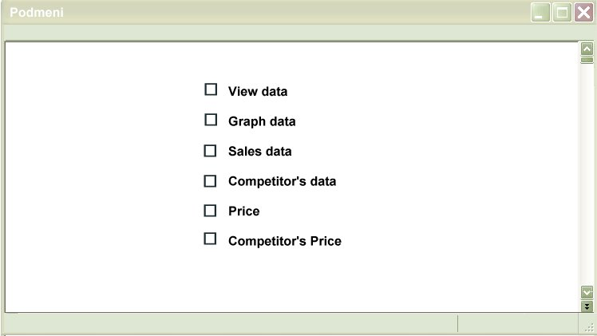
Figure 5.13: Combined Command and Object Menu

Slide 17
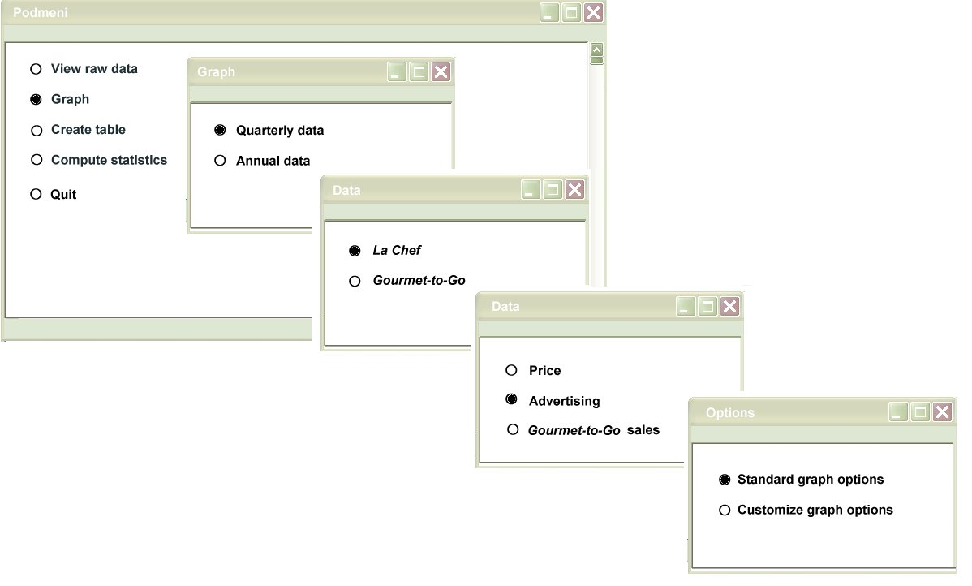
Figure 5.14: Nested Menu Structure

Slide 18
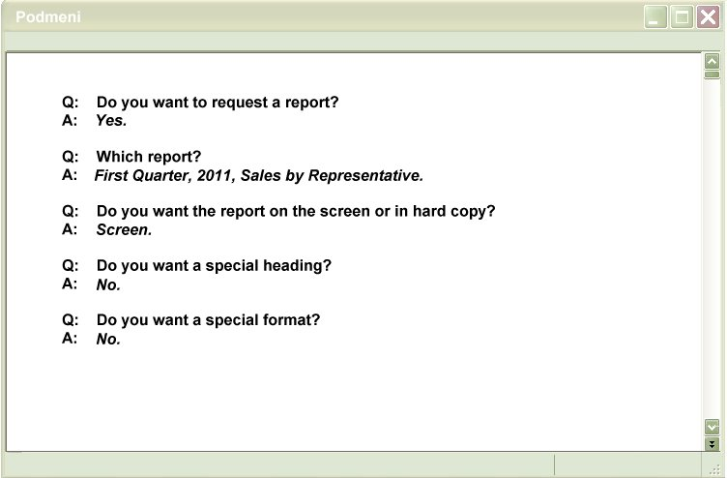
Figure 5.15: Question-Answer Format

Slide 19
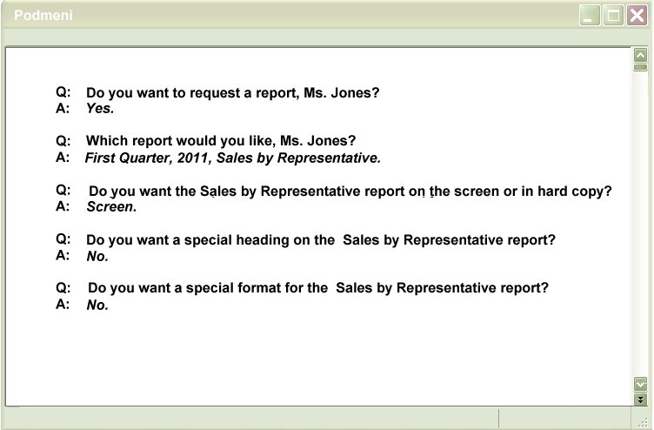
Figure 5.16: Personalized Question-Answer Format

Slide 20
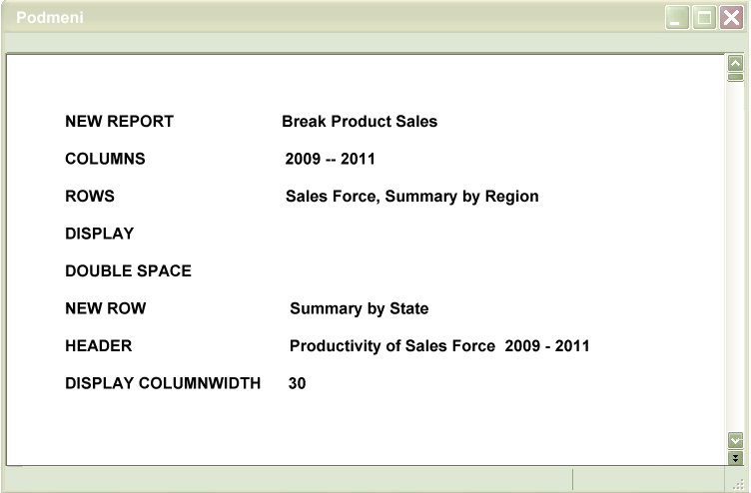
Figure 5.17: Command Language Format

Slide 21
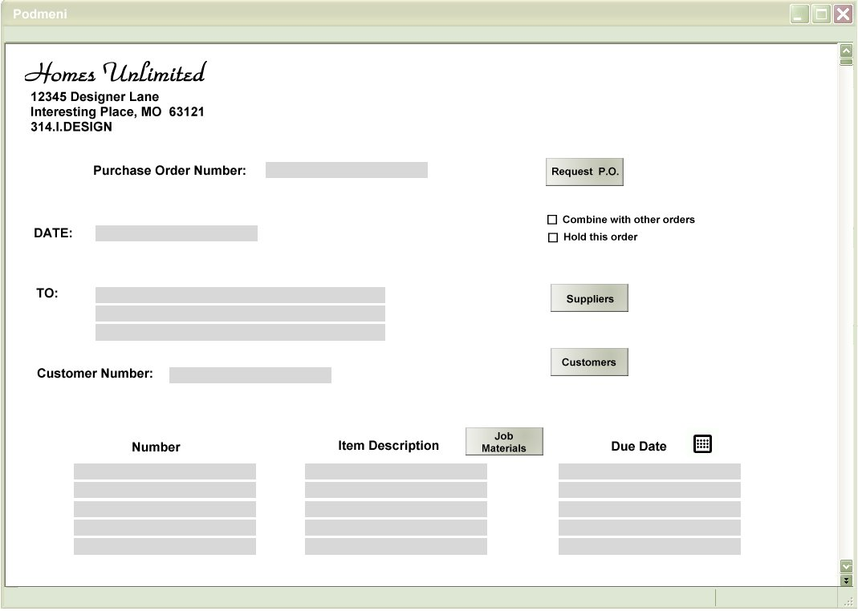
Figure 5.18: I/O Structured Format

Slide 22
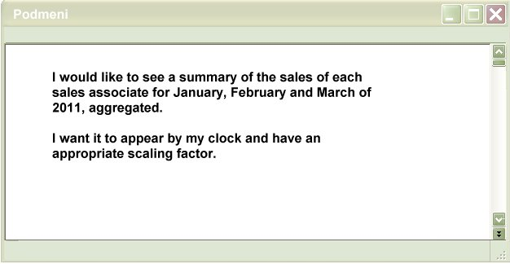
Figure 5.19: Free-Form Natural Language Format

Slide 23
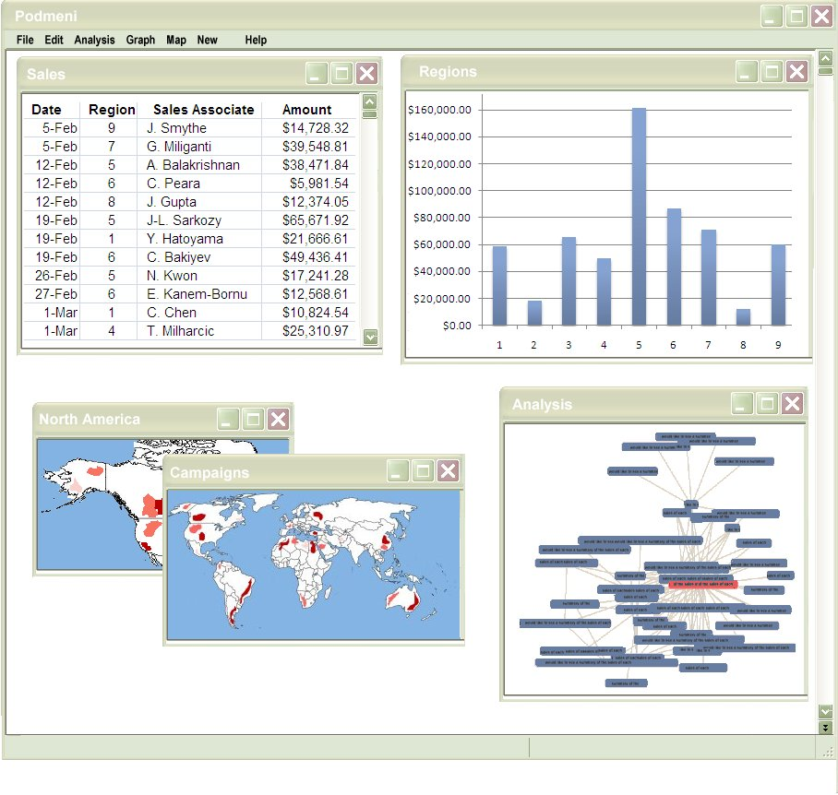
Figure 5.20: Windowed Output

Slide 24
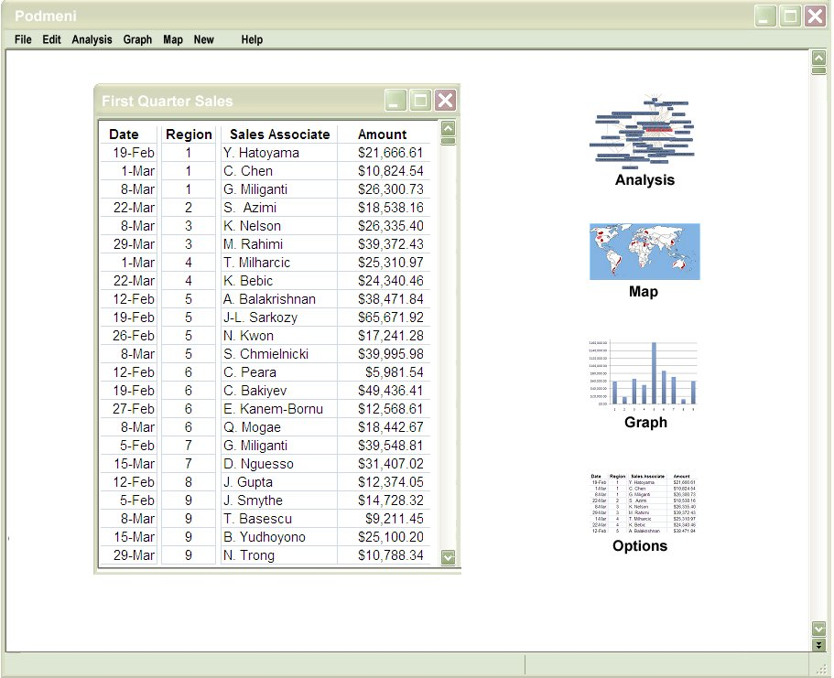
Figure 5.21: Icon Options

Slide 25
Figure 5.22: Metriglyphs

Slide 26
Figure 5.23: Using Traffic Lights as Metriglyphs

Slide 27
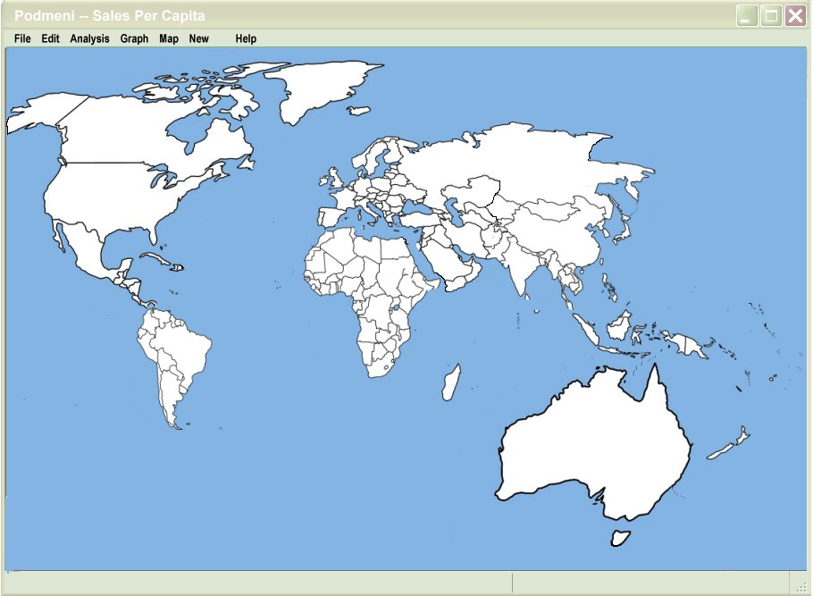
Figure 5.24: Map of Sales Volume Drawn to Scale

Slide 28
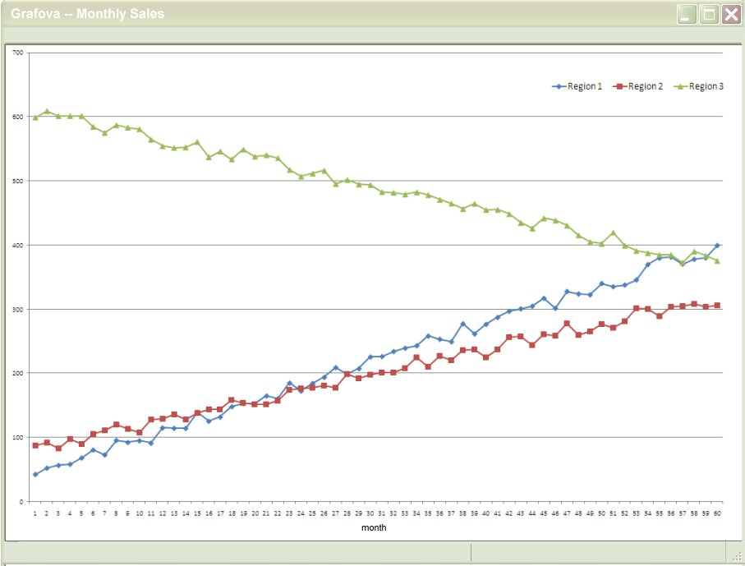
Figure 5.25: Graphical Representation

Slide 29
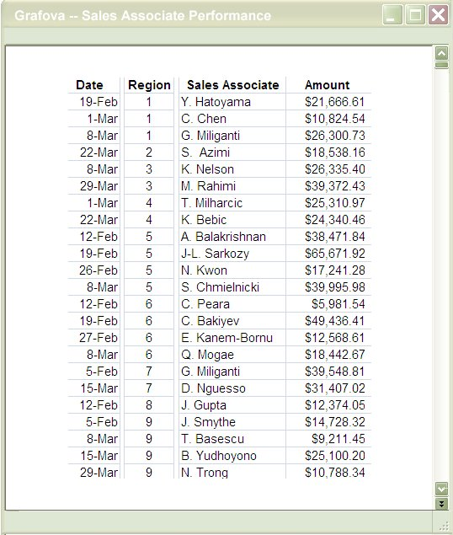
Figure 5.26: Disaggregate Posting of Results

Slide 30
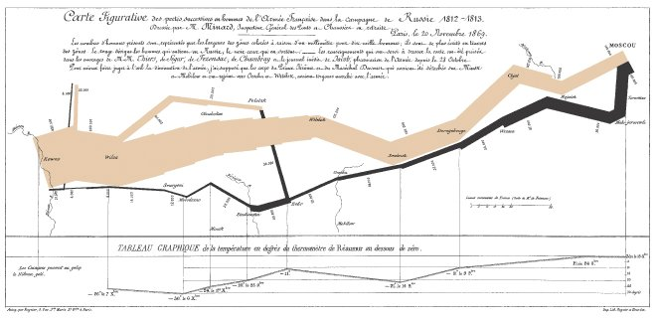
Figure 5.27: Minard’s Map of Napoleon’s 1812 Russian Campaign

Slide 31
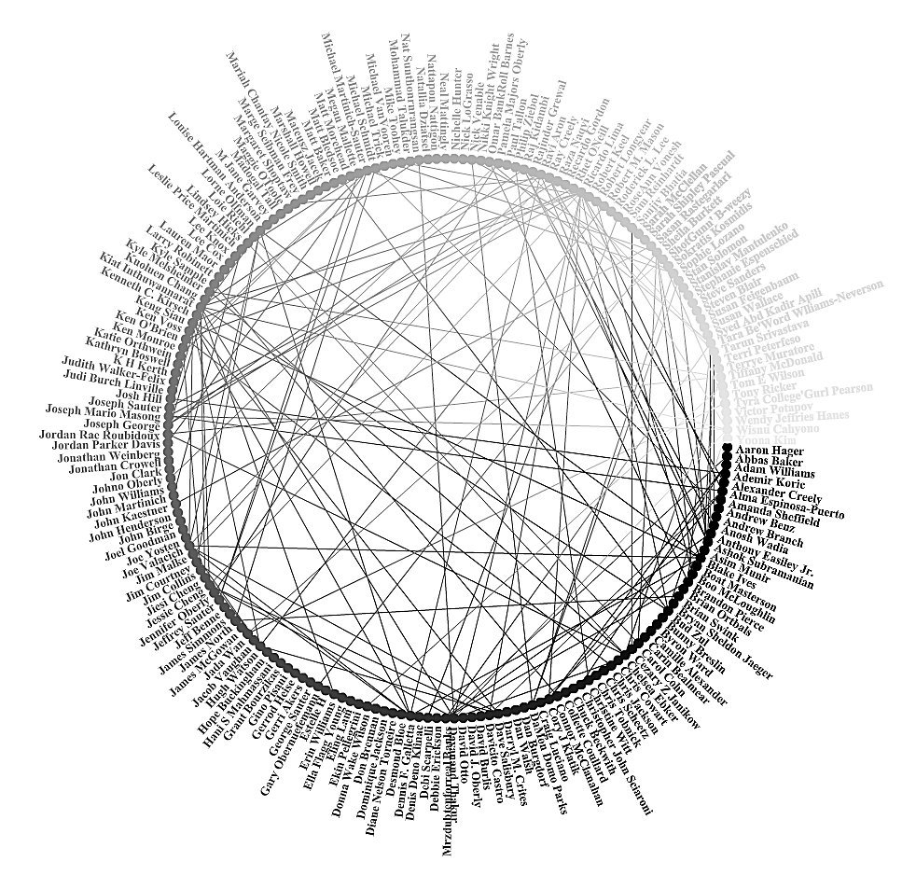
Figure 5.28: Relationship Diagram

Slide 32
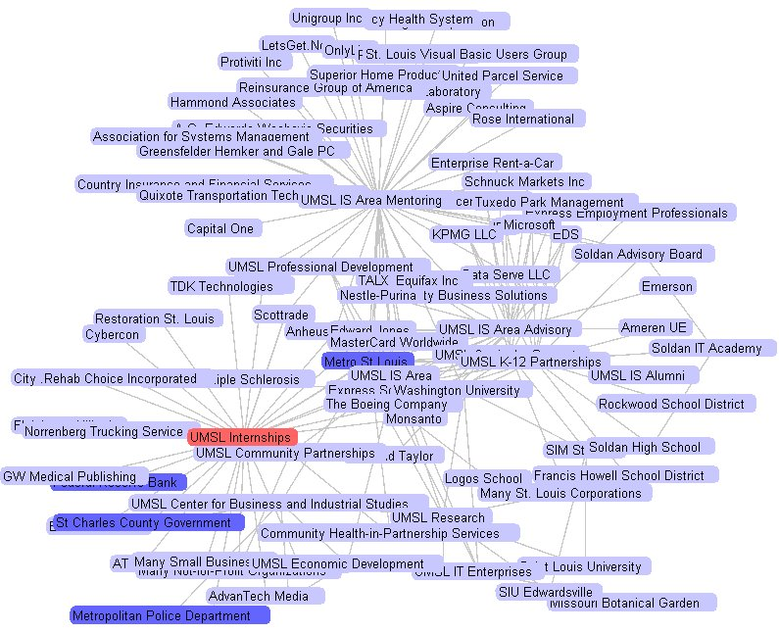
Figure 5.29: Depth of Relationship Diagram

Slide 33
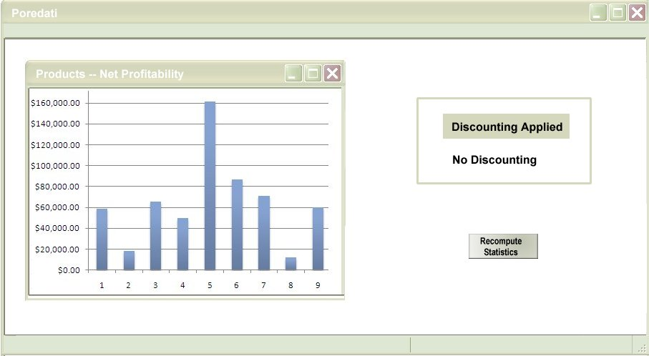
Figure 5.30: On-Screen Analysis Change Prompting

Slide 34
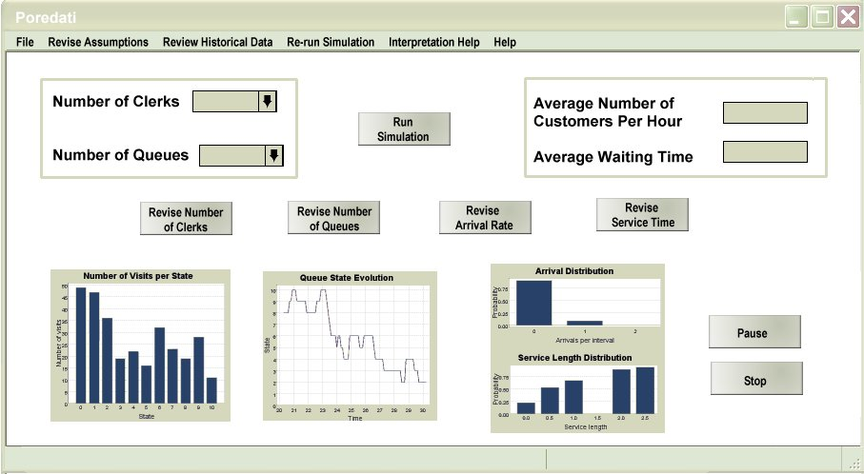
Figure 5.31: Additional On-Screen Prompting

Slide 35
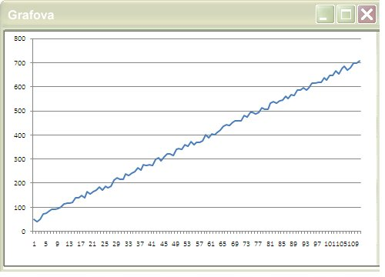
Figure 5.32a: Scaling Deception

Slide 36
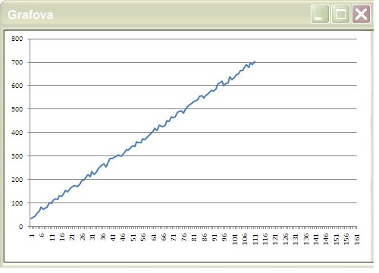
Figure 5.32b: Scaling Deception

Slide 37
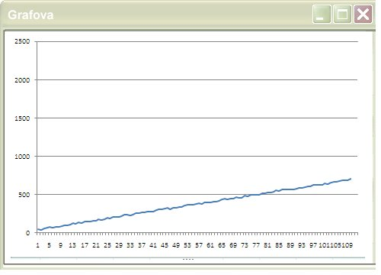
Figure 5.32c: Scaling Deception

Slide 38
Figure 5.33a: Distortion in Histogram

Slide 39
Figure 5.33b: Distortion in Histogram

Slide 40
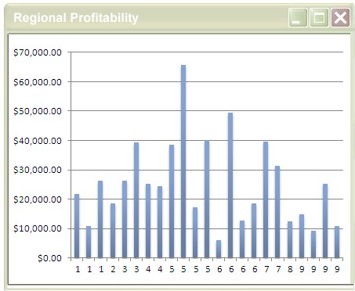
Figure 5.34: Individual Histogram

Slide 41
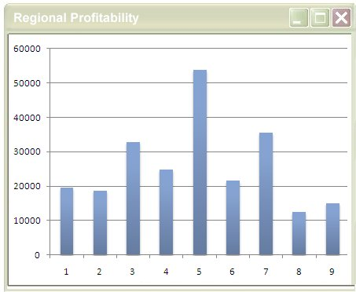
Figure 5.35: Aggregated Histogram

Slide 42
Figure 5.36: Use of International Symbols

Slide 43
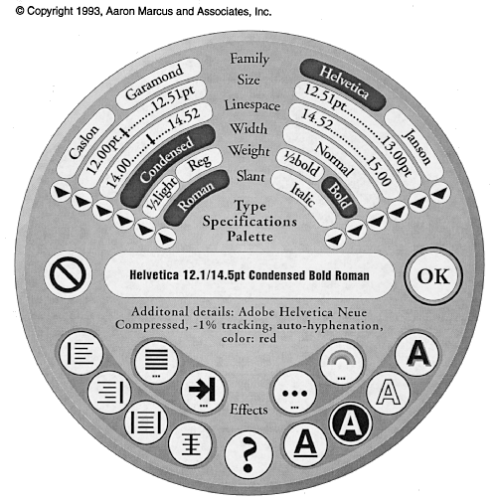
Figure 5.37: An Alternative Menu Format

Slide 44
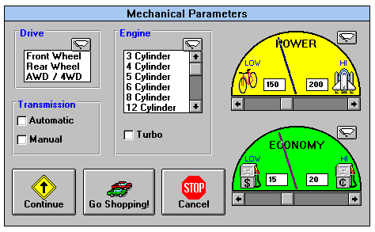
Figure 5.38a: Initial Screens from Commercial Automobile Purchasing System

Slide 45
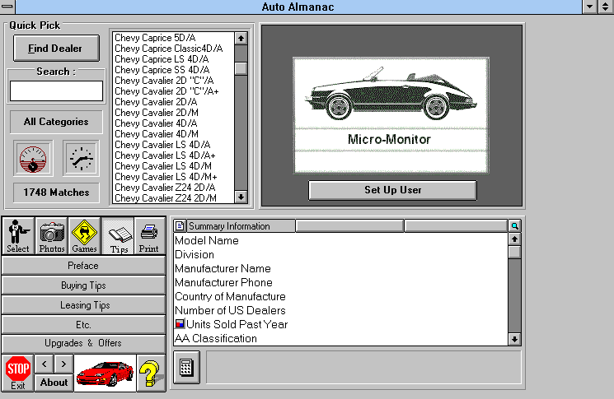
Figure 5.38b: Initial Screens from Commercial Automobile Purchasing System

Slide 46
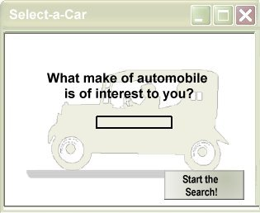
Figure 5.39a: Three Methods by Which Users can Enter Data in the System

Slide 47
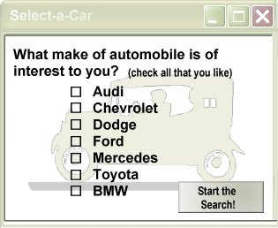
Figure 5.39b: Three Methods by Which Users can Enter Data in the System

Slide 48
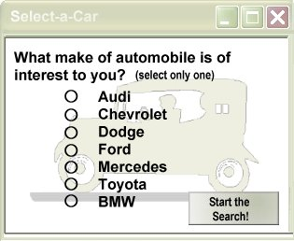
Figure 5.39c: Three Methods by Which Users can Enter Data in the System

Slide 49
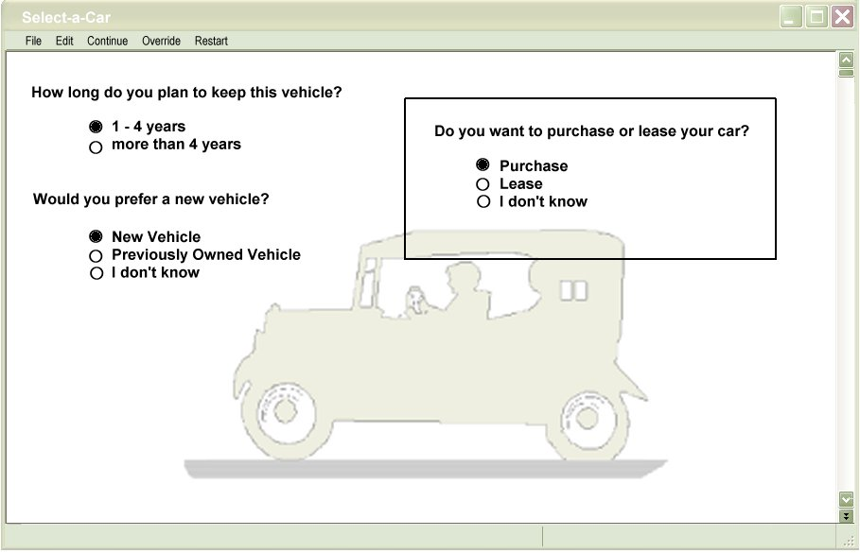
Figure 5.40: Change in Menu After Other Selections

Slide 50
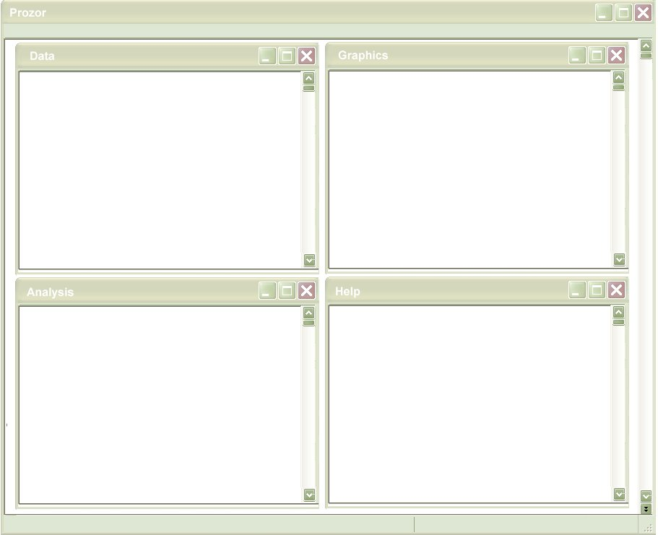
Figure 5.41: Possible Window Definitions

Slide 51
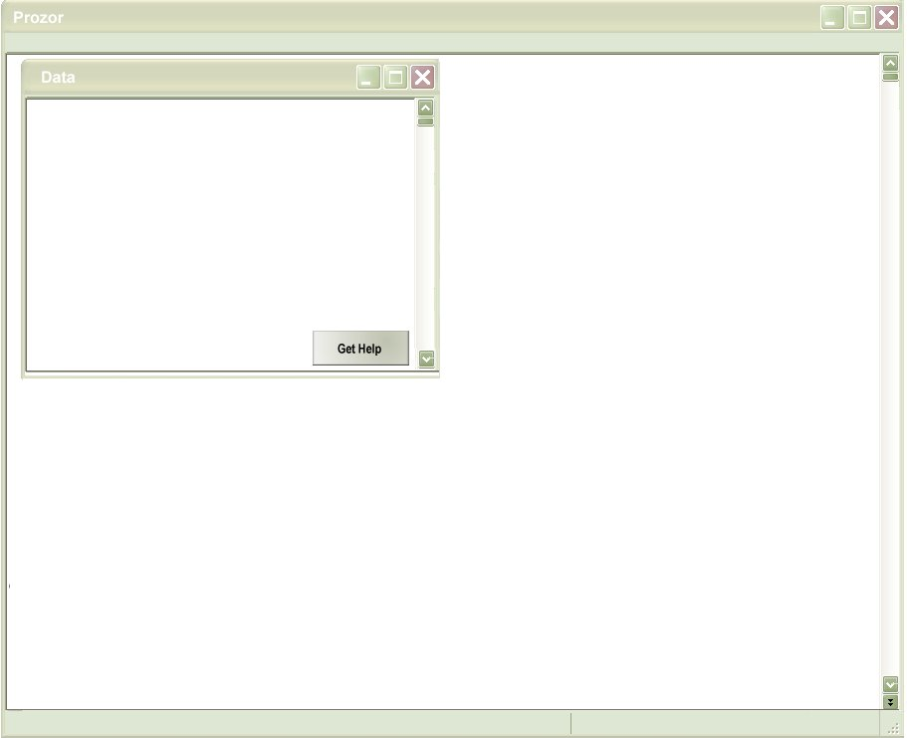
Figure 5.42: Mechanisms for Opening Windows

Slide 52
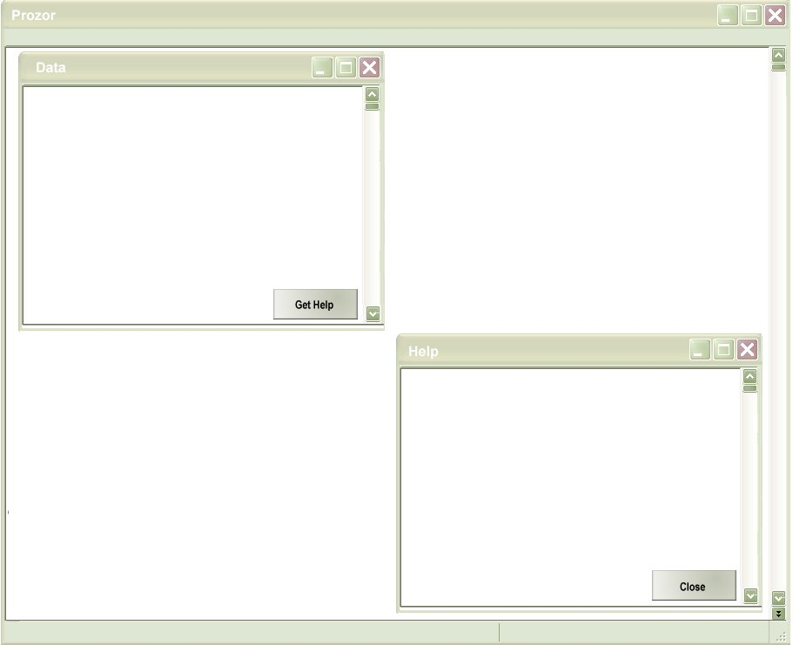
Figure 5.43: Alternative Method for Opening Windows

