Slide 1
Chapter 4S INTELLIGENCE AND DECISION SUPPORT SYSTEMS
Decision Support Systems
For Business Intelligence

Slide 2
Modeling Insights
The acceptance of artificial intelligence has not been universal. Some managers just do not trust the computers to understand all of the interworkings of the choice context. Other managers have concerned about the legal ramifications of a wrong choice.
Still other decision makers just do not believe in the reasoning process of computers. Once example of this disbelief was expressed by Garry Kasparov when he defended his World Chess Champion position against Deep Blue, an IBM computer programmed to play chess. In the first game of the match, the computer made a move that Kasparov judged to be "a wonderful and extremely human move." However, Kasparov had difficulty responding to the move because a computer "would never make such a move." Kasparov judged that although humans regularly see the impact, "a computer can't 'see' the long-term consequences of structural changes in the position or understanding how changes in pawn formations may be good or bad."
In fact, he was so sure that the computer could not reason that he was "stunned" by the move. While he had played chess against many computers before Deep Blue, this move caused him to "feel - I could smell - a new kind of intelligence across the table." Unfortunately for Kasparov, the computer had, in fact, psyched him out with the move and actually won the game.

Slide 3
Modeling Insights Continue
Kasparov, however, showed that the human's intelligence was still superior because the experience forced him to think of the shortcomings of computers throughout the remainder of the match and use that information strategically in his play development. For example, he changed moves in a well known opening sequence in one game. Since the new opening was not stored in the database, Deep Blue could not find an appropriate plan to respond to it. Neither could Deep Blue reason that Kasparov's change from the well-known sequence was meaningless and respond with a known response. In the end, Kasparov won the tournament in 1996 and kept his title.
However, IBM heavily upgraded Deep Blue to improve its logic. Later in 1997, Deep Blue won a six-game match by two wins to one with three draws. Kasparov claimed there was cheating and demanded a rematch, but IBM declined and disassembled Deep Blue.

Slide 4
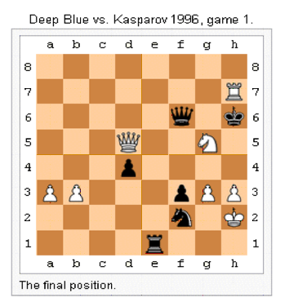
Modeling Insights Continue
Deep Blue was a combination of special purpose hardware and software with an IBM RS/6000 SP2 -- a system capable of examining 200 million moves per second, or 50 billion positions, in the three minutes allocated for a single move in a chess game.

Slide 5
Design Insights
Researchers are investigating prospective logic as a way to program morality into a computer. Using prospective logic, programmers can model a moral dilemma so the computer can determine the logical outcomes of all possible decisions and select the best (or least worst) one. This sets the stage for computers that have "ethics," which could allow fully autonomous machines programmed to make judgments based on a human moral foundation. Currently two researchers have developed a system capable of working through the "trolley problem," an ethical dilemma proposed by British philosopher Philippa Foot in the 1960s. In this dilemma, a runaway trolley is about to hit five people tied to the track, but the subject can hit a switch that will send the trolley onto another track where only one person is tied down. The prospective logic program can consider each possible outcome based on different scenarios and demonstrate logically what the consequences of its decisions might be.

Slide 6
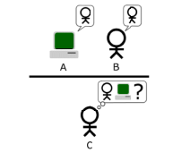
Design Insights
The "standard interpretation" of the Turing Test, in which player C, the interrogator, is tasked with trying to determine which player - A or B - is a computer and which is a human. The interrogator is limited to only using the responses to written questions in order to make the determination.

Slide 7
Design Insights
HAL 9000 is a fictional computer in Arthur C. Clarke's 2001: A Space Odyssey. The computer was a powerful representation of artificial intelligence; HAL was programmed to insure the success of the mission. It was capable of maintaining all systems on the voyage, of reasoning and speech, facial recognition, and natural language processing, as well as lip reading, art appreciation, interpreting emotions, expressing emotions, reasoning, and chess. So, when the astronauts David Bowman and Frank Poole consider disconnecting HAL's cognitive circuits when he appears to be mistaken in reporting the presence of a fault in the spacecraft's communications antenna, HAL gets nervous. Faced with the prospect of disconnection, HAL decides to kill the astronauts in order to protect and continue its programmed directives. Its chilling line "I'm sorry Dave, but this mission is just too important for me to allow you to jeopardize it" made many nervous about the future of artificial intelligence.
We are not at that point of the development of artificial intelligence yet. However, many scientists believe that future advances could lead to problems. For example, medical systems can already interact with patients to simulate empathy. Computer worms and viruses have learned to vary their structure over time to avoid extermination. The concern is an "intelligence explosion" in which smart machines would design even more intelligent machines that humans can neither understand nor control. This is especially a concern if the tools reach the hands of criminals. At a conference by the Association for Advancement of Artificial Intelligence, scientists discussed the issues, the trends and how they could be controlled. There is as yet not agreement among the researchers, and therefore no guidelines. But, it does give one pause for thought.

