Slide 1
Chapter 4S INTELLIGENCE AND DECISION SUPPORT SYSTEMS
Decision Support Systems
For Business Intelligence

Slide 2
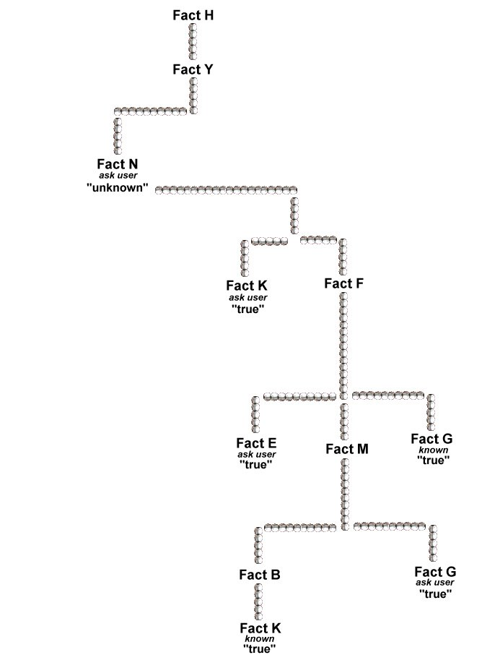
Figure 4S.1: Hierarchy of Logic—Backward Chaining

Slide 3
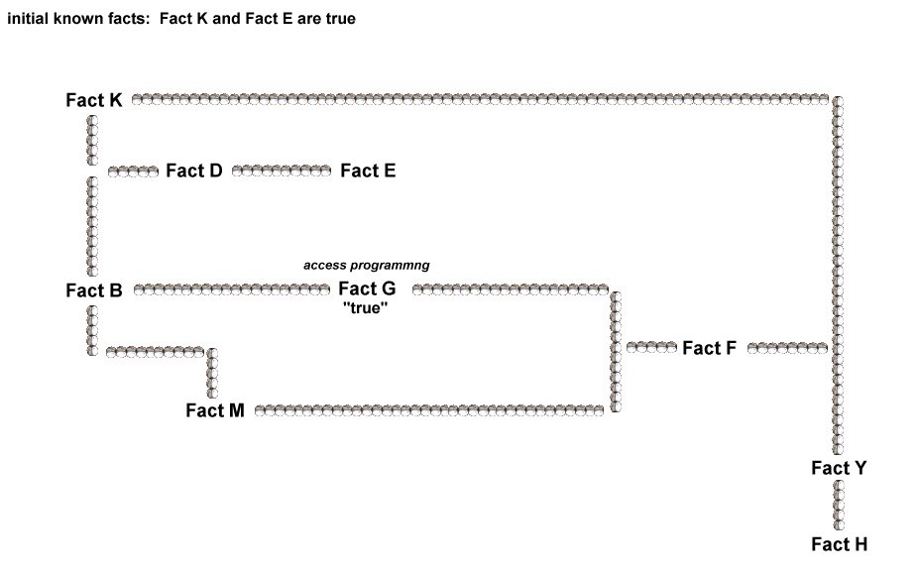
Figure 4S.2: Hierarchy of Logic—Forward Chaining

