Slide 1
Chapter 3 DATA COMPONENT
Decision Support Systems
For Business Intelligence

Slide 2
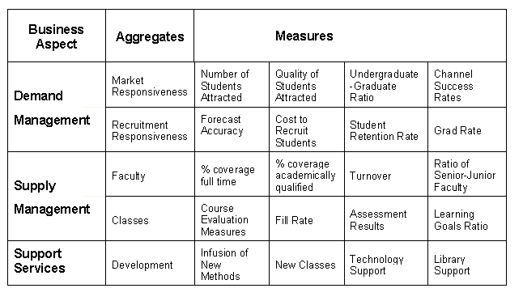
Figure 3.1: Values Matrix

Slide 3
Table 3.1: Characteristics of Useful Information
• Timeliness
• Sufficiency
• Level of Detail and Aggregation
• Redundancy
• Understandability
• Freedom from Bias
• Reliability
• Decision Relevance
• Cost Efficiency
• Comparability
• Quantifiability
• Appropriateness of Format

Slide 4
Figure 3.2: Timeliness of Data

Slide 5
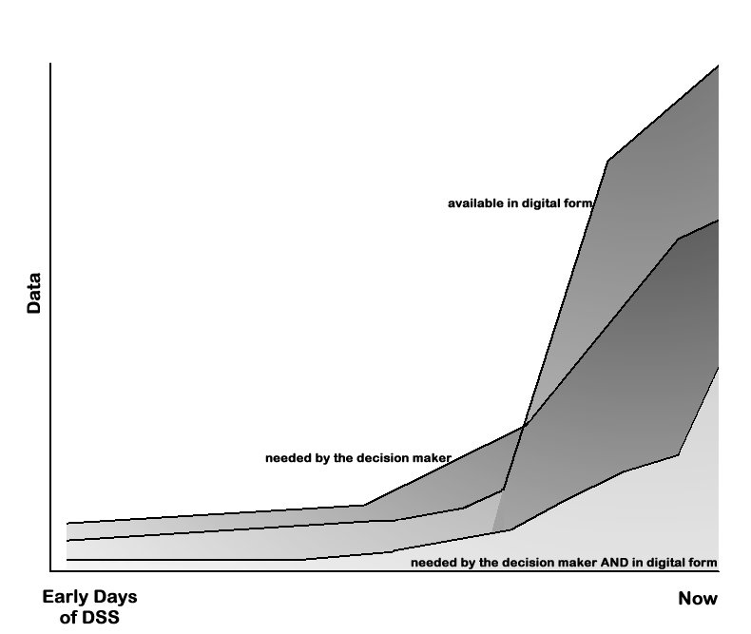
Figure 3.3: Evolution of Users’ Needs and DSS Capabilities

Slide 6
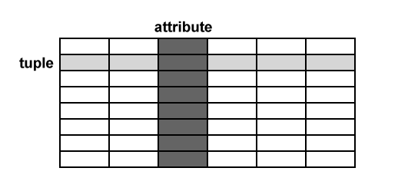
Figure 3.4: Database Relation

Slide 7
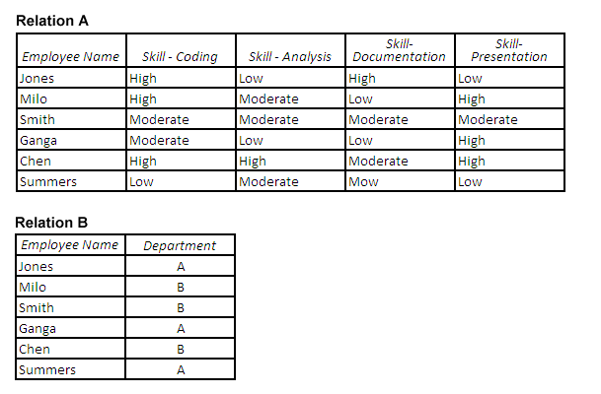
Figure 3.5: Relational Structure of a Database

Slide 8
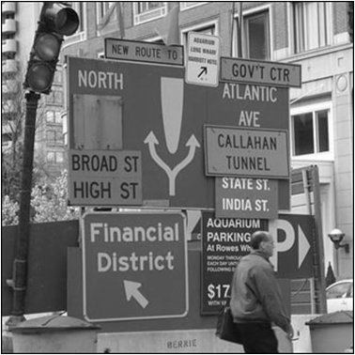
Figure 3.6: Boston

Slide 9
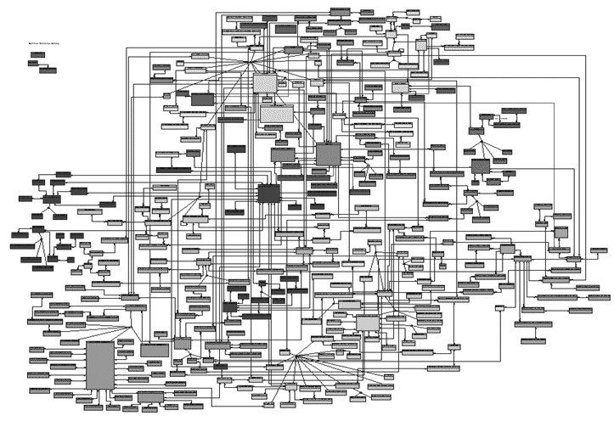
Figure 3.7: Enterprise Data Model

Slide 10
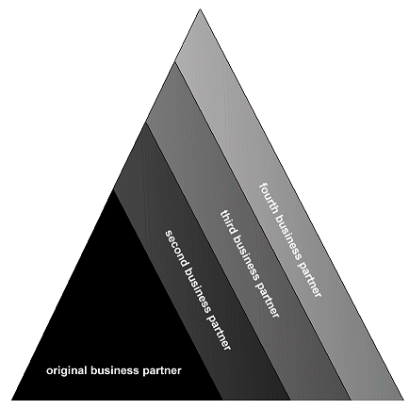
Figure 3.8: Building a Data Warehouse in Stages

Slide 11
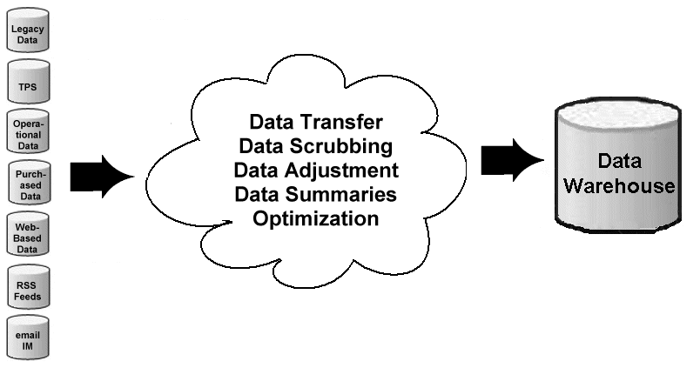
Figure 3.9: Process of Building a Data Warehouse

Slide 12
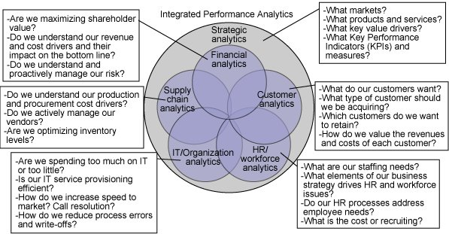
Figure 3.10: Data Warehouse Tasks

Slide 13
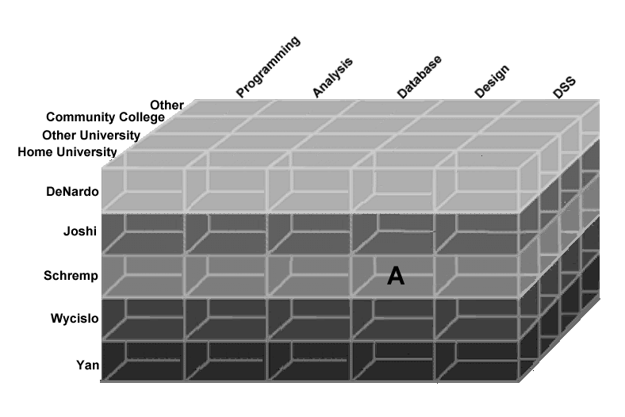
Figure 3.11: Data Cube

Slide 14
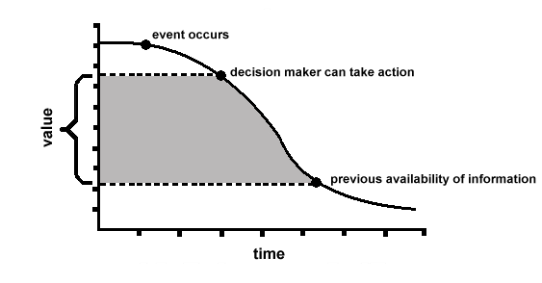
Figure 3.12: Value of Shorter Updates

Slide 15
Figure 3.13: Historic Background Information: New Automobiles

Slide 16
Figure 3.14: Historic Background Information: New Automobiles

Slide 17
Figure 3.15: Historic Background Information: Targeted Category of Automobile

Slide 18
Table 3.2: Automobile Attributes in Kiplinger’s Buyer’s Guide to New Cars
• Manufacturer
• Model
• Body Style
• Suggested Retail Price
• Dealer Cost
• Resale Value in 2 and 4 years
• Insurance Cost Index
• Engine Size
• Number of Cylinders
• Miles Per Gallon in the City and on the Highway
• Curb Weight
• Wheelbase
• Length and Width
• Turning Circle (feet)
• Legroom in the front and rear
• Headroom in the front and rear
• Cargo space
• Antilock brakes status/cost
• Automatic Transmission status/cost
• Air Conditioner cost

Slide 19
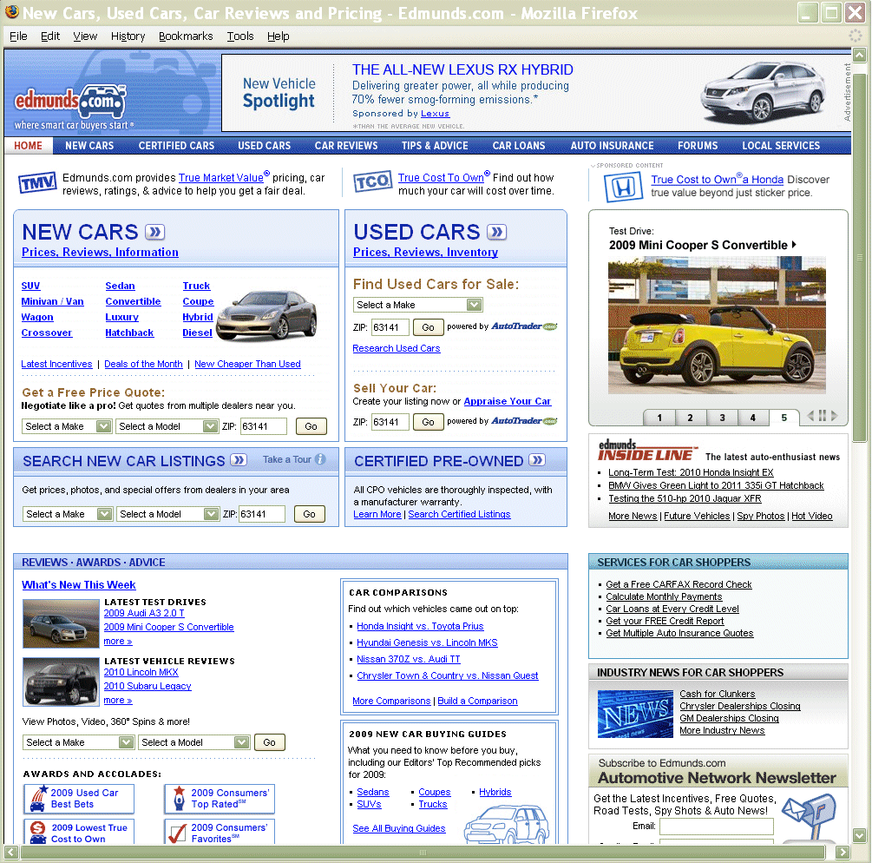
Figure 3.16: Edmund’s Web-Based Information Service

Slide 20
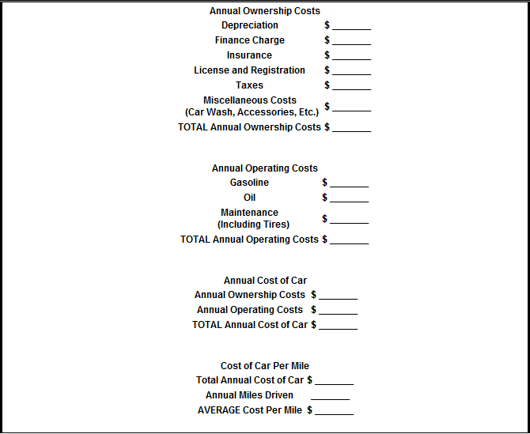
Figure 3.17: Annual Automobile Cost Worksheet

Slide 21
Table 3.3: Operators Possible in a “WHERE” Clause
= Equal to
< > or != Not Equal to
> Greater than
>= Greater than or Equal to
< Less than
<= Less than or Equal to
BETWEEN Between two values
IN An exact value, but you don’t know in which column

Slide 22
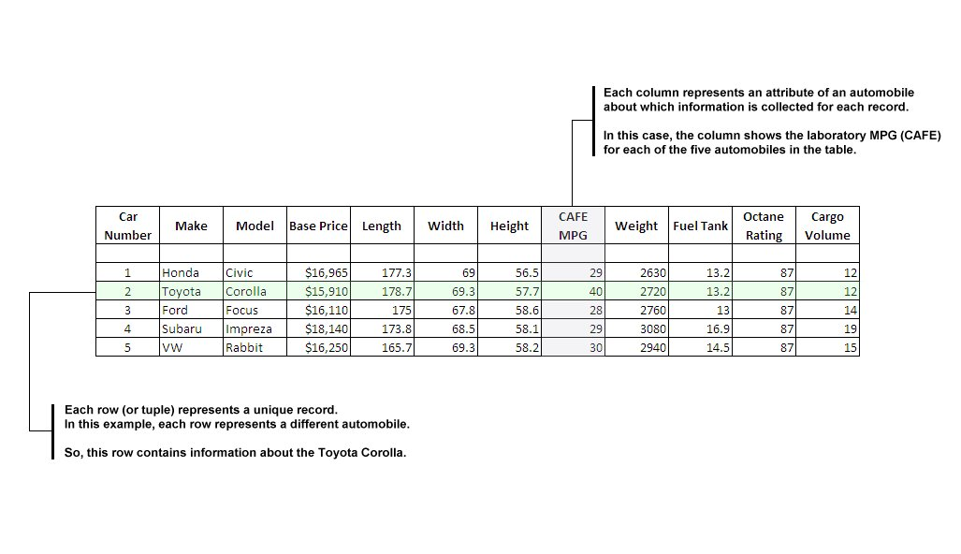
Figure 3.18: Example Relation (Table) for New Cars

Slide 23
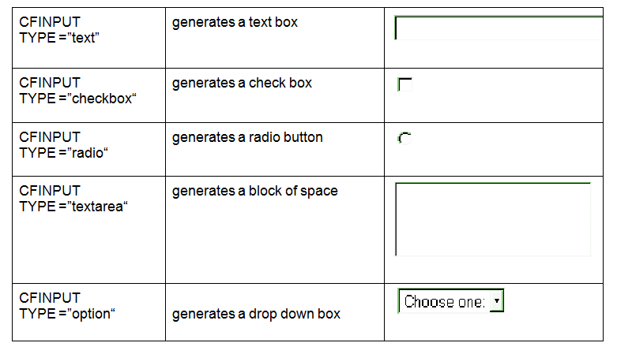
Table 3.4: Available HTML Input Option with a Form

Slide 24
Table 3.5: SQL Summary Operations
AVG() Calculates the average value of that attribute
COUNT() Identifies the number of records for which there
is data on that attribute
FIRST() Identifies the first record
LAST() Identifies the last record
MAX() Identifies the largest value of the specific attribute
MIN() Identifies the smallest value of the specific attribute
SUM() Computes the sum of all values of the specific attribute

