Slide 1
Chapter 1 Introduction
Decision Support Systems
For Business Intelligence

Slide 2
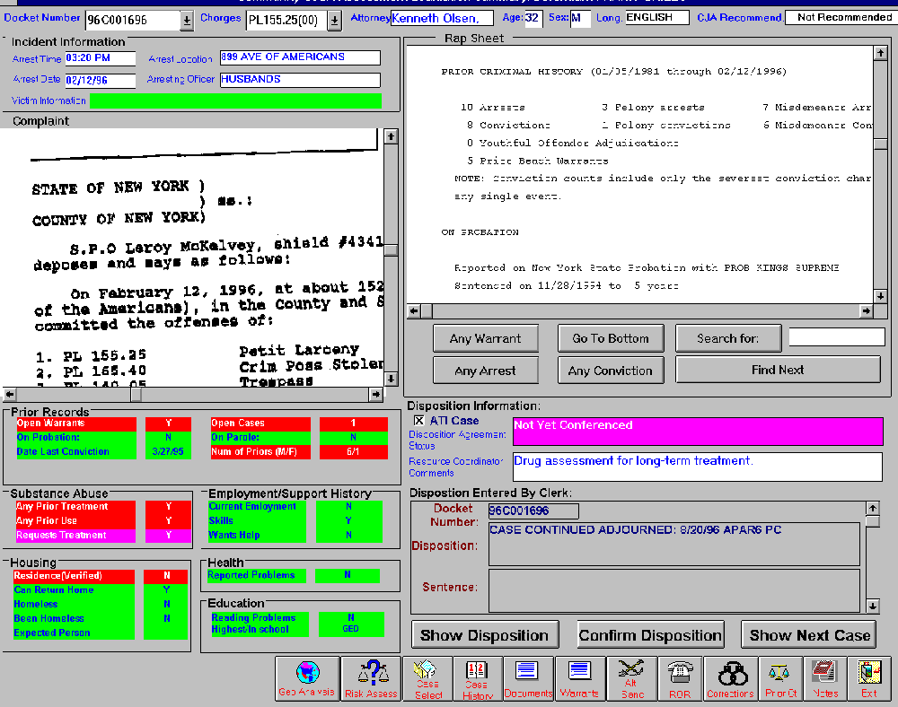
Figure 1.1: Manhattan Court DSS

Slide 3
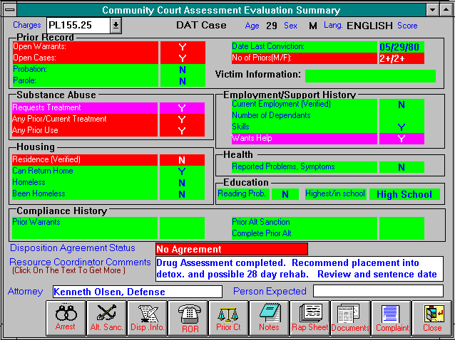
Figure 1.2a: Court DSS – Drill Down Screens

Slide 4
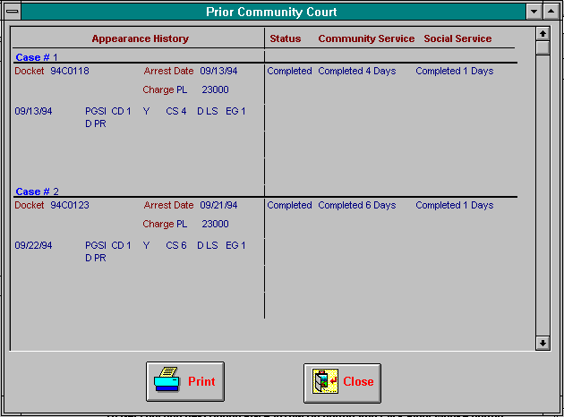
Figure 1.2b: Court DSS – Drill Down Screens

Slide 5
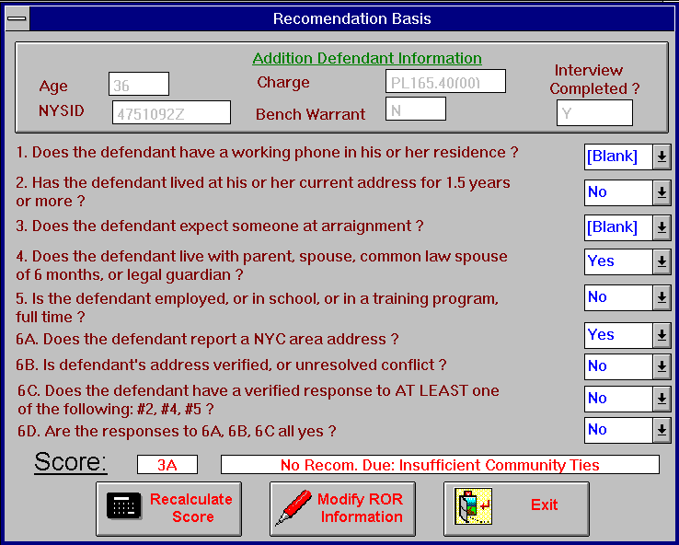
Figure 1.2c: Court DSS – Drill Down Screens

Slide 6
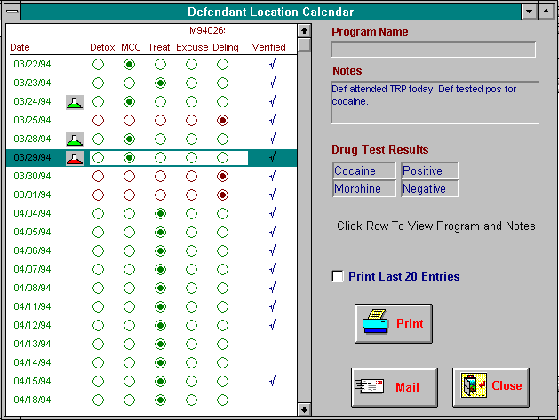
Figure 1.2d: Court DSS – Drill Down Screens

Slide 7
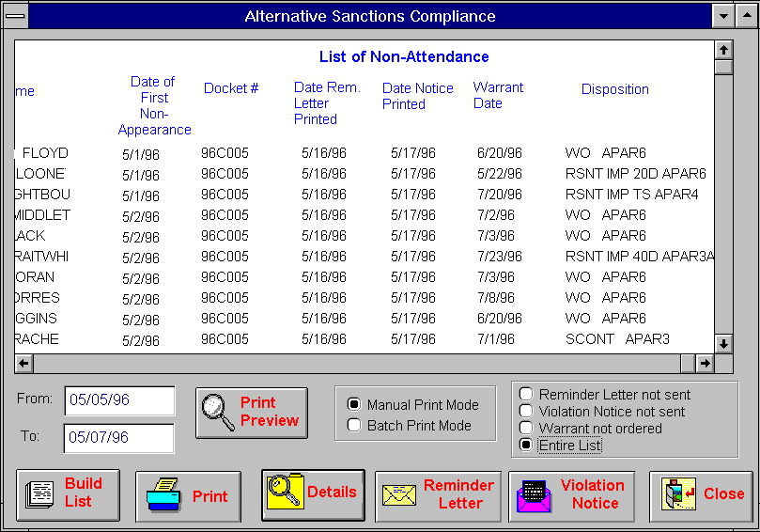
Figure 1.3: Court DSS – Flexibility in Data Analysis

Slide 8
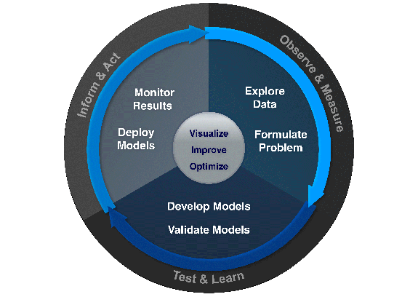
Figure 1.4: Uses of DSS in Business

Slide 9
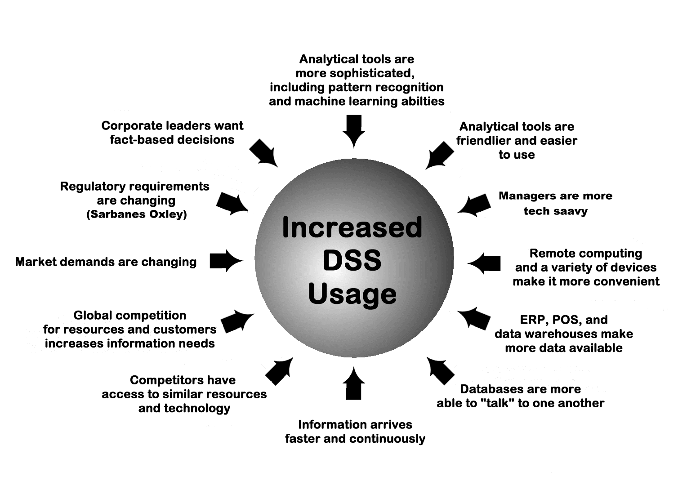
Figure 1.5: Pressure to Build DSS

Slide 10
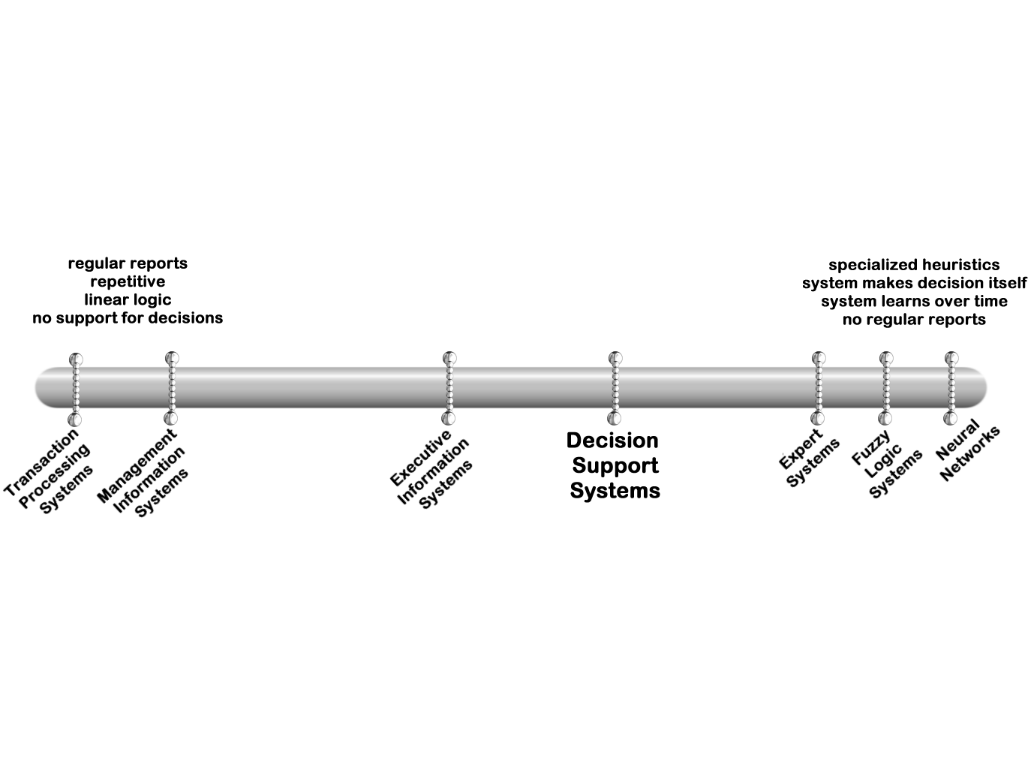
Figure 1.6: Continuum of IS Products

Slide 11
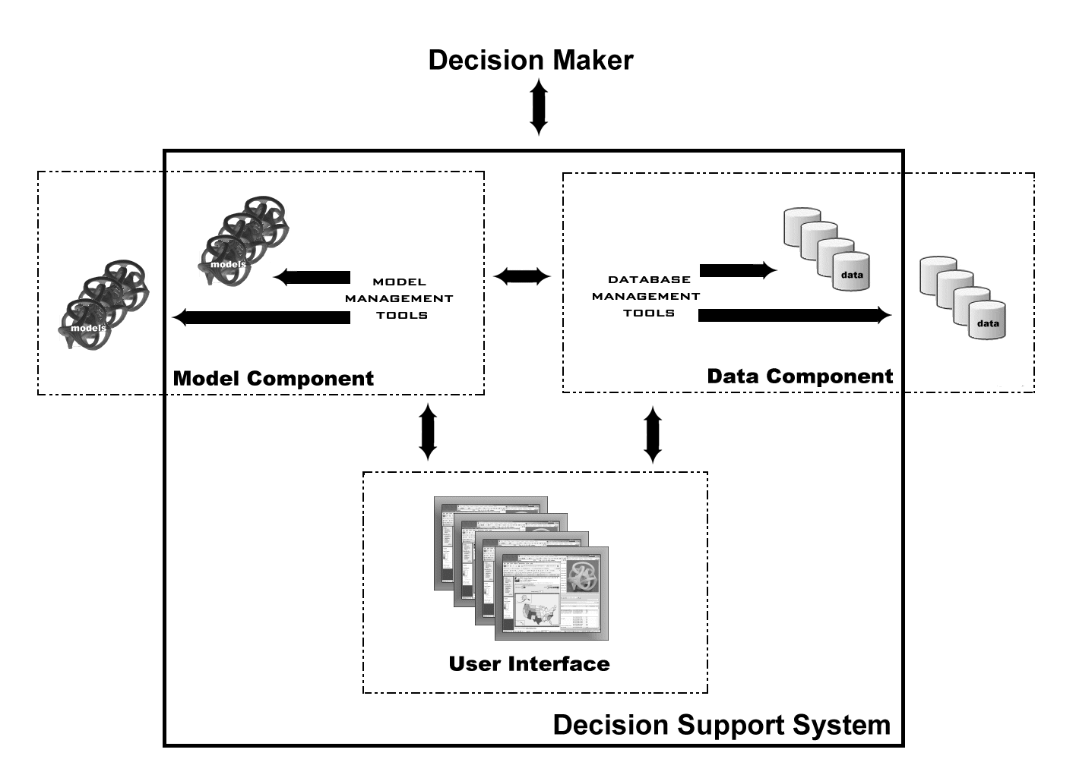
Figure 1.7: Components of a DSS

