Slide 1
Computing and Women
Vicki L. Sauter
GS 6350: Gender Language & Identity
October 7, 2015

Slide 2
Agenda
My Background
History of Computing and Women
The Barriers to Women

Slide 3
Research
Systems for Business Intelligence
Decision Support Systems for Business Intelligence
Improved Methodologies for System Development
Women in Information Technology Fields

Slide 4
Teaching
Systems for Business Intelligence
Systems Analysis
… the study of a current business system and its problems, the determination and definition of business needs and information requirements, and the evaluation of alternative solutions …

Slide 5
How I Came to Consider This Topic
How can we get better software?

Slide 6
Computer Technology is Important
Computing is one of the fastest growing occupations: Employment projections claim there will be more than 800,000 new high-end computing jobs by 2016
Five of the top ten fastest growing jobs will be in computing-related fields
Computer science, information systems, and computer engineering bachelor degrees are in high demand, and command two of the top three average salary offers from employers among all majors this year
Borrowed from: http://www.csedweek.org/key-facts

Slide 7
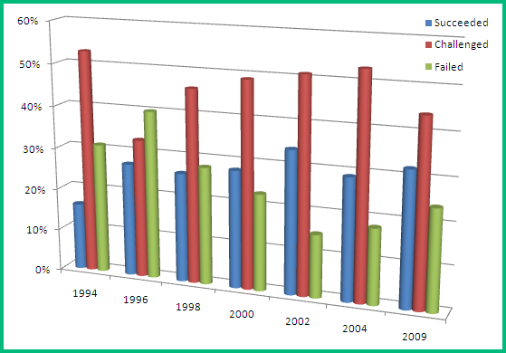
As a field, we are not good at creating software
Chaos Report from the Standish Group

Slide 8
More on Developing Software
Oxford University Study of IT
Successful Software: 16%
Challenged Software: 74%
Abandoned Software: 10%
National Institute of Standards and Technology (NIST)
Software defects cost nearly $60 Billion Annually
80% of development costs involve identifying and correcting defects
More data regarding success of IT projects can be found at http://www.galorath.com/wp/software-project-failure-costs-billions-better-estimation-planning-can-help.php

Slide 9
Why is Development Flawed?
Many hypotheses about the failure
Poor choice of Languages
Inappropriate or Missing Methodologies
Poor Requirements Definitions
Not including the User in the Process
Makeup of the Design and Coding Teams

Slide 10
Software Development Success
Diversity in team make up is critical to success
Gender
Race
Background
Skills
Personality
Recent research: more women on a team lead to a better outcome!

Slide 11
Diversity provides teams the opportunity to tap into multiple, unique perspectives on the task

Slide 12
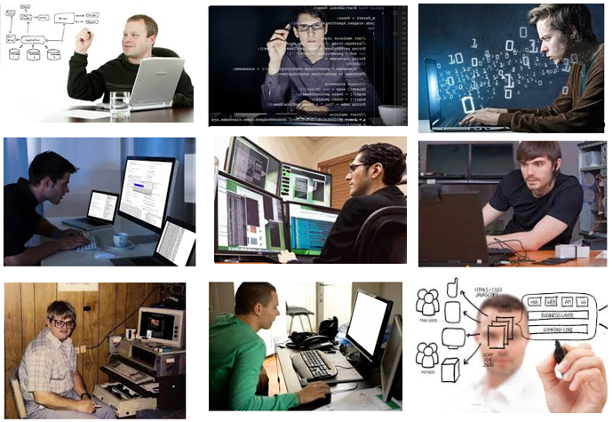
Programmer

Slide 13
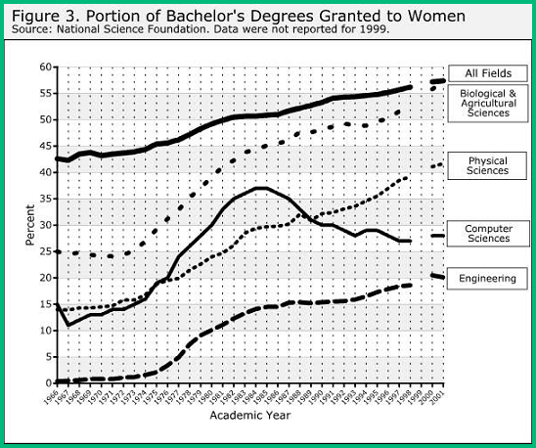
Gender Diversity is Challenging

Slide 14
WHY?

Slide 15
History?
Did the computing profession begin this way?

Slide 16
Trends with Women are Confusing
Ada, the Countess of Lovelace
(10 December 1815 – 27 November 1852)
Considered the first programmer
Worked with Charles Babbage on his Analytical Engine
Her notes contain what is considered the first computer program — an algorithm encoded for processing by a machine
She wrote about the ability of computers to go beyond mere calculating or number-crunching

Slide 17
Yet people STILL question whether Ada wrote the algorithms (programs) for the computer even though the evidence was in her own writing
Her work was provided as an addendum to another article because that was the only way publishers (men) would include her work

Slide 18
Computer
One who computes
Oxford English Dictionary (Third ed.). Oxford University Press. March 2008. 1613 ‘R. B.’ Yong Mans Gleanings 1, I haue read the truest computer of Times, and the best Arithmetician that euer breathed, and he reduceth thy dayes into a short number.
A person performing mathematical calculations
A person following fixed rules, with no authority to deviate from them in any detail

Slide 19
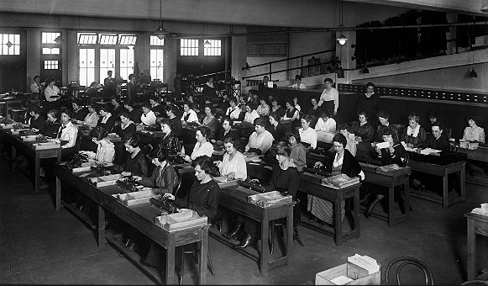
Wartime Computing
Large problems broken down into discrete parts that were computed by hand

Slide 20
The original programmers for the Eniac (first general purpose computer)
They programmed without programming manuals or courses, using only the logical diagrams
Jean Bartik was born in Gentry County Missouri (1924) and attended Northwest Missouri State Teachers College.

Slide 22
Grace Murray Hopper
(December 9, 1906 – January 1, 1992)
One of the first programmers of the Mark I computer (Harvard)
Developed the first compiler of a programming language
Conceptualized the idea of machine-independent programming languages
Lead the team that developed the language COBOL, which is still the dominant language in use by businesses

Slide 23
Hedy Lamarr
Austrian Actress
Invented early technique for spread spectrum communications and frequency hopping – the foundation for Wireless Communications

Slide 24
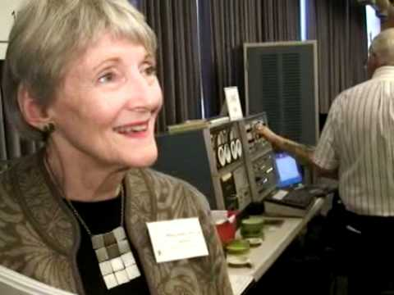
Mary Allen Wilkes
First person to design a computer for home use
She designed the multiply macromodule

Slide 25
“But despite the success of the ENIAC women in establishing a unique occupational niche for the programmer within the ENIAC community, programming continued to be perceived as marginal to the central business of computer development. By nature of their gender (female) and education (nonscientific and nonengineering), the early programmers remained isolated from the engineering and scientific managers. If software was admitted to be important, hardware was considered to be essential.”
- Nathan Ensmenger’s The Computer Boys Take Over , p. 38.

Slide 26
Subtlety
What the men worked on was HARDWARE
The development of hardware was the real business of computing
The “head” work of the (male) scientist
What the women worked on was SOFTWARE
The “hand” work of the (largely female) coder

Slide 27
“In the ENIAC project, of course, the programmers actually were women. In this respect programming inherited the gender identity of the human computing projects in which it was originated. But the suggestion that coding was low-status clerical work also implied an additional association with female labor.”
- Nathan Ensmenger’s The Computer Boys Take Over , p. 38.

Slide 28
After the War
End of the 1950s: programmers no longer considered “clerical” workers
Programmer Model emphasized individual experience and creativity
PriceWaterhouse report in 1959: the work involved is exacting and difficult enough to require real intellectual ability and above average personal characteristics

Slide 29
Programmer Recruitment
1957: Corporate Computing included 1500 “mainframes,” each of which needed 30-50 programmers
A looming shortage of computer programmers

Slide 30
Solutions
Corporate firms trained customers, but were not sufficient
Hiring based on “personality traits” of successful programmers
Hiring based on innate and artisan skills
Vocational Schools

Slide 31
NATO Conference on
Software Engineering (1968)
Portrayed programming as “too artistic”
Not up to the standards of “established branches” of engineering
Appeal is to the tradition of artisan or craftsperson (masculine) rather than effeminate artsy type

Slide 32
Emphasis on Mathematics
Programmers were good with algorithmic problems, but had difficulty solving complex business problems
Process was poorly defined/understood

Slide 33
Results
Skill descriptions fulfilled male notions of mastery and autonomy
Emphasis on mathematics (the study of which was discouraged for women)
Hiring practices encouraged hiring men
Especially the tendency not to like other people

Slide 34
Professional Status
1960s: white collar industries trying to get a “professional” status
Prerequisite of professional status was the mastery of an organized body of knowledge
Required the development of theoretical knowledge, not just a body of applications

Slide 35
“In problem preparation, the detailed work may be accomplished by two individuals. The first, who may be called the ‘programmer,’ studies the problem, determines the appropriate method of solution, and prepares the flow chart. This person must be well versed in the particular field in which the problem lies, and should also be able to fully exploit the flexibility and versatility of the UNIVAC system. …..

Slide 36
The second person, referred to as the ‘coder’ need only be familiar with the technique of reducing the flow chart to the specific instructions, or coding required by the UNIVAC to solve the problem. By differentiating between these two tasks, one clerical and the other analytic, the manual reinforced the Goldstine and von Neumann model of the programmer. In this model the real business of programming was analysis; the actual coding aspect of programming was trivial and mechanical.”
- Nathan Ensmenger’s The Computer Boys Take Over , p. 39.

Slide 37
Academic programs often started in engineering programs which were not very friendly to women students
Electrical Engineering
Mathematics
Physics

Slide 38
Conventional Wisdom
Women and people of color are not good in mathematics
Mathematics is crucial for any programming field

Slide 39
Reality
Differences in mathematical aptitude have been shown to be due to exposure to mathematics: the more mathematics classes a student takes, the better the student is at mathematics
Not all programming requires significant mathematical aptitude

Slide 40
Data
Teenage girls are now using computers and the Internet at rates similar to their male peers, but are five times less likely to consider a technology-related career or plan on taking post-secondary technology classes than those boys
The proportion of girls who take the SAT and who state they intend to major in computing fields has decreased steadily (relative to the proportion of boys): 20% in 2001 and 12% in 2006
More boys than girls (59% vs. 41%) reported course work or experience with computer programming, even though more girls reported having some coursework or experience using computers
The percentage of degrees in Computer Science awarded to women has decreased from almost 40% in 1984 to about 26% in 1998

Slide 41
More Data
A 2006 study showed only 8% of bachelors degrees in computer science were granted to African Americans and Latinos
Only 17% of AP computer science test-takers in 2008 were women, although women represented 55% of all AP test-takers
Participation in computer science AP tests among underrepresented minorities has increased in the past 10 years but is only 11%, compared to 19% of all AP test-takers
Only 4% of AP Computer Science test takers in 2008 were African Americans, although African Americans represented 7% of all AP test takers. Only 784 African American students nationwide took the AP Computer Science exam

Slide 42
So, what are the problems and what can we do?

Slide 43
Problem 1: Stereotyping
What we know
Boys tend to get called on in class more often than girls
Boys tend to take over computers more often in schools
Boys are more often encouraged to take advanced computing classes or to work with a computer

Slide 44
Stereotyping
What we can do
Ensure that all students are given equal access to computers
Make an effort to call on girls and people of color more in class
Recruit girls to the computing classes and encourage them to pursue after school programs
Mentors

Slide 45
Problem 2: Stereotype Threat
What we know
Stereotype threat is a person’s anxiety that he or she will confirm negative stereotypes about a social group (e.g., women, people of color)
Stereotype threat has been shown to reduce performance of people who belong to negatively stereotyped groups
Anxiety comes from the social situation, not the individual
Students experiencing stereotype threat are likely to disassociate themselves from the situation

Slide 46
“…the best women in a CS program are far more likely to drop out than the worst guys. When asked how they think they compare, these women consistently rank themselves far below their actual skill level. This means women aren’t good at judging their actual skill level or comparing themselves to others. They need mentors and a leg up, to help them do it. Women are also less likely to pester their boss until she finally relents to send them to a conference. Again, we need to actively invite talented women …”
-Maria Klawe
President, Harvey Mudd College
Director, Microsoft

Slide 47
Stereotype Threat
What we can do
Introduce computing as a gender-neutral and racial-neutral topic
Use examples of successful women and people of color in the discussion of the topic
Require students to find examples of successful women and people of color
Find mentors: older students, college students, people in practice
Encourage students to work together in gender-mixed and racially-mixed groups
Don’t generalize performance
Encourage each student’s effort

Slide 48
Problem 3: Women are too Social
What we know
People believe that computer careers are nothing more than “heads down” programming all day
Women worry that they will be isolated and not have enough social contact
Women want to have more impact on society

Slide 49
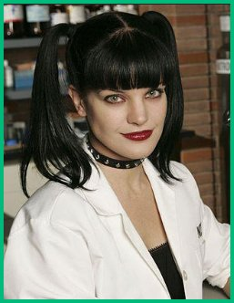
Women are too Social
The Reality
No one works on a project alone
There are many parts of a project team that require significant interaction with colleagues, users and others in an organization
Today everyone uses computers and so people can work for the kind of organization and kind of application that makes them happy

Slide 50
Women are too Social
What we can do
Recruit women students and students of color to the class
Involve students in project teams
Works well if you add some ambiguity to the project that needs to be discussed
Work on problems from a wide range of application areas
Use examples from sports and from the human genome or crime or social networks
Encourage students to think about a wide range of types of programs, even if they are not able to code them at this time
Speakers are often good to provide examples of the kind of systems they use

Slide 51
Problem 4: Stuck in the Shallow End: Education, Race, and Computing
Pioneering study by Jane Margolis and colleagues about how students of color receive little or no institutional encouragement and educational support to pursue computer science at the pre-college level

Slide 52
Results
Large disparity in learning opportunities along racial lines in the schools studied
None of the computing classes at minority schools went beyond cut-and-paste instructions
No classes that introduced the problem-solving and scientific reasoning of computer science were offered at minority schools
Teaching low-level computing skills rather than computational thinking was also the norm at the minority magnet school
The charter school provided a variety of computer courses, but few students of color were enrolled

Slide 53
Problem 5: The Code Cowboy
Cowboy coding is a form of software development method without an actual defined method – team members do whatever they feel is right.
Image borrowed from http://cowboyprogramming.com/2007/01/11/delving-into-cowboy-programming/

Slide 54
Cowboy Coding
Stays up all night recoding the entire code base, documents nothing, and forbids anyone to touch it because they aren’t good enough to understand his level of code.
Refuses meetings, chats, or any other form of communication.
Cares more about being perceived as the brilliant-uber-genius than he does about his team working well together.
Gets into silly pissing contests which boil down to “hehe, my brain is bigger than yours”.
Finds complex solutions to problems, thus proving his brilliance.
Makes a lot of mistakes due to lack of sleep, overcaffination, and ego — but thank god he is around to save the day when the bug is discovered
Is fairly certain clients, PMs, designers, and really anyone he has to deal with on a daily basis is at least three standard deviations below his IQ.
Jumps to say “me, me, me!” when credit or rewards for accomplishments are offered.
Jumps to say “me, me, me!” when opportunities to attend or speak at conferences arise. The good developer
Borrowed from: http://www.stubbornella.org/content/2010/07/26/woman-in-technology

Slide 55
Cowboy coding and cowboy coding environments tend to discourage anyone different from joining them. This includes women and people of color.

Slide 56
The Good Developer
Digs the fact that he is making products for people. Likes people and enjoys communicating with them and understanding how they think. Can put him or herself in other people’s shoes and reliably imagine how they might react to different parts of the user interface
An excellent problem solver who takes into account all aspects of a challenge when designing a solution – including human elements like maintainability and usability
Borrowed from: http://www.stubbornella.org/content/2010/07/26/woman-in-technology

Slide 57
What we can do
Discourage the vices of computing
Help students develop good coding practices

Slide 58
Four Vices of Computing
Vice 1: galloping off on one’s own without a prior plan
What we can do – encourage good practices
Require all students to outline their projects before they begin coding with flowcharts, pseudo code or pictures
Assign some complex projects (less toy-like)
Include some ambiguity in the problem definition so students experience unforeseen interactions in code
Limit the number of edit-compile-test runs
Use some (heterogeneous) group exercises

Slide 59
Four Vices of Computing
Vice 2: unnecessarily dense, unreadable code
What we can do – encourage good practices
Require documentation of all code
Meaningful field names
In-code documentation
Diagram of code
Appropriate indentation
Include documentation in the grading of code
Return code after a week or more delay and ask them to explain their approach to the class
Encourage “beautiful coding”

Slide 60
Four Vices of Computing
Vice 3: reinventing the wheel unnecessarily
What we can do – encourage good practices
Encourage students to develop code libraries
Encourage students to re-use code
Require students to use someone else’s code for part of the project

Slide 61
Four Vices of Computing
Vice 4: brute-force programming
What we can do – encourage good practices
Do not provide students with test data sets
Or provide them with only partial test sets
Limit the number of edit-compile-test runs
Students who have reached an impasse and with access to the test suite will often resort to a kind of evolutionary programming where they incrementally tweak parts of a program, test the code, and repeat

Slide 62
Majors Differ
Computer Science
A computer scientist focuses on the development of solutions to problems taking into account the limitations of the machine and its resources, as well as how to best utilize the resources.
Information Systems
IS professionals utilize their business-based backgrounds in working with managers and users to specify technology needs that benefits the organization. In addition, they write programs to codify that technology and later manage it.
http://mis.umsl.edu/misvscsc.html

Slide 63
Resources
Anita Borg Institute: http://anitaborg.org
Women in Technology: http://www.witi.com/
Addressing Core Equity Issues in K-12 Computer Science Education -- Identifying Barriers and Sharing Strategies: http://anitaborg.org/files/ABI-csta-full-report.pdf

Slide 64
Contact Information
Email: Vicki.Sauter@umsl.edu
Website: http://www.umsl.edu/~sauterv
Facebook: Vicki TheGeek Sauter
LinkedIn: Vicki Sauter
Twitter: VLSauter (but I do not tweet very often)

Slide 65
Questions?

