Slide 1
Cyber Crimes: Online Ticketing Fraud
By: Erin Dobbs, Blaine Skrainka, Nick Worth, Kyle Stamper, Suzy Kiska

Slide 2
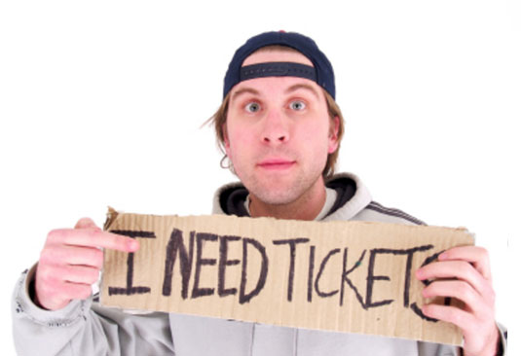
Four Indicted in $25 Million Scheme Defrauding and Hacking Ticketmaster, Tickets.com, and Other Ticket Vendors
Wiseguy Tickets made a profit of over $25 million
Illegally bought mass quantities of tickets and resold them above face value
Defendants accused of 43 counts of Wire Fraud

Slide 3
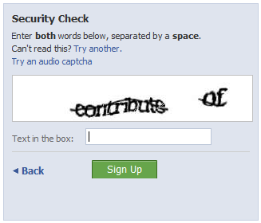
CAPTCHA Technology
CAPTCHA technology is a challenge-response test used by online vendors to ensure that the user is an individual human being.
Wiseguy developed programs to successfully bypass both visual and audio CAPTCHA tests.
This allowed them to illegally buy mass quantities of tickets, sell them at a premium, and unfairly block the public from access to the tickets.

Slide 4
Federal Laws Impacted
The Indictment:
The four gentlemen involved in this case are charged with conspiracy to commit wire fraud and to gain unauthorized access and exceed authorized access to computer systems. The indictment also charges 42 additional counts of wire fraud; gaining unauthorized access and exceeding authorized access to computer systems; or causing damage to computers in interstate commerce.
Specific Laws Impacted:
18 U.S.C. § 1029. Fraud and Related Activity in Connection with Access Devices
18 U.S.C. § 1030. Fraud and Related Activity in Connection with Computers
18 U.S.C. § 2510 et seq. Wire and Electronic Communications Interception and Interception of Oral Communications
18 U.S.C. § 2701 et seq. Stored Wire and Electronic Communications and Transactional Records Access
http://www.justice.gov/criminal/cybercrime/cclaws.htm l

Slide 5
State Laws Impacted
Though the defendants are indicted on a Federal level there are New Jersey state statutes that protect the general public from cyber crime.
Specific State Statutes Impacted:
2C:20-4. Theft by deception
2C:20-8. Theft of services
2C:20-25 Computer criminal activity; degree of crime; sentencing.
2C:20-31 Wrongful access, disclosure of information; degree of crime; sentencing.
2C:21-6.1 Definitions relative to scanning devices, reencoders; criminal use, degree of crime.
http://www.state.nj.us/njsp/divorg/invest/pdf/computer-crime-statutes.pdf
**Local Newark, New Jersey cyber crime laws or regulations were unavailable

Slide 6
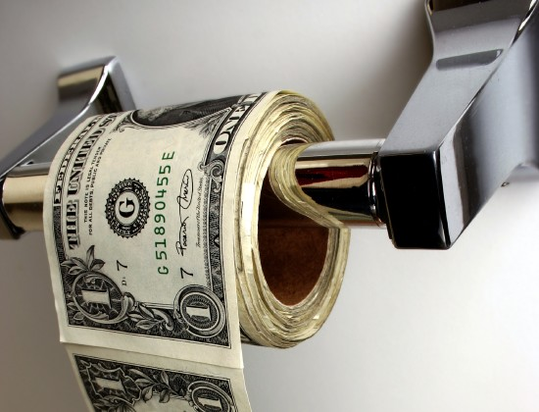
Issues Enabling Problematic Behavior
Able to deploy a nationwide computer network
Opened 1000s of simultaneous Internet connections across the U.S.
Impersonated 1000s of individual ticket buyers
Defeated online ticket vendor’s security
Sold fraudulently obtained tickets to brokers

Slide 7
Security and Fraud Measures
All Failed
Surprisingly few
Audio and visual CAPTCHA
Distorted letters or numbers
Created fake Internet domains
Created and modified the computer networks and software

Slide 8
Penalties In This Case
Suspects indicted by
Federal Grand jury
Charges include:
Wire fraud
Conspiracy to commit wire fraud
Unauthorized computer access
Computer hacking

Slide 9
Penalties In This Case
What punishments are the suspects facing?
5 years prison for conspiracy charge
20 years prison on each of the 42 counts of wire fraud
5 years prison and $250,000 fine for each of the 19 counts of unauthorized access and exceeding authorized access to computers
10 years prison for each of the six counts of damage to computers in interstate commerce
In addition, the suspects face a fine of $250,000 per count of conviction

Slide 10
Punishment of Past Computer Hacking Cases
What kind of punishment has computer hacking rendered in the past?
Large Fines
Can be as large as $250,000 for each charge
Prison Sentences
For Example, one case has a suspect facing 60 years of prison for hacking into the Pentagon’s computer system

Slide 11
How Should Computer Hacking Affect IT Management?
Essential to secure company information
Hire cyber security companies to protect a business’s vital information
Secure world wide web gateways to company’s network

Slide 12
How Should Computer Hacking Affect IT Management?
Get data stored in fully secure data center and monitor what is coming in and going from center
Background check and monitor employees
A big threat is from within a company
Employees that know passwords, etc.

Slide 13
Keys For Management to Secure Networks
Design and build with security in mind including:
Encrypted entries
Limit # of connections to Internet
Use network monitoring systems to keep track of what is going where

Slide 14
Questions???

