Slide 1
Group A
Jeremy Brugger
James Klein
Anthony Knollhoff
Sam Reinhardt
Diane Torneire

Slide 2
SPORTS MEDIA ON THE INTERNET
An Analysis of Internet Tools Used by :
espn.go.com
www.cbssports.com
sports.yahoo.com
sportsillustrated.cnn.com

Slide 3
OVERVIEW: Main Content
- -Supplement to ESPN TV station
-Up-to-date streaming & coverage of all sports
- Off-shoot of SI Magazine
- Pictures of athletes & swim suit models
- In-depth reports by acclaimed ariters
- Branch Site to Yahoo!!
- Fantasy sports leader
- Extension of CBS TV station – features anchors
-Up-to-date news with some fantasy sports
ALL- POSITIVE MESSAGE ABOUT COMPANY

Slide 4
OVERVIEW: Audience
Website | Main | Growing
 | Males, Aged 15-40 | Females
 | Males, Aged 15-40 | Even More Males (swimsuit issues)
 | Males, Aged 15-40 | Females
 | Males, Aged 15-40 | Females

Slide 5
OVERVIEW: Sources of Revenue
Website | Traditional Sales | Affiliate Marketing & Advertising
 | Pro-team merchandise & magazine subscriptions | Links to its parent company, Disney, & sister company, ABC
 | Pro-team merchandise & magazine subscriptions | Links to its parent companies, CNN & Time Warner
 | Pro-team merchandise | Links to its parent company, Yahoo!, & fantasy sports groups
 | Pro-team merchandise | Fantasy sports groups
All |  | Links to Other Blogs (tbd later)

Slide 6
OVERVIEW: Asthetics
ESP – Bold, technical, & familiar (resembles Sportscenter)
SI.com – Simple, easy.
– Focus on (& adds for) fantasy sports groups.
–Dull, disorganized

Slide 7
BLOGS: Why Blog?
Sports News Is Constant
Quick Way to Report
Allows Reader Participation
Anyone Can Blog

Slide 8
BLOGS: Set-Up
2 MAIN GROUPS:
Only Employees Blog & Readers Leave Comments
- ESPN &
Employees & Readers Blog
- I.com &

Slide 9
BLOGS: Set-Up Detail
Website | Set-Up
ESP (Employee Only) | Main Page of All Blogs for All Sports
(Employee Only) | Blog Page for Each Sport & Blogs Are Listed Chronologically within
SI.com (Anyone) | Sponsors Separate Site for Blogs Only.
(Anyone) | Main Page for All Blogs that Can Be Sorted by Sport, Title, or Blogger

Slide 10
BLOGS: Content Policies
2 MAIN GROUPS:
Bloggers (Employees) cannot disclose proprietary info, slander company or its employees, use inappropriate language
- ESP &
Bloggers (Anyone) must read & agree to lengthy terms, including the above, plus no false impersonation, no harassment, & everything posted is property of website.
- SI.com &

Slide 11
BLOGS: Blogger I.D.
Website | I.D. Type
(Employee Only) | Picture, Bio, & Resume .
(Employee Only) | Full name. (Internet Search to Find the Rest.)
(Anyone) | Employees - Not Available on Site - (Internet Search to Find It.) Non-Employees – Available to “Friends”
(Anyone) | Employees – Bio’s Non-Employees – Depends on Blogger

Slide 12
BLOGS: Affiliate Blogs
- Majority criticize ESPN, others post best/worst ESPN commercials
- Majority criticize Yahoo!Sports.com, some are favorable
SI.com -Majority repeat SI.com stories, most bloggers are male
- Majority are those of other CBS channels, some criticize CBS’s sports coverage.

Slide 13
Social Networking Purpose
Facebook & Twitter
Provide new and breaking stories
Provide links back to their site
LinkedIn:
Provides an interface with potential employees along with company information
Fantasy Sports
Provide value and reason to increase repeat visits to their site

Slide 14
Social Networking: Twitter
Twitter
All four companies use these in much the same way
They provide headlines and a link to the full story on their site.
ESPN,CBS Sports, and SI all update their accounts through an API (Application Programming Interface)
Yahoo Sports has multiple users that update content
There are no visible policies other than those enforced by Twitter (i.e.; character limits)

Slide 15
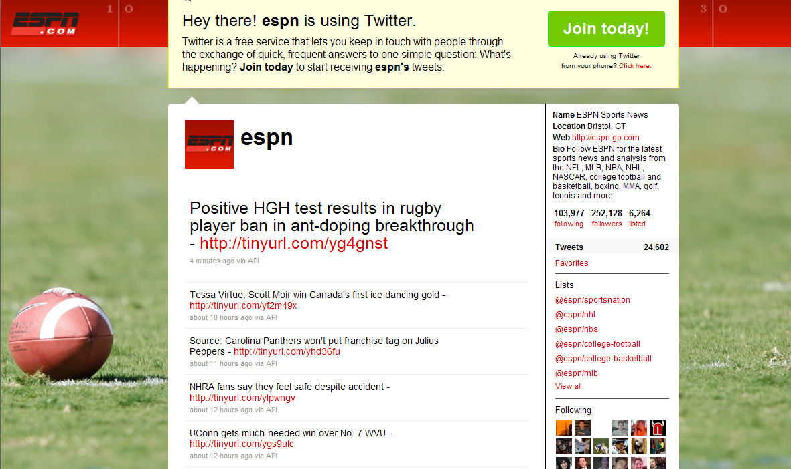
Social Networking: Twitter

Slide 16
Social Networking: Facebook
Facebook
Through the use of Facebook Pages:
They provide more information related to the companies
Provide news articles with a snippet of the news story and a link back to the full article on their site
They also utilize other features on Facebook, such as:
Discussion boards, photos, videos, audio, etc.
There are no visible policies other than those enforced by Facebook

Slide 17
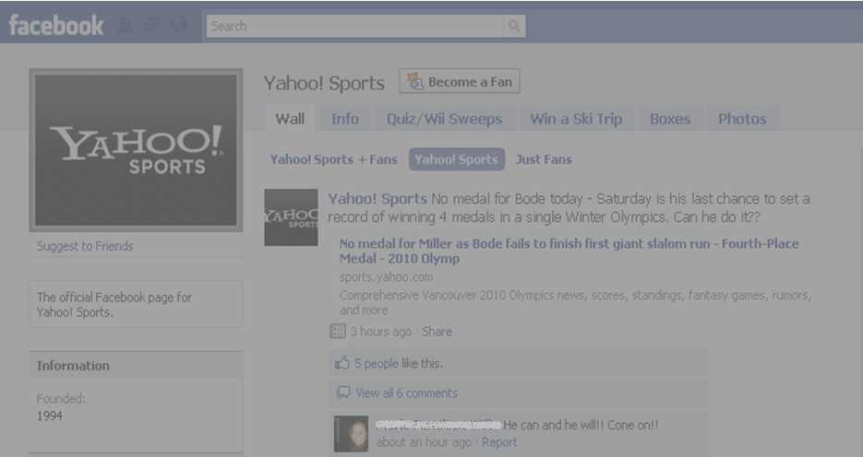
Social Networking: Facebook

Slide 18
Social Networking: LinkedIn
LinkedIn
Provides a Human Resources interface with potential and current employees
More company-focused than CareerBuilder or Monster
Due to the limited ability for customization ESPN, SI and the parent companies of Yahoo! Sports and CBS Sports use this site the same way

Slide 19
Social Networking: Fantasy Sports
Fantasy Sports
Provides sports fanatics with a place to congregate, talk about, and manage their own sports team(s).
Through private and public leagues participants keep returning to edit rosters, picks, etc.
ESPN, Yahoo! Sports, CBS Sports all offer leagues for MLB, NFL, NASCAR, collegiate sports, etc
While SI offers fantasy sports related content it doesn’t actually have fantasy sports leagues

Slide 20
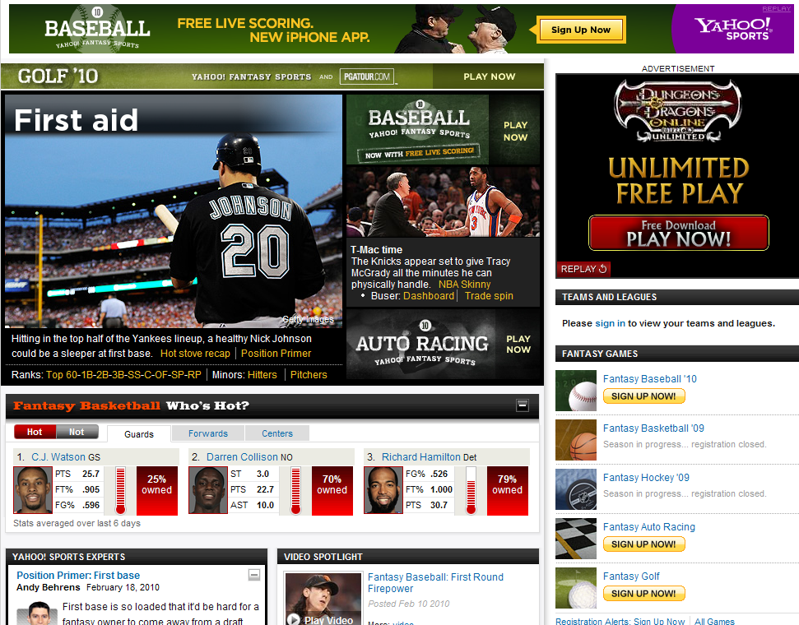
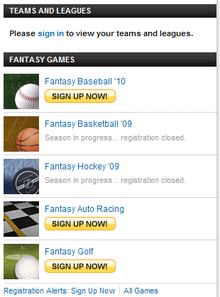
Social Networking: Fantasy Sports

Slide 21
CONCLUSION
All 4 companies feature unique websites to attract readers, but setups are similar
ESPN has established a model for competitors to follow
Blogging is prevalent within the sports media industry – providing up-to-date commentary on sporting events
ESPN and Yahoo! by staff
CBS and SI allow readers to blog themselves
Social Networking tools have become widely used in similar manners by all 4 companies

Slide 22
CONCLUSION con’t
Guidelines to Emerging Sports Media Companies:
Follow the market leaders
Create an engaging website
Provide readers with access to blogs
Keep audience informed real time with updates via Facebook and Twitter
Offer something new or something for free that the others don’t
Stay informed with new technologies so to be the first to offer something new (like Yahoo! with fantasy sports)
Prizes and value are always a way to attract new customers

Slide 23
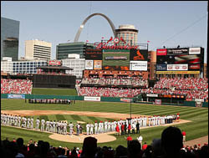
QUESTIONS??
http://www.stlrcga.org/x1849.xml
39 More Days Until Opening Day

Slide 24
REFERENCES
- http://www.imediaconnection.com/content/9599.asp
http://www.marketingcharts.com/television/top-10-sports-websites-december-2009-11847/
http://www.sgma.com/press/3_U.S.-Sports-Industry%3A-Nearly-a-%2470-Billion-Business
http://espnmediazone.com/documents/20090804_Blog_Policy.htm.
http://jeremy.zawodny.com/Yahoo!/Yahoo!-blog-guidelines.pdf.
http://biz.stats.com/client.asp
http://www.thestreet.com/_tscrss/tech/jonathanberr/10245259.html
http://www.imediaconnection.com/content/9599.asp
http://espn.go.com/
http://sportsillustrated.cnn.com/
http://sports.yahoo.com/
http://www.cbssports.com/
Additional Links:
Yahoo!: www.facebook.com/Yahoo!sports?v=app_7146470109
ESPN: www.facebook.com/ESPN?v=info
SI: www.facebook.com/SportsIllustrated
CBS Sports: www.facebook.com/CBSSports
Yahoo! Sports: http://twitter.com/Yahoo!/sports
ESPN: http://twitter.com/eSPN
SI: http://twitter.com/SI_24seven
CBS Sports: http://twitter.com/CBSsports
Yahoo!!: http://www.linkedin.com/companies/1288
ESPN: http://www.linkedin.com/companies/espn?trk=co_search_results&goback=.cps_1266463776304_1
SI: http://www.linkedin.com/companies/sports-illustrated?trk=co_search_results&goback=.cps_1266463776305_1
CBS Interactive: http://www.linkedin.com/companies/268213
Facebook
Twitter
LinkedIn

Slide 25
STATISTICS
Notes:
Discuss Reasons for Successes.

