Slide 1



The Comet-Disk Connection: Could Comets have Delivered the Ingredients for Life?
Dr. Erika Gibb
Dept. of Physics & Astronomy
April 9, 2016

Slide 2
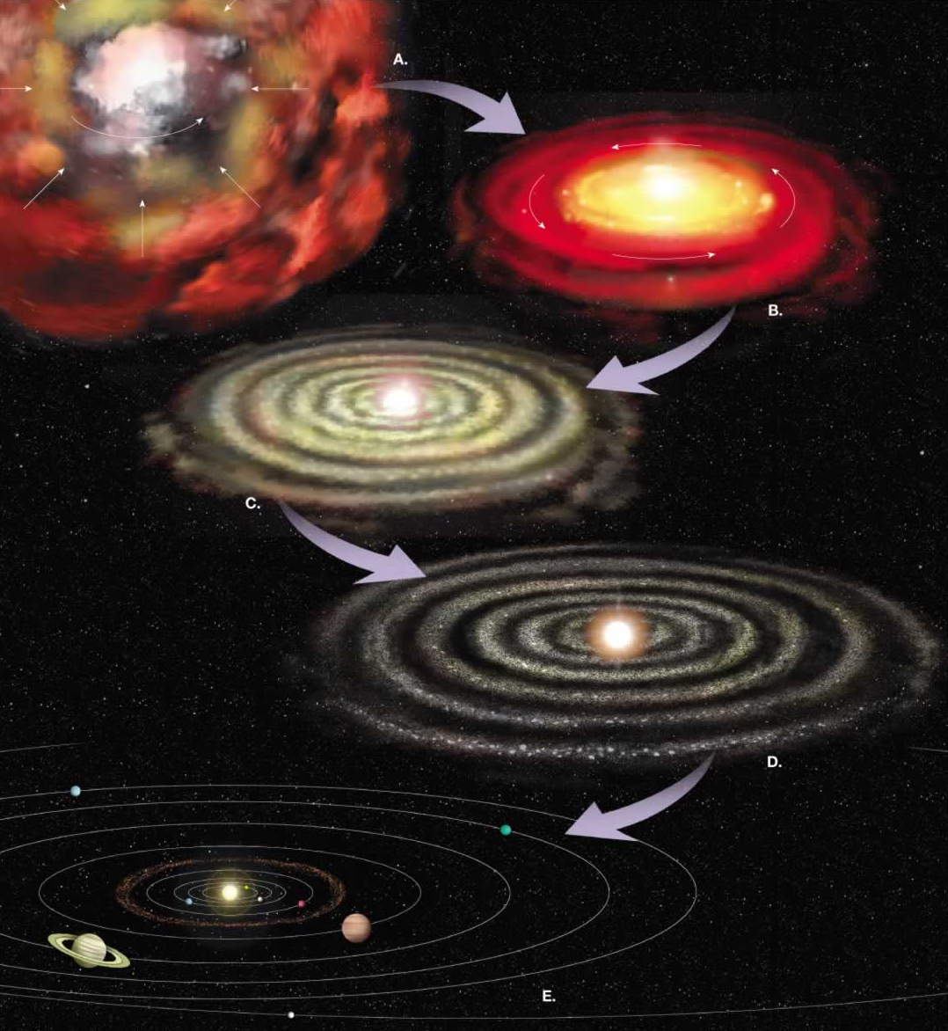
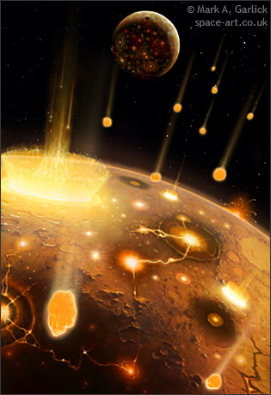
Motivation: trace the evolution of prebiotic volatile matter …
The Forming Solar System
Where and how did prebiotic molecules form?
Interstellar vs. nebular chemistry?
A
Infancy
Embryo
50,000 AU
B
Childhood
500 AU
Test the possibility for exogenous delivery to early Earth –>
C
Teenage years
D
Adulthood

Slide 3
Prebiotic Molecules of Interest
NH₃ and C₂H₂: suggested chemical precursors of amino acids;

Slide 4
Prebiotic Molecules of Interest
NH₃ and C₂H₂: suggested chemical precursors of amino acids;
C₂H₆ and CH₄ – chemical precursors of ethyl- and methylamine (discovered in the comet-return samples from the Stardust mission; Elsila et al. 2009);

Slide 5
Prebiotic Molecules of Interest
NH₃ and C₂H₂: suggested chemical precursors of amino acids;
C₂H₆ and CH₄ – chemical precursors of ethyl- and methylamine (discovered in the comet-return samples from the Stardust mission; Elsila et al. 2009);
H₂CO, CH₃OH – chemical precursor of sugars.

Slide 7
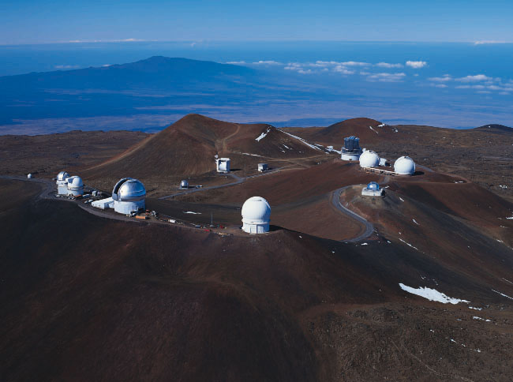
Mauna Kea Observatories
NIRSPEC on Keck 2
10 meter telescope - biggest in world!
CSHELL at NASA’s IRTF
2-5 μm region
Simple organic molecules

Slide 8
Question: How were these molecules distributed in the early solar system?

Slide 9
The Solution: Study protoplanetary disks around stars like the young Sun.

Slide 10
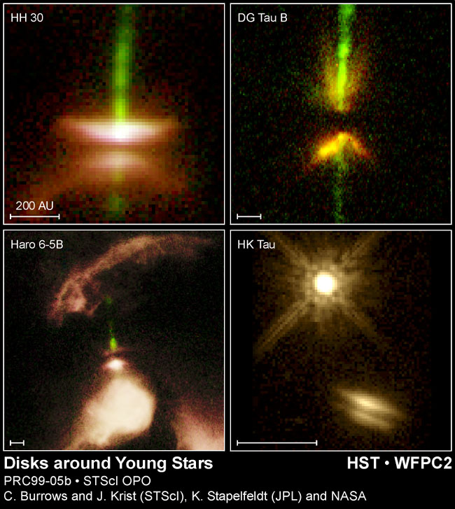
The problem:
The planet- forming regions of disks are hidden by dust!
So how can we study the chemistry of planet formation?

Slide 11
How can we study the chemistry of planet formation?
Models of protoplanetary disk
Observations of disks
Comets!

Slide 12
Disk Models
This is where comets formed

Slide 13
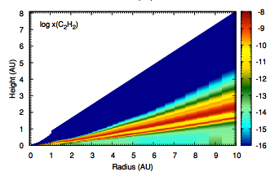
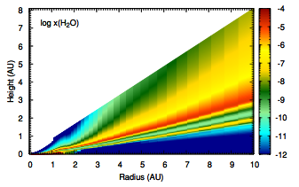
Disk Models
note high abundances of C₂H₂, H₂O, in narrow region above the mid-plane.
Walsh et al. 2012
(Note: gas phase)
Are these transported to the comet-forming region in the midplane?

Slide 14
Testing the Models: Disk Observations

Slide 15
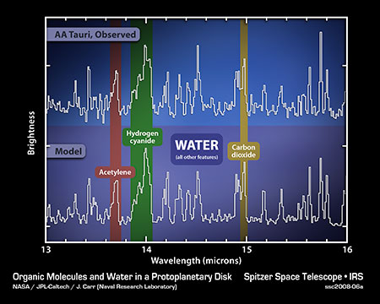
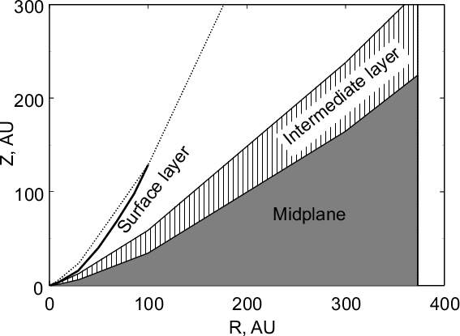
Disk Observations
Surface layer ⇒ emission lines
Easy to observe in IR & mm (ALMA)
Use spectra to determine temperature - combine with disk model to estimate location

Slide 16
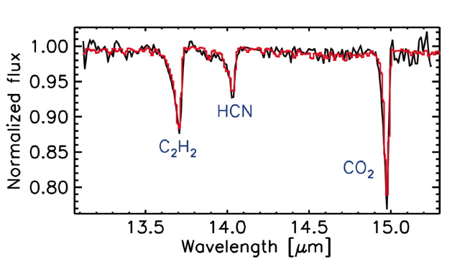
Disk Observations
Requires precise alignment to observe
Only feasible for a few disks!
Intermediate layer ⇒ rich ion-molecule chemistry, absorption
Lahuis et al. 2006

Slide 17
Disk Observations: GV Tau
Low mass binary system
Close to edge on
Surrounded by disk with just the right orientation
Warm HCN & C₂H₂ absorption seen toward GV Tau N
HCN
C₂H₂
H₂O

Slide 18
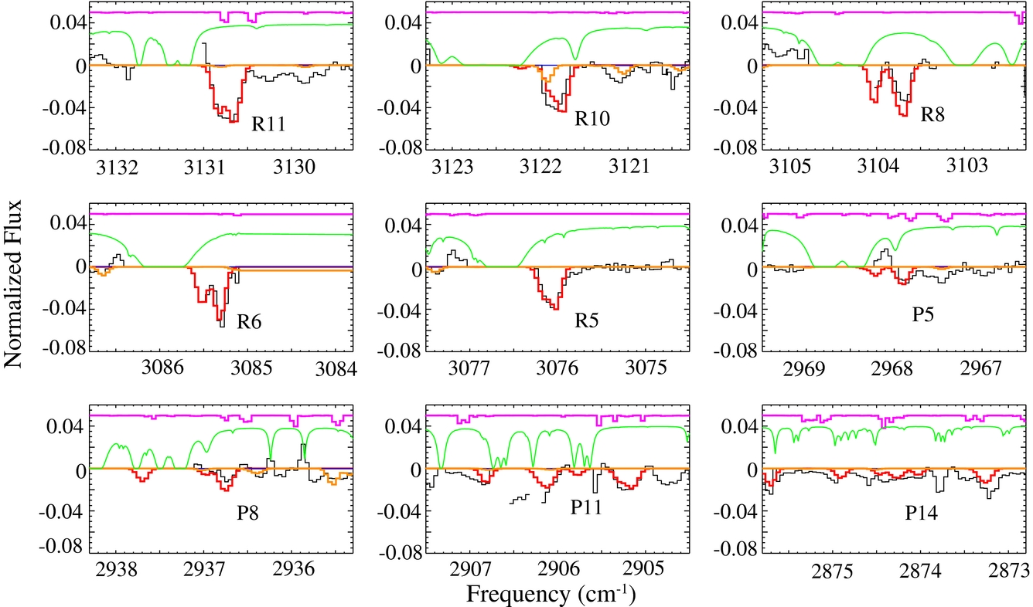
Disk Observations: GV Tau
CH₄ in GV Tau N disk, T_{rot} ~750 K

Slide 19
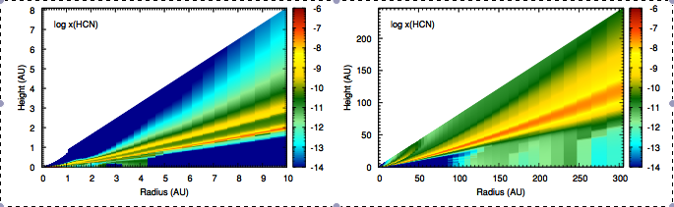
Disk Observations: GV Tau
GV Tau’s orientation was ideal for detecting gas in the warm molecular layer
Walsh et al. 2012

Slide 20
Issue: That’s not where planets form.
Does this material get incorporated into planets/comets?

Slide 21
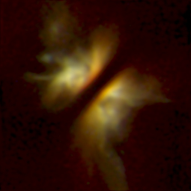
We need the midplane!
Midplane ⇒ cold
  volatiles frozen onto grains
Do comets retain the ice signature from this region/epoch?
Can’t directly observed this region because we can’t see through the dense dust!

Slide 22
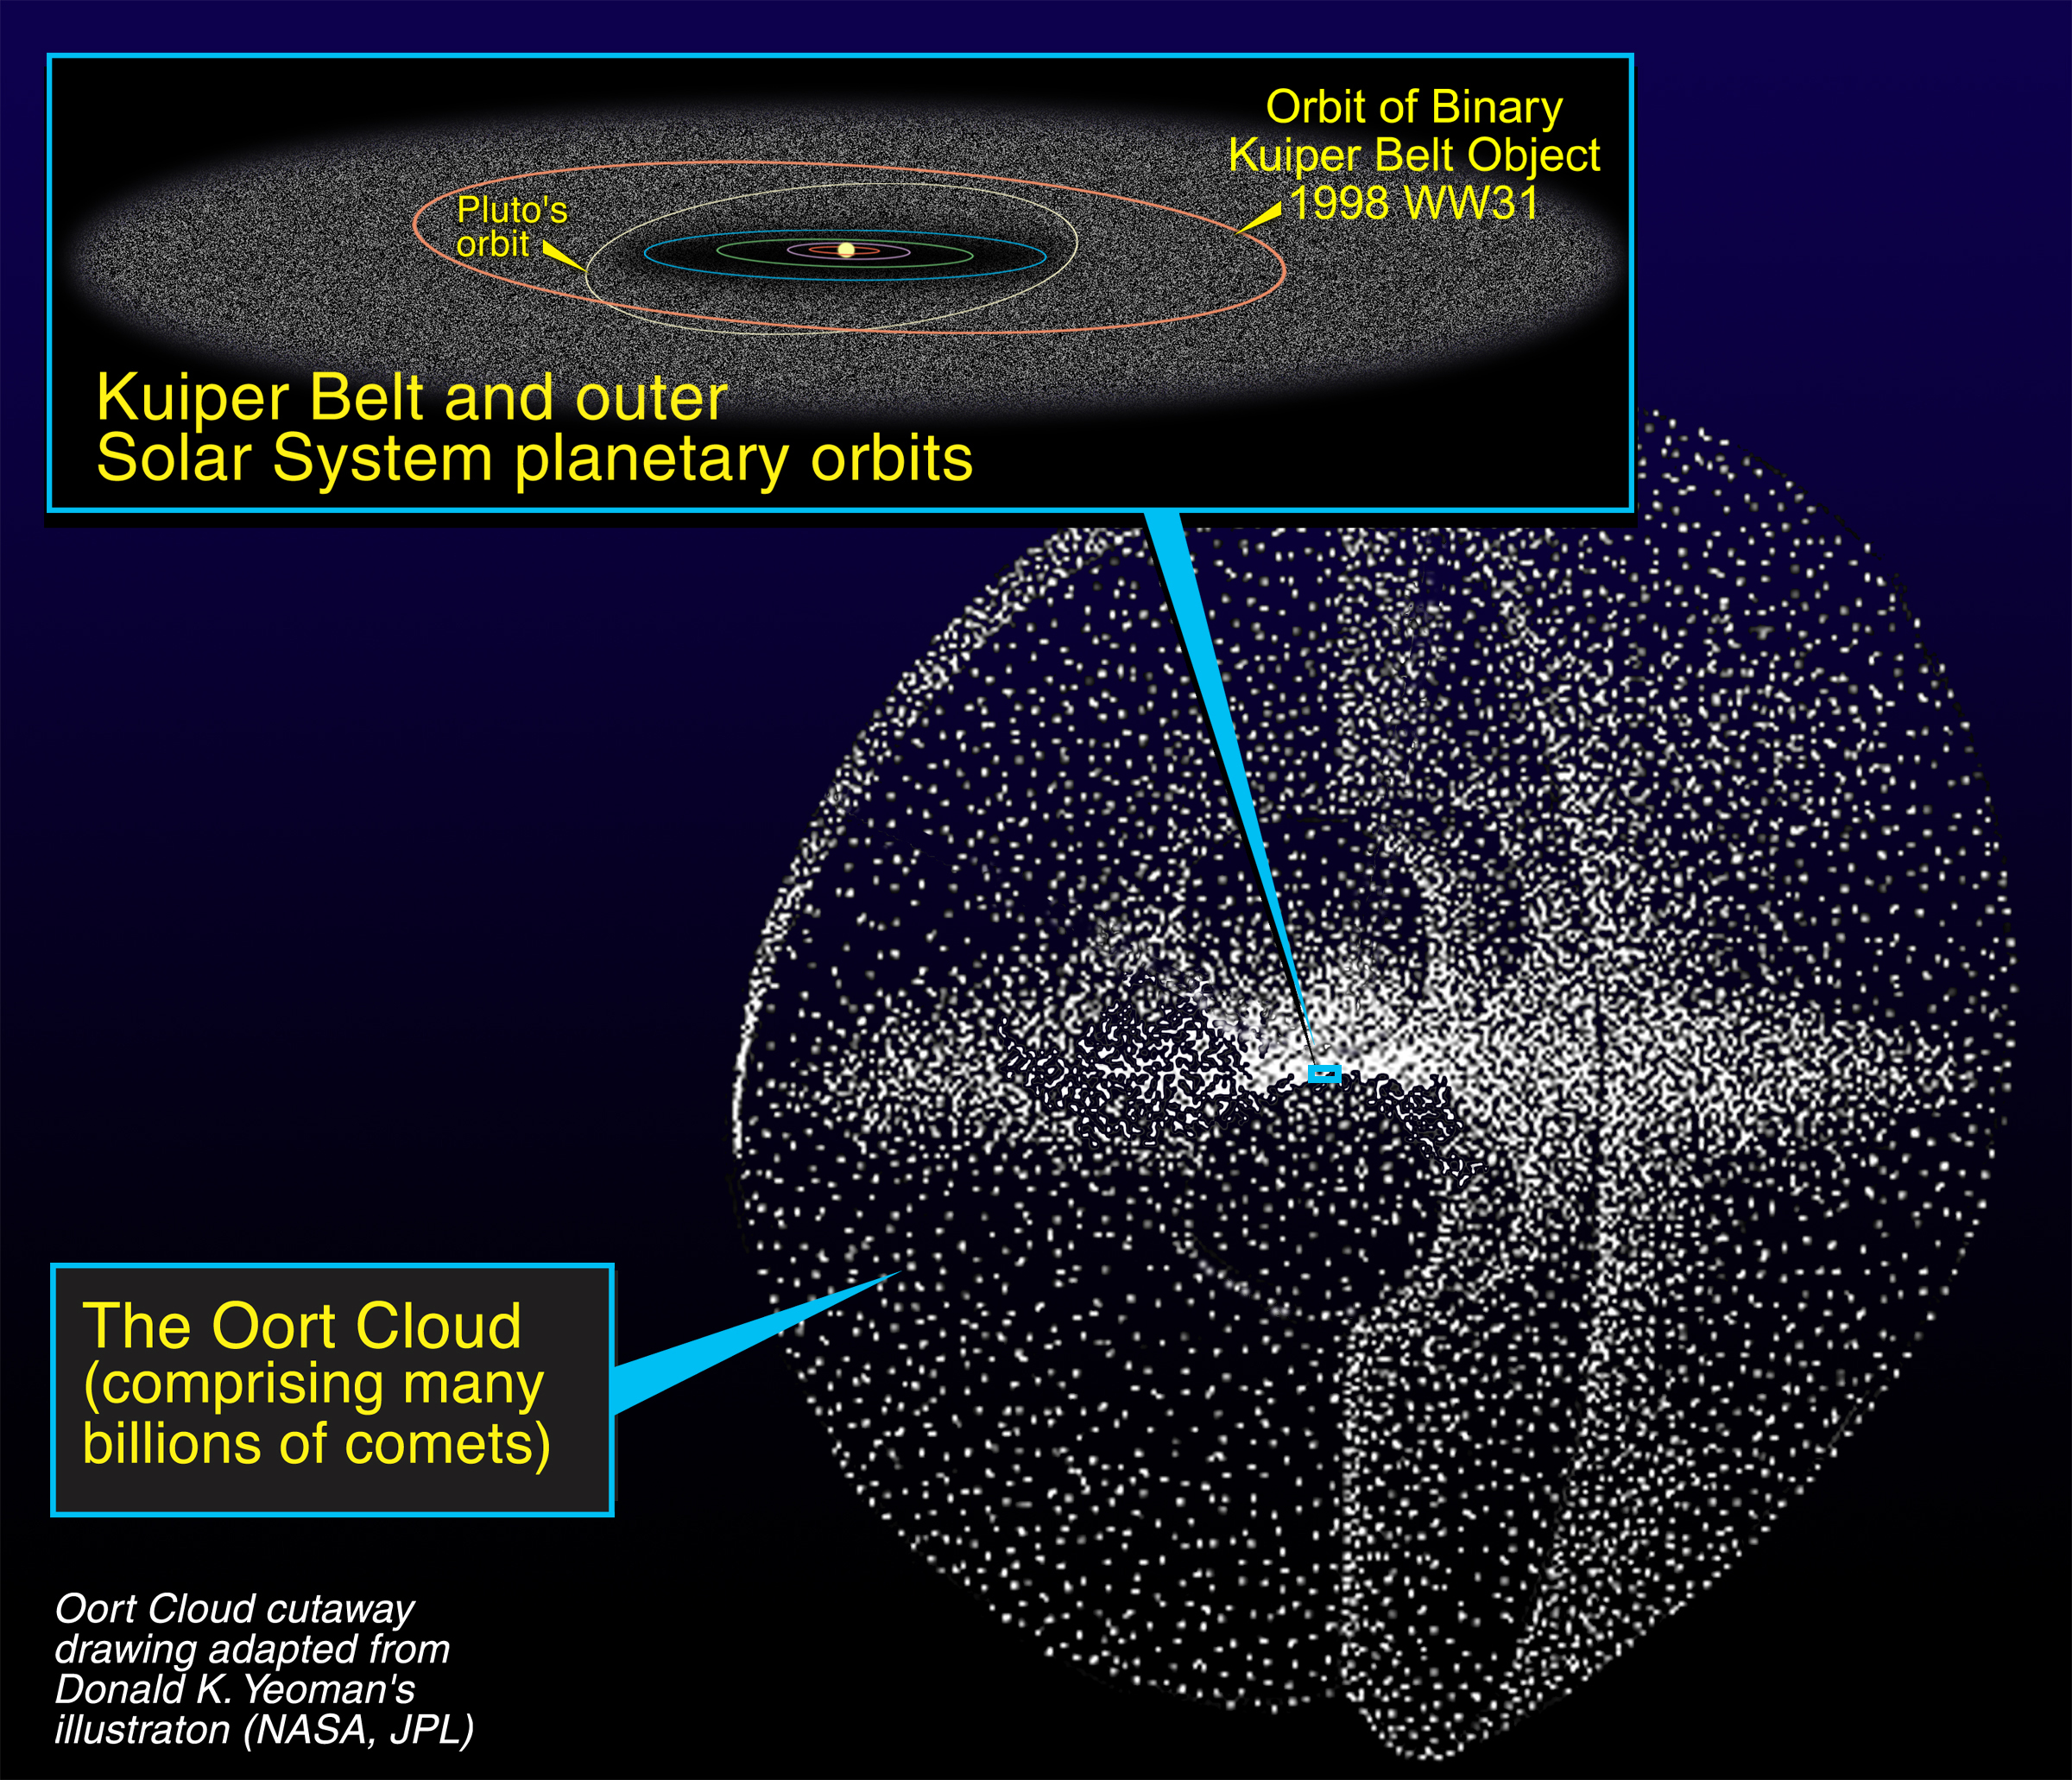
Comets?

Slide 23
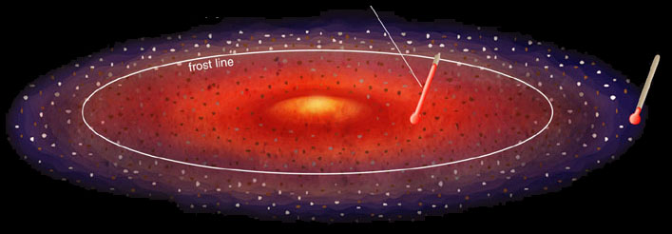
Within frost line, rocks and metals condense, hydrogen compounds stay gaseous
Beyond frost line, hydrogen compounds, rocks, and metals condense.
Water (H₂O)
condenses
to form ice
Methane (CH₄)
condenses
to form ice
© 2004 Pearson Education
Solar nebula
temperature
2000 K
300 K
50 K
Early Solar System

Slide 24
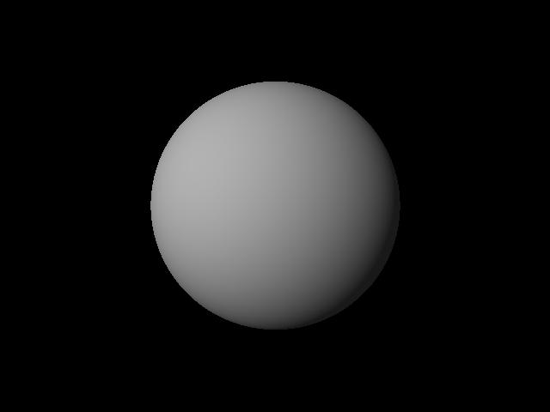
Within frost line, rocks and metals condense, hydrogen compounds stay gaseous
Beyond frost line, hydrogen compounds, rocks, and metals condense.
Water (H₂O)
condenses
to form ice
Methane (CH₄)
condenses
to form ice
© 2004 Pearson Education
Solar nebula
temperature
2000 K
300 K
50 K
Proto planets
Comets
Early Solar System
Scatter of small bodies

Slide 25
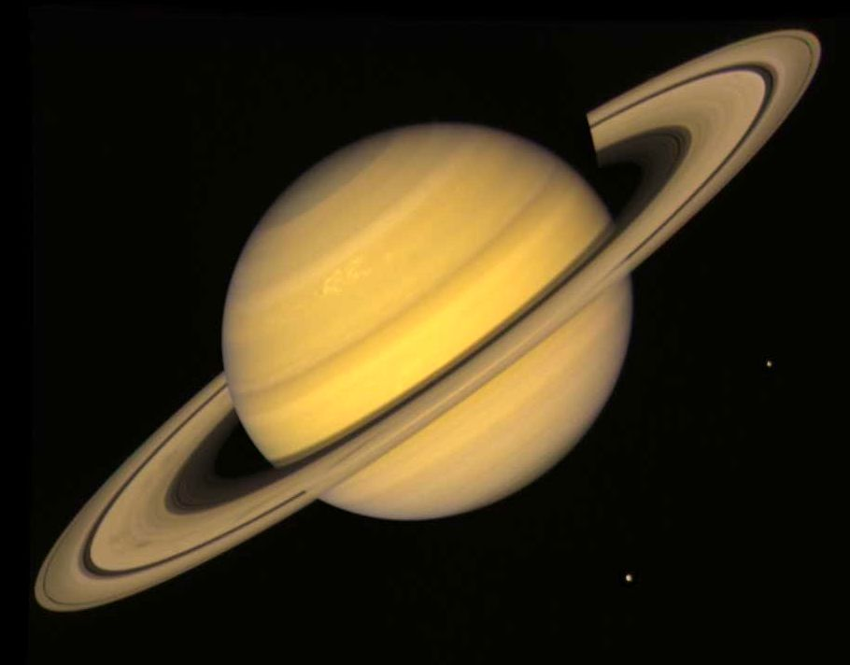
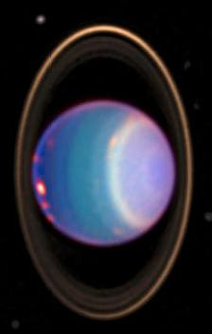
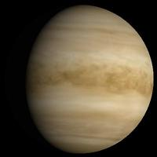
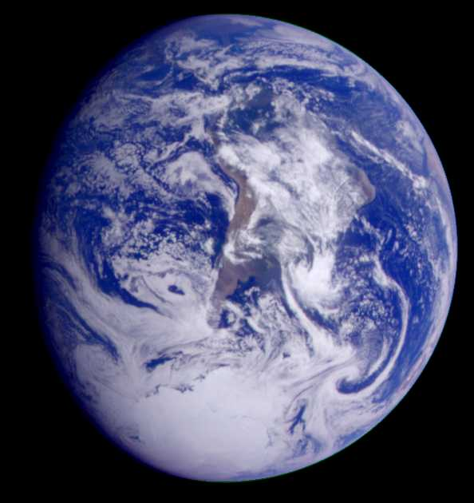
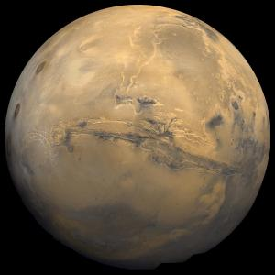
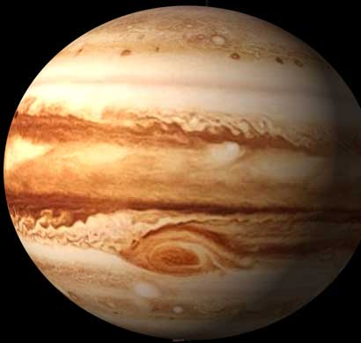
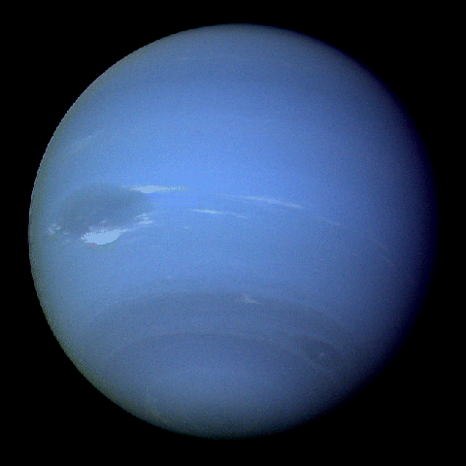
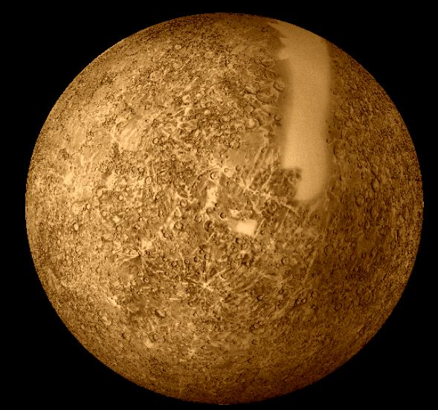
Within frost line, rocks and metals condense, hydrogen compounds stay gaseous
Beyond frost line, hydrogen compounds, rocks, and metals condense.
Water (H₂O)
condenses
to form ice
Methane (CH₄)
condenses
to form ice
© 2004 Pearson Education
Solar nebula
temperature
2000 K
300 K
50 K
Proto planets
Comets
Early Solar System
Scatter of small bodies
Rocky planets
Gas giants
3-5 AU
~30 AU

Slide 26
We clearly need a good understanding of protoplanetary disks to understand planets!

Slide 27
Question: If Earth’s formation environment was too warm for water and organics, how did we get the ingredients for life?

Slide 28
Question: If Earth’s formation environment was too warm for water and organics, how did we get the ingredients for life?
Comets?

Slide 29
Question: Can comets tell us about conditions in the planet forming region of the young solar system?

Slide 30
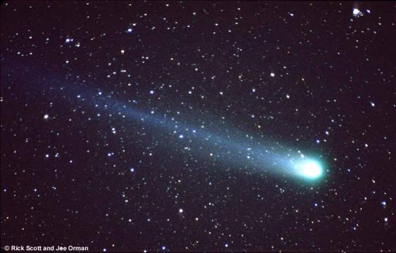
Comets
Closest to pristine
Retain volatiles
Represent midplane volatile abundance in the disk during planet formation
Assumption: comet compositions have not changed since their formation

Slide 31
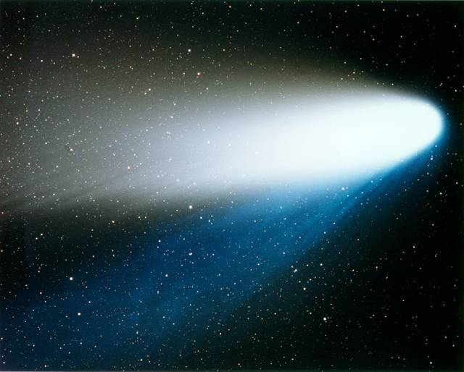
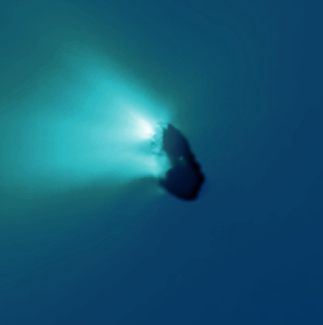
Parts of a Comet
Coma
Dust Tail
Gas or Ion Tail
Nucleus
Not usually visible!

Slide 32
Comets
Spectrum of comet C/2007 N3 Lulin from 2009 (Gibb et al. 2012)

Slide 33
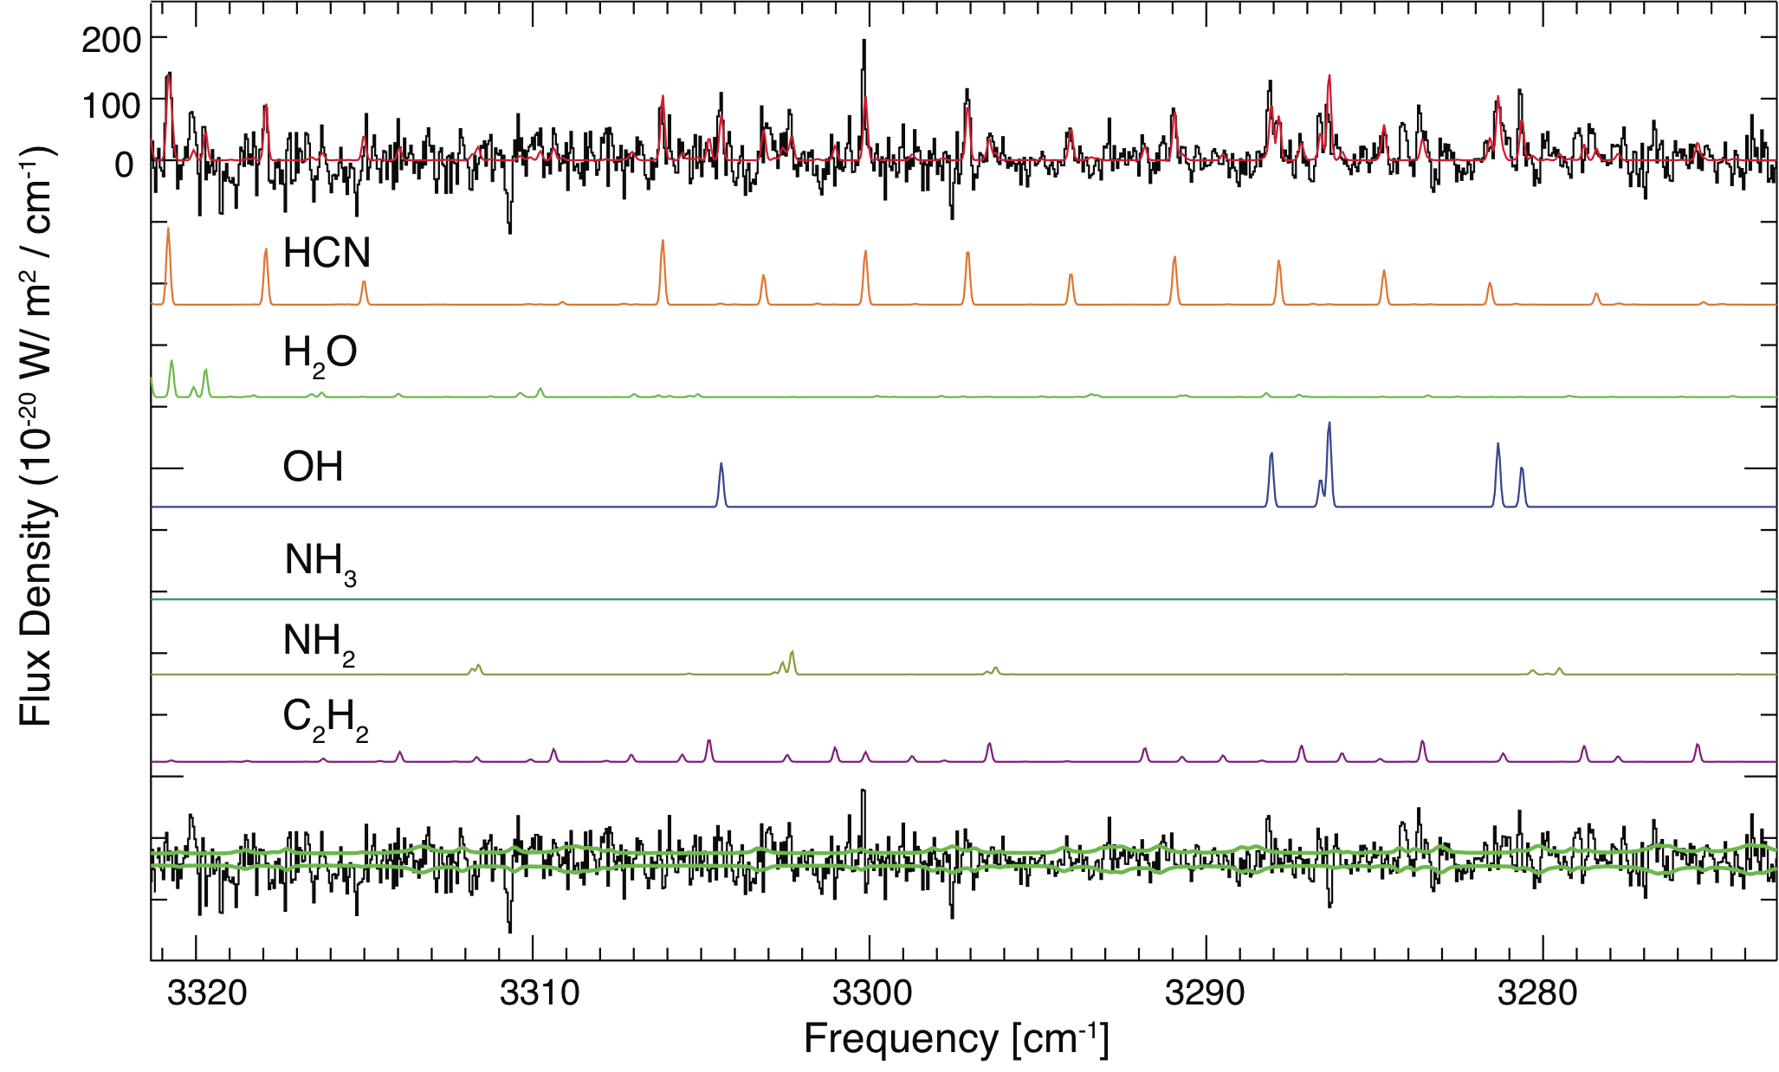
Comets
Spectrum of comet C/2007 N3 Lulin from 2009

Slide 34
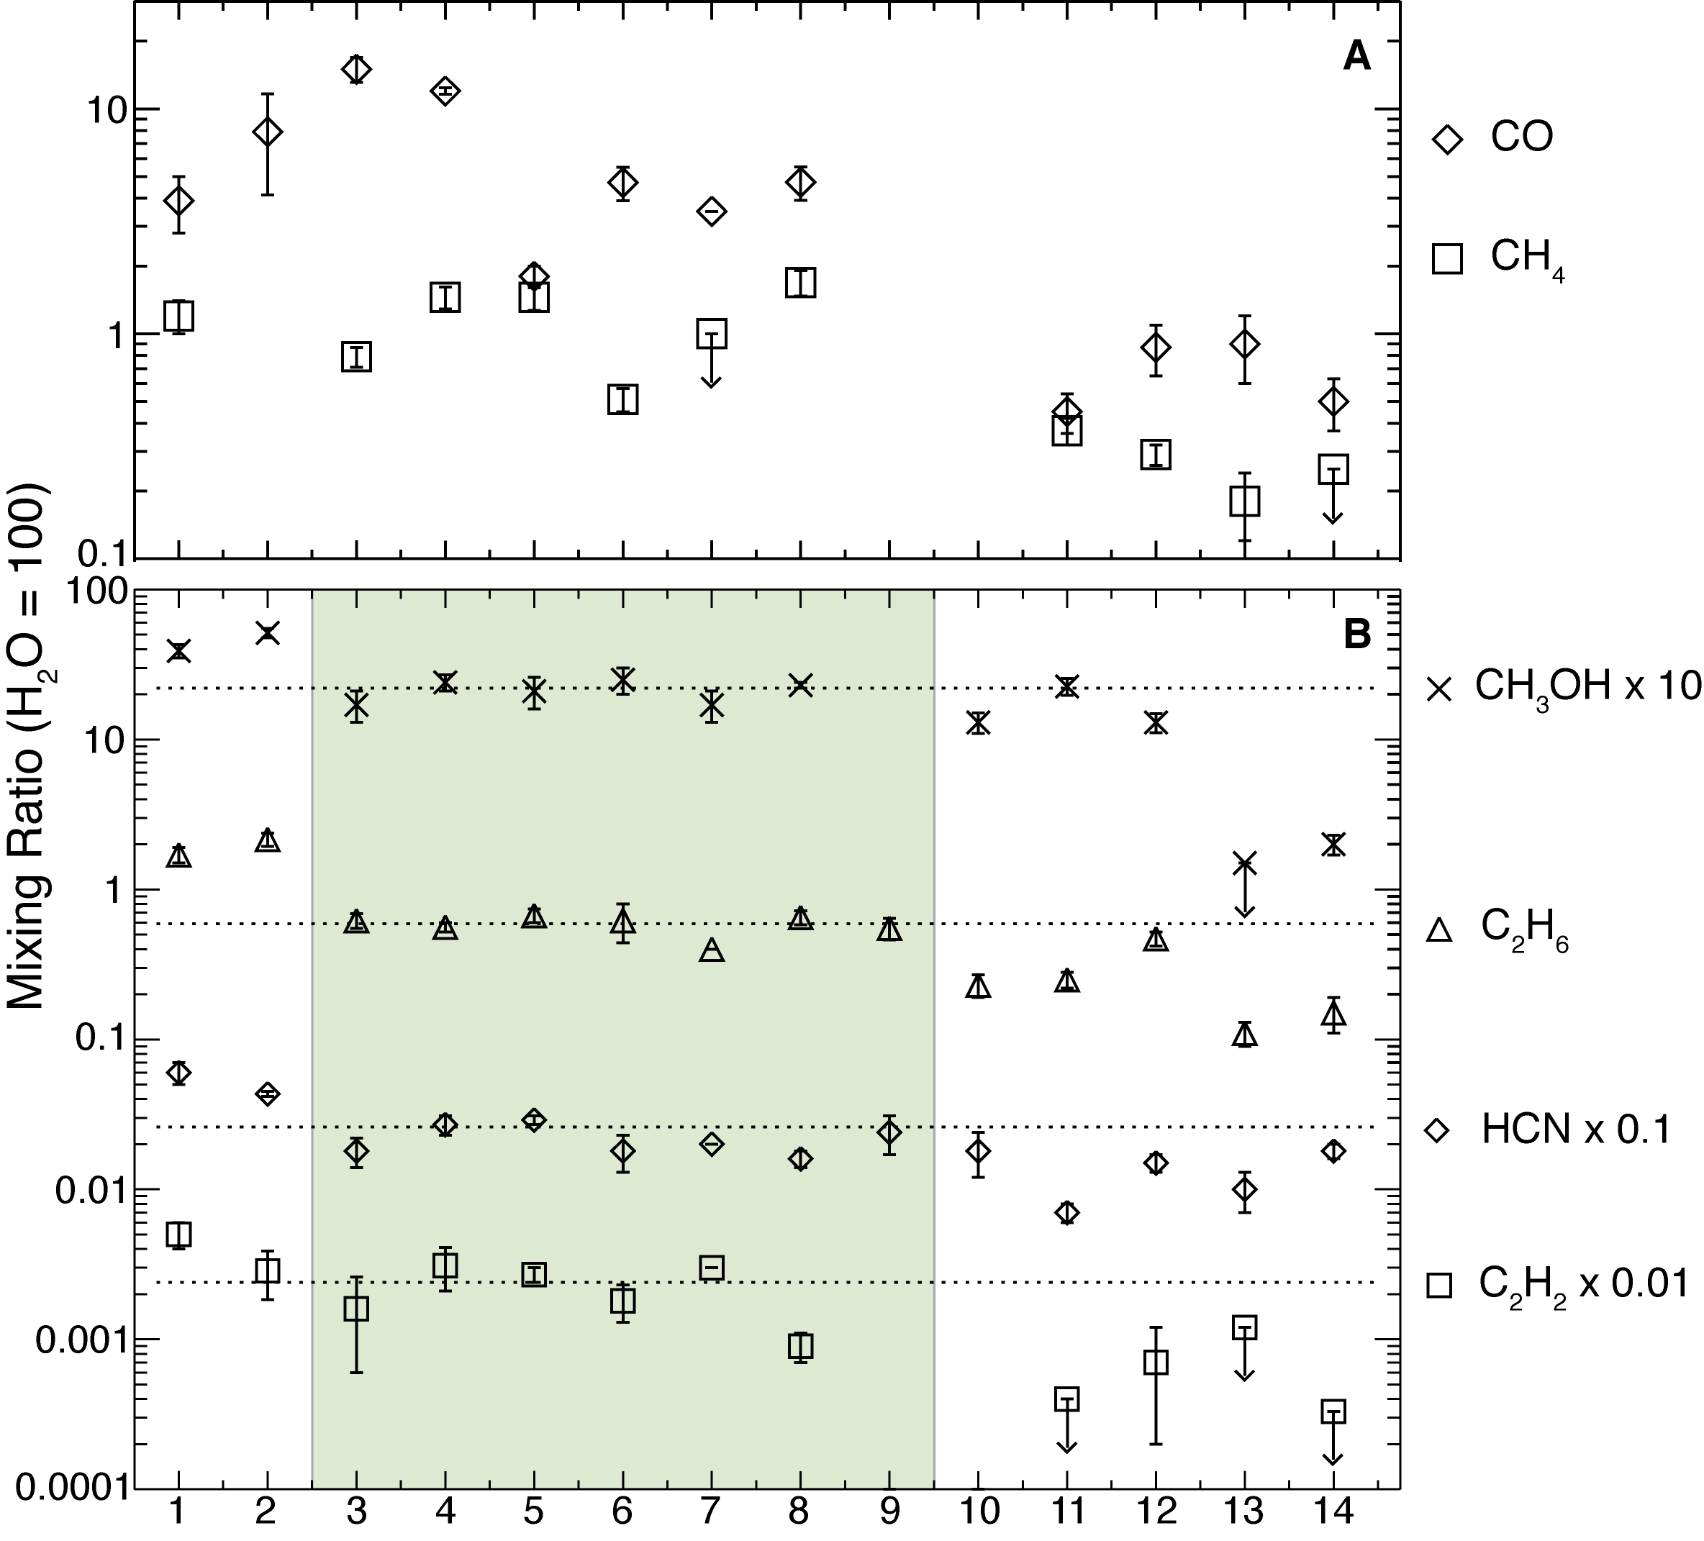
Comet Abundances
Abundances of 6 key molecules
Vary by ~1 order of magnitude for many species
CH₄ & CO do not correlate (even though they have similar volatility)
Mumma & Charnley 2011

Slide 35
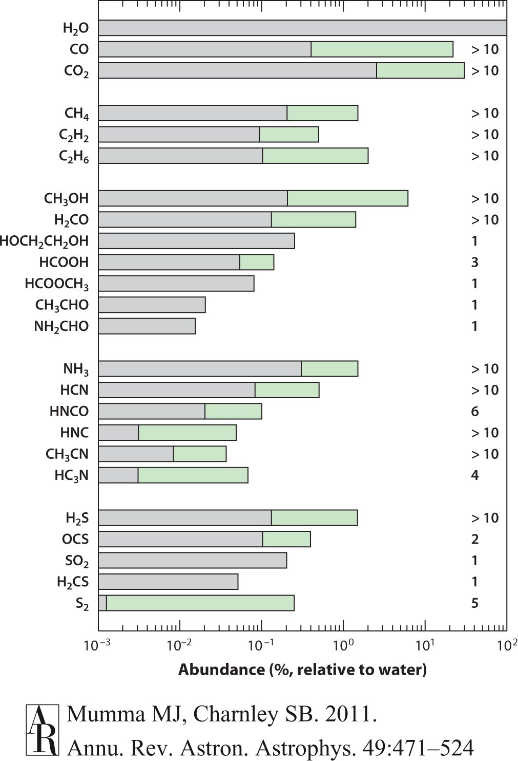
Comet Abundances
Overall composition of comets from radio & IR
Most molecules have similar abundances to those found in hot cores & ice mantles

Slide 36
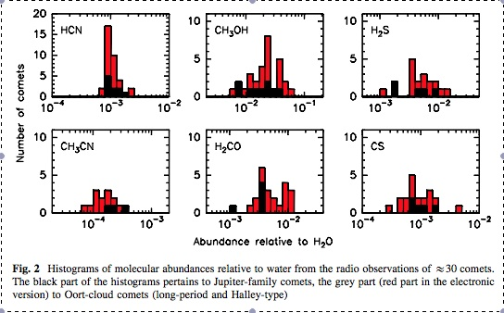
Comet Abundances
Comet abundance distributions – can these be explained by disk models?
Crovisier et al. 2009, Earth, Moon, & Planets

Slide 37
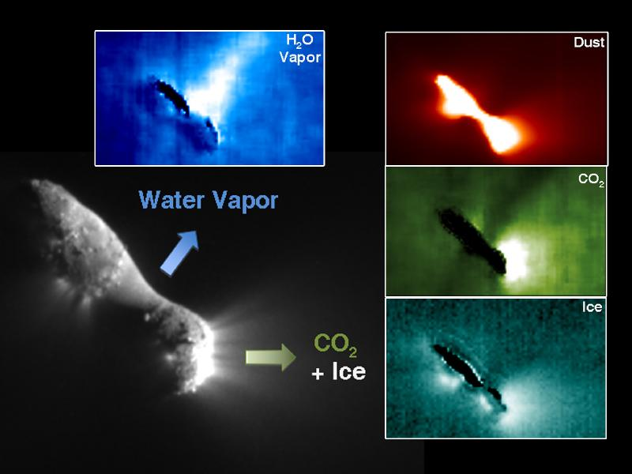
Caveat: Hartley 2 – abundances aren’t “global”?

Slide 38
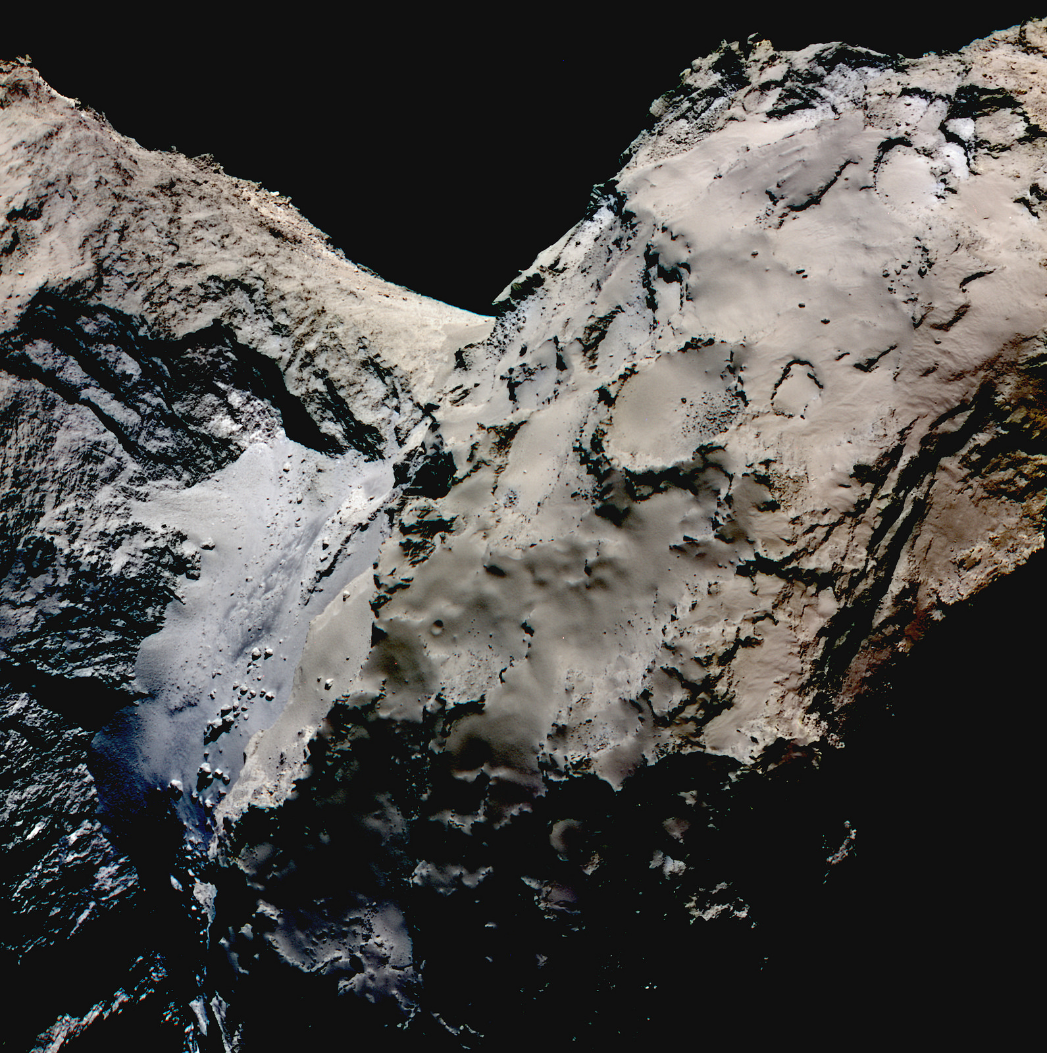
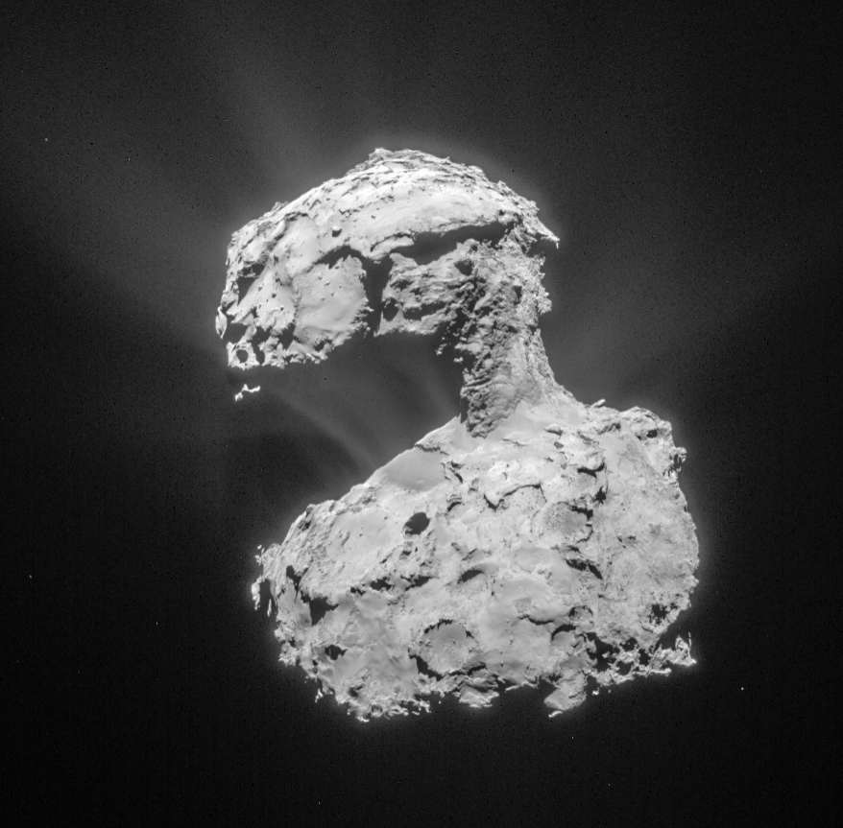
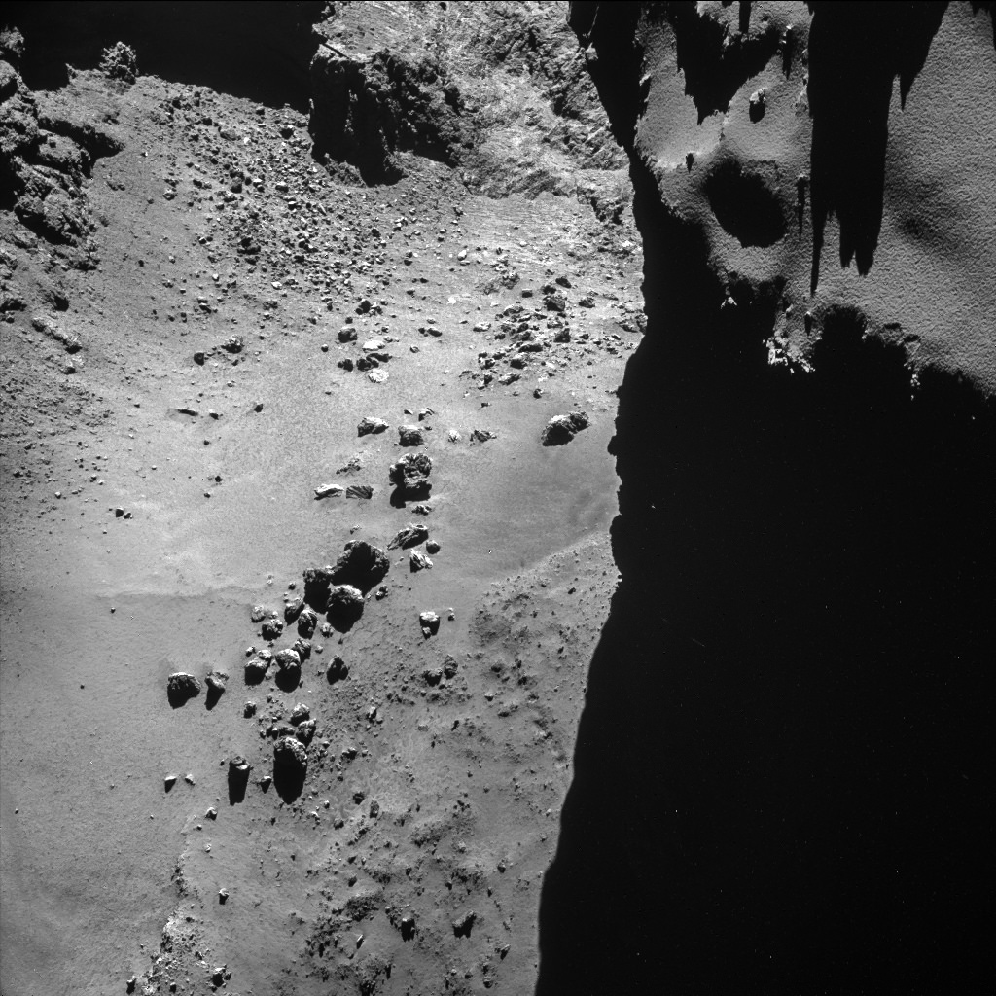
Comet 67P

Slide 39
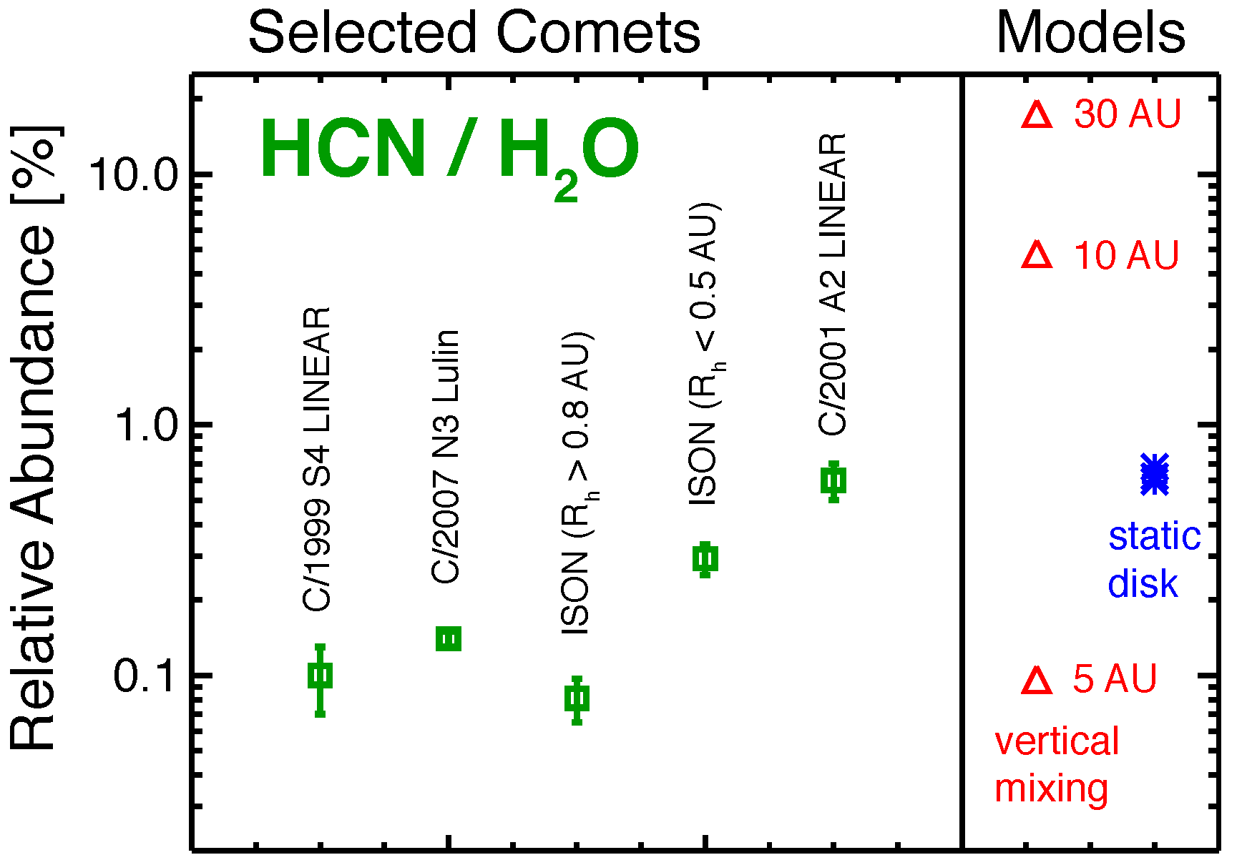
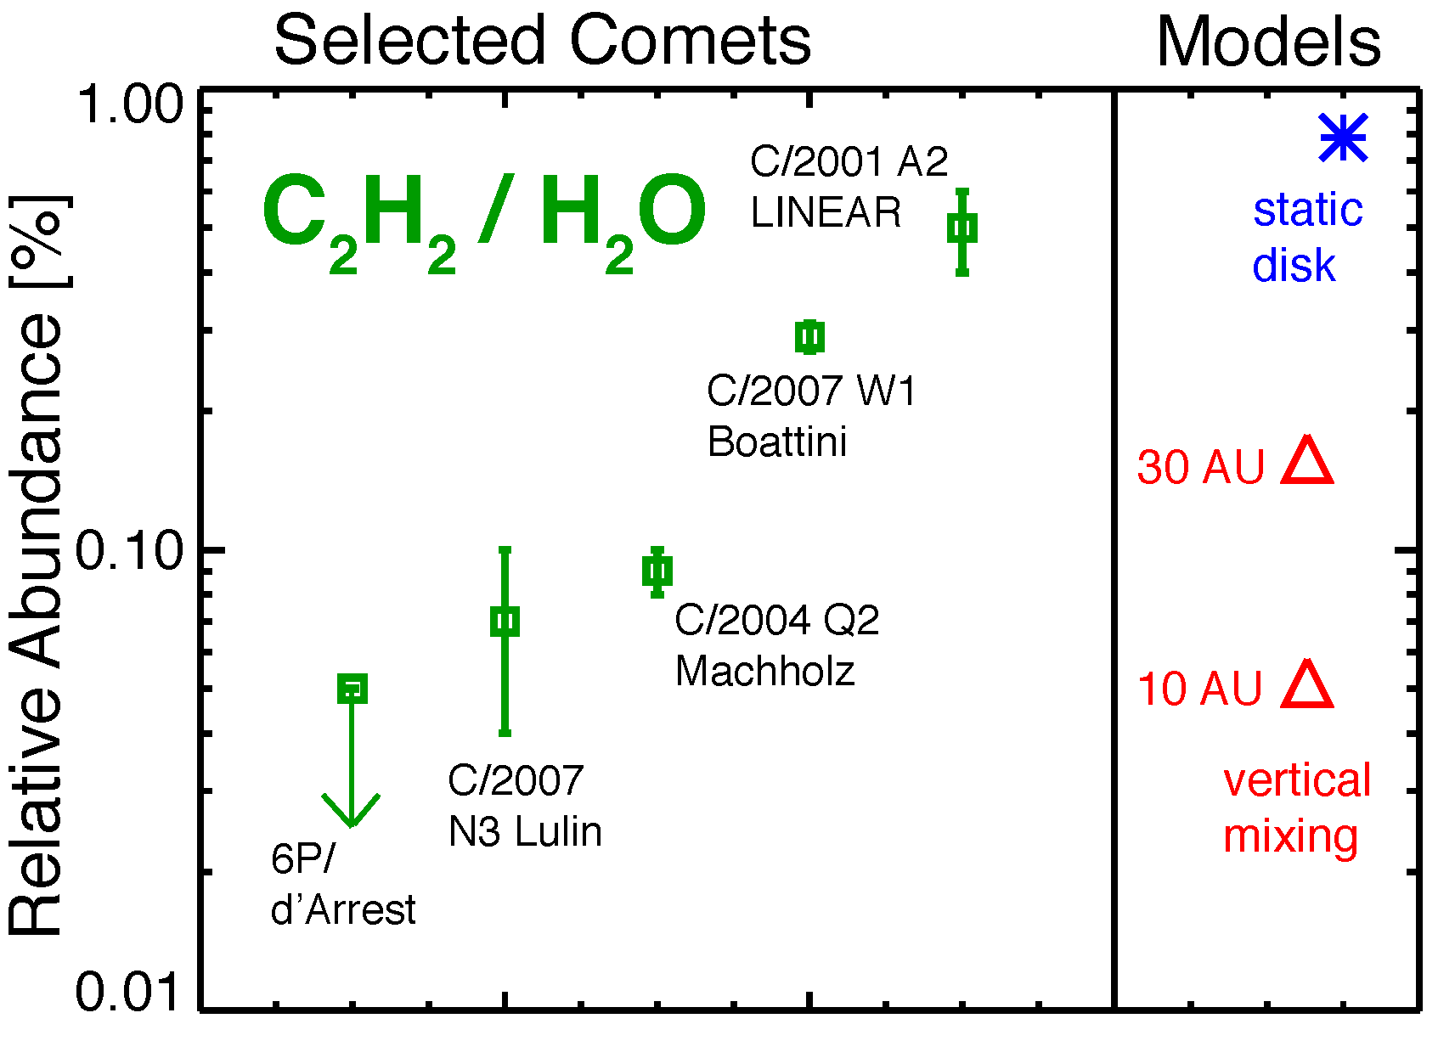
Comparison: Comets to Models
Disk models with vertical mixing that predict midplane ice abundances!
In collaboration with Karen Willacy
First results are promising

Slide 40
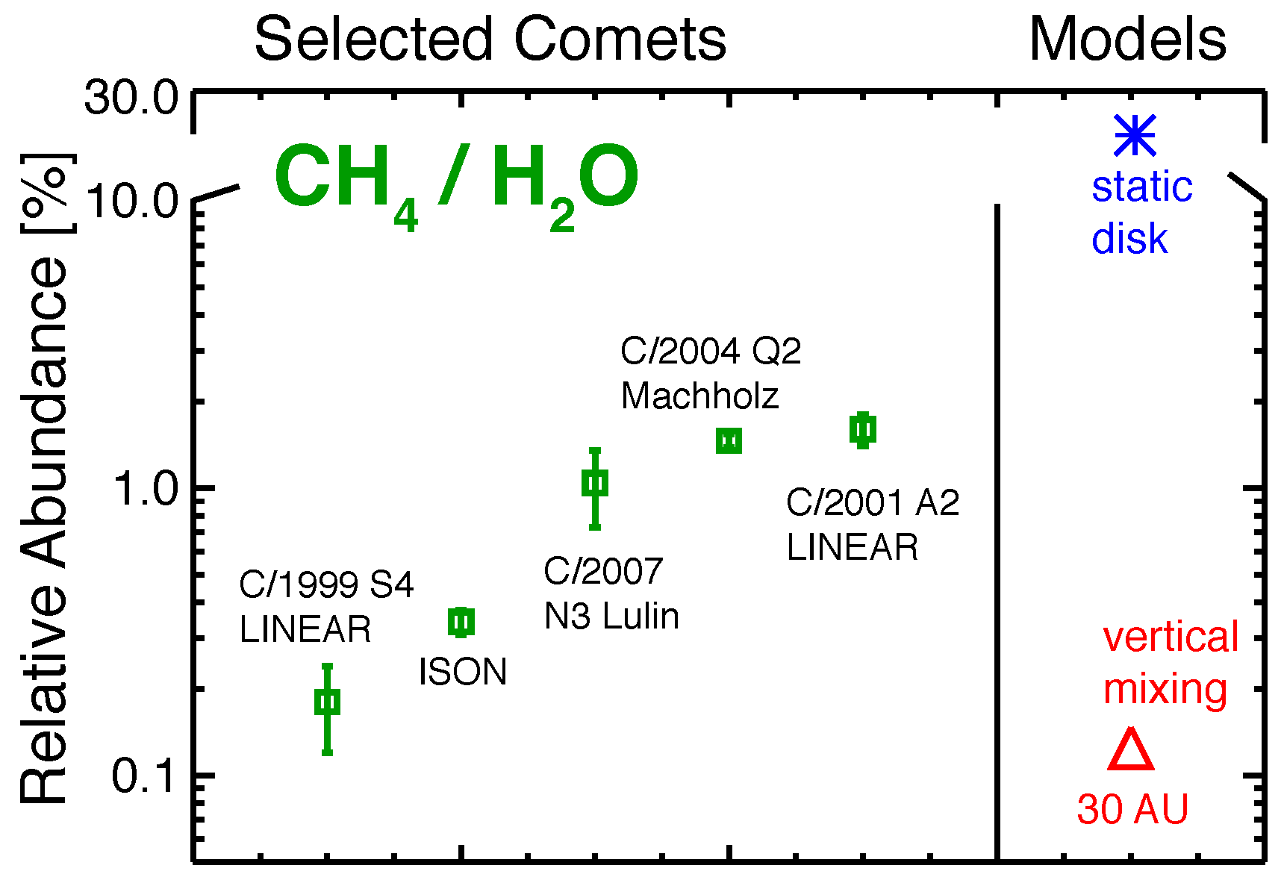
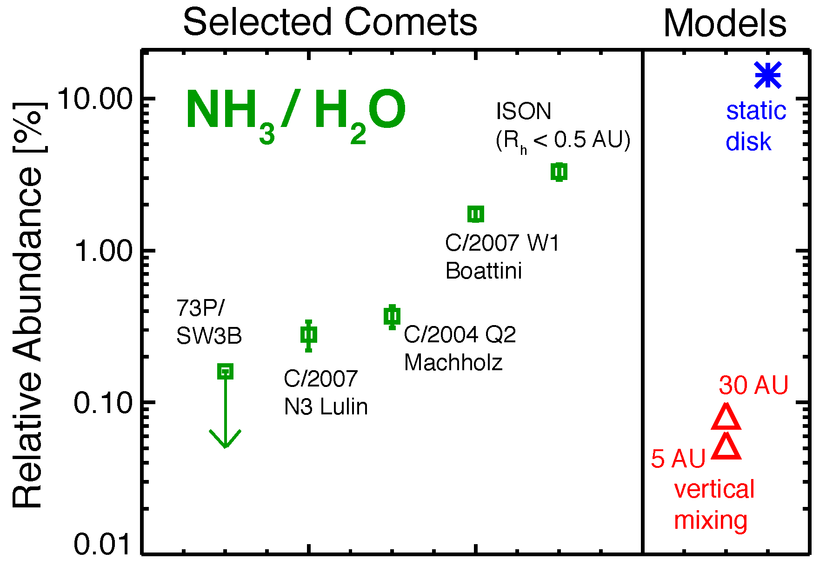
Comparison: Comets to Models
But we are not quite there yet!
Molecules that are fully hydrogenated are not well explained by the current models
  Temperature effect?

Slide 41
Comparison: Comets to Models
D/H in comets: Can we explain Earth’s ocean water with comets?

Slide 42
Comparison: Comets to Models
D/H in comets: Can we explain Earth’s ocean water with comets?
Only models with vertical mixing can explain comet D/H ratios

Slide 43
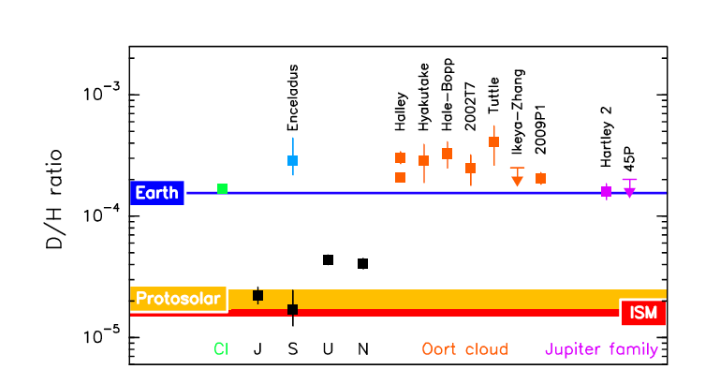
D/H Ratio in Water
Hartogh et al. 2011
Comet D/H implied they couldn’t be responsible for our oceans

Slide 44
D/H Ratio in Water
Lis et al. 2013
Emphasizes the importance of characterizing other D-bearing species!

Slide 45
D/H Ratio in Water
Lis et al. 2013
67P
Emphasizes the importance of characterizing other D-bearing species!

Slide 46
Comparison: Comets to Models
Example of HDO/H₂O disk model
Albertsson et al. 2014

Slide 47
Future Work
Disks: just beginning to determine molecular component and location to test disk models (ISSI?)
Comets:
  Midplane abundances during planet formation?
  Models indicate mixing is necessary to explain observations
In both we have small numbers: need a bigger sample

Slide 48
Acknowledgements
Students
  Logan Brown, Nathan Roth (see posters in lobby)
  Many undergraduates (Aaron Butler, Brigid Costello, Warren Li, Nicholas Moore, Cameron Nunn, Joe Oberender, Lindsey Rodgers)
Collaborators
  Boncho Bonev, Neil Dello Russo, Michael DiSanti, Michael Mumma, Lucas Paganini, Geronimo Villanueva, David Horne, Karen Willacy
Funding
  NASA Exobiology (NNX11AG44G), NASA Planetary Atmospheres, NSF Planetary Astronomy (1211362)

