Slide 1
MR NAHAL
Books open in Silence
Today’s date 01/12/08
Ready for Lesson Objectives.

Slide 2
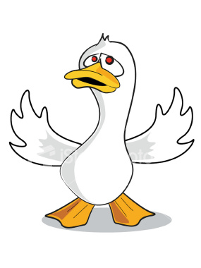
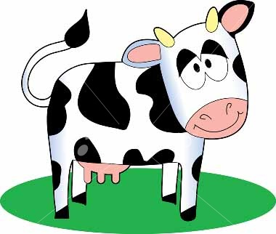

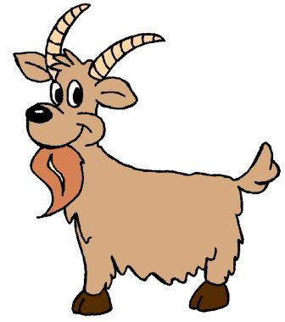
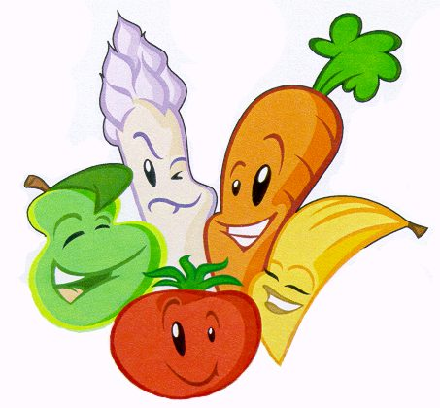
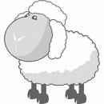
To understand the importance of Jewish food laws
Lesson Objective

Slide 3
Starter task
What is your favourite 3 course meal?
My favourite meal is.... Because...
Eg: my favourite meal is roast chicken dinner because I love chicken and roast potatoes.

Slide 4
. Recall what Kosher means and an example of Kosher and non-Kosher foods (L2)
2. Describe the meaning of Kosher and how it would influence their lives (L3)
3. Show understanding of the importance of keeping Jewish food laws for Jewish people (L4)
4. Explain in detail Kosher rules and how keeping tem gives meaning and purpose to Jewish people (L5)

Slide 5
KOSHER
“Kosher” means “ok”. When Jews say that food is kosher, they mean that Jews are allowed to eat it.

Slide 6
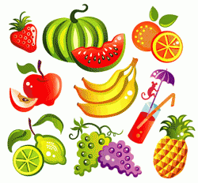
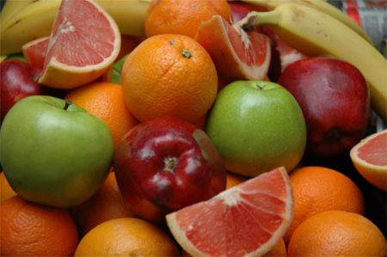
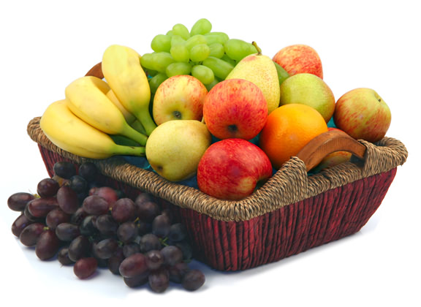
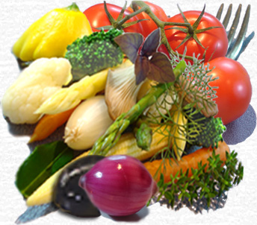
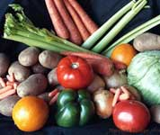
Kosher? Or Not kosher?
Lesson Objective
To understand the importance of Jewish food laws

Slide 7
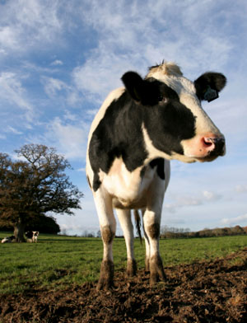
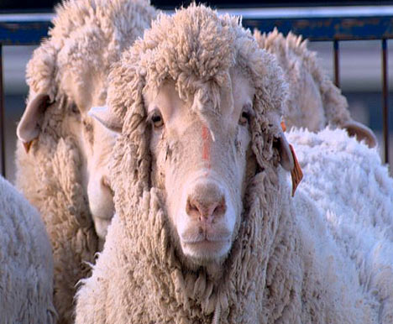
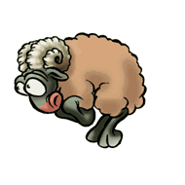
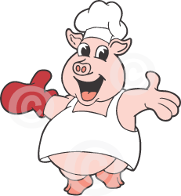
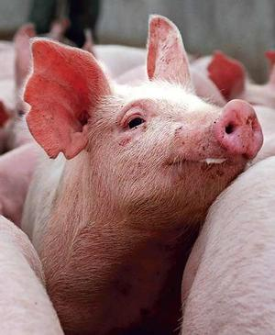
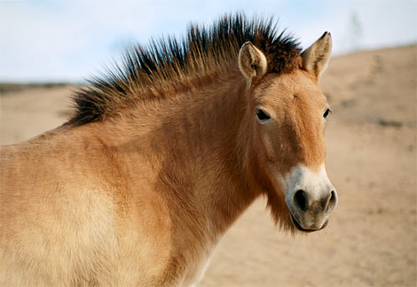

Kosher? Or Not kosher?
Lesson Objective
To understand the importance of Jewish food laws

Slide 8
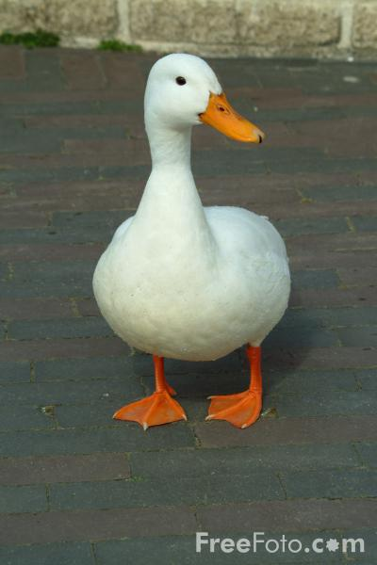
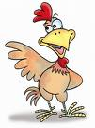


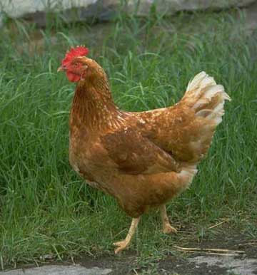
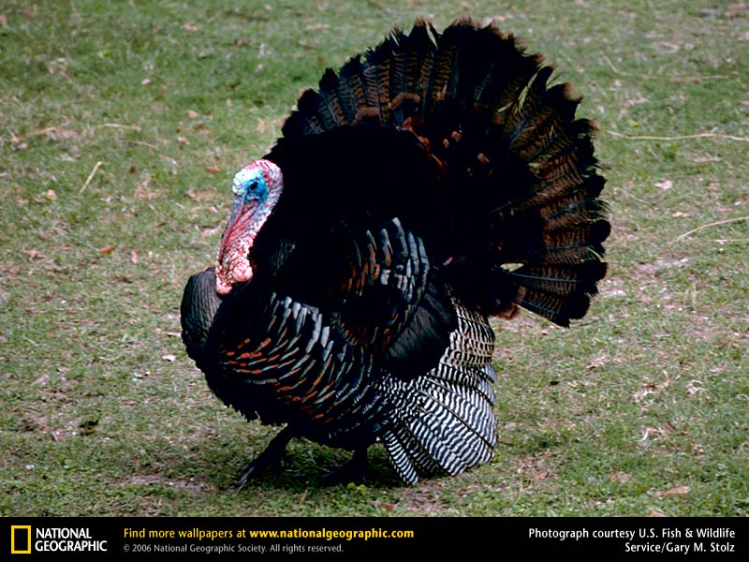
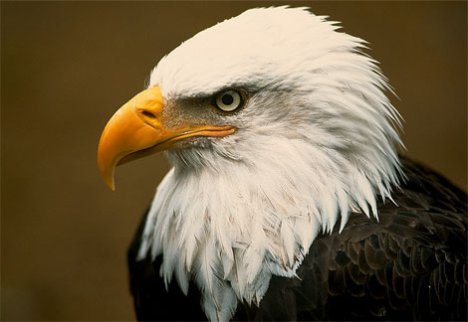

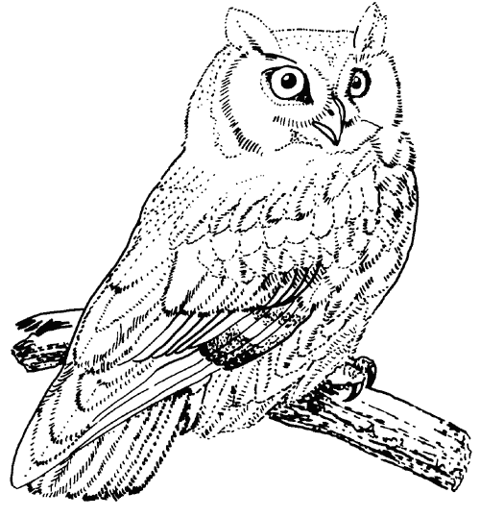



Kosher? Or Not kosher?
Lesson Objective
To understand the importance of Jewish food laws

Slide 9
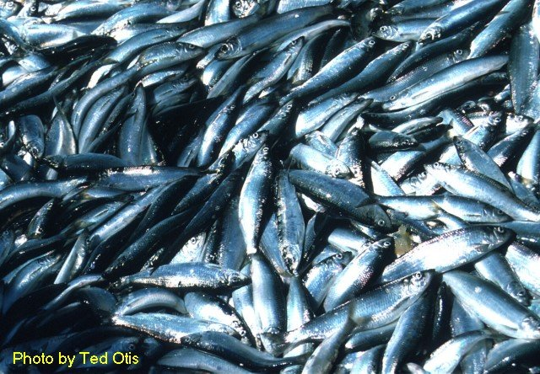
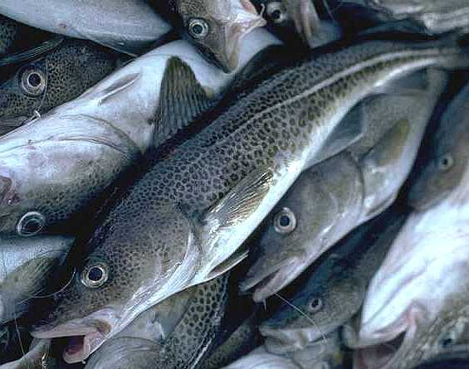
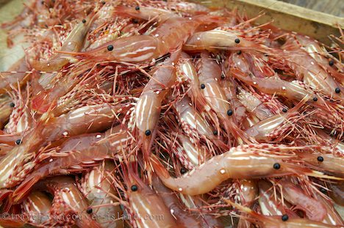
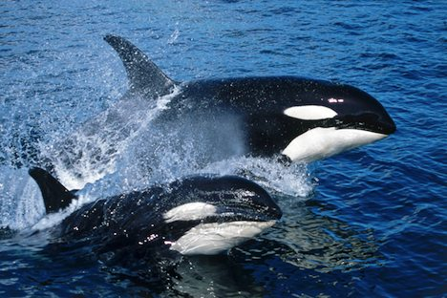
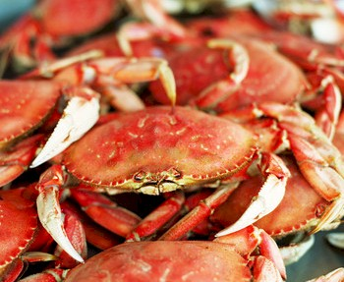
Kosher? Or Not kosher?
Lesson Objective
To understand the importance of Jewish food laws

Slide 10
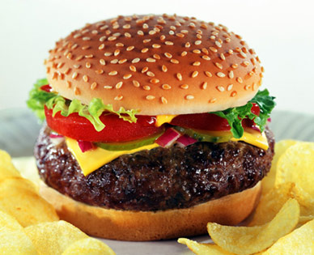
Kosher? Or Not kosher?
Lesson Objective
To understand the importance of Jewish food laws

Slide 11
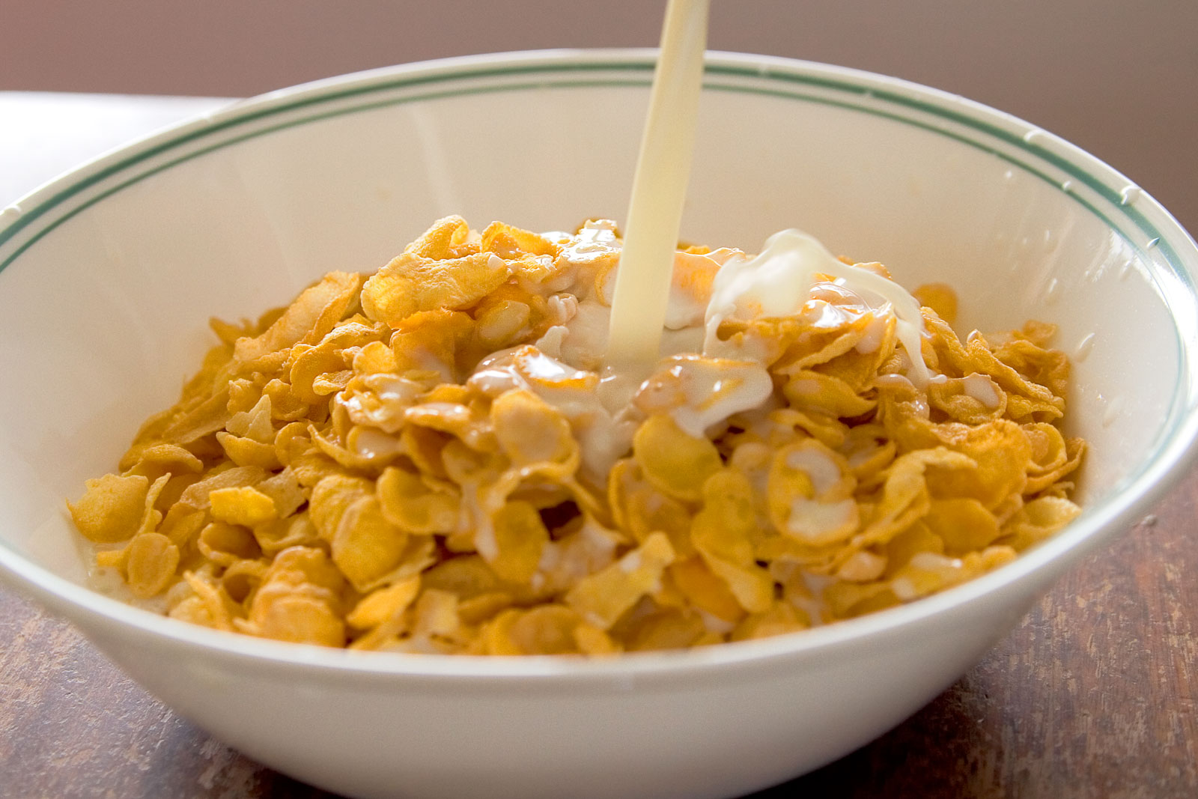
Kosher? Or Not kosher?
Lesson Objective
To understand the importance of Jewish food laws

Slide 12
Could the following meals be eaten?
Cheese burger
Bacon sandwich
Roast beef and vegetables
Fish and chips
Chicken and roast potatoes
Ham sandwich
What did you have for tea last night? If you were Jewish would you have been able to have it?

Slide 13
Kosher Plate
Draw a plate and create a Kosher meal for some Jewish guests who are coming to your house
Fish fingers, cod, salmon, herring
. Water Animals
Plants
Carrots, peas, rice, potatoes, salad, fruit
Birds
Chicken, duck, goose, turkey
Land mammals
Beef, goat, lamb
My meal is...... This is a Kosher meal because......

Slide 14
Hands up if you can......
Lesson Objective
To understand the importance of Jewish food laws
1. Recall what Kosher means and an example of Kosher and non-Kosher foods (L2)
2. Describe the meaning of Kosher and how it would influence their lives (L3)
3. Show understanding of the importance of keeping Jewish food laws for Jewish people (L4)
4. Explain in detail Kosher rules and how keeping tem gives meaning and purpose to Jewish people (L5)

Slide 15
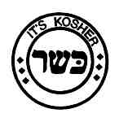




HOMEWORK
Homework Planners out please: RS
Design a Kosher sticker for food products suitable for Jews. Use pictures, symbols, lettering. It must be recognisable and clear that the product abides by JEWISH FOOD LAWS. (make it colourful)
Planners out please at stamp page.

Slide 16
