Slide 1
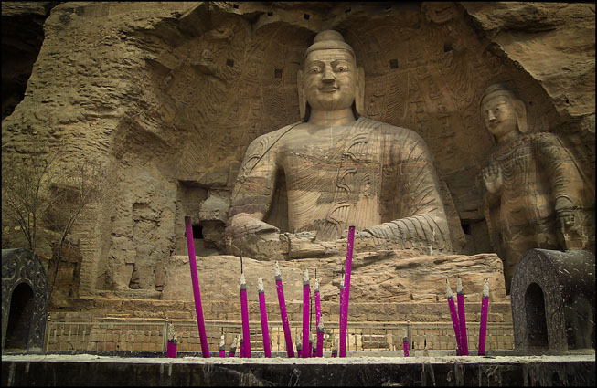
Buddhism: Vesak Day May 18, 2011
celebrate the birth, enlightenment, and death of Buddha

Slide 2
The Celebration
Commonly called "Budda's birthday," Vesak Day is a time for Buddhists worldwide to come together and celebrate the birth, enlightenment, and death of Buddha. The commemorations range from meditations and quiet prayers to alms giving events to long colorful processions. In Indonesia, such events take place at the Borobudur Mahayana Buddhist monument, making it the most visited tourist attraction in the country. Vesak is observed every year during the full moon occurring in May or June. -- Lloyd Young

Slide 3
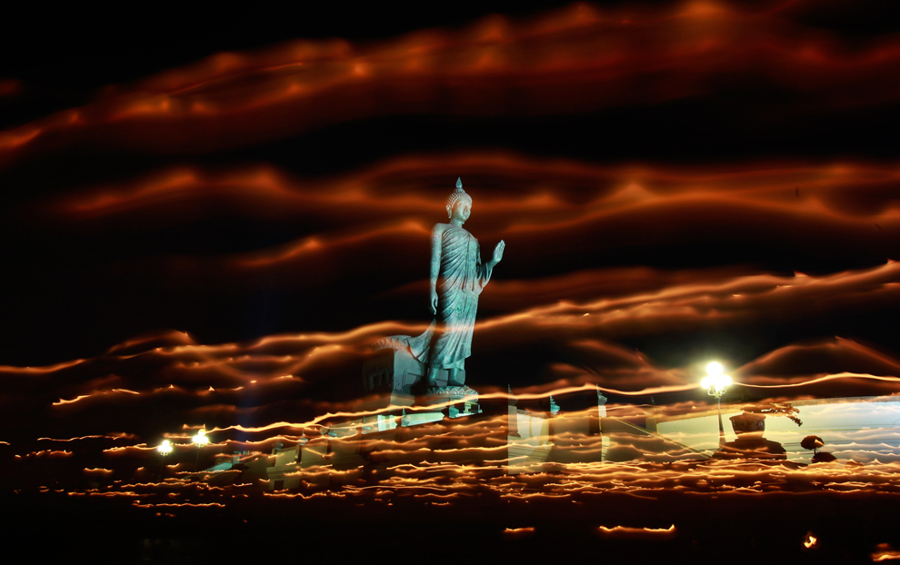
Buddhists carry candles while encircling a large Buddha statue

Slide 4
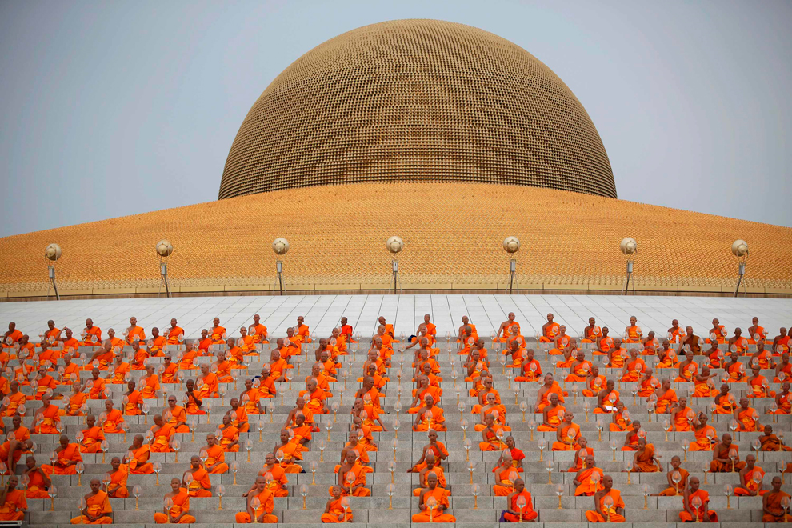
Prayer at Wat Dharmmakaya in Pathum Thani province

Slide 5
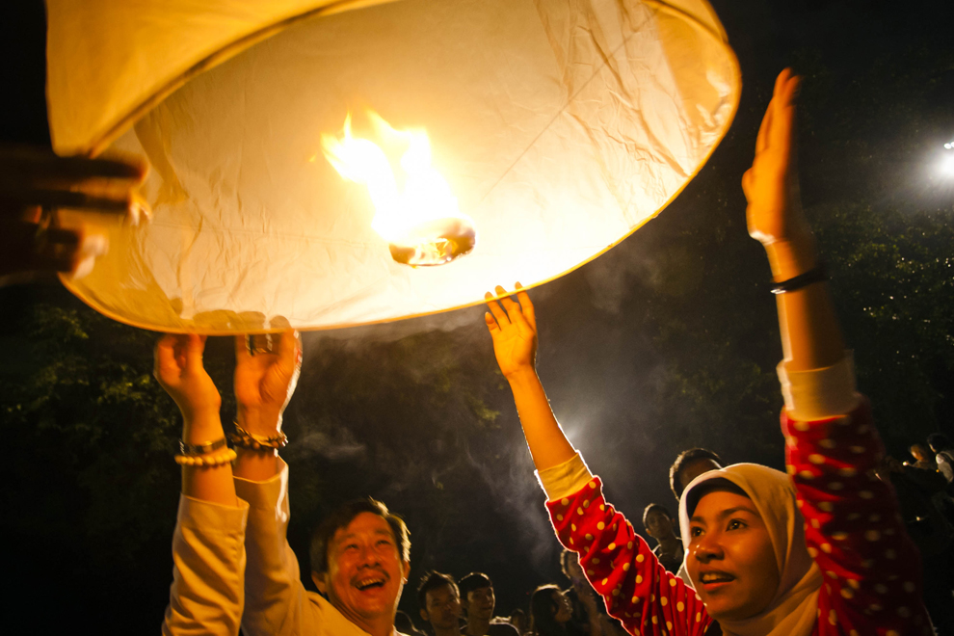
Muslim woman with Buddhist followers

Slide 6
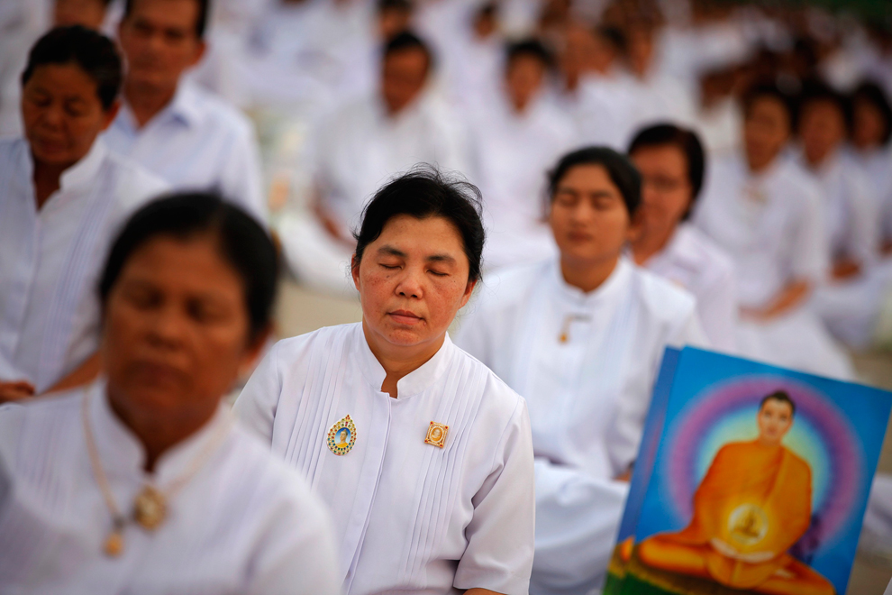

Slide 7
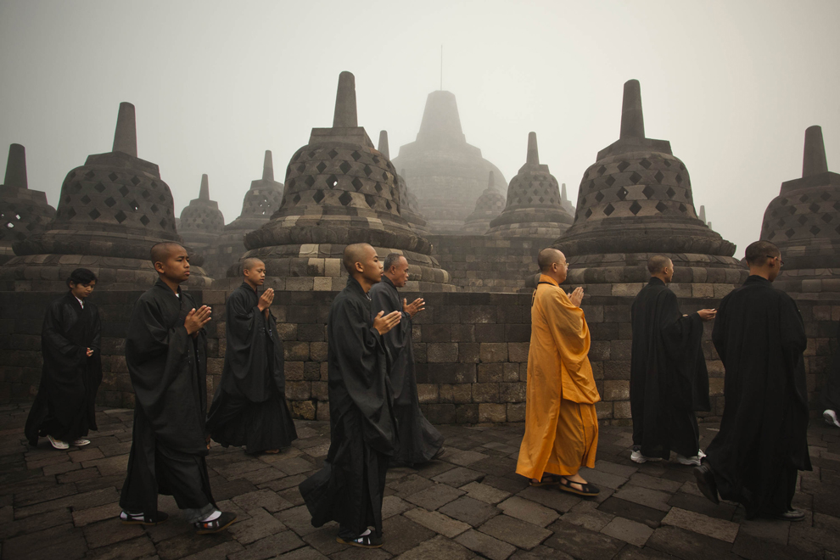
Borobudur temple in Magelang, Indonesia

Slide 8
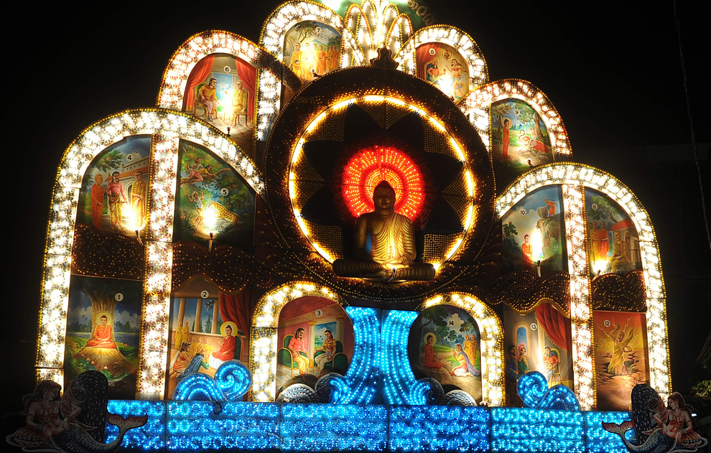
Buddhist festival in Colombo, Sri Lanka

Slide 9
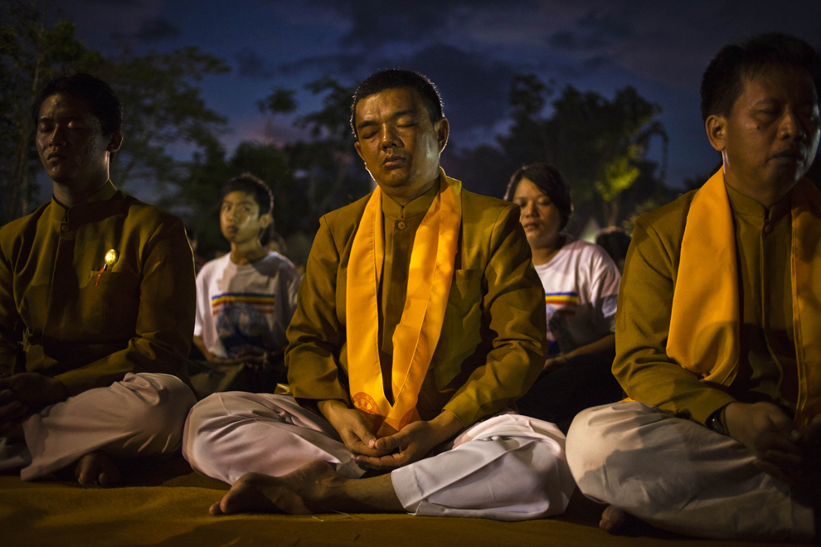
Buddhist followers in meditation

Slide 10
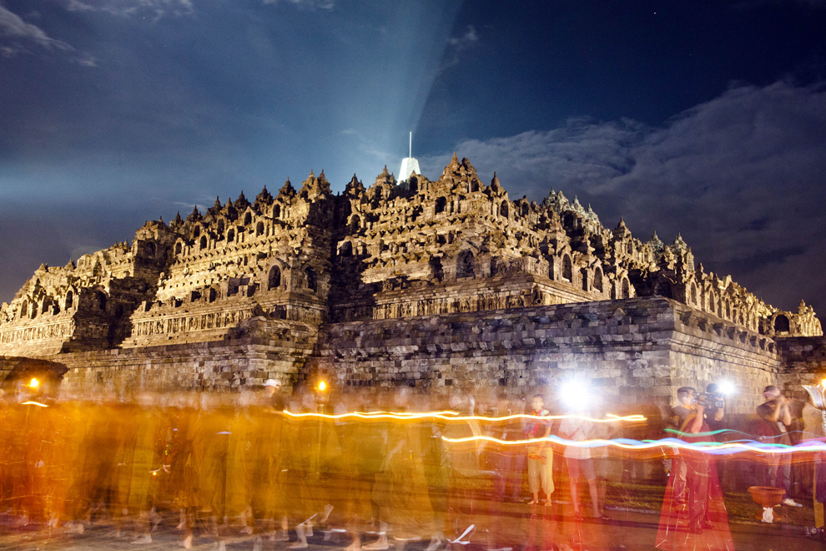
A view of Borobudur temple

Slide 11
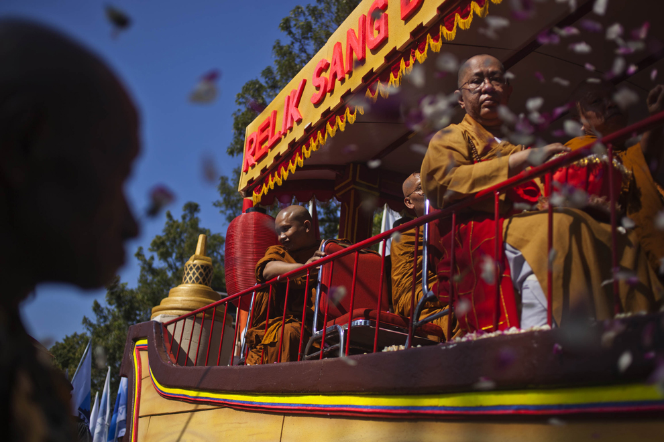
procession from Mendut temple to Borobudur temple

Slide 12
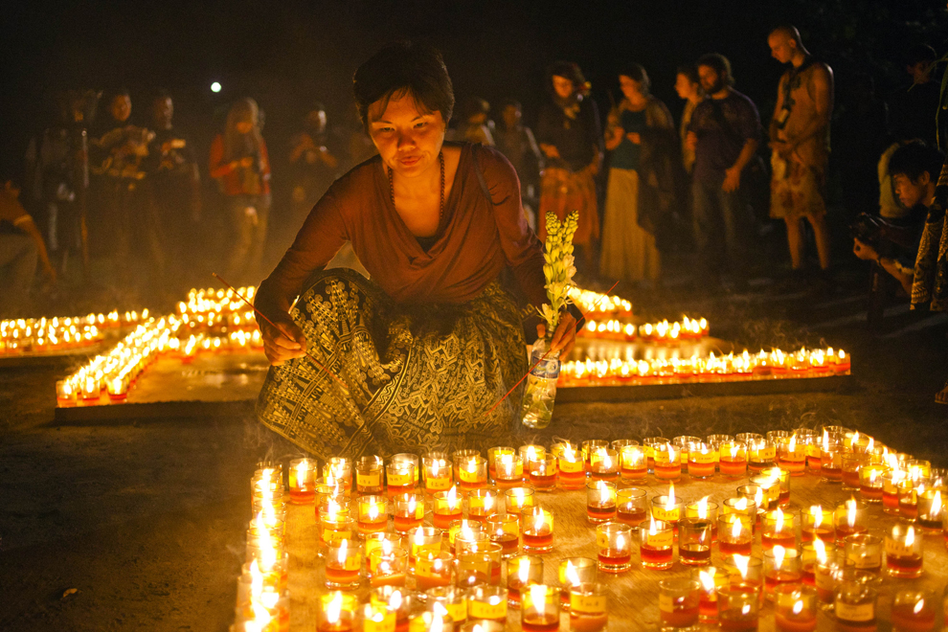

Slide 13
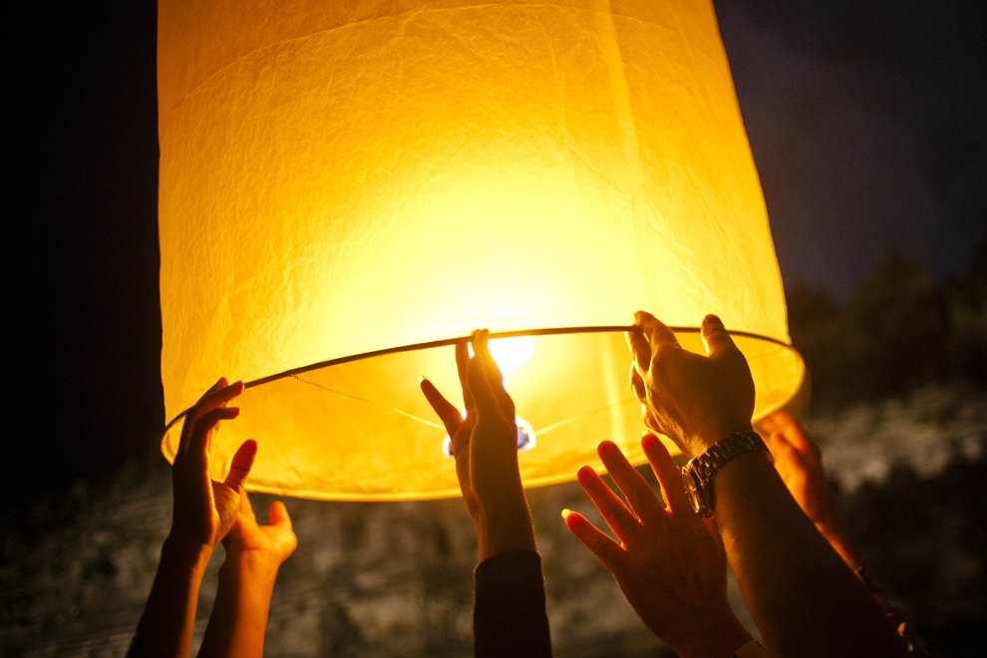
Buddhist followers release a lantern into the air

Slide 14
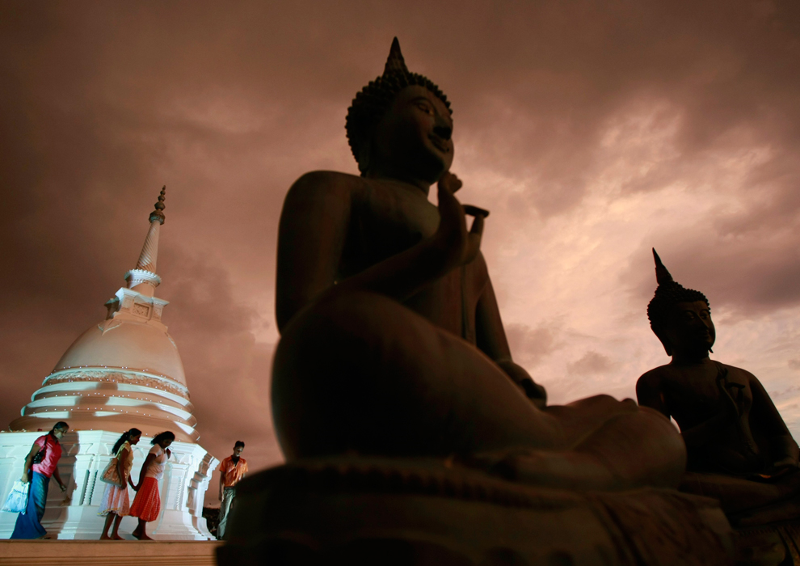

Slide 15
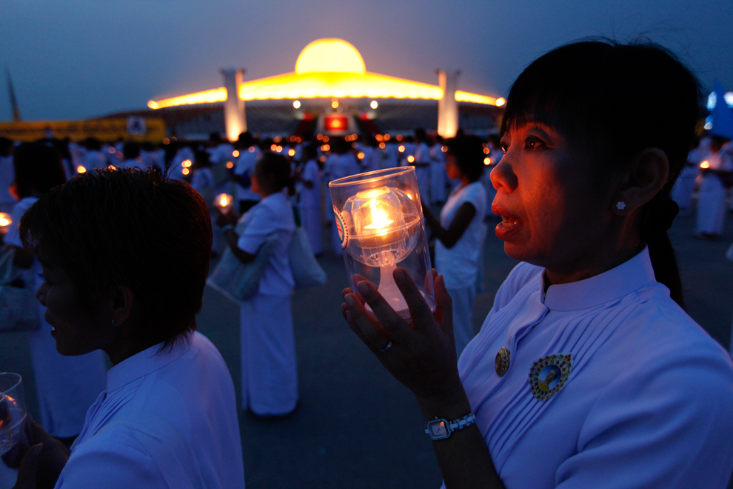
Buddhists carry candles while encircling Wat Dharmmakaya

Slide 16
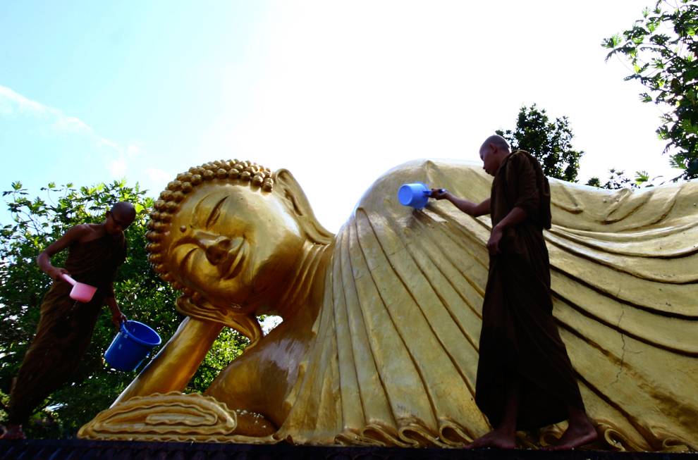
Dhammadipa Arama temple in Malang town in Eastern Java

Slide 17
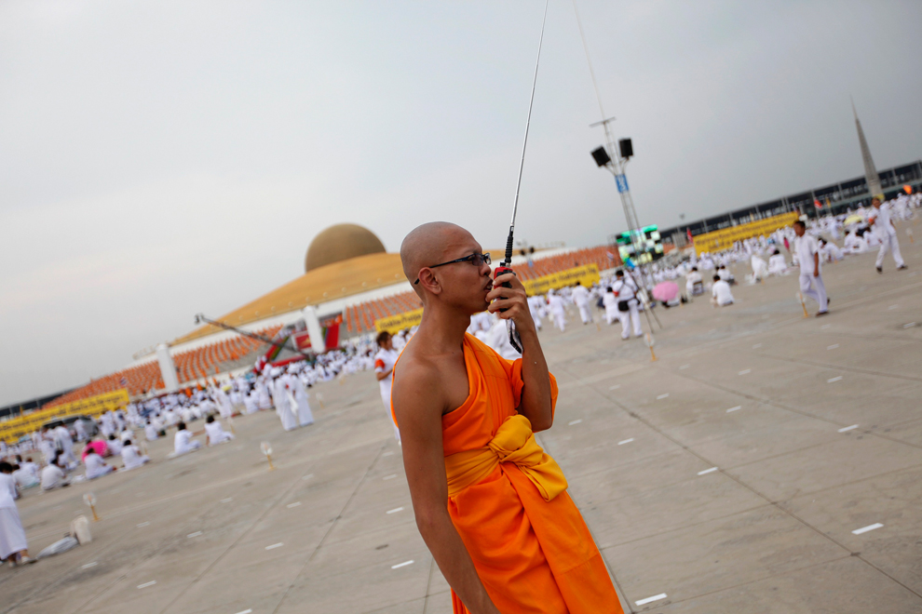
Giving instructions to others arriving for a prayer

Slide 18
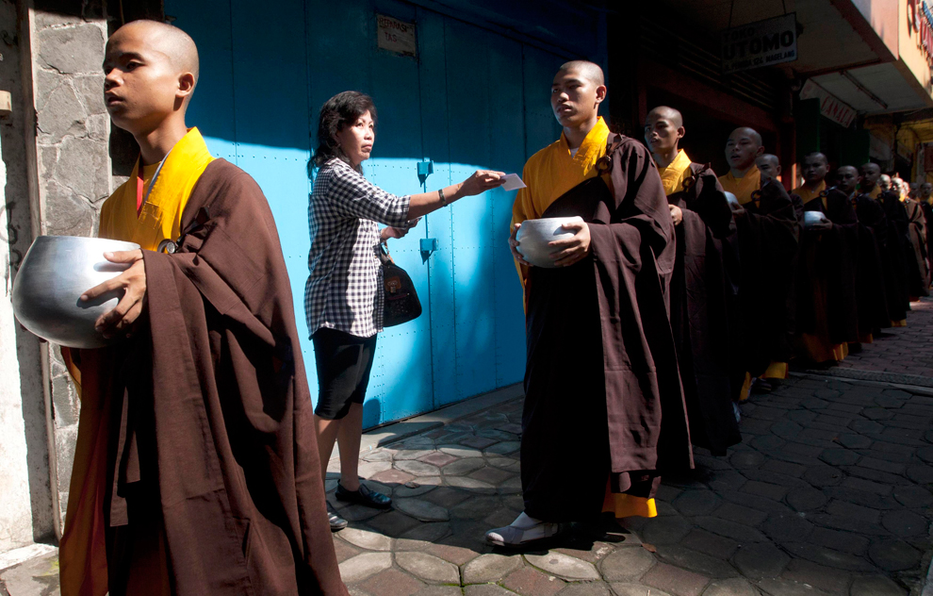
A resident gives a donation to Buddhists monks

Slide 19
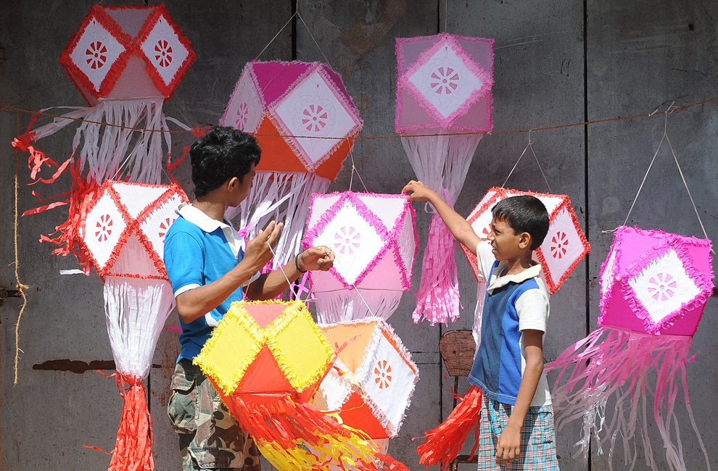
On Vesak Day, lanterns made from bamboo frames and decorated in coloured paper are hung inside every home

Slide 20
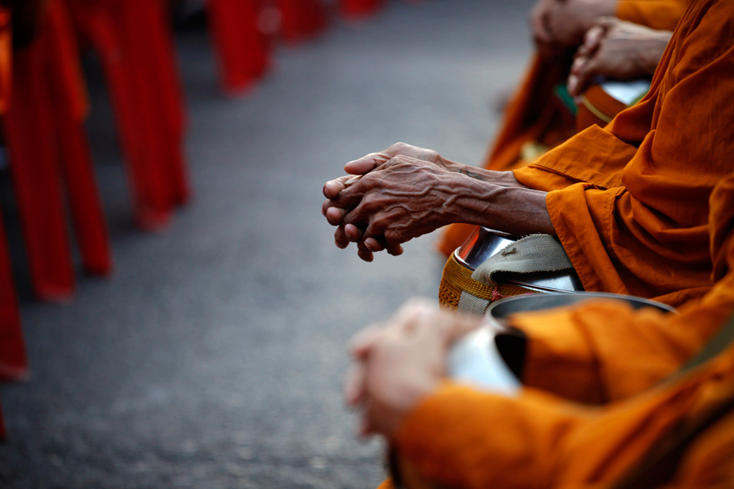
Buddhist monks attend an alms offering ceremony

Slide 21
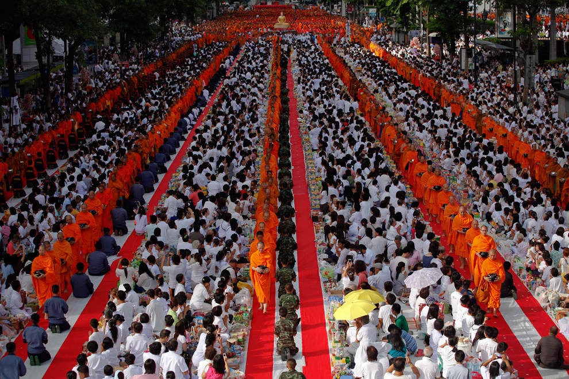
Buddhist monks walk among believers during an alms offering ceremony in Bangkok's shopping district

Slide 22
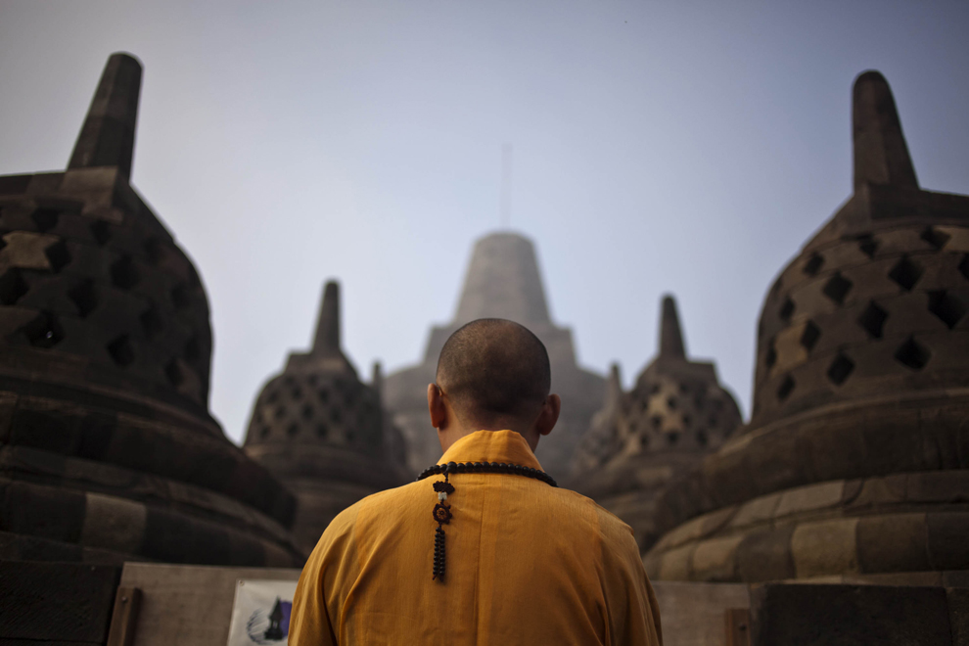
A Buddhist monk prays

Slide 23
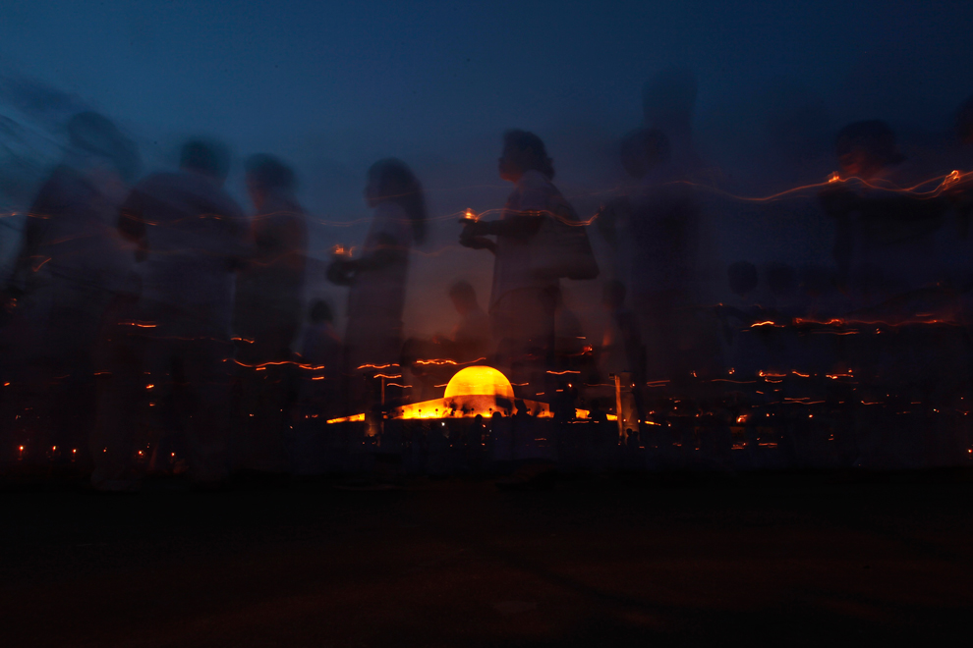
Buddhists carry candles while encircling Wat Dharmmakaya

Slide 24
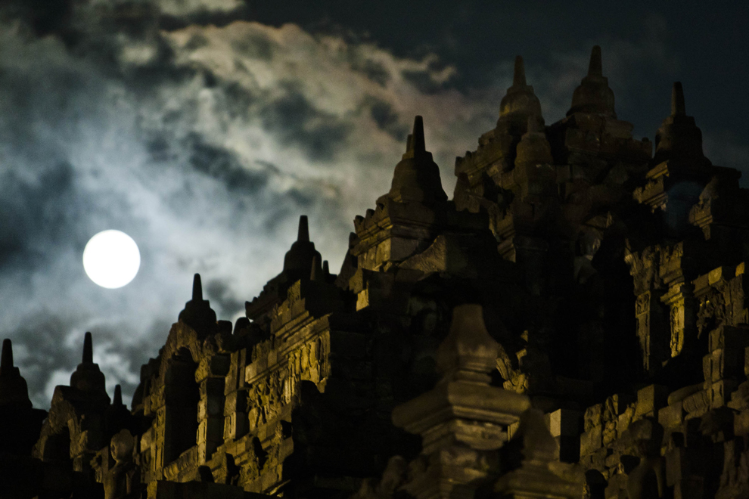
Borobudur temple during Vesak Day

Slide 25
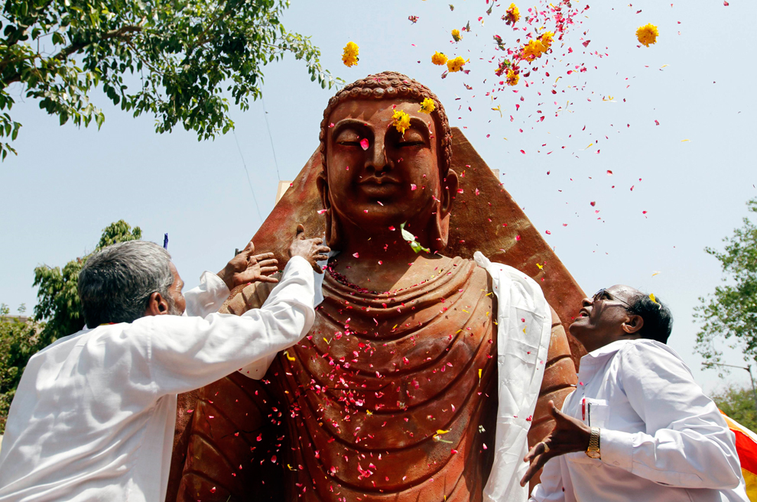
Ahmedabad, India

Slide 26
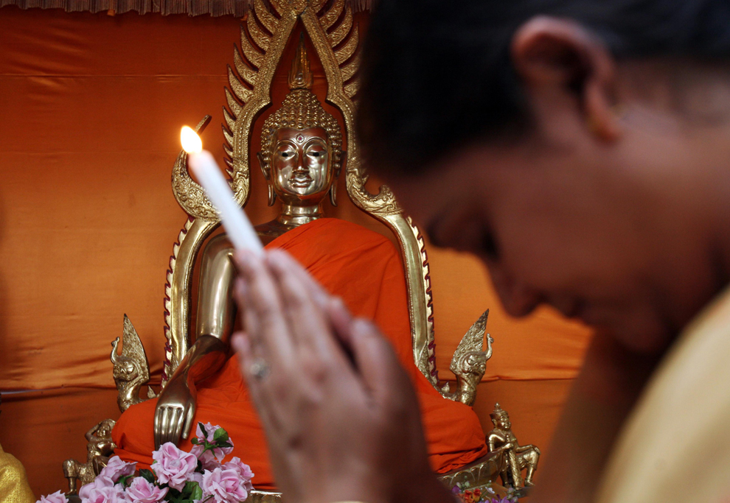
A devotee offers prayers

Slide 27
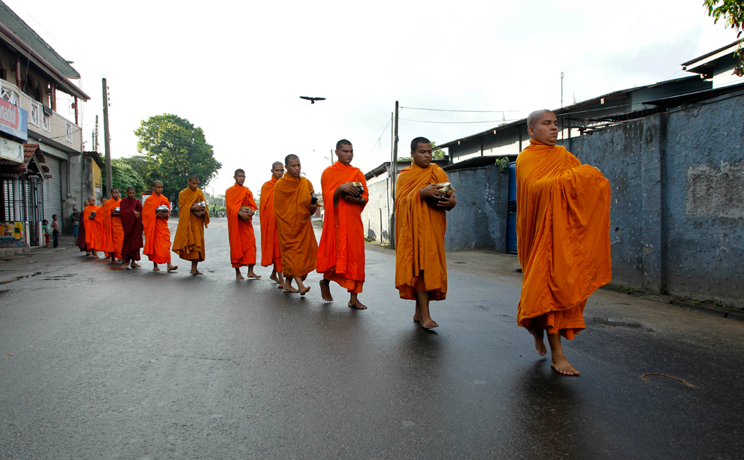
Buddhist monks from Bangladesh parade on a street during a ceremony to mark the religious week

Slide 28
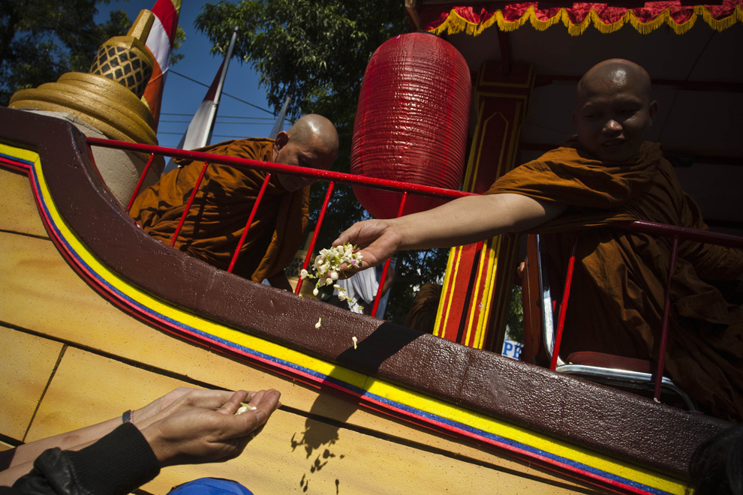
Buddhist monks give holy flowers to Buddhist members

Slide 29
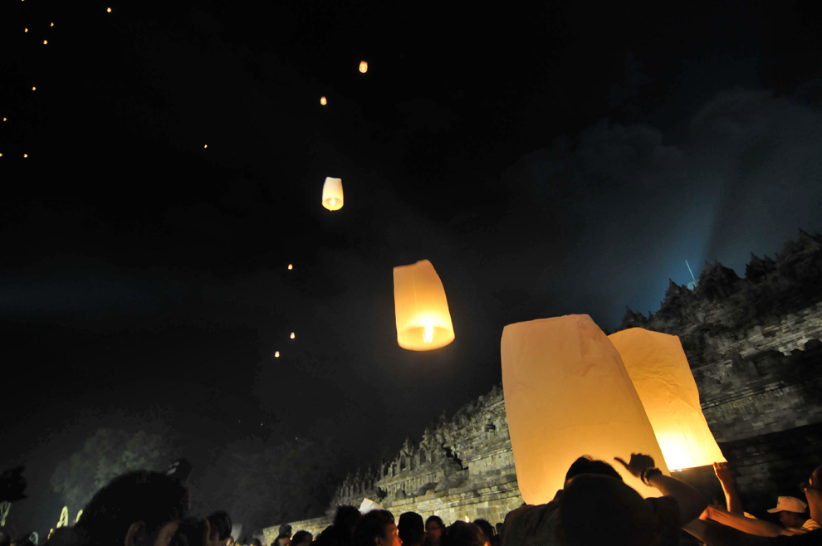
Buddhist devotees release flying lanterns during Vesak Day celebrations at the ancient Borobudur temple in Magelang town in Central Java province

