Slide 1
Spain – Granada – the Alhambra

Slide 2
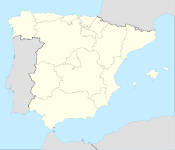

Slide 3
The Alhambra, the complete form of which was Calat Alhambra, is a palace and fortress complex located in the Province of Granada, Spain. It was constructed during the mid 14th century by the Moorish rulers of the Emirate of Granada in al-Andalus, occupying the top of the hill of the Assabica on the southeastern border of the city of Granada. The Alhambra's Moorish palaces were built for the last Muslim Emirs in Spain and its court, of the Nasrid dynasty. After the Reconquista (reconquest) by the Reyes Católicos ("Catholic Monarchs") in 1492, some portions were used by the Christian rulers. The Palace of Charles V, built by Charles V, Holy Roman Emperor in 1527, was inserted in the Alhambra within the Nasrid fortifications. It is now one of Spain's major tourist attractions.

Slide 4
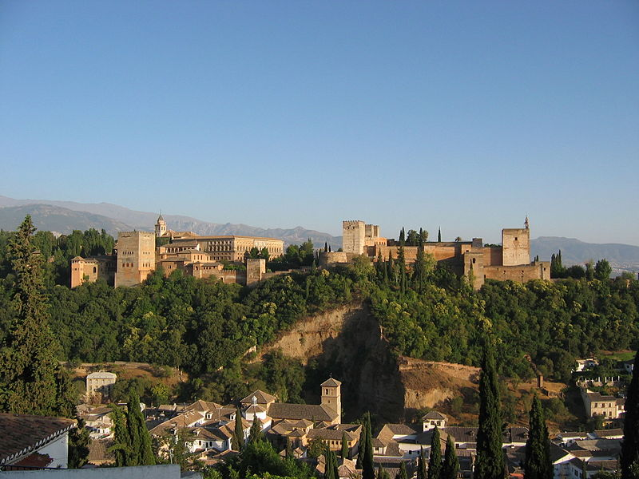

Slide 5
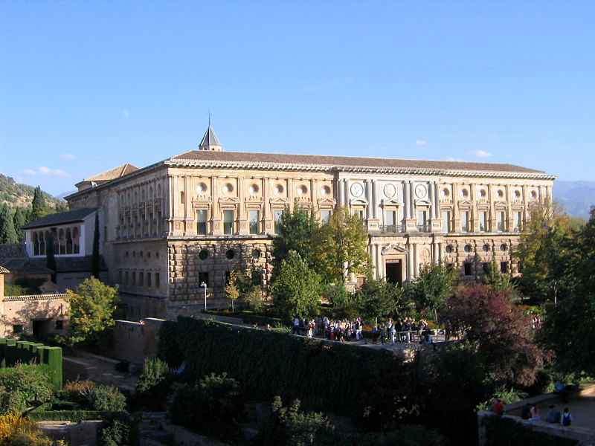

Slide 6
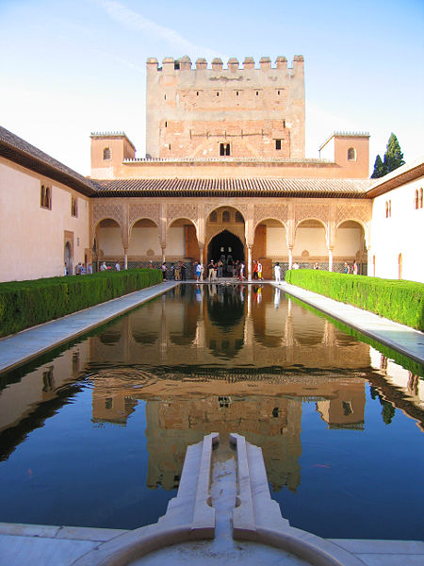

Slide 7
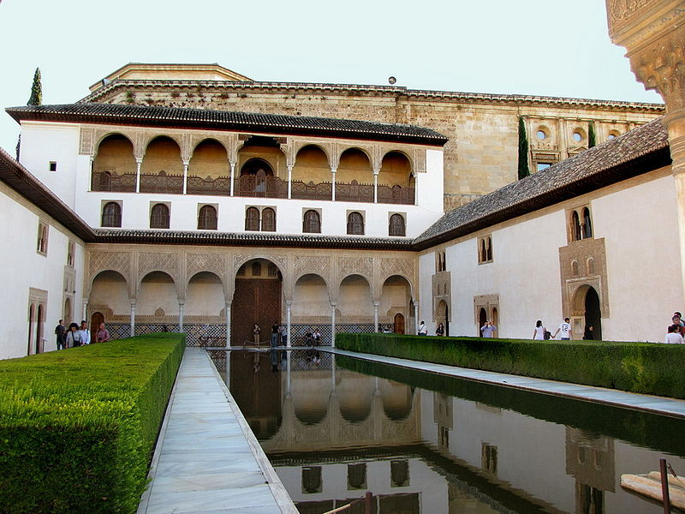

Slide 8
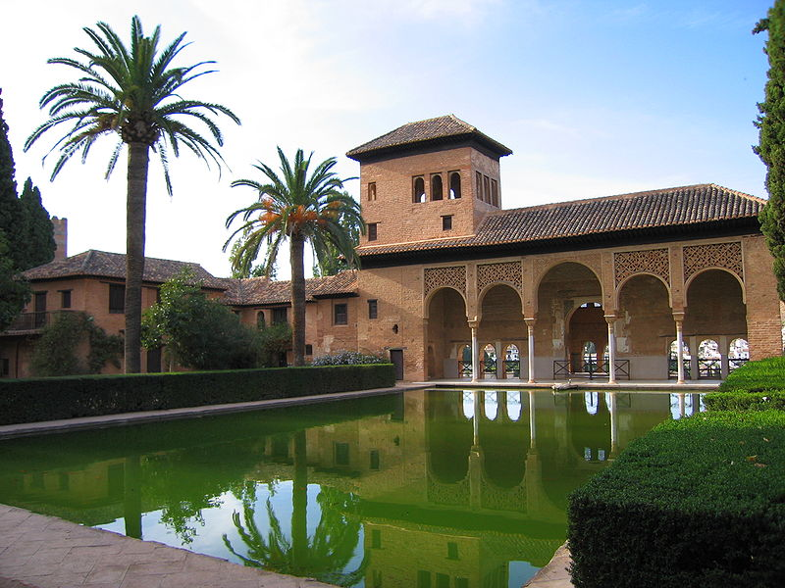

Slide 9
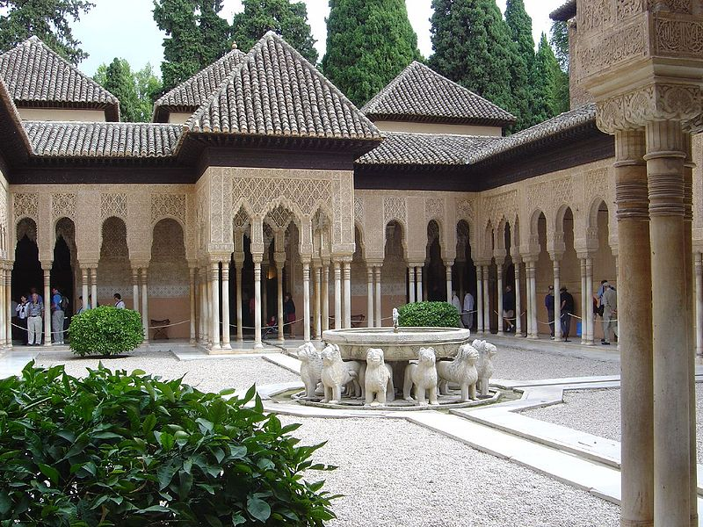

Slide 10
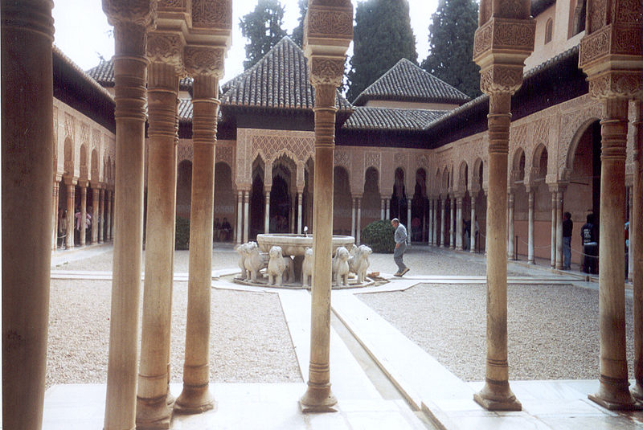

Slide 11
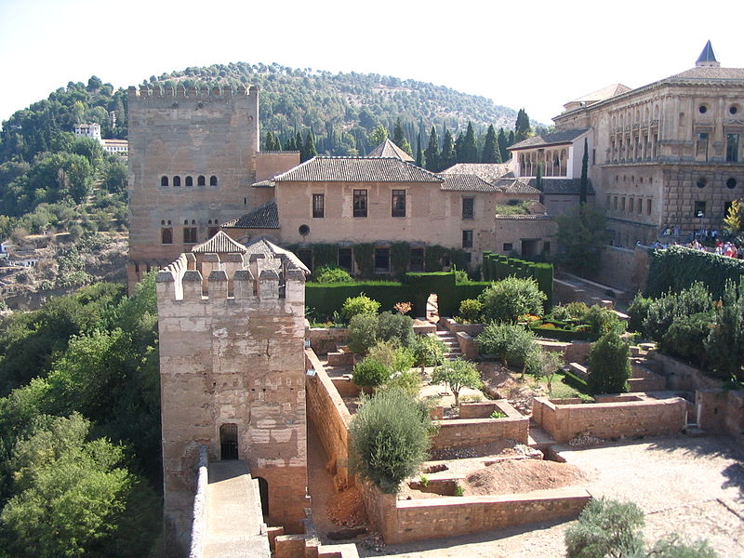

Slide 12
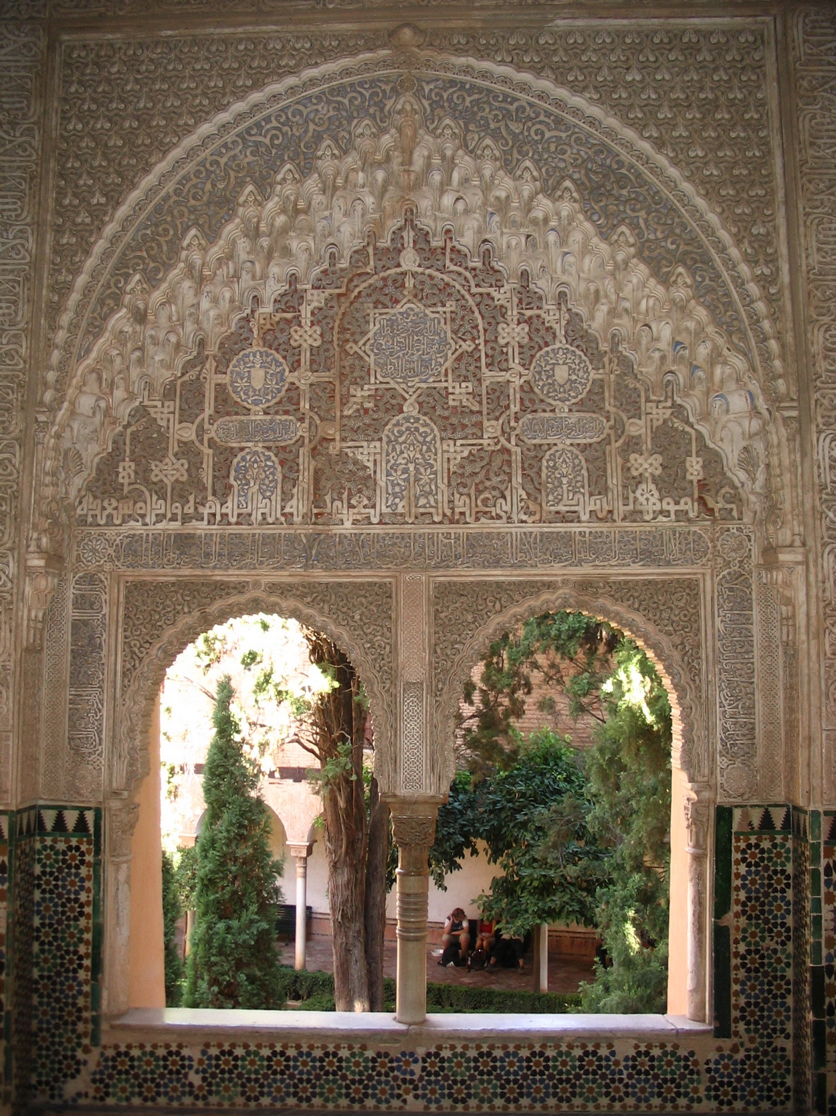

Slide 13
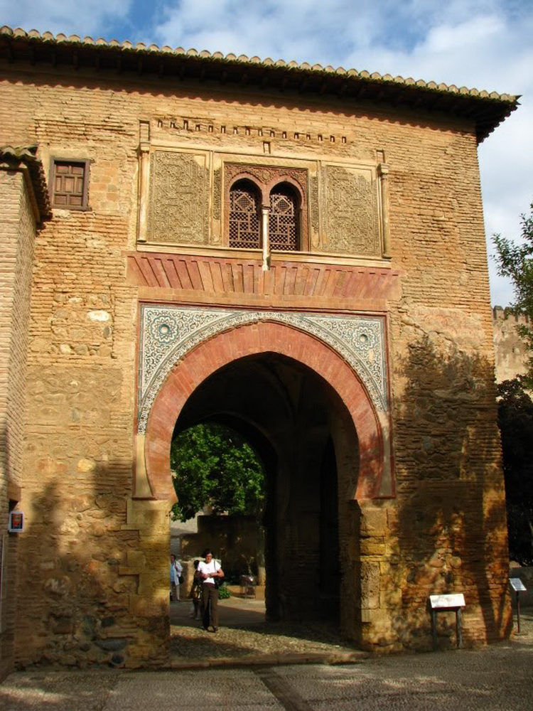

Slide 14
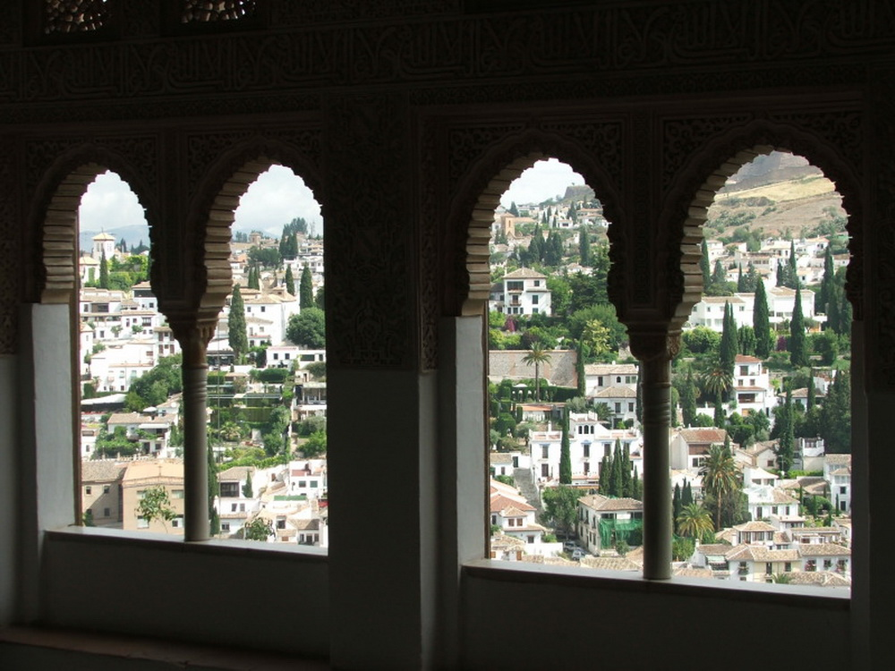

Slide 15
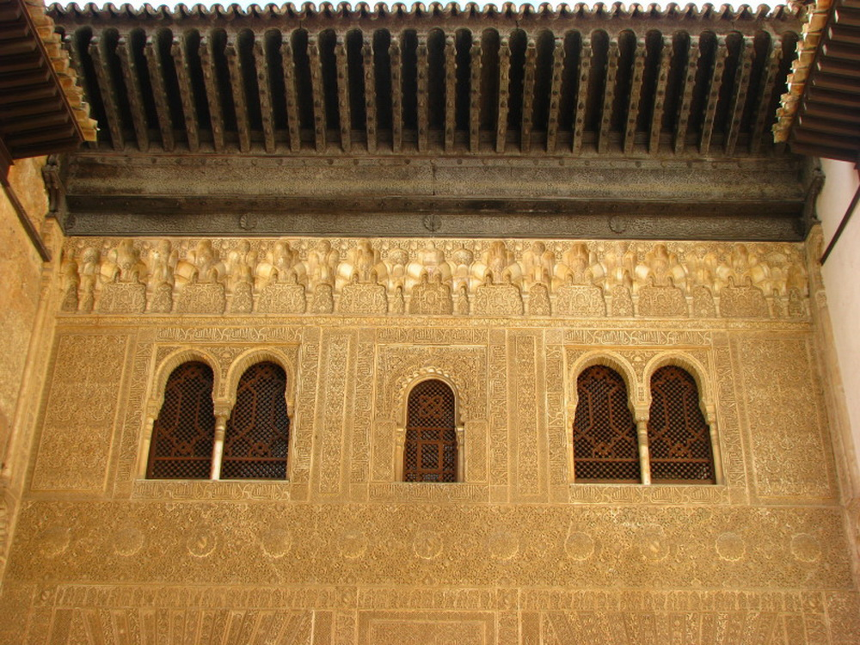

Slide 16
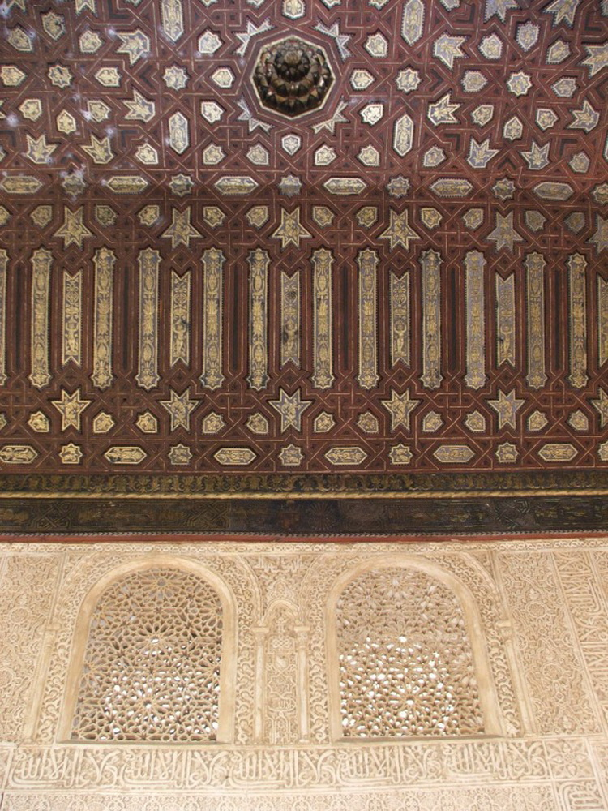

Slide 17
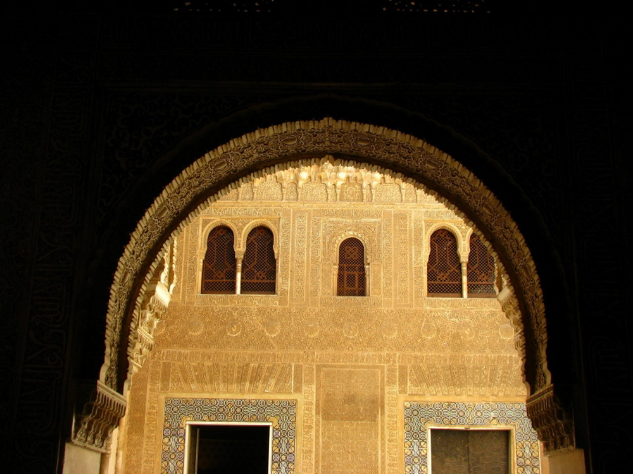

Slide 18
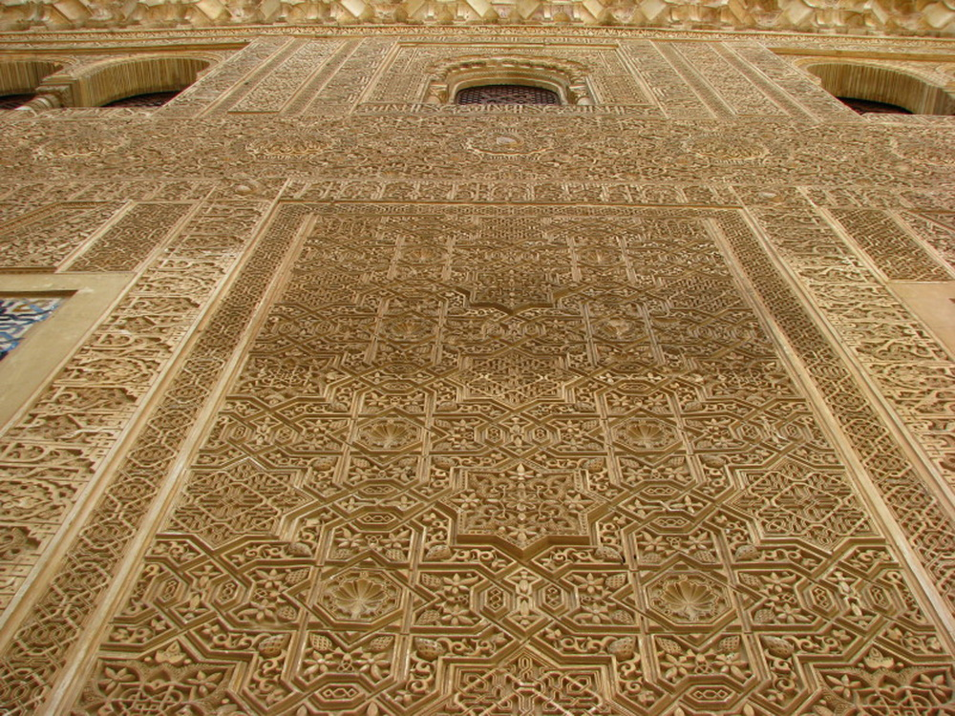

Slide 20
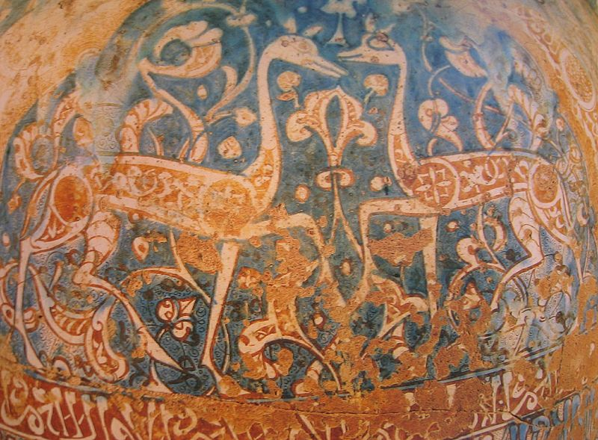

Slide 22
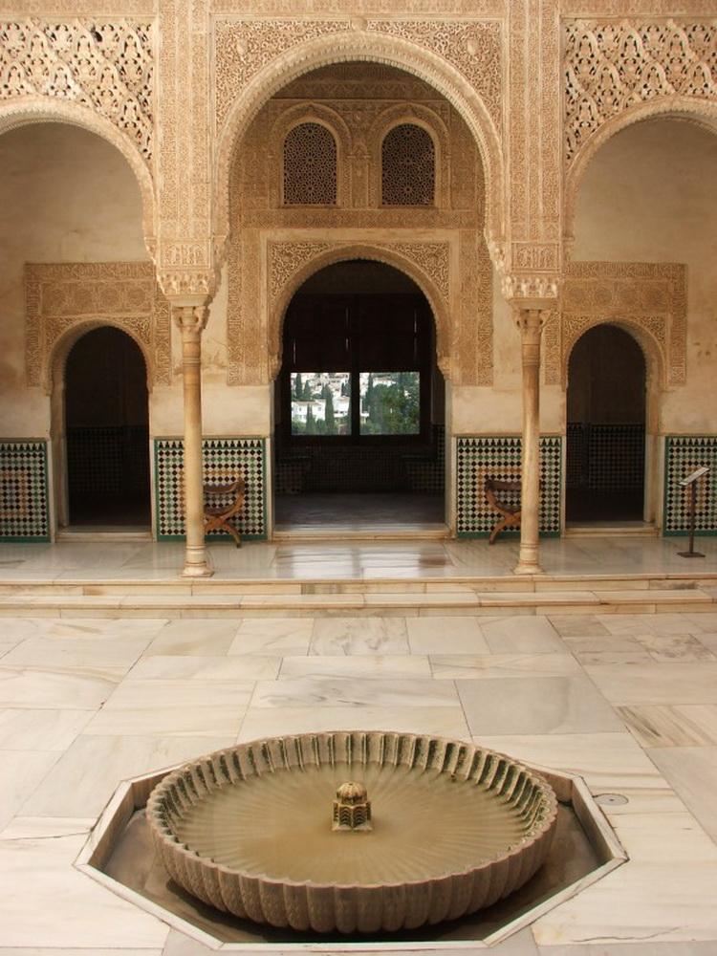

Slide 23
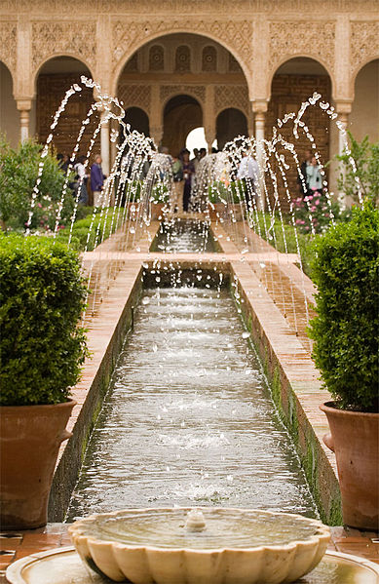

Slide 24
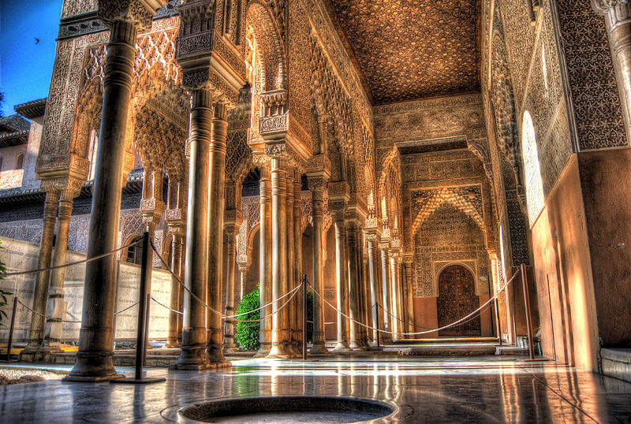

Slide 25
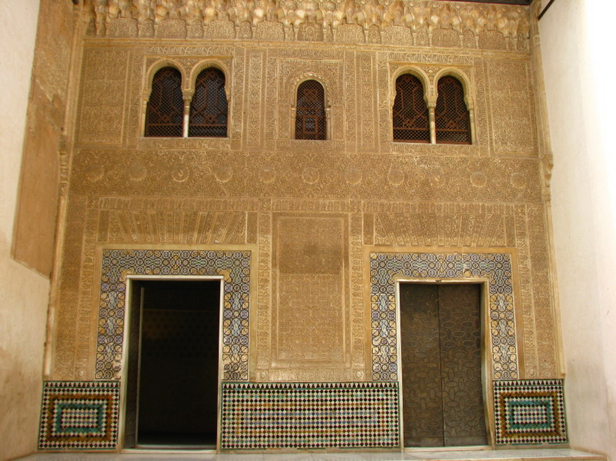

Slide 26
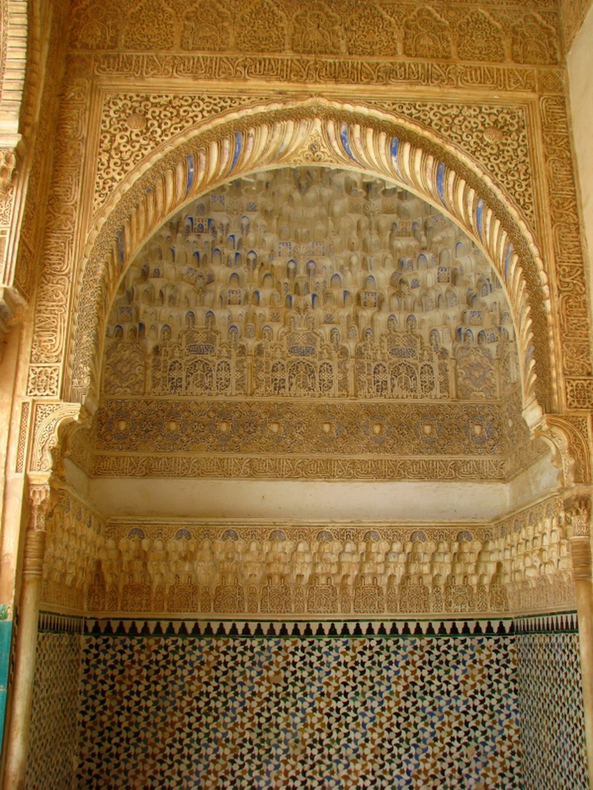

Slide 27
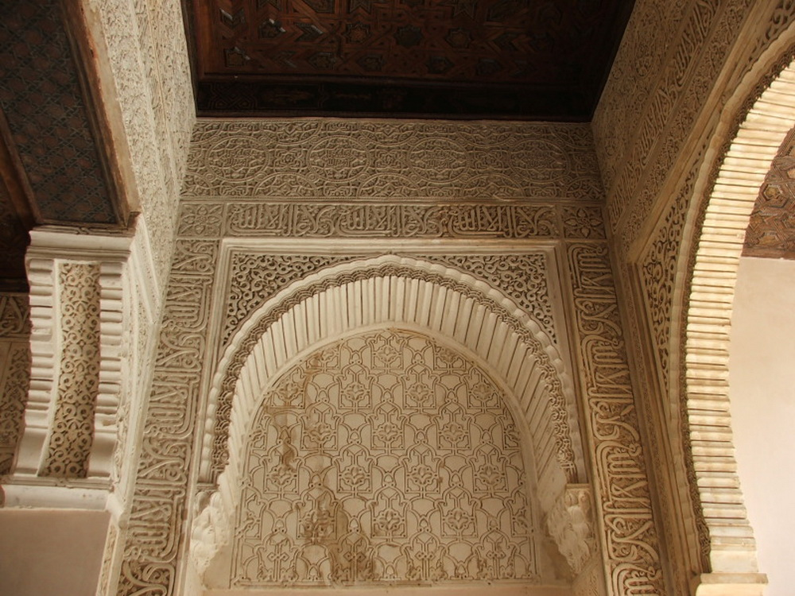

Slide 28
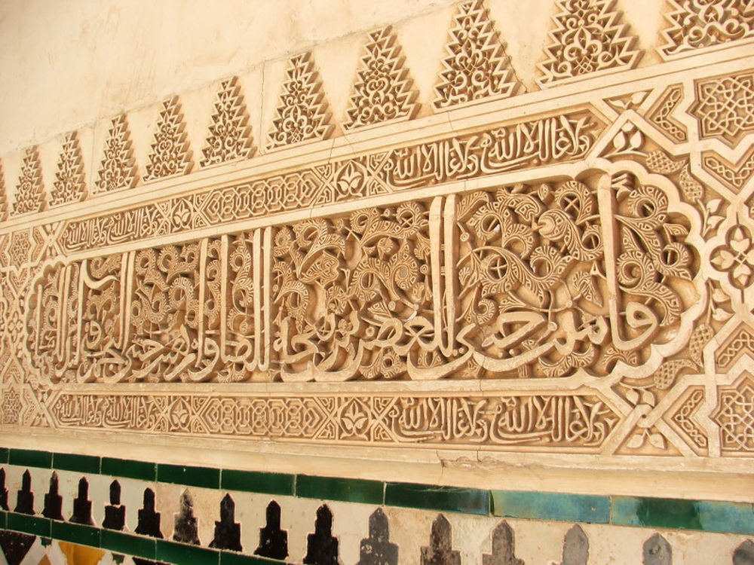

Slide 29
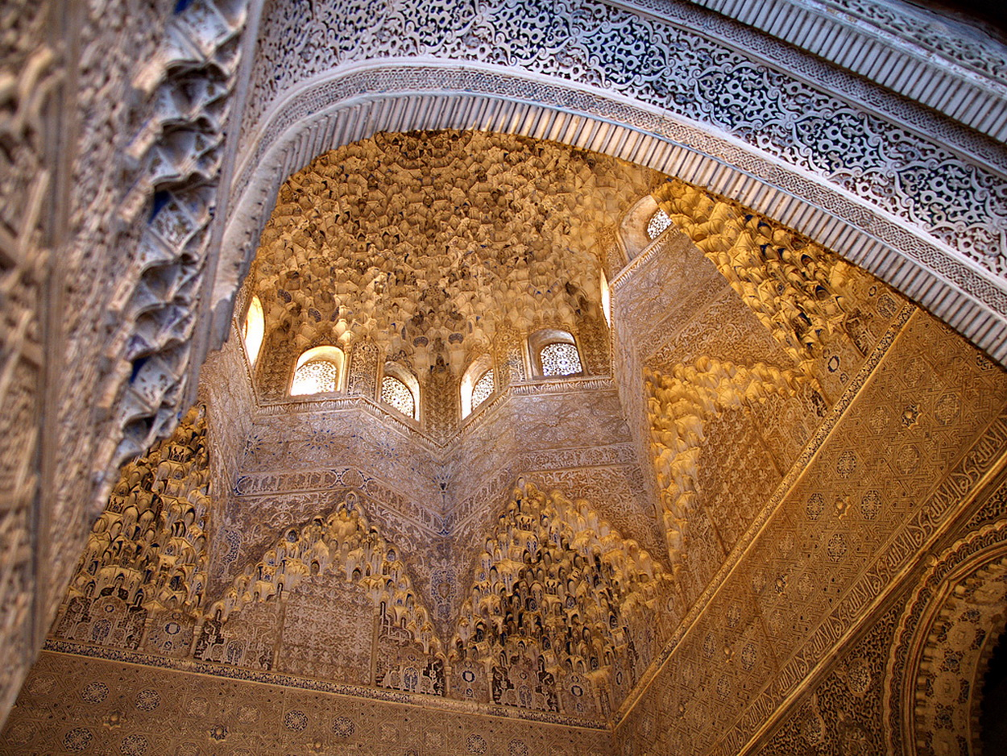

Slide 31
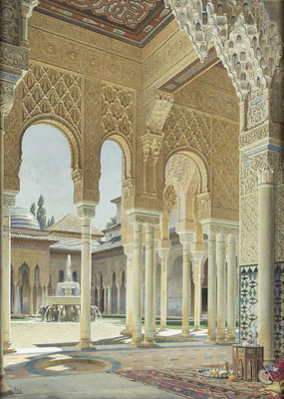

Slide 32
