Slide 1
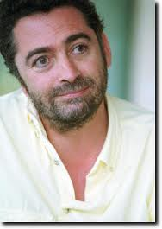
Spanish sky at night given splash of colour by spectacular lightning storm
Photos by Martin Zalba

Slide 2
Great Photography
Bright white lightning explodes out of a thick bank of black clouds - sparking a spectacular natural light show. These incredible moments were masterfully captured on camera by amateur photographer Martin Zalba. Despite taking up photography as a hobby a little over two years ago, Martin's powerful images crackle with electricity and power.

Slide 3
In September, Martin took his camera equipment to Bardenas Reales de Navarra in the south of the country and spent three hours watching the storms unfold. 'I had to be careful as it is dangerous,' he said. 'It's not good to get too far away from the car. There was certain danger because a tripod in a storm is like a lightning rod. 'There were so many lightning bolts in the sky, it was very impressive. With my pictures I try to express my respect towards nature and convey the idea that human beings are only one part of the world, and that each part is as important as the rest.'

Slide 4
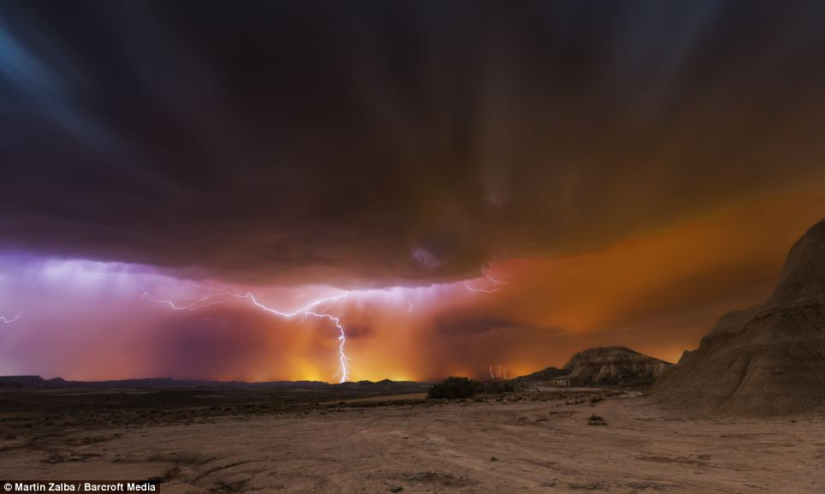

Slide 5
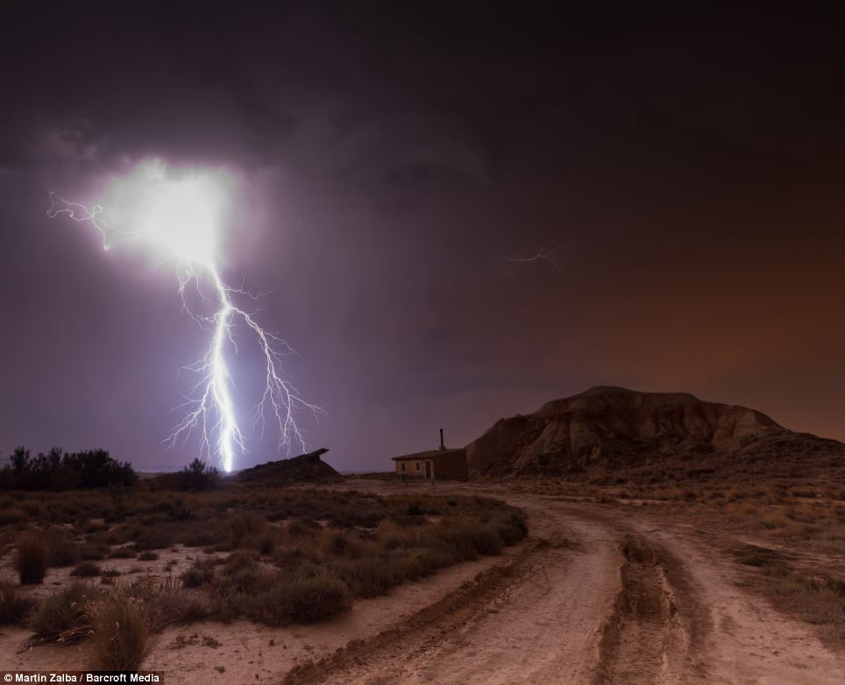

Slide 6
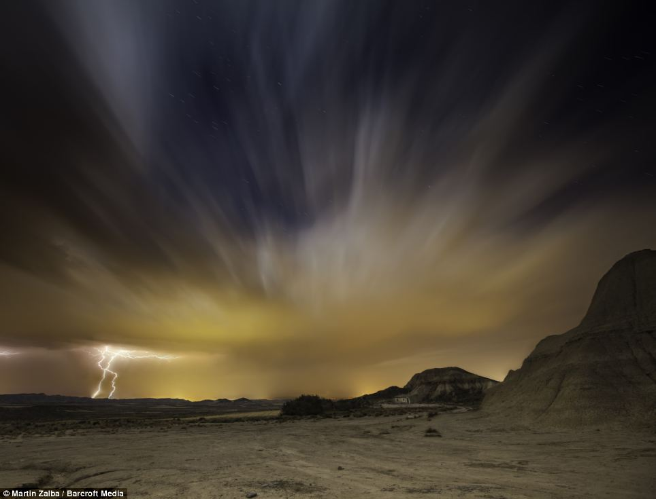

Slide 7
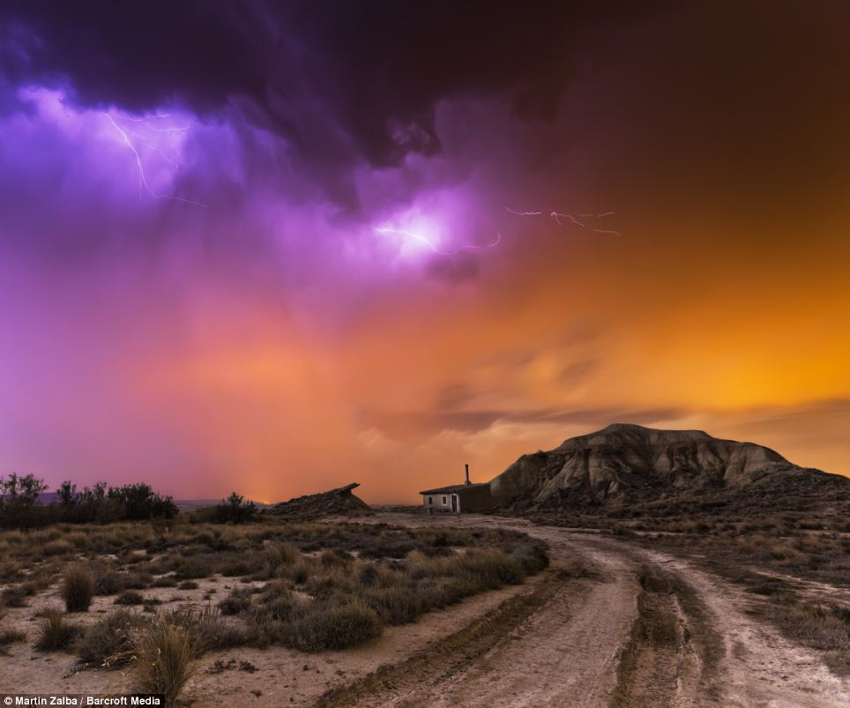

Slide 8
Other photos by martin zalba

Slide 9
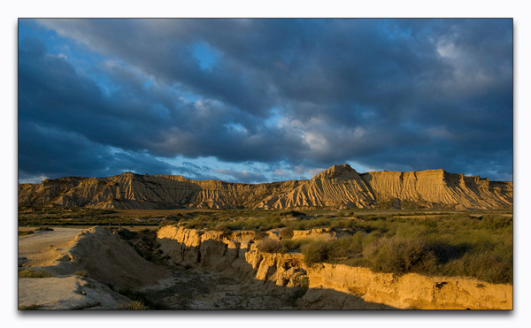

Slide 10
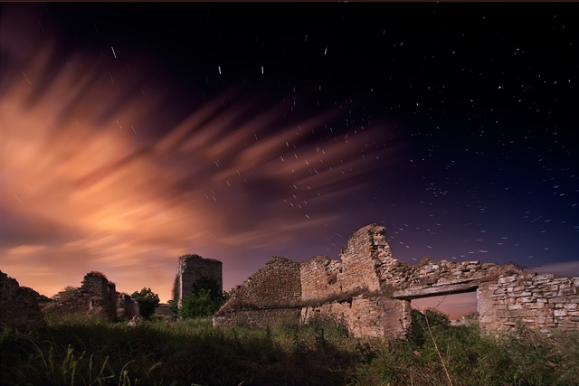

Slide 11
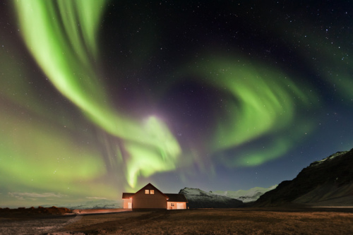

Slide 12
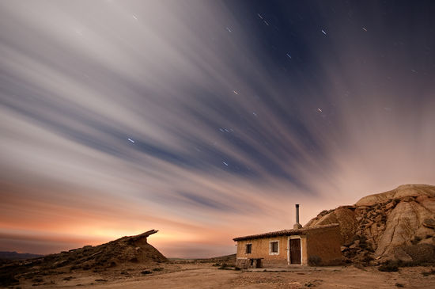

Slide 13
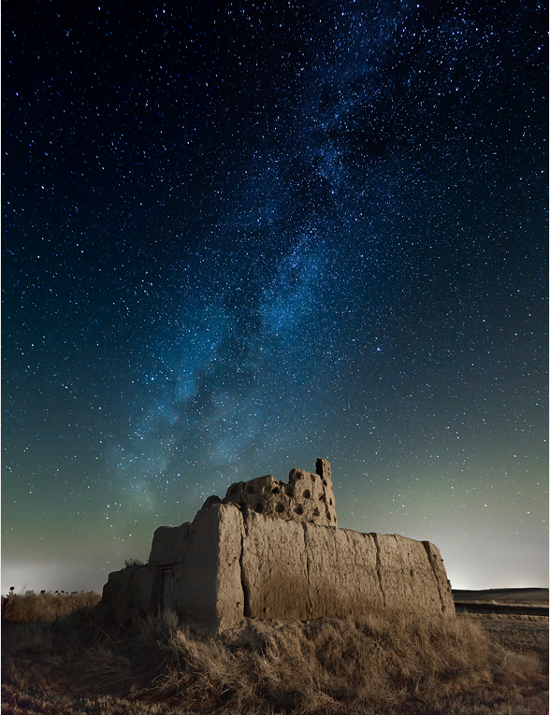

Slide 14
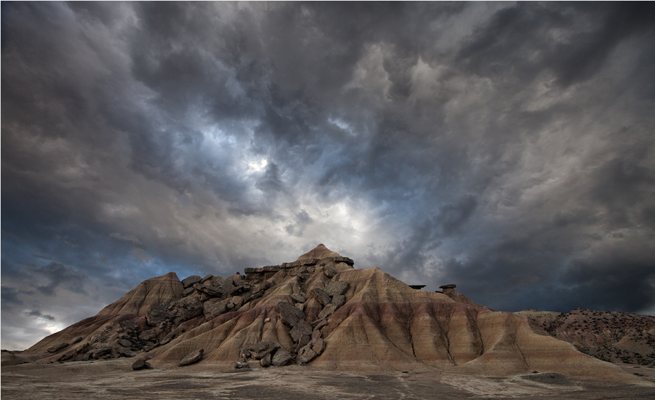

Slide 15
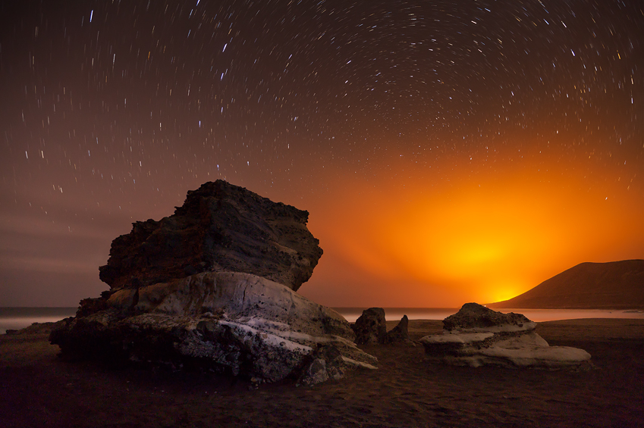

Slide 16
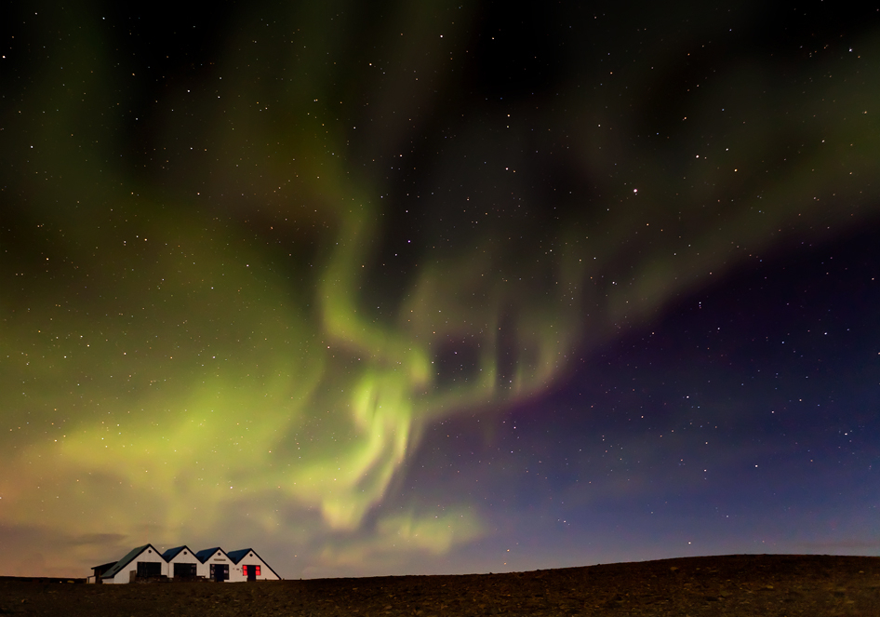

Slide 17
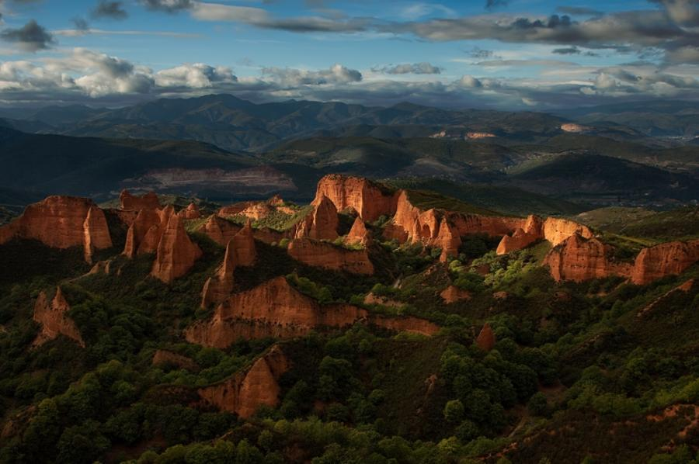

Slide 18
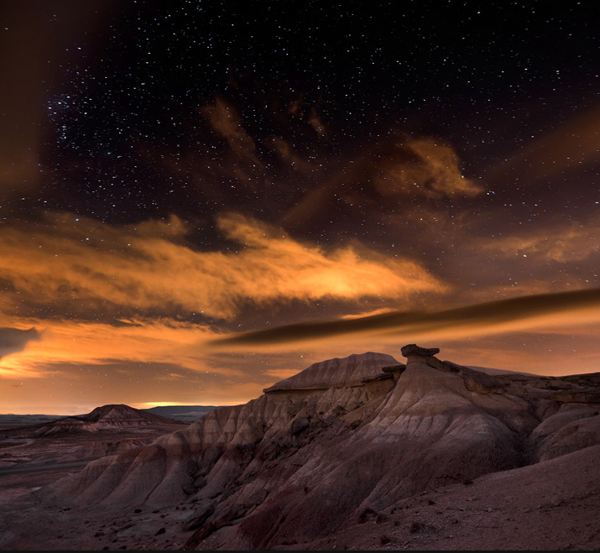

Slide 19
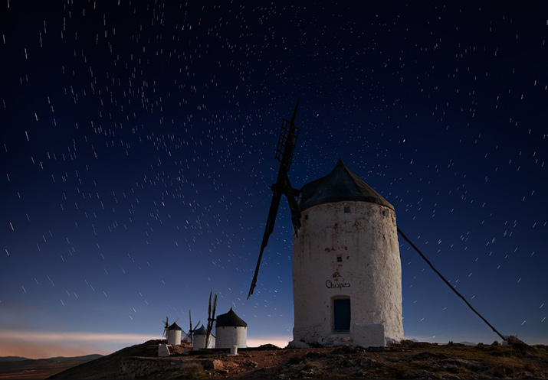

Slide 20
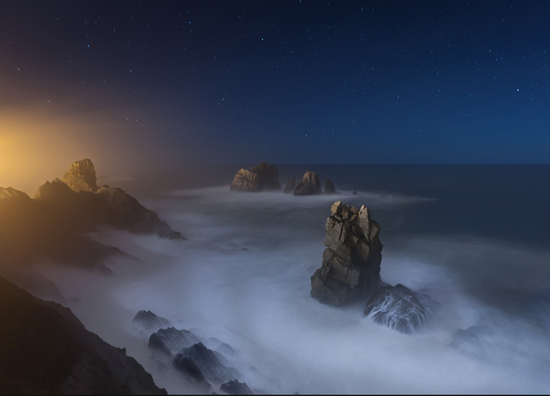

Slide 21
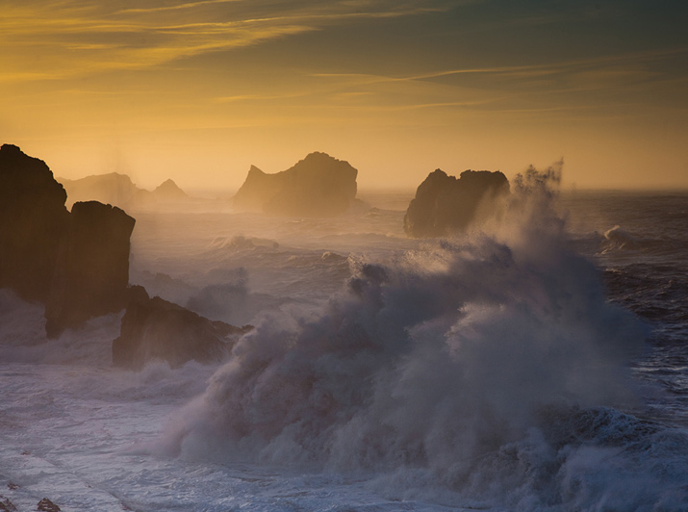

Slide 22
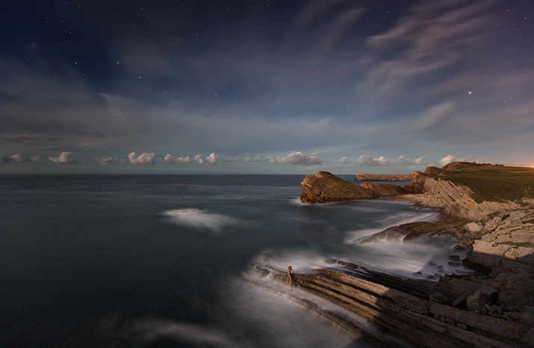

Slide 23
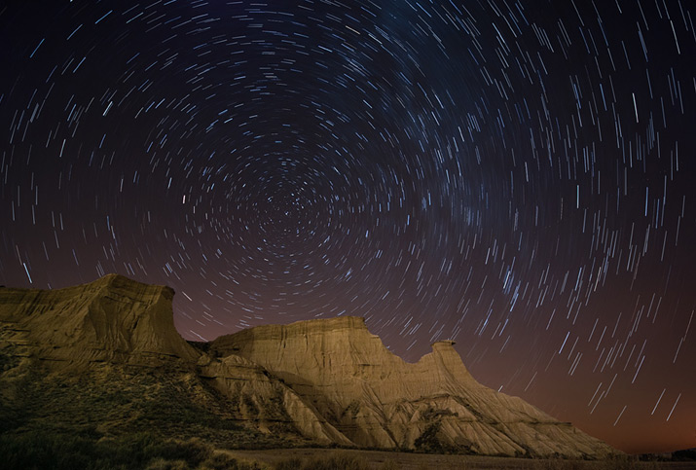

Slide 24
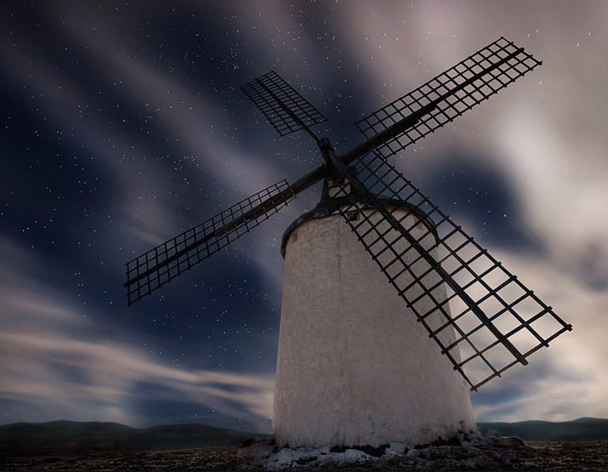

Slide 25
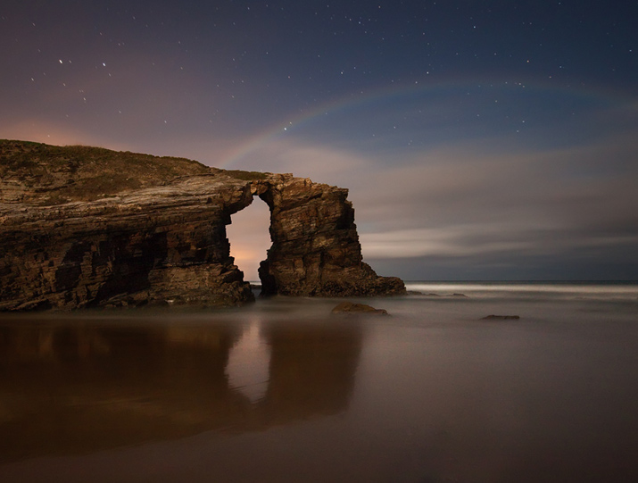

Slide 26
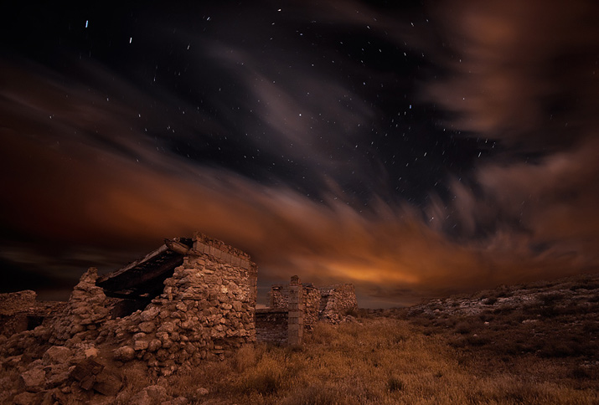

Slide 27
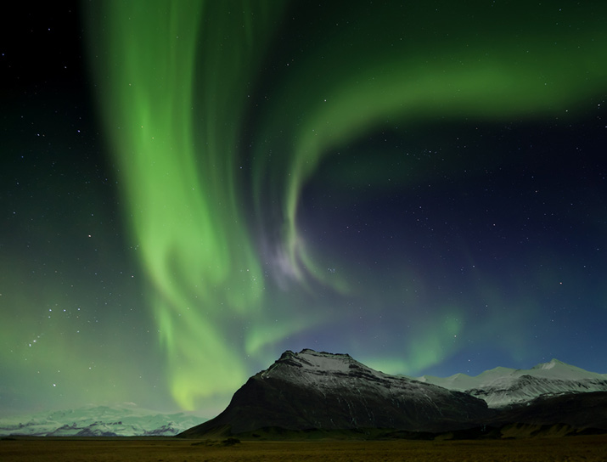

Slide 28
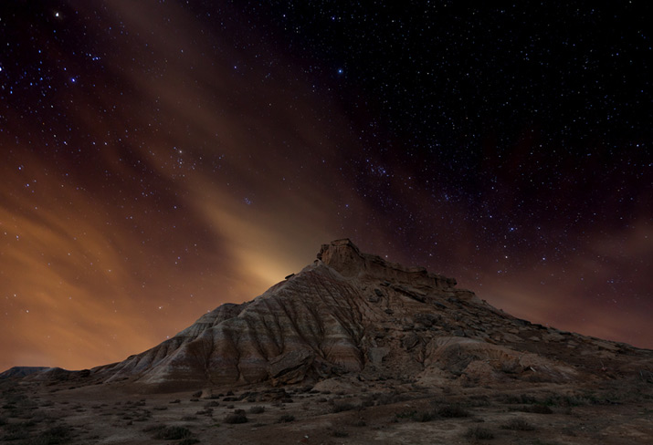

Slide 29
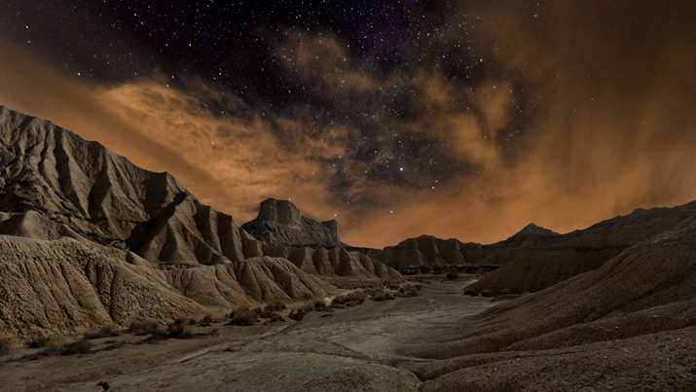

Slide 30
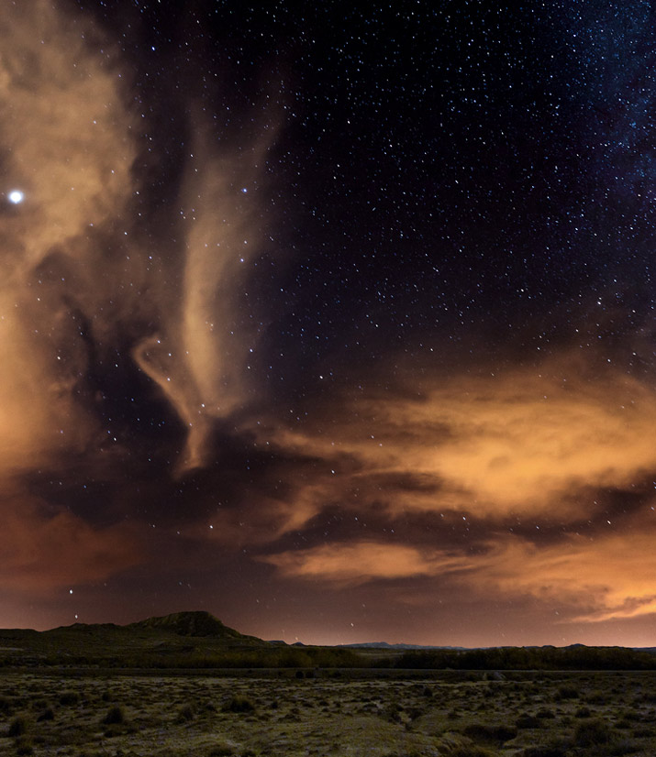

Slide 31
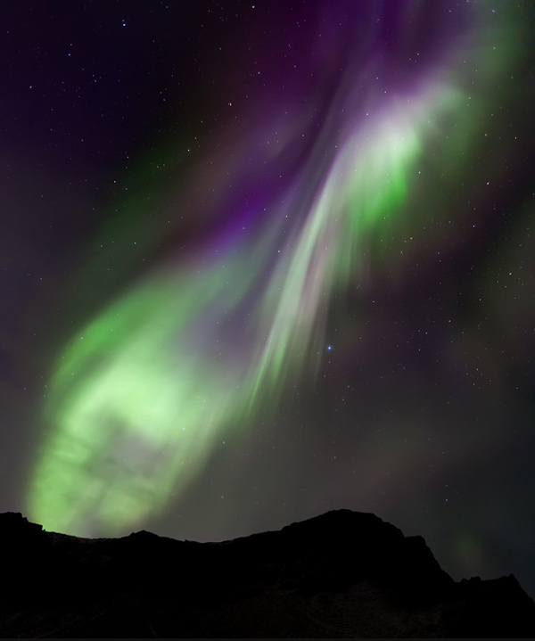

Slide 32
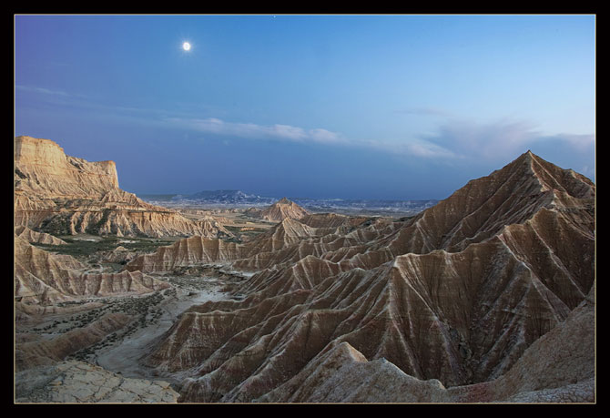

Slide 33
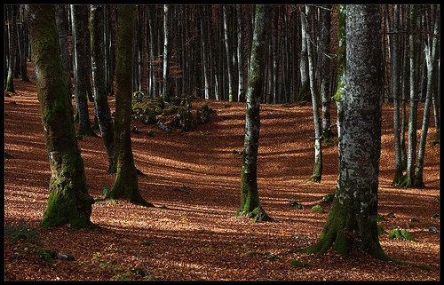

Slide 34
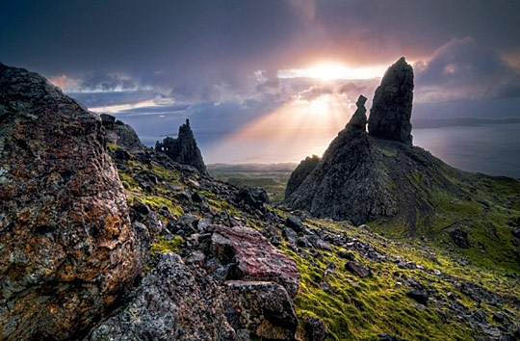

Slide 35
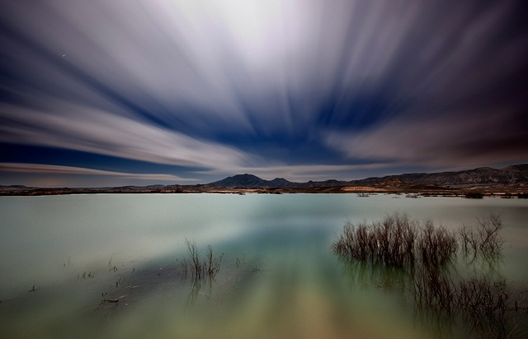

Slide 36
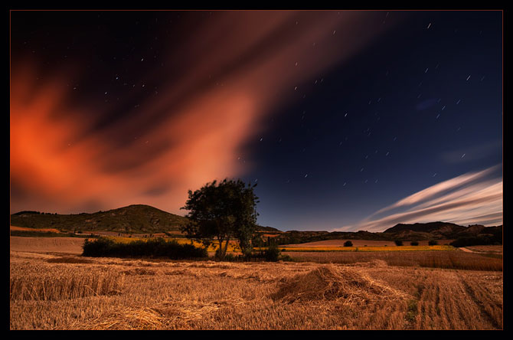

Slide 37
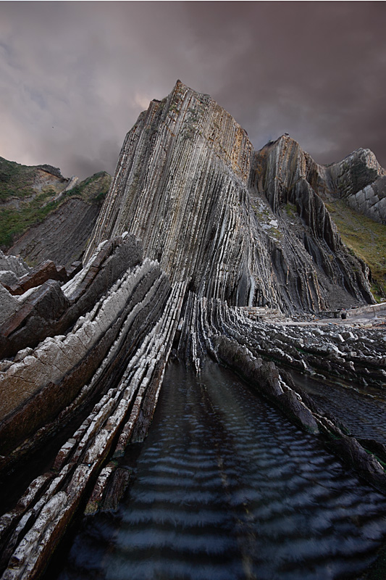

Slide 38
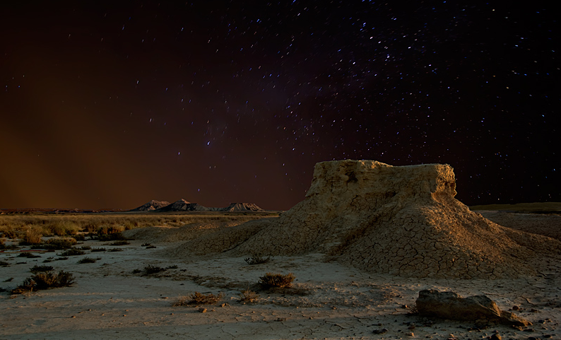

Slide 39
