Slide 1
Spain (Part 8)
Engineering, Architecture, and Design
Cervantes – Literature

Slide 2
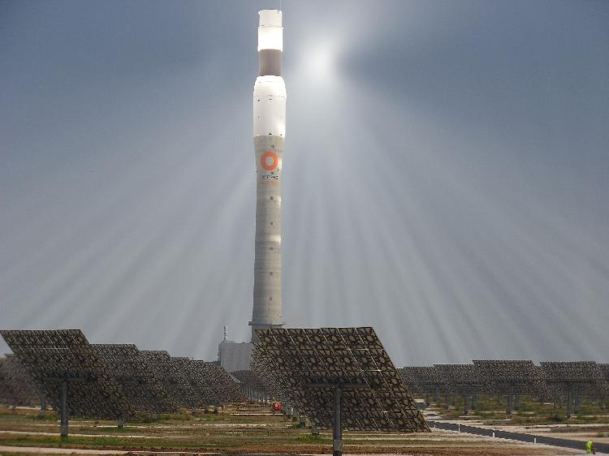
Engineering Feats
Solar Power

Slide 3
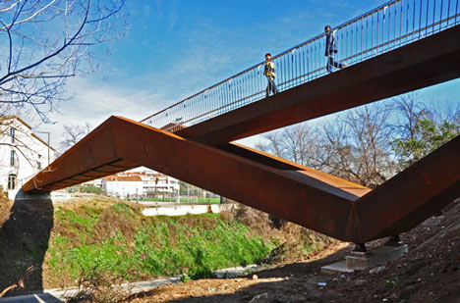

Slide 4
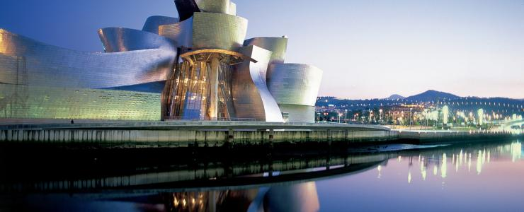
Guggenheim Museum Bilbao, Spain

Slide 5
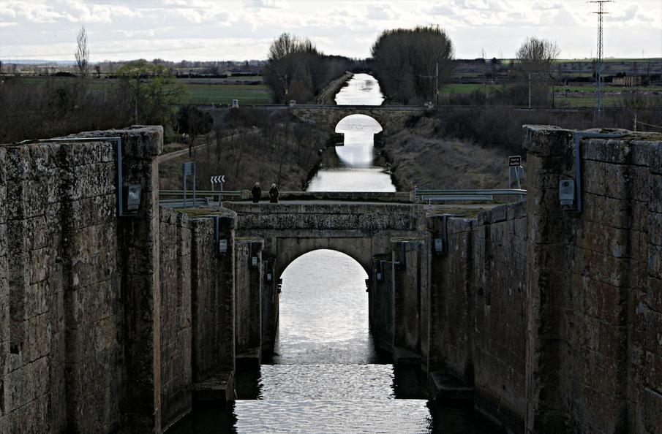
The Canal de Castilla is one of the works of Civil Engineering (Hydraulic) most important of those between mid-eighteenth century and first third of XlX-Castile n leon

Slide 6
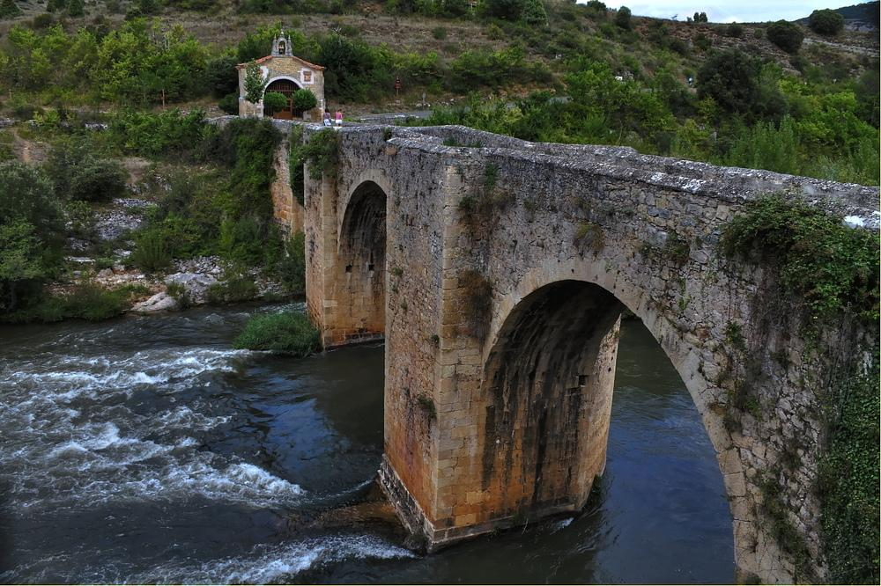
Chapel Bridge and Pesquera de Ebro

Slide 7
Architecture and Design

Slide 8
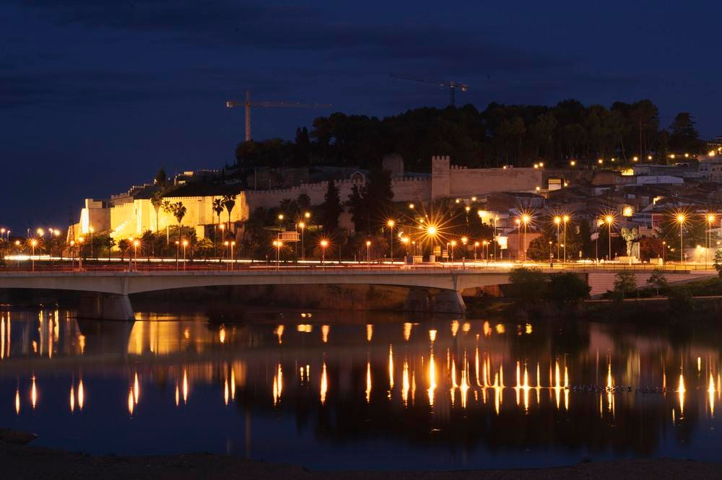
Badajoz - La Mancha

Slide 9
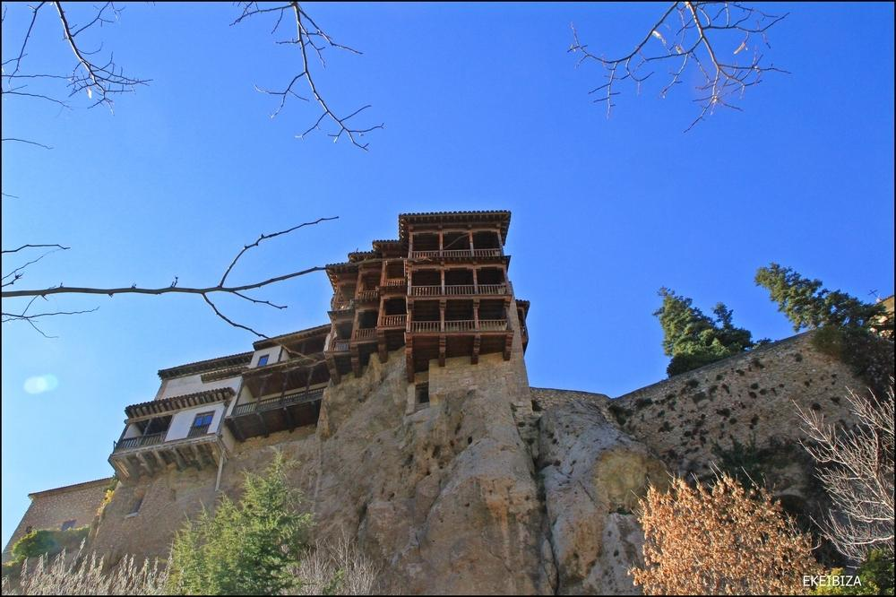
Cuenca- terraced houses

Slide 10
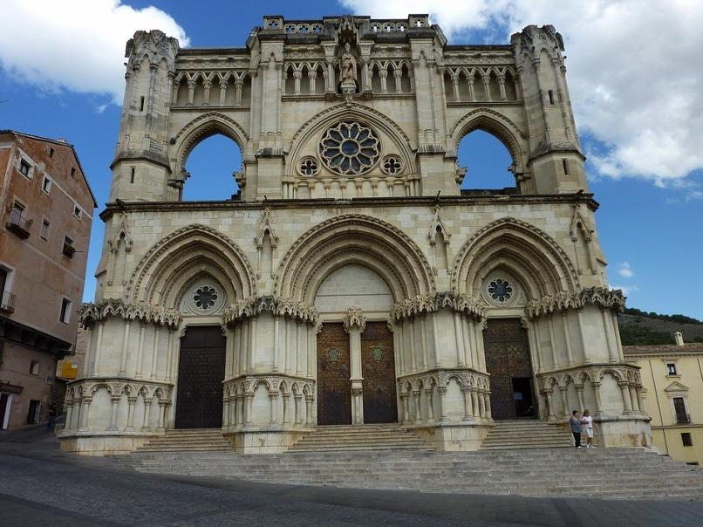
Cuenca

Slide 11
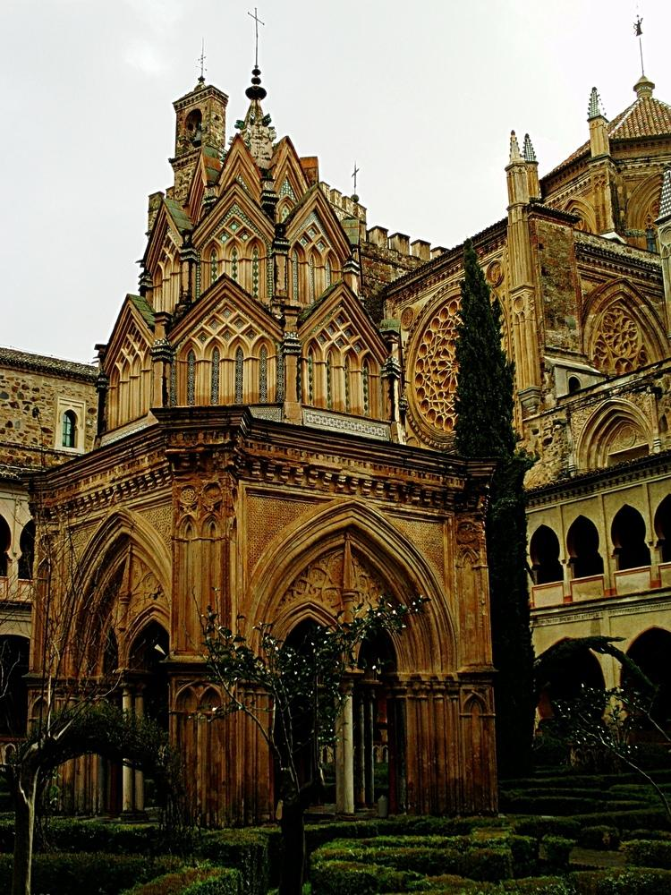
Guadalupe

Slide 12
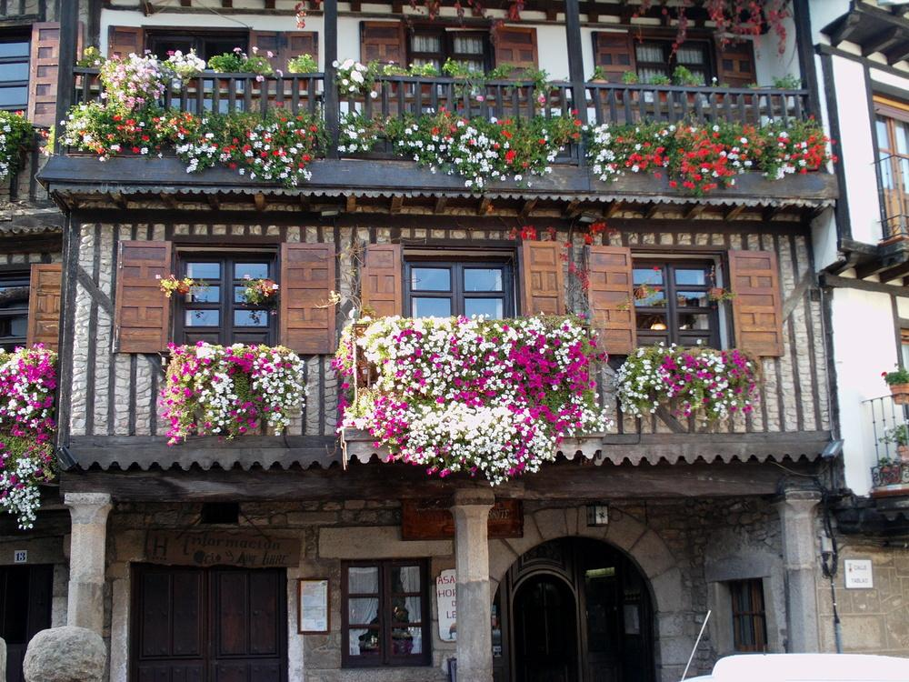
La Alberca

Slide 13
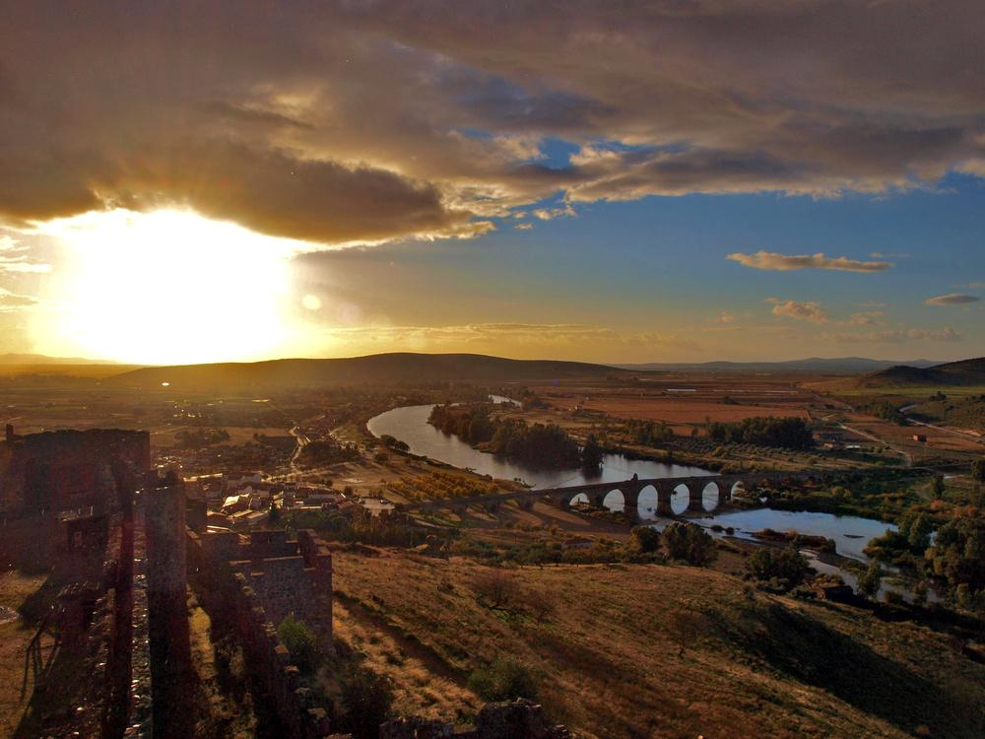
Medellin

Slide 14
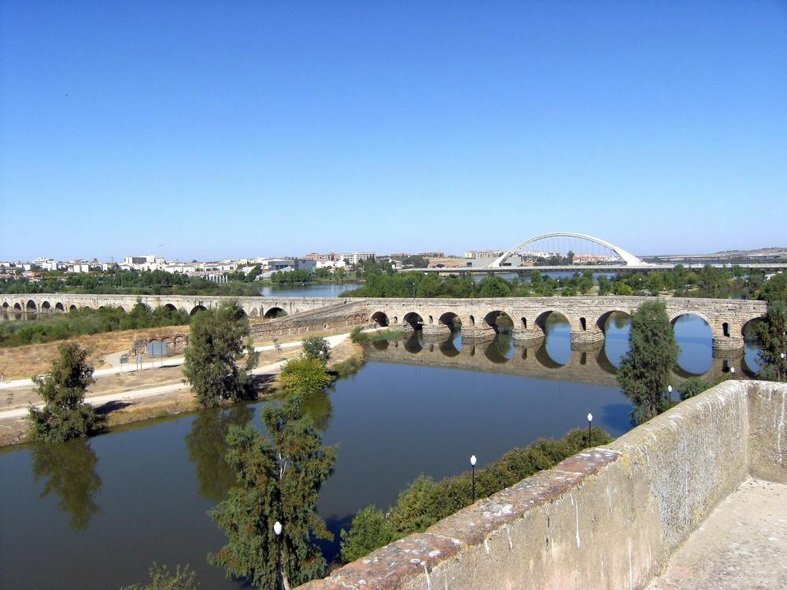
Merida bridge

Slide 15
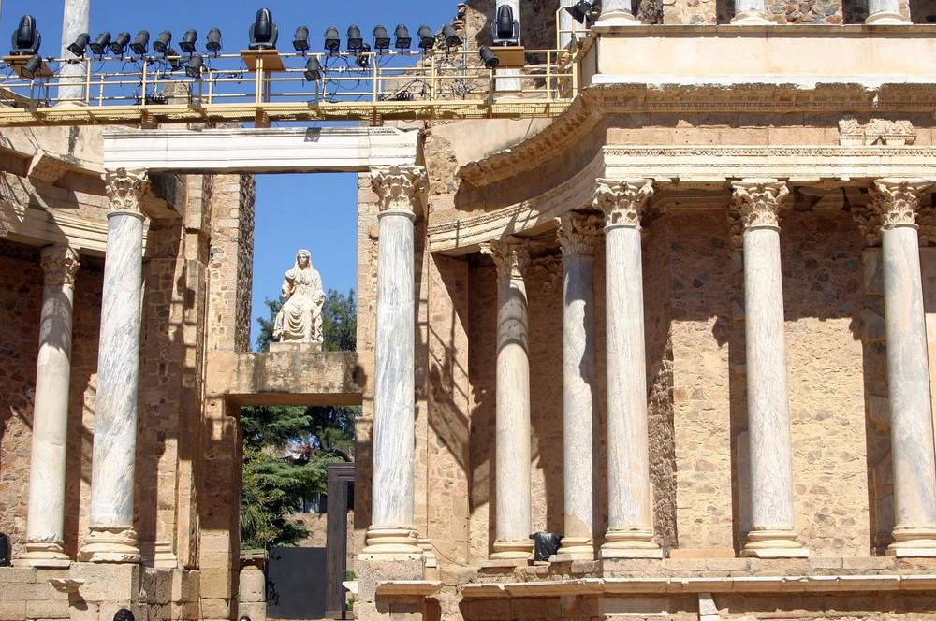
Roman Theatre in Mérida.Extremadura

Slide 16
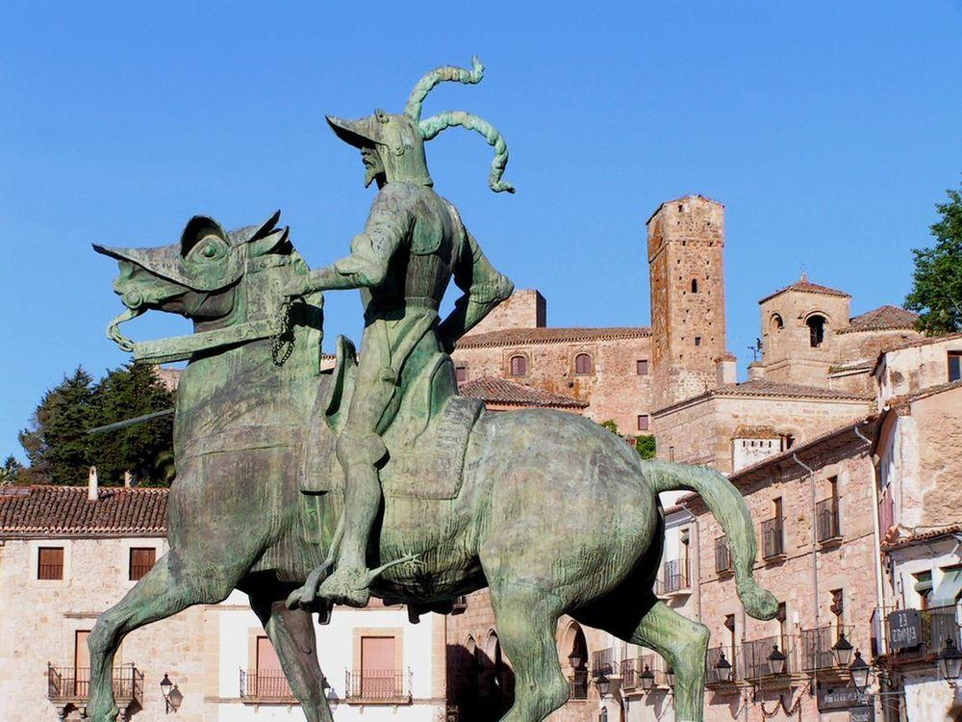
Bronze equestrian statue of Francisco Pizarro in Trujillo

Slide 17
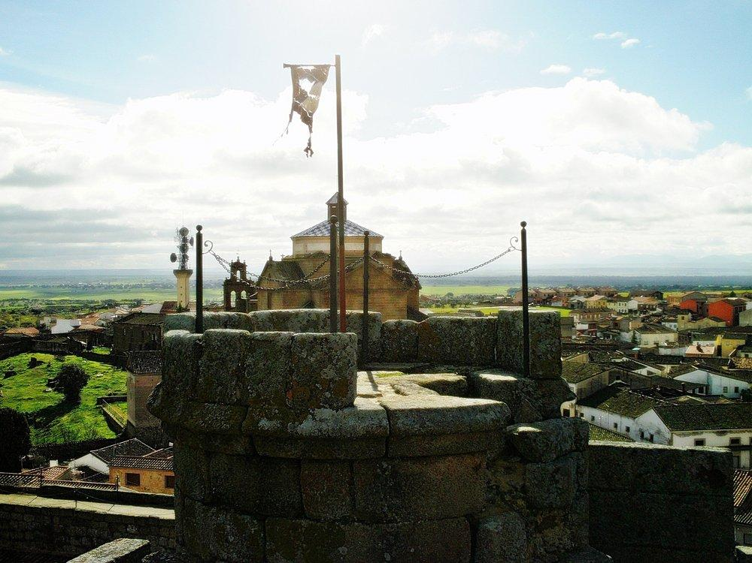
Atalaya De Cuenca, Castilla-La Mancha

Slide 18
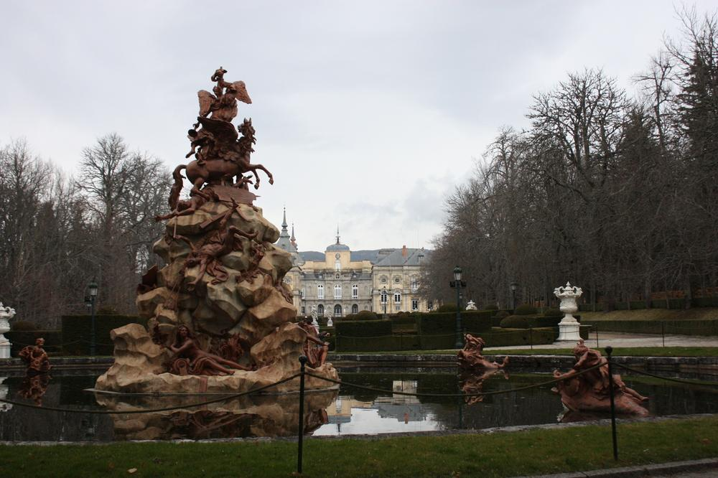
Dedicated to San Ildefonso Archbishop

Slide 19
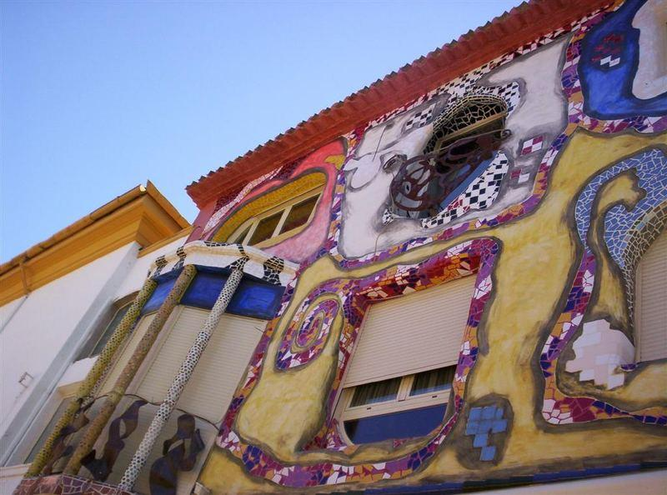
Casas-Ibáñez - Albacete

Slide 20
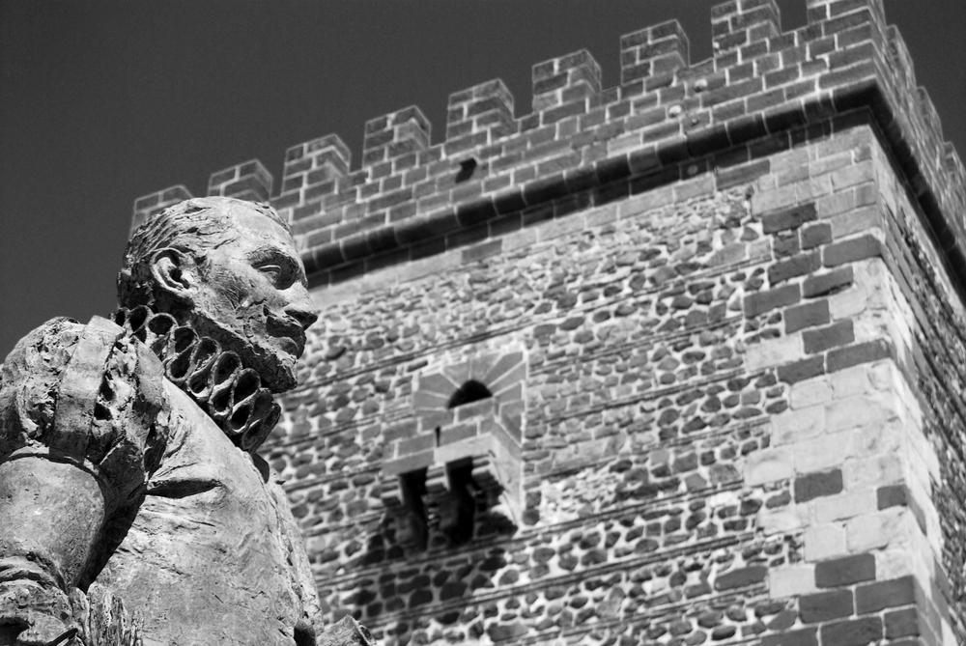
Cervantes – Literature
Miguel de Cervantes

Slide 21
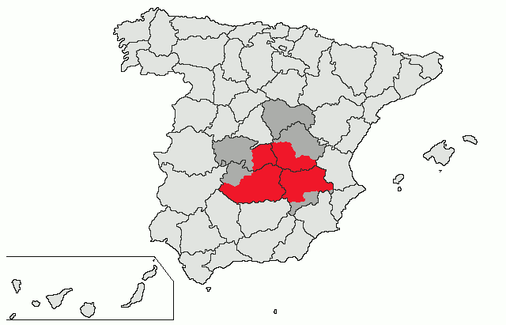
In red, location of La mancha natural region. In dark gray, present-day Castile–La Mancha autonomous community territories not included in historical La Mancha.

Slide 22
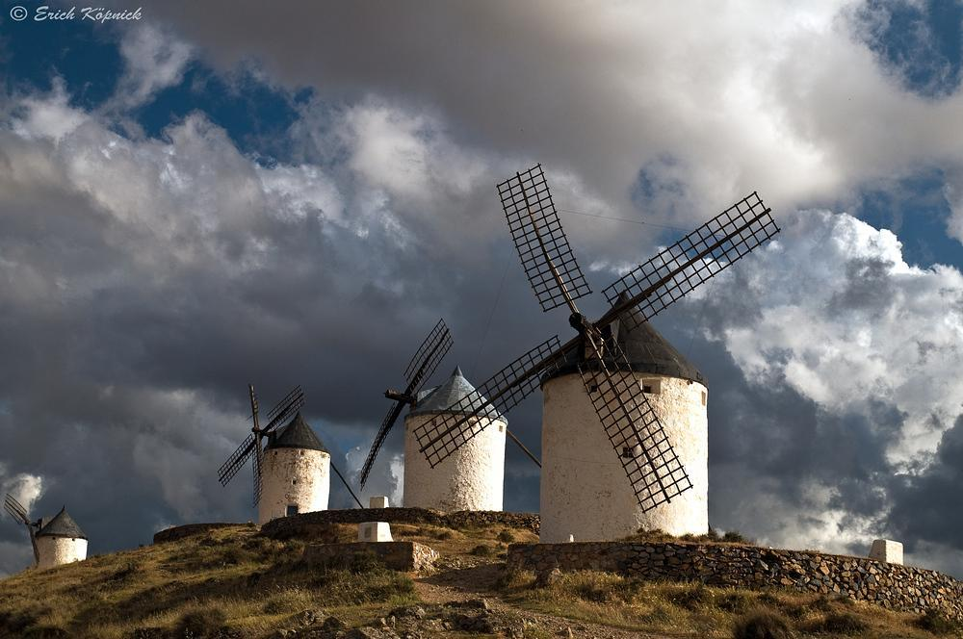
Windmills of La Mancha - Writer Miguel de Cervantes made La Mancha's windmills famous

Slide 23
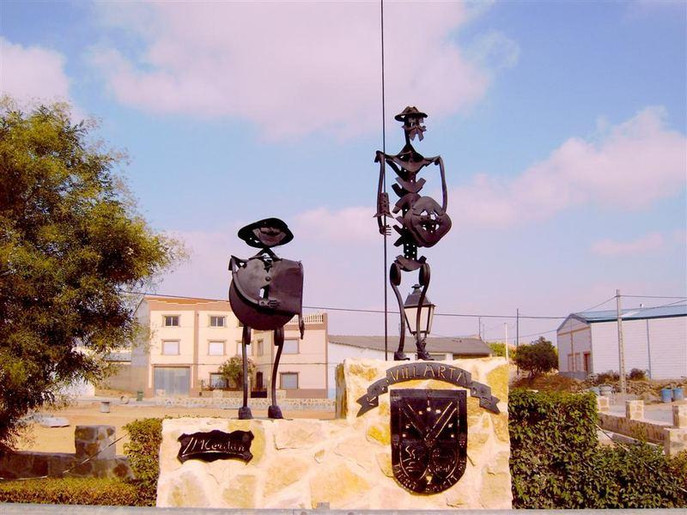
Sancho Panza ad Don Quixote - Villarta-Cuenca

Slide 24
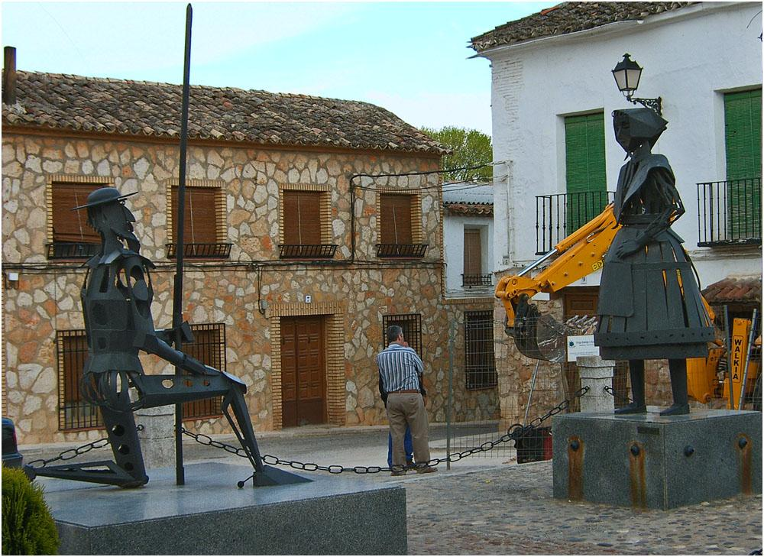
Don Quixote and Dulcinea in El Toboso - La Mancha

Slide 25
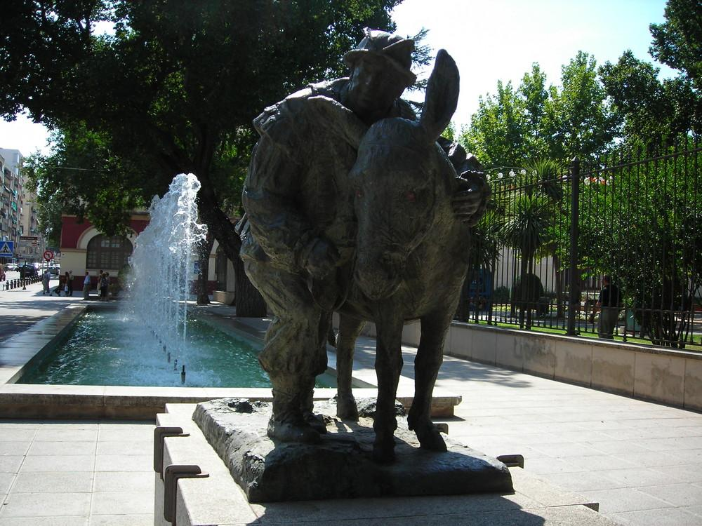
Sancho Panza

Slide 26
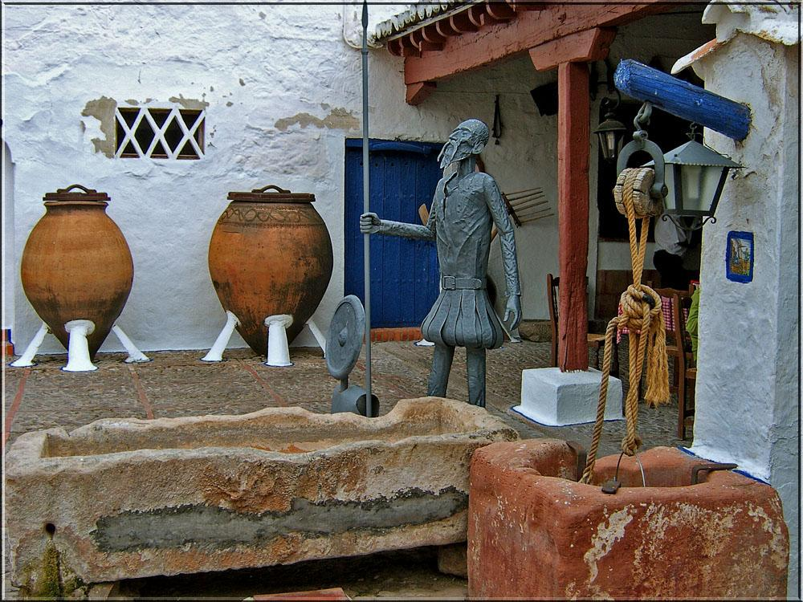
Don Quixote - Puerto Lápice - La Mancha

Slide 27
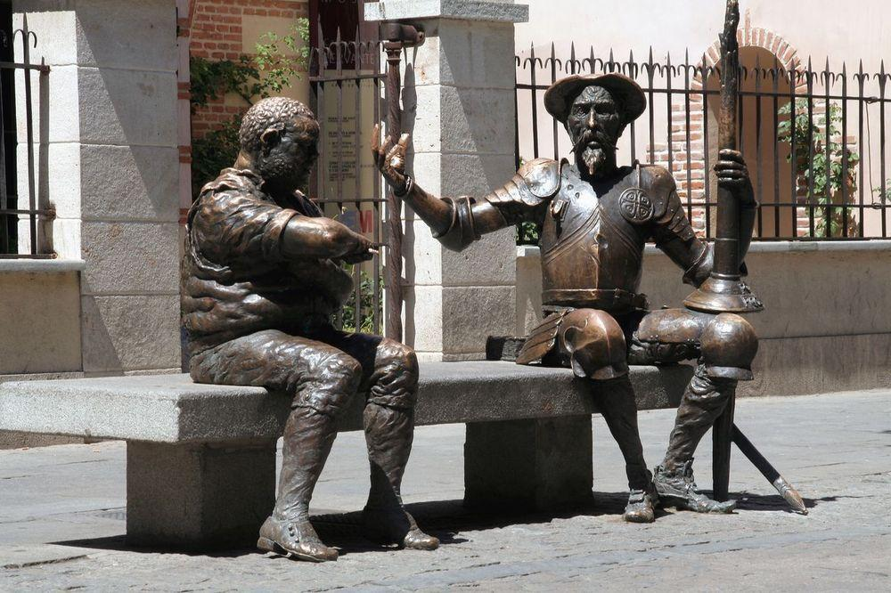
Don Quixote, Sancho Panza - Alcala de Henares, the birthplace of Cervantes - Castilla-La Mancha

Slide 28
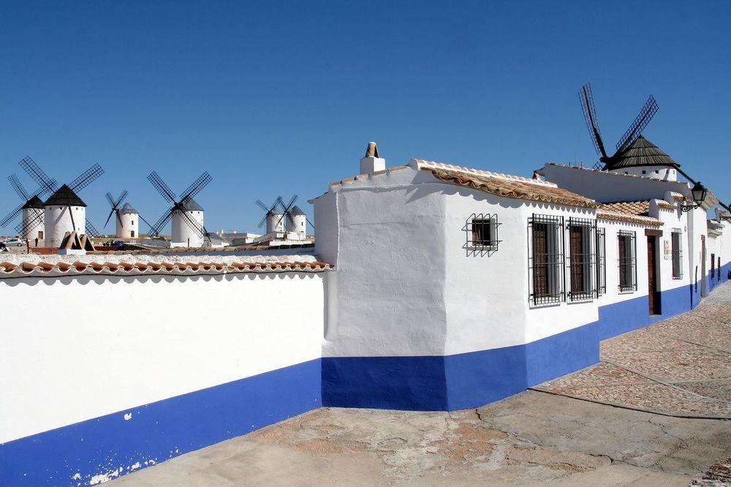
Windmills of Criptana field

Slide 29
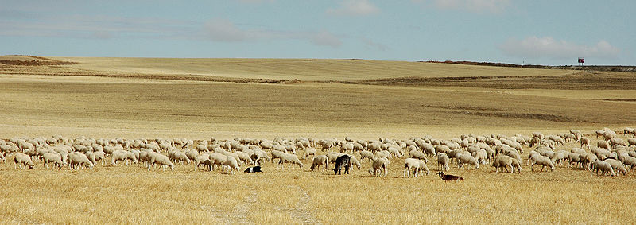
La Mancha (natural region)
Pastures and goats in La Mancha.

Slide 30
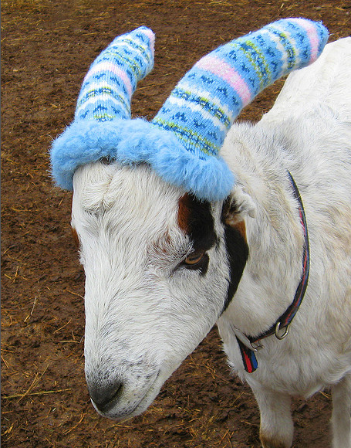

Slide 31
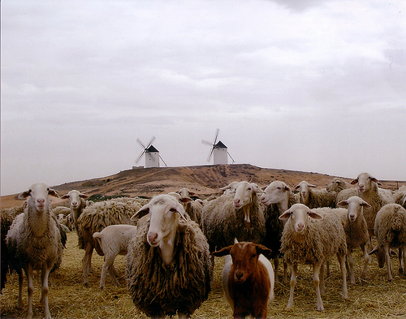

Slide 32
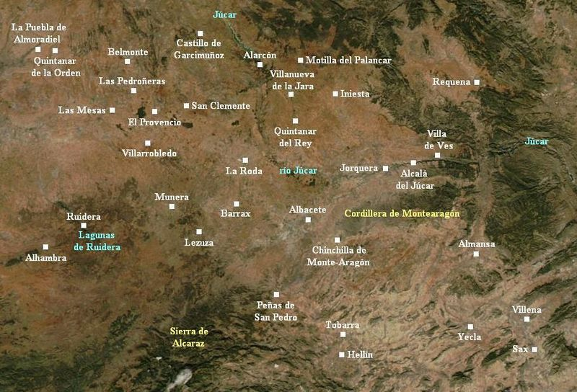
La Mancha de Montearagón subregion.

Slide 33
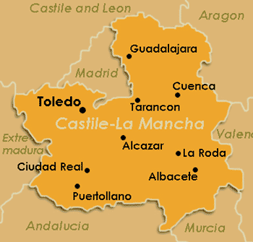

Slide 34
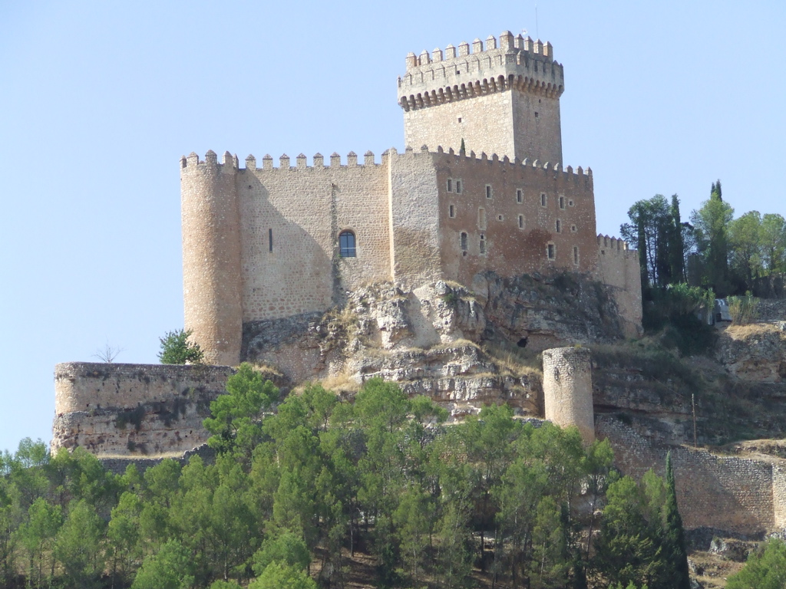
Parador de Alarcón, Castilla-La Mancha

Slide 35
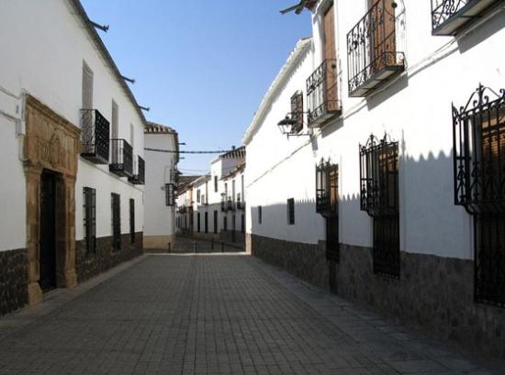
Parador de Almagro, Castilla-La Mancha

Slide 36
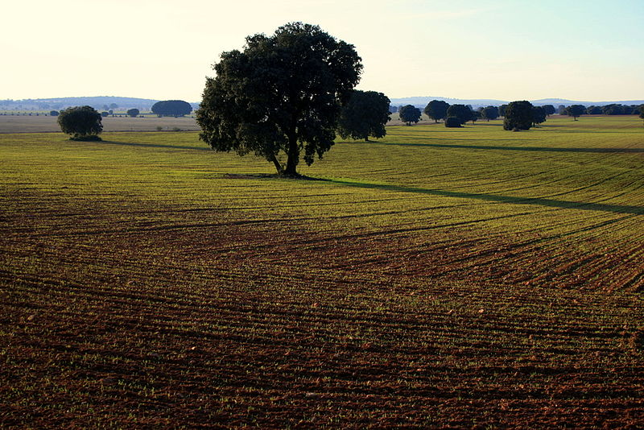
Landscape of the fields in La Mancha.

Slide 37
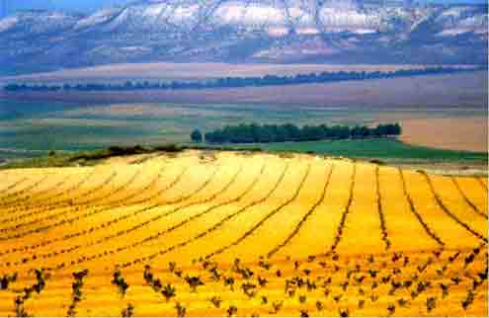

Slide 38
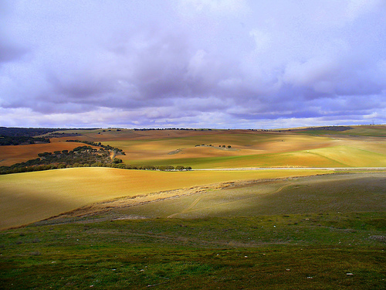

Slide 39
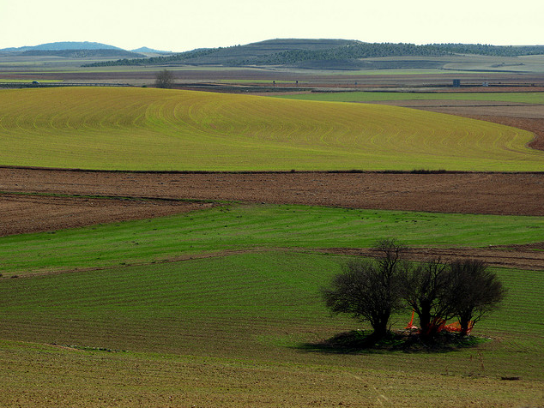

Slide 40
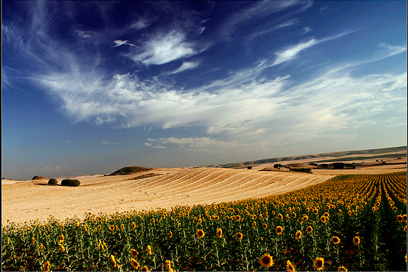
Summer Landscape

Slide 41
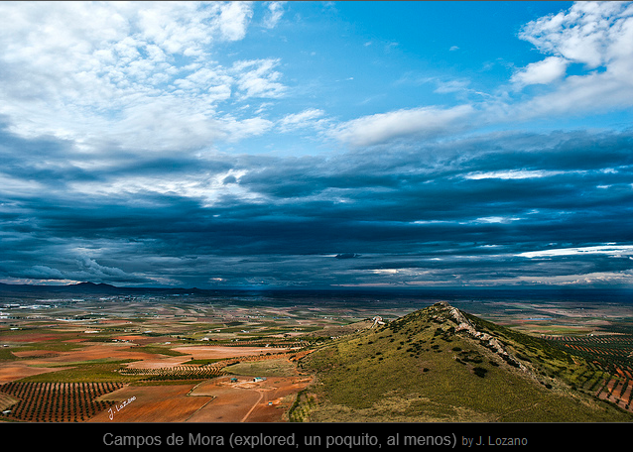

Slide 42
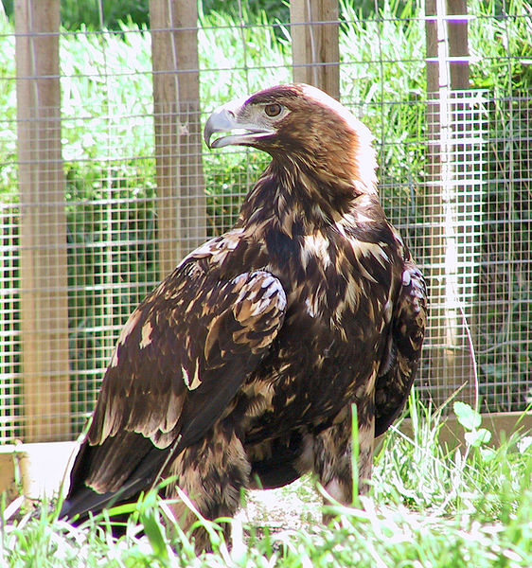
The Spanish Imperial Eagle can be found mostly in the region of La Mancha.

Slide 43
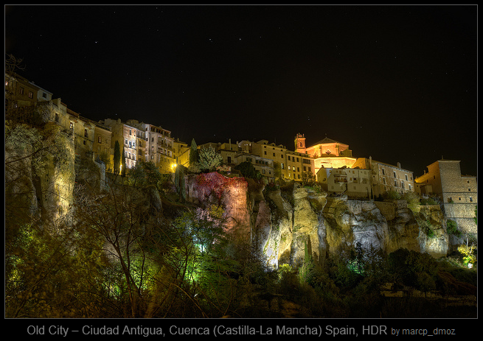

Slide 44
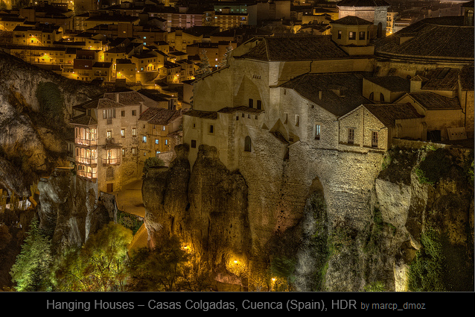

Slide 45
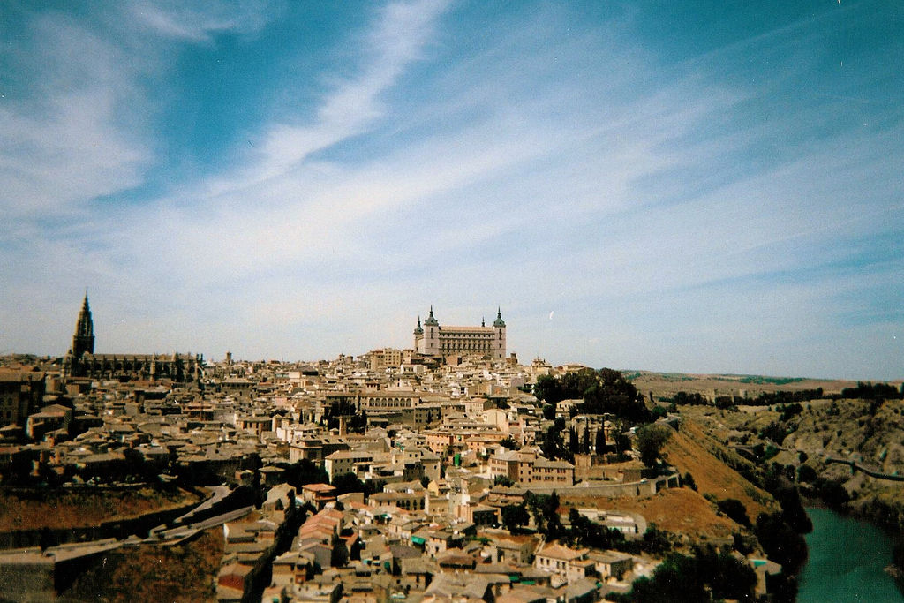
Toledo

Slide 46
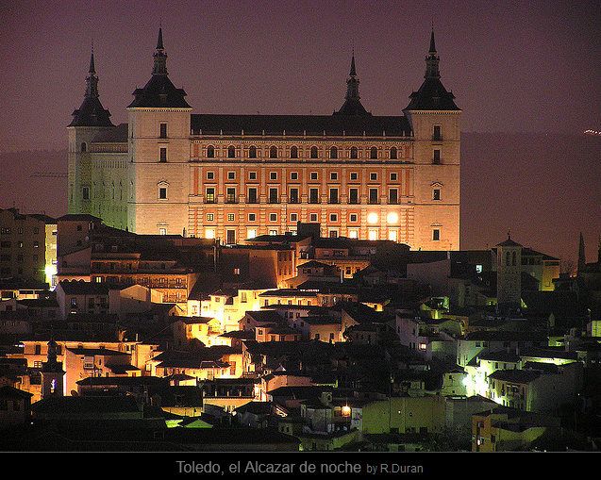

Slide 47
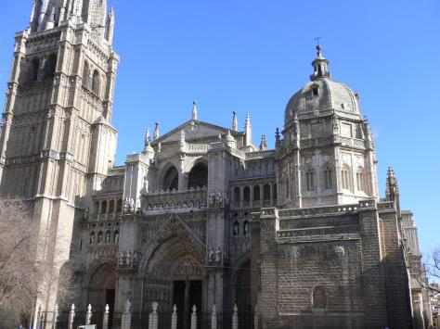

Slide 48
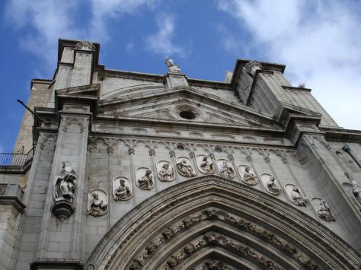

Slide 49
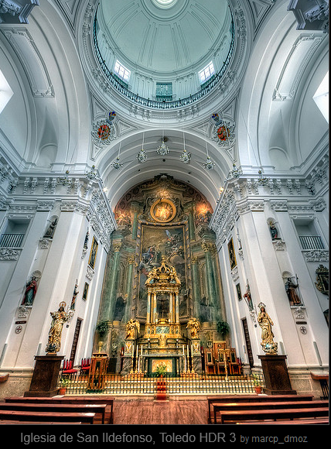

Slide 50
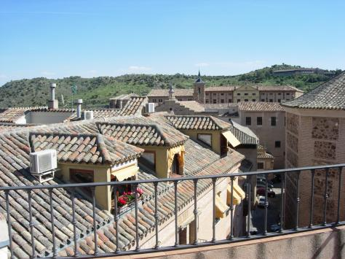

Slide 51
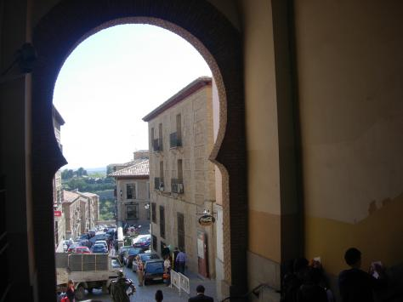

Slide 52
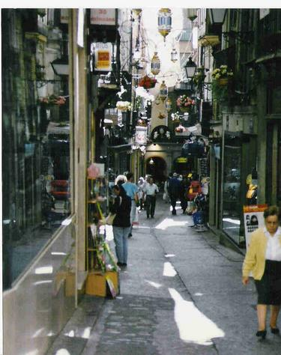

Slide 56
Toledo – Roman bridge

