Slide 1
Spain (Part 3)

Slide 2
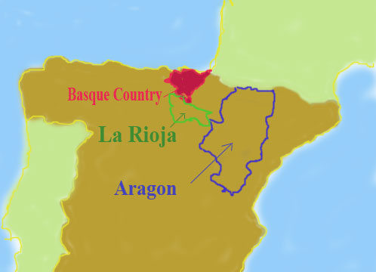
basque spain

Slide 3
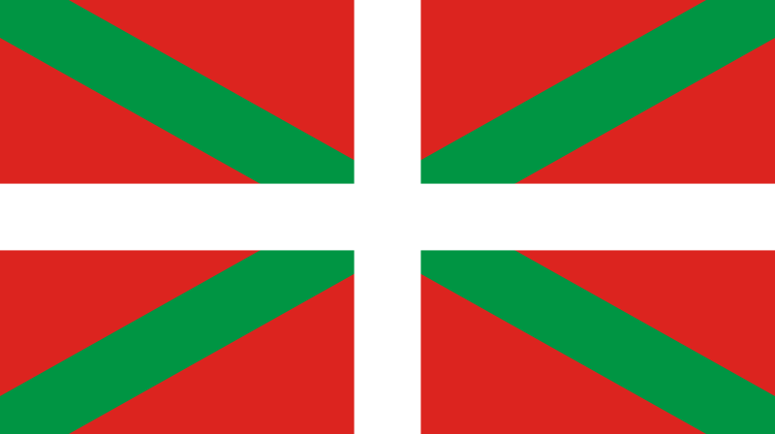
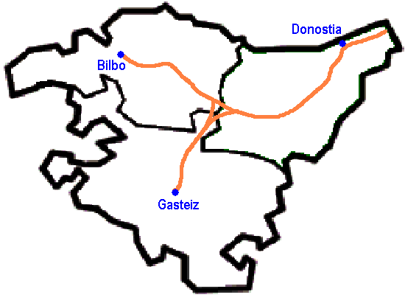
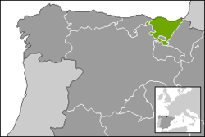
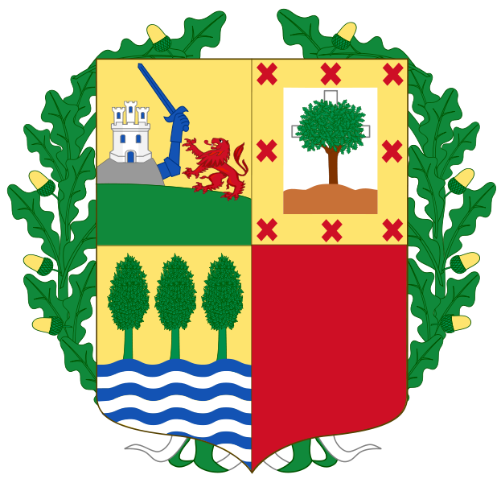
Autonomous Community of the Basque Country

Slide 4
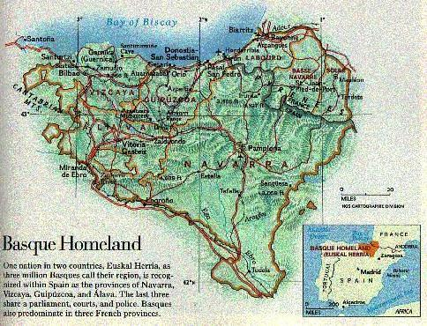

Slide 5
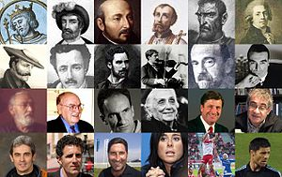
The People

Slide 6
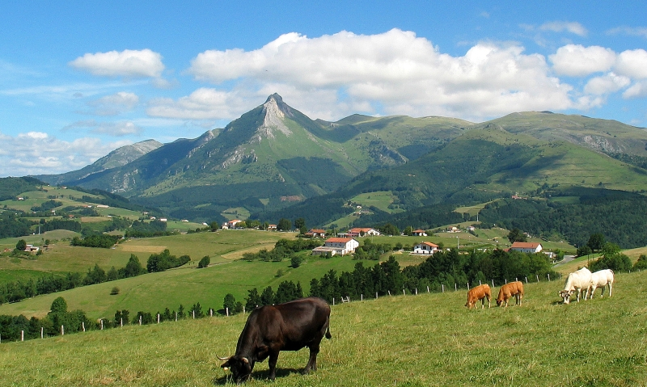
Txindoki mountain from Lazkaomendi

Slide 7
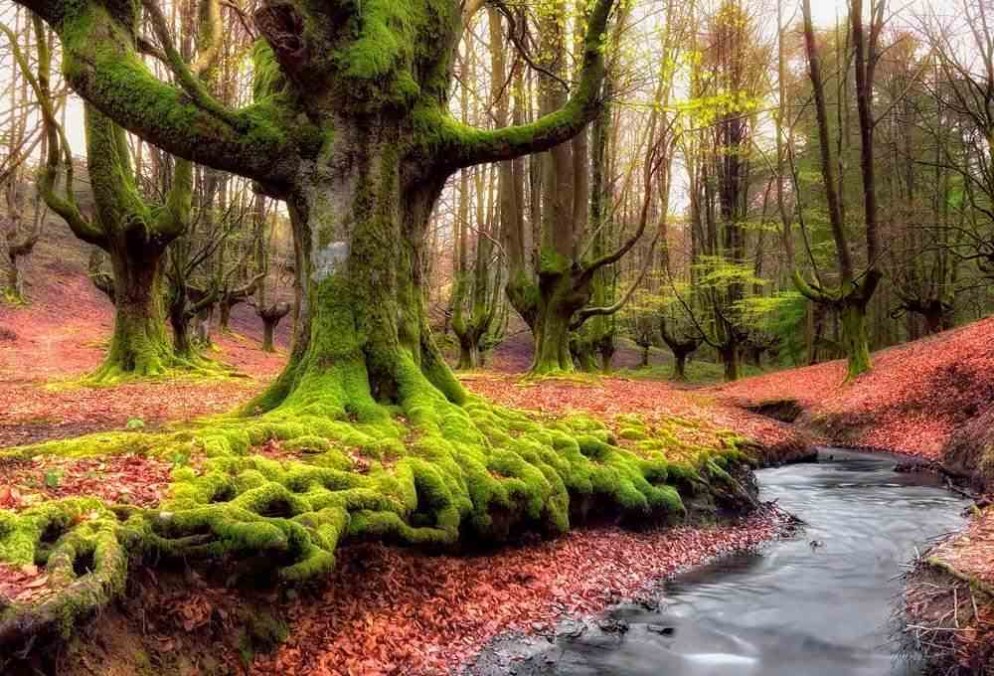

Slide 8
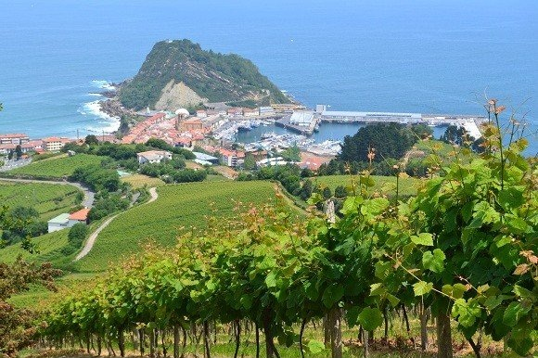

Slide 9
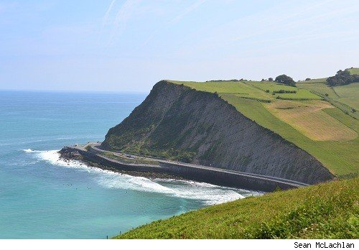

Slide 10
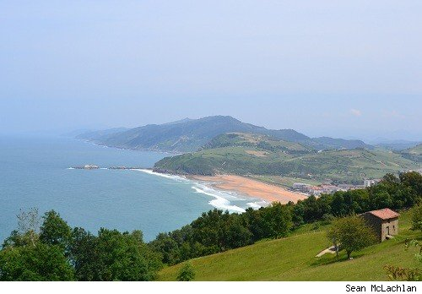

Slide 11
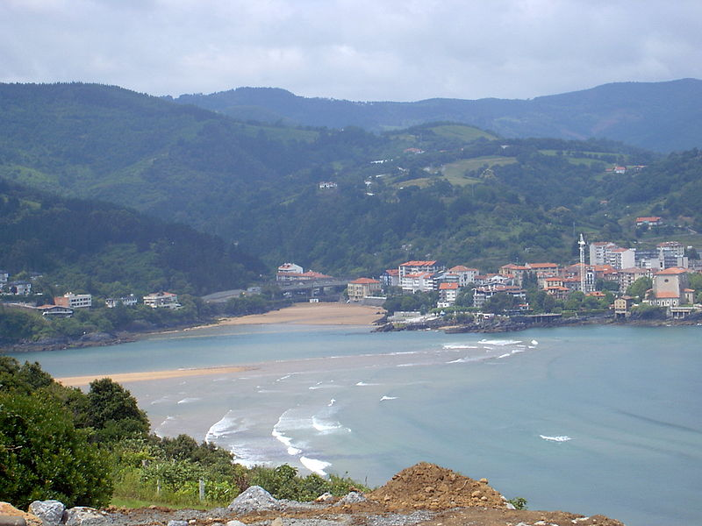
Basque coast near Mundaka

Slide 12
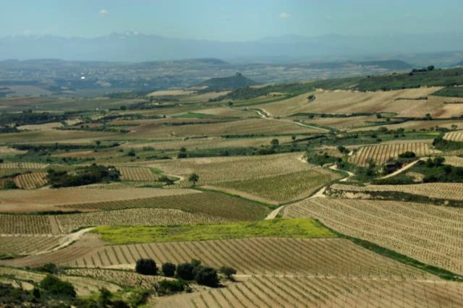
Rioja vineyards near the Ebro

Slide 13
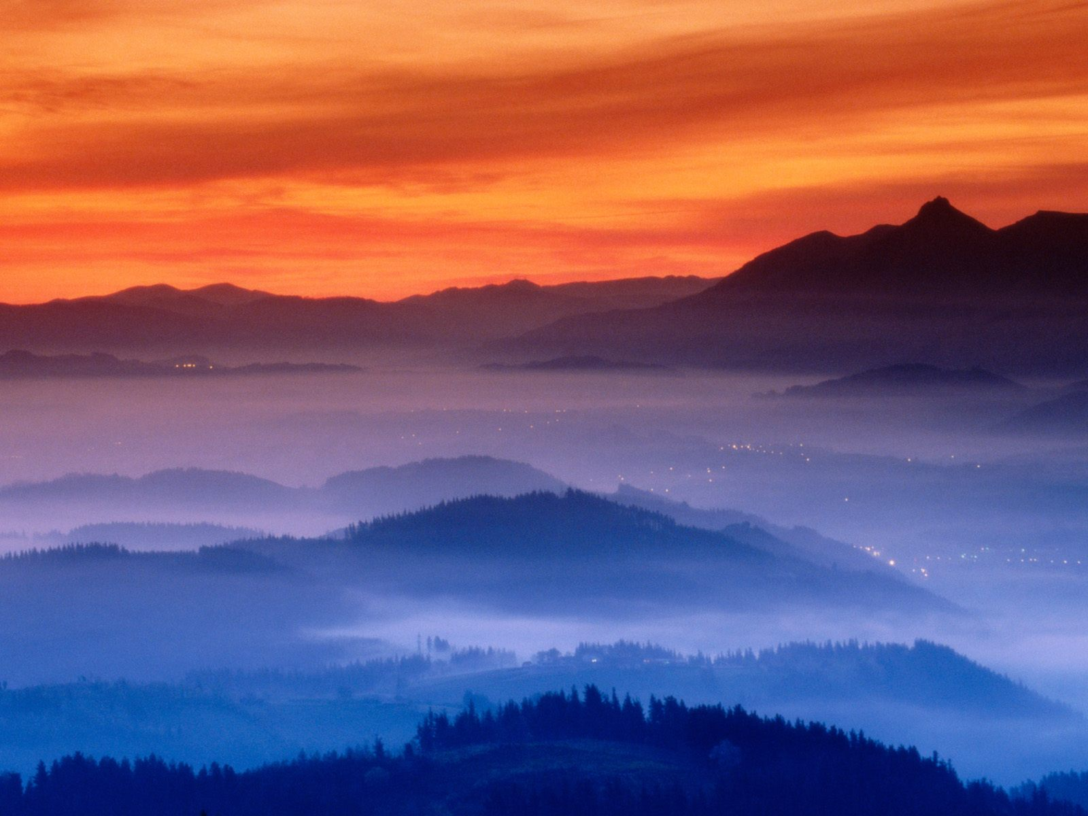
Fog in Guipuzcoa Valley

Slide 14
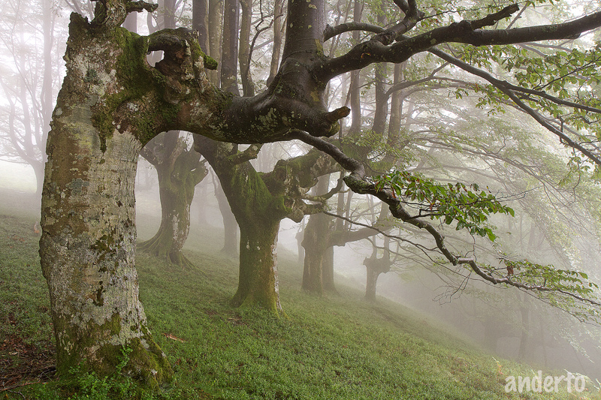

Slide 15
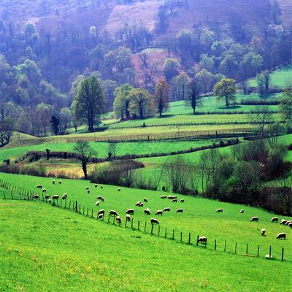
Sheep grazing

Slide 16
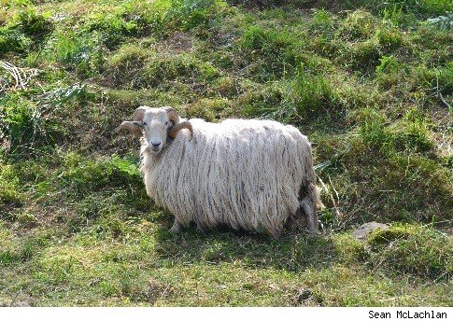

Slide 17
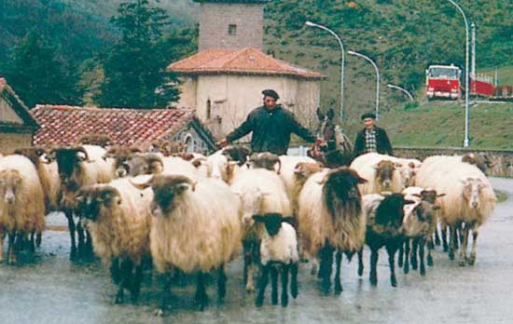
Basque shepherds, Navarra, Spain.

Slide 18
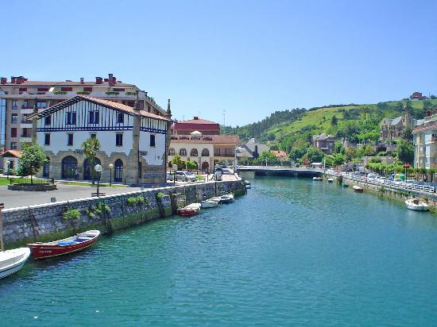
Zumaia

Slide 19
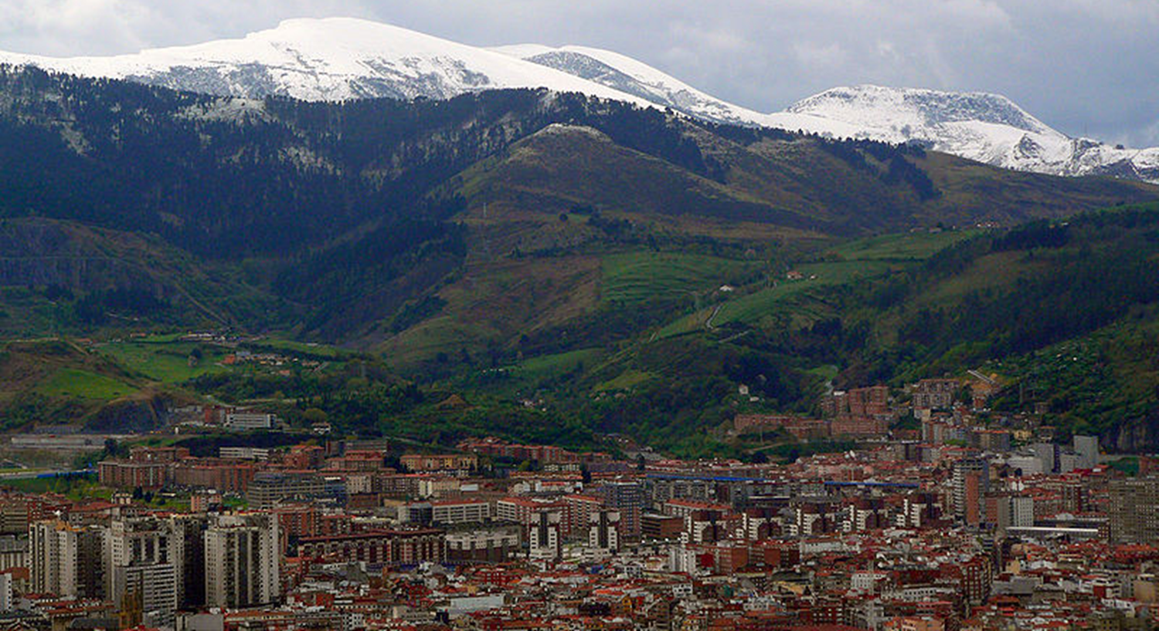
Bilbao (Basque Capital)

Slide 20
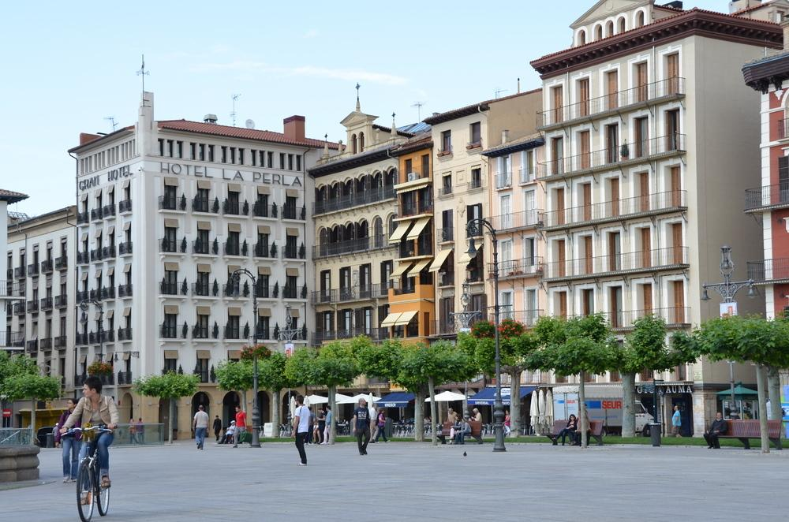
Bilbao (capital city)

Slide 21
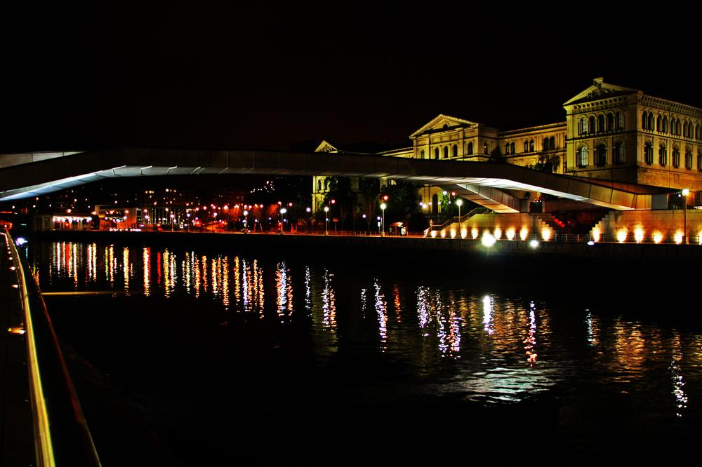
Bilbao at night

Slide 22
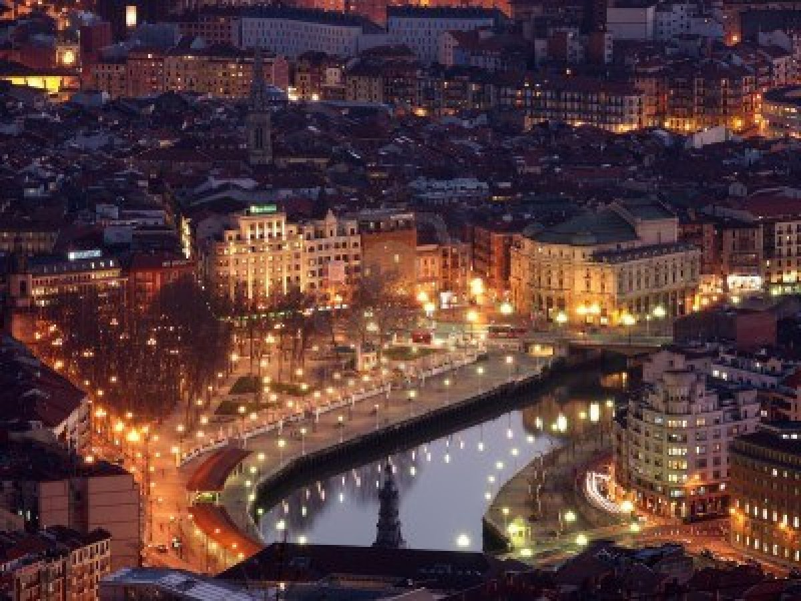

Slide 23
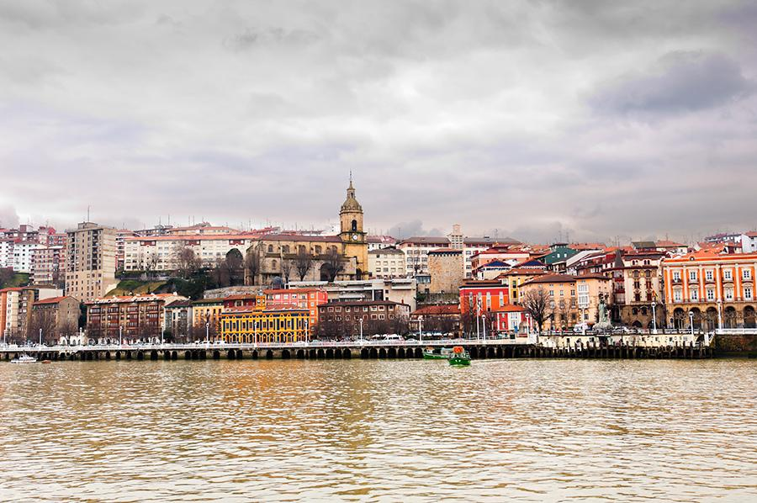
Estuary of Bilbao

Slide 24
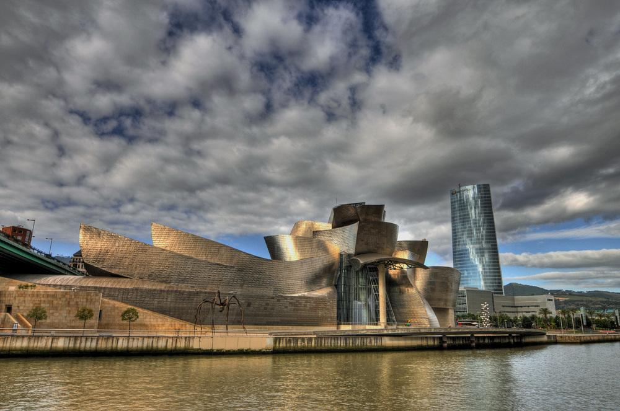
Guggenheim Museum - Bilbao

Slide 25
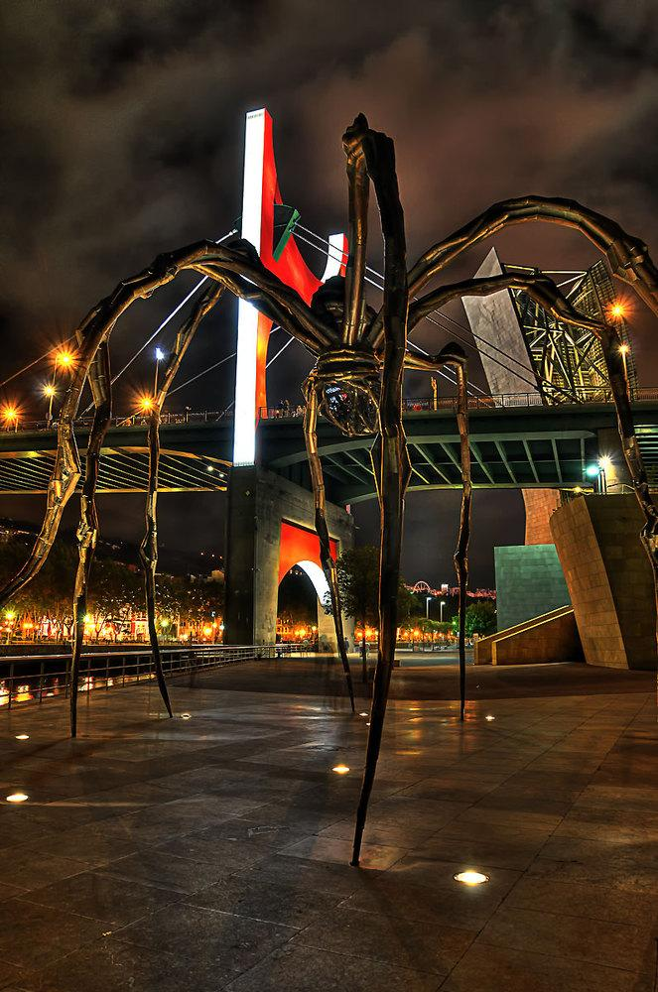
Guggenheim Museum - Bilbao

Slide 26
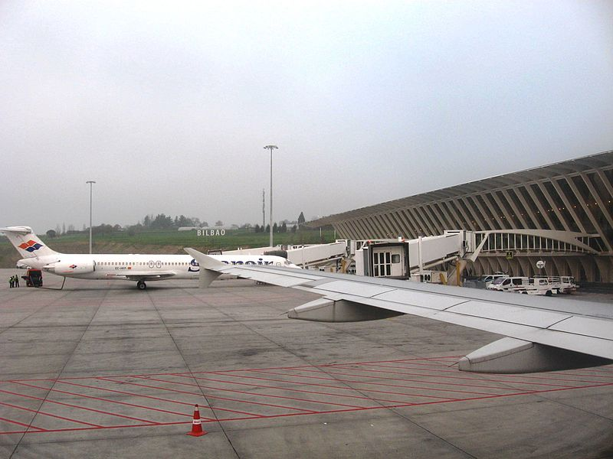
Bilbao Airport

Slide 27
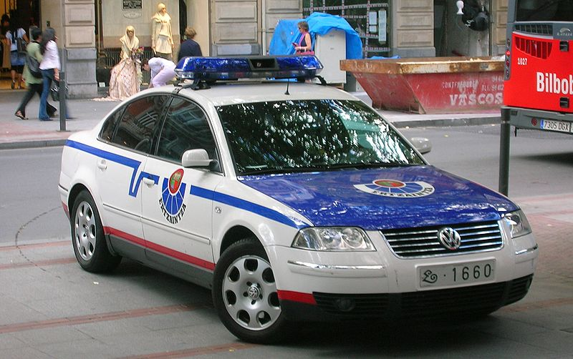
Police car in Bilbao

Slide 28
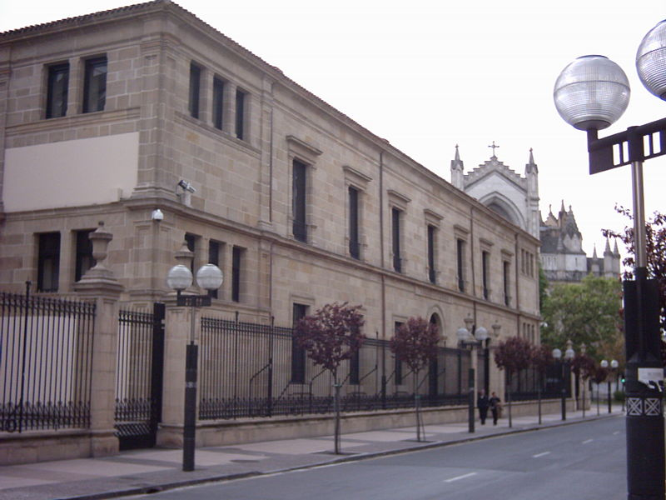
Basque parliament building in Vitoria-Gasteiz.

Slide 29
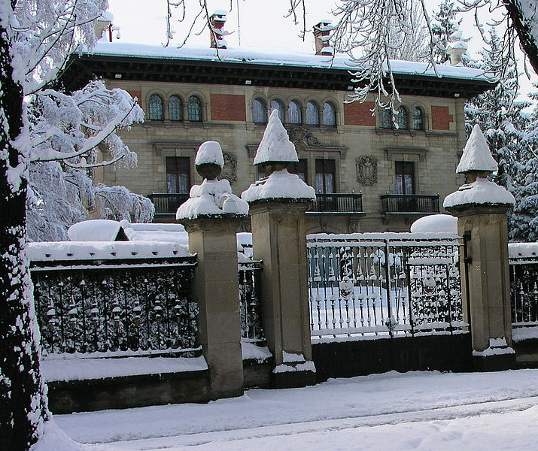
Ajuria Enea Palace, official residence of the President in Vitoria-Gasteiz

Slide 30
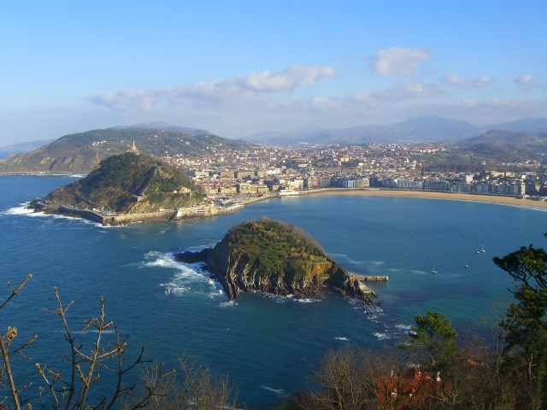
View of San Sebastián

Slide 31
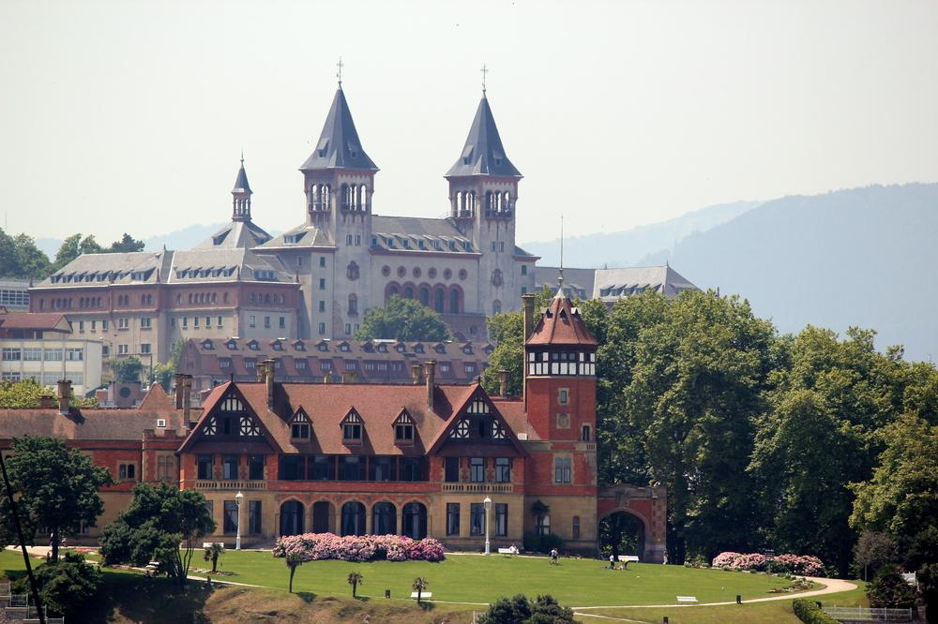
San Sebastian

Slide 32
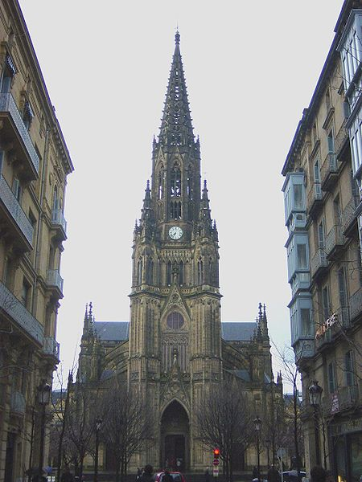
Good Shepherd Cathedral of San Sebastián

Slide 33
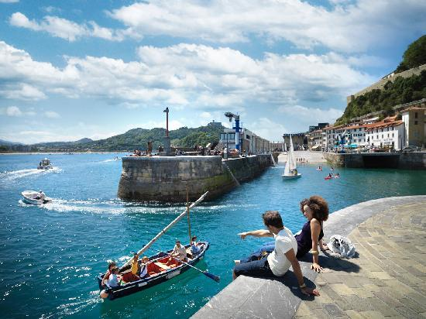
The Port of San Sebastián

Slide 34
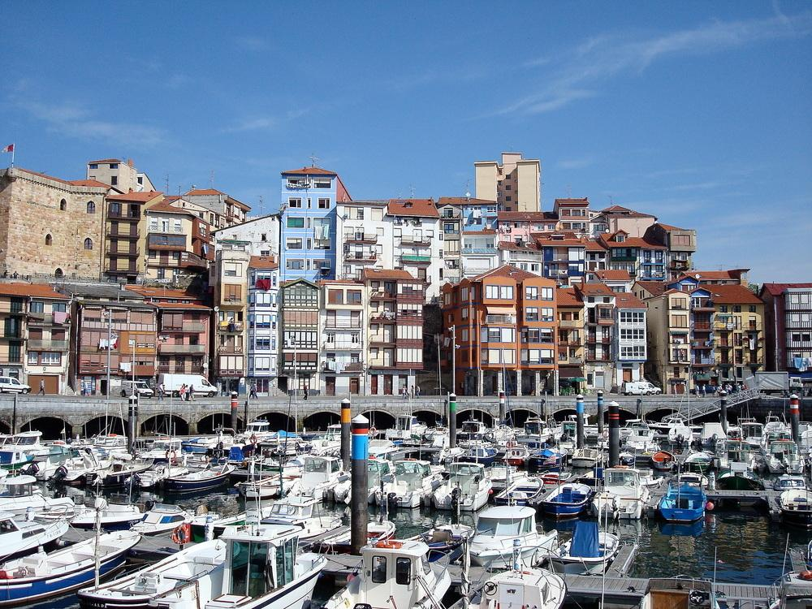
Bermeo

Slide 35
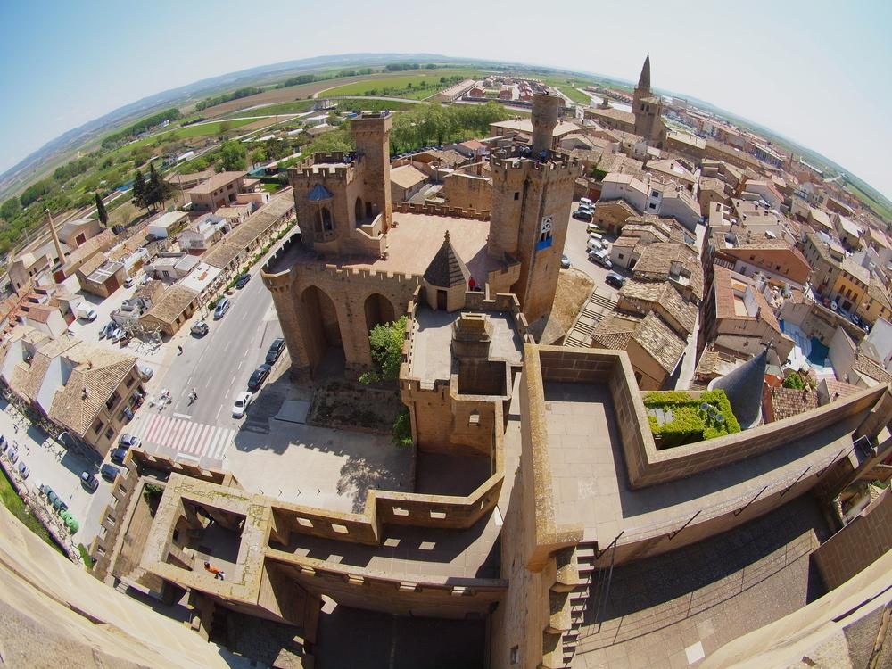
Castle of Olite - Navarre

Slide 36
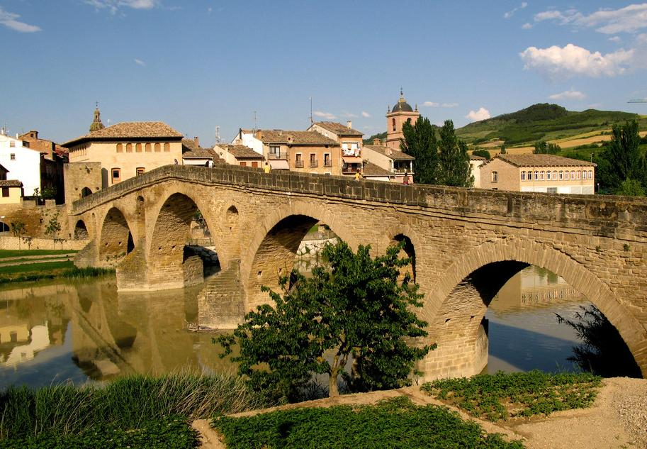
Puente La Reina - Navarre

Slide 37
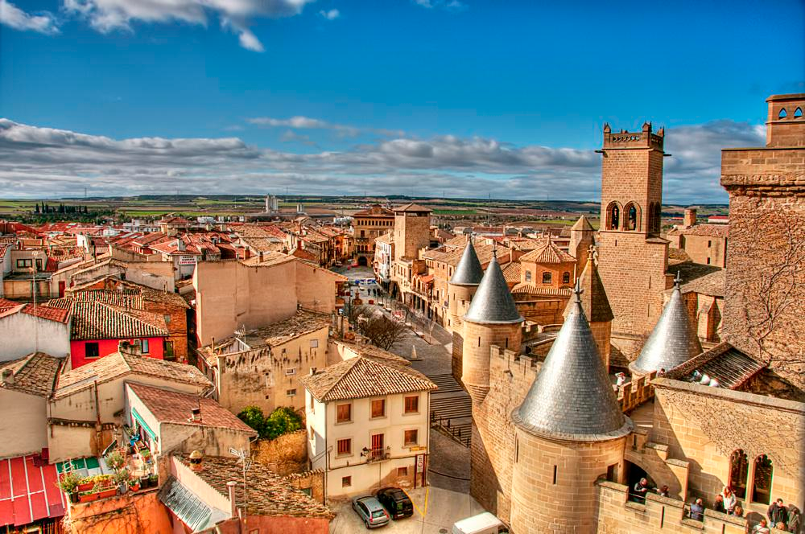
Olite-navarre

Slide 38
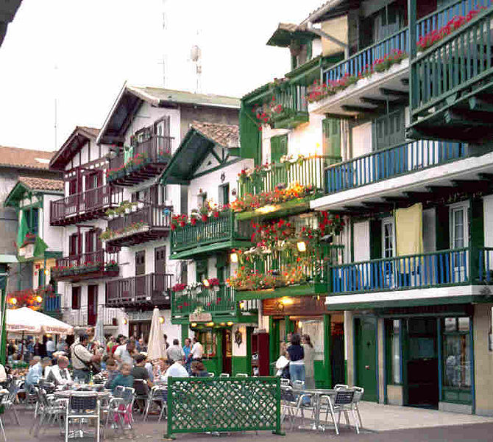
Hondarribia town

Slide 39
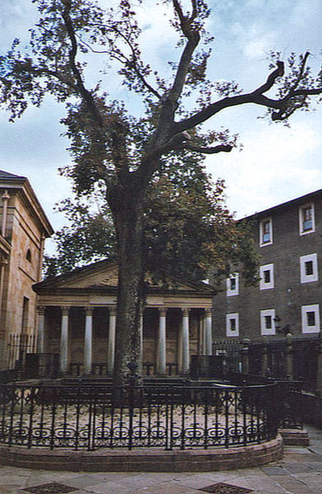
The historic Oak of Gernika, symbol of the Basque institutions.

Slide 40
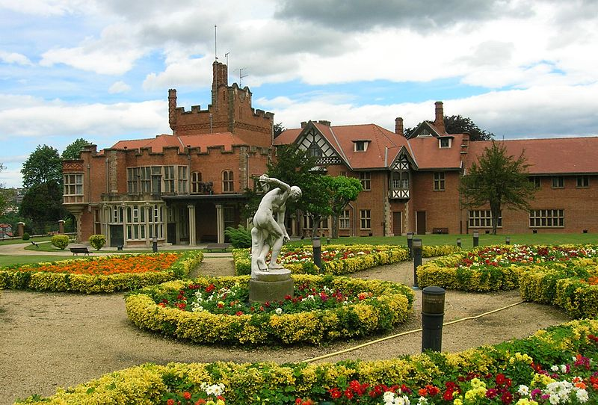
Back side and gardens of Artaza Palace, in Leioa, Biscay.

Slide 41
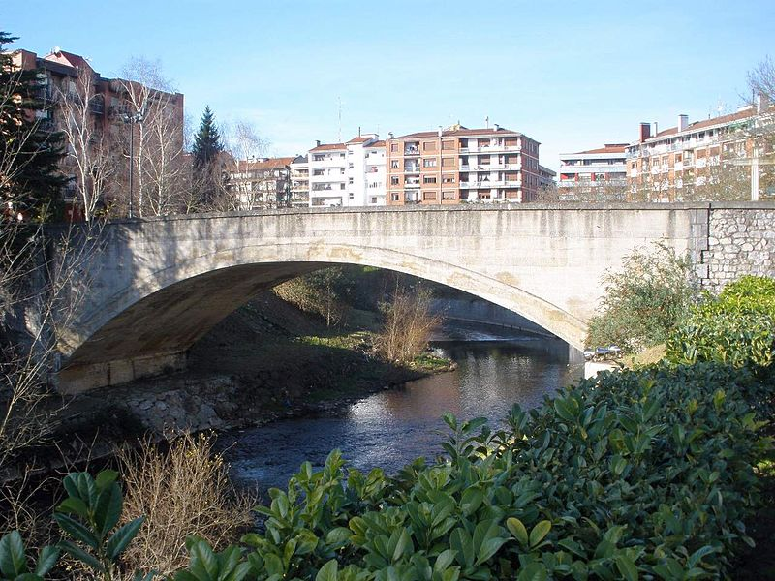
Bridge in Biscay

Slide 42
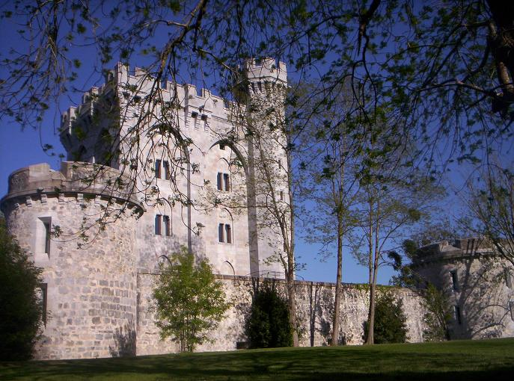
Arteaga Tower

Slide 43
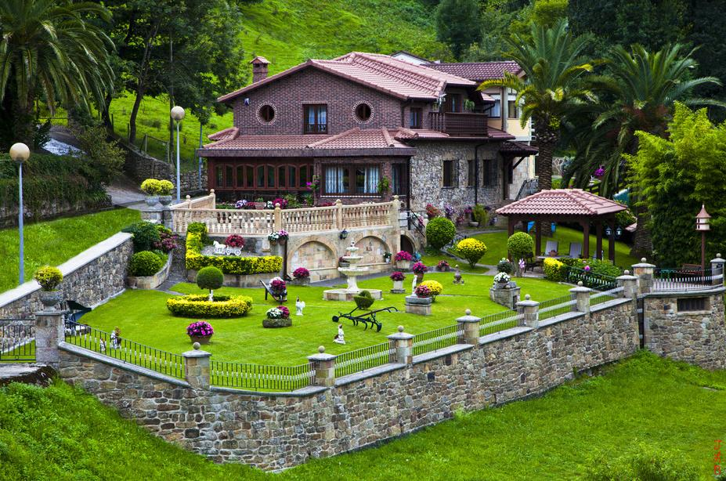
Liérganes - Cantabria

Slide 44
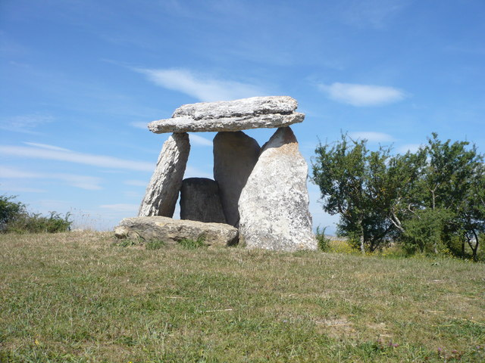
Archaeology in the Basque Autonomous Community

Slide 45
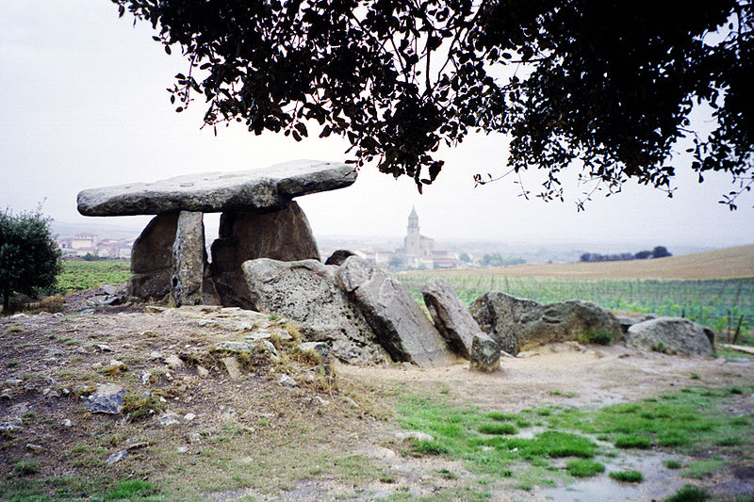

Slide 46
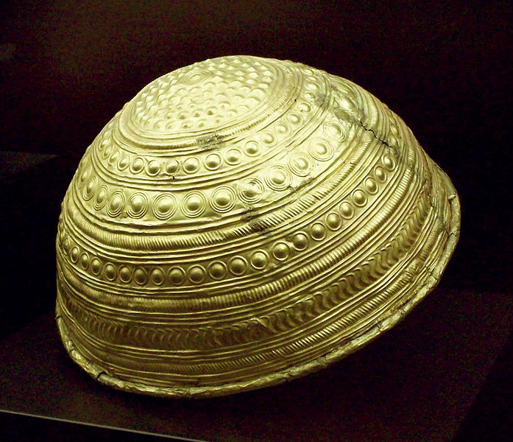
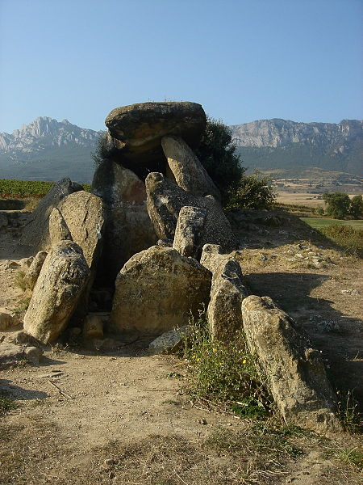
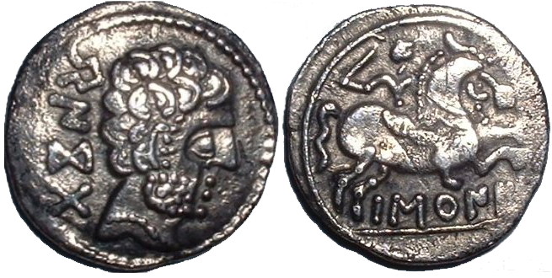

Slide 47
Balearic islands
The Balearic Islands are an archipelago of Spain in the western Mediterranean Sea, near the eastern coast of the Iberian Peninsula. The four largest islands are: Majorca, Minorca, Ibiza and Formentera.

Slide 50
Formentera

Slide 51
Formentera

Slide 52
Formentera

Slide 53
Cala Blanca - Ibiza

Slide 54
Ibiza

Slide 55
Cala Benirras - Ibiza

Slide 56
Eivissa-Ibiza

Slide 57
Ibiza

Slide 58
Ibiza streets

Slide 59
Majorca

Slide 60
Port d'Andratx on the blue hour-Majorca

Slide 61
Cathedral of Saint Mary (La Seu)-Majorca

Slide 62
Majorca

Slide 63
Menorca

Slide 64
People and culture

Slide 67
In Jerez de la Frontera, famous for its horse breeding

Slide 69
Irish Pub

Slide 70
La Fontanilla Taverna

Slide 76
Dragon Fruit La Boqueria

Slide 79
The Rinconcillo

Slide 80
Churros with Chocolate

Slide 88
Flamenco

Slide 98
Tile bench in Marabella

Slide 99
Andalusian patterns

Slide 107
Siesta

