Slide 1
CLIMATE CHANGE --Navajo Nation Witnesses Changing Landscape --Growing Sand Dunes

Slide 2
A U.S. Geological Survey researcher says she's worried about the Navajo because drought, combined with increasing temperatures, are making it harder for them to live in the harsh conditions.
DAVID GREENE, HOST: The Navajo Nation is being buried in sand. A third of that land is now covered with sand dunes as a result of climate change. Roads carouse for livestock; even entire homes have been enveloped, creating what President Obama calls climate change refugees. Laurel Morales from member station KJZZ brings us more.
LAUREL MORALES, BYLINE: Thirty-foot-tall sand dunes the color of flower pots flank the road to the now dry Tolani Lake in the Navajo Nation. At one time, streams flooded the road. Today, it's sand. The community frequently bulldozes the dunes, but they creep back as much as 40 feet a year.

Slide 3
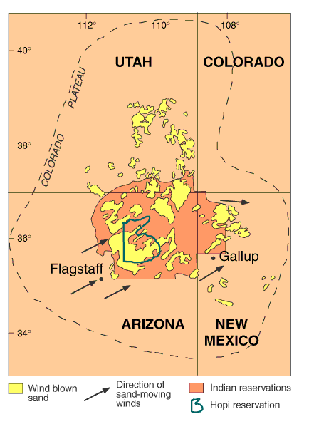

Slide 4
MARGARET HIZA REDSTEER: It's a losing battle, unfortunately.
MORALES: Margaret Hiza Redsteer points to a dune blowing toward someone's home.
REDSTEER: They have to plow the road quite frequently to keep the road open so they can get in and out to their house.
MORALES: Hiza Redsteer is a research scientist for the U.S. Geological Survey. She's been studying Navajo sand dunes for 15 years.
REDSTEER: I'm really worried about Navajo people and concerned for their welfare.
MORALES: Hiza Redsteer says the current drought, combined with increasing temperatures are making it harder and harder to live in these harsh conditions. On this clear spring morning, the sun is already blazing hot.

Slide 5
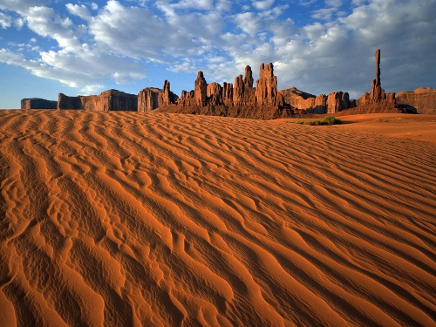

Slide 6
Hiza Redsteer says the Navajo are not simply victims of something happening hundreds of miles away. Many Navajos work at the largest coal-fired power plant in the West on the reservation itself. The EPA says such power plants are responsible for almost 30 percent of the country's carbon dioxide emissions, which contribute to climate change. When you add up sand, the heat, water scarcity and dust storms you can see from space, you start to hear terms like uninhabitable. That's the word Carletta Chief uses to describe parts of the Navajo Nation. She's a member of the tribe and an assistant professor at the University of Arizona.
CARLETTA CHIEF: People live in these homes, and they have to either continually shovel the sand dunes back every time, or I've seen in some cases, like in Kayenta, where they've built barriers.
MORALES: For the Navajo, the land where you are born is sacred. Long ago, the federal government allotted each family a parcel, a permanent homeland.
CHIEF: And even to move from one community to the next is nearly impossible because your ancestral land is where your family has lived for many, many years.
MORALES: Traditional Navajo people subsist off the land. Redsteer says many overgraze their livestock and that's left the land barren. Without plants to hold the land in place, the sand dunes become mobile. One invasive plant has made matters worse – tumbleweed, a scourge of the Navajo landscape.

Slide 7
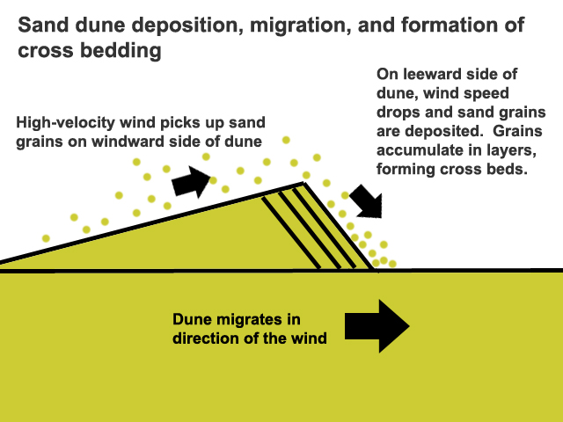

Slide 8
REDSTEER: We have these new sprouts of tumbleweed coming up.
MORALES: Hiza Redsteer plucks a baby tumbleweed out of the sandy ground. She says the tumbleweed, or salsola, chokes out native plants that hold the sand dunes in place.
REDSTEER: It's very effective at drawing moisture out of the ground, much more effective than the native plant species. So during a drought, the salsola will get the upper hand simply because it's more efficient at drawing moisture out of the soil.
MORALES: Then when the wind blows, the tumbleweed detaches, tumbles and spreads its many seeds. For NPR News, I'm Laurel Morales in Flagstaff.

Slide 9
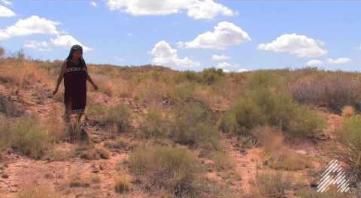
Tumbleweeds

Slide 10
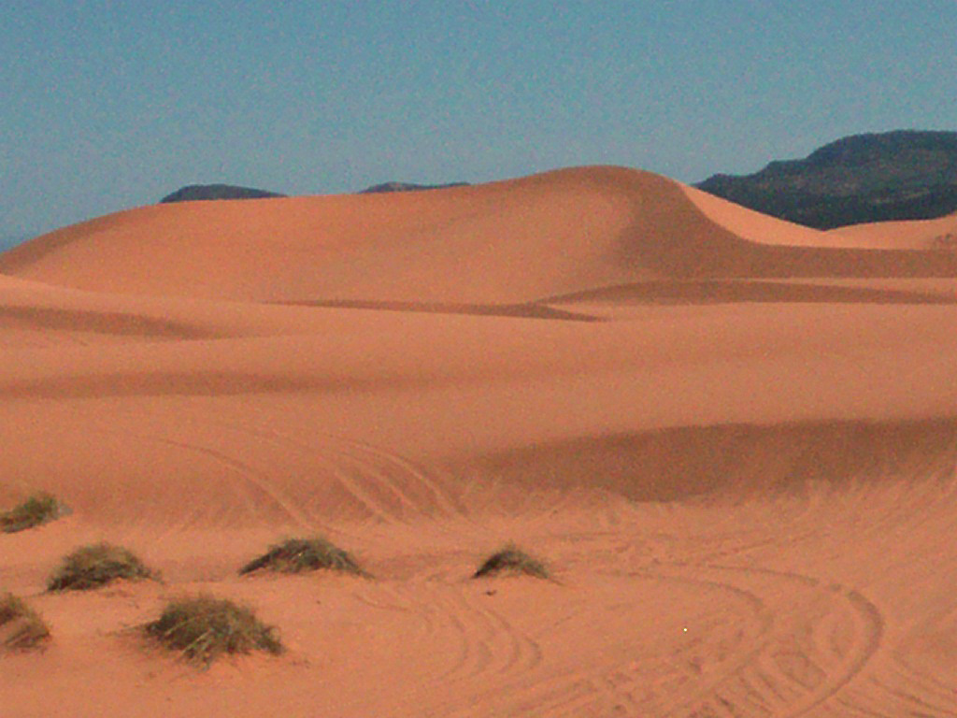

Slide 11
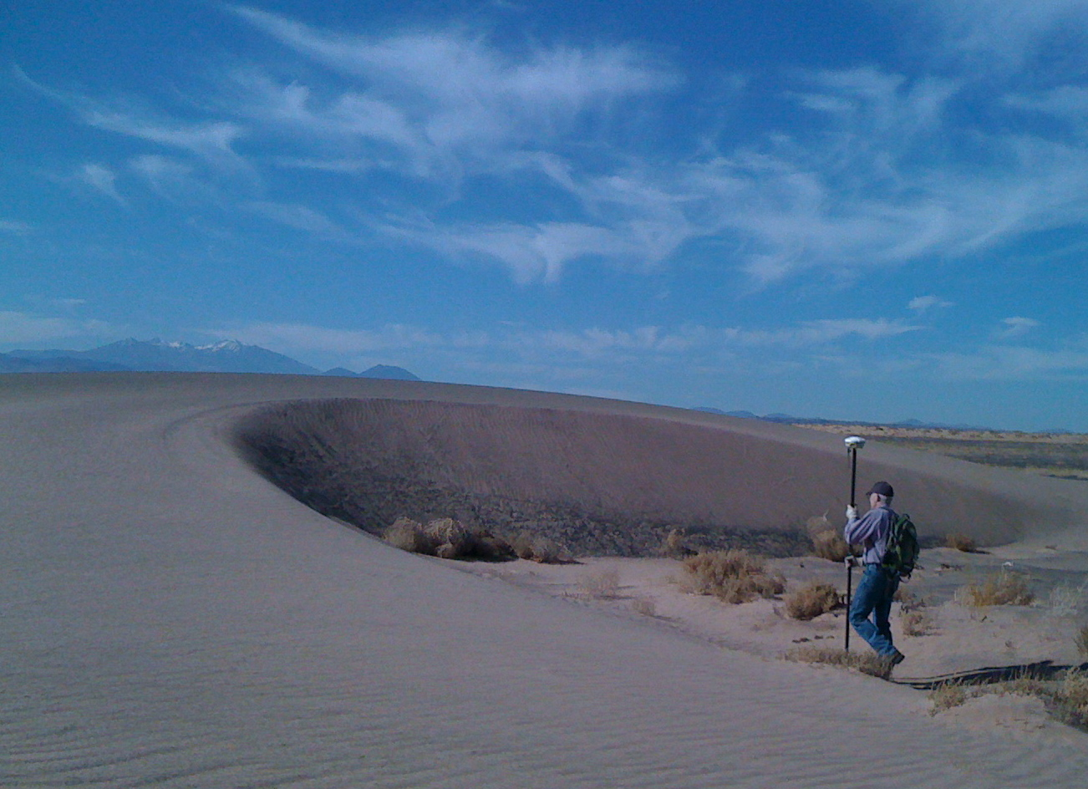

Slide 12
