Slide 1
Physical Geography
Glaciation and Glacial Landforms
UMSL

Slide 2
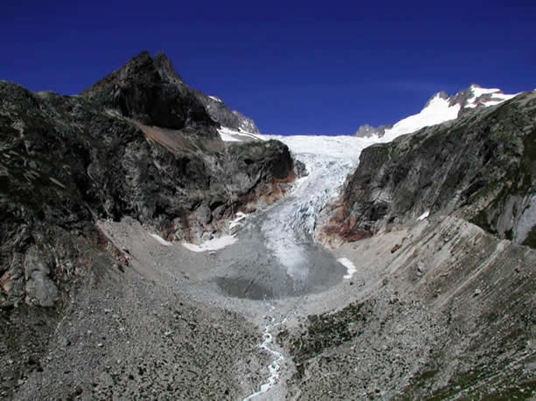
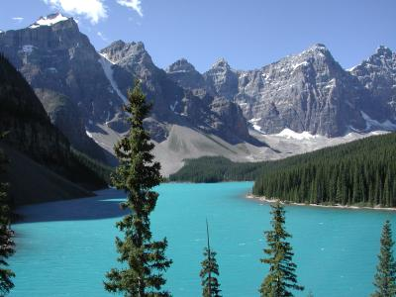
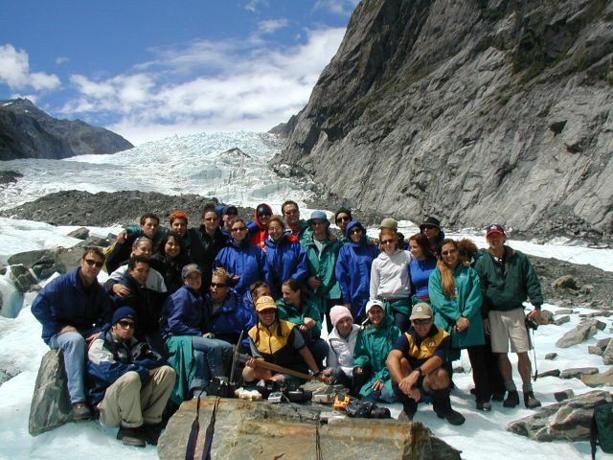
Glacial Processes and Landforms

Slide 3
Initial questions
What is a glacier?
How do glaciers form?
What’s left when they melt back (recede)?
I do not like the term “retreat”

Slide 4
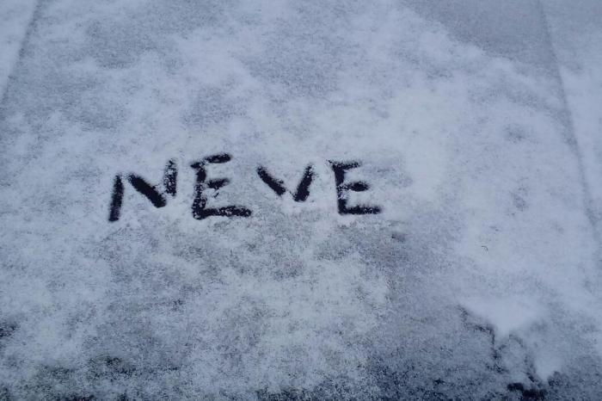
What is a glacier?
A glacier is simply the existence of year-round ice on the landscape.
There are two broad types: continental and alpine.
How do glaciers form?
Glaciers form whenever snowfall exceeds snowmelt year after year. The snow accumulates incrementally, pressure increases, and it is changed into névé and then ice by this pressure.
névé in British. (ˈnɛveɪ ) Also called: firn. a mass of porous ice, formed from snow, that has not yet become frozen into glacier ice. a snowfield at the head of a glacier that becomes transformed into ice.

Slide 6
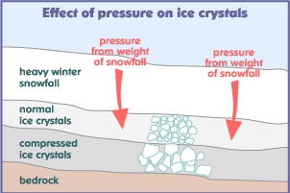

Slide 7
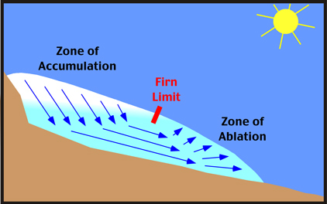
Greater than Ablation
Advancement

Slide 8
Less than Ablation
Receding

Slide 9
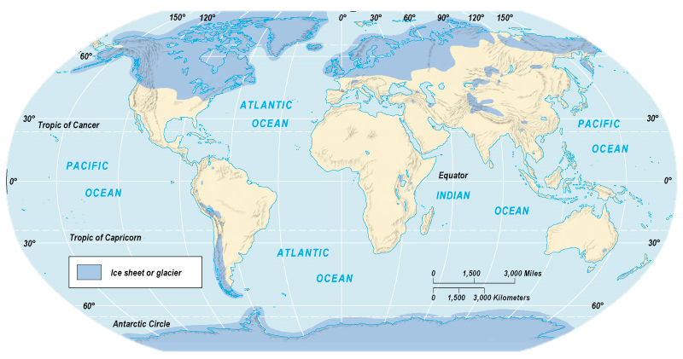
Maximum Extent of Pleistocene Glaciation - 1/3 of land surface
Most recent glacial maximum peaked 18,000 years ago and is considered to have ended 10,000 B.P.

Slide 10
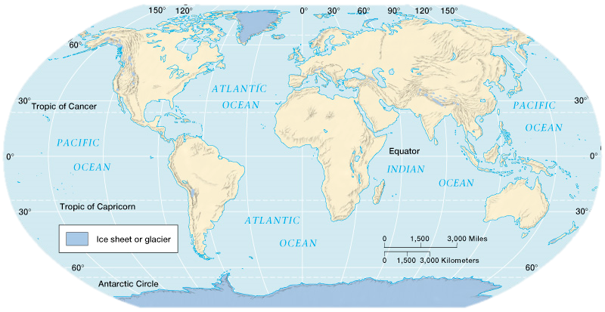
Current Extent of Glaciation - about 10% of land surface

Slide 11
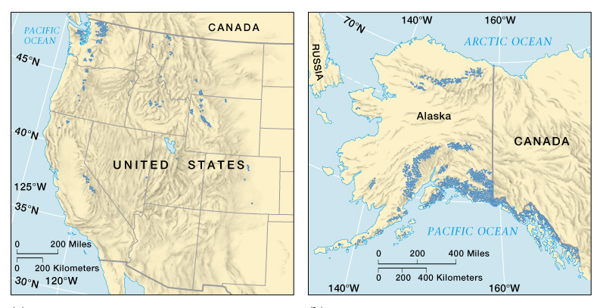

Slide 12
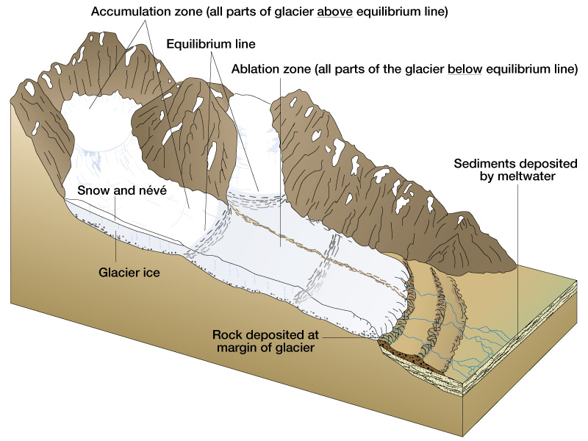

Slide 13
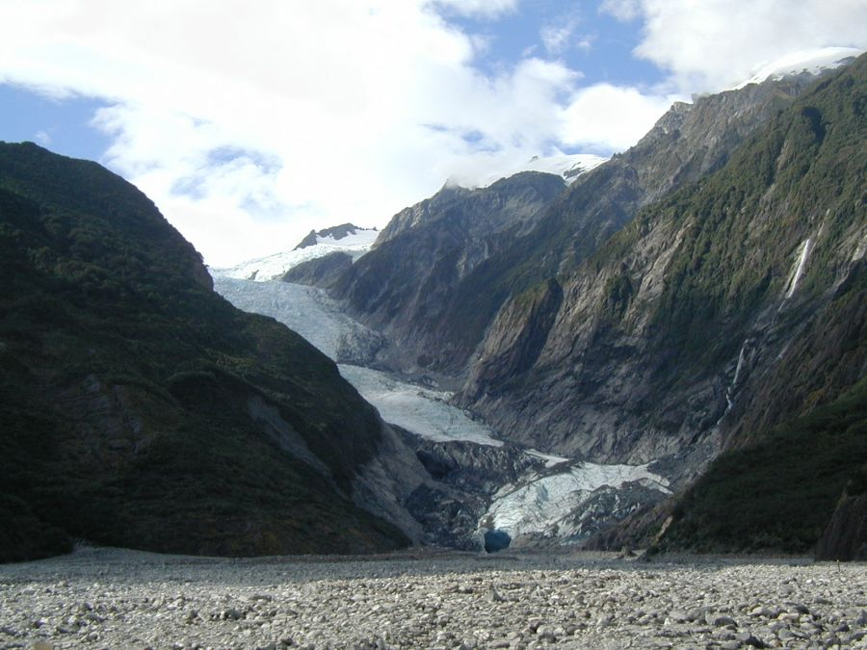
Franz Joseph Glacier and Outwash Plain, New Zealand

Slide 14
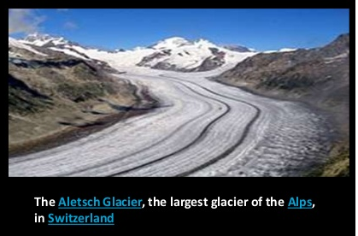
Something to think about . . .
Why is a glacier the only thing that is ever coming and going at the same time?

Slide 15
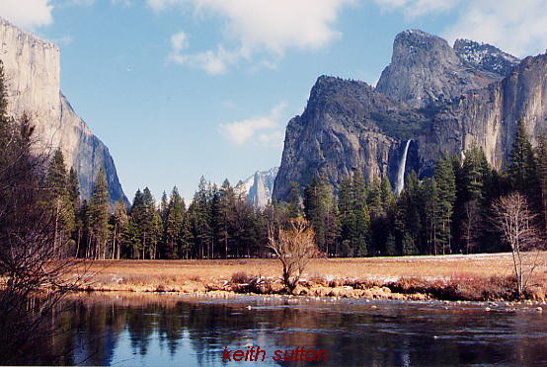
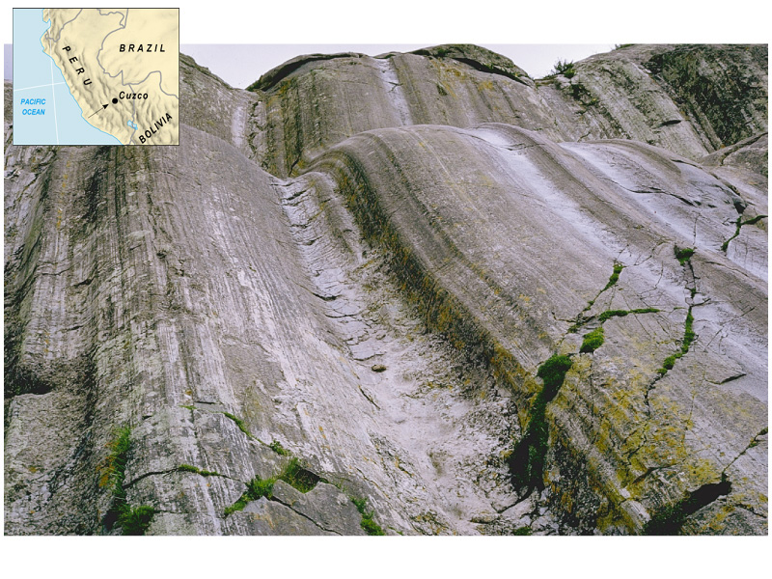
Erosion by Glaciers
volume and speed determines amount of erosion.
erodes slightly more effectively than water.
plucking and abrasion (rock-tipped blade).
polishing and striations.
Continental glaciers remove all soil, plants, and small hills.
Alpine glaciers change V-shaped valleys to U-shaped.

Slide 16
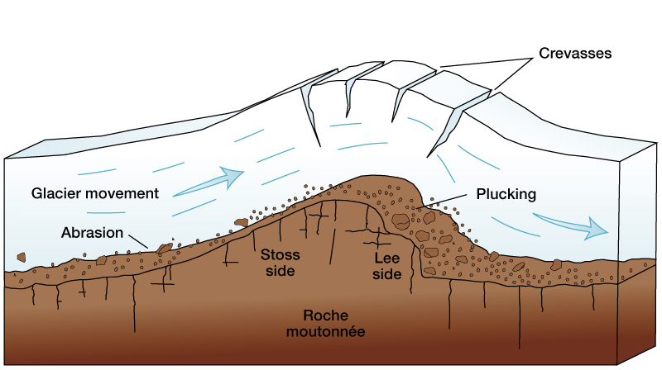

Slide 17
Glacial Striations
Glacial striations are scratches or gouges cut into bedrock by glacial abrasion. These scratches and gouges were first recognized as the result of a moving glacier in the late 18th century when Swiss alpinists first associated them with moving glaciers.

Slide 18
Glacial polish
Glacial polish is a characteristic of rock surfaces where glaciers have passed over bedrock, typically granite or other hard igneous or metamorphic rock. Moving ice will carry pebbles and sand grains removed from upper levels which in turn grind a smooth or grooved surface upon the underlying rock.

Slide 19
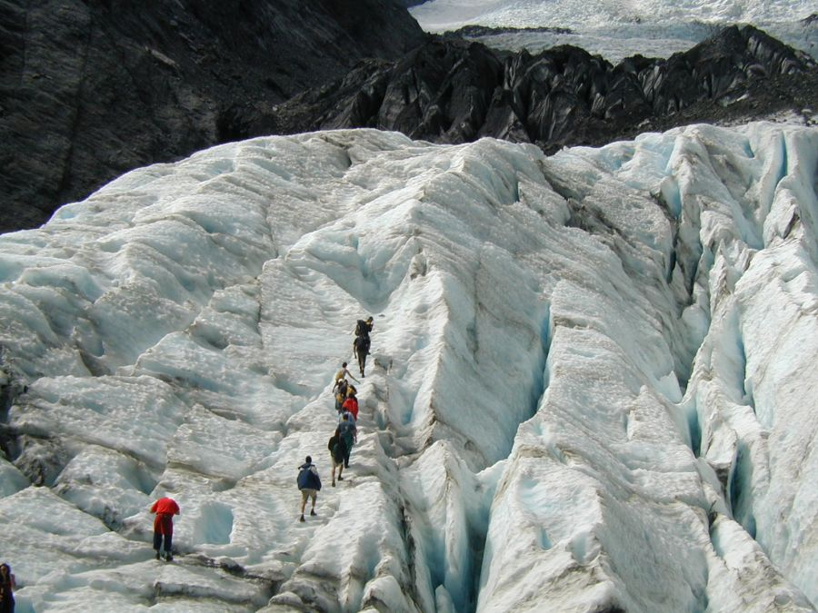
Walking on a glacier can be very dangerous

Slide 20
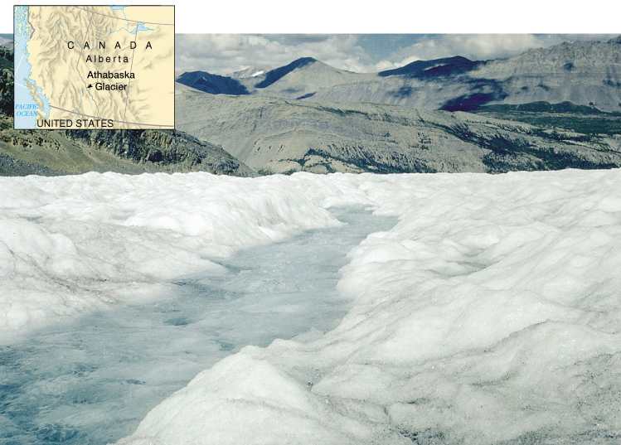
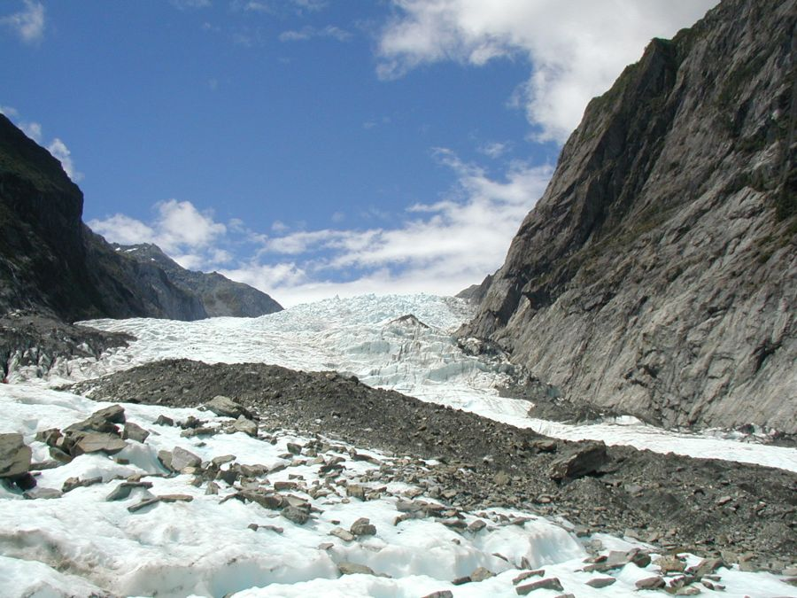
Transportation by Glaciers
will move material of all sizes, from glacial flour to massive boulders.
The soil of Canada is quite thin and young (12 to 18 thousand years old). The last continental glacier pushed all the soil that had been in what is now Canada and deposited it all over the northern U.S.A.
Slow transport.
Water in, on, and under glaciers (pluvial processes) moves much sediment as well.

Slide 21
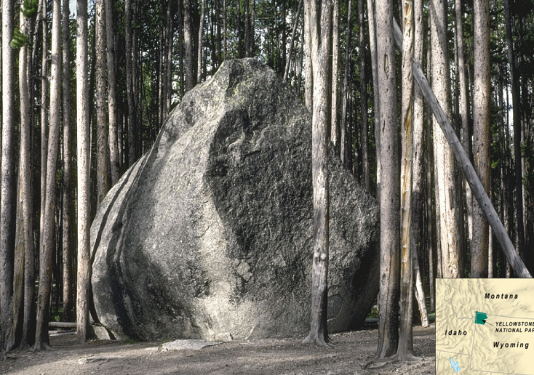
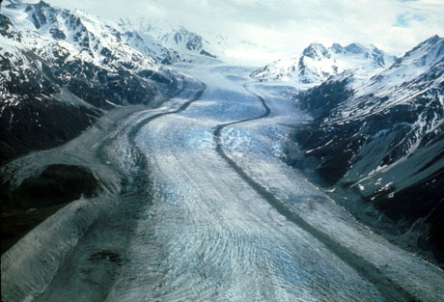
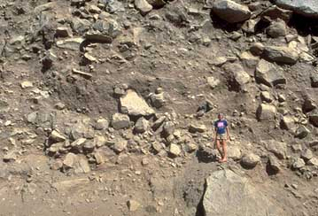
Deposition by Glaciers
drift is any material deposited by glaciers or their meltwater.
Till is that unsorted material that is deposited directly by ice.
Moraines are linear features deposited at bottom or along sides of glaciers.
Glacial erratics are enormous boulders transported and deposited by glaciers, often far from their source region.

Slide 22
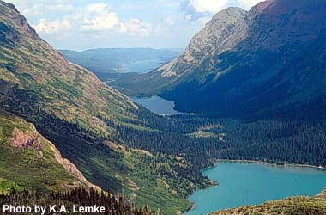
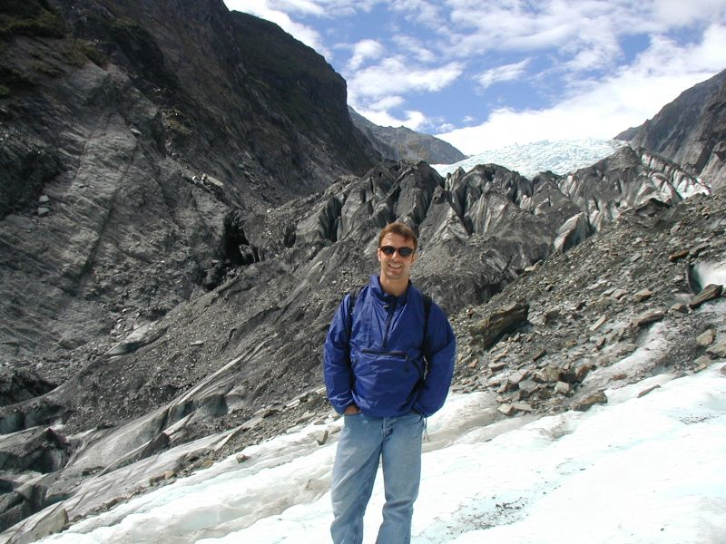
Alpine Glaciers

Slide 23
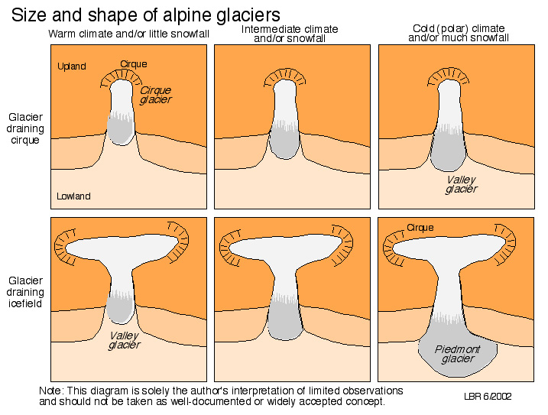
Sometimes, alpine glaciers push beyond the valley and merge with other valley glaciers

Slide 24
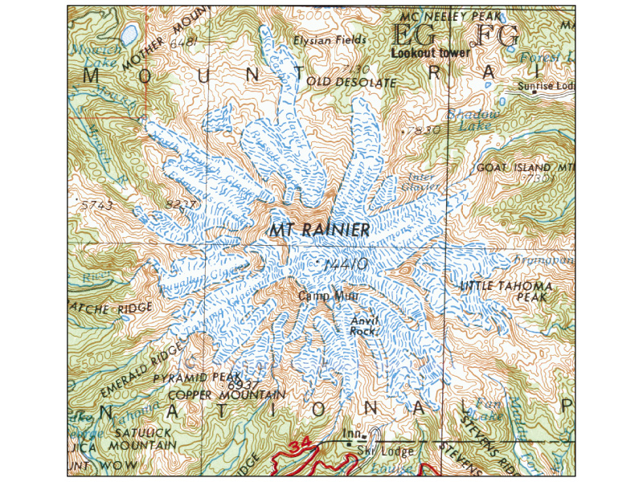

Slide 25
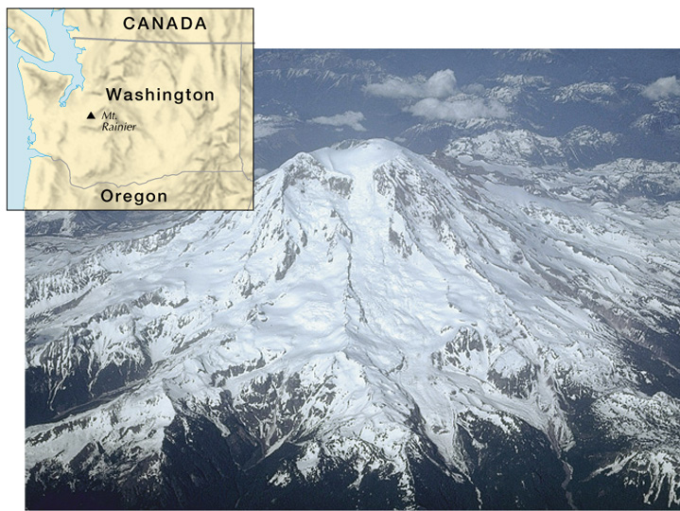

Slide 26
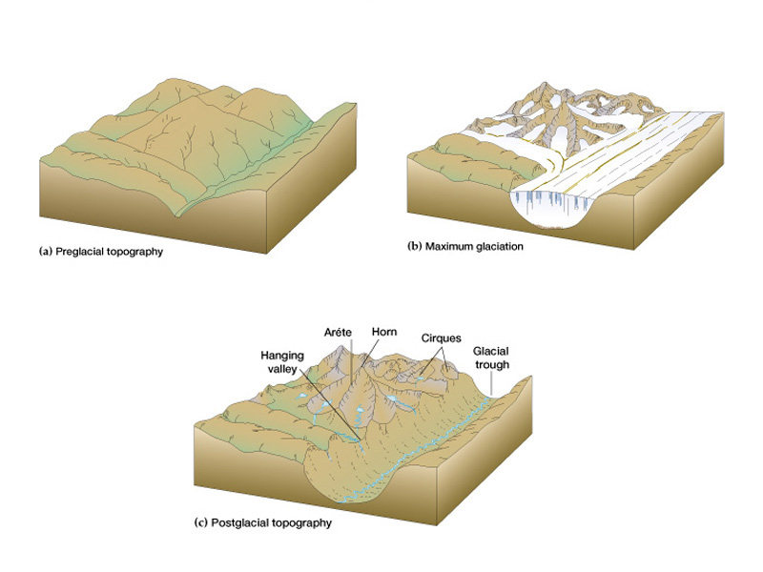

Slide 28
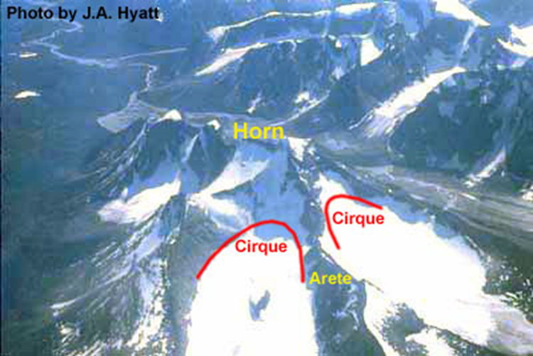

Slide 29
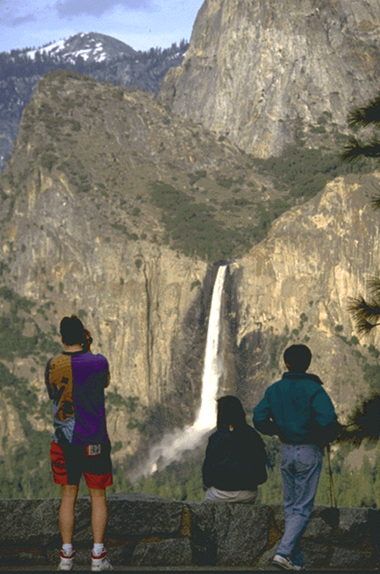
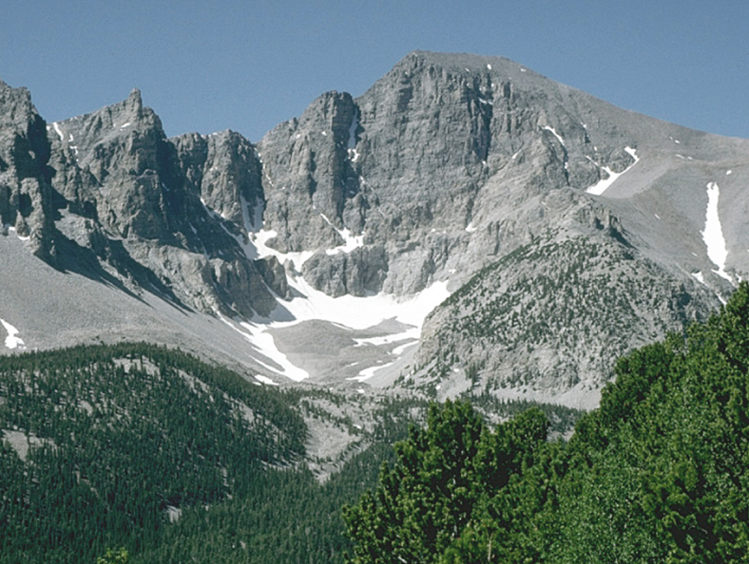
Hanging Valley
Cirque with almost all the glacier that had formed it melted away

Slide 30
Definitions
A hanging valley is a shallow valley carved by a small glacier and thus the elevation of the valley floor is "hanging" high above the elevation of the valley floor carved out by the larger glacier. The hanging valley in the top right photo in Glacier National Park contains a waterfall called Bird Woman Falls.
A cirque is an amphitheatre-like valley formed by glacial erosion. Alternative names for this landform are corrie and cwm. A cirque may also be a similarly shaped landform arising from fluvial erosion. The concave shape of a glacial cirque is open on the downhill side, while the cupped section is generally steep.

Slide 31
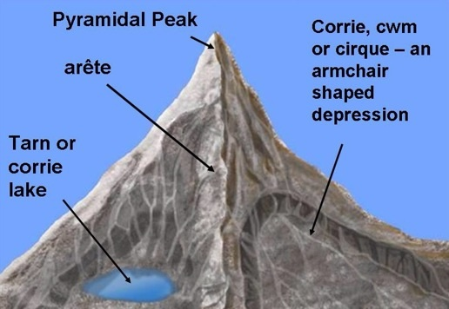
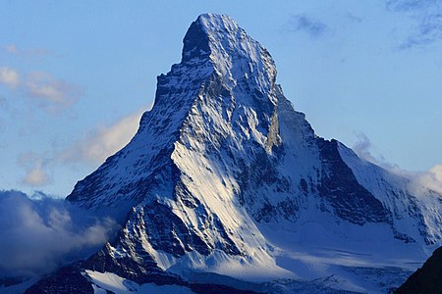
An arête is a narrow ridge of rock which separates two valleys. It is typically fArêtes ormed when two glaciers erode parallel U-shaped valleys. can also form when two glacial cirques erode headwards towards one another, although frequently this results in a saddle-shaped pass, called a col.
A horn results when glaciers erode three or more arêtes, usually forming a sharp-edged peak. Cirques are concave, circular basins carved by the base of a glacier as it erodes the landscape.

Slide 32
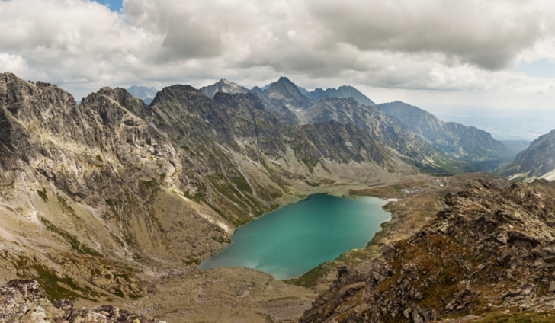
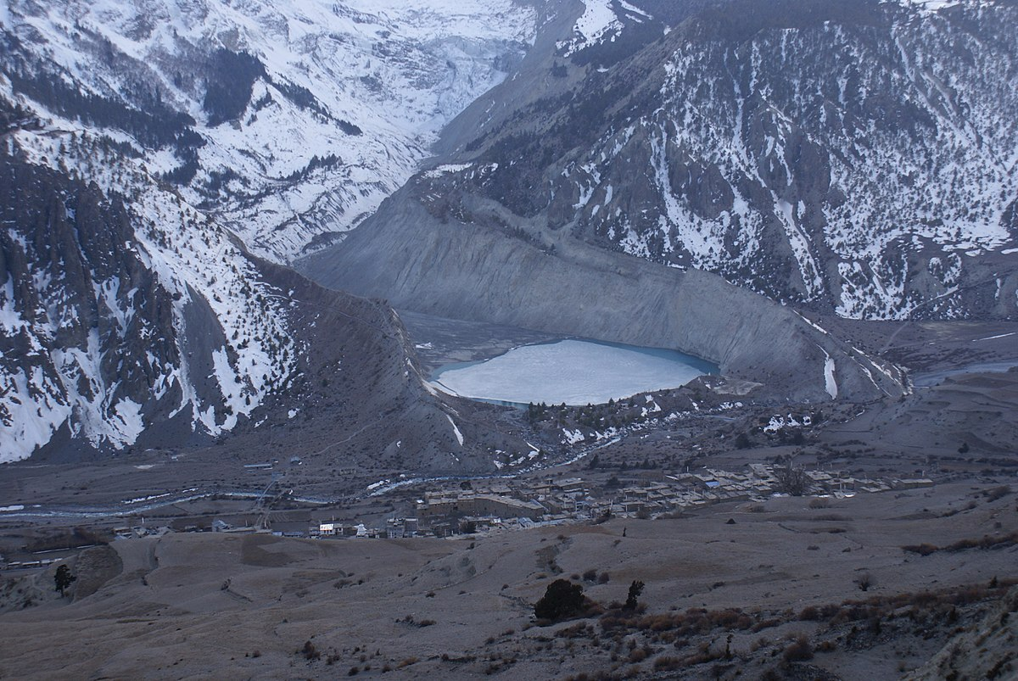
A tarn is a mountain lake or pool, formed in a cirque excavated by a glacier. A moraine may form a natural dam below a tarn
A moraine is any glacially formed accumulation of unconsolidated glacial debris that occurs in both currently and formerly glaciated regions on Earth, through geomorphological processes.

Slide 33
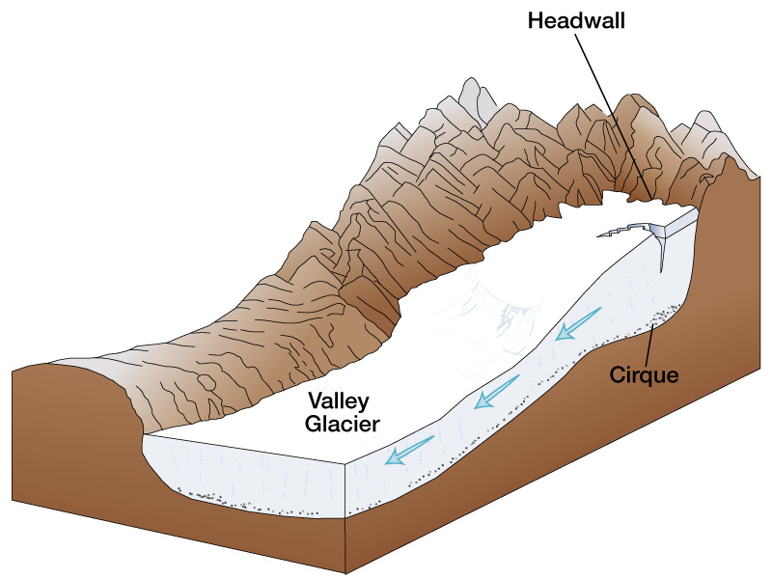

Slide 34
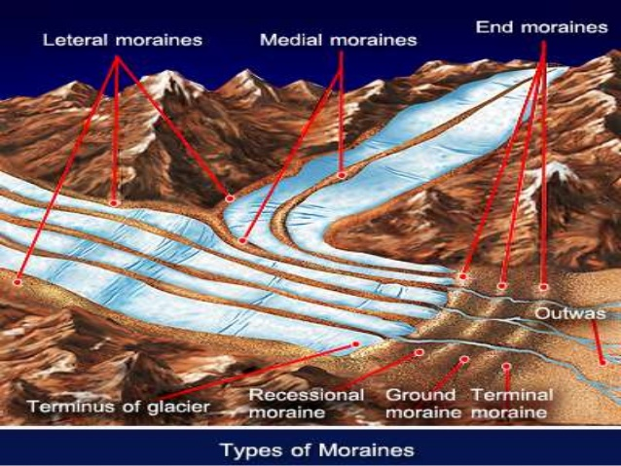

Slide 35
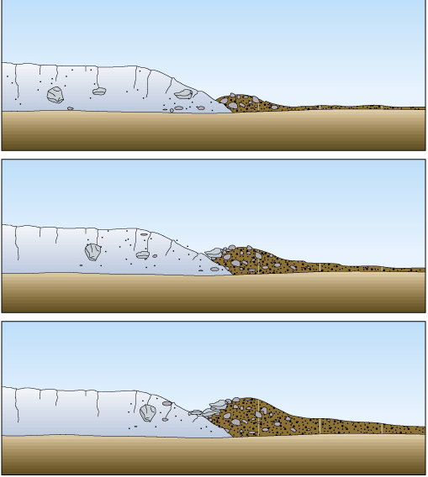
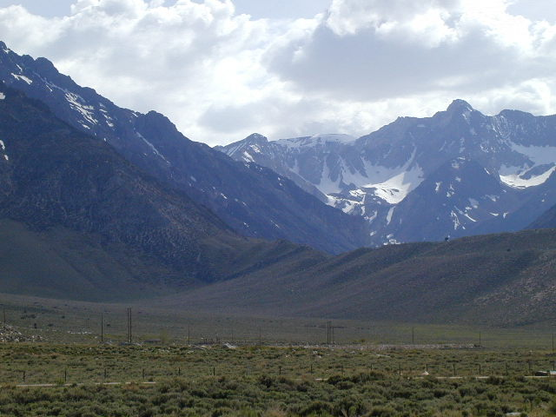
Moraines

Slide 36
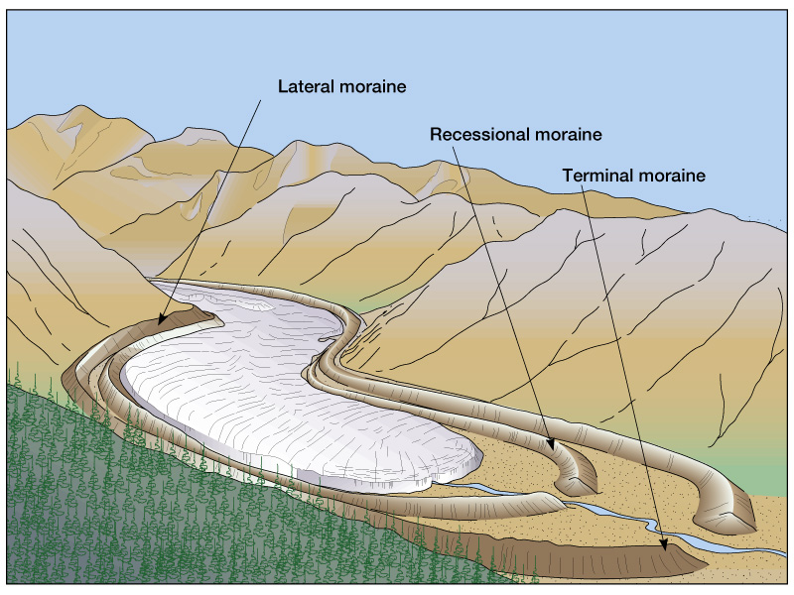

Slide 37
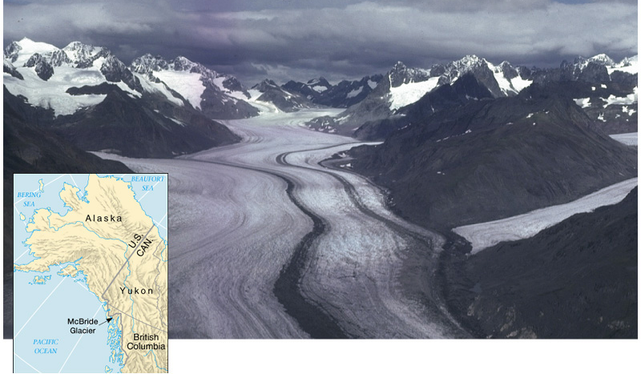

Slide 38
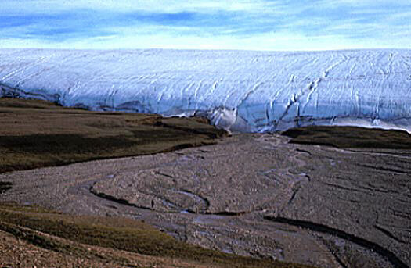
only two true ice sheets exist today: Greenland and Antarctica
where they meet the sea they can form ice sheets.
vary in thickness from hundreds of feet to two miles deep
scour away all soil and vegetation and dramatically reshape the landscape and ecology of large regions.
much change occurs in the periglacial environment.
Continental Glaciers or Ice Sheets
Ellesmere Island, Canada

Slide 39
SHIFTING

Slide 40
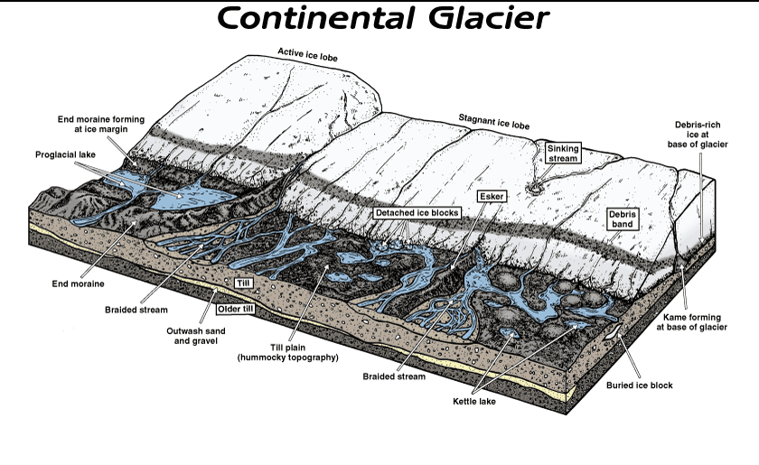

Slide 41
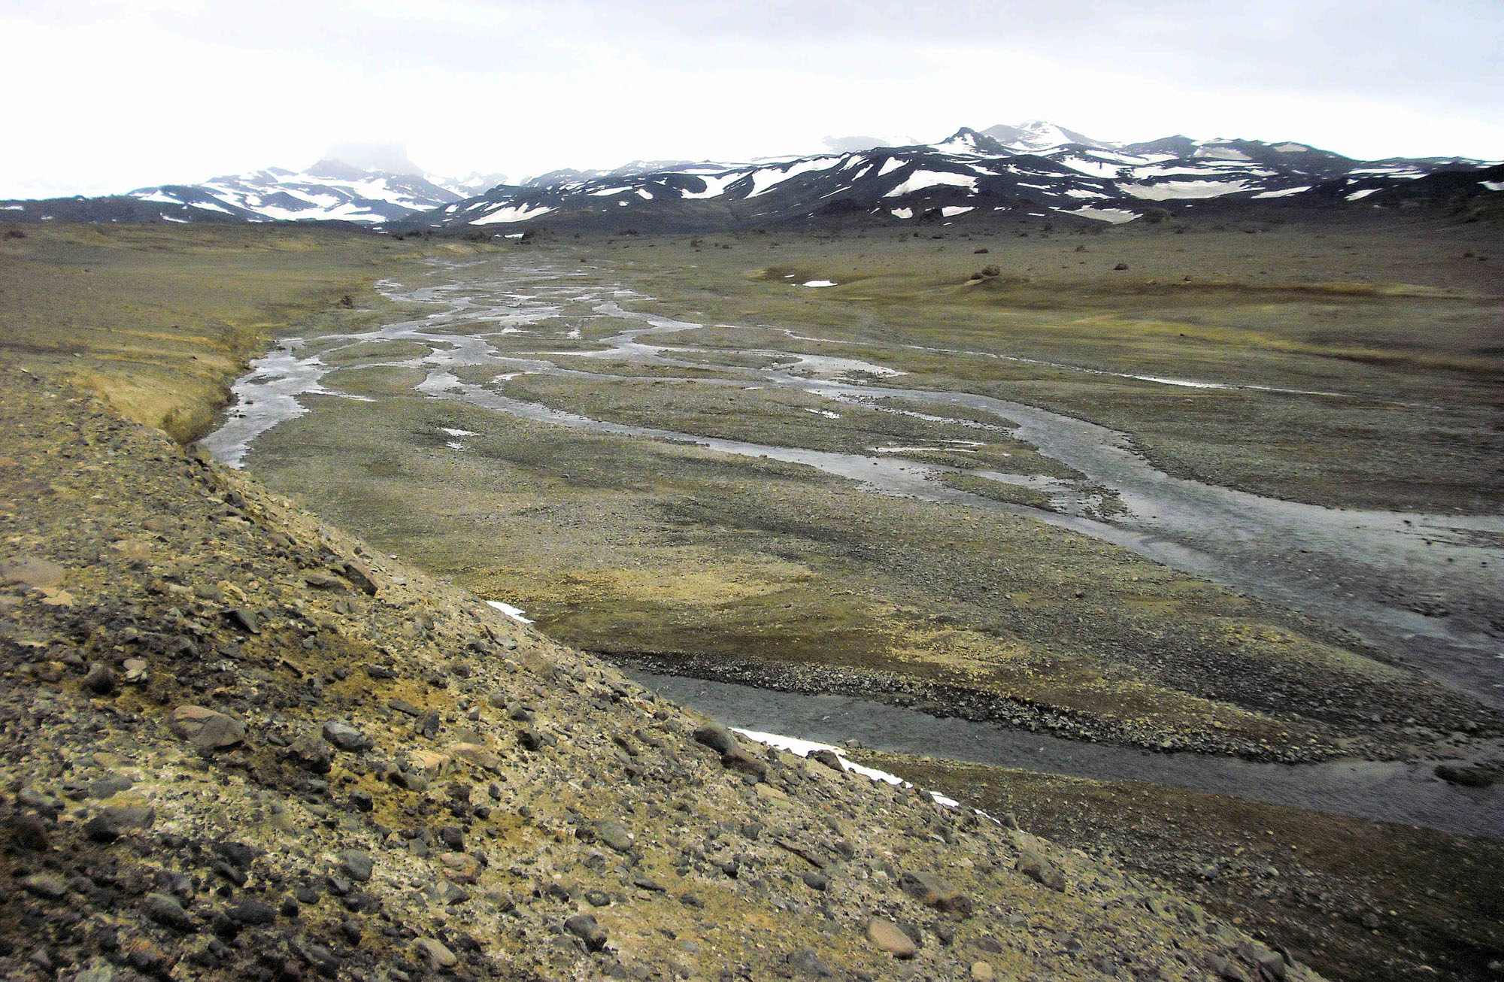
Periglacial Environment
The periglacial environment is a cold climate, frequently marginal to the glacial environment, and is characteristically subject to intense cycles of freezing and thawing of superficial sediments. Permafrost commonly occurs within this periglacial environment.

Slide 42
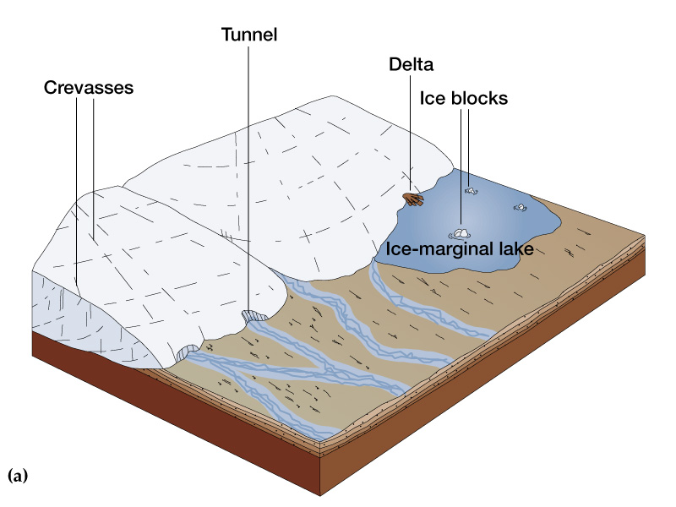
Continental Glaciers or Ice Sheets
During the glacial period

Slide 43
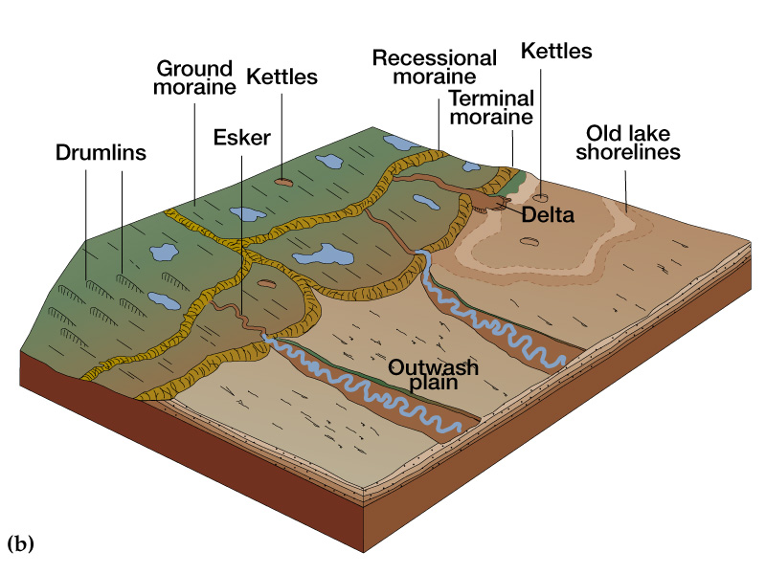
Continental Glaciers or Ice Sheets
After the glacier has receded

Slide 44
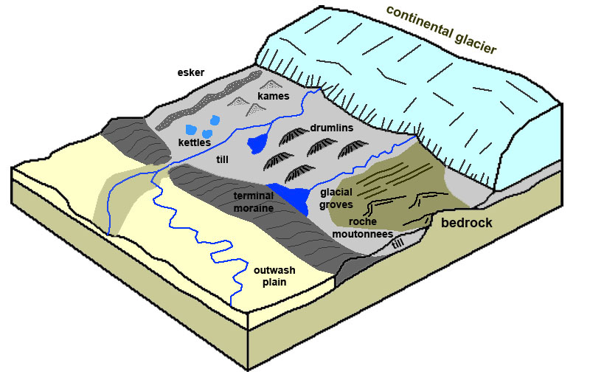

Slide 45
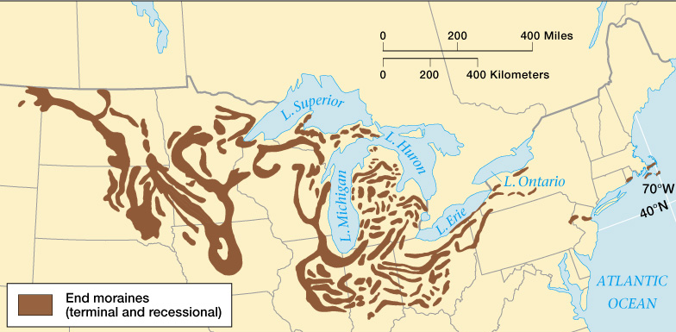
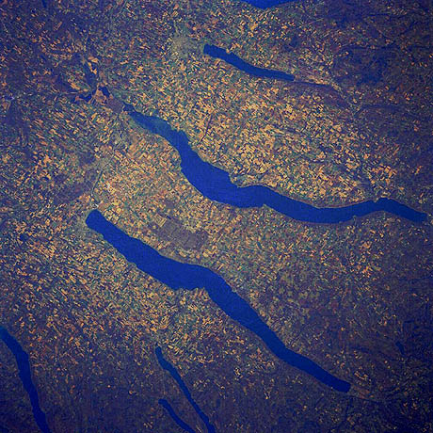
The process of a continental glacier melting back (receding) greatly disrupts the drainage pattern of the area. This accounts for the fact that Canada has more lakes than any other country in the world. Take a look at a detailed map of Canada that shows the topography.
Finger Lakes Region, New York

Slide 46
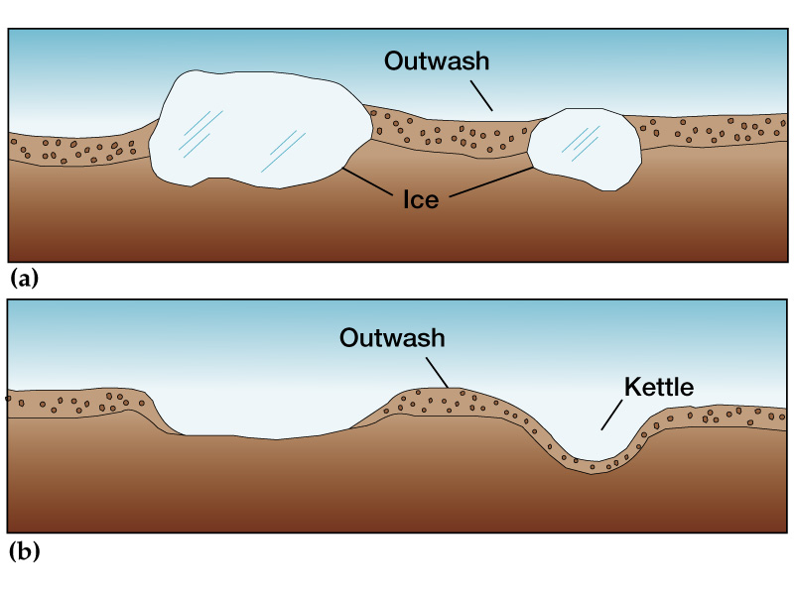
A kettle is a shallow, sediment-filled body of water formed by retreating glaciers or draining floodwaters. The kettles are formed as a result of blocks of ice calving from glaciers and becoming submerged in the sediment on the outwash plain. Another source is the sudden drainage of an ice-dammed lake.

Slide 47
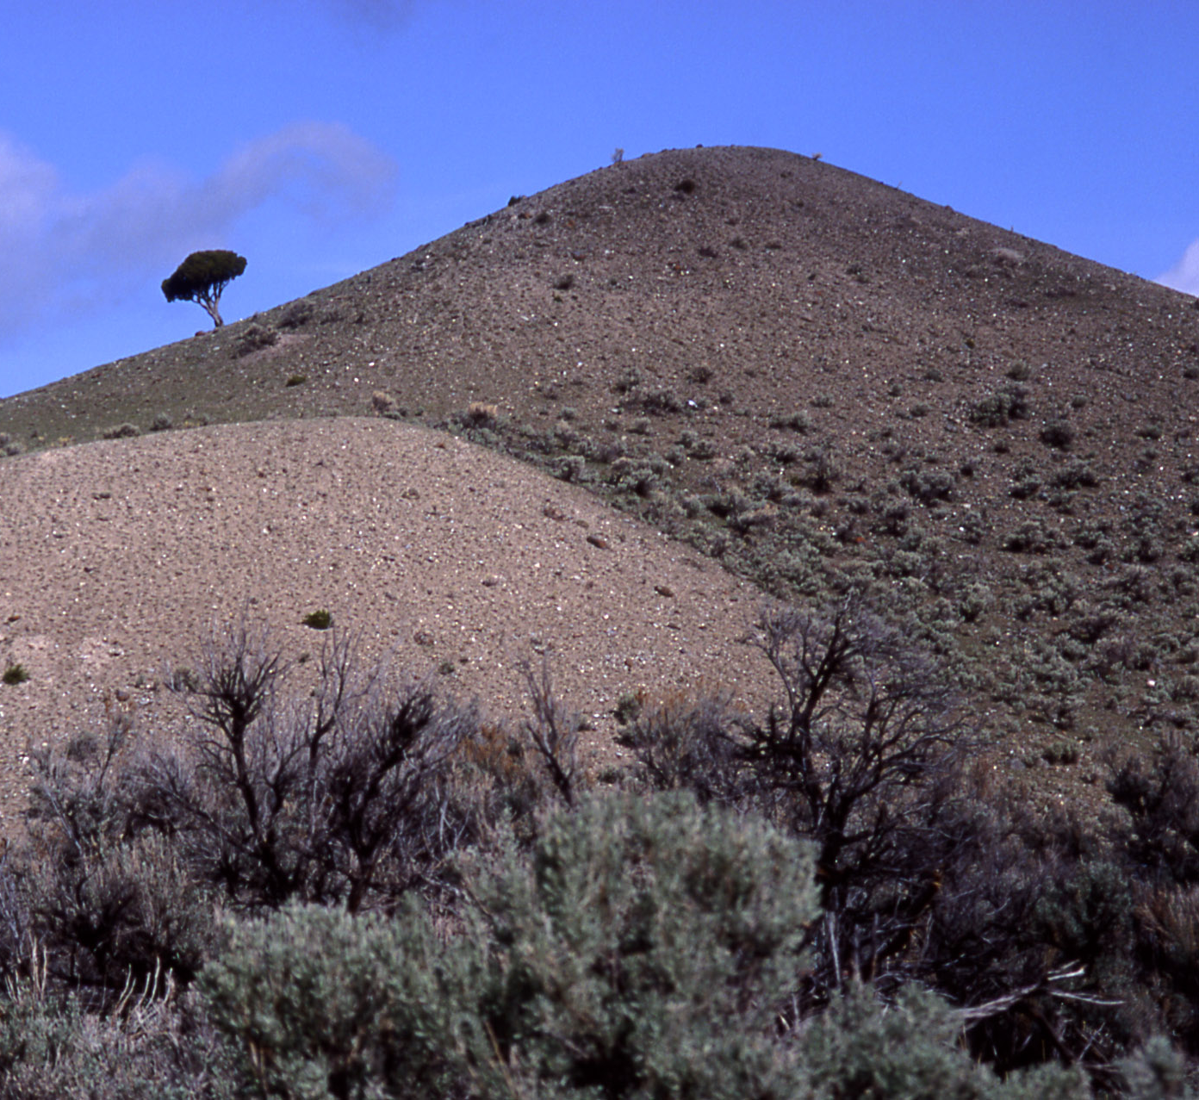
A kame is a glacial landform, an irregularly shaped hill or mound composed of sand, gravel and till that accumulates in a depression on a retreating glacier, and is then deposited on the land surface with further melting of the glacier.
Most eskers are argued to have formed within ice-walled tunnels by streams which flowed within and under glaciers. They tended to form around the time of the glacial maximum when the glacier was slow and sluggish. After the retaining ice walls melted away, stream deposits remained as long winding ridges.

Slide 48
A drumlin, from the Irish word droimnín, first recorded in 1833, and in the classical sense is an elongated hill in the shape of an inverted spoon or half-buried egg formed by glacial ice acting on underlying unconsolidated till or ground moraine.
A till plain is an extensive flat plain of glacial till that forms when a sheet of ice becomes detached from the main body of a glacier and melts in place, depositing the sediments it carried. Ground moraines are formed when the till melts out of the glacier in irregular heaps, forming rolling hills

Slide 49
An outwash plain, also called a sandur (plural: sandurs), sandr or sandar, is a plain formed of glacial sediments deposited by meltwater outwash at the terminus of a glacier. As it flows, the glacier grinds the underlying rock surface and carries the debris along.

Slide 50
When Glaciers Reach Large Water Bodies

Slide 51
In recent years, unprecedentedly large sections of ice shelfs have broken off as a result of climate change. One was the size of the state of Delaware.

Slide 52
Fjords
A fjord is formed when a glacier recedes, after carving its typical U-shaped valley, and the sea fills the resulting valley floor. Often the result of receding glaciers and sea level rising.

