Slide 1
Up-Close Photos of a Volcano Eruption

Slide 2
To be a truly great photographer you need to put fear aside, and go all the way to get those really amazing photos. That is what Chilean photographer Francisco Negroni did, perfectly capturing the epic and primal fury of the mighty volcano. Francisco spent a night camped just several hundred meters from the eruption of one of the Puyehue-Cordon Cauelle mountain chain, central Chile, which began erupting back in 2011, and is still active today.

Slide 3
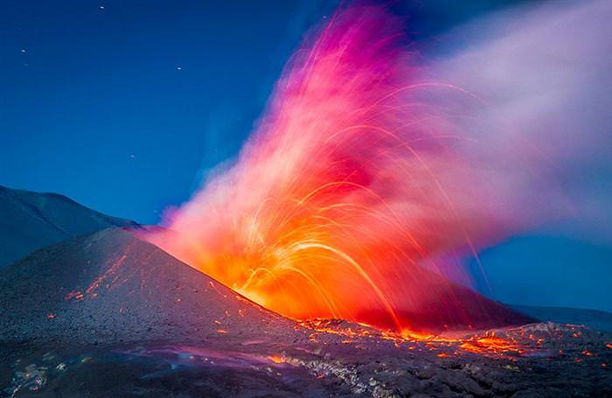

Slide 4
From his standpoint, he took the previous photo after photo of one of the most aggressive acts of nature, the red heat of the magma contrasting with the blue and black skies.

Slide 5
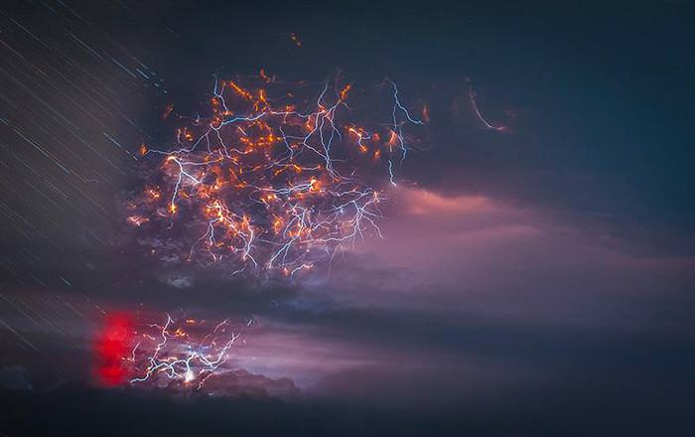

Slide 6
But even more commanding than the magma is the dazzling light show that took place above it, with huge amounts of ash and other particles shot by the volcano into the atmosphere, generating enormous amounts of electricity, manifested as mighty bolts of lightning.

Slide 7
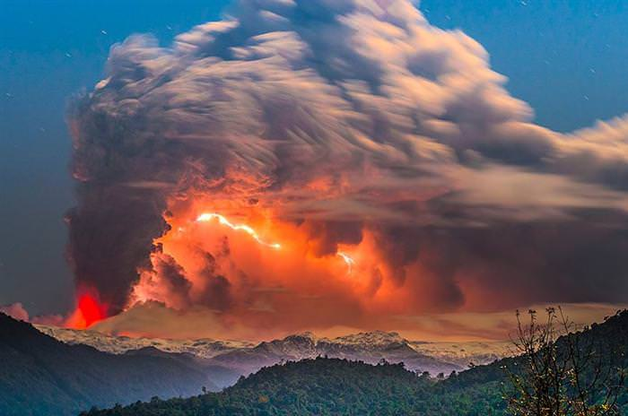
This is known as a “dirty” storm.

Slide 8
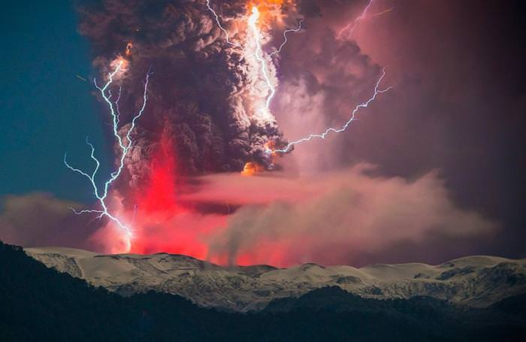

Slide 9
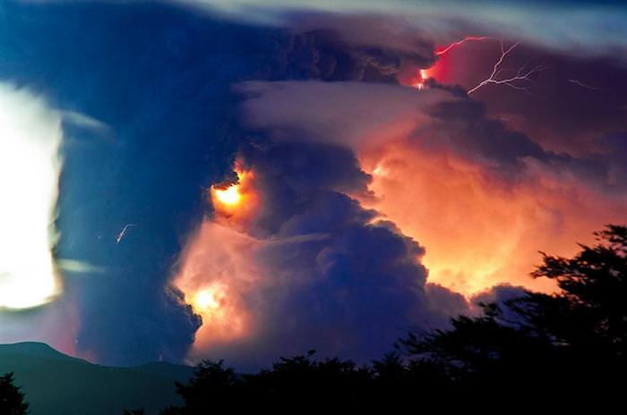

Slide 10
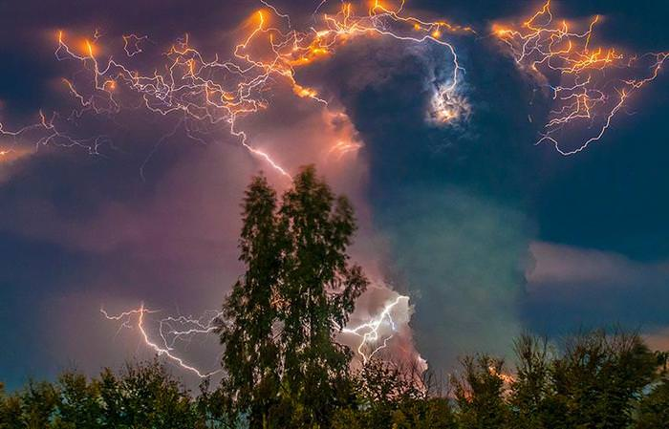

Slide 11
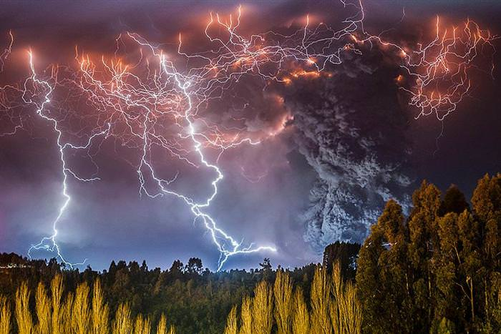

Slide 12
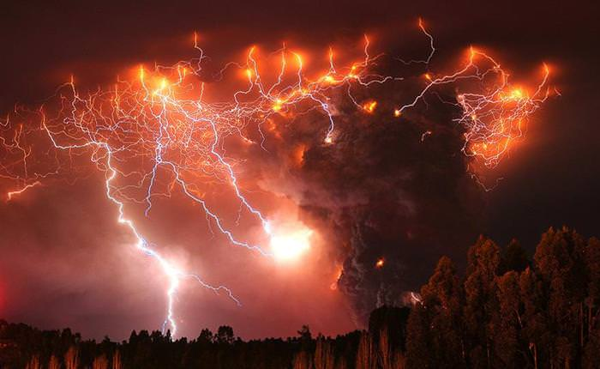

Slide 13
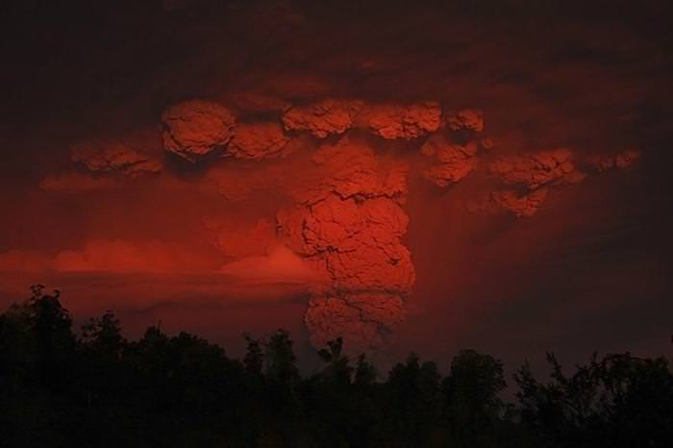

Slide 14
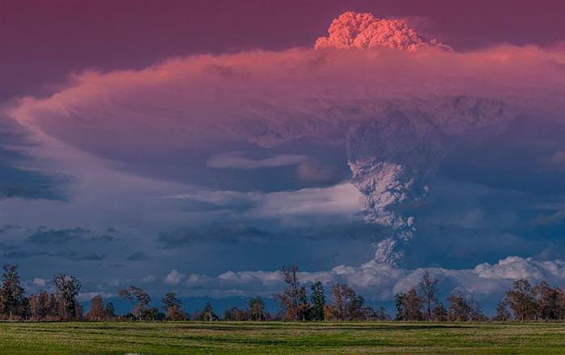

Slide 15
When he's not risking his life for an amazing shot, Francisco works as a licensed tourist guide, which allows him to keep travelling in the areas he loves most.

Slide 16
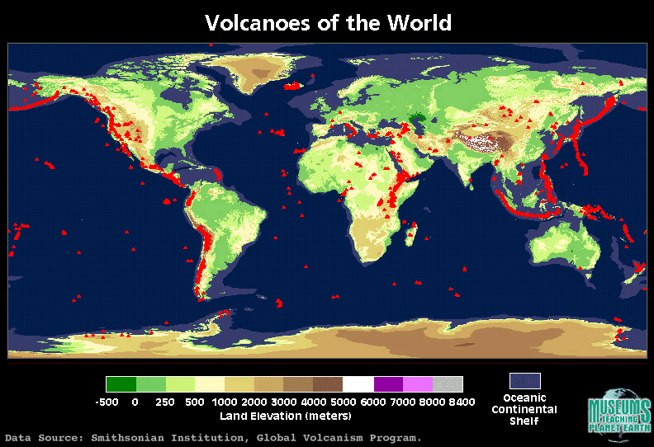

Slide 17
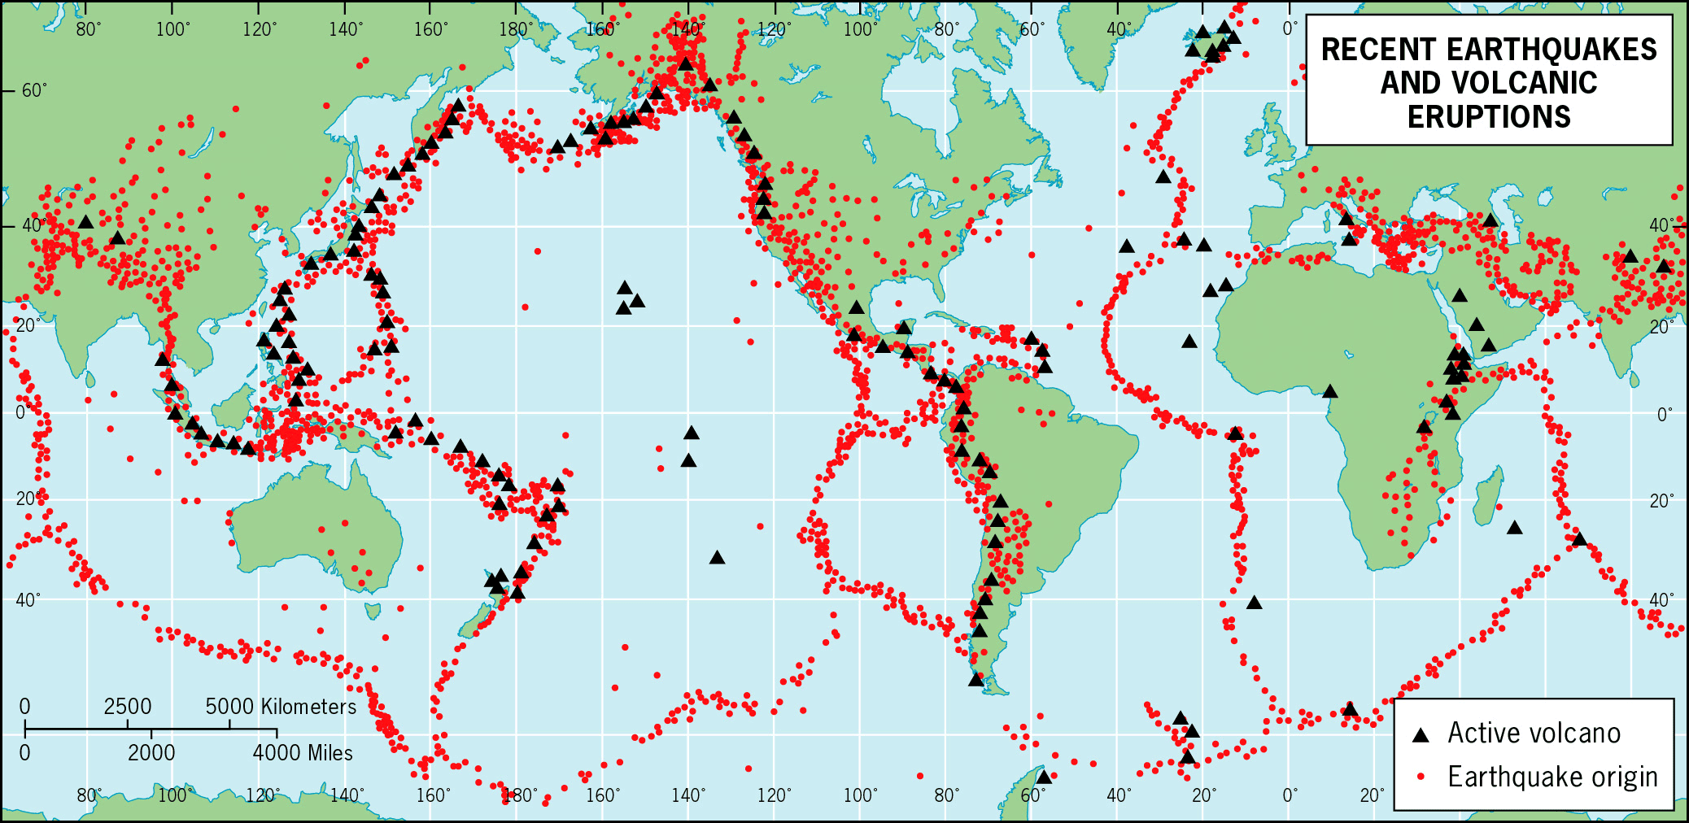

Slide 18
Up-Close by other photographers

Slide 19
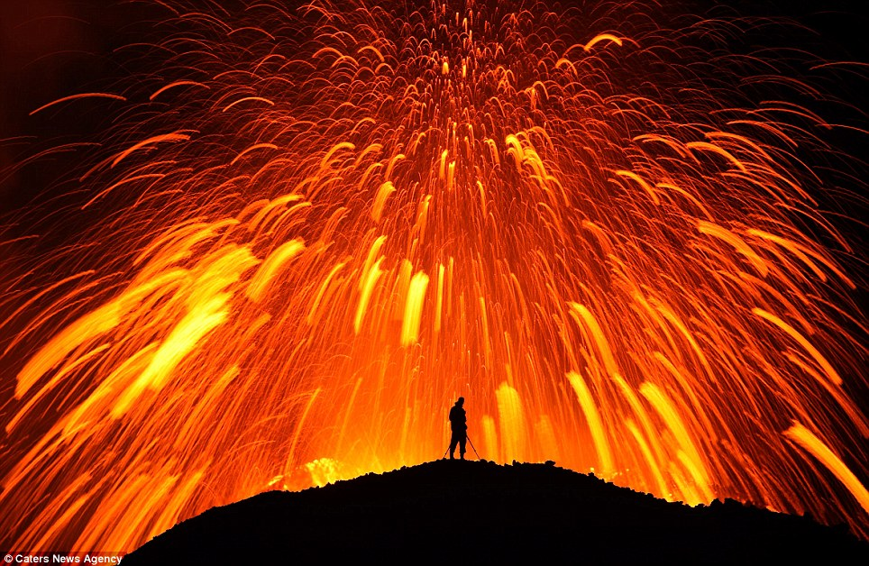

Slide 20
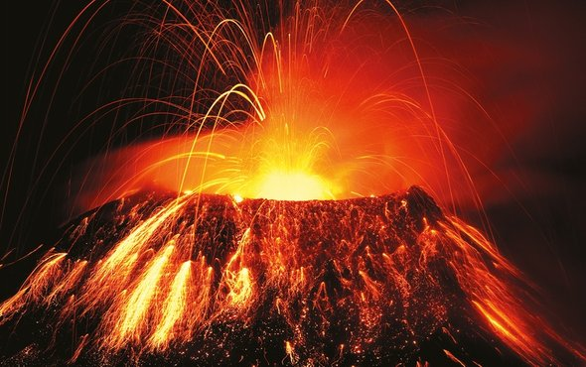

Slide 21
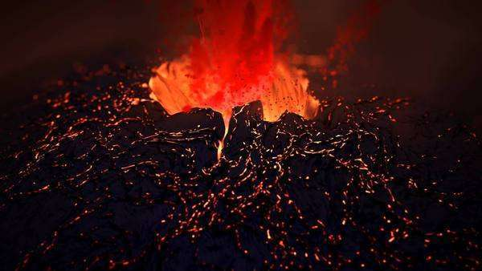

Slide 22
