Slide 1
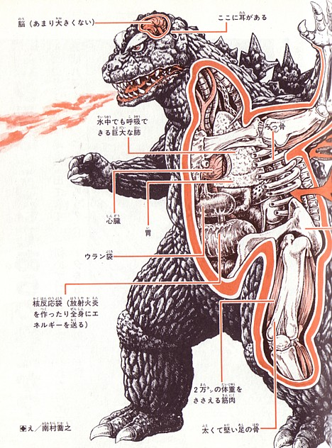
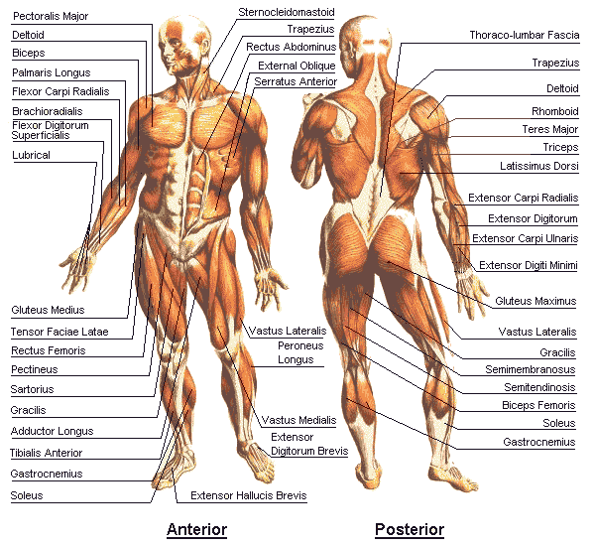
GLY 326 Structural Geology
Lecture 7
The anatomy of continents
Autumn, 2015

Slide 2
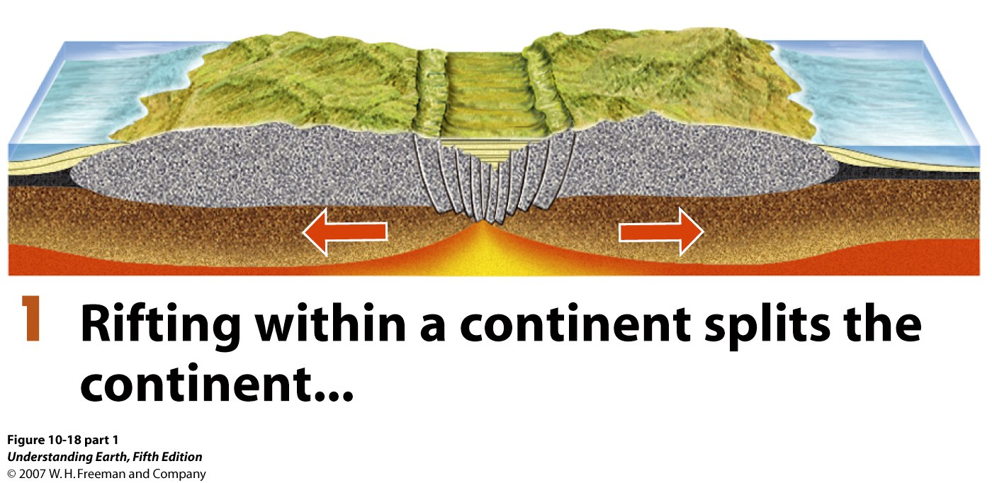
The Wilson Cycle

Slide 3
The Wilson Cycle

Slide 4
The Wilson Cycle

Slide 5
The Wilson Cycle

Slide 6
The Wilson Cycle

Slide 7
The Wilson Cycle

Slide 8
The Wilson Cycle

Slide 9
Structures of Continents
continents are made and deformed by plate motion
continents are (in general) older than ocean rocks

Slide 10
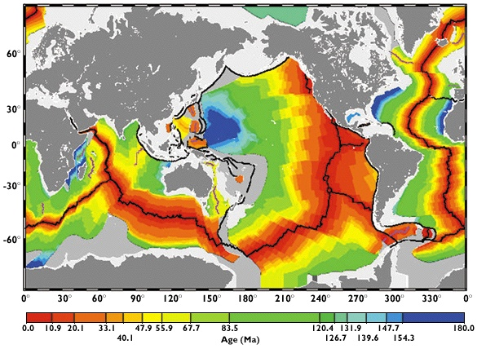
This is because old oceanic crust has been recycled already!

Slide 11
Anatomy of a continent
shields
stable platforms
folded mountain belts

Slide 12
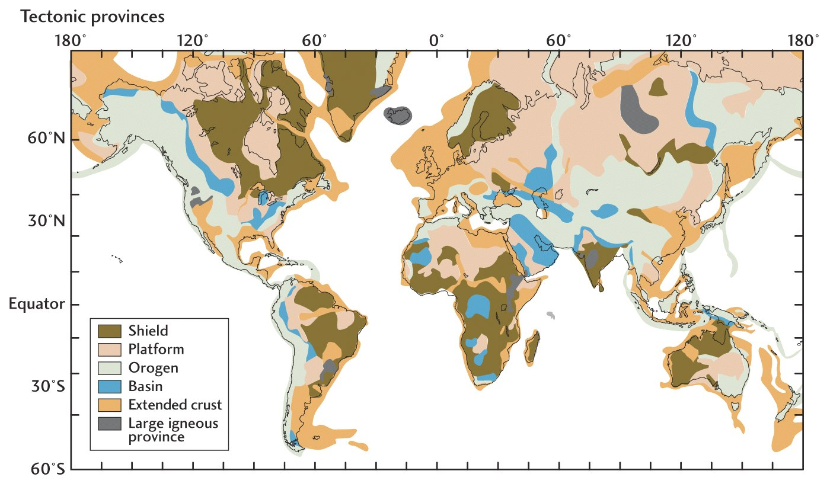
World Tectonic Provinces

Slide 13
Tectonic Age
The time of the most recent major episode of crustal deformation

Slide 14
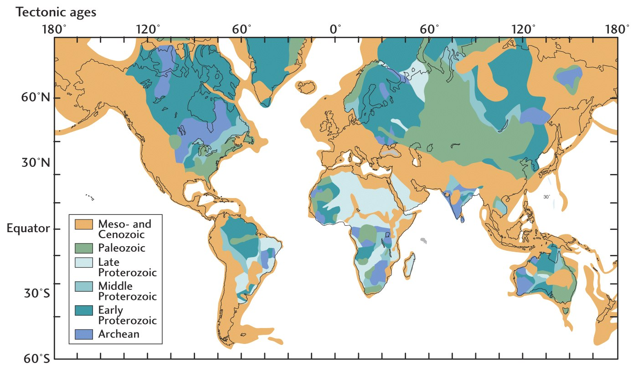
Tectonic Ages

Slide 15
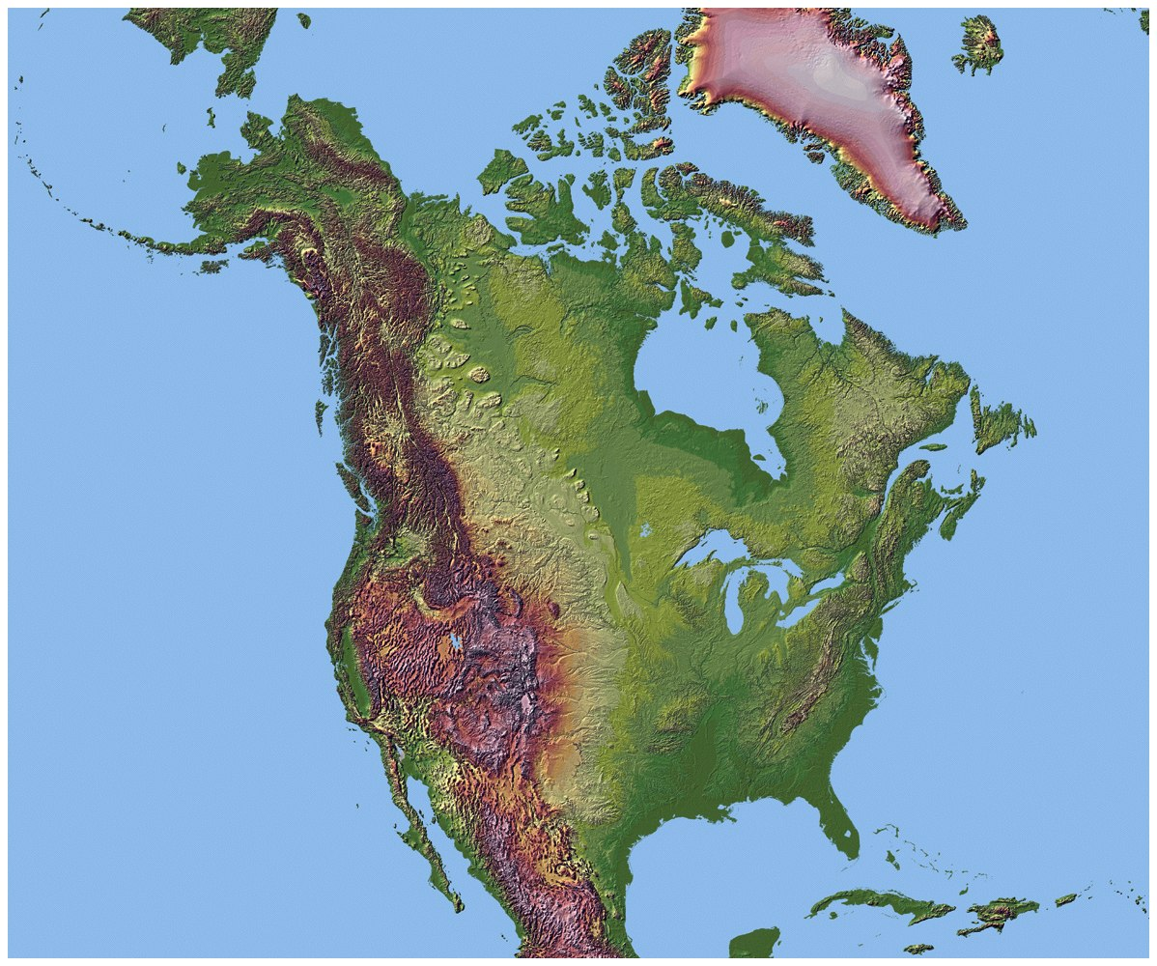

Slide 16
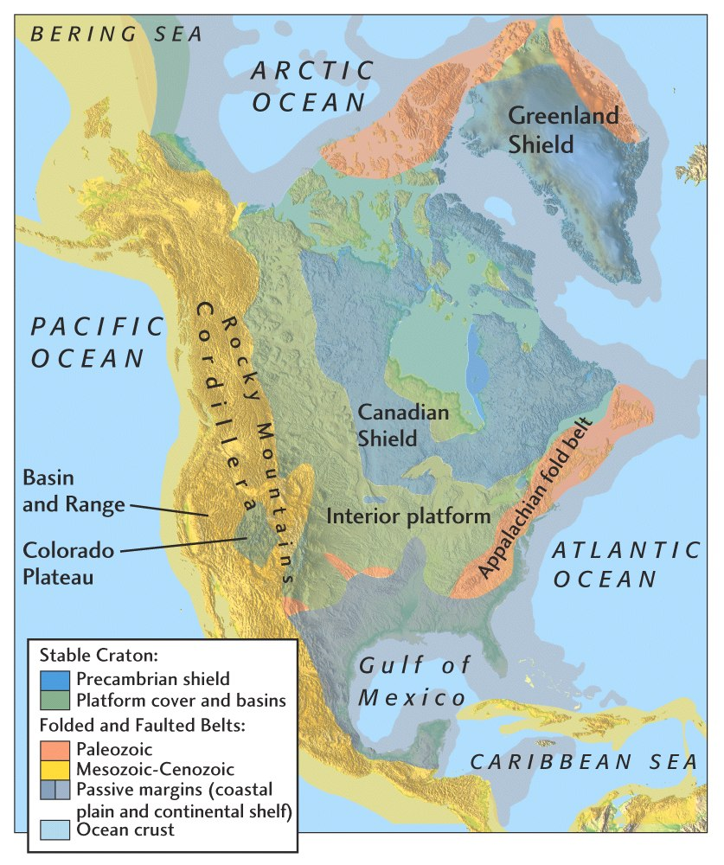

Slide 17
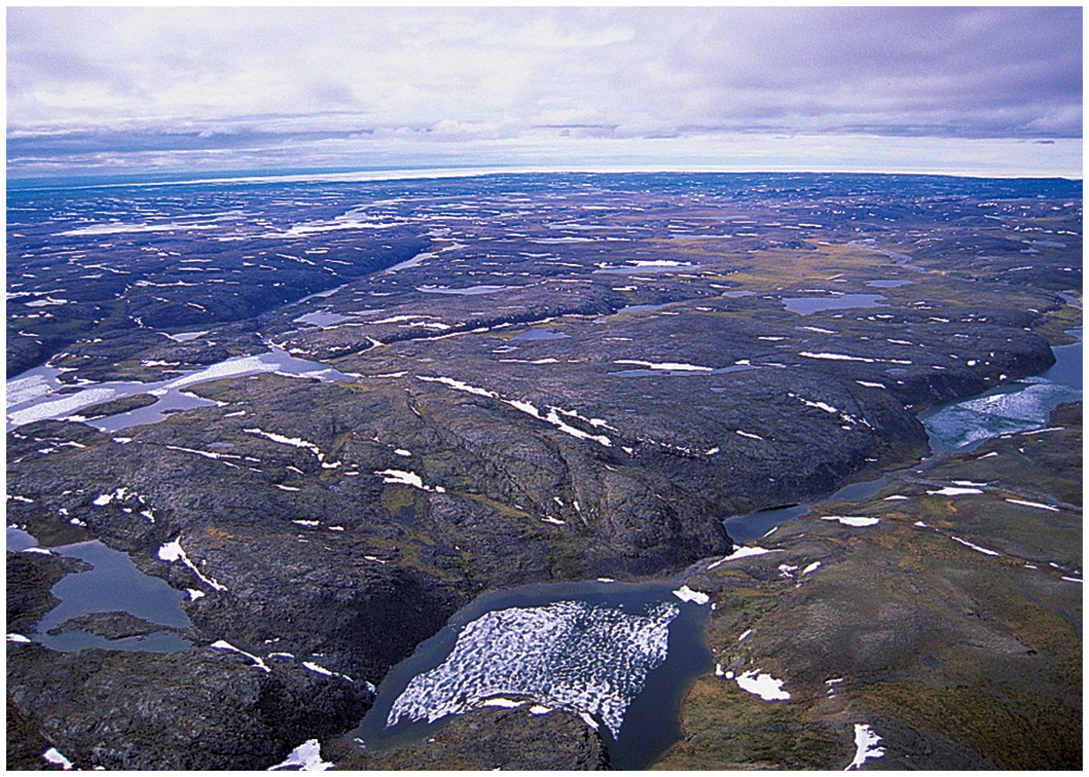
Canadian shield!

Slide 18
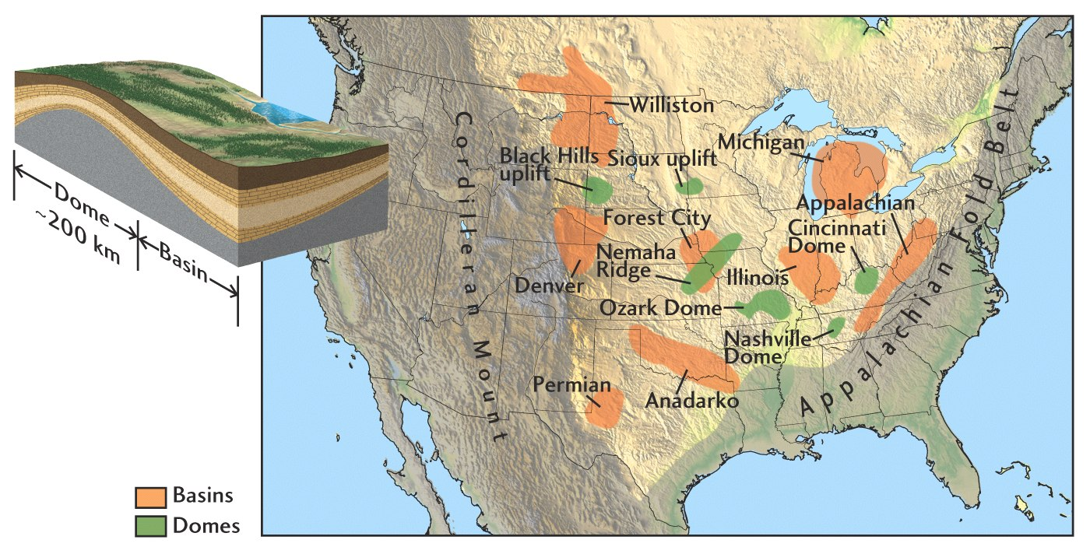
Stable platforms: Shallow ancient seas

Slide 19
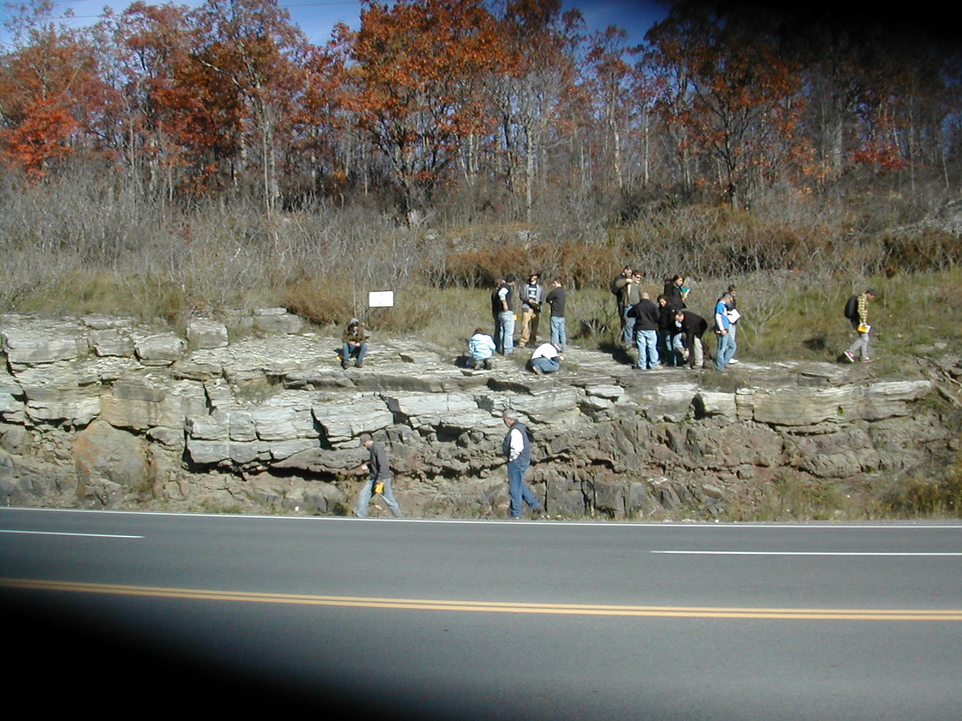

Slide 20
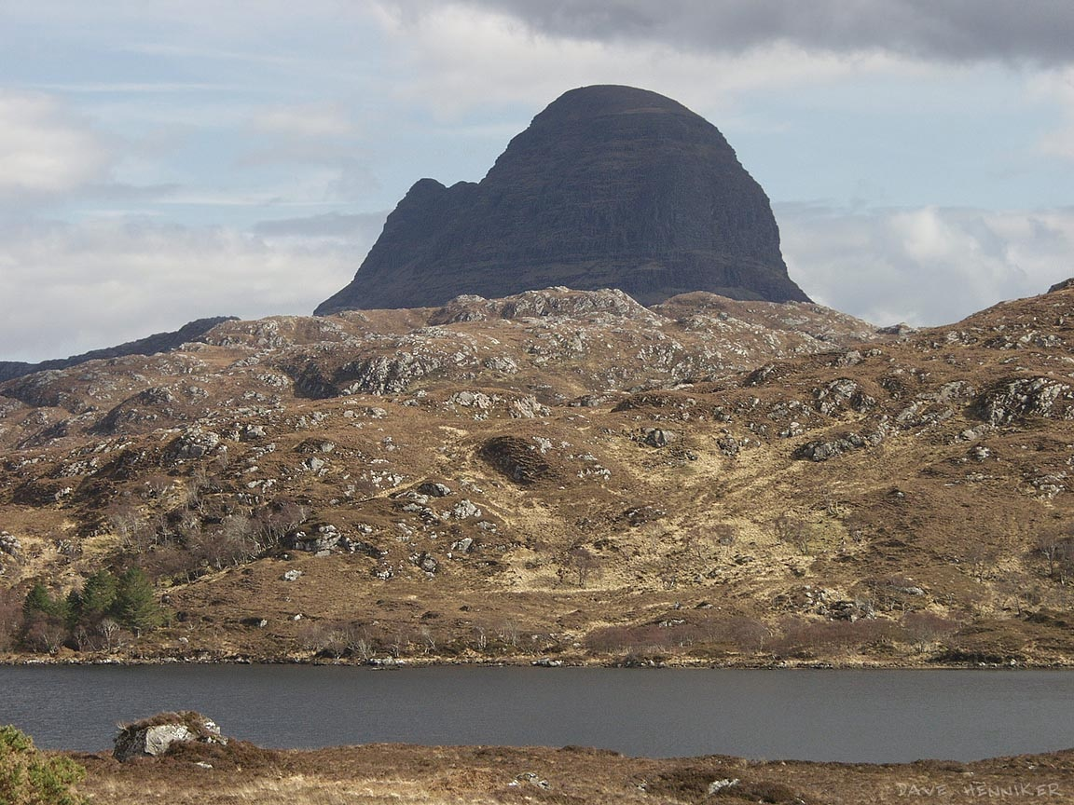

Slide 21
The Great Unconformity Thermopolis, Wyoming

Slide 22
550 Million Year old Sandstone
Ancient Soil
(550 Ma)
3 Billion Year old Granite
The Great Unconformity Thermopolis, Wyoming

Slide 23
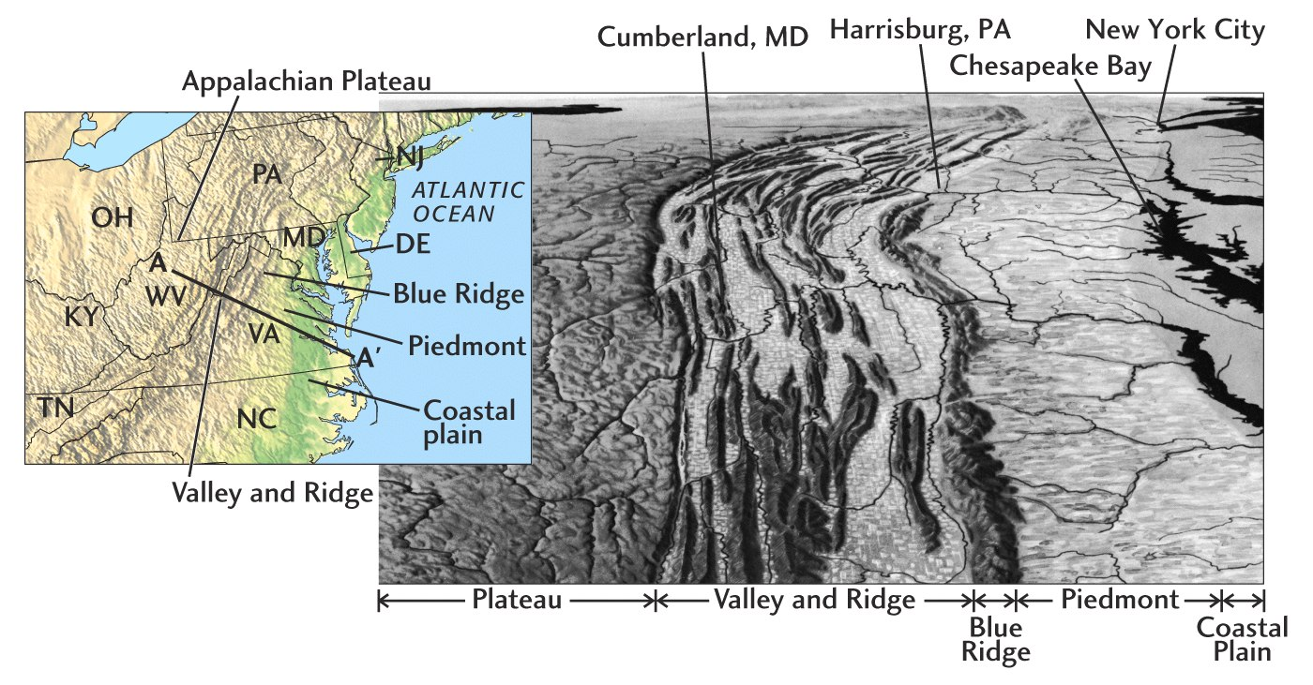
Mountain Belts

Slide 24
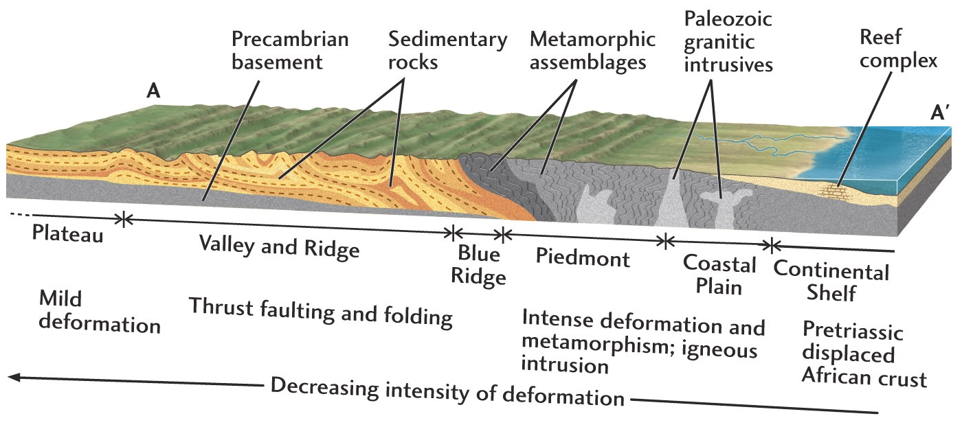
Mountain Belts

Slide 25
How Continents Grow
Magmatic differentiation: magma transferred to continents at subduction zones
Continental accretion: buoyant fragments of continents attached to continents as the result of plate motions

Slide 26
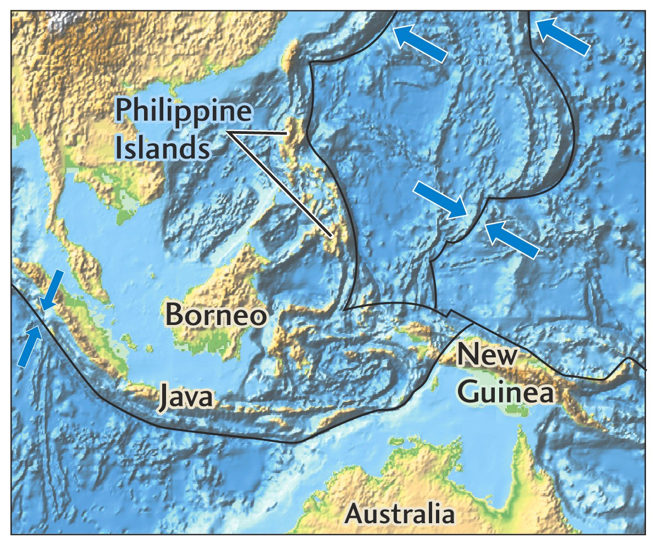
Island Arcs - the Beginning of
Continental Accretion

Slide 27
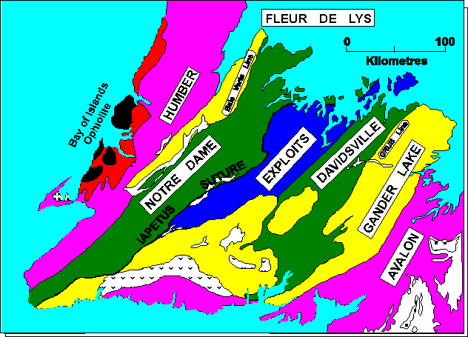
Accreted Terrains
Allochthon
Autochthon
Parautochthon

Slide 28
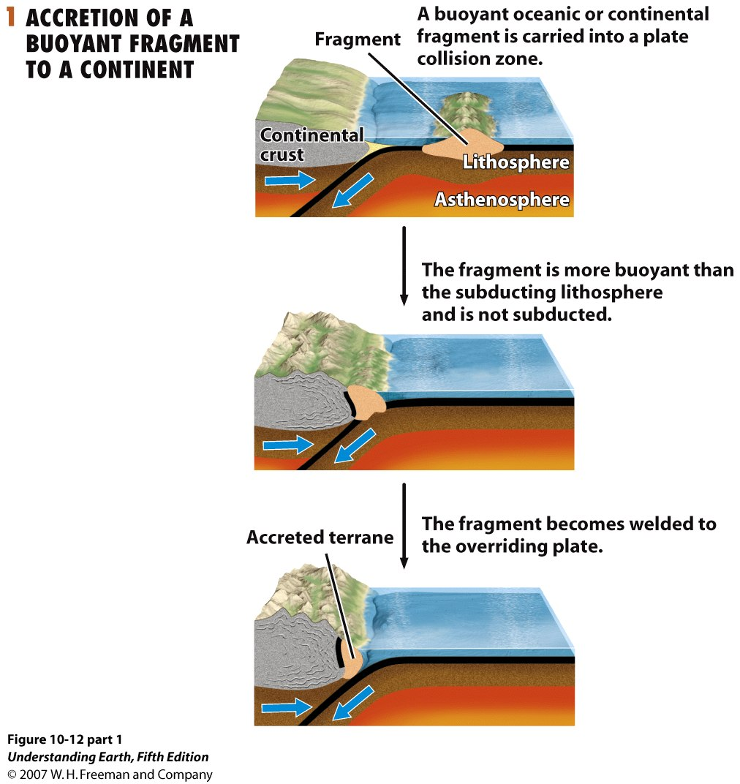

Slide 29
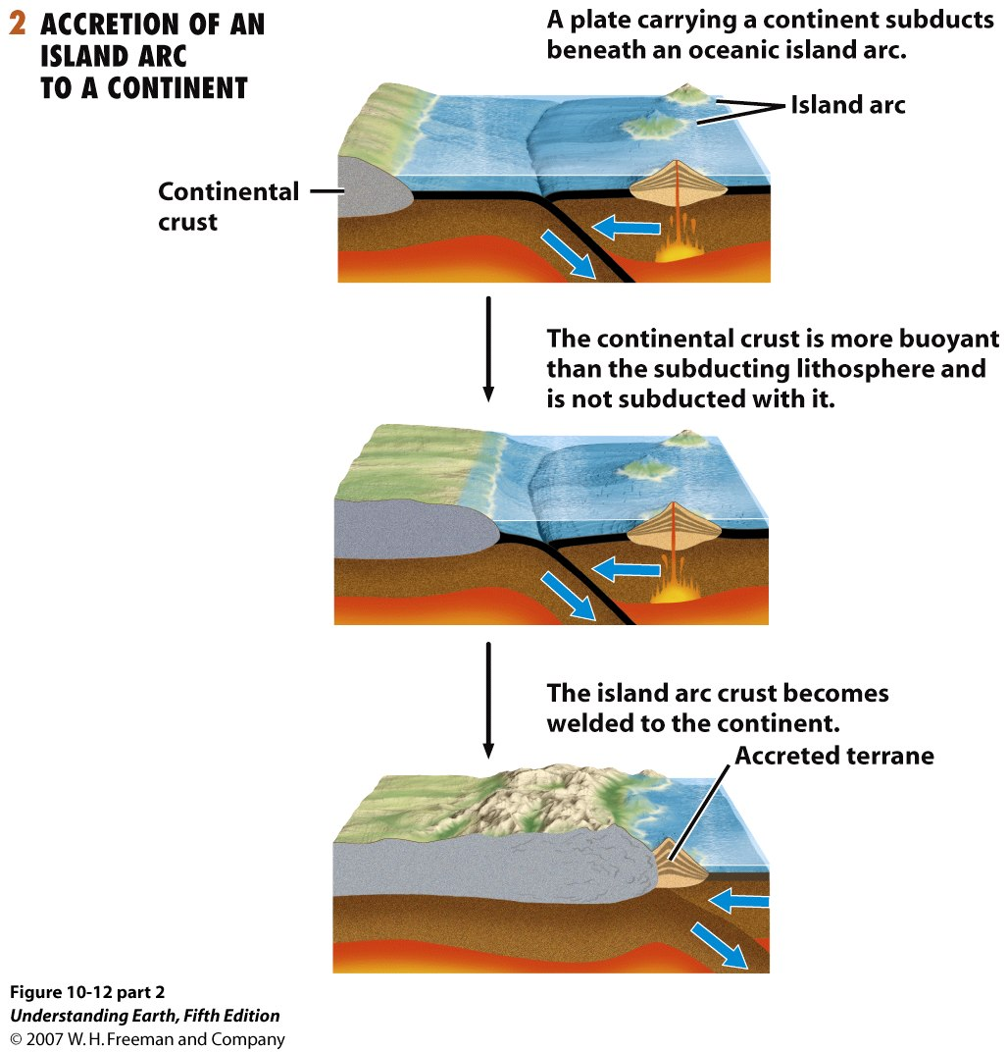

Slide 30
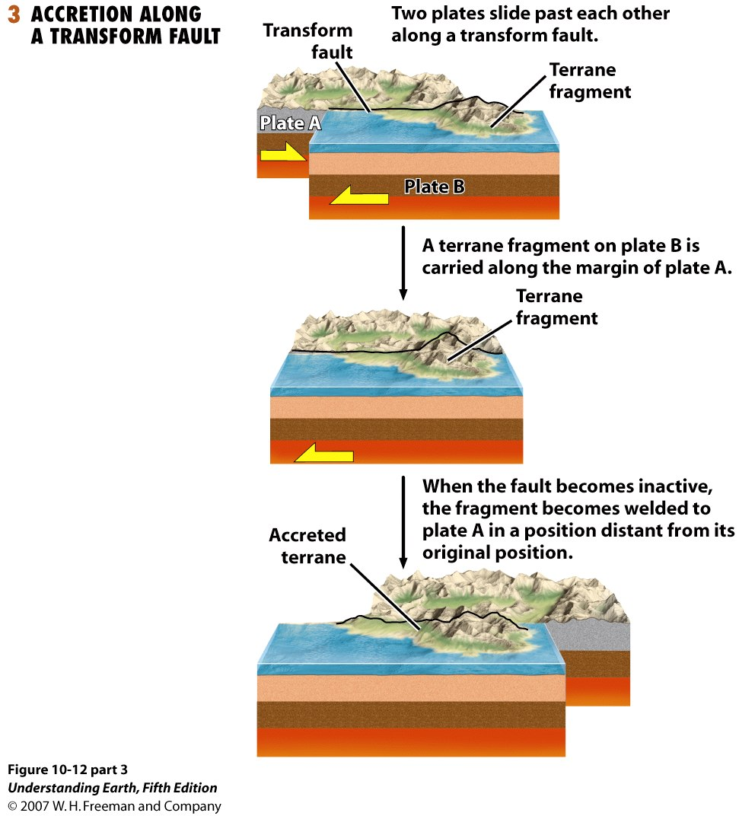

Slide 31
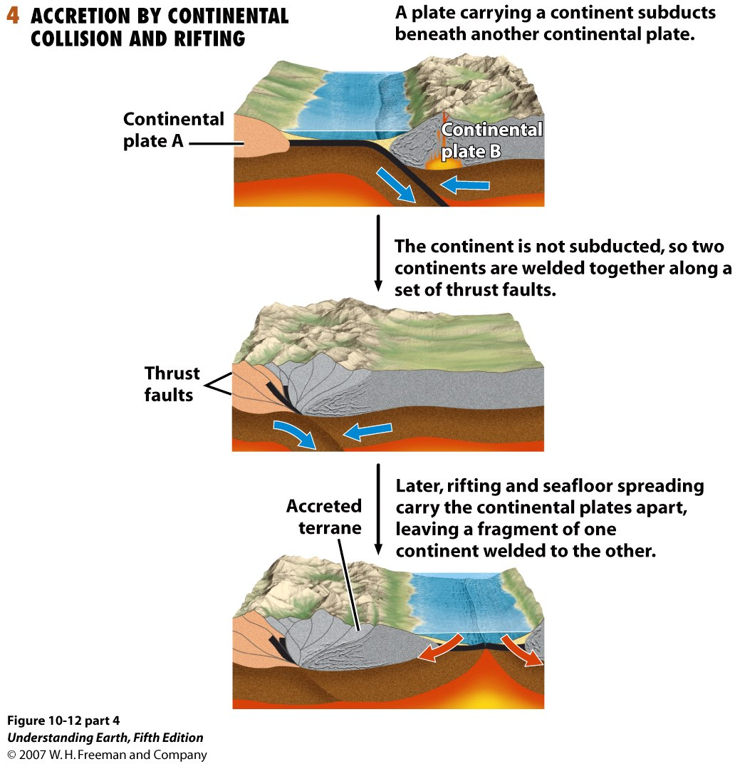

Slide 32
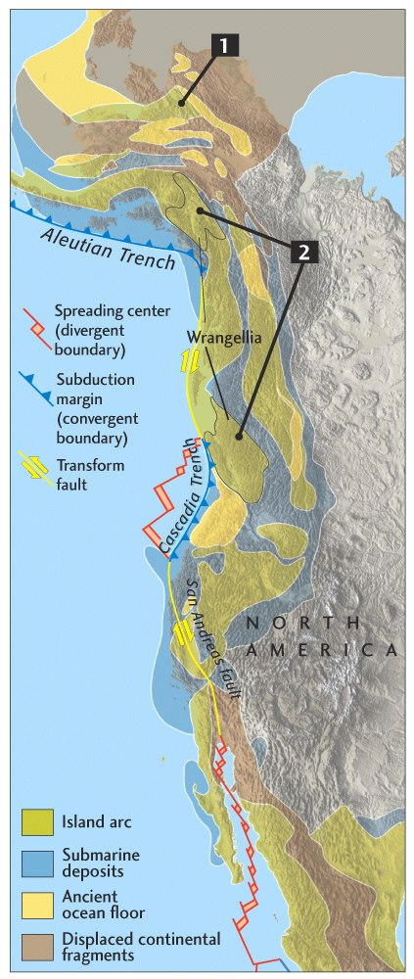
“Suspect Terranes” of Western North America
Multiple accretions of older island arcs, oceanic plateaus, oceanic crust, and marine sedimentary rocks.

Slide 33
How continents are modified
Orogeny: mountain-building process of folding, faulting, magmatism, and metamorphism
Epeirogeny: vertical motions of largely flat-lying rocks without faulting or significant folding

Slide 34
Orogeny
mountain building
particularly by folding and thrusting of rock layers
often accompanied by magmatic activity

Slide 35
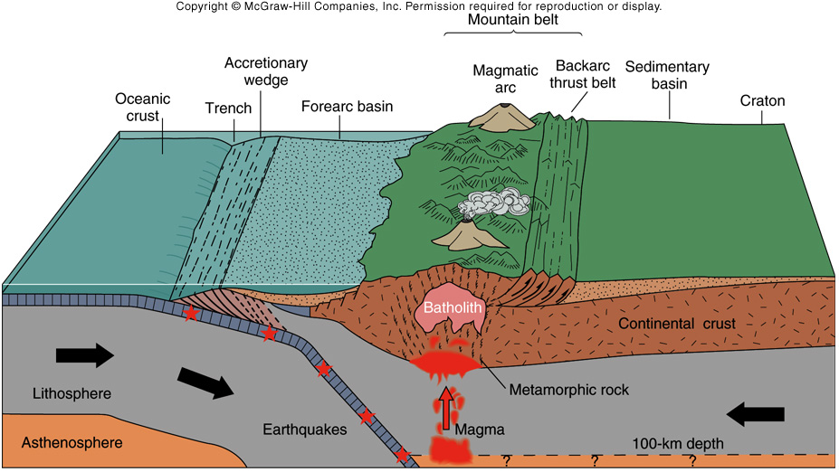
Orogeny

Slide 36
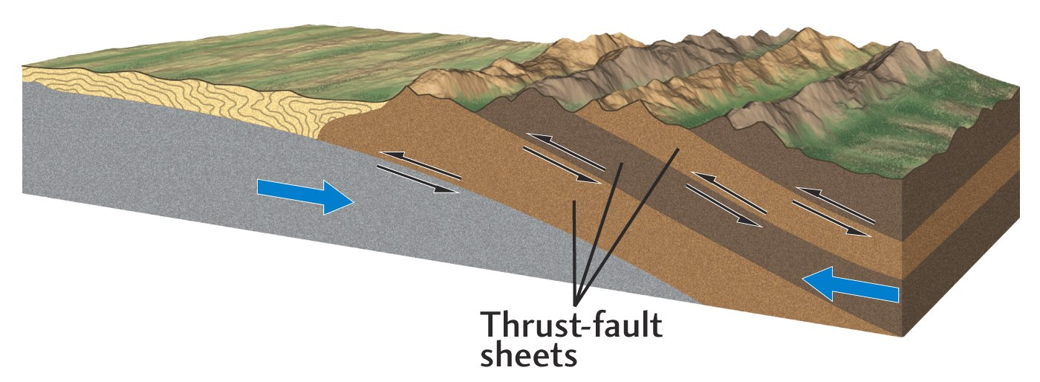
Orogeny

Slide 37
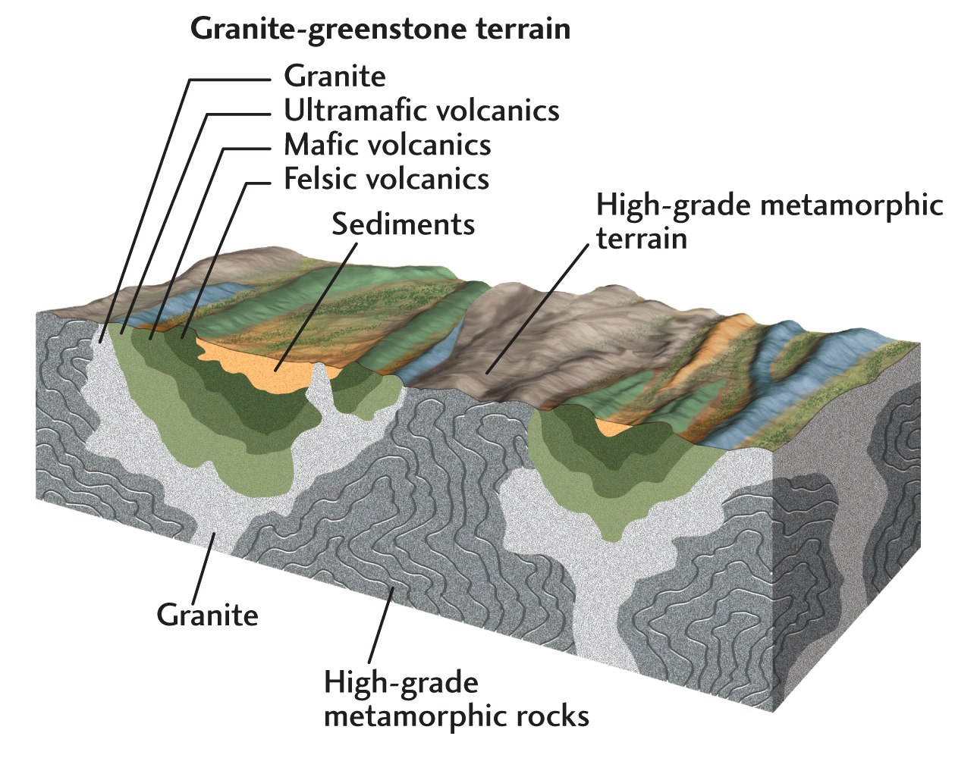

Slide 38
