Slide 1
Mountain orogeny
Geog 3251 Mountain Geography
summer term B, 2010
Adina Racoviteanu

Slide 2
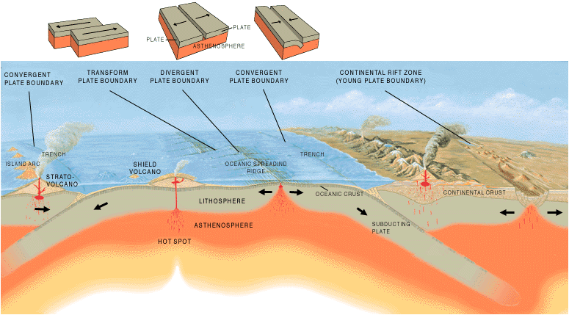
Three types of plate boundary

Slide 3
ORIGIN OF MOUNTAINS
Orogeny = process of mountain building
takes tens of millions of years;
usually produces long linear structures, known as orogenic belts
Two main processes:
1) Deformation: continental collisions, resulting in
folding and faulting
2) Volcanic Activity
Other processes:
Metamorphism, intrusions: batholiths, etc.

Slide 4
TYPES OF MOUNTAINS (according to their origin)
Fault-block: tension, normal faulting
Folded: compression, reverse faulting
Volcanic: Shield and Composite
Complex: mixture of most of the above

Slide 5
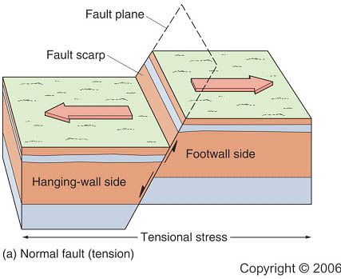
1. Fault-block mountains
large areas widely broken up by faults
Normal fault
Force: TENSION
Footwall moves up
relative to hanging
wall
HANGING WALL

Slide 6
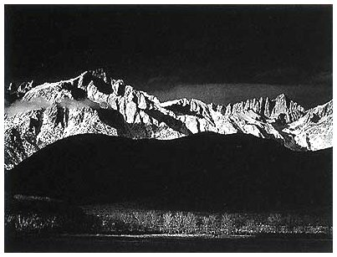
Tilted fault-block range: Sierra Nevada from east,
Steep side of block fault; Ansel Adams photo

Slide 7
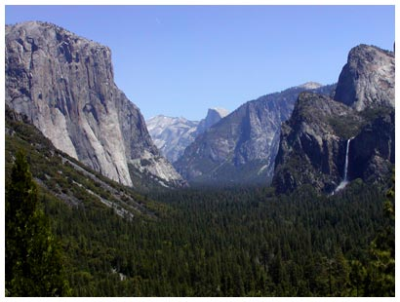
Tilted Fault-block
Sierra Nevada from west
Side, low angle
Yosemite valley = the result
of glaciation on low-angle
relief
Batholith
Central cores consists of intrusive igneous rocks (granite).
Half Dome is a core (batholith) that was exposed by erosion

Slide 8
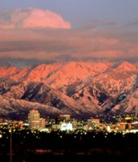
Wasatch Range
from Salt
Lake City
Typically fault-
Block system

Slide 9
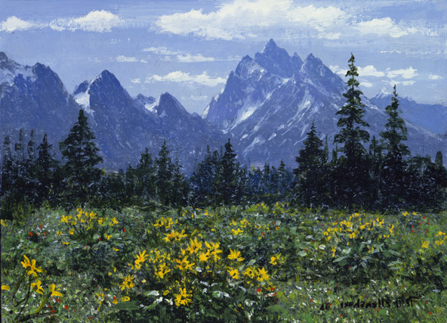
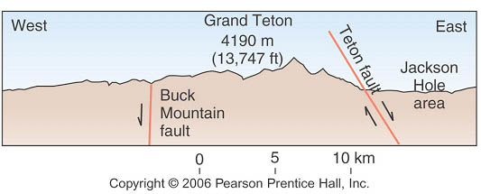
Grand Tetons: another fault-block system

Slide 10
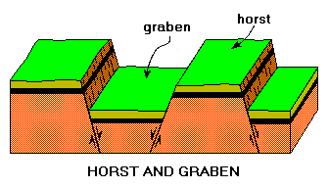
Horst and graben
Alternating normal faults lead to a characteristic pattern called a
“horst and graben” system. An area under tension will often have
multiple mountain ranges as a result.

Slide 11
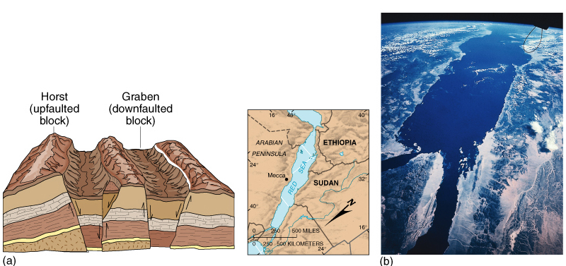
Horst and Graben Landscapes
Figure 12.14

Slide 12
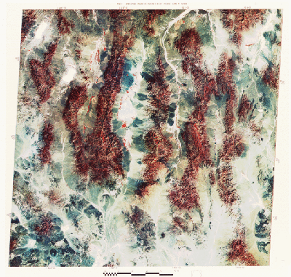
Basin and Range province:
tilted fault-block
mountains in Nevada
result of a horst and
graben system
Sierra Nevada and Wasatch Ranges part of this system

Slide 13
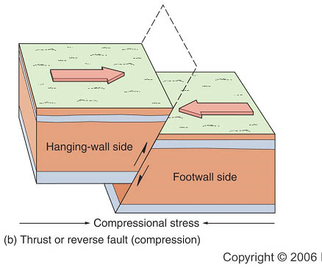
Reverse fault
Force: COMPRESSION
Hanging wall moves up
relative to footwall
Two types:
-low angle
-high angle
Individual layers can move 100’s of kilometers
Alps are a great example

Slide 14
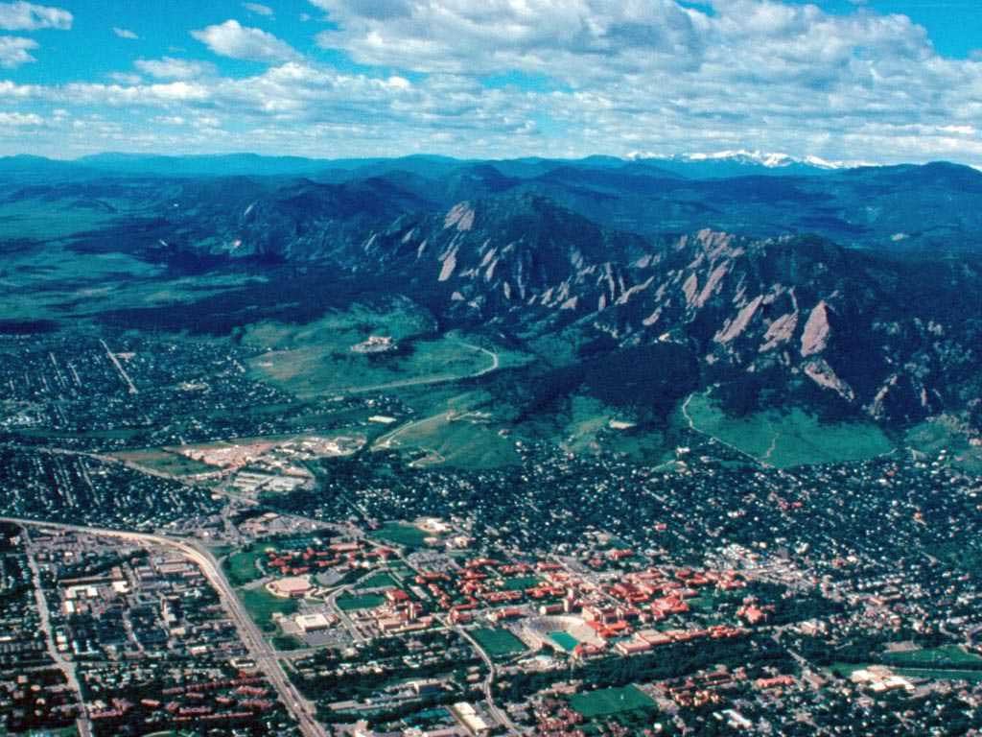
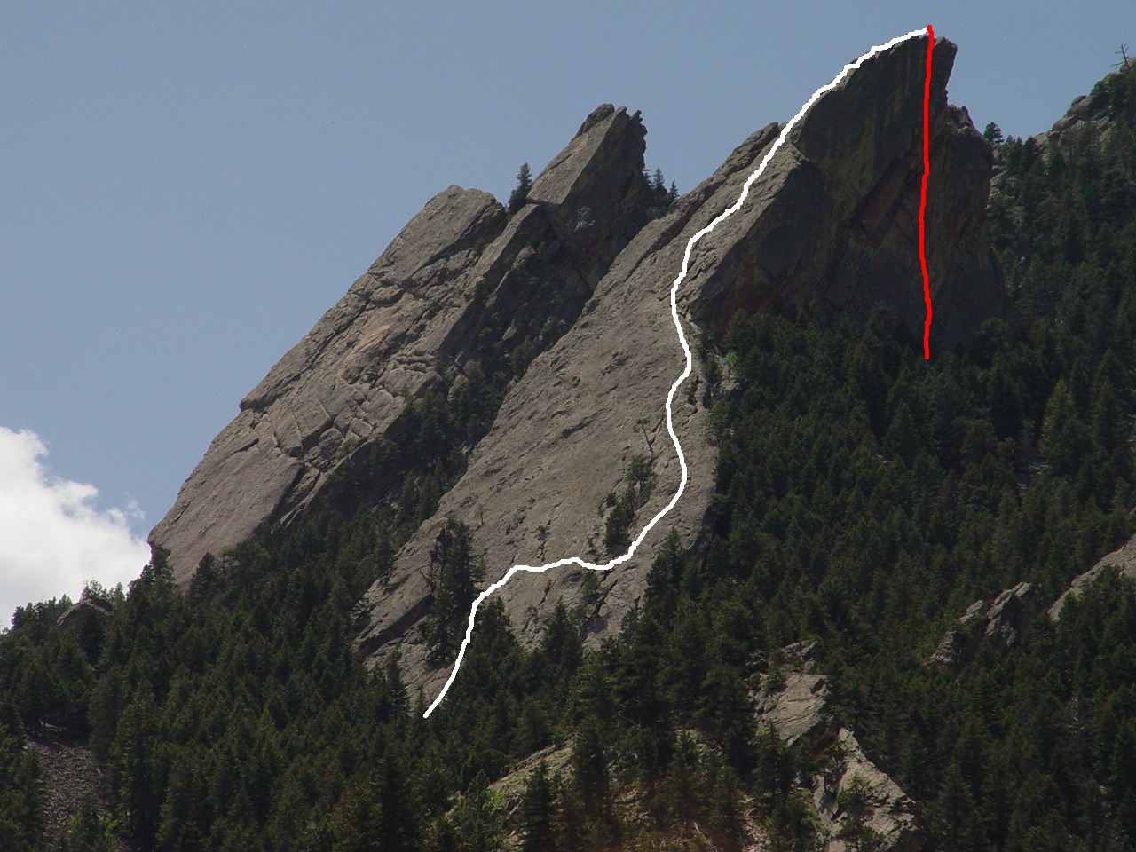
Flatirons
Classic example of
high-angle reverse faults
-> Form “Sawtooth Mtns”
due to differential erosion
Seal rock

Slide 15
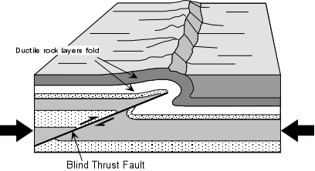
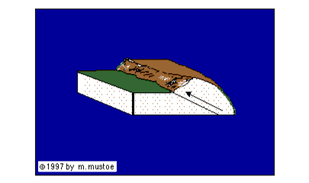
3. Folded mountains
“nappe” (fr.) =
table cloth
Thrust faults main cause of folded
mountains
Where rock does not fault it folds,
either symmetrically or asymmetrically.
upfolds:anticlines
downfolds: synclines

Slide 16
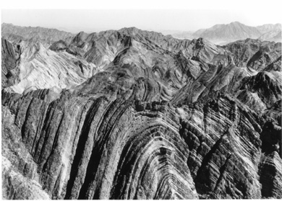
Classic folded terrain: well-developed anticline

Slide 17
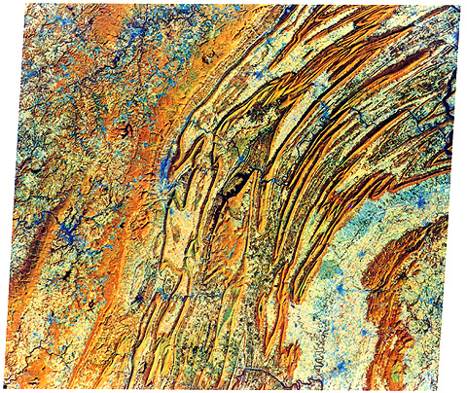
Appalachian Mountains of the US

Slide 18
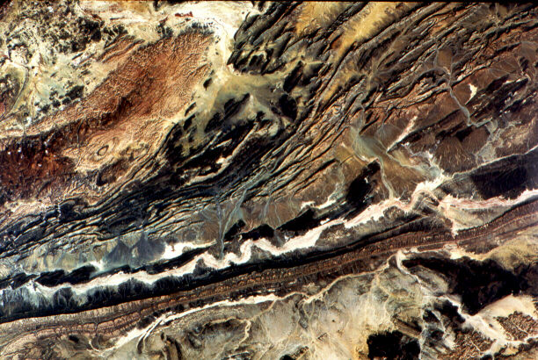
Atlas Mountains, Northern Africa

Slide 19
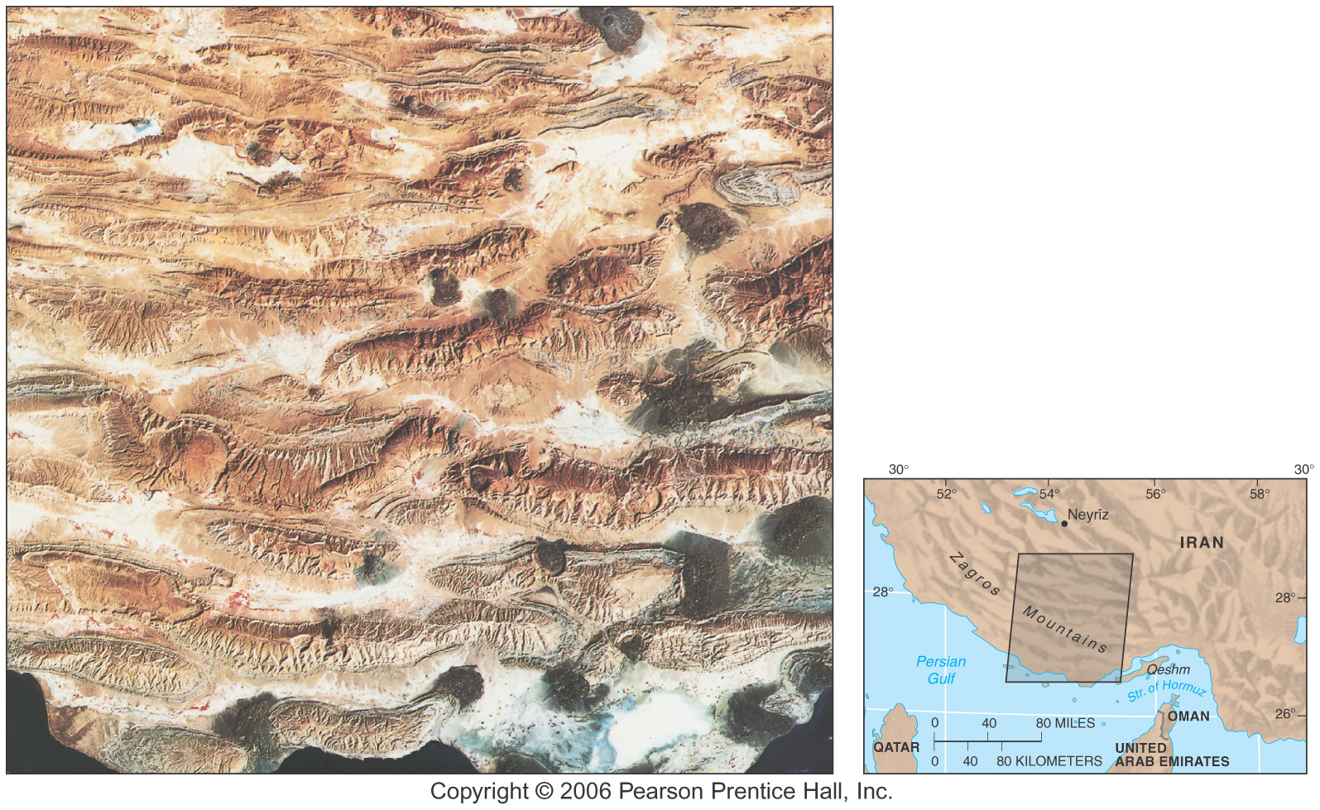
Zagros Crush Zone
Alternating
Anticlines and
Synclines

Slide 20
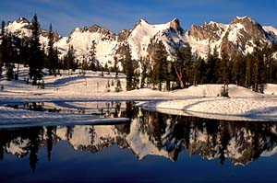
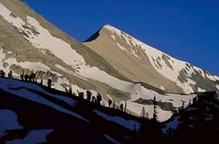
SAWTOOTH RANGE,
IDAHO
Alice Lake
White Cloud peak

Slide 21
3. Volcanic mountains
2 types of volcanoes:
Shield volcanoes
Composite volcanoes

Slide 22
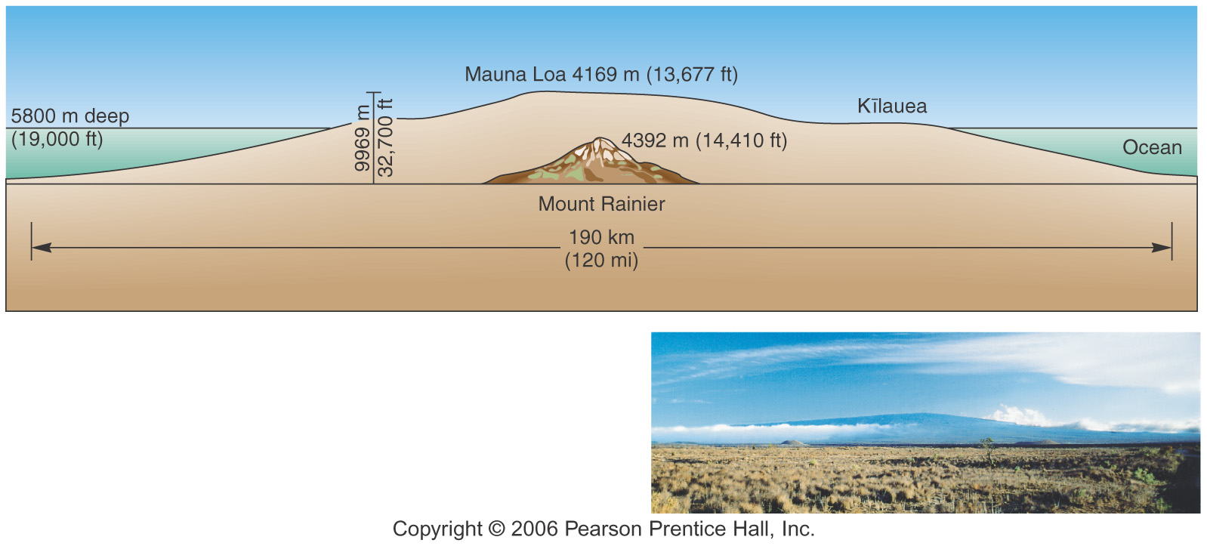
Shield volcanoes
gentle-sloping
basaltic lava flows
At hot spots
-Compressive forces
-Basaltic composition

Slide 23
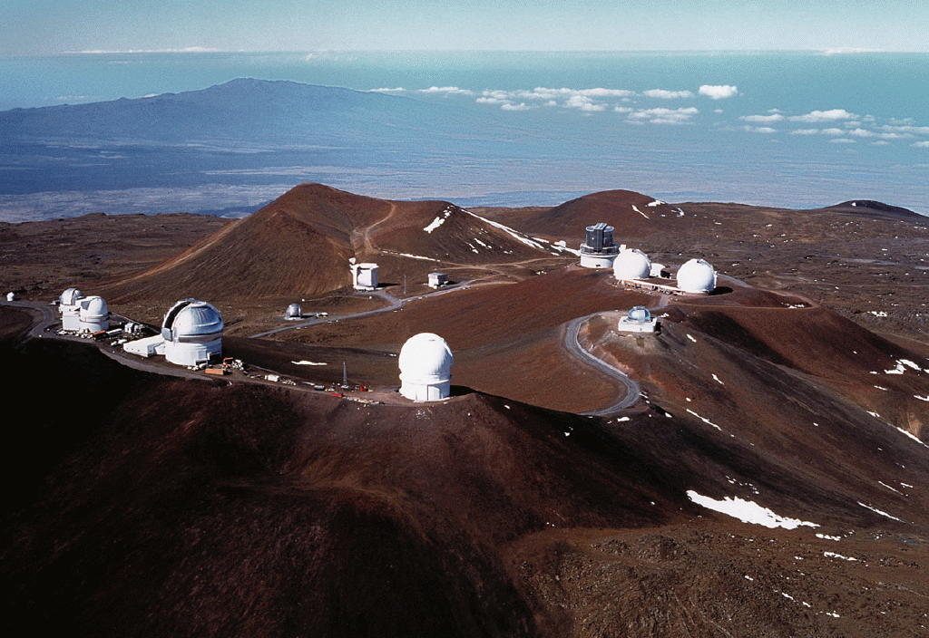
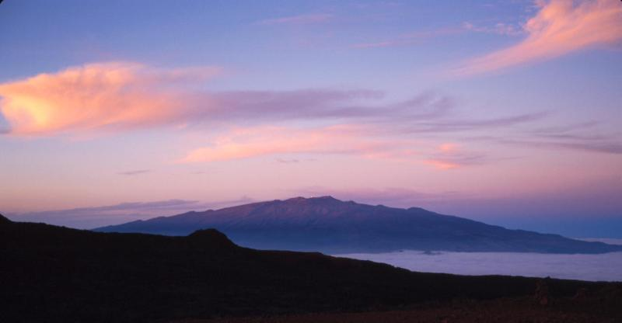
Mauna Loa in
Background
Kilaeua is
Behind Mauna
Loa
Mauna Kea
Shield volcano
Hot Spot
Basalt

Slide 24
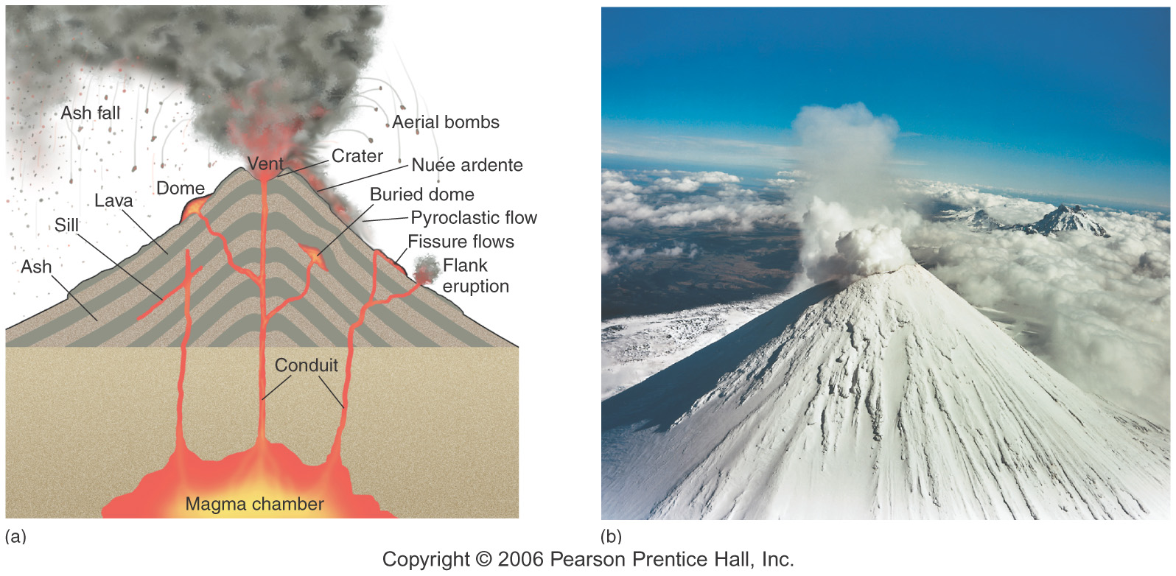
Composite volcanoes
Encountered at subduction zones
-andesitic composition
-steep cones, explosive

Slide 25
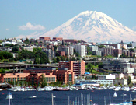
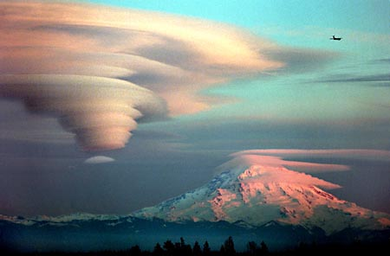
Mt Rainier:
example of composite volcano

Slide 26
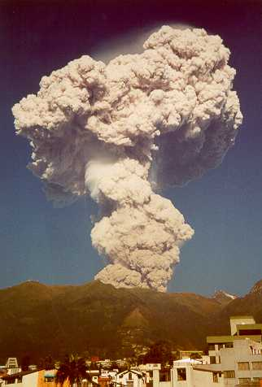
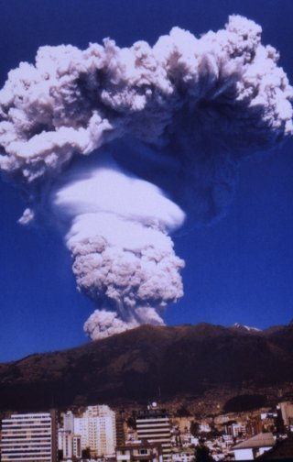
Guagua Pichincha, Ecuador
Quito in foreground
Composite volcanoes explosive!

Slide 27
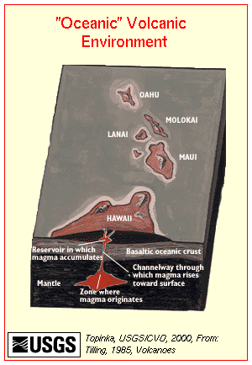
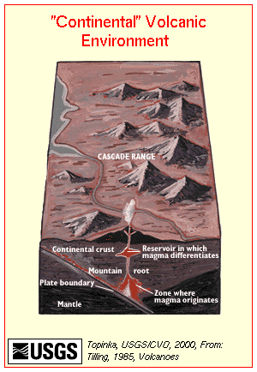
Why do shield and composite volcanoes differ in composition?
Basaltic magmas rise along fractures through the basaltic layer. Due to the absence of granitic crustal layer, magmas are not changed in composition and they form basaltic volcanoes.
Mountainous belts have thick roots of granite rock. Magmas rise slowly or intermittently along fractures in the crust; during passage through the granite layer, magmas are commonly modified or changed in composition and erupt on the surface to form volcanoes constructed of nonbasaltic (andesitic) rocks.

Slide 28
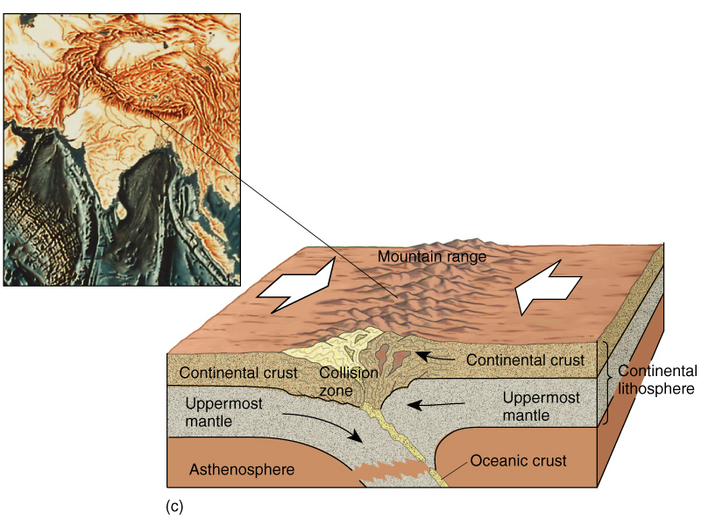
4. Complex Mountains
continental-continental collision
tend to have a little of everything: volcanoes,folds, thrust faults, normal
faults

Slide 29
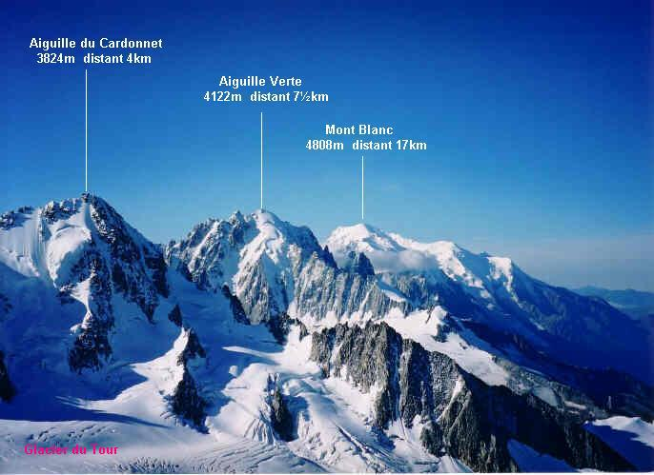
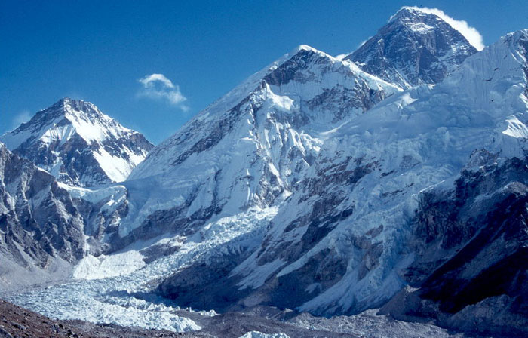
ALPS
COMPLEX MOUNTAINS
HIMALAYAS
View of Everest and
Khumbu ice fall from
Kala Patar, Nepal
Himalayas
Δ

Slide 30
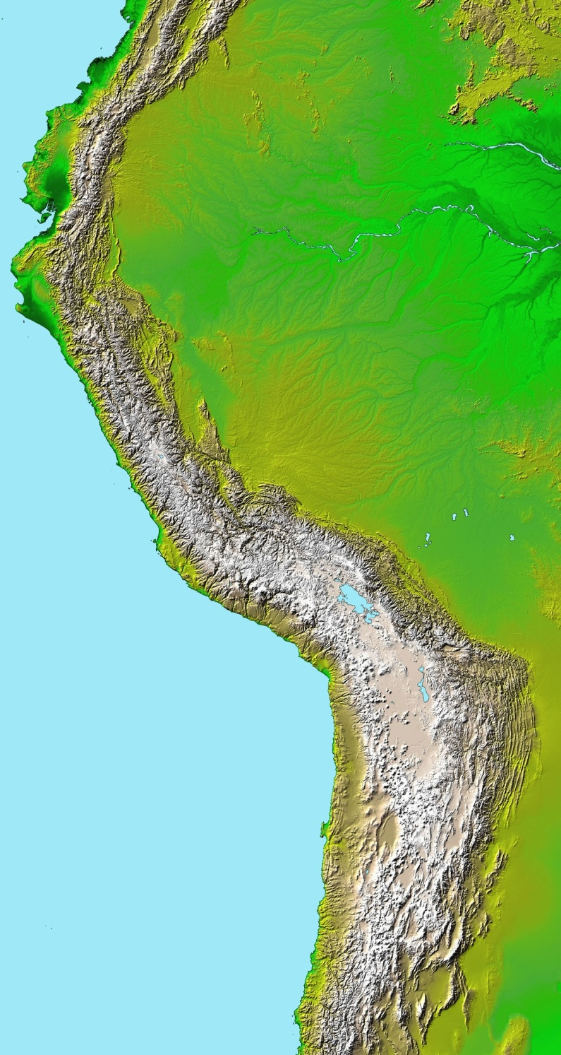
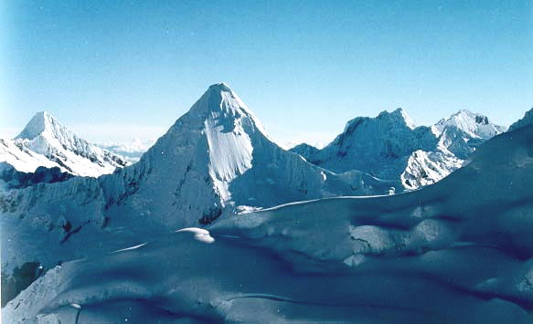
ANDES: classic example of orogenic belt “cordillera”
View from Nev. Pisco,
Cordillera Blanca
NASA satellite image

Slide 31
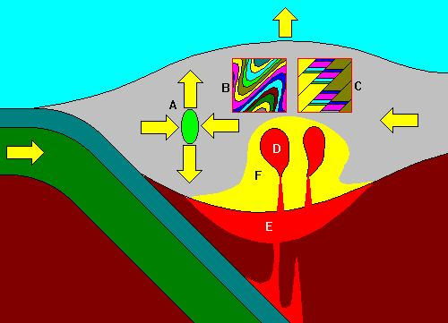
Compression causes expansion
Layered rock formed
Thrust-faulting
Igneous intrusions: Plutons
Underplating
Regional metamorphism
South American Plate
Nazca Plate

Slide 32
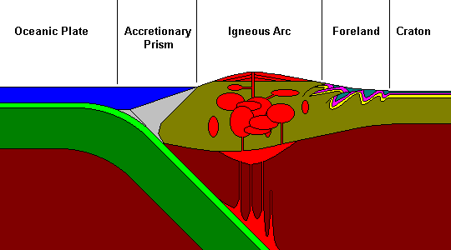
ANATOMY OF AN OROGENIC BELT

Slide 33
Mountain orogeny summary
Orogeny = mountain building
Plate tectonics used to explain mountain building
Plate collisions- 3 types:
oceanic-oceanic
oceanic-continental
continental-continental
Forces: tension, compression, shear
Mountain types: faulted, folded, volcanic, complex
Know examples of each

