Slide 1
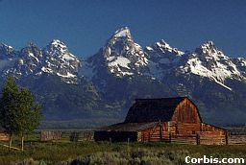
Orogenesis: Folding, Faulting, and Volcanism

Slide 2
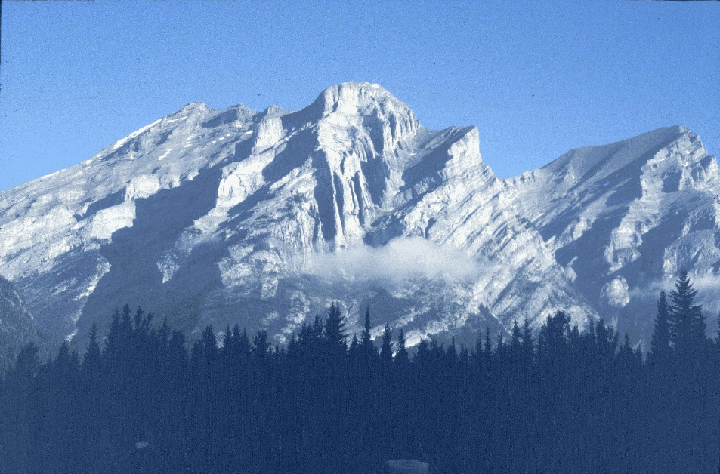
Folding
response to compression or shear

Slide 3
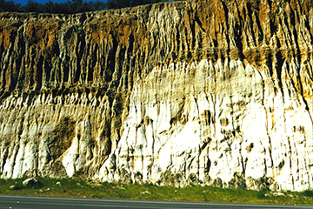
Faulting
Definition: fractures where some type of displacement (movement) has occurred.
Three types
normal
reverse/thrust
transform (strike-slip)
Carmel Valley Fault, CA

Slide 4
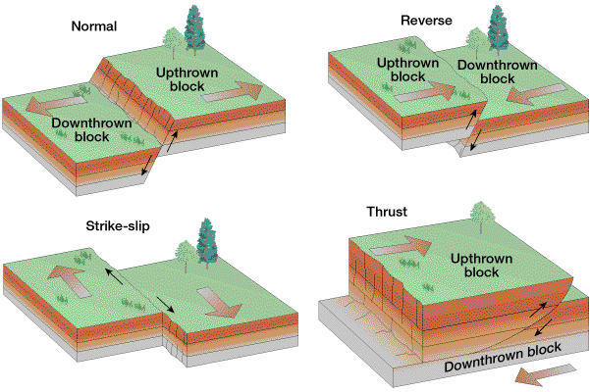

Slide 5
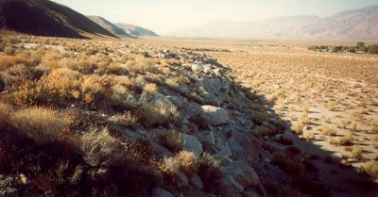
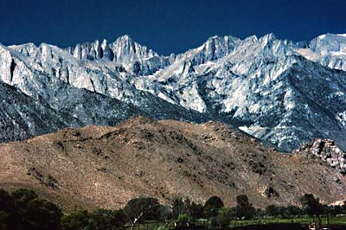
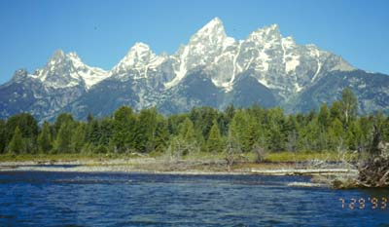
Landforms - Normal Faulting
Fault escarpment
Owens Valley, CA
Sierra Nevada, CA
Grand Tetons, WY

Slide 6
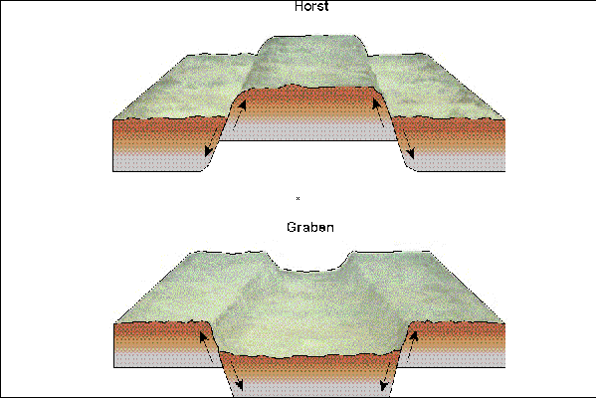
Normal Faulting
Horst and graben (“hill” and “grave”)
Death Valley/ Panamint Ranges

Slide 7
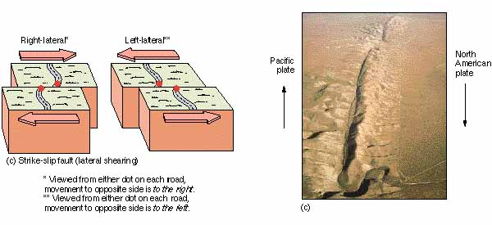
Transform (strike-slip) faults

Slide 8
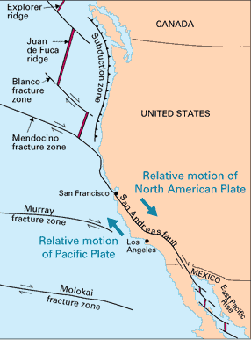
San Andreas fault System
How long is it? About 600 miles (1000 km)
Relative motion of the Pacific Plate? @ 2 inches (5 cm) northwest per year. (We’ll be off the coast of San Francisco in 12 million years!)

Slide 9
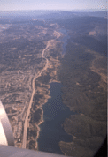
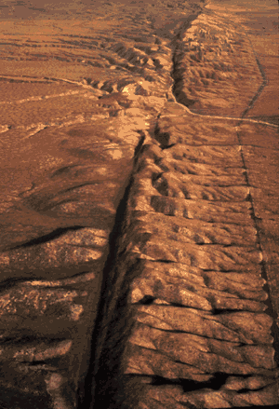
Transform Plate Boundary
Features:
shallow, linear rift valleys
Carrizo Plain, central CA
San Andreas Lake (Crystal Springs Reservoir)
- looking south along fault
- San Francisco water supply
- geology ⇔ vegetation

Slide 10
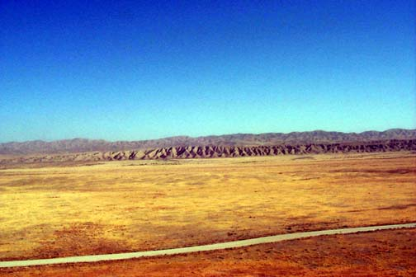
Transform Plate Boundary
Activity:
shallow to moderate earthquakes
little to no volcanism
Temblor Range
Dragon’s Back
Carrizo Plain, CA (view to the east)

Slide 11
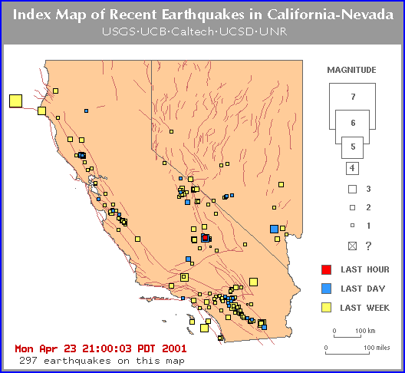

Slide 12
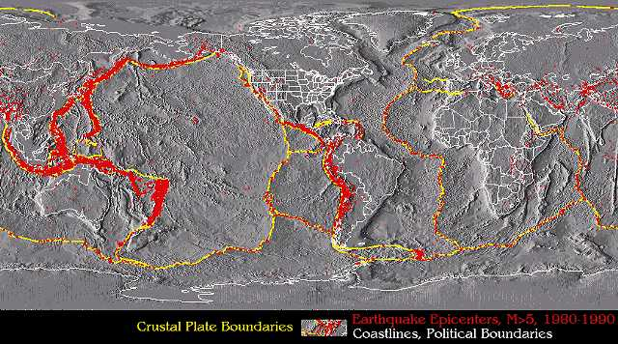
The Geography of Earthquakes
Globally: primarily at plate boundaries
Intraplate earthquakes do occur!

Slide 13
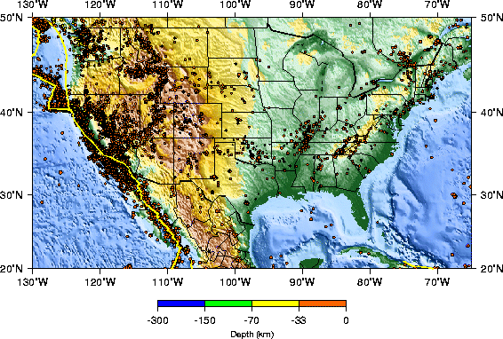
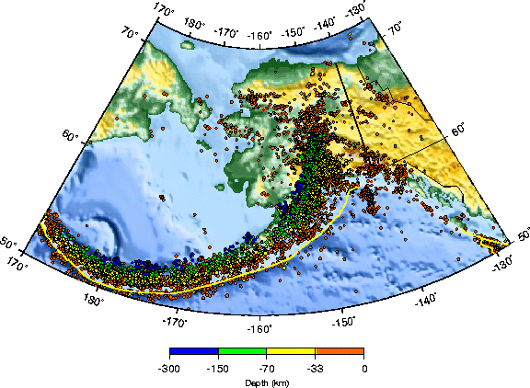
The Geography of Earthquakes
USA: 1977-1997 earthquake events
USA: every state except ND, FL

Slide 14
Earthquakes
Earthquakes are the shaking or vibration of the ground as a result of rocks suddenly breaking along a fault.
Focus (hypocenter) = rupture point
Epicenter = point on surface above focus
Foreshocks
Aftershocks

Slide 15
Process: the earthquake cycle (elastic rebound theory)
Earthquakes are a ‘release of energy’ in the form of a seismic wave (vibrates the crust).
Plate movement ⇒ strain builds rocks “locked together” (frictional bond)
Rocks bend ⇒ hit limit --> rupture/break
Cycle repeats ⇒”start-stop” motion along fault

Slide 16
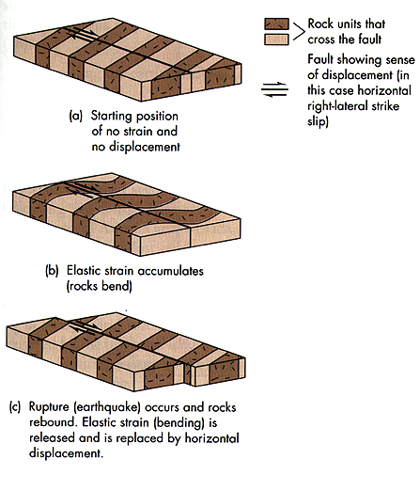

Slide 17
Seismic Waves
Some of the waves that are generated by an earthquake travel within the earth and others travel along the surface.
Waves traveling within the earth are known as body waves.
Surface waves cause the most damage to buildings during an earthquake.

Slide 18
Surface Waves
Surface waves can set up liquefaction in alluvium. This is where the most extensive damage to buildings occurs.
Liquefaction: wavelike, almost liquid, rolling of surface
Alluvium: fine material deposited by water over many years.

Slide 19
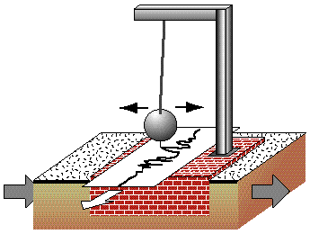
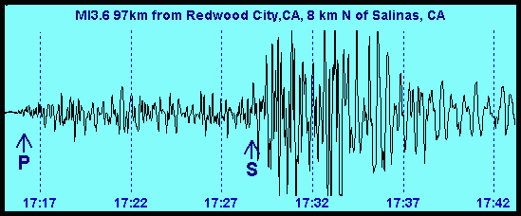
Measuring Earthquakes
seismograph: records the vibrations of the crust (Richter Scale)
seismogram: tracing record
Modified Mercalli Scale (I-VII) measures damage

Slide 20
Major California Earthquakes
Fort Tejon, 1857 - 8.0 magnitude
San Francisco, 1906 - 7.9 magnitude
1933 Long Beach - 6.3 magnitude Destroyed Glendale College Buildings!
San Fernando, 1971 - 6.6
Northridge, 1994 - 6.7
Hector Mine, 1999 - 7.1

Slide 21
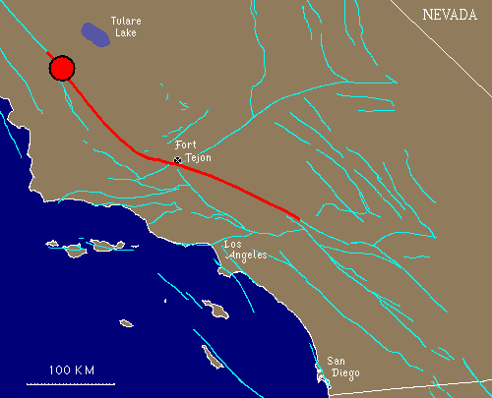
Fort Tejon, 1857
TIME: January 9, 1857
LOCATION: about 72 km (45 miles) northeast of San Luis Obispo
MAGNITUDE: M_{w} 8.0 (approx.)
TYPE OF FAULTING: right-lateral strike-slip
FAULT RUPTURED: San Andreas fault
LENGTH OF SURFACE RUPTURE: about 360 km (225 miles)
MAXIMUM SURFACE OFFSET: about 9 meters (30 feet)
California’s largest ever!

Slide 22
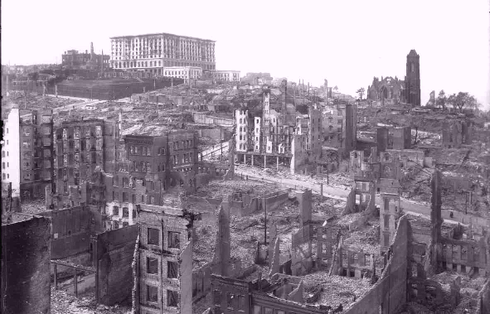
San Francisco Aftermath, 1906 Magnitude: 7.9

Slide 23
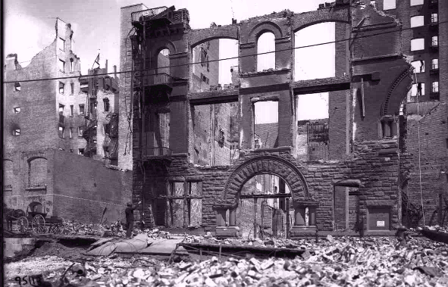
San Francisco, 1906 Magnitude: 7.9

Slide 24
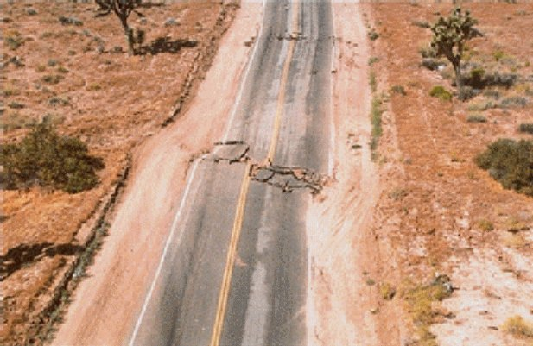

Slide 25
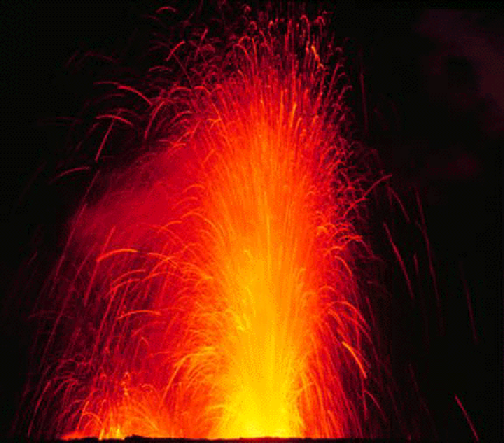
Volcanoes and Volcanic Activity

Slide 26
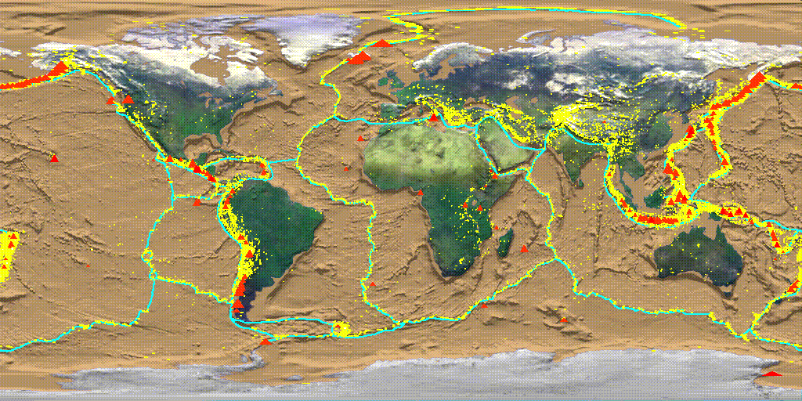
The Geography of Volcanism
Three major zones of volcanic activity
convergent plate boundaries
divergent plate boundaries
hot spots

Slide 27
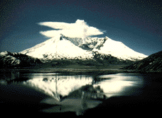
Volcano Classification
active: has erupted in recorded history. (Kilauea, Hi, Mt. Etna, Italy, Mt. Lassen)
dormant: has not been seen to erupt in history, but shows evidence of recent activity. (Mammoth Mtn, CA or Crater Lake, OR)
extinct: no sign of recent or historic activity (Mt. Kilimanjaro, East Africa)

Slide 28
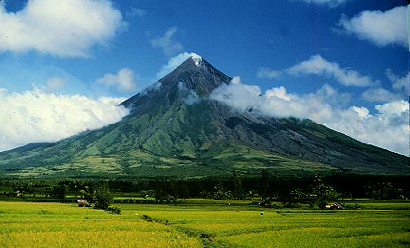
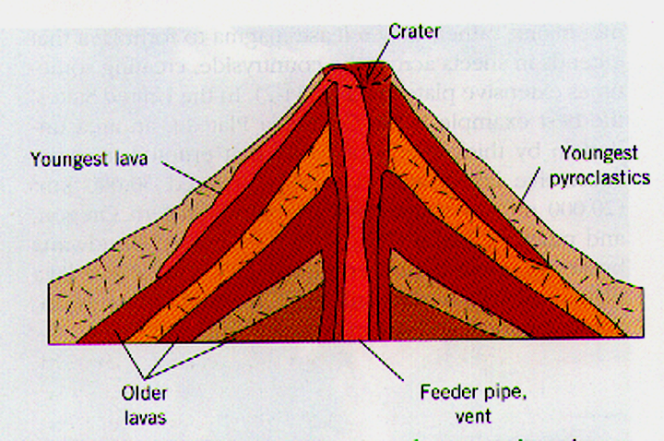
Volcanoes: Explosive
Composite cones (stratovolcano)
pointed, steep-sided, tall volcanoes
“Composite”: layers of pyroclastics and lava (mostly felsic)
Explosive and dangerous; found in subduction zones

Slide 29
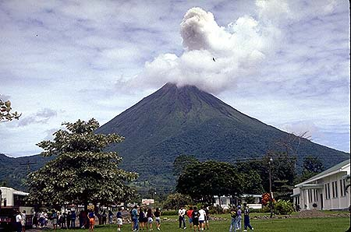
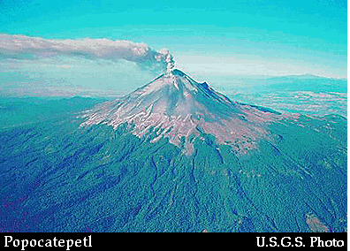
Landforms: Explosive
Arenal, Costa Rica

Slide 31
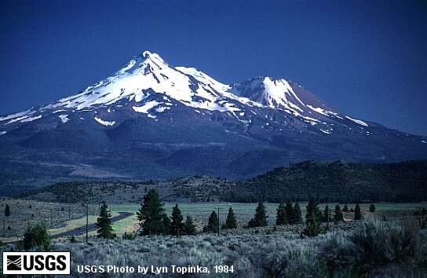

Slide 32
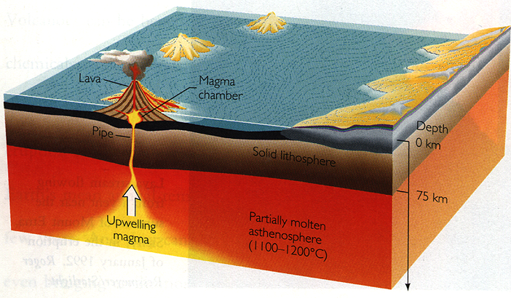
Hot Spots
Isolated columns of hot magma rising slowly within the aesthenosphere (mantle).
Melts overlying crust, “burning a hole through”
Can be underneath continents or ocean plates.

Slide 33
Landforms: Effusive
Shield volcanoes
large, rounded volcanoes with a gentle slope
central vent
flat terrain (or can not build up dome)
constructed by a series of basalt flows over time.

Slide 34
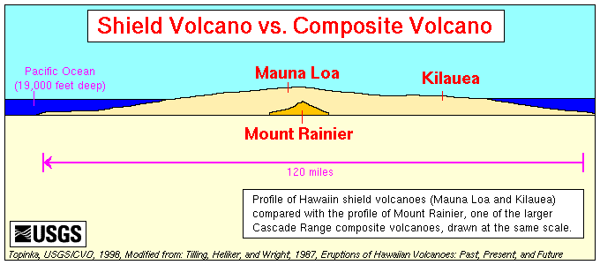

Slide 35
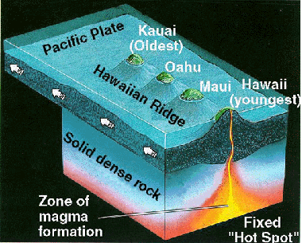
Hot Spot Example: Hawaii

Slide 36
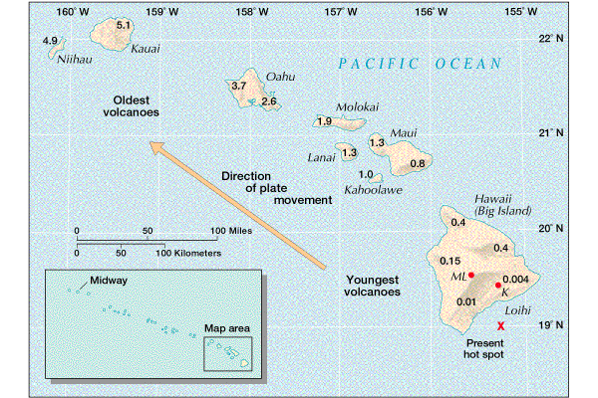

Slide 37
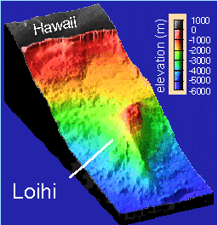
Hot Spots
Loihi
building, but still 1000 m below surface
will eventually replace the Big Island

Slide 38
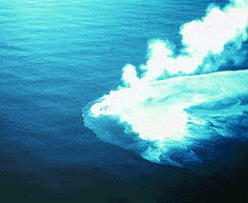
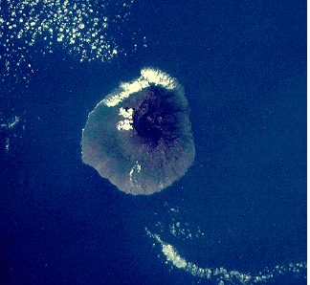
The Geography of Volcanism
Volcanism primarily submarine.
several thousand volcanoes are continental (about 600 are active)
over 50,000 in the Pacific ocean alone

Slide 39
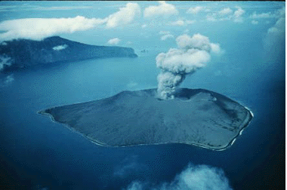
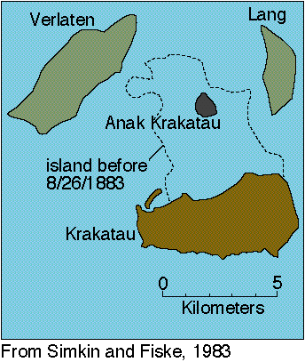
(Selected) Major Historic Eruptions
Krakatoa (1883), Indonesia
eruption obliterates an entire group of islands, leaving a submerged caldera.
blast heard for thousands of miles
ash reaches mesosphere (80km / 50 mi)
tsunami’s kill about 40,000 people

Slide 40
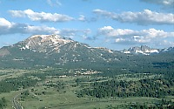
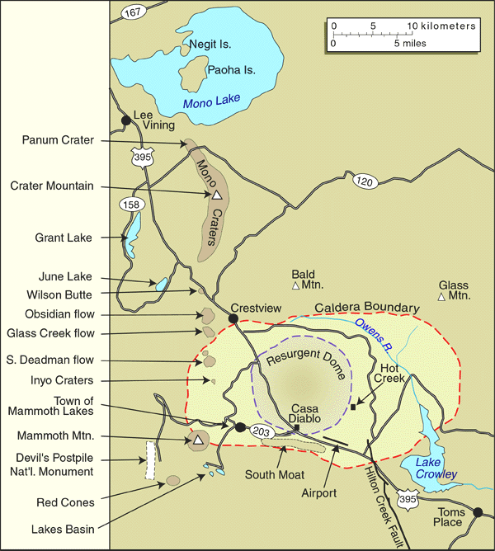
Mammoth Lakes
part of Long Valley Caldera
Eruption 760,000 years ago
500 x more material ejected than Mt. St. Helens!

Slide 41
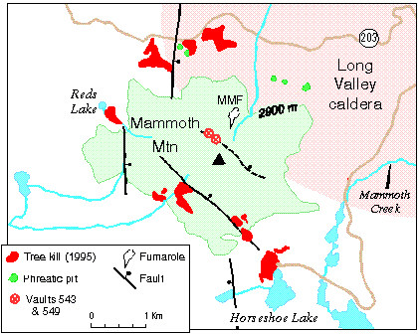
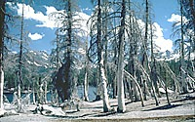
Mammoth Mtn next?
Active, moving magma at about 3 km depth
1200 tons of CO2 per day coming up through the soil ⇒ tree kills
earthquake swarms
little surface deformation
Classification?
dormant

Slide 42
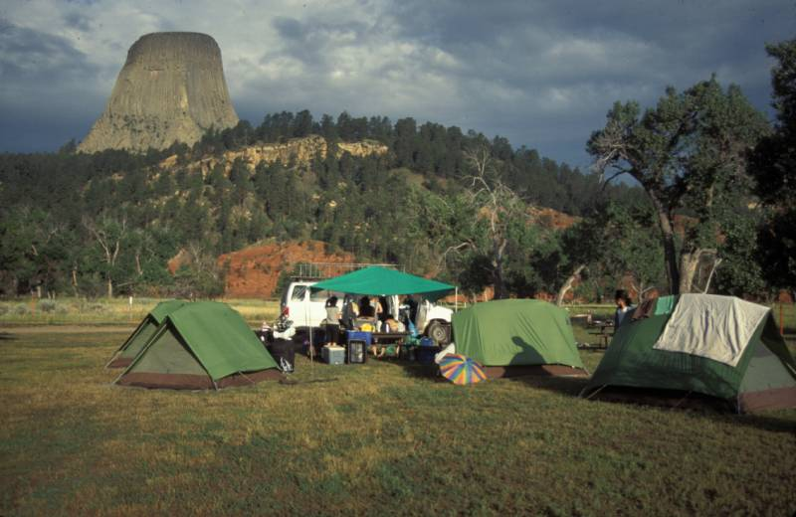
Devil’s Tower National Monument, Wyoming

Slide 43
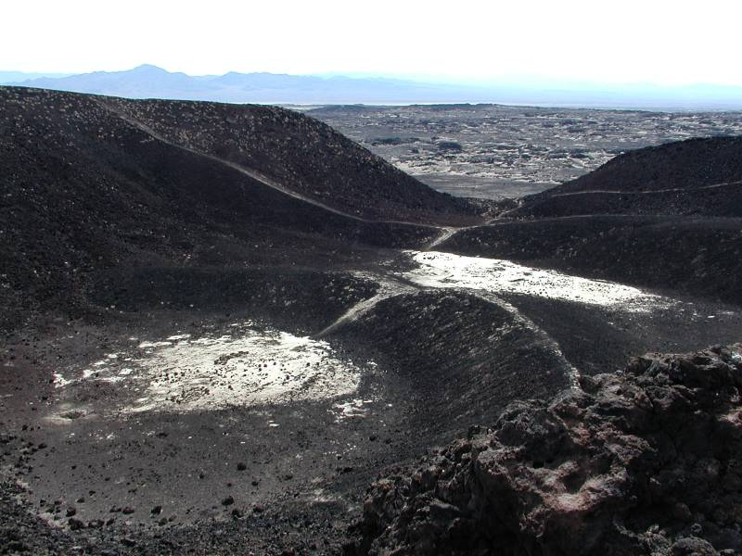

Slide 44
