Slide 1
Endogenic Processes:
Building up the landscape
Part I Tectonics

Slide 2
Bedrock structure
Material properties
Tectonics
Geologic history
Landscapes
or
Land forms
~
(geology, surficial processes, time)
~
Controls others
Climate
Biology
Weathering
Transport
Hydrology
erosion

Slide 3
Tectonic Geomorphology
Effect of tectonics (faulting, uplift, etc.) on
Surface processes and its signature on the
Landscape/Landforms

Slide 4
Types of Tectonics
Orogenic – mountain building
Epeirogenic – uplift or depression on a regional
scale without internal deformation
of original rock structures
- Mountains experience epeirogeny
after the orogeny that formed them

Slide 5
Orogenic Uplift/Subsidence

Slide 6
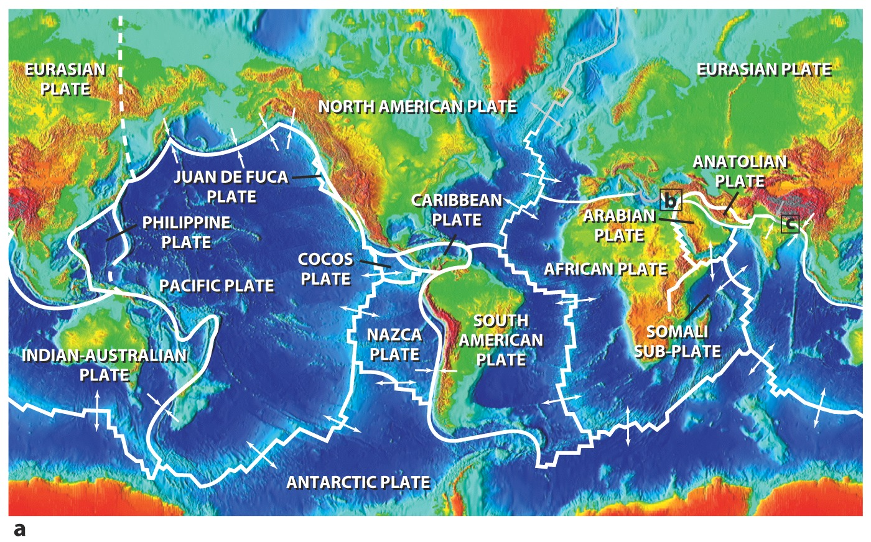

Slide 7
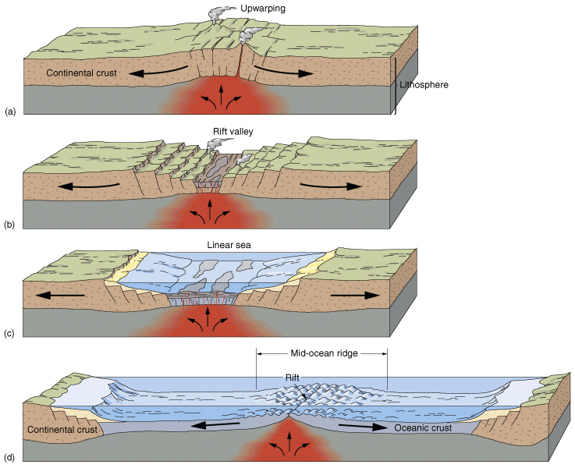
Divergent Plate boundaries

Slide 8
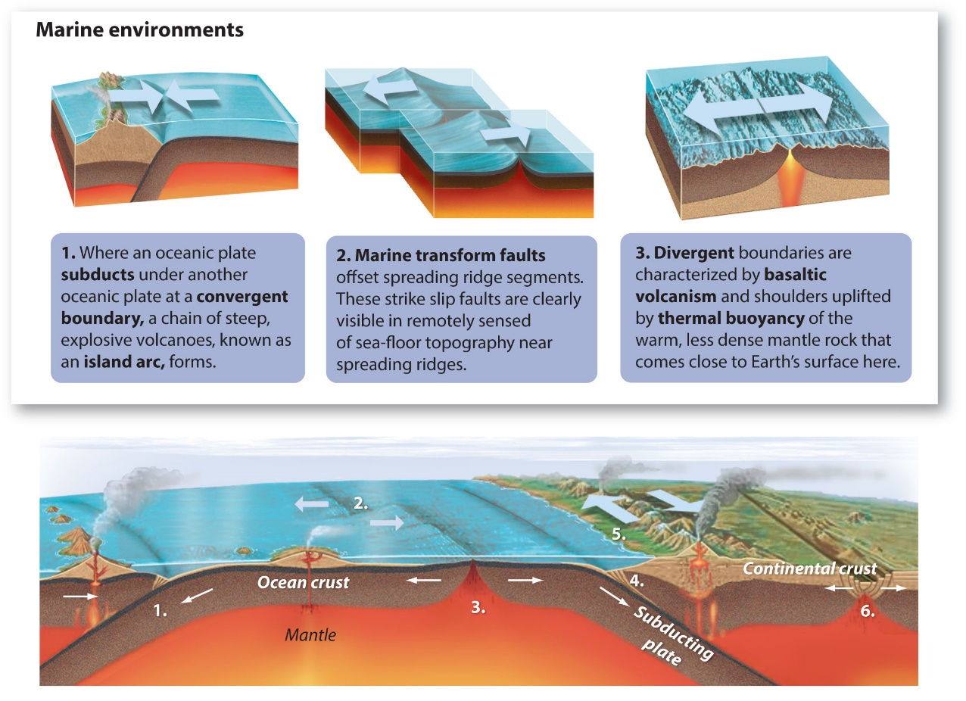

Slide 9
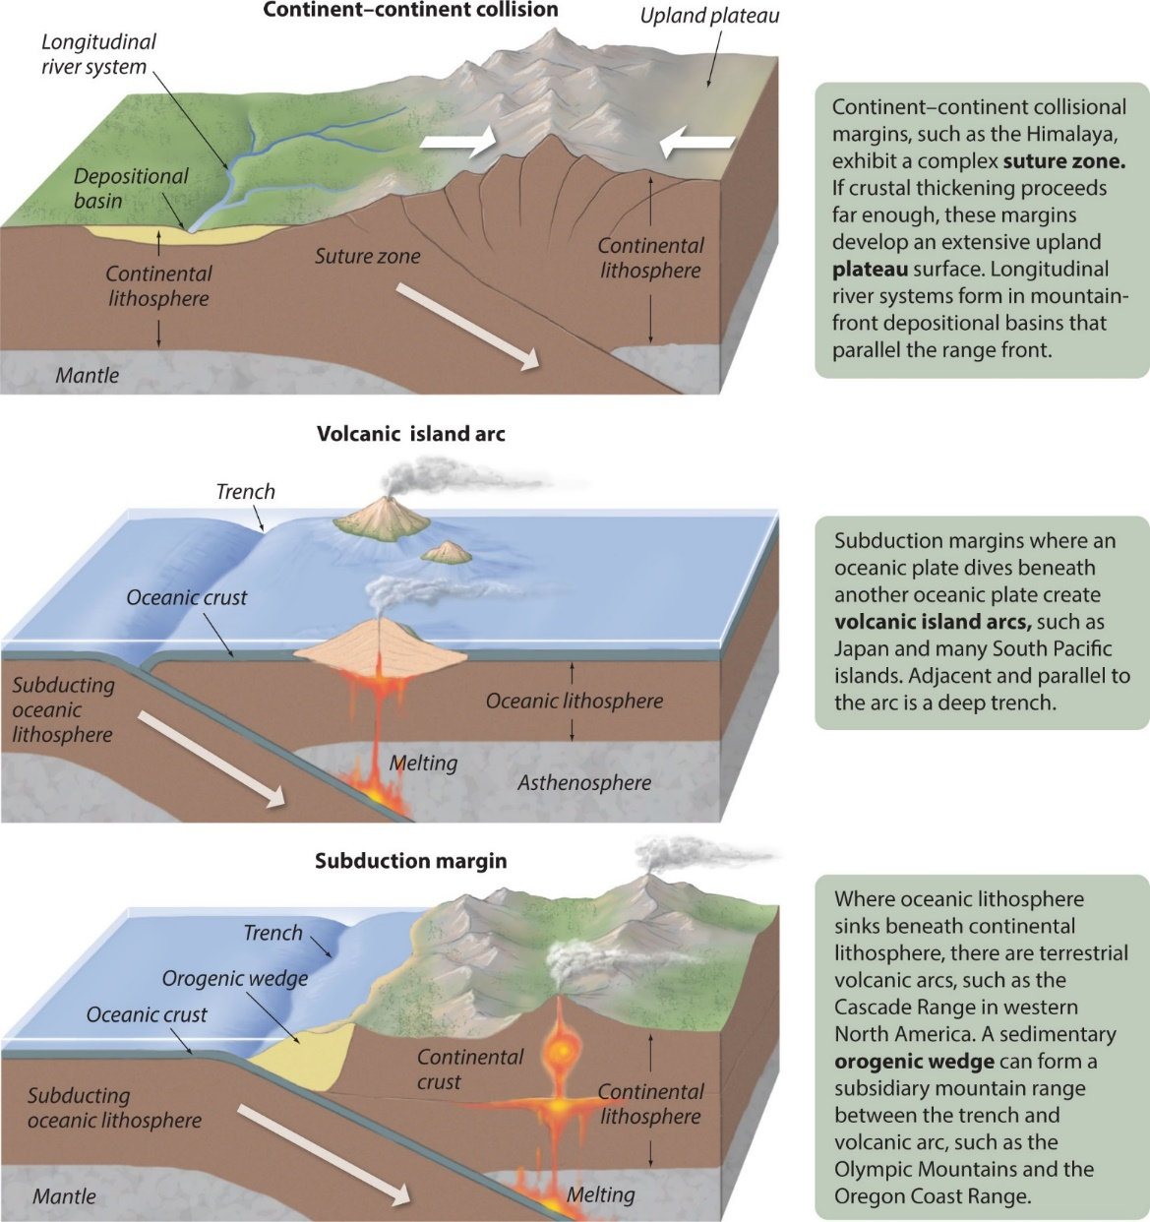
Convergent Plate boundaries

Slide 11
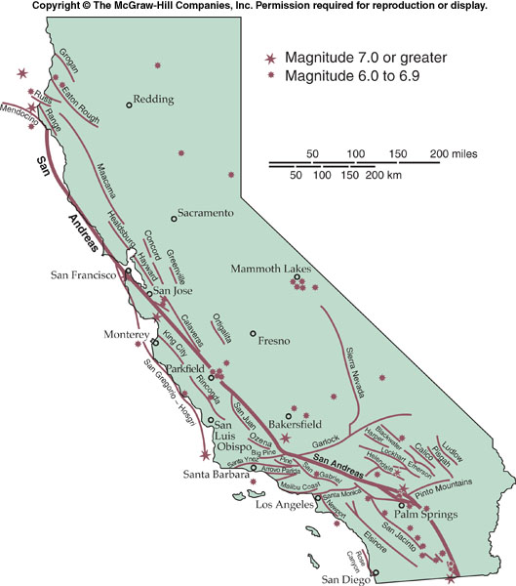
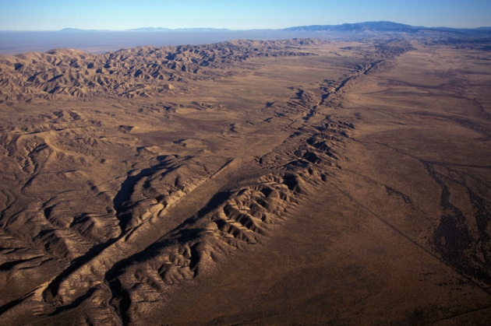
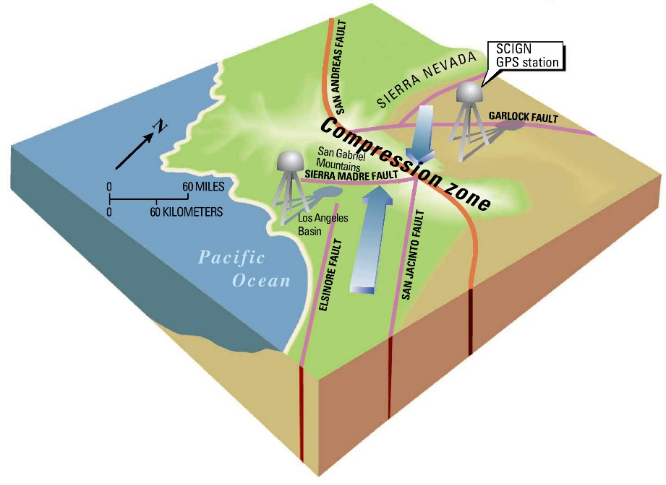
San Andreas Fault

Slide 12
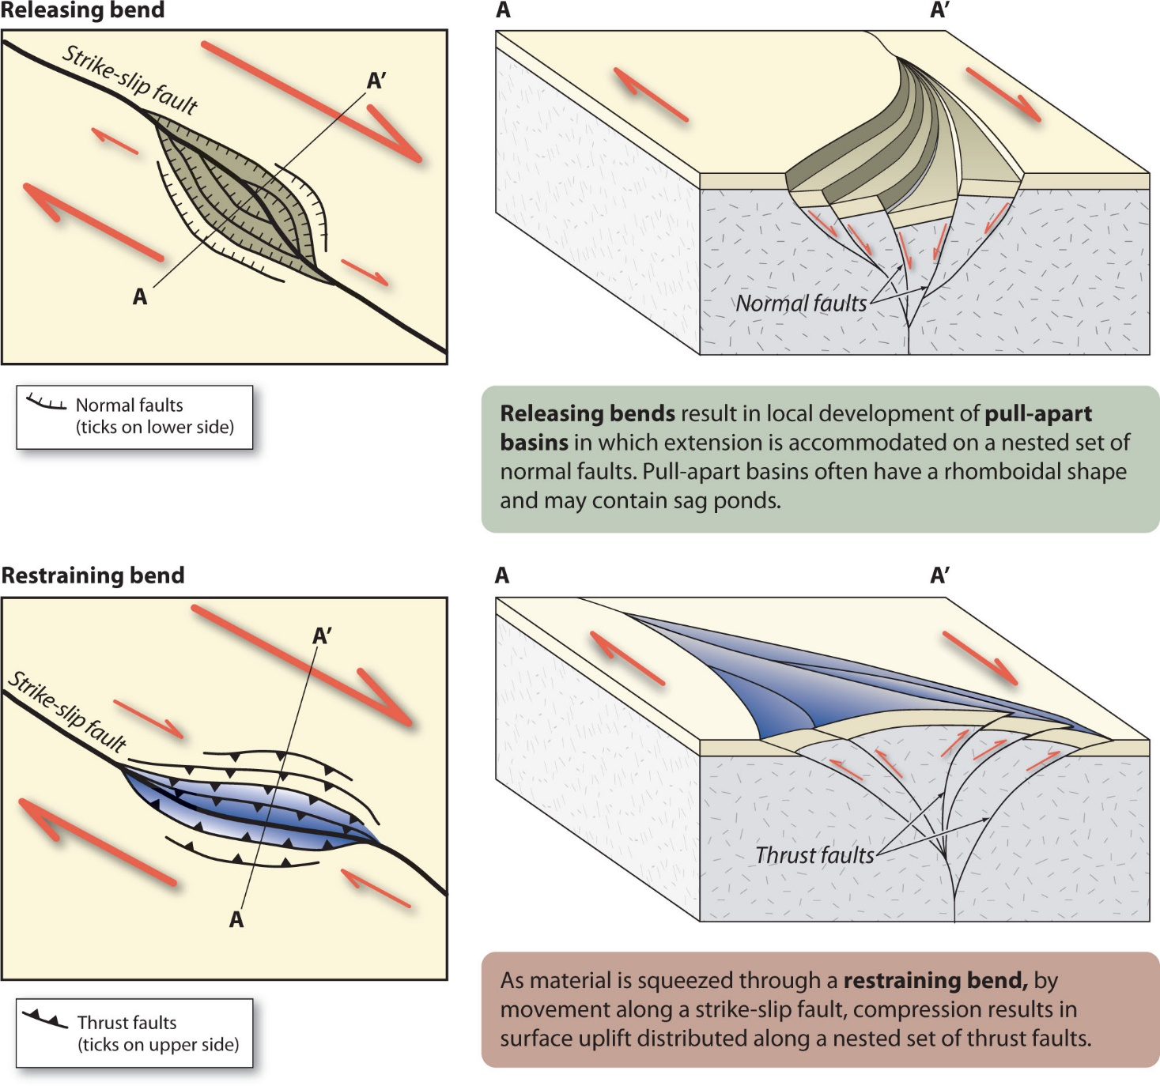
Creation of relief due to strike-slip faulting

Slide 13
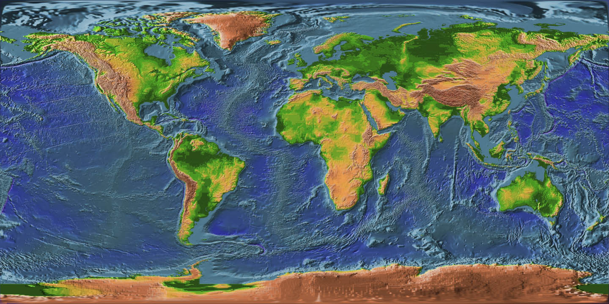
But, classic Plate Tectonics do not explain everything…

