Slide 1
Clouds

Slide 2
What is a cloud?
Warm air contains water vapor
The air cools as it rises
The water condenses around a solid object, such as dust or smoke, and forms either water droplets or ice crystals

Slide 3
When you see a cloud, how can you tell what type of cloud it is? By observing two characteristics: the first is the cloud’s physical appearance. The second is how high a cloud is above the Earth. These two things then help us determine the cloud’s type.

Slide 4
Let’s start with the cloud’s appearance. Clouds can be thick and white, dark and gray, or thin and nearly transparent (see- through). They can be round, oval, tall or flat. They can be large or small.

Slide 5
3 Basic Cloud Types

Slide 6
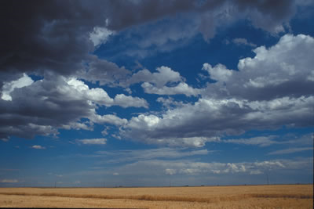
Cumulus Cumulus clouds are large, rounded, fluffy, cottony-looking clouds. Cumulus means heap or pile.

Slide 7
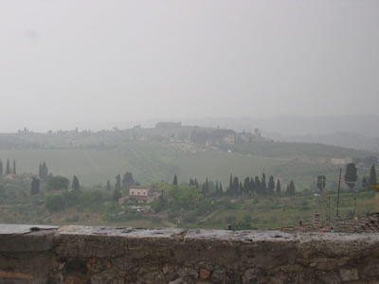
Stratus Stratus clouds are low, flat sheets of clouds that look like one huge cloud covering the whole sky. Stratus means layer.

Slide 8
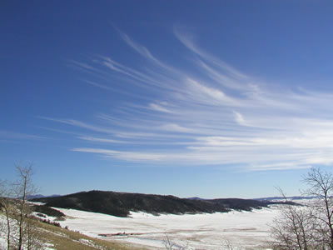
Cirrus Cirrus clouds are high, thin, wispy, and feathery. Cirrus means curl or wisp of hair.

Slide 9
How High is High?

Slide 10
Altitude is how high something is above the Earth’s surface. Clouds can be high in the sky way above Earth, low in the sky, or in the middle of the sky. What does that really mean?

Slide 11
Generally speaking, an altitude of 6,000 feet or less is low level. That means a plane or a cloud in the sky at 6,000 feet or less above the Earth’s surface is at a low altitude. A middle altitude is more than 6,000 feet, but less than 20,000 feet above the Earth’s surface. An altitude of 20,000 feet or more is a high level altitude.

Slide 12
Because you are here on the ground and the clouds are in the sky, you can’t know how high they are – you can’t really know their altitude. But you can tell if the cloud is low is the sky, high in the sky, or in the middle of the sky by just looking at them. Sometimes clouds can be at different altitudes than usual.

Slide 13
Altostratus Stratus clouds, usually low, can also be at middle altitudes. When they are, we call them altostratus clouds. Alto means higher. And altostratus means stratus clouds at higher levels than regular stratus clouds.

Slide 14
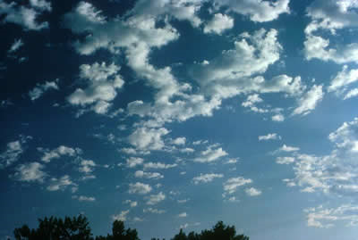
Altocumulus Cumulus clouds are also usually low, but can be at middle altitudes. When they are, we call them altocumulus clouds. Alto means higher. And altocumulus means cumulus clouds at higher levels than regular cumulus clouds.

Slide 15
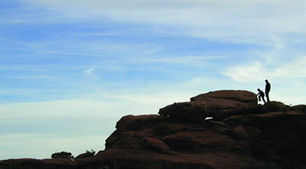
Cirrostratus When the prefix cirro is added to the name of one of the basic cloud types it tells us that the cloud is at very high levels. When stratus clouds are at high levels they are called cirrostratus clouds.

Slide 16
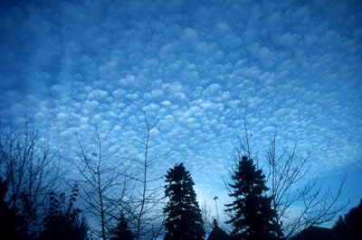
Cirrocumulus When the prefix cirro is added to the name of one of the basic cloud types it tells us that the cloud is at very high levels. When cumulus clouds are at high levels they are called cirrocumulus clouds.

Slide 17
Rain Clouds The word nimbus means rain. Another form of the word nimbus is nimbo. So, if a cloud contains rain, sleet, snow, or hail, we add nimbus or nimbo to its name.

Slide 18
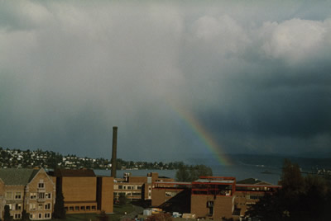
Nimbostratus A stratus cloud that produces rain, sleet, or snow is called a nimbostratus cloud. Nimbo is a form of the word nimbus.

Slide 19
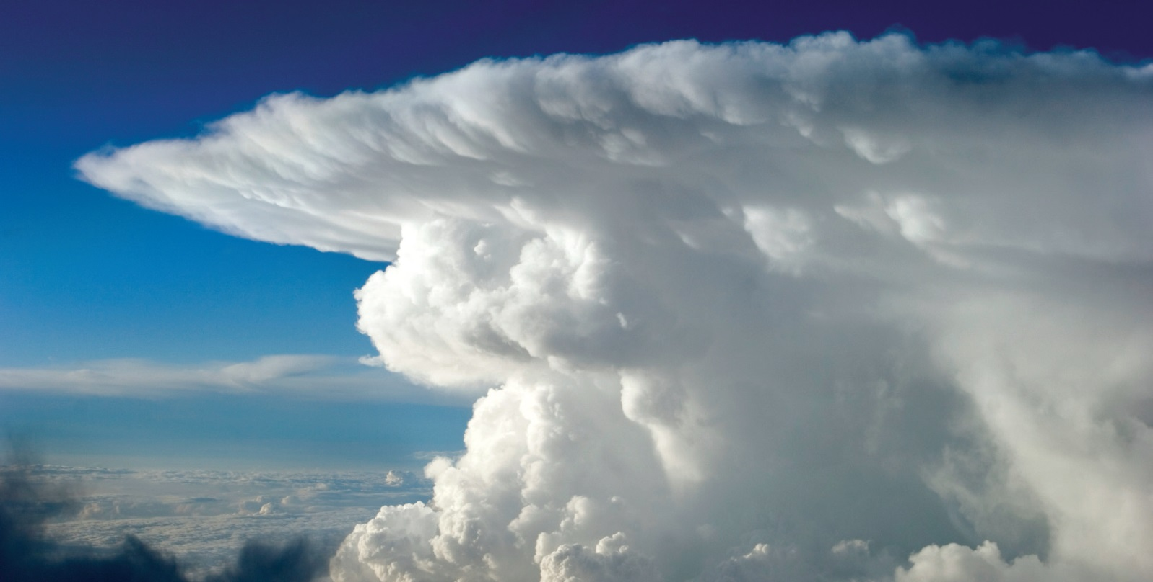
Cumulonimbus A cumulus cloud that produces rain, sleet, snow, or hail is called a cumulonimbus cloud. That word is a combination of the words cumulo (a form of the word cumulus) and nimbus.

Slide 20
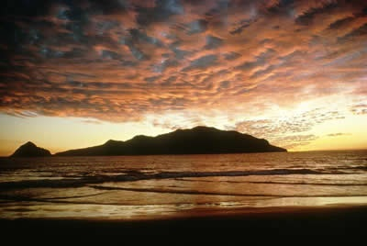
Stratocumulus A stratocumulus cloud typically forms after it rains, but before the sky clears. That word is a combination of the words strato (a form of the word stratus) and cumulus, so we know that this cloud type has characteristics of both stratus and cumulus clouds.

Slide 21
Let’s Review

Slide 22
Word | Meaning
Cumulo | heap
Strato | spread out or layer
Cirro | curl or wisp of hair
Alto | higher
Nimbo | rain

Slide 23
Low Level Clouds Clouds found at low levels include cumulus, stratus, stratocumulus, nimbostratus and cumulonimbus clouds. Although the bottoms of cumulonimbus clouds are at low altitudes, they can be very tall and their tops can be at very high altitudes.

Slide 24
Mid-Level Clouds Clouds found at middle-levels include altocumulus and altostratus clouds.

Slide 25
High-Level Clouds Clouds found at the highest levels include cirrus, cirrostratus, and cirrocumulus clouds.

Slide 26
How are clouds formed?

Slide 27
Cloud Formation Basics
All clouds form when warm, moist air rises into the upper troposphere.
The air cools as it rises.
The water vapor that it contains condenses and forms the water droplets or ice crystals that form clouds.

Slide 28
Cloud Formation
Although the basics of how clouds form is the same, different clouds do form in slightly different ways
The difference is what causes the warm, moist air to rise into the upper troposphere.

Slide 29
3 Cloud Formation Methods

Slide 30
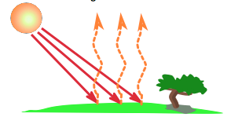
Convection When the sun warms the ground, the air above the ground is heated and begins to rise. This warm air, containing water vapor, rises in a process known as convection. Since the upper troposphere has less pressure than the troposphere below it, the rising air and water vapor will expand, become cooler and the water vapor will condense.

Slide 31
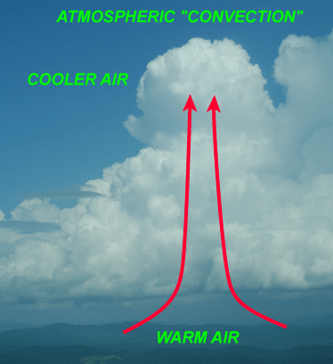
Convection This is a cloud that is forming by convection.

Slide 32
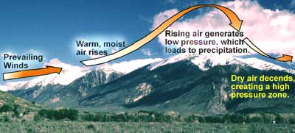
Lifting Some clouds are formed when warm, moist air moves up the side of a mountain. Along its journey, the air is lifted higher into the troposphere where the pressure is lower. Again, the water vapor in the air is allowed to cool and form clouds. This is why we often see clouds over mountains.

Slide 33
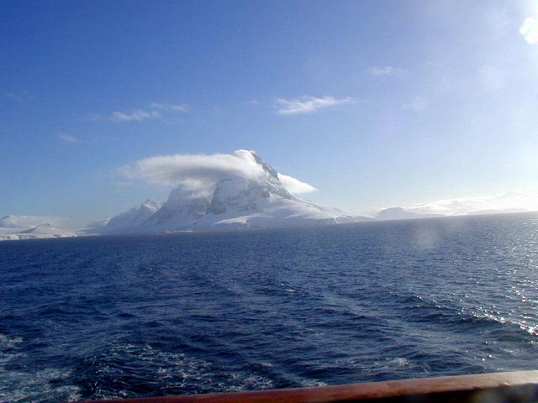
Lifting This is a cloud that is forming by lifting.

Slide 34
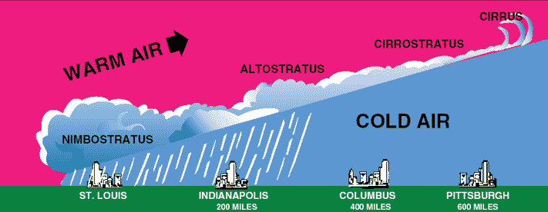
Frontal Activity Sometimes a warm, moist air mass, will run into a colder air mass. When the two meet, the warm, moist air rises higher into the troposphere. The lower pressure of the upper troposphere causes the water vapor in the warm air to cool and form a cloud.

Slide 35
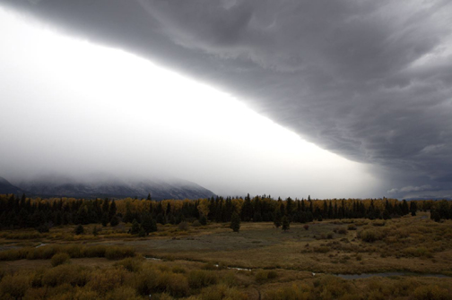
Frontal Activity This is a cloud that is forming by frontal activity.

Slide 36
Let’s Review some more!

Slide 37
3 Cloud Formation Methods
Convection – Warm, moist air rising.
Lifting – Warm, moist air sliding up the side of a mountain.
Frontal Activity – Warm, moist air being forced to rise by a cooler air mass.

Slide 38
Unusual cloud formations

Slide 39
Roll Cloud

Slide 40
Lenticular

Slide 41
Wave Clouds

Slide 42
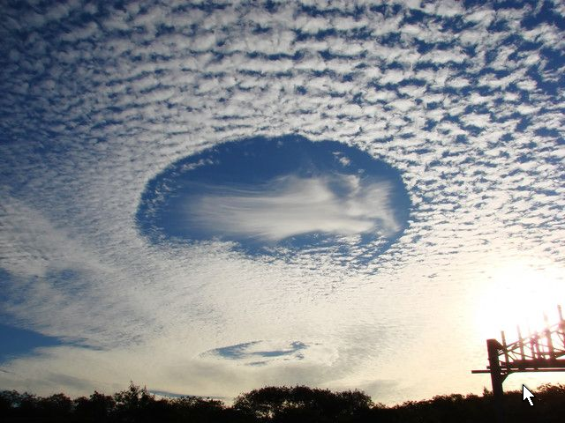

Slide 43
Mammatus Cloluds

Slide 46
