Slide 1
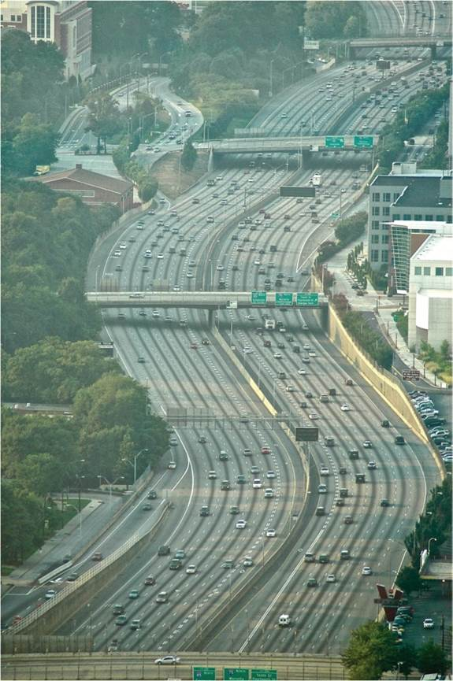
Chapter 17: Networks of Cities
Cities exist not only as singular places but also as nodes in a variety of networks.
Expanded by Joe Naumann, UMSL
Interstate highway, Atlanta.
Notes:
Chapter 17 Opener

Slide 2
Chapter Learning Objectives
Consider the city as a node in a network.
Understand central place theory.
Discuss the distribution of cities in a national network.
Outline the various methods for defining and identifying the global scale network of cities.
Describe the flows that connect cities in global, national, and regional urban networks.

Slide 3
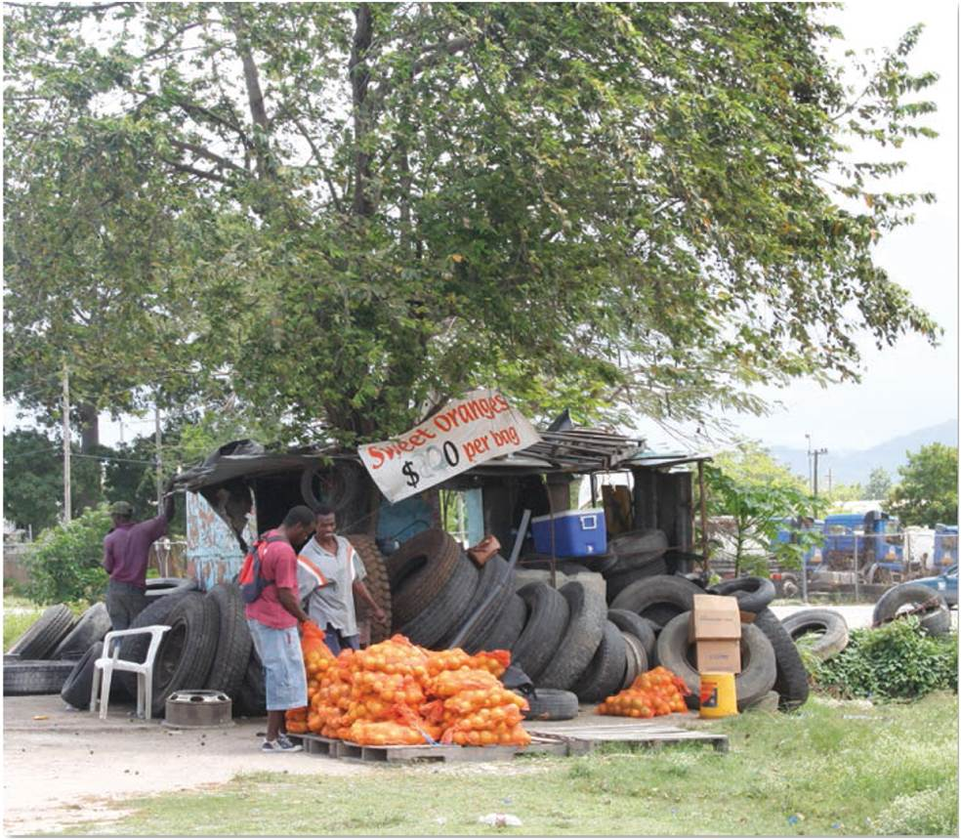
Regional Networks
Earliest forms of urban network
Periodic market system occurs when demand density is low, vendors are relatively mobile
Geometry to periodicity
Fixed markets
As demand grows, traders stay in place
Roadside sale in Jamaica.
Notes:
Figure 17.1

Slide 4
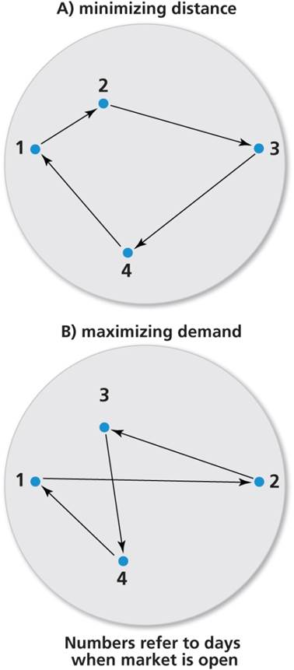
Periodic Market Systems
Markets minimize travel for vendors (left) or maximize demand across space (right).
Notes:
Figure 17.2A and B

Slide 5
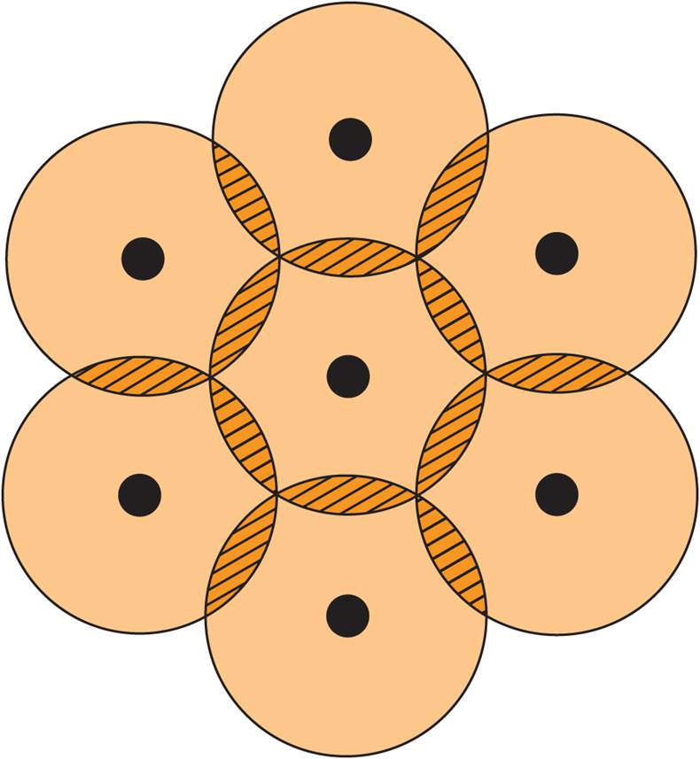
Regional Networks
Towns located at regular intervals, attracting people travel to nearest
Range of a good is distance consumers willing to travel
Threshold is necessary minimum demand to support continued supply
The Galpin Model. Ideal pattern.
Notes:
Figure 17.4

Slide 6
Regional Networks
Central place theory
Market towns distributed in hierarchy
Higher-order items with larger thresholds located in larger towns
Case studies
Help uncover socio-spatial relations in urban networks

Slide 8
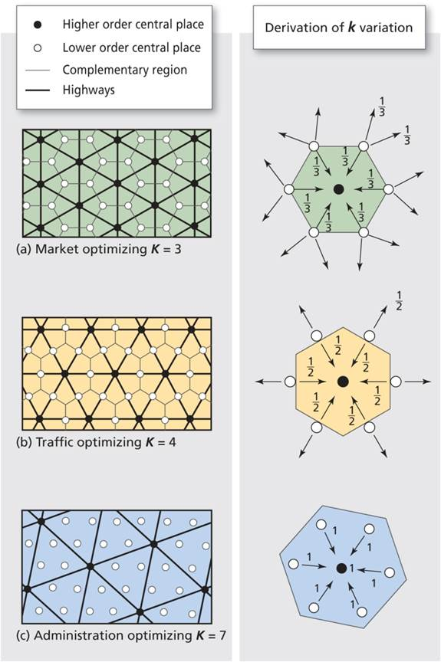
Regional Networks
Market areas in central place systems.
Notes:
Figure 17.5

Slide 9
Estimating City Population
Problems in reporting urban population
Poor quality of comparative data
Countries record data in a variety of ways
United Nations, politics and data reporting
Distinctions between city and metro region

Slide 10
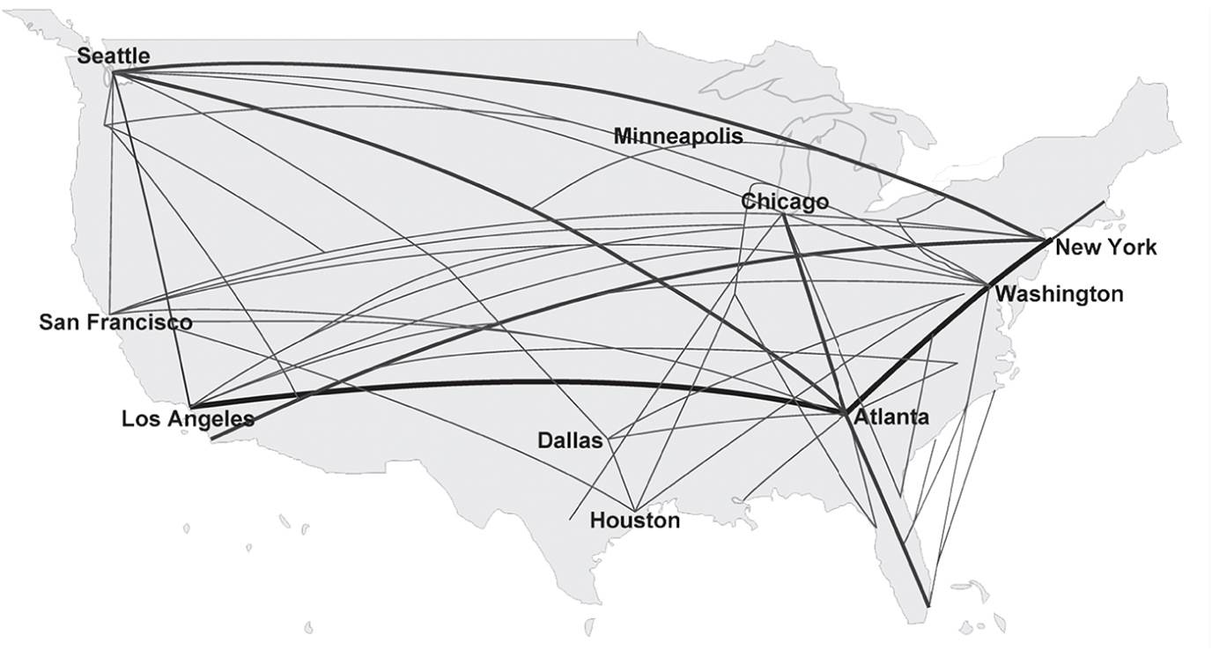
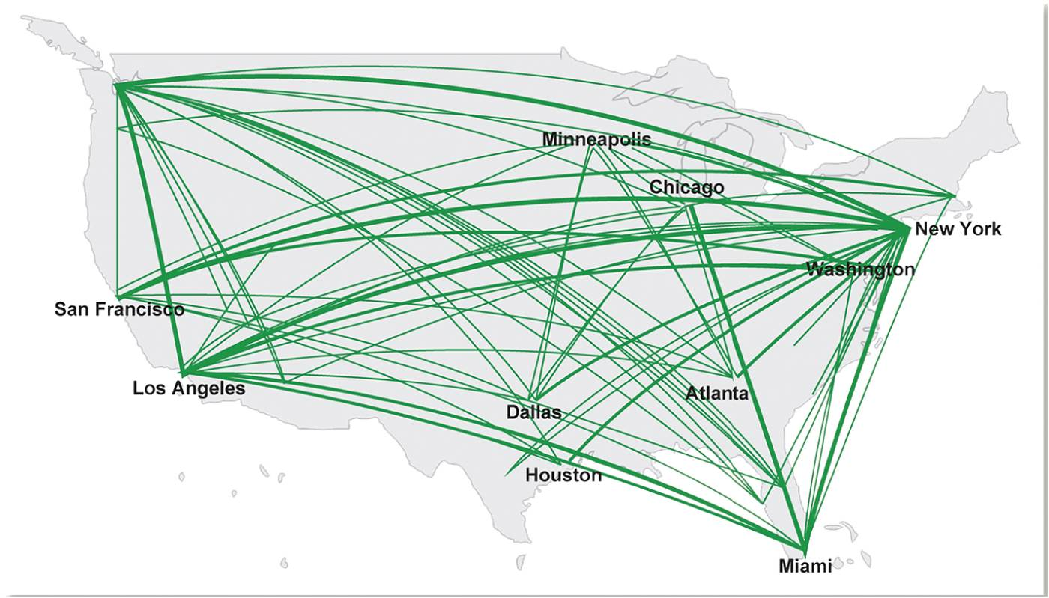
Estimating City Population
TOP LEFT: Network flows in the US: Internet connectivity.
BOTTOM RIGHT: Network flows in the US: recorded business travel flows.
Notes:
Box 17.2 Figures

Slide 11
National Networks
National Urban Network
Zipf’s Law or rank-size distribution relationship between city’s rank and its population
Urban Primacy
Primate distribution when one city dominates its national network
Primacy ratio between population of largest cities in a country

Slide 12
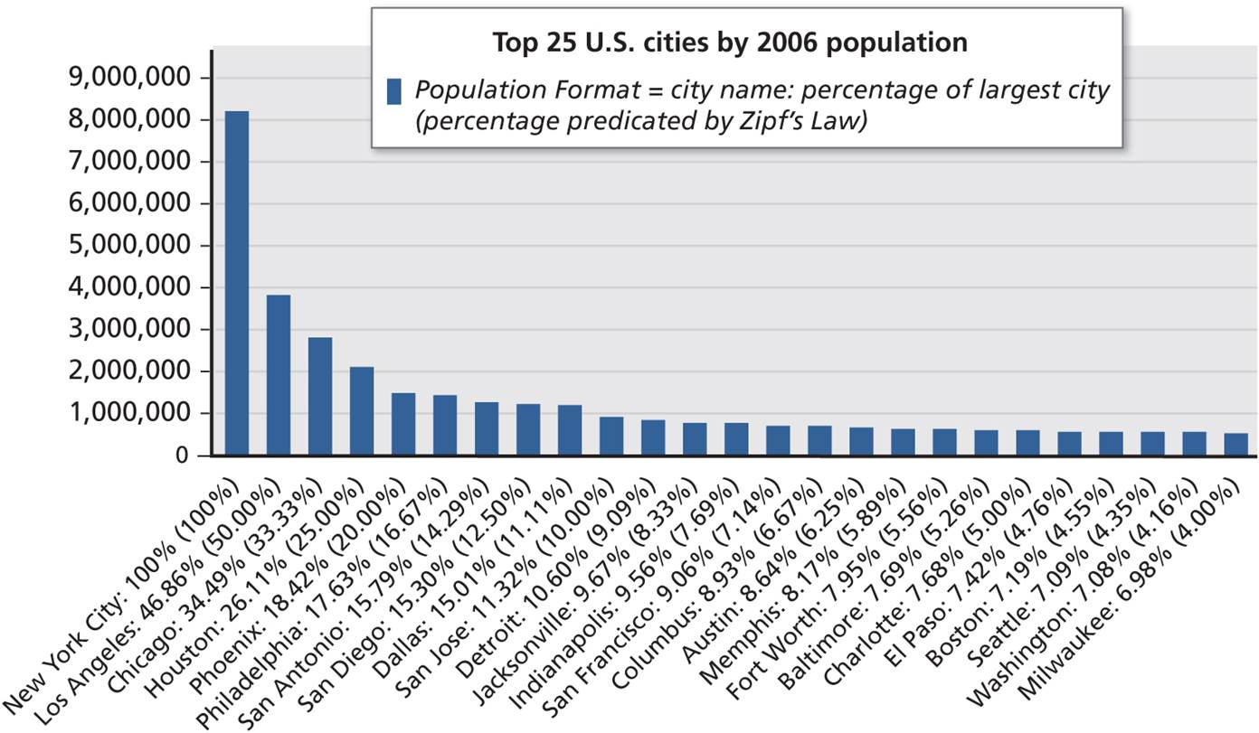
US city population plotted against expected values according to Zipf’s Law.
Notes:
Figure 17.6

Slide 13
Urban Primacy
In urban studies, urban primacy indicates the ratio of the largest city to the next largest i.e the second largest in a country. Such a city is called a primate city. In other words, urban primacy can be defined as the central place in an urban or city network that has acquired or obtained a great level of dominance.
A rough estimate is usually the primate city is at least twice the size (population) as the next biggest city (urban area) OR three times the size of the combined population of the next two large cities (your text book)

Slide 16
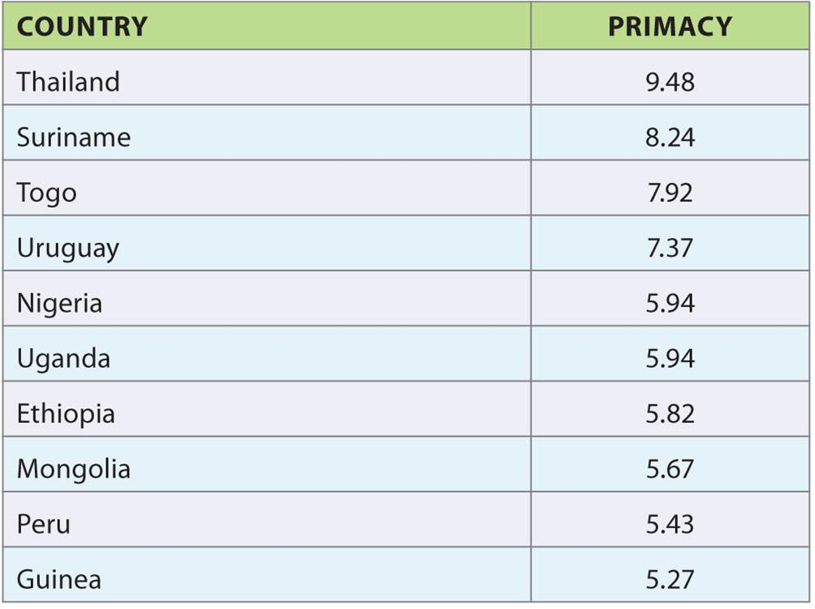
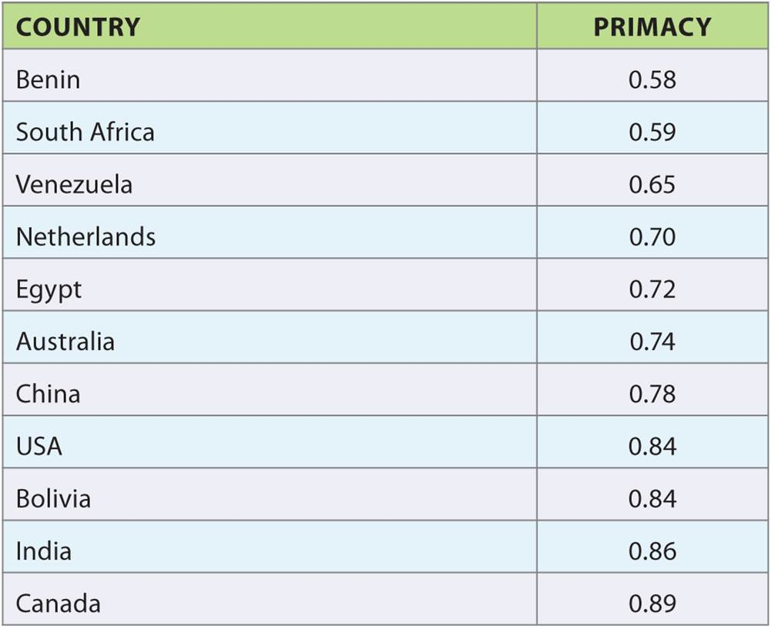
Urban Primacy
Table 17.1
Table 17.2
LEFT: High Urban Primacy. RIGHT: Low Urban Primacy.
Notes:
Tables 17.1, 17.2

Slide 17
National Networks
Looking closer into urban national network
Case of Australia
Best depicted as a series of primate states in a federal system
Each Australian state exhibits hyperprimate concentration of activity
Colonial legacy

Slide 18
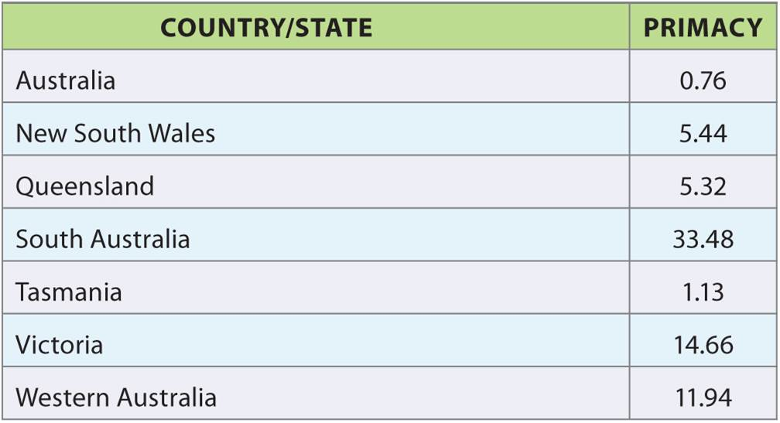
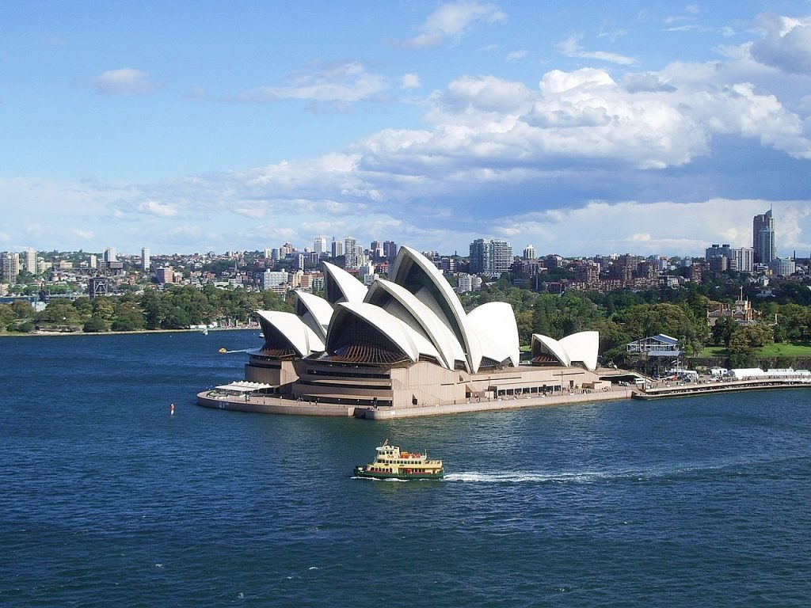
National Networks
Table 17.3
Urban Primacy in Australia.
Notes:
Table 17.3

Slide 19
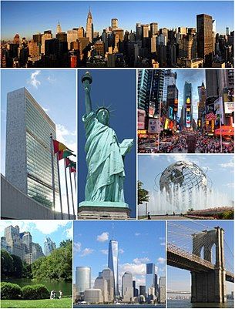
Global Networks
Globalization and World Cities (GAWC)
Metageography of urban networks
Global hierarchy and advanced producer firm
NY-LON an important pivot in global network
World cities are sites of dense networks, and centers of social-capital

Slide 20
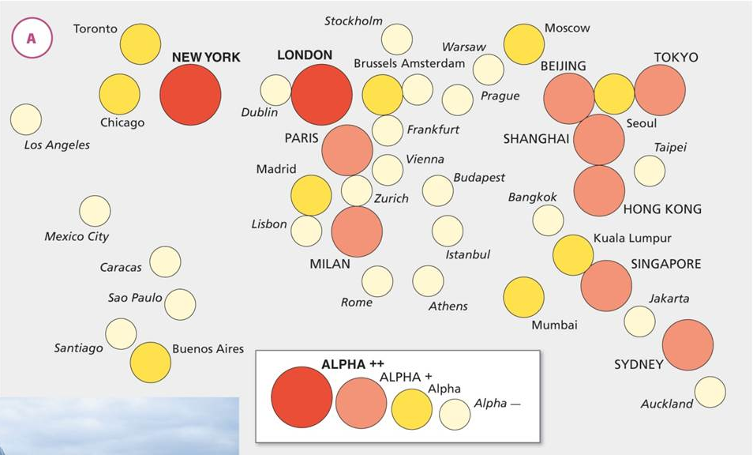
Global Networks
Global urban network according to GAWC. Cartogram of alpha cities in advanced producer services.
Notes:
Figure 17.8A

Slide 21
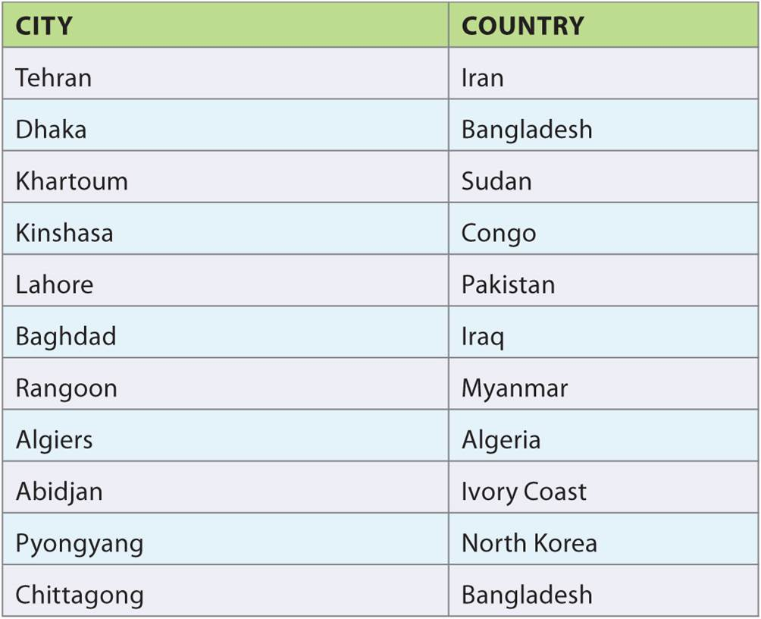
Global Networks
Black holes of advanced global capitalism
Over 3 million people, no world city in its national territory
Three types of non-world cities
Poor city
Collapsed city
Excluded city
Black Holes.
Notes:
Table 17.4

Slide 22
Global Networks
Flows of people
Global network based on flows of immigration
Similarities, differences in city rankings
Differences relate to regulations, labor demand, relative openness
There is no one fixed global urban hierarchy; has different configurations depending on flows investigated
“Spaces of transformative flows”
Money, people, ideas, goods, and practices flow through the urban network and get transformed

Slide 23
Visualizing National Urban Network Flows
The Case of the United States
Study of the 60 major cities of US national network
Using 2010 data mapped intercity flows
Network flows in the United States: internet connectivity.
Notes:
Box 17.2 Figure (top)

Slide 24
Chapter Summary
Cities as nodes in regional, national, and global networks.
One of the earliest forms of urban network is the periodic market system, in which villages and towns with low demand density and relatively mobile vendors periodically host open markets where goods are sold.
However, as demand grows, some traders stay in place, and eventually periodic markets are replaced by fixed markets.
The basics of central place theory, and in particular the notions of complementary region and of the range and threshold of goods and services, are still important tools for uncovering some of the socio-spatial relations in urban networks as the measurement and definition of complementary regions allow us to identify the effective influence of a city across space.

Slide 25
Chapter Summary
Cities are also part of national networks.
In primate distributions, one city dominates the urban system.
The Globalization and World Cities (GAWC) research network attempts to provide an understanding of global urban networks by collecting data on the distribution of global advanced producer service firms across cities in order to identify a global urban hierarchy.
An alternative method looked at immigration into cities around the world and established an index based on the percentage of foreign-born, the total number of foreign-born, the percentage of foreign-born not from a neighboring country, and the diversity of immigrant home countries, broken down into a threefold division.

Slide 26
Chapter Summary
The two methods have some similar results, as some cities are in the same categories in both studies, but there are also an array of differences that demonstrate the need for better data as well as the ways in which network flows vary.
A global system of cities, connected by flows of capital, ideas, information, and skilled personnel, “landscapes” the world into concentrated nodes of heightened connectivity and accumulated control.
Rather than mere transfers, flows along the urban networks are transformative experiences that change the medium and the networks; as people adapt, ideas are tweaked, money is reimagined, and commodities are reappropriated.

