Slide 1
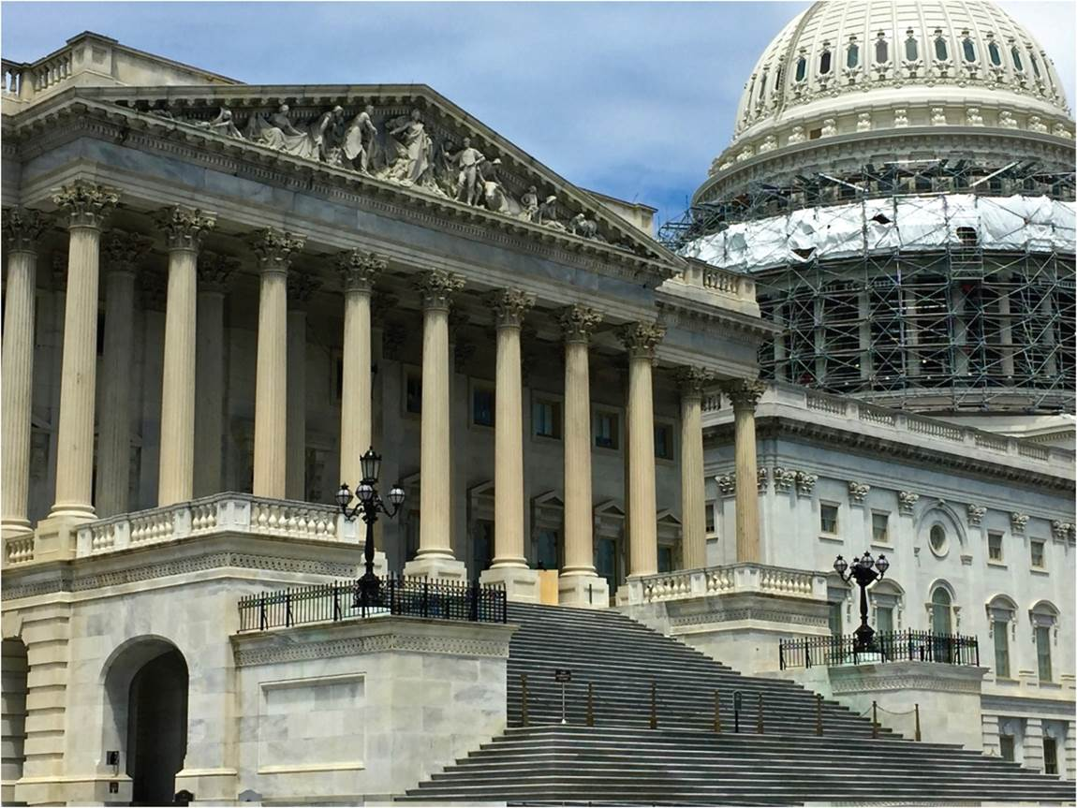
Chapter 15: The Nation-State
The state is an important building block of the political organization of space.
US Capitol
Notes:
Chapter 15 Opener

Slide 2
Chapter Learning Objectives
Summarize the role of states in the political organization of space and the trends associated with global integration.
Describe the diversity of states.
Recognize the distinction between a state and a nation as differing political entities.
Consider how the state wields power within its territory.
Explain reasons for and patterns of state borders, and how they relate to contested boundaries.
Understand the geographies of voting and elections.

Slide 3
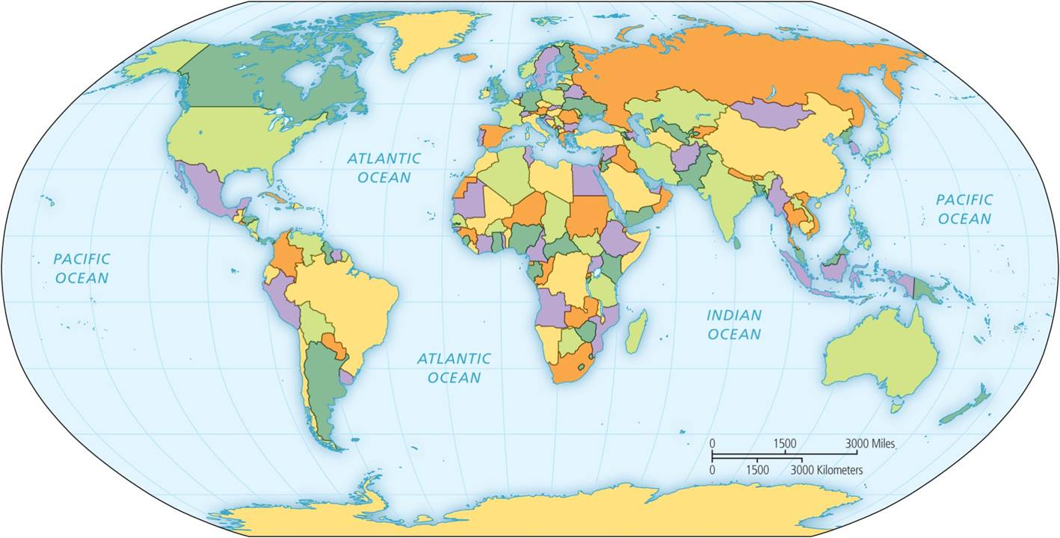
The Range of States
Political organization of space
  states
  nation-states
Division of space
  Separate units of political authority
  Steady rise in number of states
  Global integration allows for smaller states
Political map of world.
Notes:
Figure 15.1

Slide 4
National Political Systems
Terms: Nations, States, and Nation-States
  Nation: A group of people with a sense of oneness – an ethnic group.
    Should not be used to mean a country
  State: A part of the earth’s land surface which is organized under a government and has boundaries.
  Nation-state: High coincidence between the territory occupied by a nation and that which is organized as a state – A nation which has its own political structure for the territory it occupies.
  Multi-national state: A state in which more than one nation resides
    Canada, Nigeria, Spain, and many others

Slide 5
Stateless nation & part-nation state
Stateless nation – an ethnic group which is divided among several countries and which does not comprise the majority of the population of any of the countries.
  Kurds
  Poles before the Treaty of Versailles
Part-nation state – A nation whose territory may expand beyond the territory of a state and may encompass several states
  Arab nation

Slide 6
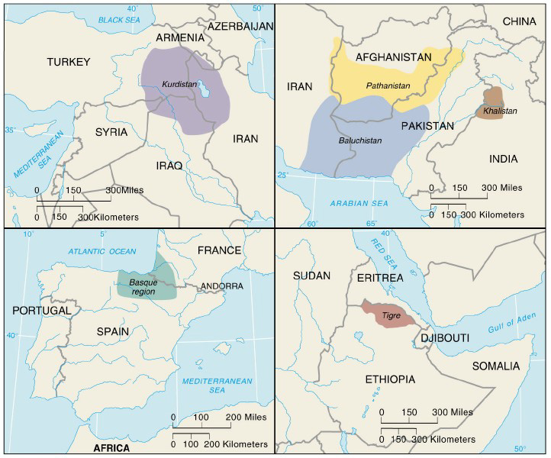

Slide 7
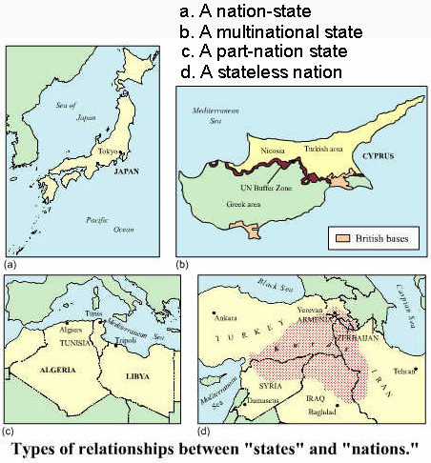
State & Nation –
Both the multinational state and the stateless nation situations have the potential for armed conflict

Slide 8
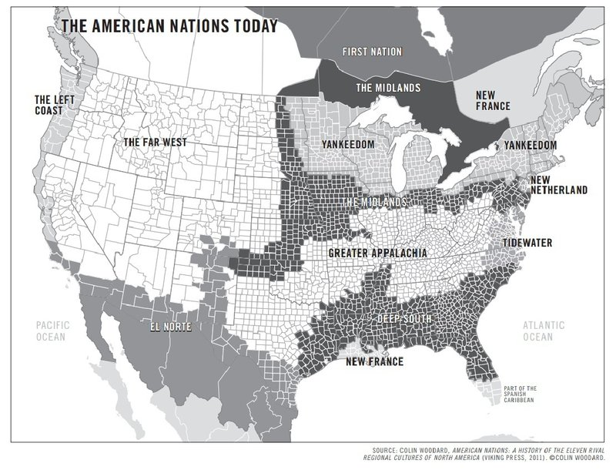
Interesting concept

Slide 9
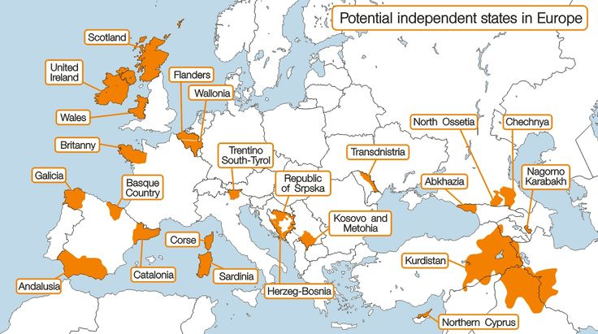

Slide 10
The Range of States
POWER OF STATES
Not all states are equal
  Superpowers influence world events
  Minor and major powers
Rise and fall
  Today US remains as largest superpower
  Dominance in global military spending
  France had a harder time adjusting to be a 2nd rate power than did the U.K.
Hard power vs soft power

Slide 11
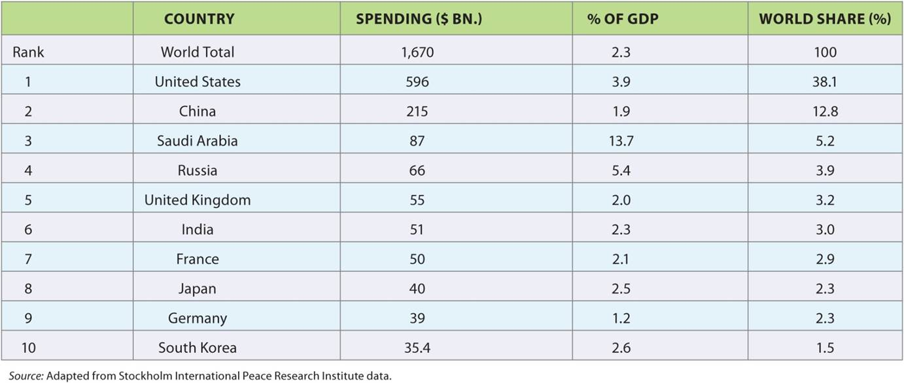
The Range of States
Table 15.1
Ten largest military spenders in 2015.
Notes:
Table 15.1

Slide 12
The Range of States
WEALTH OF NATIONS
Use of gross national income per capita
  Does not represent the actual incomes of various people and it doesn’t show how large the income gap is between the rich and the poor
  High, upper middle, lower middle, and low income
Shift in categories
  Economic growth and decline
  Global variations
  Comparisons

Slide 13
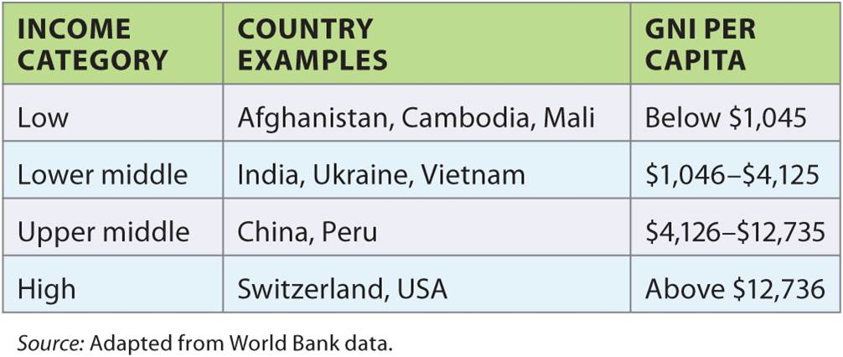
The Range of States
Table 15.2
World Bank classifies countries by gross national income. Income categories, 2015.
Notes:
Table 15.2

Slide 14
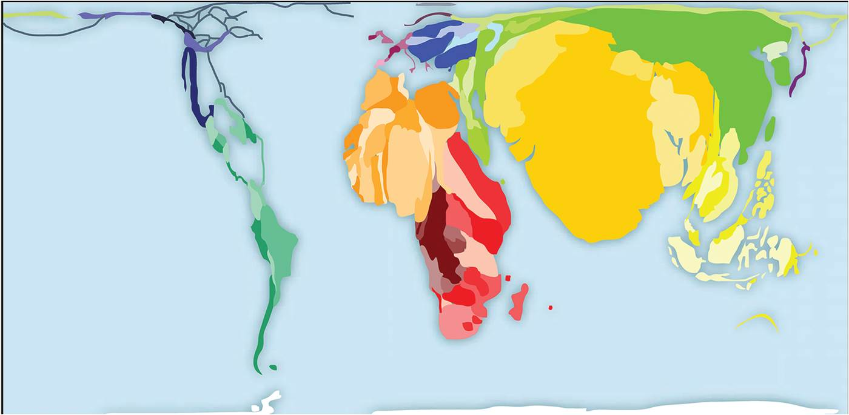
Depicting Countries in Relative Space
Map projections distort absolute space
  Affects shapes of areas
  Mercator projection
Relative space
  Cartograms expand and contract areas in relation to data
The world’s poor.
Notes:
Box 15.1 Figure

Slide 15
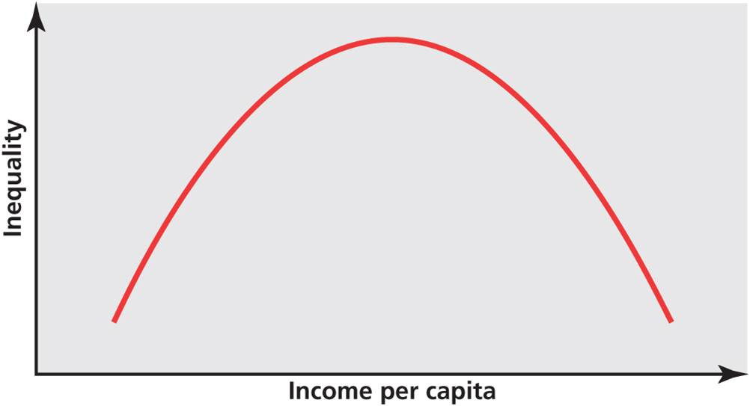
The Range of States
UNEQUAL STATES
Income varies within countries
  Gini index measures spread of wealth across a population
  Most unequal vs. equal
  Kuznets Curve: inequality relationships
  Political stability and national income
Variation by social group
  Infant mortality and race
Kuznets Curve. Pattern depicting how inequality is a measure of industrialization and urbanization.
Notes:
Figure 15.2

Slide 16
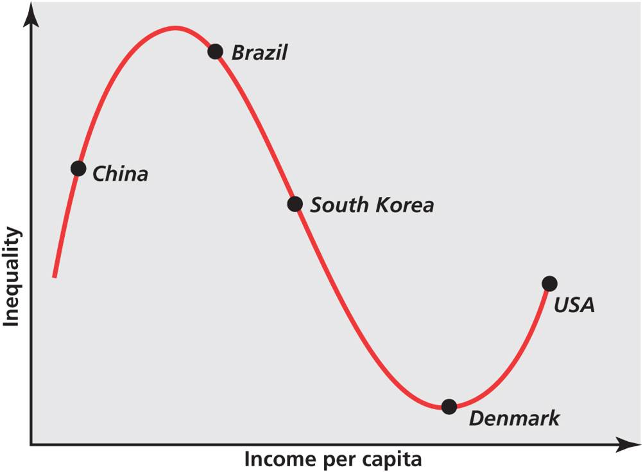
The Range of States
Amending of Kuznets Curve as an inflexion curve of rising inequality associated with advanced service sectors.
Notes:
Figures 15.3, 15.2

Slide 17
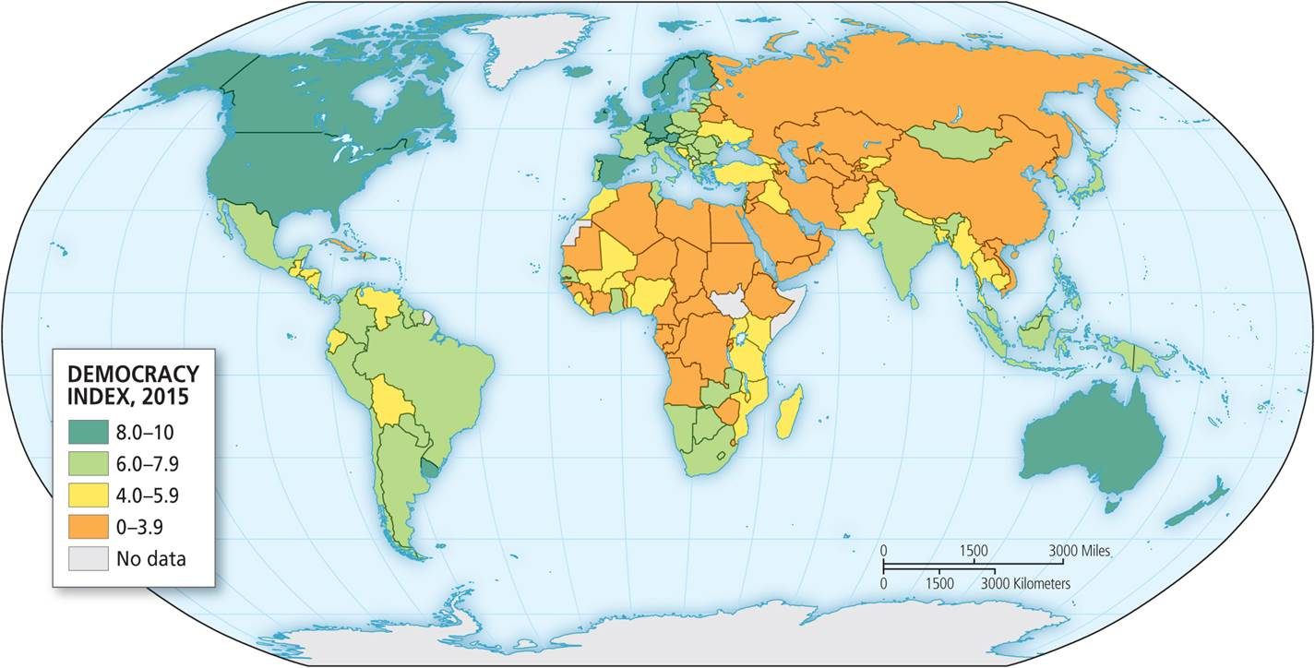
The Range of States
DIMENSIONS OF DIFFERENCE
Three main regimes of political organization
  Totalitarian
  Authoritarian
  Democracies
Democracy index gauges level of democracy
  Most democratic to least
Democracy Index
Notes:
Figure 15.4

Slide 18
The Range of States
The Democracy Index uses sixty indicators related to electoral process and political culture.
Notes:
Figure 15.4

Slide 19
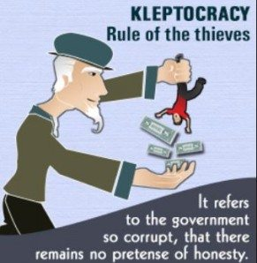
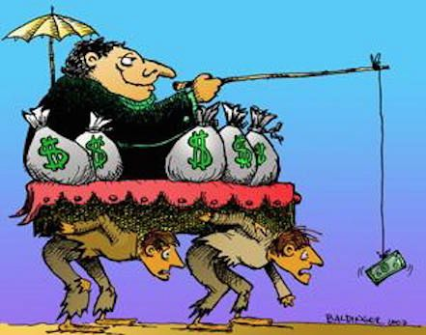
The Range of States
DIMENSIONS OF DIFFERENCE
Democracy index relates to variables
  Kleptocracies enrich the political elite
  Classifications are snapshots in time
  States vary by quality of life

Slide 20
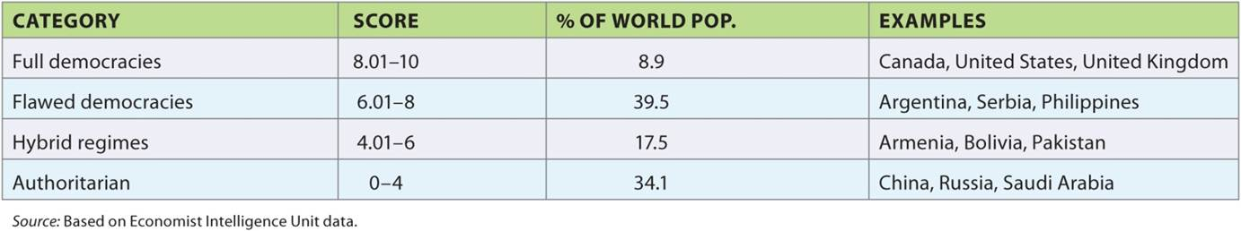
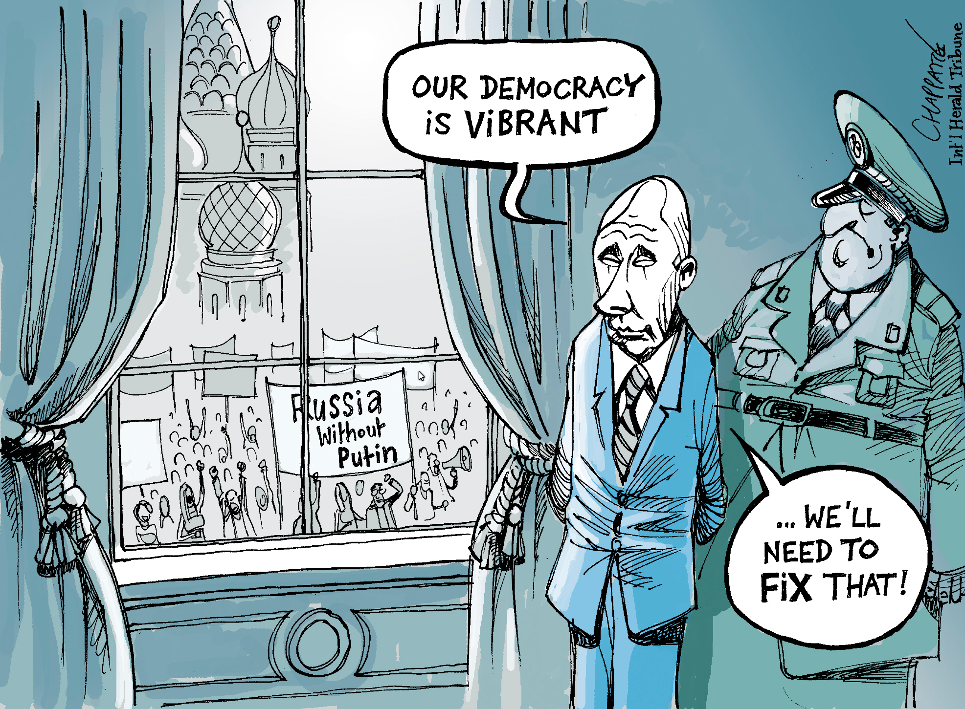
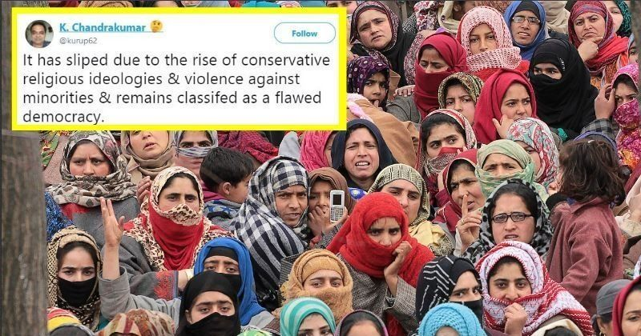
The Range of States
Table 15.3
India
The Democracy Index classifies countries into different regimes.
Notes:
Table 15.3

Slide 21
The Range of States
DIMENSIONS OF DIFFERENCE
Easterlin Paradox
  Once basic needs are met, life difference in happiness occurs if income increases
Prospective measure: Gross national happiness
  Case of Bhutan

Slide 22
Rise and Fall of States
Political geography of states constantly changing
CRISES OF THE STATE
Interlinked crises
Fiscal crisis occurs when state has more expenditures than revenues
  Tax flaws and shadow economy
Legitimation crisis occurs when a state loses its popular appeal and ability to govern
Rationality crisis occurs when a state makes poor decisions and other crises emerge

Slide 23
Spatial Nature of the State
Self-governing political unit with monopoly control over territory
  Must be recognized by other states to be legitimate
SIZE
Spatial characteristics
  Territory and population
Top five of both sizes
  US and BRICs

Slide 24
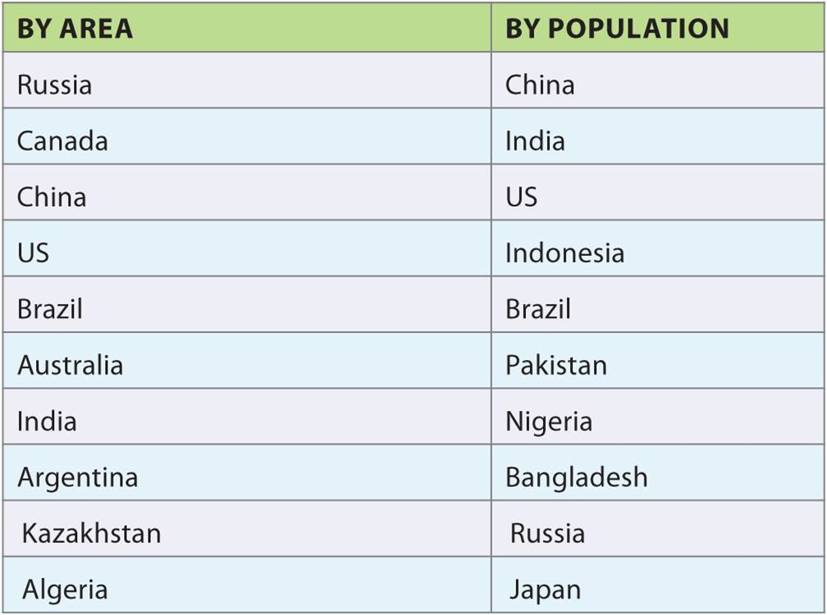
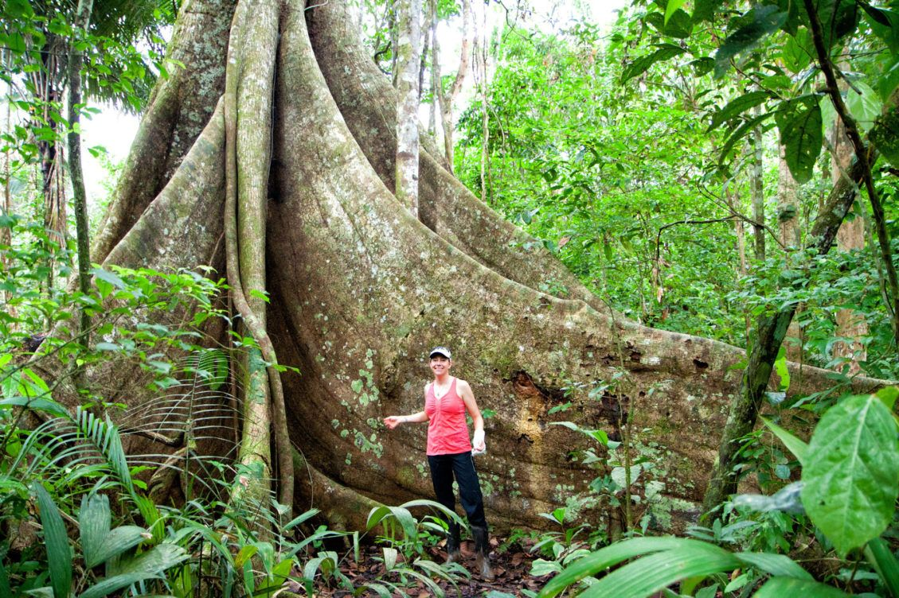
Spatial Nature of the State
Table 15.4
Top ten countries by area and population.
In the Amazon rain forest
Notes:
Table 15.4

Slide 25
Spatial Nature of the State
SIZE
Size and potential
  Resources, demographics – not always a positive correlation
    Russia #1 in area but #9 in population
  Extending reach beyond territory and economic unions
Location of states
  Access to sea and landlocked states
  Resources, Dutch Disease and the “resource curse”

Slide 26
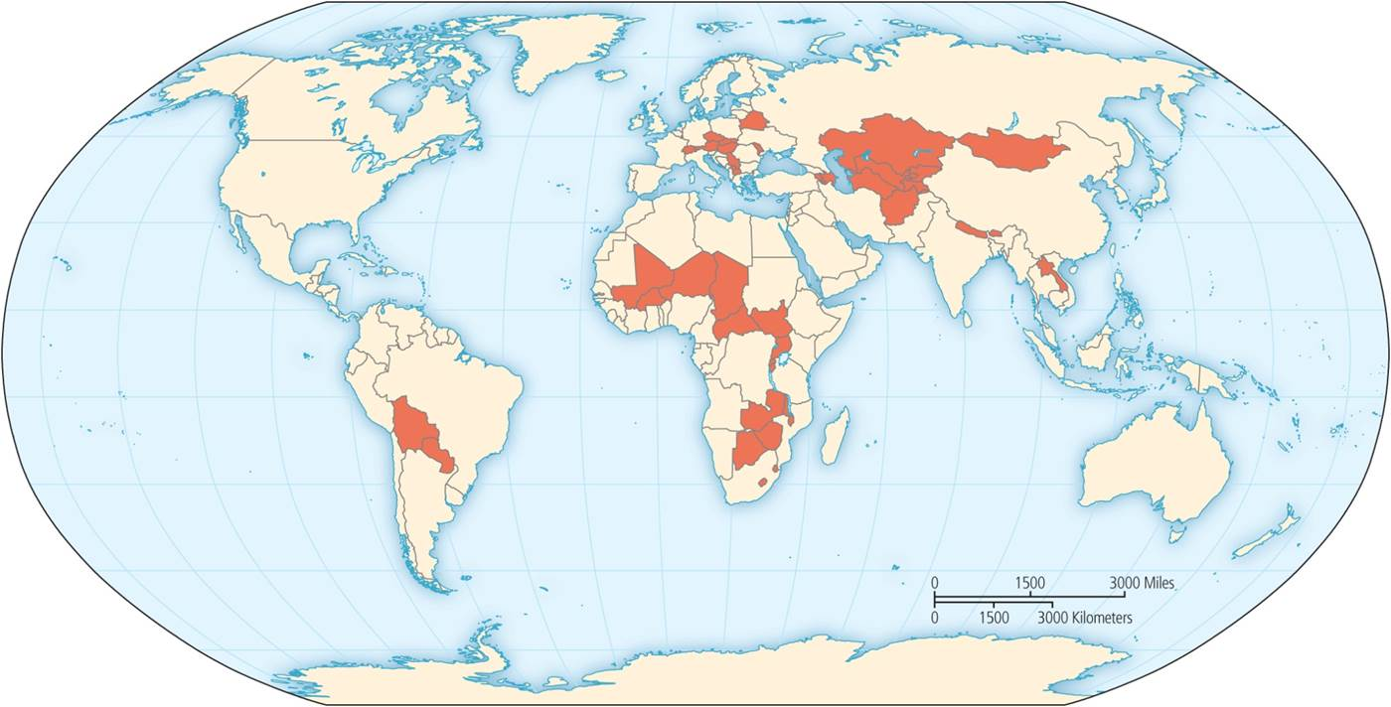
Spatial Nature of the State
Landlocked states have additional effort to access global markets.
Notes:
Figure 15.5

Slide 27
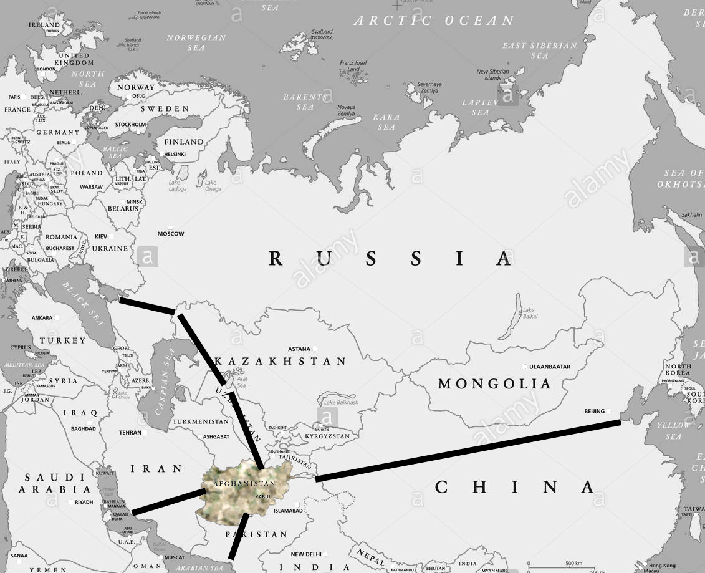
Difficulties of Landlocked Countries
Can only use air transportation if the neighboring countries permit planes to travel over their territory
Can only import or export by river, road, or railroad if the neighboring country permits it.
The cost of shipping good in or out of the country will probgably be higher than for countries which are not landlocked.
Consider Afghanistan
Questionable

Slide 28
Landlocked States
Afghanistan | Burkina Faso | Lesotho | Paraguay | Transnistria
Andorra | Burundi | Liechtenstein | Rwanda | Turkmenistan
Armenia | Central African Republic | Luxembourg | San Marino | Uganda
Artsakh | Chad | Macedonia | Serbia | Uzbekistan
Austria | Czech Republic | Malawi | Slovakia | Vatican City
Azerbaijan | Ethiopia | Mali | South Osset | West Bank
Belarus | Kazakhstan | Moldova | South Sudan | Zambia
Bhutan | Kosovo | Mongolia | Swaziland | Zimbabwe
Bolivia | Kyrgyzstan | Nepal | Switzerland
Botswana | Laos | Niger | Tajikistan

Slide 29
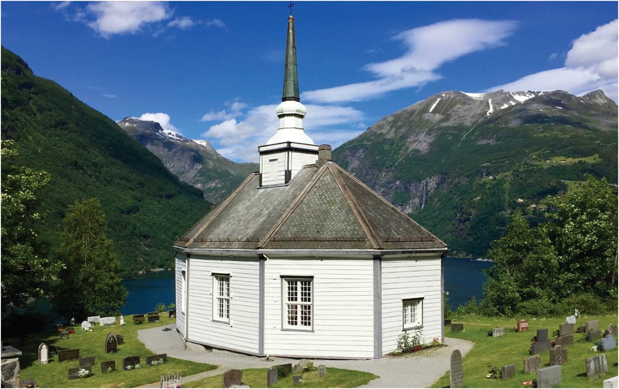
Spatial Nature of the State
SIZE
National Environmental Ideologies – affected by the world view of the culture
  Identity bound up with territory and its creative representation
  Wilderness, countryside, cities are texts used to generate national identity
A rustic church at Geirangerfjord embodies an idealized picture of the national landscape of Norway.
Notes:
Figure 15.6

Slide 30
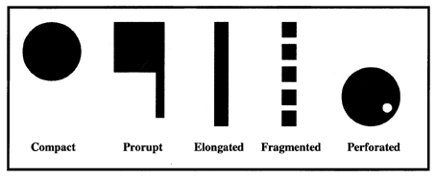
Shape Morphology – Positives? Negatives?
(protruded)
_

Slide 31
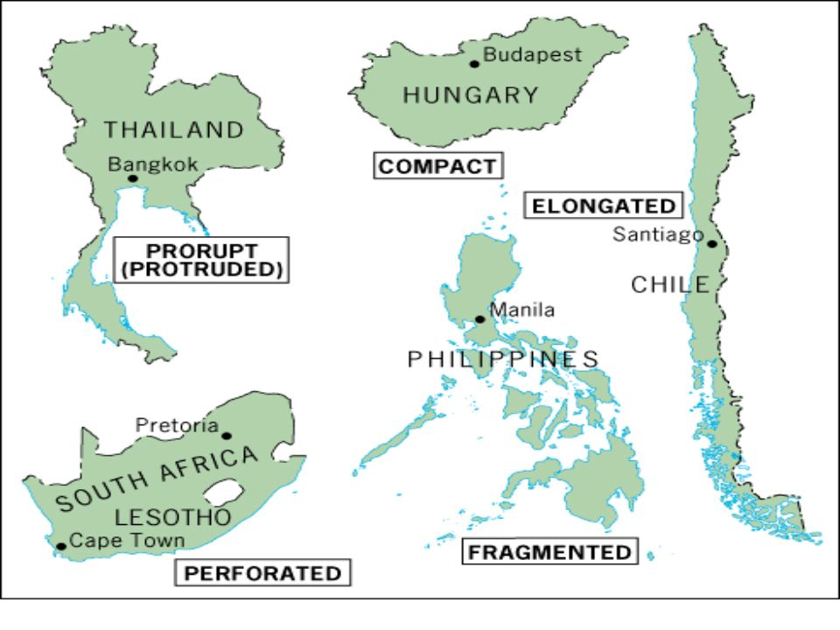
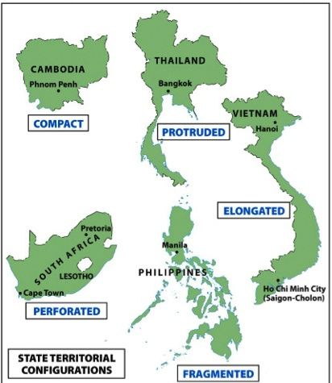

Slide 32
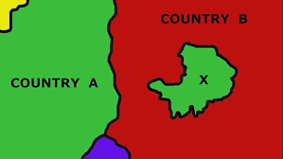
Enclaves and Exclaves
Country A sees territory X as an exclave – a part of itself which is physically separated from the main part of the country.
Country B sees territory X as an enclave – piece of territory totally within its borders over which it does not have sovereign power.
Not all enclaves are also exclaves: Vatican City, San Marino, Gambia, and Lesotho are small entire countries that exist inside a larger country (making the larger country a perforated state)

Slide 33
Imagined Communities
Benedict Anderson and national imaginaries
  Print capitalism and national discourse
Three institutions of power
  The census, the map, and the museum
  Together allow to imagine dominance over people and territory
Shifting national imaginaries
  Rarely stable
  (Re)enacted through commemorative activities

Slide 34
Nation, State, and Minorities
NATIONS AND STATES
State v nation
  Political organization
  Community of people
Incongruence between nation and state
  Nation lacks a state
  States with more than one nation
    If the minority nation is spread out living all over the country, it is less of a threat to unity
    If the minority nation(s) is/are mostly living in one part of the country, it is a greater threat to unity – i.e. Canada, Czechoslovakia, Yugoslavia, Spain, U.K., Russia
  Minority groups, tolerance, and protections

Slide 35
Britain has granted Scotland its own parliament and Wales may follow. Sometimes granting greater autonomy can stave off a full scale revolt and independence.
Scotland had a referendum on separating from the UK. In 2017. There were more votes to remain in the U.K.; however, the vote was very close. After the BREXIT, a new referendum in Scotland might just produce the opposite of the previous referendum. As of 2018, there doesn’t seem to be a big movement to have a new referendum.

Slide 36
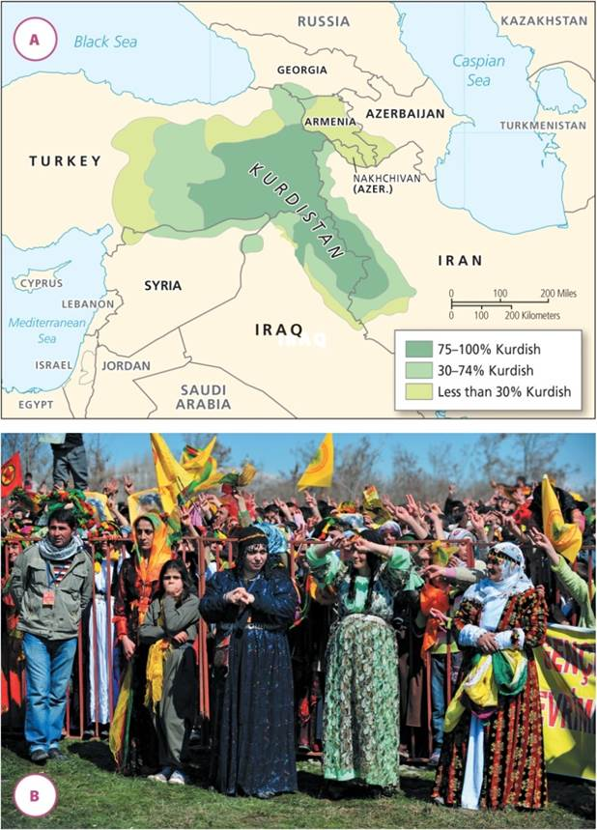
Nation, State, and Minorities
Distribution of Kurds in the Middle East. Kurdish nation divided among separate states.
Notes:
Figure 15.7A and B

Slide 37
The Territory of the State
FORCES OF POWER
Government, state, and national territory
  Deep state of entrenched power despite change in government
Centripetal forces that unify state’s power
  External aggressions, federal structures, and national mass media and education, shared culture and language
Centrifugal forces that disrupt state’s power
  Political and economic inequality
  Separatist movements

Slide 38
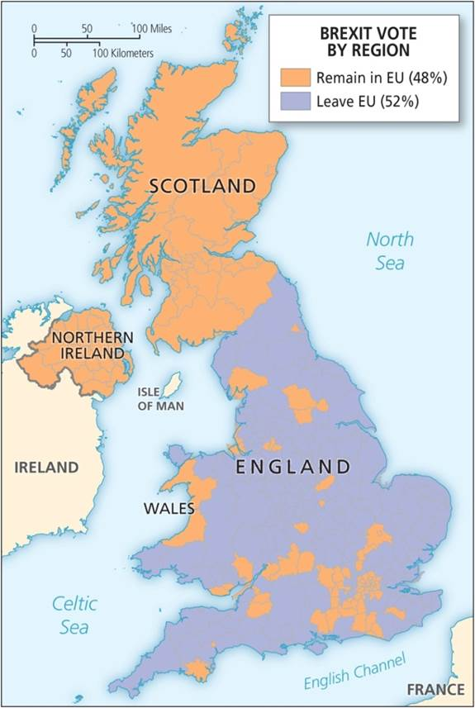
The Territory of the State
FORCES OF POWER
Territorial integrity
  Legitimate force and territorial control
  Sameness and internal territorial integrity, marked differences can pressure state control
Example of Brexit
  Political geography of UK forces of power
The Brexit vote
Notes:
Figure 15.8

Slide 39
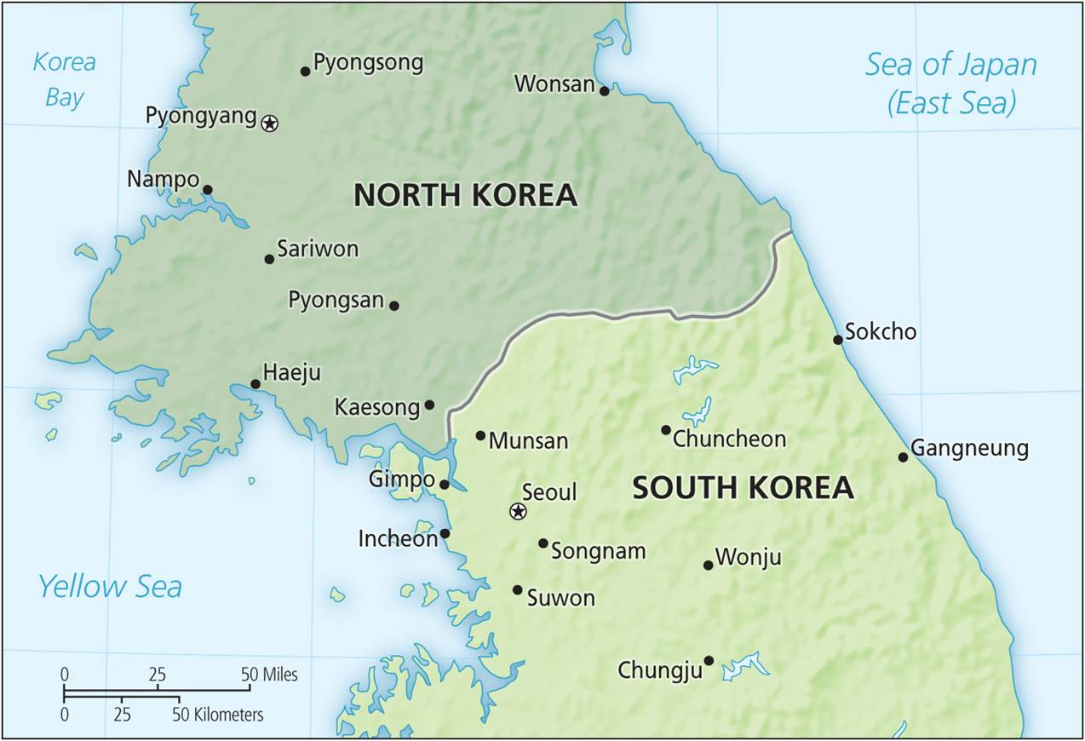
Boundaries and Frontiers
Type of borders: natural and artificial
Stage for performance of national identity
  Tell a country’s history
  Define and contain
Porosity of Borders
  Hard and soft
  Porous and nonporous
Boundary between North and South Korea.
Notes:
Figure 15.9

Slide 40
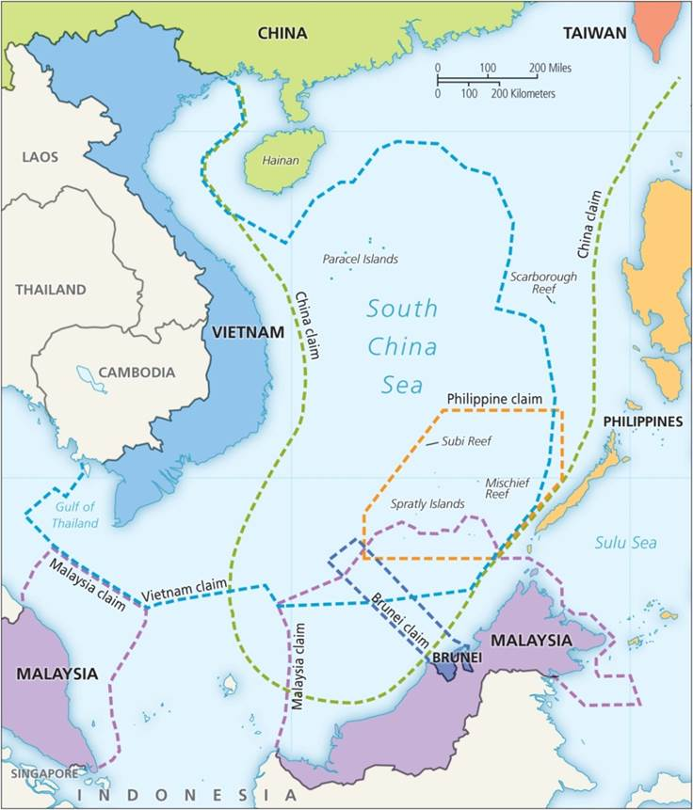
Boundaries and Frontiers
Borders and conflict
  Where territorial sovereignty is disputed
Maritime boundaries: the South China Sea
  Search for valuable resources in the seas
  Claims and exclusive economic zones (EEZs)
Borders and cooperation
New perspectives
  Social construction of borders and importance to national identity
The South China Sea claims.
Notes:
Figure 15.10

Slide 41
Rivers and Mountains make poor boundaries
Mountains
  May be delimited (described in words and latitude & longitude)
  May be extremely difficult to demarcate - a lot of room for disputes
Rivers
  The course of a river is constantly changing (usually extremely slowly). Particularly during floods, rivers have been known to make big changes in their courses.
    There is at least one part of Illinois that is now on the west side of the Mississippi River, separated from the rest of Illinois. The same is true between Kansas and Missouri on the Missouri River.

Slide 42
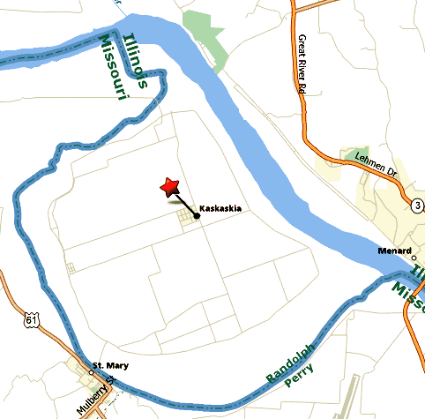
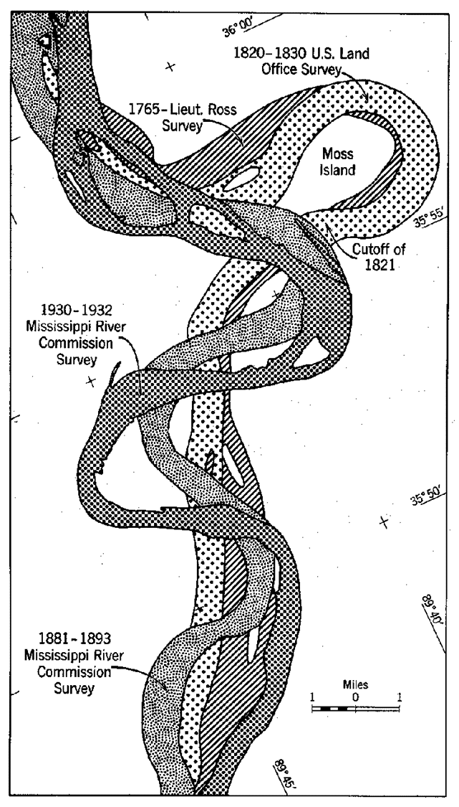

Slide 43
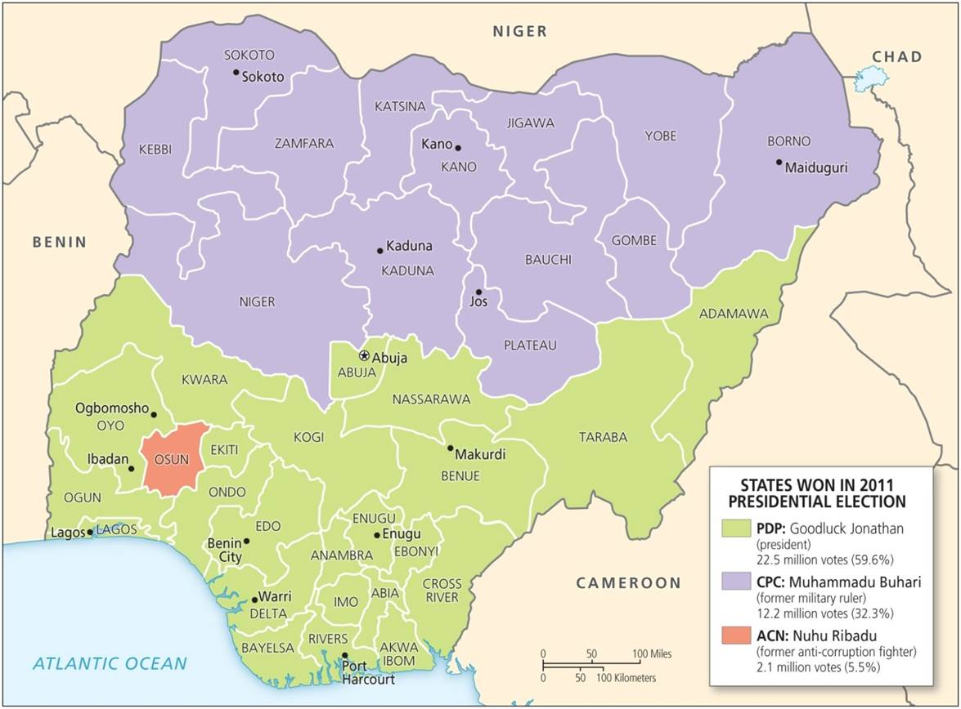
Geography of Elections
Maintain legitimacy by act of elections
Distribution of votes
  National and regional
  Local patterns and the neighborhood effect
Marked spatial polarization of voting
  US elections
Gerrymandering even though it is unconstitutional in USA
Voting for presidential candidates in Nigeria, 2011.
Notes:
Figure 15.11

Slide 44
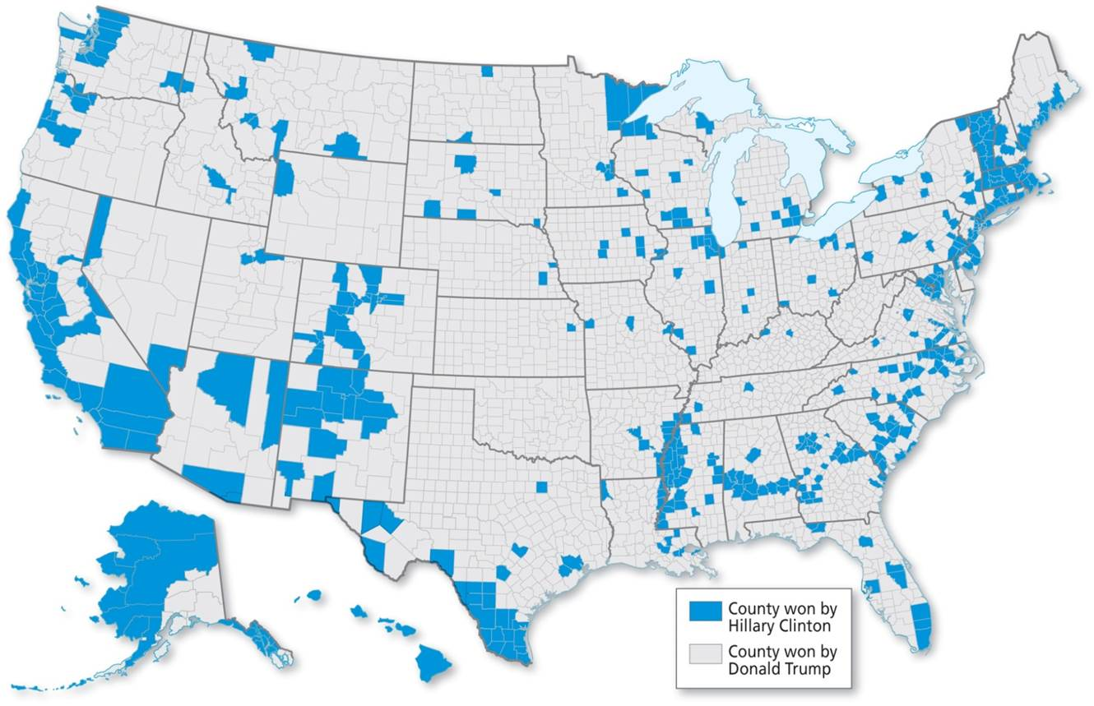
US Geography of Voting
Clinton’s America.
Notes:
Figure 15.12

Slide 45
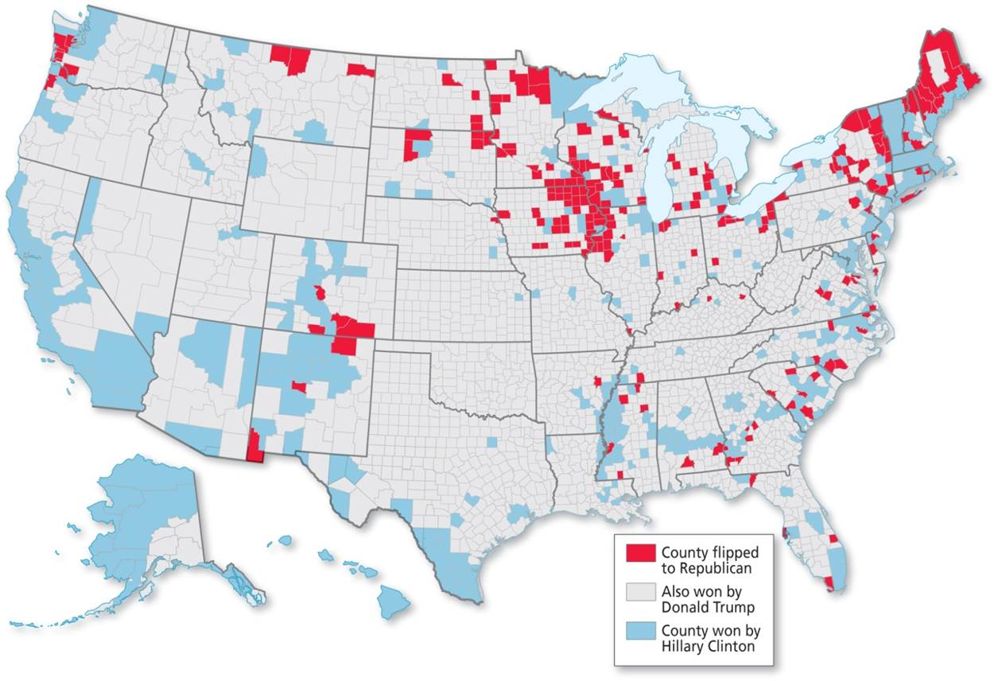
US Geography of Voting
The Swing to Trump.
Notes:
Figure 15.13

Slide 46
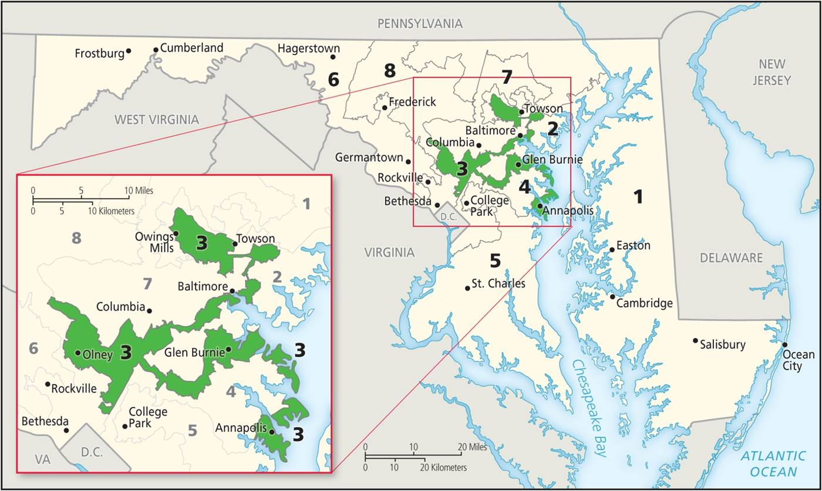
Geography of Elections
Geography of representation
  Political constituencies
  Malapportionment and political power
  Gerrymandering and voting boundaries
Electoral systems
  “First past the post” or plurality voting
  Proportional representation systems
Congressional boundary redistricting in Maryland.
Notes:
Figure 15.14

Slide 47
Geopolitics
Study of the power relations between empires and states
  Concern of strategic world geographies
Critical form looks at social construction of political space and social identity
  Material interests involved in such narratives
Popular geopolitics
  Role of popular culture and mass media structure in national identities and geographic understandings
Exploring meaning, contestation, construction, and maintenance of political organization of space

Slide 48
Chapter Summary
States are separate units of political authority that are important building blocks of the organization of space.
States have increased in number, especially since the beginning of the twentieth century.
Not all states are equal. The more powerful are able to use their military strength to exert an outsized role in the world and impose their will on others. Some also have stronger economies that afford different levels of world influence and power.
Income inequality is a useful predictor of political stability. More equal societies tend to be more peaceful and less riven by conflict.
It is not only the wealth of society that structures health outcomes and social performances; so does the level of inequality.

Slide 49
Chapter Summary
In terms of political organization, three main regimes can be identified: totalitarian systems, in which the government has control over wide and deep swathes of social, political, and economic life; authoritarian regimes, where power is concentrated but not so deeply entrenched as in the totalitarian regimes; and democracies, where political power arises from the majority will of the people.
States vary enormously along a variety of dimensions, including military might, economic wealth, and political freedom.
We can identify three contemporary and interlinked types of crises that nations face: fiscal, legitimation, and rationality.
A state is a self-governing political unit that must be recognized by other states and the majority of its own population in order to be legitimate.

Slide 50
Chapter Summary
One way that smaller countries try to offset their limited size is through organizations with other states, such as in economic unions (e.g., the European Union) that try to extend the size of the market.
As spatial units, states can be lucky or unlucky in their territorial endowment. For example, some have vast oil reserves, while others are landlocked with few available natural resources.
A distinction can be made between a state and a nation. A state is a political organization that controls a particular territory. A nation is a community of people with a common identity, shared cultural values, and a commitment and attachment to a particular area.
There are nations without states, and most states have more than one nation.
The population of a state is rarely homogenous. Differences in religion, ethnicity, and language, if they have distinct spatial expression, can create tensions in the internal coherence of the state.

Slide 51
Chapter Summary
A distinction can also be made between government and state. The government is the political expression of power. “State” is a wider term that covers the more embedded power structures, such as the army, the police, and the educational system.
We can identify centripetal forces that unify the state’s power across space and centrifugal forces that disrupt it. Centripetal forces include external aggression, which may stimulate national bonding against a common enemy; federal structures that allow the safe expression of regional and other subnational differences; and national mass media and education, which create a shared culture and language. Centrifugal forces include political and economic inequality.
A state has a monopoly of legitimate physical force, but in some instances, the rule of the state does not extend to all of its territory, which may lead to a territorial crisis.

Slide 52
Chapter Summary
The internal territorial integrity of the state is more assured where there is a homogenous population. When marked differences are overlaid by economic inequality and profound cultural differences, there are pressures on the integrity of state control over national space.
Political geographers used to make a distinction between artificial and natural borders, but more recent work tends to view borders as social constructions, the result of bordering practices rather than the embodiment of “natural” differences.
Viewing borders as socio-spatial constructions focuses attention on their origin and evolution and interprets them as stages for the performance of national identity.
Three distinct elements can be identified in the geography of elections: those of voting, representation, and electoral systems.

