Slide 1
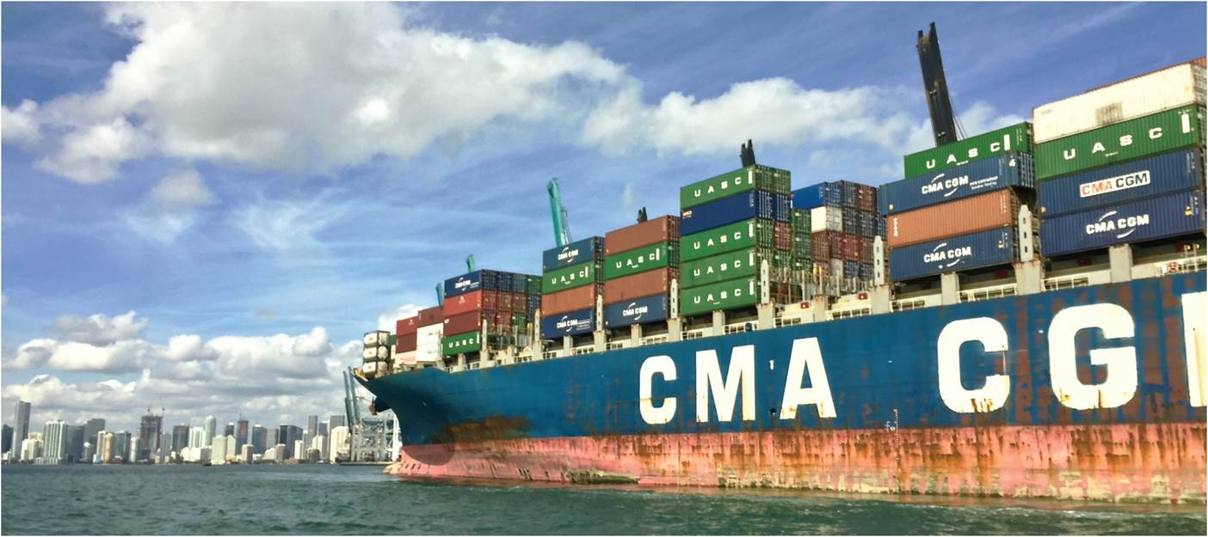
Chapter 12: Creating a Global Economy
Our focus in this chapter is the growing economic interaction between peoples and societies spread around the globe.
Container ship sailing into Miami, FL.
Expanded by Joe Naumann, UMSL
Notes:
Chapter 12 Opener

Slide 2
Chapter Learning Objectives
Relate the concept of space-time convergence to advances in transportation technologies.
Identify and explain each of the three waves of globalization that have furthered space-time convergence.
Discuss various networks that connect global locations.
Describe the occurrence of a global shift in location of manufacturing economic activities and associated consequences.
Consider claims of a “flat” world, its critiques, and the emerging requirements of successful participation in economic globalization.

Slide 3
Space-Time Convergence Defination
Has to do with how long it takes (time) to travel a particular distance
This is related to the available technology of a particular culture
EXAMPLE
1790S Travel from Florissant to St. Louis by horse back on unimproved roads may have taken 4 hours
In the 19th century, a streetcar line was built between Florissant and St. Louis and the time was reduced to maybe one and one half hours (it stopped along the way to pick up riders at other locations like Ferguson and Normandy)

Slide 4
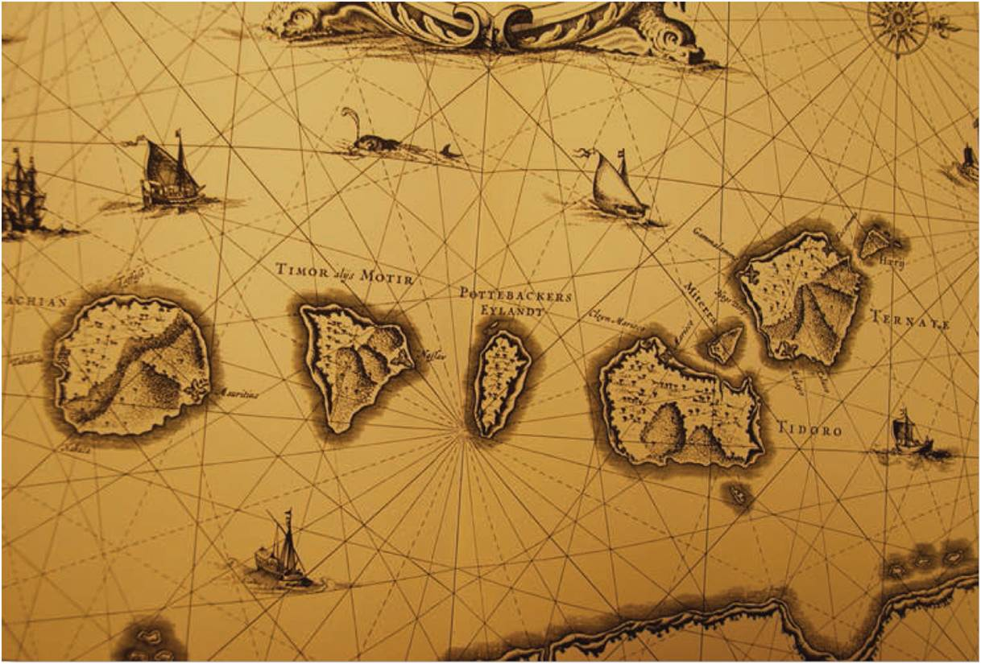
Space-Time Convergence
Space-time convergence
Widening economic transactions
New developments in transportation
Maritime navigation
The compass
New geographies of global maritime trade
Luxury goods
The Spice Islands.
Notes:
Figure 12.1

Slide 5
Space-Time Convergence
The Age of Steam
More goods capacity
More reliable
Faster and cheaper
Widening of comparative advantage
Reduced transport costs
Allowed search for reduced costs further abroad
Princess Sophia steamship ca. 1912 Source: © Library and Archives Canada on Wikimedia Commons.
Notes:
Source: © Library and Archives Canada on Wikimedia Commons.

Slide 6
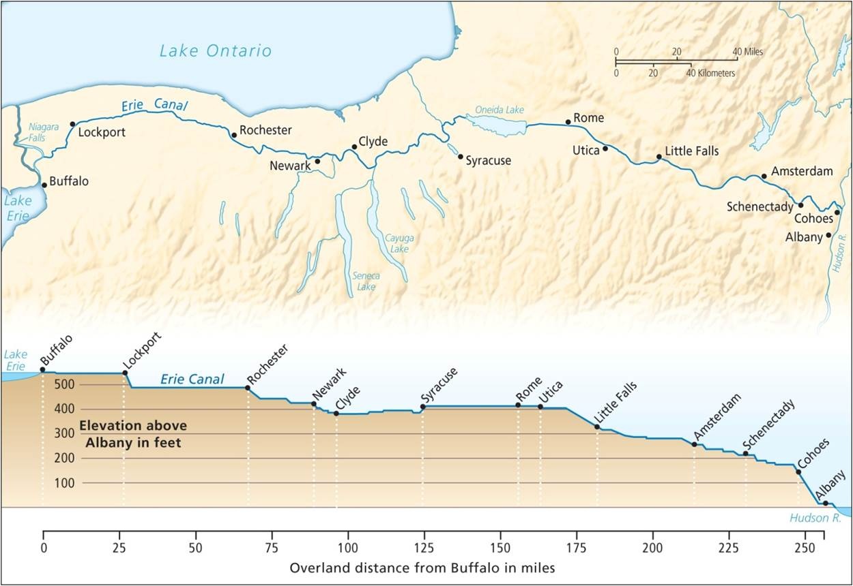
Space-Time Convergence
Inland canals
Reduction in overland transport time and cost
Canal adjacent transformations
Erie Canal 1817-1825
Surpassed by rail
Compressed space and time further
Canals and adjacent towns obsolete
The Erie Canal cut a straight line to connect the Great Lakes with New York City.
Notes:
Figure 12.2

Slide 7
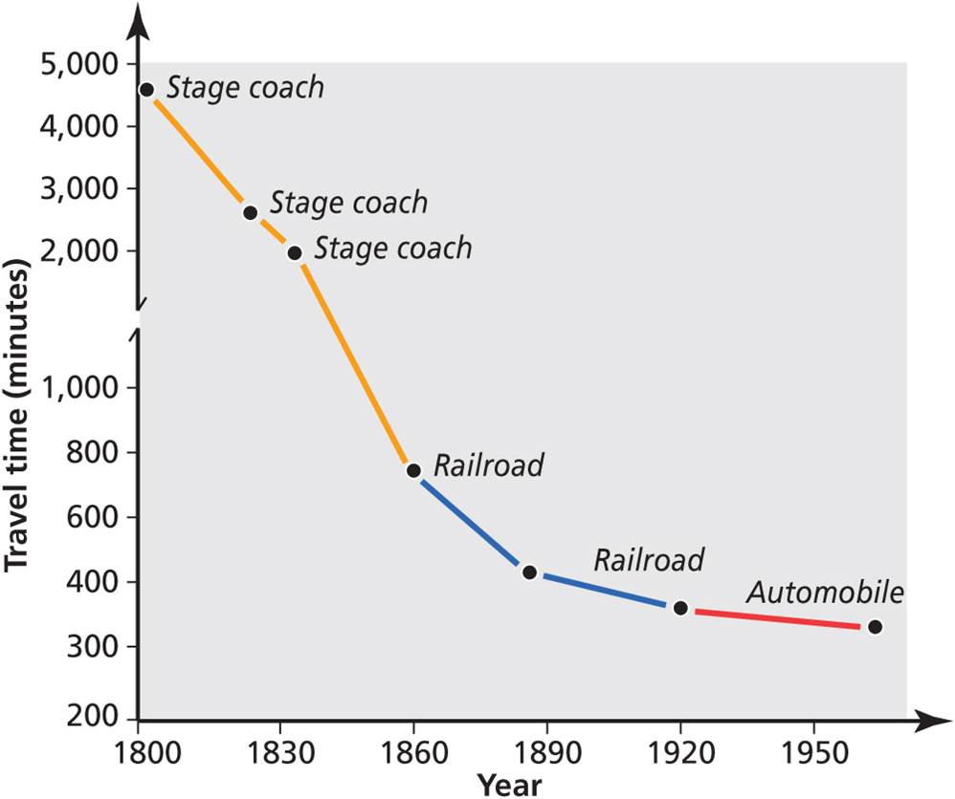
Space-Time Convergence
Railways
Declining travel time between linked cities
Brought cities closer together and made interaction cheaper
Space-time convergence between Boston and New York. Plot of travel times between Boston and New York.
Notes:
Figure 12.3

Slide 8
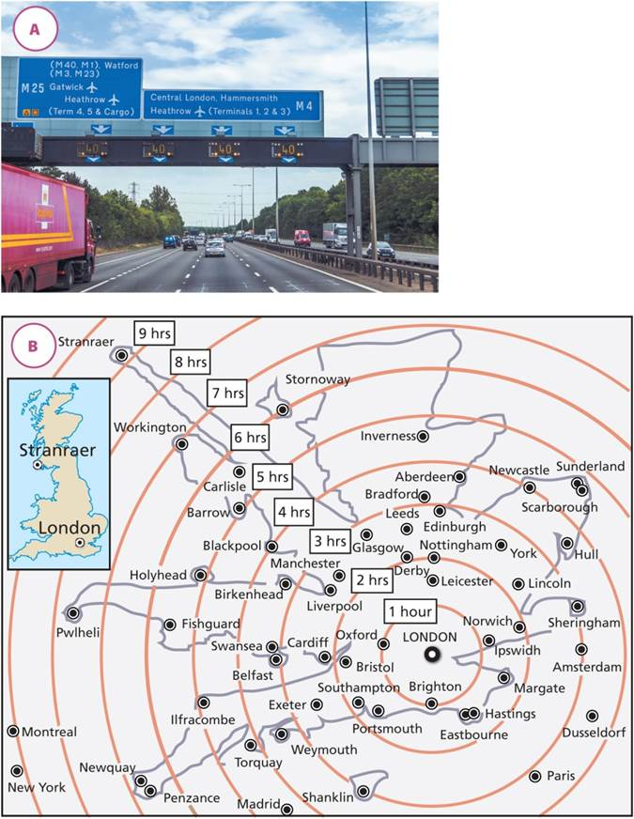
Space-Time Convergence
Bend physical space
Uneven space-time arrays
Variation in transport connections
Unsustainability of reducing travel time and increasing distance
Case of London
Leaving the City, it takes longer to travel to some UK towns than it takes to travel to Paris
(A) Traffic leaving London, (B) Space-time connections of London.
Notes:
Figure 12.4A and B

Slide 9
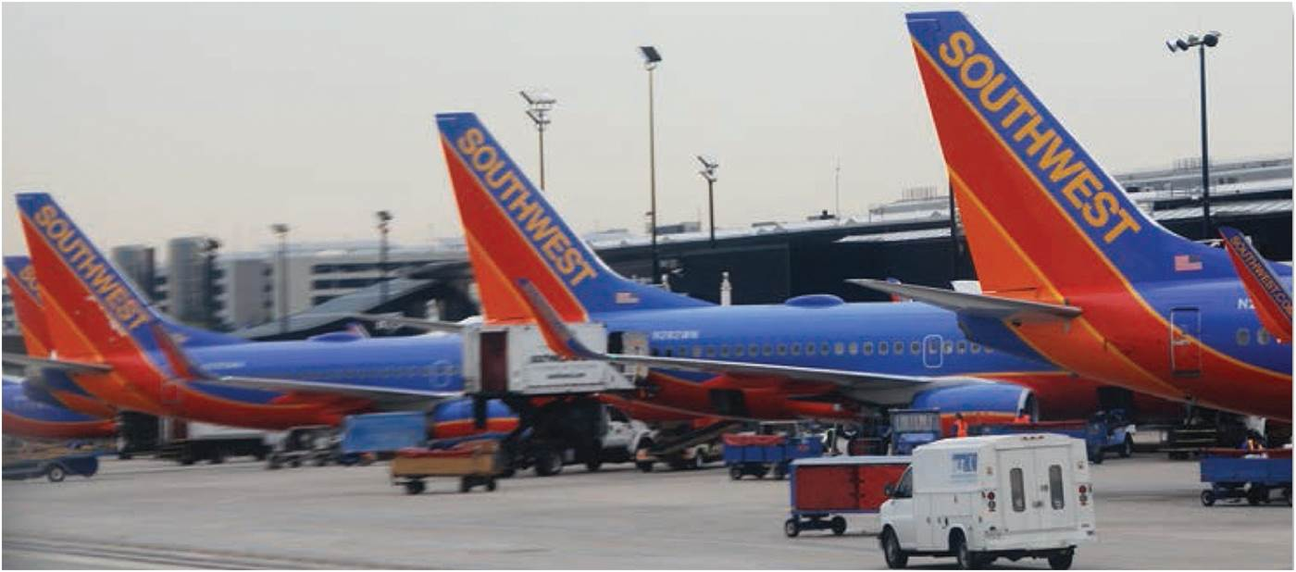
Space-Time Convergence
Maritime trade
Large box containers
Unit cost and shipping times decline
Increased ship size required new port types
Decline in upstream, shallow ports
Increasing air transport
Most rapid form
Best for people and high-value/perishable goods
Space-time convergence: cheap air travel shrinks the globe. Baltimore/Washington International Airport.
Notes:
Figure 12.5

Slide 10
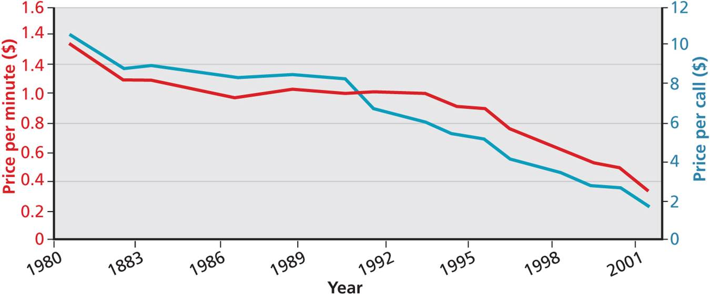
Space-Time Convergence
In mature economies, exchange of information as important as of goods
Time-cost compression
Value of reducing cost in information transfer
Waves of advancing communication technologies
Each wave creates new markets and new economic geographies
Decline in telephone costs.
Notes:
Figure 12.6

Slide 11
Three Waves of Globalization
FIRST WAVE OF GLOBALIZATION
The Columbian Encounter of 1492 inaugurated a global economy
Demographic holocaust, need for imported labor, and the slave trade
Biotic exchange of crops and livestock, with associated environmental changes
` | Europe got | The Americas got
Diseases | Gonorrhea | Syphilis, small pox, measles, mumps, etc. (germ warfare?)
Plants | Tomato, potato, beans, maize, tobacco, cotton, sugar, rum, etc. | Wheat, rye, oats, barley, etc.
Animals | Turkey | Horses, cows, pigs, sheep, etc.
Other | Gold, silver, etc. | Africans

Slide 12
Three Waves of Globalization
SECOND WAVE OF GLOBALIZATION
Economic expansions
Low tariffs, international labor and investments
Neither fair nor equitable
Economic globalization centered on London
Space-time convergences
Steam, rail, and telegraph
Global canals reduced time
Panama Canal & Suez Canal as highways to India

Slide 13
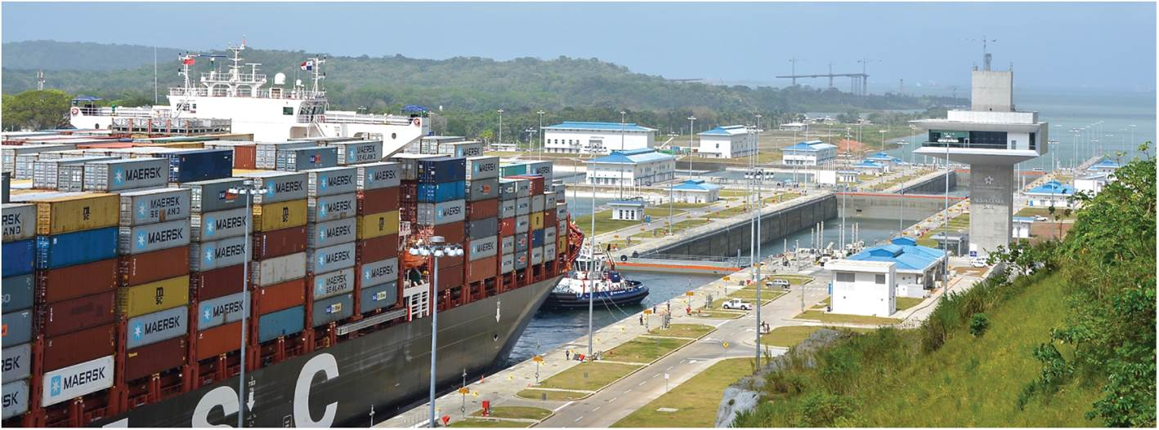
Three Waves of Globalization
Panama Canal: the new locks that opened in 2016 can handle bigger ships.
Notes:
Figure 12.7

Slide 14
The Flow of Capital
Phases of global capital mobility
First phase of capital flow had few restrictions
London markets to developing economies
1880 to 1914, end with WWI, Depression, and WWII
Second phase was a period of stability
Relatively small and regulated, until 1970s
Current phase of increased capital mobility
Financial deregulation promoted increase in foreign direct investment
Qualifiers of current phase: FDI is highly variable, FDI occurs between already rich countries, dangers of rapid and destabilizing capital flows, and costs of capital bonanzas

Slide 15
Three Waves of Globalization
SECOND WAVE OF GLOBALIZATION
Economic and political merging of the world
London was the pivot of the international trading system
Overseas territories served as source of raw materials and secure markets for manufactured goods
Age of imperialism
Economic control of territories
Protection of home industries
Wartime dislocation and postwar integration
New global political and economic order

Slide 16
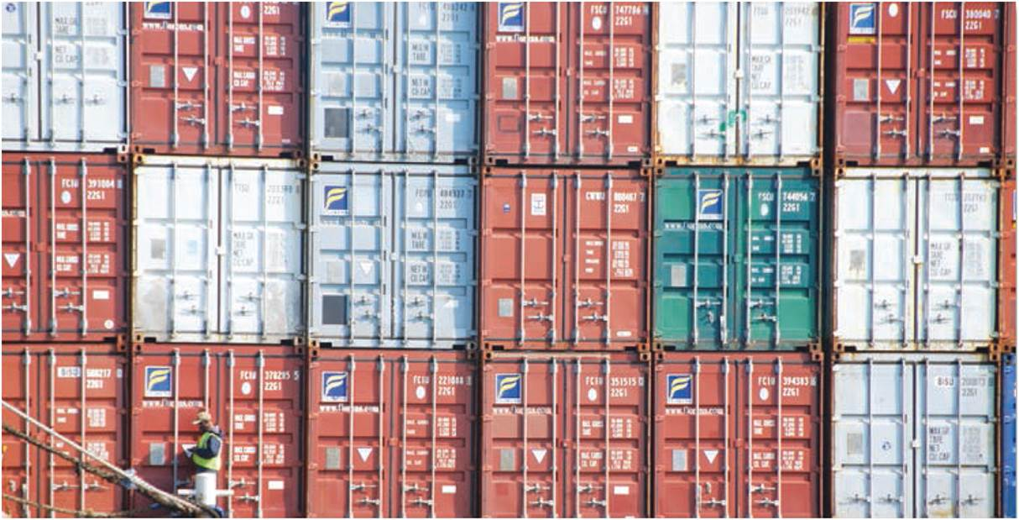
Three Waves of Globalization
THIRD WAVE OF GLOBALIZATION
Further space-time-cost compression
Global production chains
Deregulated global financial system
Flat world of quicker global economic links
Shipping container
Easy loads transfer easier from ship, to train, to truck
Allows truly global breadth of goods available daily
Box containers sit on a wharf in Bermuda. Shipping containers are icons of the flat world.
Notes:
Figure 12.8

Slide 17
The Flow of Remittances
Remittances
Funds that temporary and permanent migrants send back to their home countries
Increases with both international migration and capital mobility
Impacts on receiving countries
Source of cash and capital, for local construction, education, and other social services
Economic relations between countries and varying flows over time

Slide 18
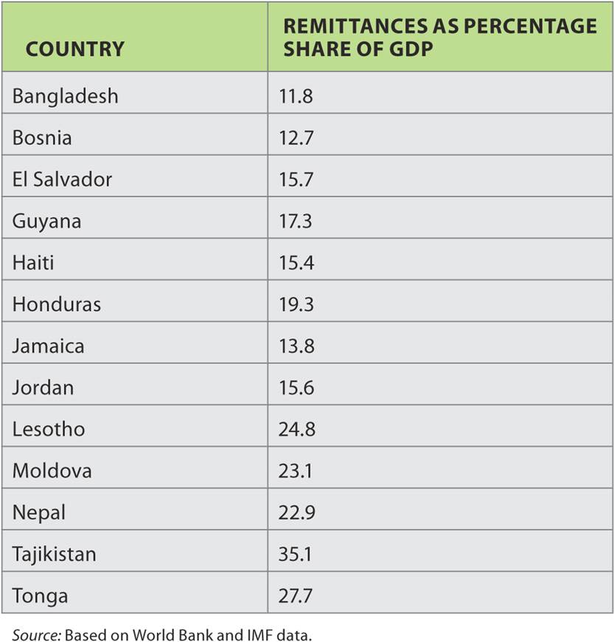
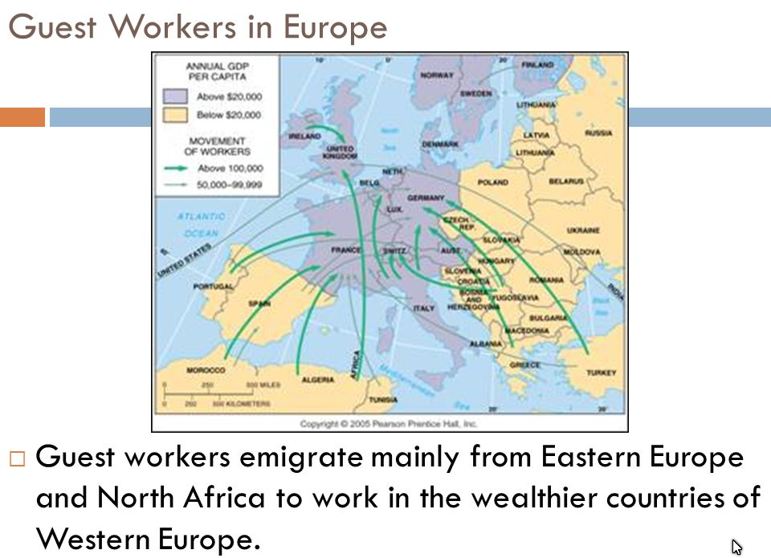
The Flow of Remittances
Table 12.1
Inflows of remittances, 2010.
Notes:
Table 12.1

Slide 19
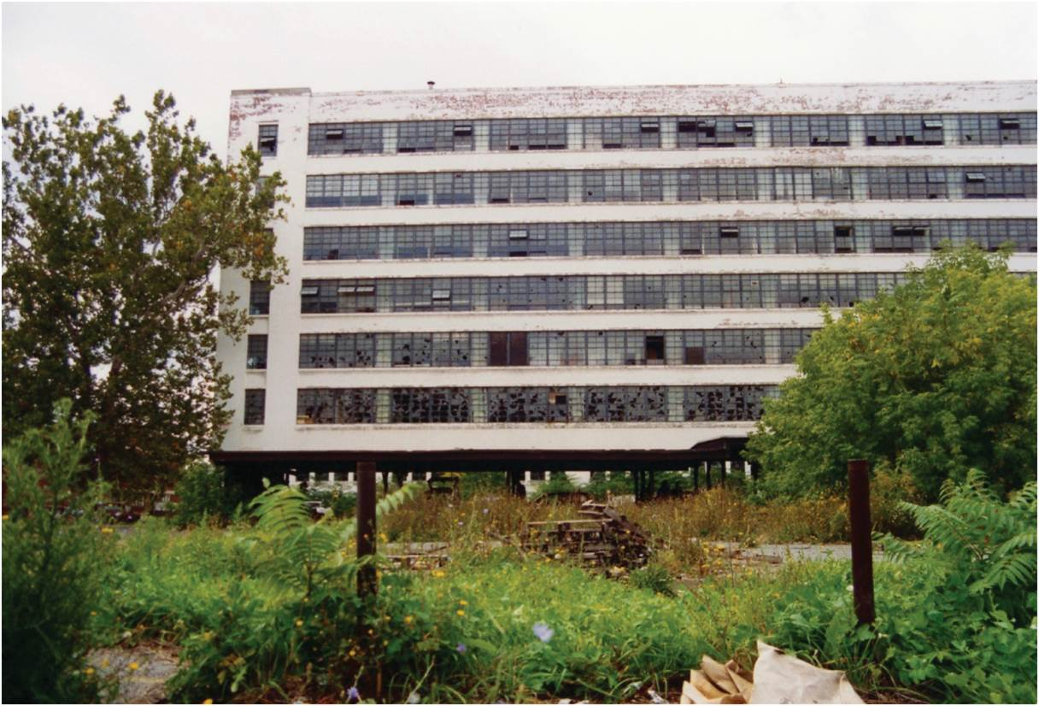
Global Shift
Shift of industrial employment to developing countries
Rapid industrialization of select developing world cities
Deindustrialization of advanced economies
Deterritorialization of US companies
Consequences
New female working class
Decline in strength of organized labor
Abandoned factory in Syracuse, New York.
Notes:
Figure 12.9

Slide 20
Transnational Corporations
Four Types of Transnational corporations (TNCs)
multinationals are decentralized, operating as a series of semi-independent entities
internationals are controlled by a central HQ with overseas operations
globals have a centralized hub of parent-company strategies to reach a global market
integrated networks are complex, globally integrated operations
Nike as integrated network TNC
Not a direct producer, contracts with local factory owners, sells to consumers
Following low labor costs
Toyota as international and integrated network
HQ in Japan, built factories abroad to circumvent tariffs in national markets
Starbucks as global TNC
Recent, rapid globalization
Nod to place characteristics with a generic nature

Slide 21
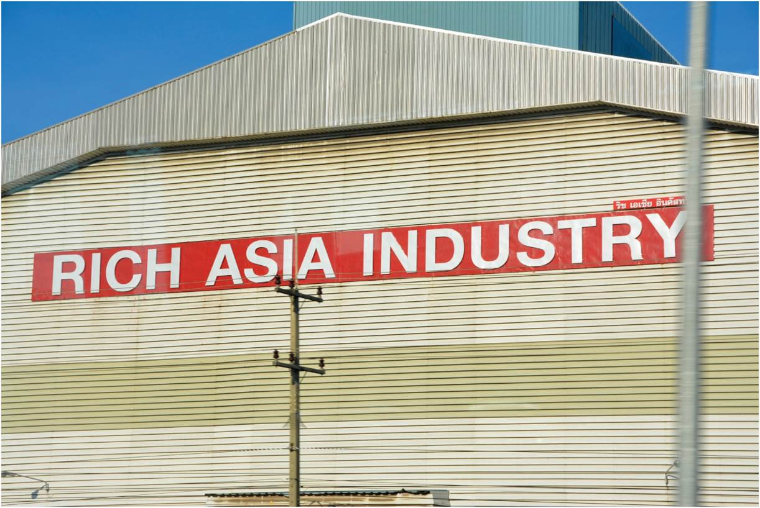
Global Shift
Redistributions and reshifting
Manufacturing returns to US as China’s wages rise
Productivity and innovation attractive for advanced manufacturing
Big-box retailers forced the manufacturing shift
Large customer base and high turnover
Flexible production
Producer competition to meet strict cost limits
New factory on outskirts of Bangkok, Thailand.
Notes:
Figure 12.10

Slide 22
Global Shift
Complex, global production chains
Competitive advantage, shrinking distance
Link up regional manufacturing clusters
Clothes retailers and just-in-time production
Low wage textile industries produce quickly to meet diverse, changing demand

Slide 23
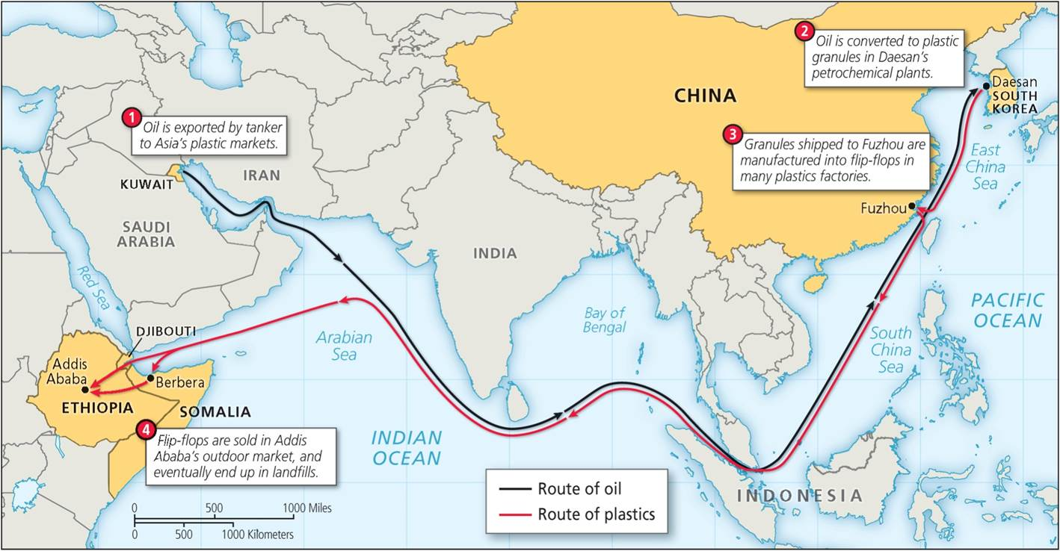
Global Shift
On the Trail of the Flip-Flop
From oil to plastic to shoe
Factory to global markets
Disposal and recycling
Notes:
Figure 12.11

Slide 24
Global Shift
Measuring risk in the global economy
Ranking of countries by vulnerability to crisis
Vital for capital mobility, global investors and trade
Political instability indices use a breadth of indicators
Socioeconomic conditions, like infant mortality
Regime type, corruption, state-led discrimination
Internal conflict, ethnic tension, conflict-ridden neighborhoods

Slide 25
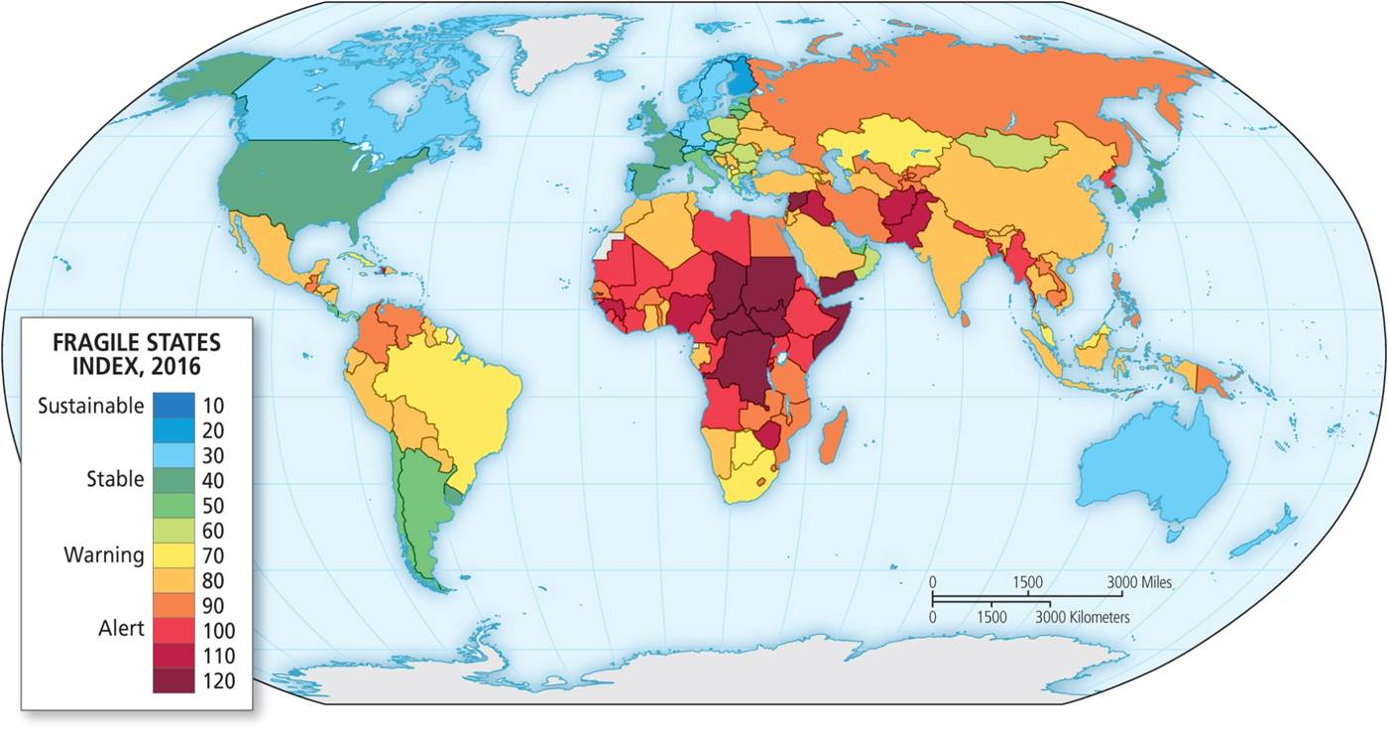
A risky world. Map of Fragile States Index produced by Fund for Peace.
Notes:
Figure 12.12

Slide 26
International Nongovernment Agencies
Nongovernment agencies
Governments as members
Funds or supranational policy decisions
Influence on global economy and promotion of free trade
International Monetary Fund (IMF)
Initially to provide monetary and currency stability
Power through voting and fund provisions
Rich countries’ larger influence
IMF surveillance of member economies and policies
World Bank development fund
Breadth of actors investing in development projects
Current emphasis on eradicating poverty through development
World Trade Organization (WTO)
Lower trade barriers, reduce protectionism
Trade rules, disputes, and settlements

Slide 27
The Promise and Reality of Neoliberalism
Neoliberalism
Economic ideology of small government, deregulation, low taxes, and free trade
Privatization of public goods and reduced social services
Improve corporate profitability and competitiveness
In reality, neoliberal practice altered by political interests
Subsidies and tariff barriers are common global practice
Resistance in the name of human rights, environmental protection, and shared world poverty reduction

Slide 28
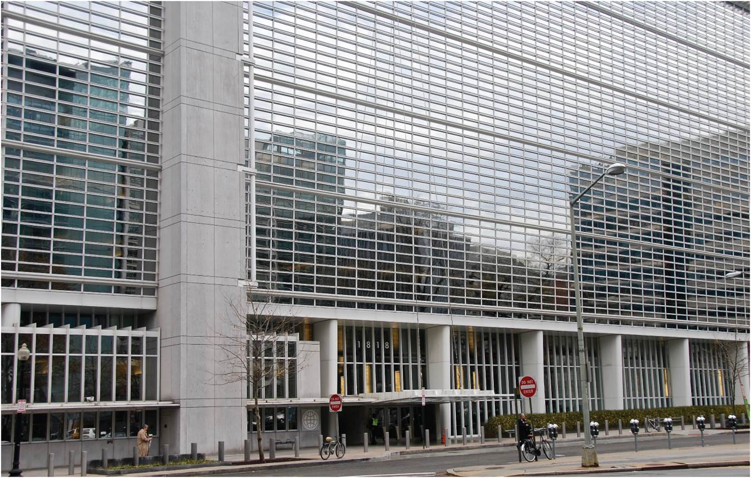
The Promise and Reality of Neoliberalism
Headquarters of World Bank, Washington, DC.
Notes:
Figure 12.13

Slide 29
A Flat World?
“Flat World” asserted by Friedman
Smoothing economic distances
Lessening friction of national economic differences
Differential flattening: some parts are flat
Misshapen world that is more varied than flat
Within flatter countries, there are inaccessible areas
Network world: hierarchies of spatial difference
Advanced producer services in mature capitalist economies
Different effects on capital and labor, in different sectors
Different levels to flows of globalization and mobilities

Slide 30
Chapter Summary
While pace of globalization has increased, it is an established process of human occupancy of the globe, growing interaction among its peoples and societies.
Space-time convergence has reduced cost and time to transport people and goods, bringing the world closer together and contributing to globalization.
Series of space-time convergences caused by new developments in transportation brought the world closer, including the invention of the wheel and compass, improved navigation, steam power, new canals and railways, modern ships and containers, and proliferation of the usage of cars and planes.
As an economy matures, exchange of information is as important as the movement of goods; time-cost begins to outweigh space-time compression.

Slide 31
Chapter Summary
Space-time convergences in three distinct waves of globalization: the first wave following the Columbian Encounter of 1492; the second wave, spanning 1865 to 1970 and triggered by the appearance of the railways, the telegraph, and the steamship, but also impacted by the two world wars and subsequent worldwide depressions; and the third wave that has emerged since 1970 and created even easier and quicker global economic links.
The icon of the third wave’s “flat world” is the shipping container, which allows easy and cheap global transportation of trailer-sized loads from ships to trains and trucks without breaking bulk. It is not the shipping container that created economic globalization, but globalization that created the container.
As both international migration and capital mobility have increased, so has the level of remittances. As it becomes easier and much cheaper to send relatively small amounts of money back home, modest remittances have joined the global money flow.

Slide 32
Chapter Summary
The global trade in goods is an important part of our everyday lives and has the power to influence, affect, and even destroy local and national economies.
Since the 1970s a global shift has redistributed manufacturing employment from Western Europe and North America to Asia, Latin America, and other parts of the world.
The low cost of international transport and the growing ease of international trade, crucial requirements of economic globalization, have allowed capital to be more easily disassociated from national interests and local community concerns.

Slide 33
Chapter Summary
Globalization has involved a pronounced global shift of manufacturing employment from the rich industrial countries in North America and Western Europe to newly industrializing regions. Two resulting consequences are the new working class created in the newer regions and the declining economic and political strength of the organized working class in the old.
Some researchers now point to an increasingly “flat” world in which economic distances and differences are reduced; however, some parts of the world are considered more flat than others.
Decent, reliable infrastructure, cheap transport links, the rule of law, and a stable political system are all prerequisites for long-term global shift and are inhibitors of economic globalization.

