Slide 1
What US Cities Looked Like Approximately 100 Years Ago

Slide 2
They call the 20th century the greatest century of change the world has ever known. Come to think of it, the 21st century hasn't been much of a slouch either, with internet, cell phone and computer technology. But looking at these photos taken more or less a century ago, you realize that yes, a lot has changed, in fascinating ways.

Slide 3
New York, 1905

Slide 4
Grand Central Station and Hotel, Manhattan, New York, 1903

Slide 5
Today

Slide 6
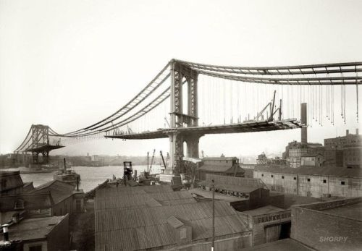
View of Manhattan Bridge from Brooklyn, 1909

Slide 7
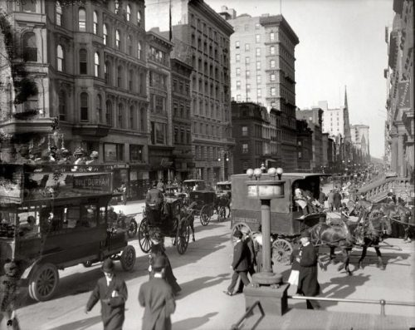
Corner of Fifth Avenue and 42nd Street, New York, 1910

Slide 8
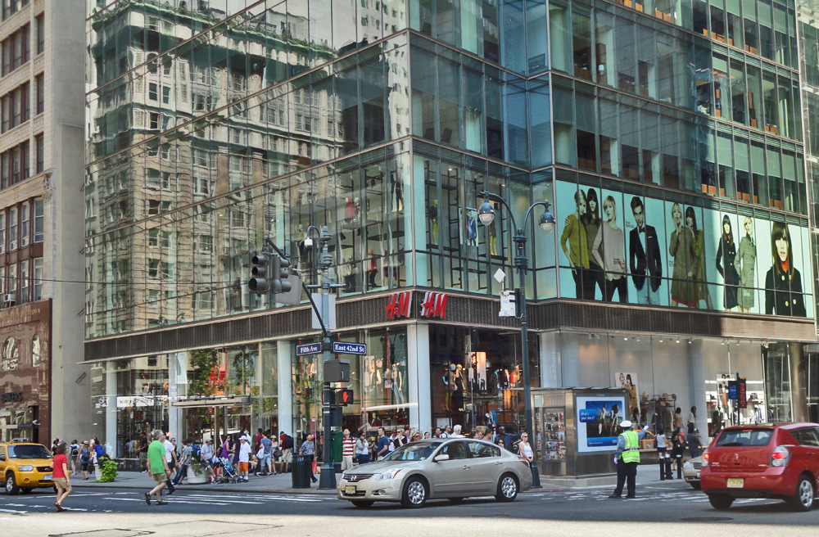
Today

Slide 9
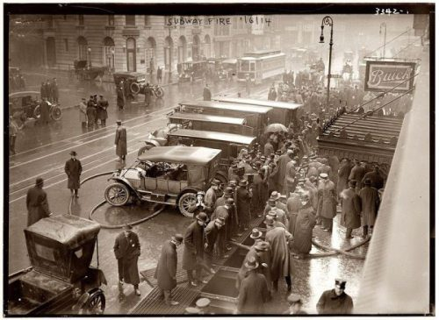
Fire at 55th Street, New York, 1915

Slide 10
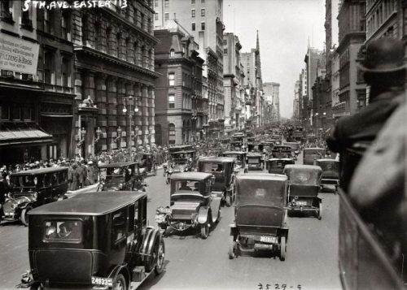
The northern part of Fifth Avenue, New York, 1913

Slide 11
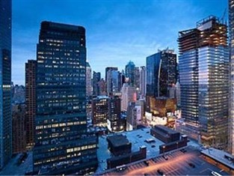
Today

Slide 12
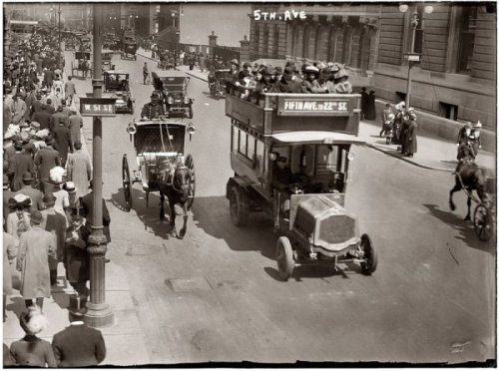
Fifth Avenue, New York, 1913

Slide 13
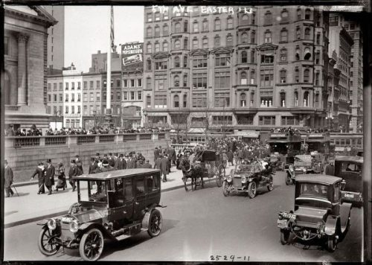
Fifth Avenue, New York, 1913

Slide 14
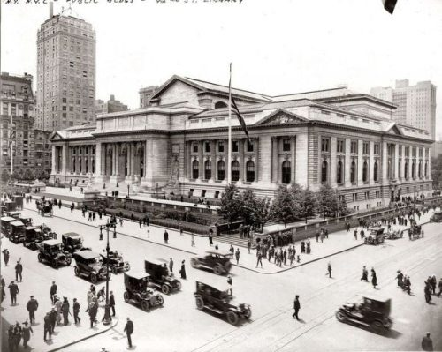
The New York Public Library, New York, 1915

Slide 15
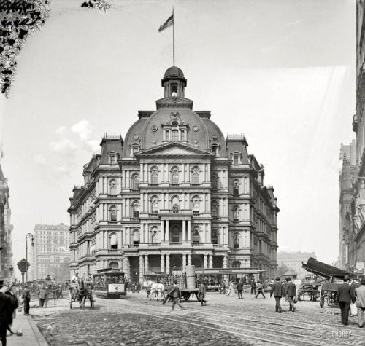
City Hall – City Hall in New York.

Slide 16
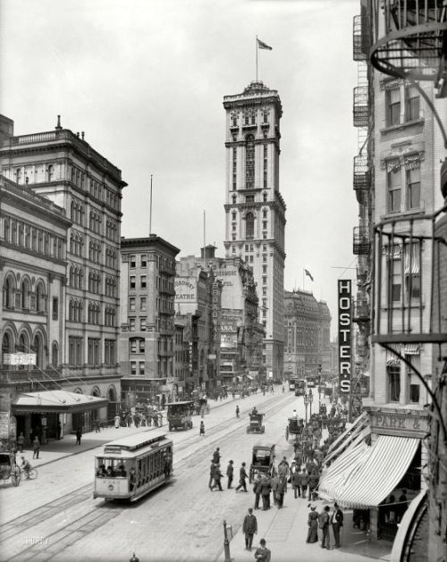
Broadway and the building of “The Times”, New York, 1915

Slide 17
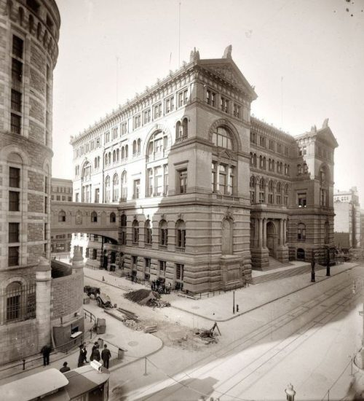
Manhattan, 1907

Slide 18
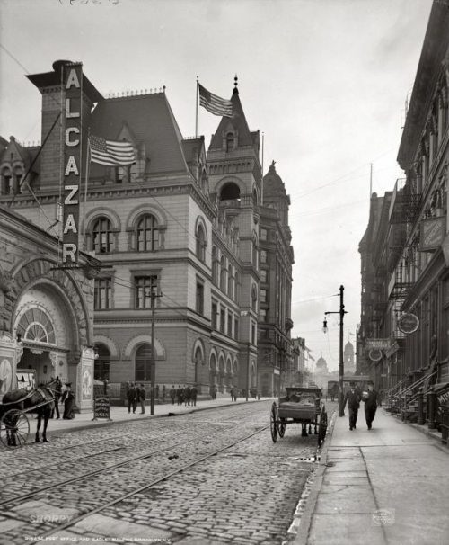
Post Office, Brooklyn, New York, 1906

Slide 19
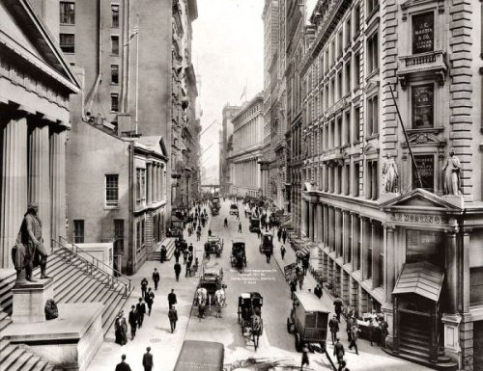
Wall Street, New York, 1911

Slide 20
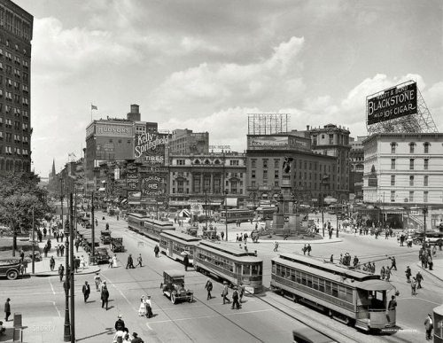
Woodward Avenue, Detroit, Michigan, 1917

Slide 21
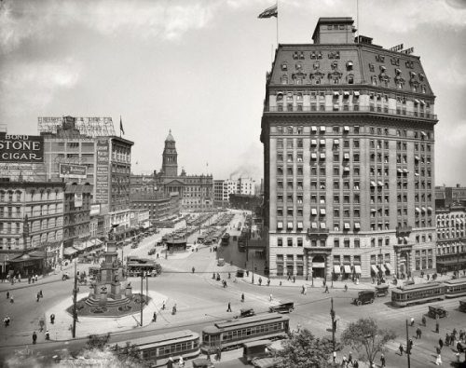
Cadillac Square, Detroit, Michigan, 1916

Slide 22
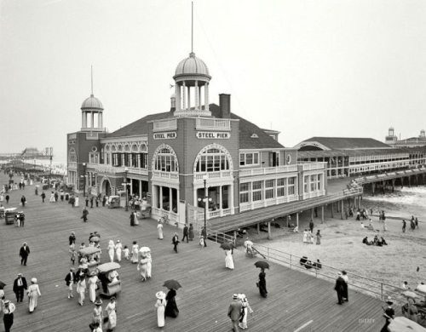
Steel Pier, Atlantic City, 1910

Slide 23
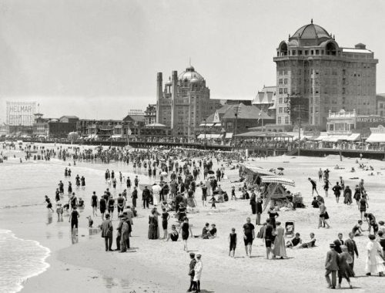
Beach in Atlantic City, 1915

Slide 24
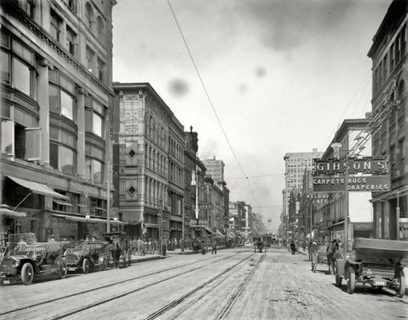
The main street of Memphis, north of Avenue Gayoso, 1910

Slide 25
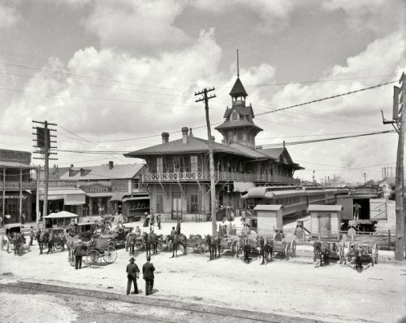
Station “Louisville-Nashville”, Florida, 1910

Slide 26
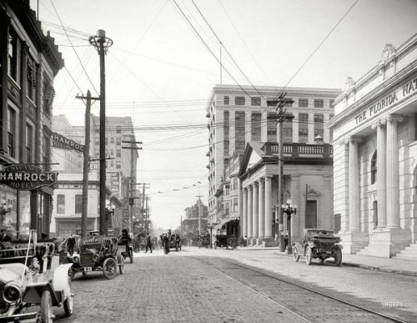
Forsyth Street, Jacksonville, Florida, 1910

Slide 27
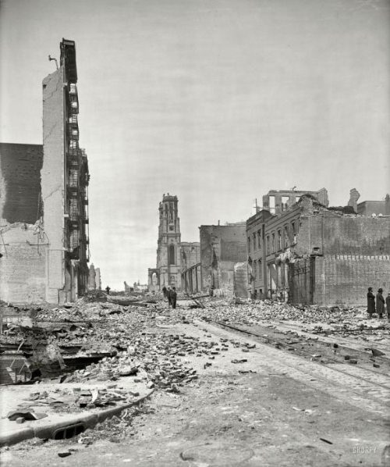
Grant Avenue after an earthquake in San Francisco, 1906

Slide 28
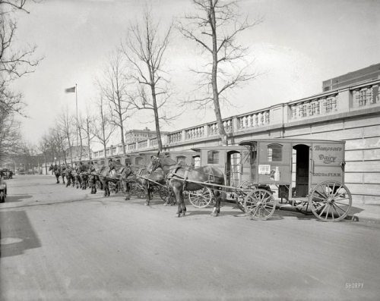
Carts for transporting dairy Thompson, Washington, 1927

Slide 29
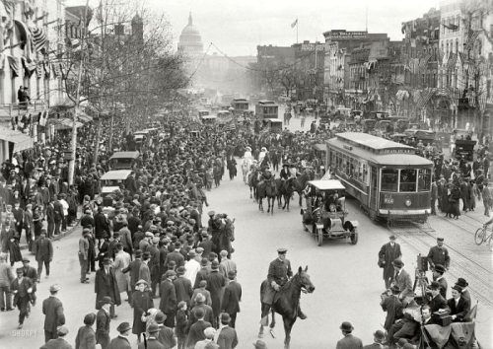
Washington, 1913

Slide 30
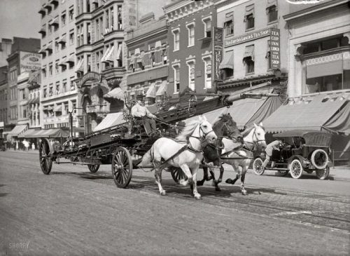
Washington, 1914

Slide 31
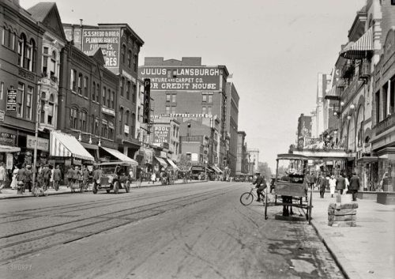
Ninth Street, Washington, 1915

Slide 32
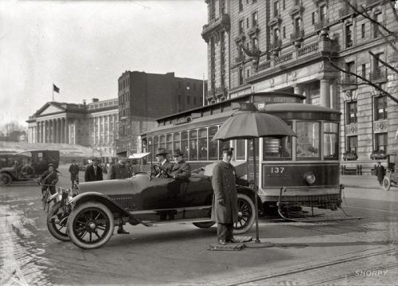
Treasury Building, Washington, DC, 1913

Slide 33
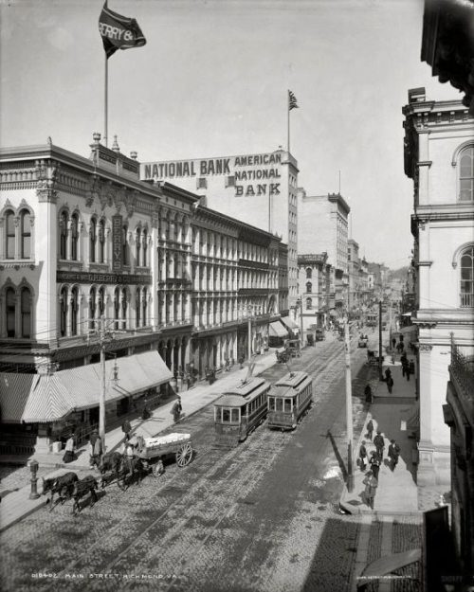
The main street of Richmond, Virginia, 1905

Slide 34
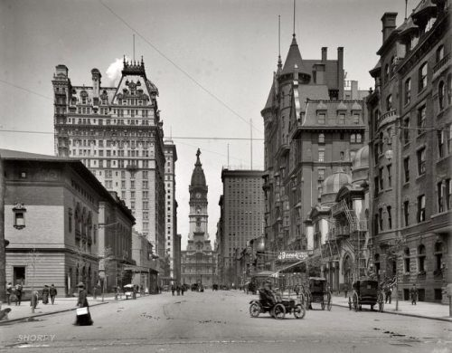
Broad Street north of Spruce Street, Philadelphia, 1905

Slide 35
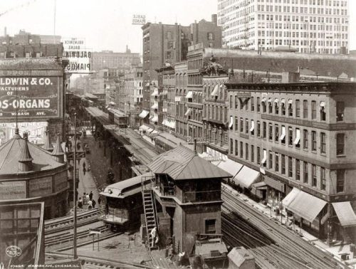
Wabash Avenue, Chicago, 1907

Slide 36
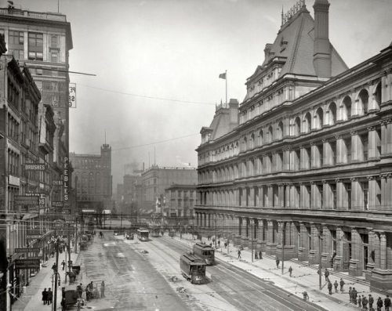
Size of Government in Cincinnati, Ohio, 1905

Slide 37
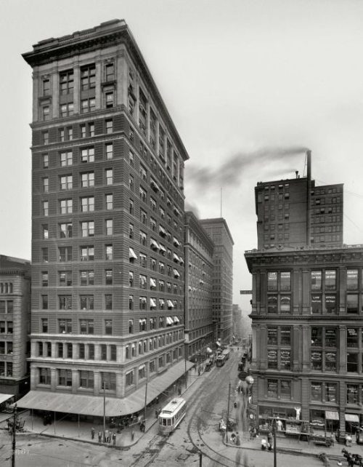
Valnut Street, Cincinnati, Ohio, 1910

Slide 38
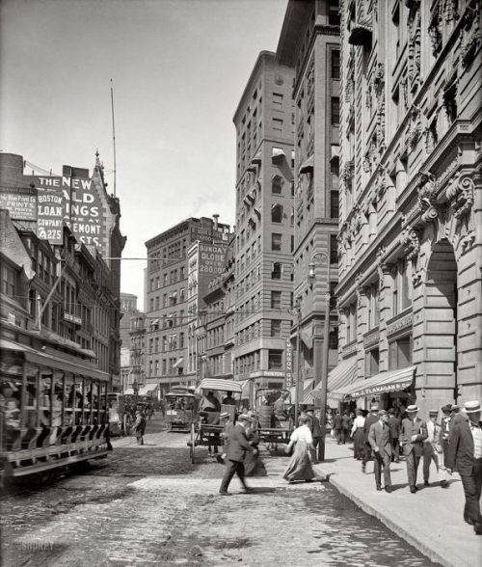
Boston, MA, 1906

Slide 39
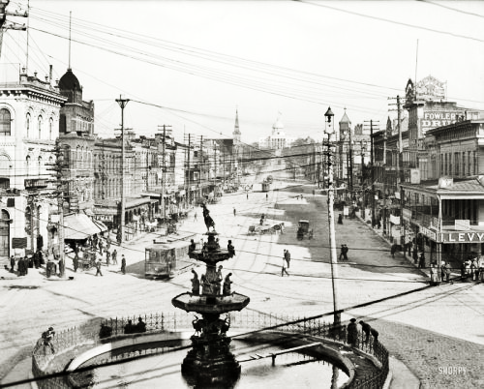
Dexter Avenue and the Capitol, Montgomery, Alabama, 1906

Slide 40
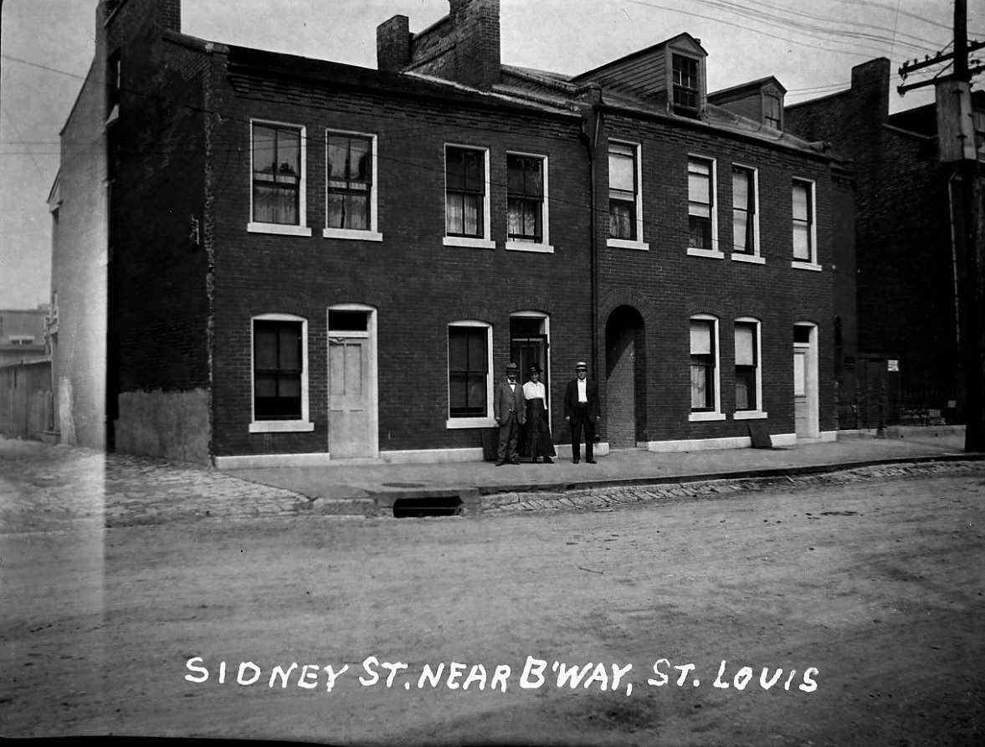
St. Louis, MO

Slide 41
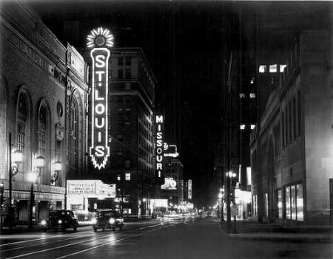
Grand Avenue, St. Louis

Slide 42
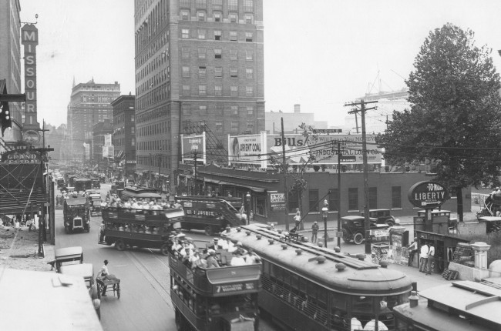
Grand Center

Slide 43
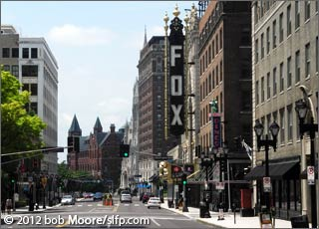
Grand Avenue Today

Slide 44
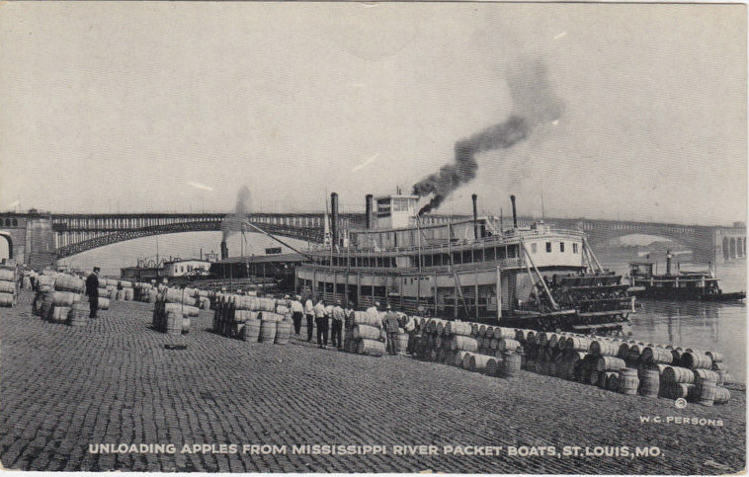
St. Louis, Riverfront

Slide 45
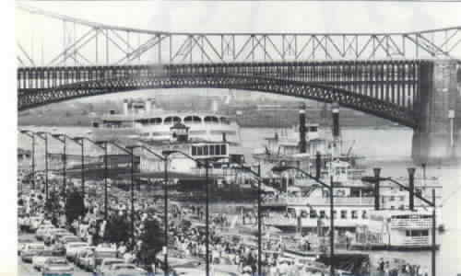
St. Louis, riverfront & Eads Bridge

Slide 46
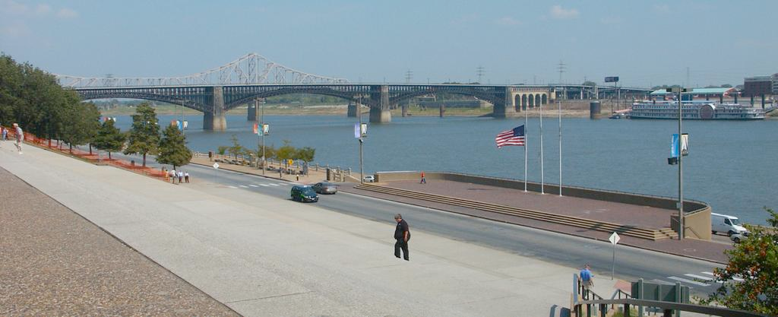
Today

Slide 47
St. Louis

Slide 48
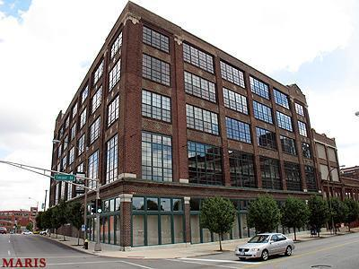

Slide 49
St. Louis

Slide 50
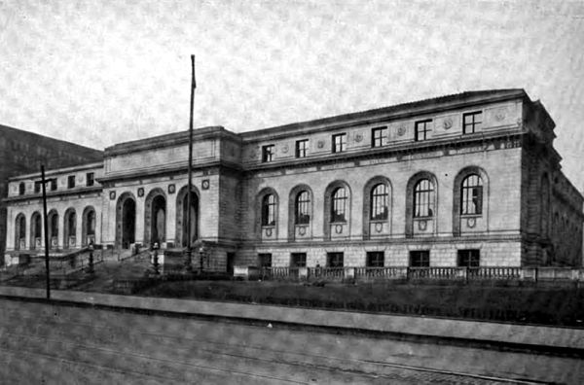
St. Louis Public Library, 1920

Slide 51
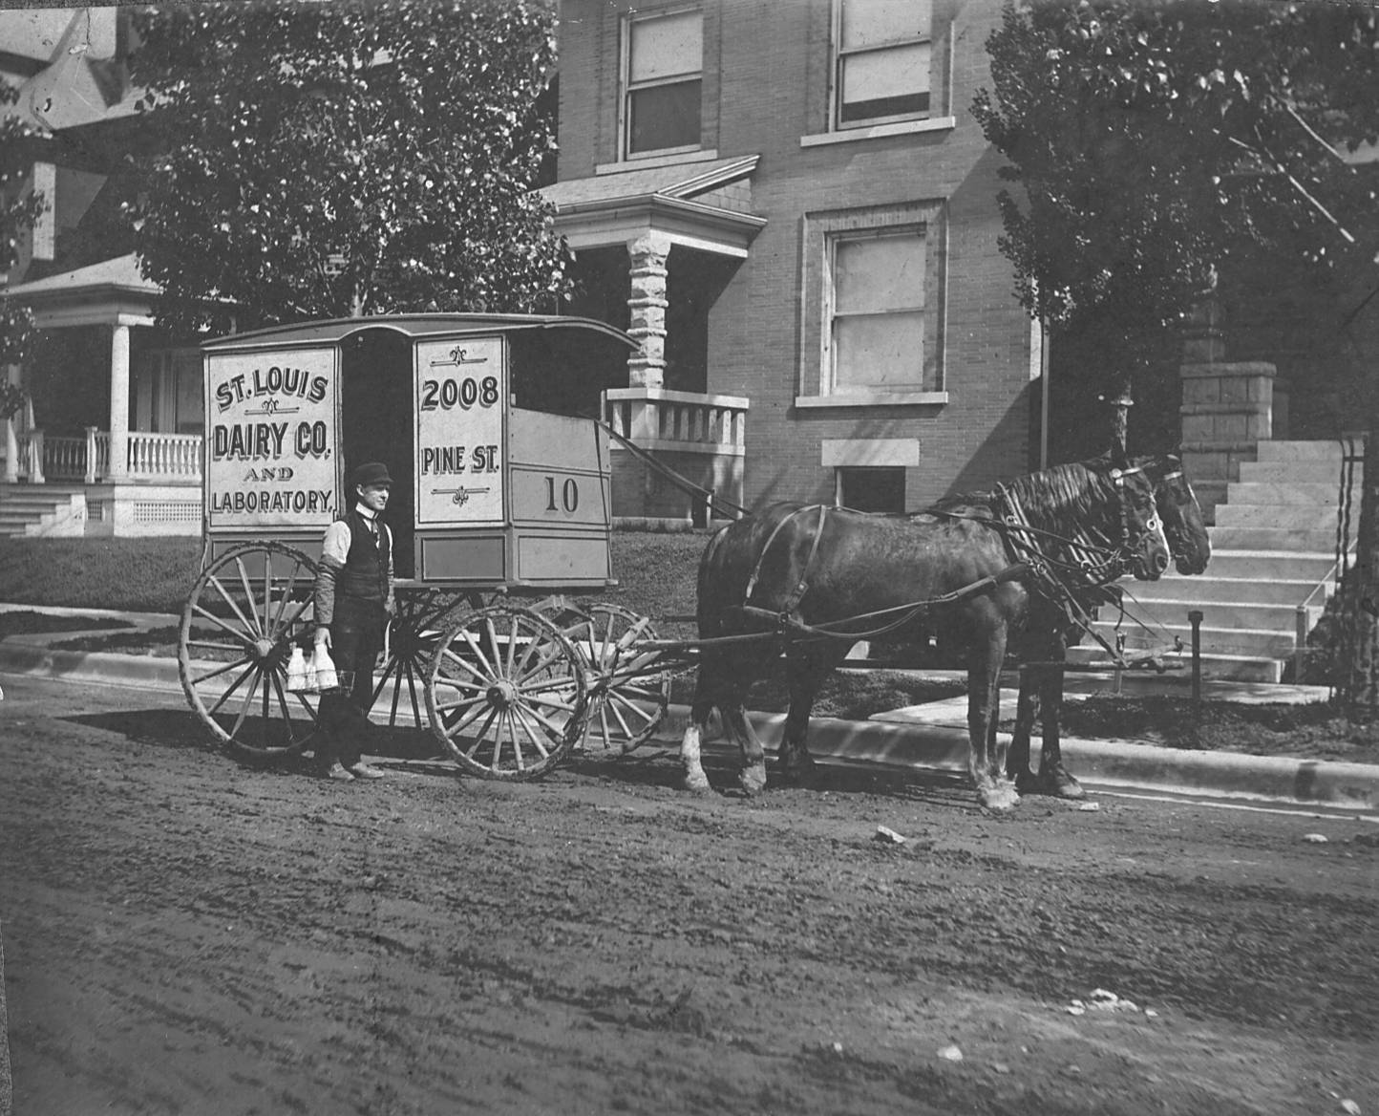

Slide 52
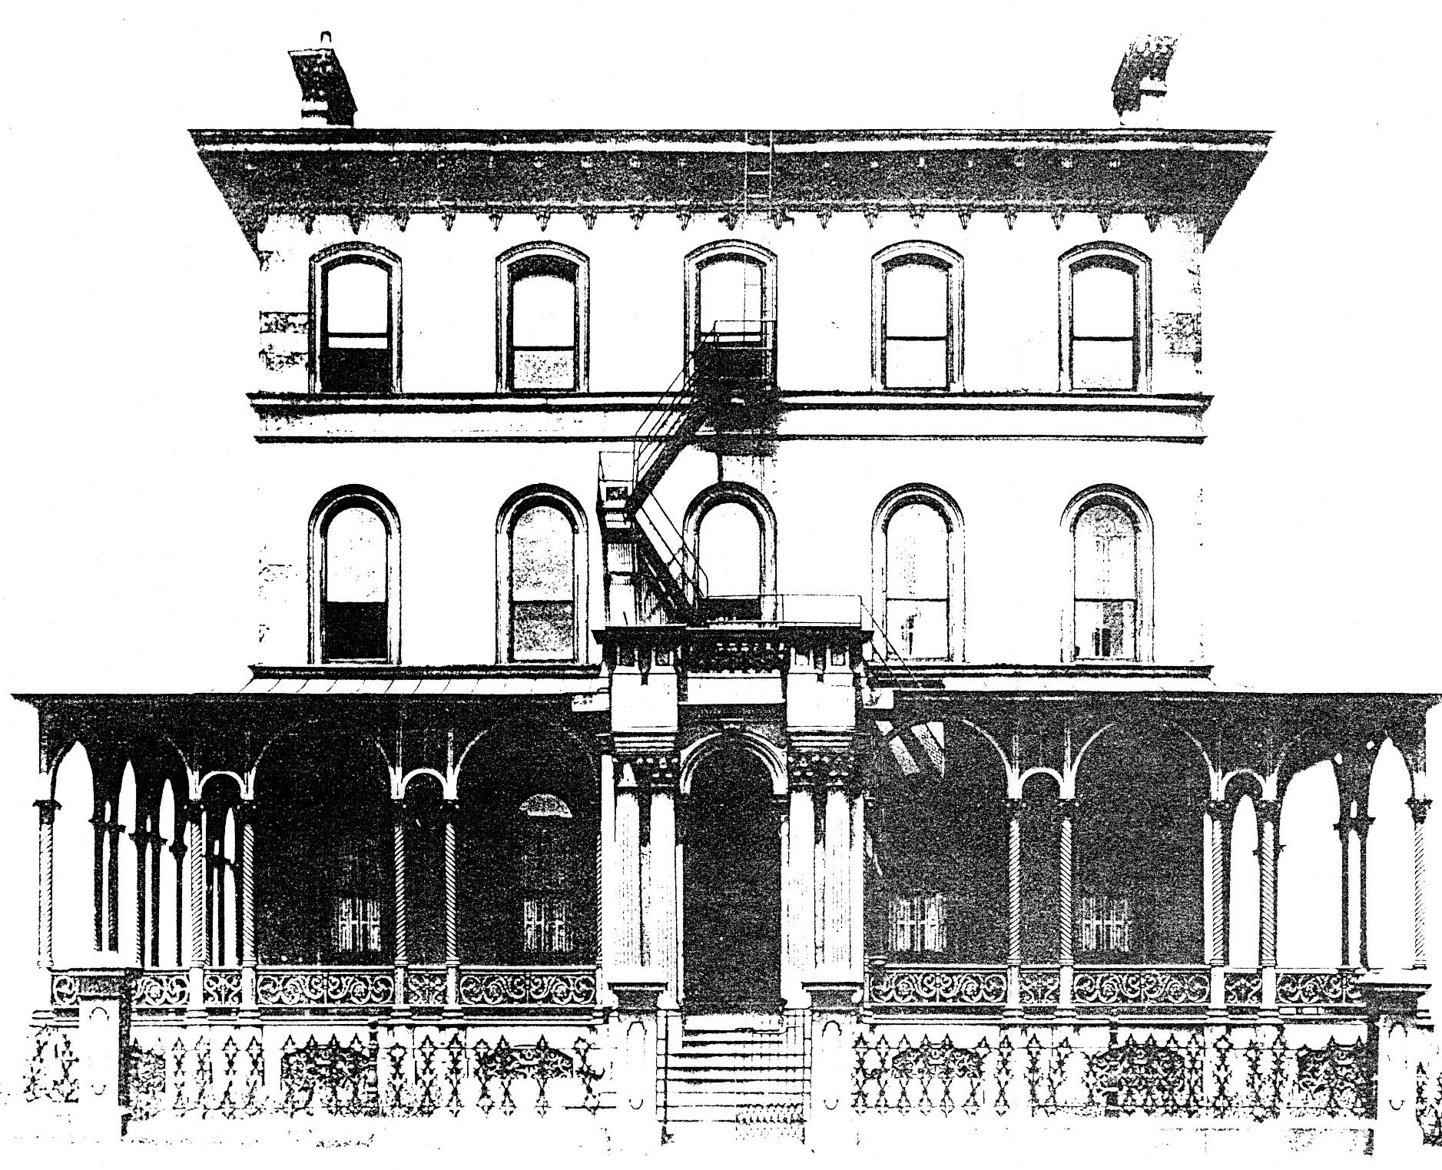
Campbell House. 1920

