Slide 1
These Are the 15 Most Corrupt Countries in the World

Slide 2
Corruption and economic turmoil often go hand-in-hand. In western nations, we often see corruption come to light as the result of whistleblowers or journalistic efforts. But in many other areas of the world, corruption plays a major role in fostering staggering poverty and broken economic systems. Often, this kneecaps a nation’s ability to function.
In some countries, specific power structures and government architectures provide an easier means for corrupt officials to exploit the system. Many governments have their roots in constitutions written generations ago and have outgrown their current systems. Other countries simply lack a centralized power structure.
How do you quantify corruption? Transparency International has managed to do it by developing a comprehensive list of the world’s most corrupt countries. The annual report ranks countries on a scale from 0 to 100, with zero being the most corrupt, and 100 being the least.

Slide 3
Ranking worldwide corruption
Although not among the top fifteen, we’ve also included the United States to give some perspective as to where America ranks internationally. By Transparency International’s calculations and scale, the U.S. is doing quite well — but we’ll get to that.
Here are the most corrupt nations in the world, as ranked by Transparency International’s 2015 report.

Slide 4
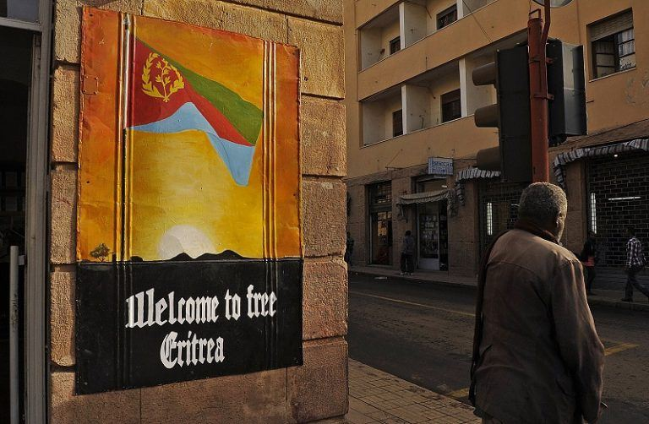
15. Eritrea
Corruption score: 18
Power structure: Single-Party Presidential Democracy
Corruption in Eritrea is getting worse. The country vaulted from No. 25 in 2013 to No. 10 in 2014, for example. Eritrea is located in Africa, bordering the Red Sea directly across from Saudi Arabia, bordering Djibouti to the south and Sudan to the north. Eritrea is a small and relatively poor country, with a GDP of only $3.44 billion, and a population of 6.3 million. Most of its issues stem from the recent influx of foreign investment and its single-party government.

Slide 5
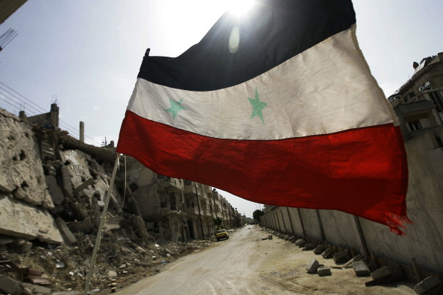
14. Syria
Corruption score: 18
Power structure: Presidential Republic
There isn’t a country on Earth that is in worse shape than Syria right now. Syria has been in a state of civil war since the Arab Spring, and there’s no end in sight. It’s caused mass migrations to Europe and created issues in the United States as well. Russia and ISIS are involved, too. Needless to say, it’s a mess. President Bashar al-Assad is still holding on to power, and there’s really no indication as to how the country can get back on track.

Slide 6
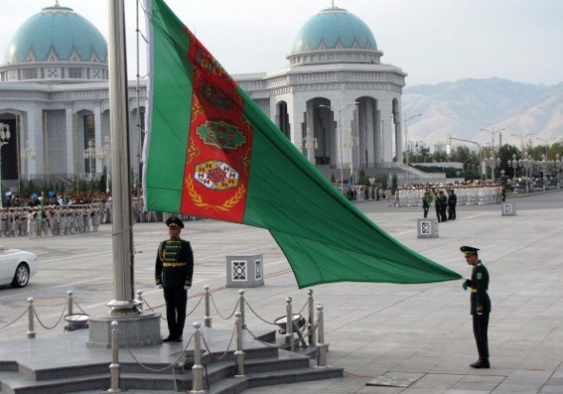
13. Turkmenistan
Corruption score: 18
Power structure: Presidential Democracy/Authoritarian
Bordered by Iran, Afghanistan, Uzbekistan, and Kazakhstan, Turkmenistan lies in a virtual hotbed of corrupt states. With the constant turmoil all over the Middle East, it’s been very easy for the country to fall into corrupt affairs. Many concern the authoritarian presidential figure, Gurbanguly Berdimuhamedow. The CIA’s file says the country is a secular democracy and presidential republic. But in practice, its government more closely resembles an authoritarian dictatorship. The country itself was founded as a result of the Soviet Union’s collapse and the resulting power struggle has left the nation highly corrupt and vulnerable to tomfoolery.

Slide 7
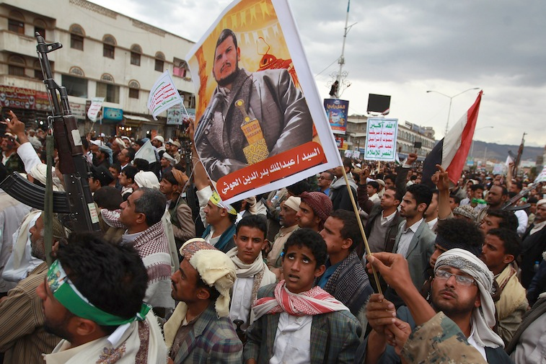
12. Yemen
Corruption score: 18
Power structure: Constitutional Republic
Yemen, like many other Middle Eastern countries, is muddled in conflict. It’s adjacent to Oman and Saudia Arabia and borders the Persian Gulf to the west. Given its location, it’s been swept up in many of the issues plaguing the Middle East. It’s undergoing its own civil war, as Syria is, with rival factions vying for control of the government.

Slide 8
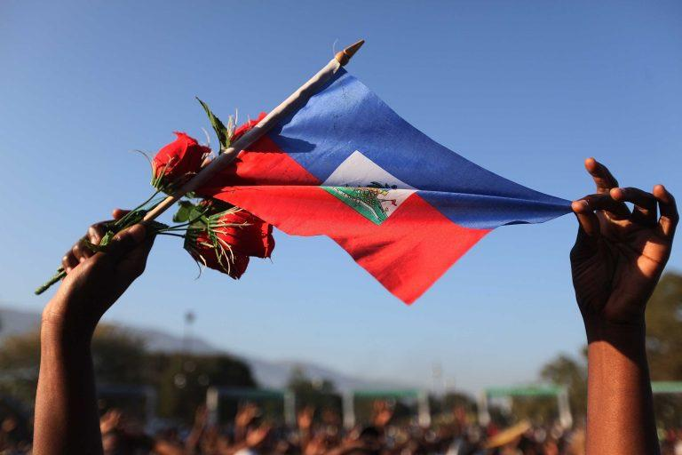
11. Haiti
Corruption score: 17
Power structure: Presidential Republic
The problems in Haiti became quite clear in the wake of the devastating earthquake in 2010. The quake killed more than 300,000 people, and the government’s inability to handle the aftermath became clear. Much of the corruption in the country stems from collusion among the rich and politicians. Corruption is still a serious issue, but things continue to improve.

Slide 9
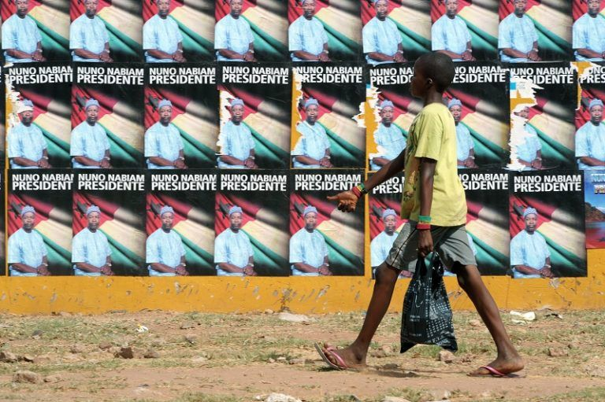
10. Guinea-Bissau
Corruption score: 17
Power structure: Semi-Presidential Republic
If you’ve never heard of Guinea-Bissau, you’re not alone. The country is located in western Africa, between Guinea and Senegal. Guinea-Bissau is home to 1.7 million people, the vast majority of whom are relatively poor. Corruption is something of a national pastime, too. Since being founded in the early 1970s, no president has ever finished a term in office. The country is also a major hub for trafficking and organized crime.

Slide 10
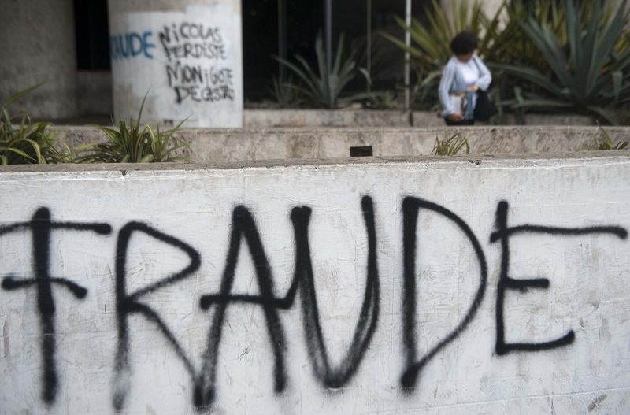
9. Venezuela
Corruption score: 17
Power structure: Federal Republic
Venezuela is a mess. Hugo Chavez, elected in 1998, caused a number of issues, and the nationalization of the country’s rich oil reserves created more. Money that was supposed to go to the people was instead being funneled to high-ranking government officials. Since then, things have deteriorated even more. The country’s currency is nearly worthless, and its economy is in serious trouble.

Slide 11
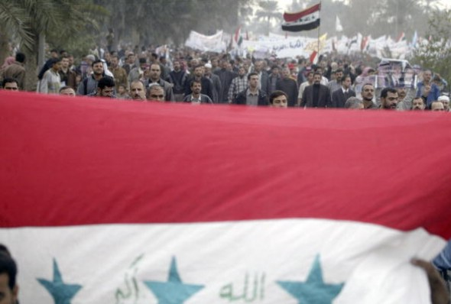
8. Iraq
Corruption score: 16
Power structure: Federal Parliamentary Constitutional Republic
The current state of affairs in Iraq is fairly messy. After the second American invasion in 15 years, the pullout of U.S. forces has left Iraq a virtual power vacuum, with several different sects fighting for power over the embattled nation. Fighting is mostly concentrated between the Kurds, the Shiites and the Sunnis, but the arrival of ISIS from Syria is adding to the issues. Iraq’s vast wealth and natural resources have made it a target for all kinds of industry and war profiteers. And, unsurprisingly, corruption. Iraq has actually seen some economic growth as the country rebuilds itself, but there is also a lot of outside interference from American and European contracting companies, hired to rebuild infrastructure and tap into the country’s oil reserves.

Slide 12
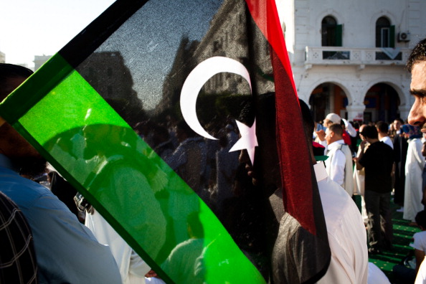
7. Libya
Corruption score: 16
Power structure: Transitional
Few nations have experienced as much turmoil over the past few years as Libya. The country’s government saw its downfall during a mass uprising and protest. That ultimately led to protestors parading around with the body of former president Muammar Gaddafi on the streets. The country’s fall was a part of the “Arab Spring.” Libya is still in a state of turmoil. No formal government has taken root, and fighting between rebels and those loyal to the old administration is still taking place. Due to the high levels of uncertainty, the country’s GDP contracted 9.4% during 2013, according to The World Bank. The power vacuum has left open a great opportunity for arms dealers and corrupt military higher-ups to take charge and profit.

Slide 13
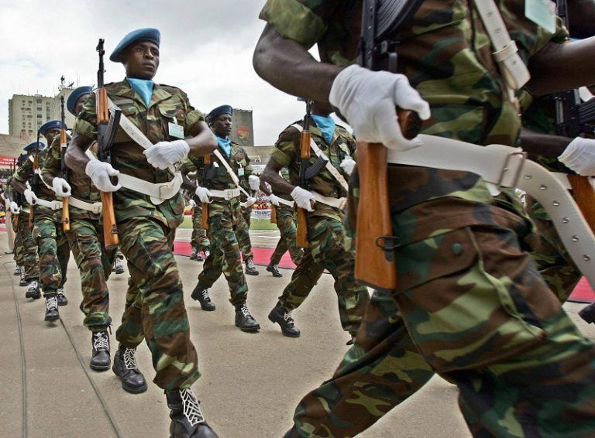
6. Angola
Corruption score: 15
Power structure: Republic
Angola, located along southern Africa’s western coast, has jumped several spots on the Corruption Index in recent years. There are many forms that it takes, from the looting of state assets by government officials to widespread money laundering and embezzlement. Angola is rich with oil reserves, which attract a lot of attention. That makes it a corruption magnet. Also, it’s the worst place in the world to be a child.

Slide 14
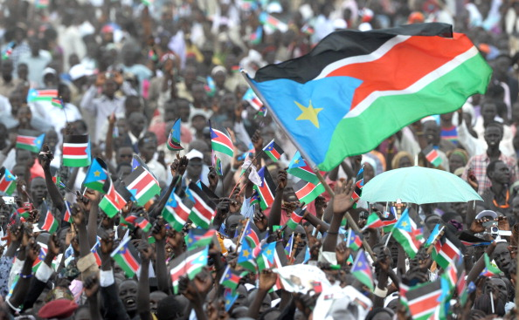
5. South Sudan
Corruption score: 15
Power structure: Republic
South Sudan officially declared independence in 2011. That, following long-standing conflicts with its parent country, Sudan, which gained its independence in 1956. Between the mid-1950s and now, conflicts in the region have resulted in the deaths of as many as 2.5 million people, or so the CIA contends. South Sudan now stands as an independent republic, composed of 10 states. A nation still in its infancy, South Sudan does not have the traditional long-standing government structures in place that many others do. This has led to ripe opportunities for corrupt politicians to step in. The country remains mostly undeveloped, and its citizens participate in a largely subsistence-based economic system. One other issue is the lack of a sense of nationhood among the 200 or so distinct ethnic groups occupying the country.

Slide 15
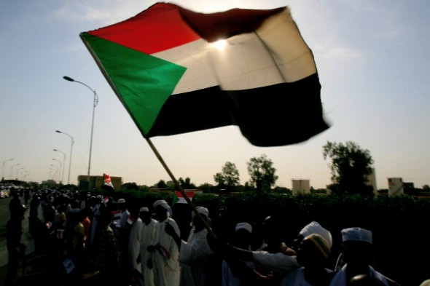
4. Sudan
Corruption score: 12
Power structure: Federal Republic
Long-standing conflicts between competing factions and ethnic groups have destabilized Sudan’s ability to efficiently operate from an economic standpoint. The result has been devastating to many of the country’s citizens. South Sudan has also recently broken off from the rest of the country, taking with it vast oil reserves. CNN reports that Sudan’s GDP is expected to continue to contract due to South Sudan’s departure. According to the CIA, the country is ruled by the National Congress Party. The NCP came to power after a coup d’etat in 1989, and has not been able to successfully repair the nation’s issues. As a result of the prolonged instability, Sudan’s GDP has tanked since spiking in 2006.

Slide 16
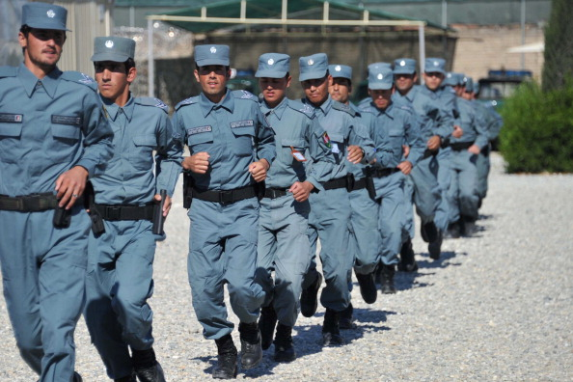
3. Afghanistan
orruption score: 11
Power structure: Islamic Republic
Afghanistan’s nickname is “the graveyard of empires,” and for good reason. The country has been loosely held together by a central government that largely lacks power, and has been carved up by numerous local tribal leaders and warlords. The country’s now-former president Hamid Karzai was notoriously corrupt — he’s been recently busted for taking bagfuls of money from the American military, among other things. Afghanistan is also home to an enormous amount of the world’s heroin production, which has brought lots of wealth to a lucky few.

Slide 17
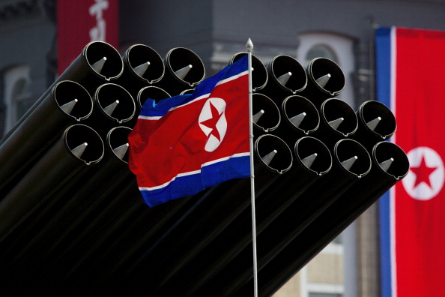
Tie – 1. North Korea
Corruption score: 8
Power structure: Dictatorship
The CIA lists North Korea’s government as a “communist state one-man dictatorship,” with an estimated GDP of $28 billion as of 2009. The inner workings of the North Korean government and economy are quite mysterious. While it does receive aid from countries like China, North Korea has had problems producing enough fuel and food to properly care for its citizens. Military spending far outweighs spending on social programs and aid, mostly to put on appearances for the rest of the world in their famous outbursts of saber-rattling. The country’s major issues can be traced back to a number of natural disasters and the collapse of the Soviet Union, as the land, people and equipment have all been “worn out” over the years, according to a CNN report. With little hope for change in the near future, North Korea is destined to remain one of the planet’s most corrupt and destitute nations.

Slide 18
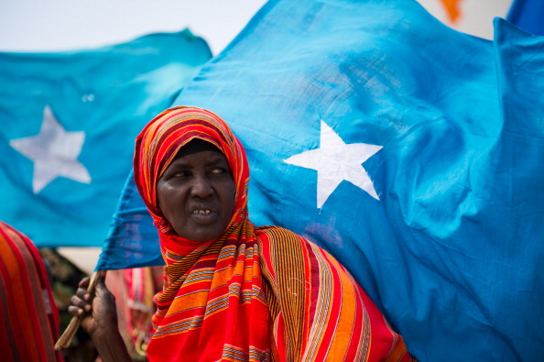
Tie – 1. Somalia
Corruption score: 8
Power structure: Almost none; “in the process of building a federal parliamentary republic” – CIA
Somalia may just be the most unstable country on the entire planet. The country has become infamous in the United States for piracy, and the Blackhawk Down incident. Somalia is being loosely held together by a central government. The reality, however, is that it’s being run by a number of competing clans and warlords. Life in Somalia is notoriously tough. On the economic front, many people make a living from raising livestock or farming, and others from fishing. Of course, with things remaining such a mess at the top of the power structure, any long-term planning for social programs and infrastructure is difficult. According to The World Bank, only 29% of the country’s population has been enrolled in school, and life expectancy is only 55 years. Both of these numbers rank well below most other countries and provide some insight into the internal strife the country is experiencing. Beyond these things, information on the inner workings of Somalia’s government and its economic system are scarce. That alone is rather telling, as corrupt officials may not want outsiders seeing the true picture of what’s going on inside the country’s borders.

Slide 20
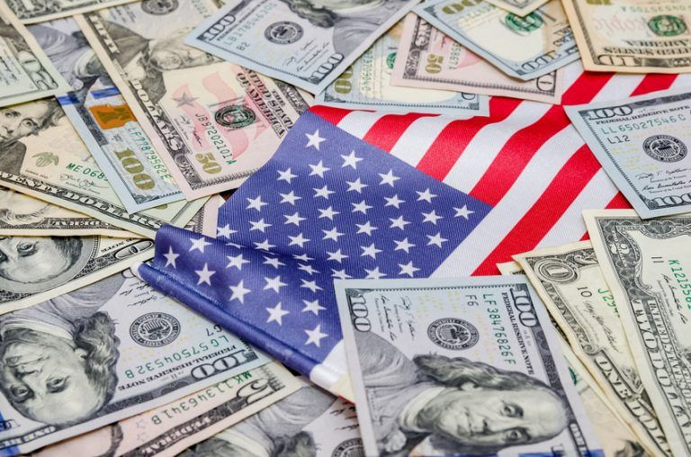
What about the United States?
Corruption score: 76
Power structure: Democratic Republic
Many Americans think that our government is plenty corrupt. But in comparison to the rest of the world? We’re a role model. Overall, the U.S. ranks as the 17th-least corrupt country in the world.
We have a great deal of corruption in many forms, like lobbying, bribery, and gerrymandering. But according to the corruption index, the U.S. pales in comparison to countries in Africa, Asia, and the Middle East. The U.S. clearly has issues to work out. With the status quo firmly set in place, however, there isn’t much indication that citizens should expect changes in the near term.

