Slide 1
The World's 50 Greatest Leaders
2014 Fortune Magazine
Organization Name Strategic Plan

Slide 2
In an era that feels starved for leadership, we've found men and women who will inspire you -- some famous, others little known, all of them energizing their followers and making the world better. By Geoff Colvin

Slide 3
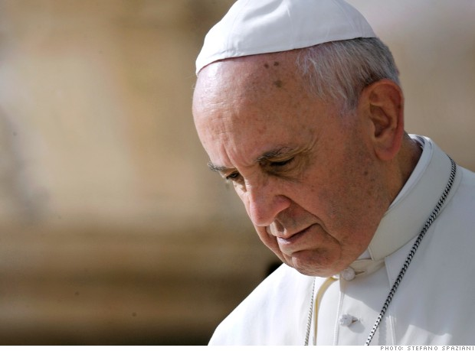
1. Pope Francis

Slide 4
Age: 77
Pontiff, Catholic Church
In the brief time since, Francis has electrified the church and attracted legions of non-Catholic admirers by energetically setting a new direction. He has refused to occupy the palatial papal apartments, has washed the feet of a female Muslim prisoner, is driven around Rome in a Ford Focus, and famously asked "Who am I to judge?" with regard to the church's view of gay members. He created a group of eight cardinals to advise him on reform, which a church historian calls the "most important step in the history of the church for the past 10 centuries." Francis recently asked the world to stop the rock-star treatment. He knows that while revolutionary, his actions so far have mostly reflected a new tone and intentions. His hardest work lies ahead. And yet signs of a "Francis effect" abound: In a poll in March, one in four Catholics said they'd increased their charitable giving to the poor this year. Of those, 77% said it was due in part to the Pope.

Slide 5
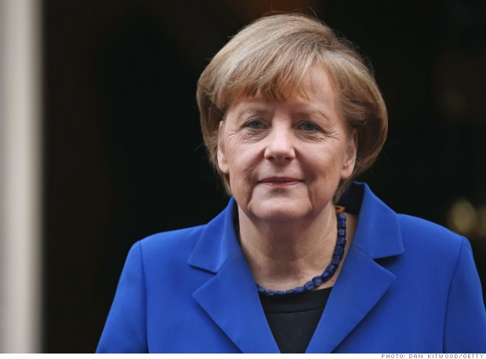
2. Angela Merkel

Slide 6
Age: 59
Chancellor, Germany
Merkel may be the most successful national leader in the world today. She is, practically speaking, the leader of the European Union, which as a whole is the world's largest economy, and Merkel has held that position for almost nine years. She played the lead role in managing Europe's debt crisis, keeping the EU intact while setting even Greece on the road to recovery.

Slide 7
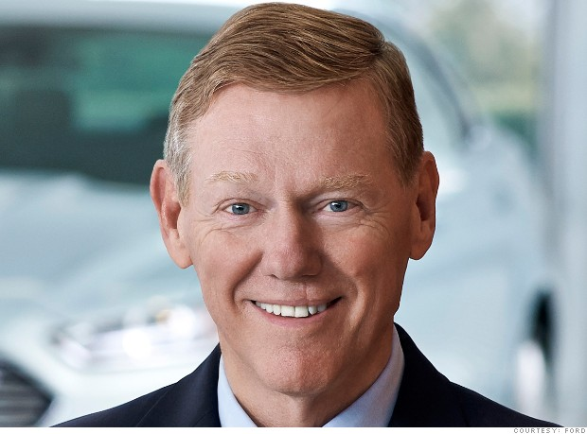
3. Alan Mulally

Slide 8
Age: 68
CEO, Ford Motor Co.
Ford's (F, Fortune 500) miracle worker saved the company without resorting to bankruptcy or bailouts by doing what previous leaders had tried and failed to do: change Ford's risk-averse, reality-denying, CYA-based culture. After earning $7.2 billion of profit last year -- far more than General Motors (GM, Fortune 500) or Chrysler -- the company paid its 47,000 UAW workers a record $8,800 each in profit sharing.

Slide 9
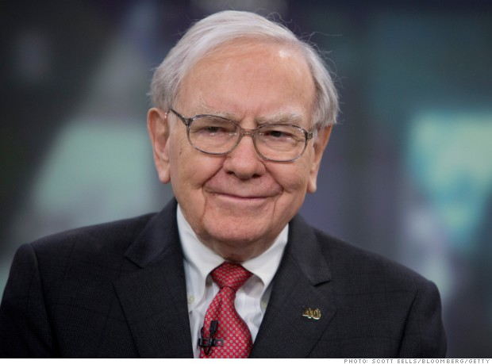
4. Warren Buffett

Slide 10
Age: 83
CEO, Berkshire Hathaway
While lauded as an investor, Buffett also leads 300,000 employees with a values-based, hands-off style that gives managers wide leeway and incentivizes them like owners. The result is America's fifth-most-valuable company (BRKA, Fortune 500). His influence extends much further than that, though: The world looks to the "Oracle of Omaha" for guidance on investing, the economy, taxes, management, philanthropy, and more.

Slide 11
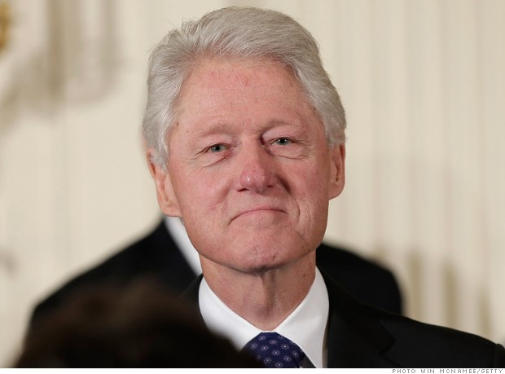
5. Bill Clinton

Slide 12
Age: 68
Founder, The Clinton Foundation
In the 13 years since he left office, President Clinton has been a relentless and forceful advocate for a number of causes: the fight against HIV/AIDS, malaria, and tuberculosis, and the need to stem greenhouse gas emissions. Through his Clinton Global Initiative, he persuades billionaires, heads of state, and others to declare commitments (2,300 so far) to specific projects.

Slide 13
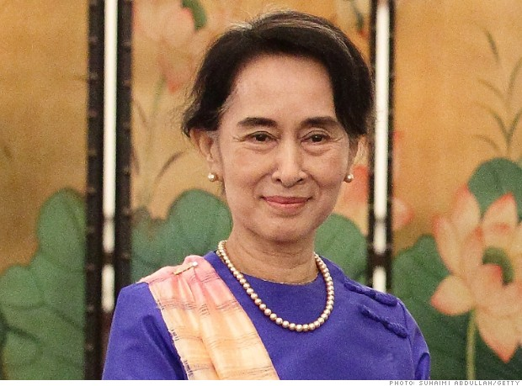
6. Aung San Suu Kyi

Slide 14
Age: 68
Chair, National League for Democracy
The Nobel Peace Prize winner gave up freedom and a life with her family in Britain to protest military rule in Burma (now Myanmar). But nearly two decades of house arrest could not quash the opposition leader's determination. Since Suu Kyi's 2010 release, her political party has clinched dozens of seats in Parliament. Current law bars a presidential run in 2015; even that may change before long.

Slide 15
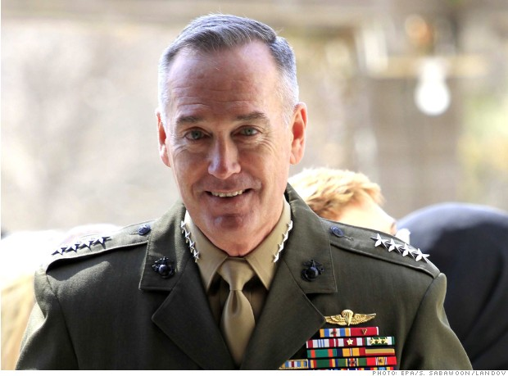
7. Gen. Joe Dunford

Slide 16
Age: 58
Commander, U.S. Forces, Afghanistan
The Marine four-star general and leader of NATO's coalition in Afghanistan "is probably the most complete warrior-statesman wearing a uniform today," says a former Marine commandant. Dunford tells Fortune his first battalion commander told him the three rules to success. The first? Surround yourself with good people. "Over the years," says Dunford, "I've forgotten the other two."

Slide 17
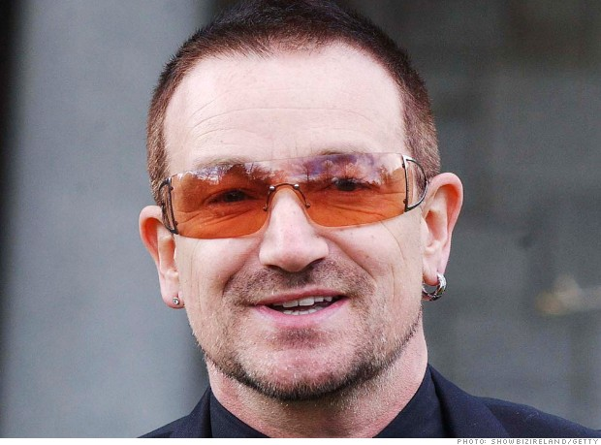
8. Bono

Slide 18
Age: 53
Lead singer, U2
"Real leadership is when everyone else feels in charge," Bono tells Fortune. And he has lived by this maxim. He helped persuade global leaders to write off debt owed by the poorest countries and encouraged the Bush administration and others to vastly increase AIDS relief. Now, through his ONE and (RED) campaigns, he is enlisting major companies and millions of people to combat AIDS, poverty, and preventable diseases.

Slide 19
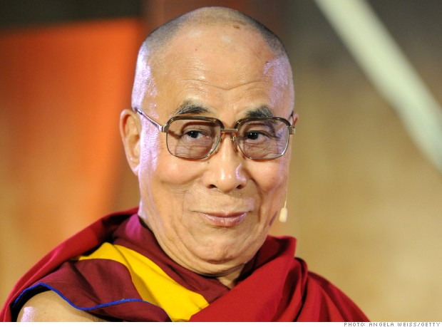
9. Dalai Lama

Slide 20
Age: 78
Spiritual leader of the Tibetan people
For over 50 years he has campaigned tirelessly for peace, nonviolence, democracy, and reconciliation, especially among world religions; he has met countless times with popes, rabbis, imams, and others to find common ground. Winner of the 1989 Nobel Peace Prize, the Dalai Lama radiates charisma. As for his influence, just ask those who look for his guidance on Twitter. All 8.6 million of them.

Slide 21
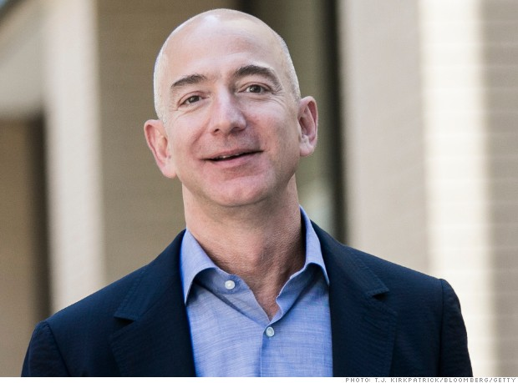
10. Jeff Bezos

Slide 22
Age: 50
CEO, Amazon.com
Bezos is an extremely rare combination of visionary and master builder -- 20 years ago seeing something no one else could see and then turning it into the world's No. 2 Most Admired Company (after Apple) on our list, with a recent market value of $174 billion (AMZN, Fortune 500). Prospective employees are still drawn to his vision; though he's highly demanding, thousands aspire to work for him. That's one way to know a great leader when you see one.

Slide 23
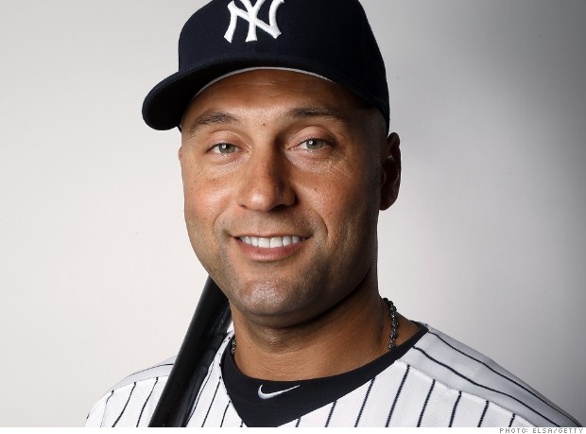
11. Derek Jeter

Slide 24
Age: 39
Shortstop & captain, New York Yankees
As he begins his 20th and final season in pinstripes, Jeter remains the type of role-model player that even a Red Sox fan must grudgingly respect. It's not the five World Series rings he's won or his team record for career hits. In a steroid-tainted, reality-TV era, Jeter, the son of two Army veterans, continues to stand out because of his old-school approach: Never offer excuses or give less than maximum effort.

Slide 25
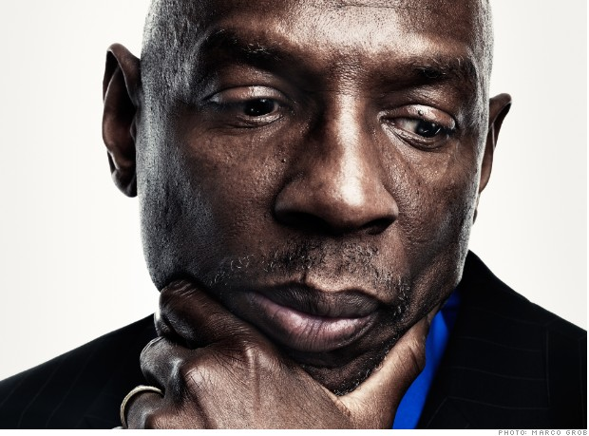
12. Geoffrey Canada

Slide 26
Age: 62
CEO, Harlem Children's Zone
Dissatisfied with the results of most organizations helping the urban poor in the mid-1990s, Canada launched an experiment, an effort to reach all the kids in a 24-block zone of New York City -- he called it the Harlem Children's Zone -- and give them education, social, and medical help starting at birth. The idea was to make success a self-reinforcing phenomenon, as children and their families saw it all around them and recalibrated their expectations. The experiment has worked spectacularly. The zone now covers over 100 blocks and serves more than 12,000 children, with 95% of high school seniors going off to college. Canada plans to step down as CEO later this year, but his idea -- and leadership here -- will no doubt endure.

Slide 27
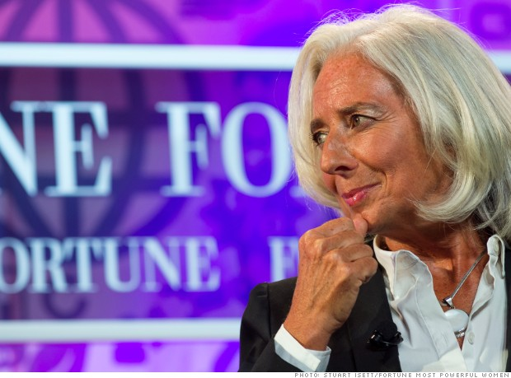
13. Christine Lagarde

Slide 28
Age: 58
Managing director, International Monetary Fund
Lagarde became IMF chief in July 2011 as the European debt crisis grew most acute. Her unenviable task required juggling the concerns of 188 member countries while supporting IMF bailouts of Greece, Ireland, Portugal, and other troubled countries. She did so and is still doing so largely with success, though the IMF's stringent conditions on aid have angered some. Lagarde combines her tough prescription of austerity with an argument that reforms will help the poor and unemployed above all -- a balance that has increased acceptance of her message.

Slide 29
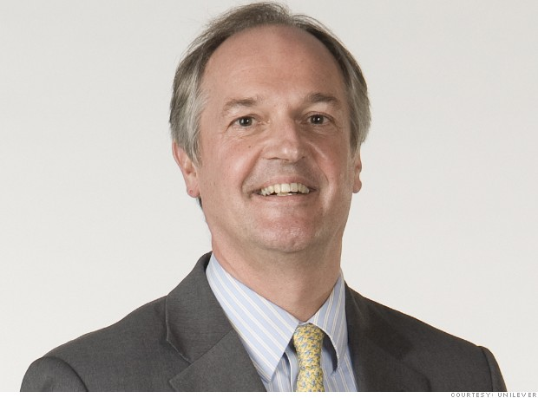
14. Paul Polman

Slide 30
Age: 57
CEO, Unilever
With rare skill, Polman has combined noble corporate goals with savvy management in his five years as CEO (UL). Of course, strong leadership also often goes hand in hand with bold ambition: Polman took a big risk by declaring his -- to double the company's size even while reducing its environmental footprint and increasing its positive social impact. He is pulling it off and energizing employees in the process.

Slide 31
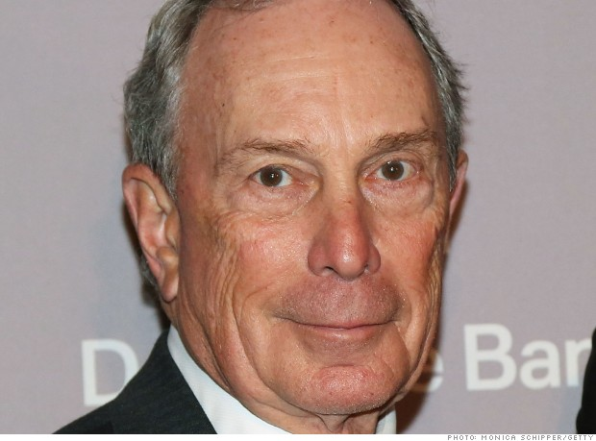
15. Michael Bloomberg

Slide 32
Age: 72 Majority owner, Bloomberg L.P.
Bloomberg maintained high approval ratings for nearly all of his 12 years as New York City's mayor (2002-14), winning his first reelection by a 20-point margin, the largest ever for a Republican in the heavily Democratic city. He has now returned to the financial data firm he founded but is hardly giving up his high-wattage policy activism -- leading campaigns for gun control and against smoking and obesity.

Slide 33
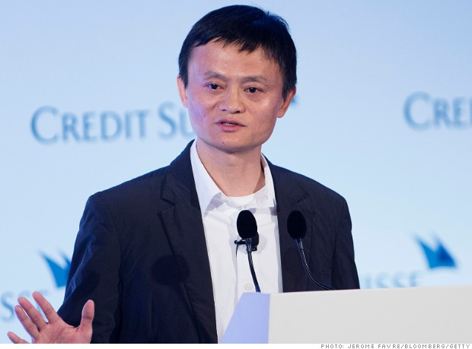
16. Jack Ma

Slide 34
Age: 49
Executive chairman, Alibaba Group
Ma became a billionaire not just through brilliant management but also by leading his company in a big, brash way. From the day in 1999 when he founded Alibaba in a Hangzhou apartment, he has exhorted employees to "think big" and "work for their dreams!" He did that himself and built Alibaba into the world's largest online business, with some 100 million shoppers a day and higher revenues than Amazon and eBay combined.

Slide 35
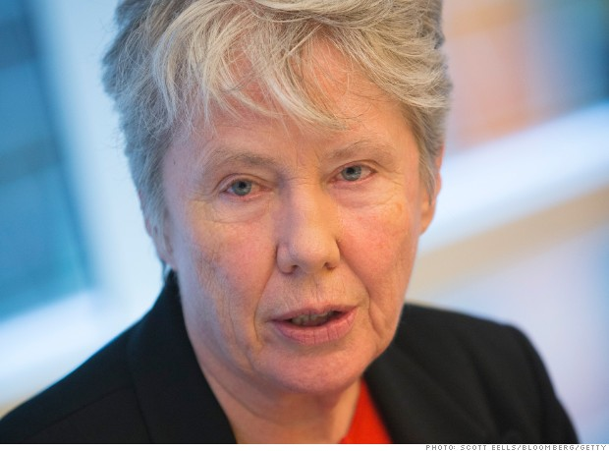
17. Maria Klawe

Slide 36
Age: 62
President, Harvey Mudd College
A mathematician and computer scientist by training, Klawe is leading the charge to bring more women into science, technology, and engineering. At Harvey Mudd, freshman women go to computer conferences, and introductory coding classes are now designed to be more welcoming to newcomers. Thanks in no small part to Klawe, women now make up 40% of computer science majors at the college, up from 10% in 2005.

Slide 37
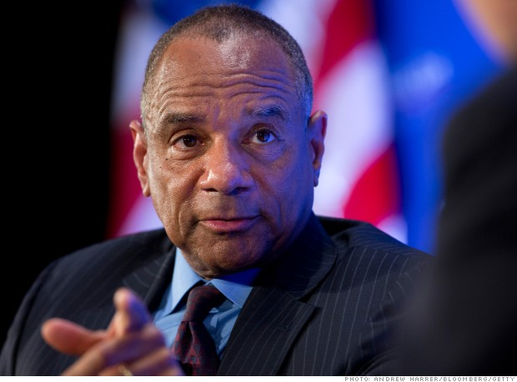
18. Ken Chenault

Slide 38
Age: 62
CEO, American Express
He's the most accomplished leader in global finance. Operating in the economy's most hobbled and reviled sector since the 2008 meltdown, Chenault has kept AmEx (AXP, Fortune 500) noncontroversial, strong, stable, and admired. At least twice during the crisis he declined offers to lead even larger institutions, insiders say. Chenault previously led the company through the 9/11 attacks, which decimated travel, the basis of its business.

Slide 39
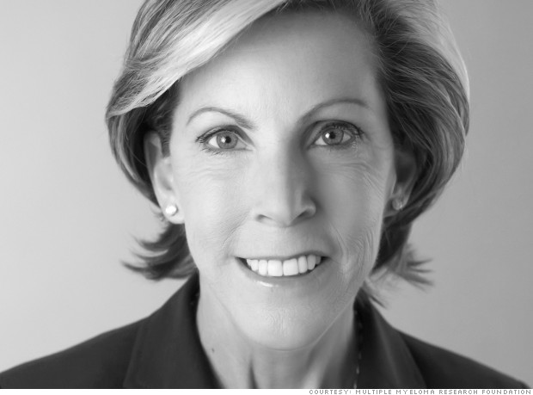
19. Kathy Giusti

Slide 40
Age: 55
CEO, Multiple Myeloma Research Foundation
Within weeks of her diagnosis in 1996, Giusti began disrupting the myeloma research culture -- getting isolated doctors and scientists to share data, and building an unheard-of consortium to develop drugs. Harvard B-School Dean Nitin Nohria calls her "an entrepreneur in the truest sense of the word -- someone who sees beyond existing constraints to imagine novel solutions to once intractable problems."

Slide 41
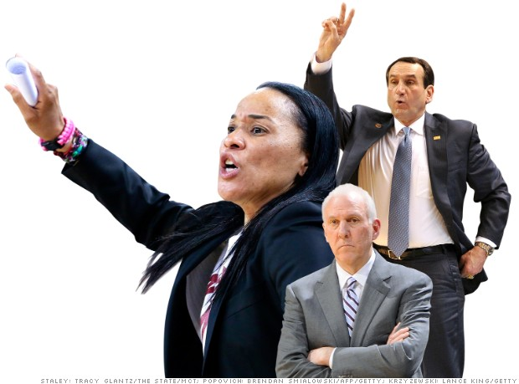
20. Tie: Mike Krzyzewski, Gregg Popovich, Dawn Staley

Slide 42
Krzyzewski, 67, Head coach, Duke University men's basketball team
Popovich, 65, Head coach, San Antonio Spurs
Staley, 43, Head coach, University of South Carolina women's basketball team
Three active coaches with very different styles stand out. We're hard-pressed to say which is best:

Slide 43
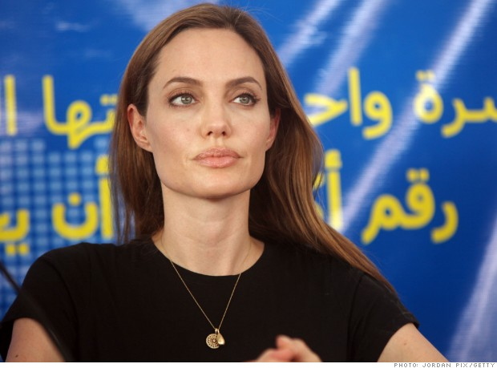
21. Angelina Jolie

Slide 44
Age: 38
Actress, humanitarian
There's no such thing as a fleeting cause célèbre for Jolie; since joining forces with the UN's refugee agency in 2001, first as a goodwill ambassador and now as special envoy, she's undertaken 50 field missions to countries including Iraq, Syria, and Pakistan. Her decision to explain her preemptive double mastectomy in a New York Times editorial, though controversial in some health circles, underscored her willingness to foster hard conversations by taking a public stand. "Angelina Jolie represents a new type of leadership in the 21st century," says U.K. Foreign Secretary William Hague, who has worked with Jolie on efforts to end a plague of rape in war-torn regions. "Her strength lies in the fact that she is able to influence governments and move public opinion at the same time." That Jolie chooses to use her global influence to highlight neglected human rights and humanitarian issues, adds Hague, "is in keeping with the finest traditions of leadership."

Slide 45
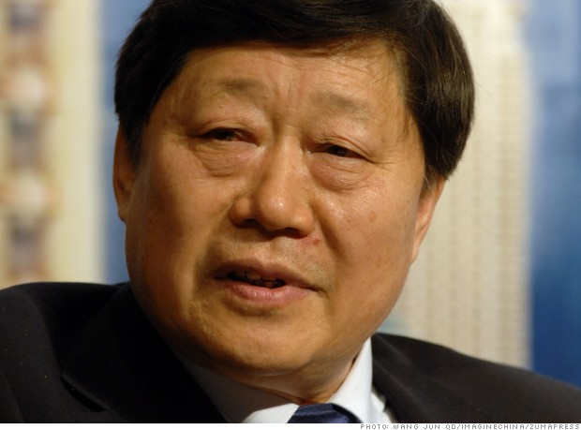
22. Zhang Ruimin

Slide 46
Age: 65
CEO, Haier Group
His radical management innovations have transformed Haier from a small, failing, state-owned refrigerator maker into the world's largest appliance brand. He groups employees into small, self-managing teams that choose their own managers, compete for internal talent, and can earn big bonuses -- unusual in the West and unheard-of in China.

Slide 47
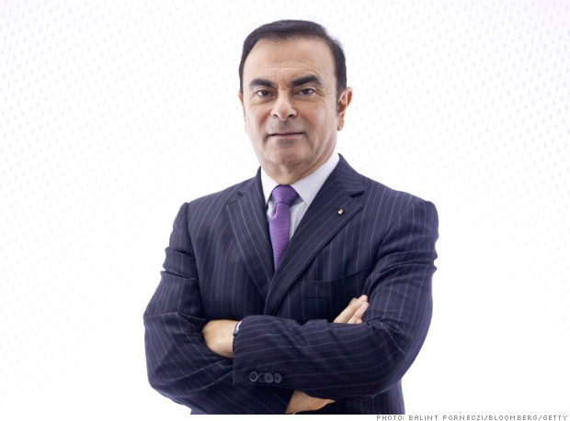
23. Carlos Ghosn

Slide 48
Age: 60
CEO, Nissan; CEO, Renault
Rescuing a giant, old industrial corporation in decline is almost impossible; few leaders have ever done it. Fewer still -- maybe none except Ghosn -- have done it while also a top executive at a separate industrial giant on the other side of the world. His salvation of Nissan from 1999 to 2005 remains "one of the most dramatic turnarounds in the history of the modern corporation," says McKinsey. He did it by smashing Japanese cultural norms -- laying off thousands of workers and cutting ties with members of the Nissan keiretsu. Japanese citizens and media were enraged, but the shock treatment worked, and Ghosn soon became a Japanese hero, his exploits even celebrated in a manga comic book. No wonder the Insead business school calls Ghosn a "transcultural leader."

Slide 49
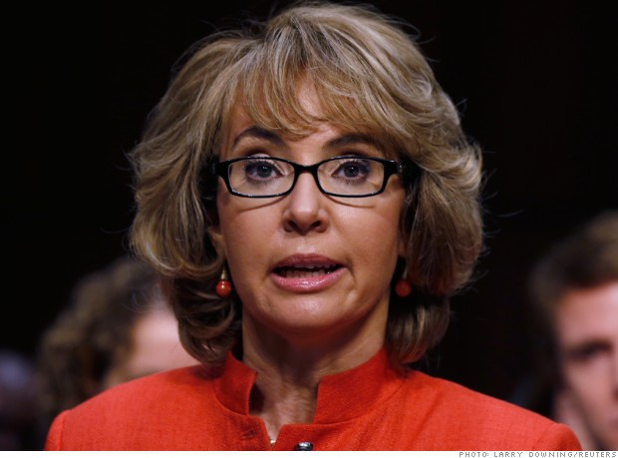
24. Gabrielle Giffords

Slide 50
Age: 43
Co-founder, Americans for Responsible Solutions (ARS)
Three years after she was shot at a Tucson supermarket, the former Arizona congresswoman has become a major force in the effort to end the plague of gun violence. In 2013 she and husband Mark Kelly, both gun owners, launched a Super PAC, ARS, a move that Daniel Webster, director of John Hopkins' Center for Gun Policy and Research, calls a true "game changer."

Slide 51
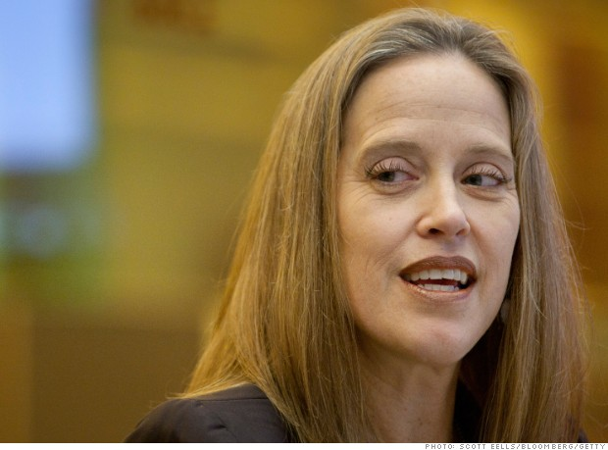
25. Wendy Kopp

Slide 52
Age: 46
CEO and co-founder, Teach for All
Twenty-five years after turning her Princeton senior thesis into a national education reform program called Teach for America, Kopp is taking her model global. A low-ego leader with big dreams, the 46-yearold Kopp has recruited social entrepreneurs in 32 countries to become teachers in underfunded public schools. Her aim? "To narrow educational disparities around the world."

Slide 53
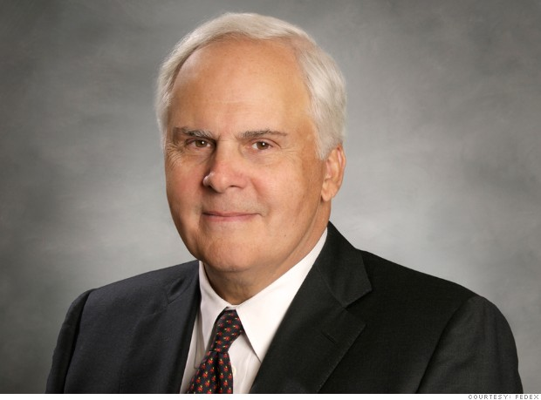
26. Fred Smith

Slide 54
Age: 69
CEO, FedEx
Smith created a world-changing industry -- overnight air delivery -- that no one knew they needed until finding they couldn't live without it. His ability to continue leading FedEx (FDX, Fortune 500) to be bigger and more successful for 40 years is nearly unique and has sparked such transformative improvements as online package tracking. He's still pushing and is a hero to the company's 300,000 employees.

Slide 55
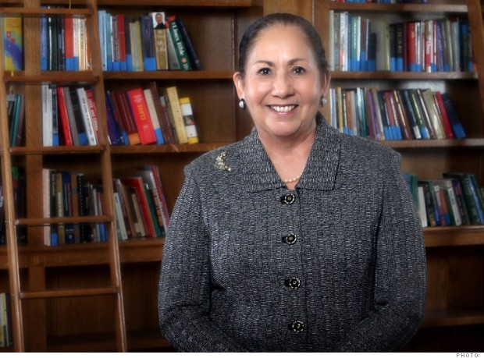
27. Juliet V. García

Slide 56
Age: 64
President, University of Texas at Brownsville
García has utterly reengineered educational opportunities for Hispanics in South Texas, forging, in 1991, the innovative partnership between a community college and the UT system, and helping create UT-Rio Grande Valley, opening in 2015. Ford Foundation president Darren Walker lauds her "rare capacity" for bridging grassroots and elites.

Slide 57
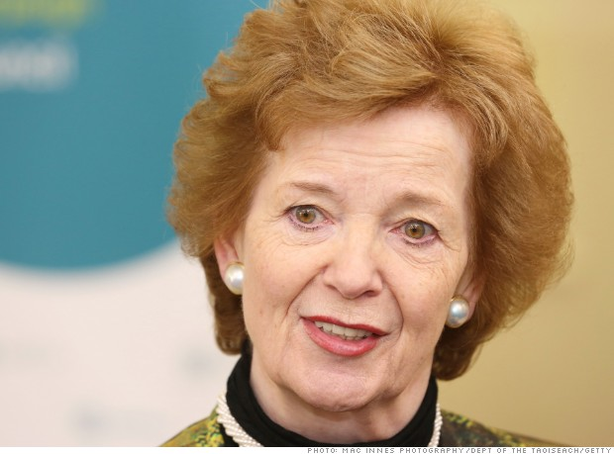
28. Mary Robinson

Slide 58
Age: 69
President, Mary Robinson Foundation -- Climate Justice
As the first female president of Ireland, Robinson broke barriers. As a long-serving UN high commissioner for human rights, she framed crimes against humanity in strikingly personal terms. Now, through her foundation, she is vividly -- and convincingly -- showing the world how climate change is affecting the poorest of the poor.

Slide 59
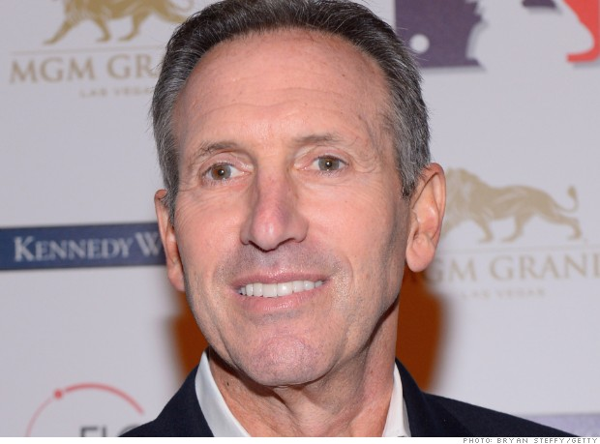
29. Howard Schultz

Slide 60
Age: 60
CEO, Starbucks
A small Seattle coffee retailer has become 20,000 shops worldwide under Schultz's leadership (SBUX, Fortune 500), with many more planned. Crucially, he understood that he was creating an experience, not selling a product. Far ahead of most CEOs, he saw the value of offering medical insurance to all employees, even part-timers, and pursuing environmental and social projects that inspire employees and attract customers.

Slide 61
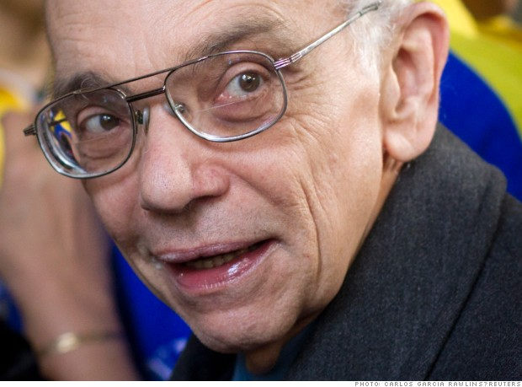
30. José Antonio Abreu

Slide 62
Age: 74
Founder, El Sistema
Abreu started El Sistema in a garage with 11 musicians in 1975. Today it teaches music to 400,000 poor kids in Venezuela and has inspired similar programs worldwide. Its value is that it teaches not just music but also discipline, practice, cooperation, and culture. A canny leader, Abreu has cultivated support from Venezuela's many varying governments over the past 39 years.

Slide 63
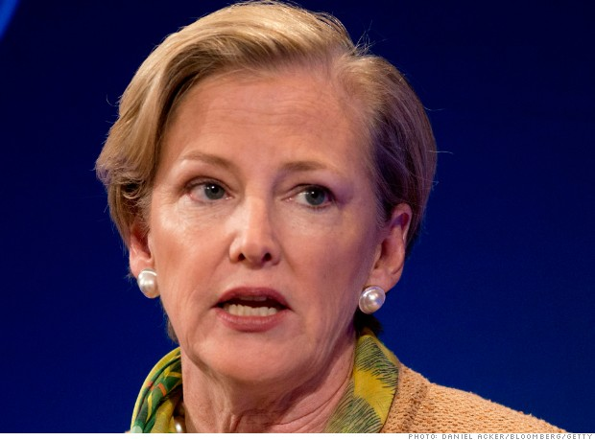
31. Ellen Kullman

Slide 64
Age: 58
CEO, DuPont
The first woman to head the 212-year-old company (DD, Fortune 500), Kullman took over as a dismal 2009 began and by year-end had publicly vowed to raise earnings over three years at a 20% annual compound rate. She did 24%, as she accelerated a major strategic change -- "and nobody likes change," says a colleague -- that downplayed chemicals and positioned agriculture and nutrition to power DuPont's third century.

Slide 65
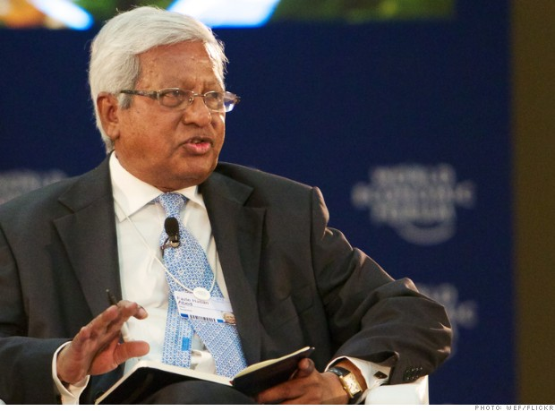
32. Sir Fazle Hasan Abed

Slide 66
Age: 77
Chairman, BRAC
After his native Bangladesh fought a war to become independent, Abed established BRAC (originally Bangladesh Rehabilitation Assistance Committee) to aid the rural poor, including 10 million returning refugees. He has built it into the world's largest nonprofit, with over 100,000 employees serving millions in 10 Asian and African countries. He was knighted in 2010.

Slide 67
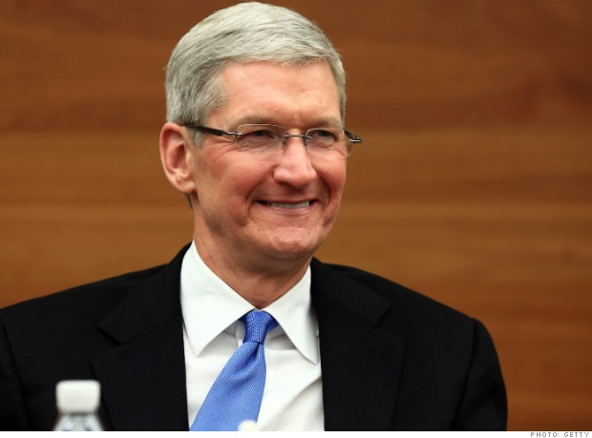
33. Tim Cook

Slide 68
Age: 53
CEO, Apple
Following Steve Jobs has arguably been the toughest corporate leadership assignment in decades, yet Cook has carried it off with mostly quiet aplomb. In 2½ years he has kept the parade of winning new products marching (the Retina display, new operating systems, the iPhone 5), and he is bringing in Burberry's savior, Angela Ahrendts, to run Apple's (AAPL, Fortune 500) retail stores. That's thinking different.

Slide 69
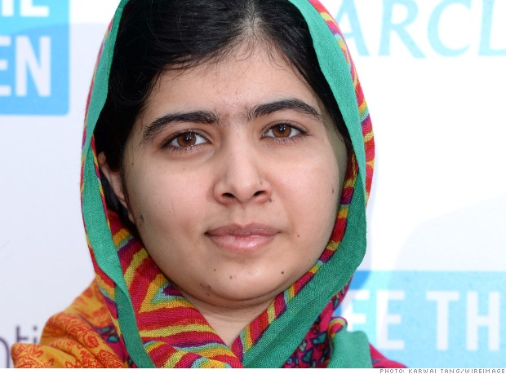
34. Malala Yousafzai

Slide 70
Age: 16
Advocate for education rights
Malala Yousafzai first stood up to the Taliban when she was 11. A fierce and outspoken defender of a female's right to education, the Swat Valley schoolgirl was shot by them four years later aboard her school bus. The senseless act stunned the world, just as her recovery and continued activism -- despite more death threats -- have drawn many to her cause. Bede Sheppard of Human Rights Watch calls Malala a "radiant example that children can be intelligent and savvy advocates for their own rights."

Slide 71
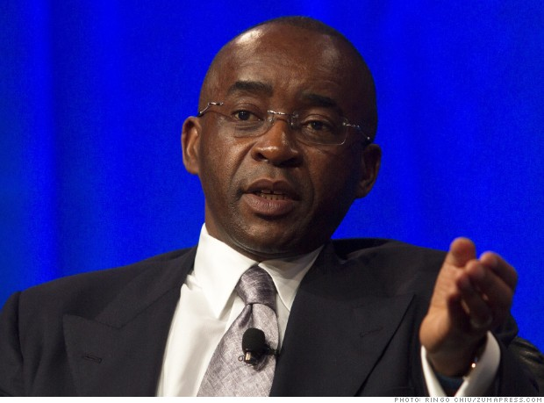
35. Strive Masiyiwa

Slide 72
Age: 53
Founder & chairman, Econet Wireless
Nearly two decades ago Masiyiwa fought and won a key court battle to open Zimbabwe's telecom industry to private investment. Masiyiwa, who sits on the Africa Progress Panel as well as the boards of Alliance for a Green Revolution in Africa and the Rockefeller Foundation, is a persuasive advocate for development opportunities and the creation of strong government institutions. "He is truly one of Africa's most influential figures, with his good counsel sought by world leaders and CEOs," says Rockefeller Foundation president Judith Rodin, who calls him "a champion for the power of technology to improve the lives of millions."

Slide 73
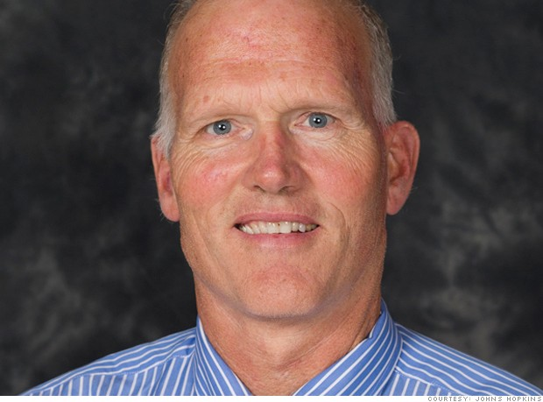
36. George Kennedy

Slide 74
Age: 58
Head coach, Johns Hopkins University swim teams
Kennedy is in his 29th coaching season at Johns Hopkins, but veterans of his swim teams say you'd never know it. Kennedy sees not just each season, but each meet as a new chance to change things up. Maybe that's how his teams have won 23 conference titles and had 17 top-five NCAA finishes. "My four favorite words," he says, are 'We can do better.' "

Slide 75
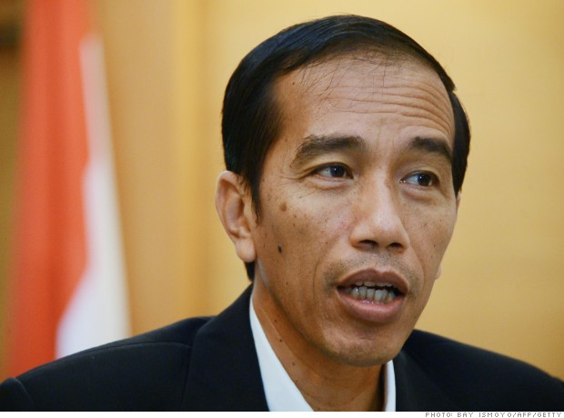
37. Joko Widodo

Slide 76
Age: 52
Governor, Jakarta, Indonesia
In 2005 the self-made furniture exporter was elected mayor of Solo, a 500,000-person city in Indonesia. "Jokowi," as he's known, cleaned up the city and rooted out corruption, thrilling an Indonesian public weary of the status quo. His ascent since then has been swift: In 2012 he became governor of Jakarta. Now he's the favorite for Indonesia's July 2014 presidential election.

Slide 77
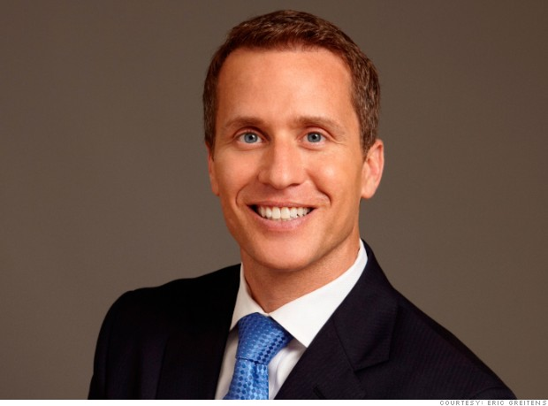
38. Eric Greitens

Slide 78
Age: 39
Founder & CEO, The Mission Continues
"I think fundamentally leadership is a species of courage," says Missouri-bred Greitens, a former Navy SEAL and a Rhodes Scholar. "A lot of people approach leadership from a different perspective, but for me a true leader is someone who confronts fear, embraces pain, and welcomes suffering. It's on the frontline of hardship, pain, and difficulty that leaders really make a difference." In 2007, Greitens took his commitment back to the frontlines, founding a nonprofit organization that serves post-9/11 veterans by deploying them to service projects across the country. It's about providing them with "a challenge, not charity," he says -- and changing the way Americans, and the veterans themselves, think about veterans.

Slide 79
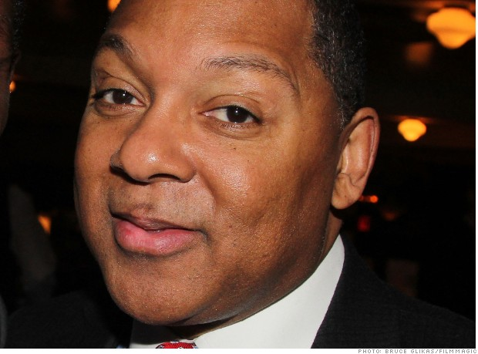
39. Wynton Marsalis

Slide 80
Age: 52
Managing and artistic director, Jazz at Lincoln Center
Call him the guardian of American jazz: Pulitzer Prize winner Marsalis has relentlessly played, composed, and taught throughout his career, and built Jazz at Lincoln Center into a bastion of the art form. Moreover, "he has developed a generation of musicians," says longtime friend and American Express CEO Ken Chenault.

Slide 81
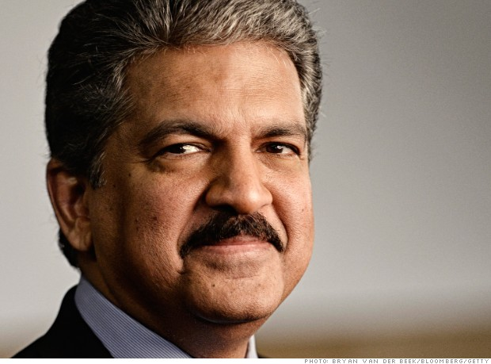
40. Anand Mahindra

Slide 82
Age: 58
Chairman, Mahindra & Mahindra
A third-generation corporate aristocrat, Mahindra has aggressively expanded the big conglomerate through acquisitions in autos, computer services, aeronautics, and more, while maintaining the company's standing as one of India's most sought-after employers. The company remains well regarded in Indian society as he has reinforced a policy of integrity in a notoriously corrupt environment.

Slide 83
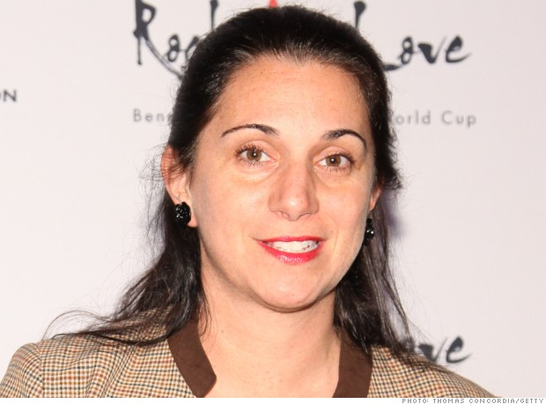
41. Nancy Lublin

Slide 84
Age: 42
CEO, Do Something
Lublin is a standout among social entrepreneurs. Back in 1996, at age 24, she turned a $5,000 inheritance into Dress for Success, a nonprofit that provides interview suits and career development training to women. Six years later, having finished law school at night, she became CEO of a failing nonprofit called Do Something; by embracing technology, she created one of the largest youth organizations in the world.

Slide 85
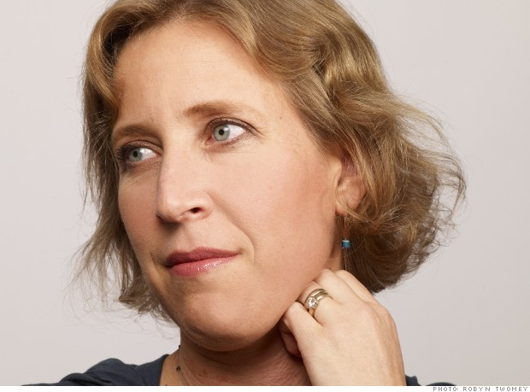
42. Susan Wojcicki

Slide 86
Age: 45
CEO, YouTube
Google's (GOOG, Fortune 500) employee No. 16 officially joined the company in 1999 as its first marketing manager, just a year after Larry Page and Sergey Brin set up their first office in her Menlo Park, Calif., garage. Widely admired within the Googleplex for her management style, Wojcicki was instrumental in guiding the evolution of the company's hugely successful advertising and commerce platforms. Now, many expect Wojcicki, who took the helm of Google's YouTube division in February, to rev up the troops there.

Slide 87
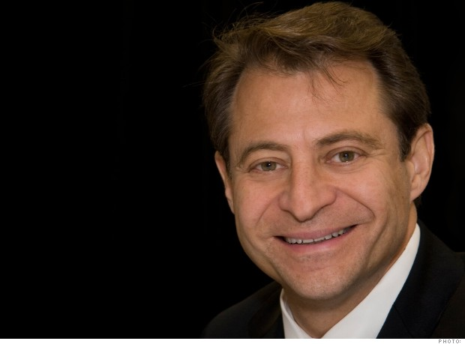
43. Peter Diamandis

Slide 88
Age: 52
CEO, X Prize Foundation
Apart from the 14 other companies he has founded, Diamandis presides over X Prize Foundation, which hosts $10 million competitions to solve global problems. "He has an infectious optimism, which becomes a self-fulfilling prophecy," says futurist Ray Kurzweil. He makes "each person understand that their role is critical to the success of their organization and in turn that the overall project is critical to transforming the world."

Slide 89
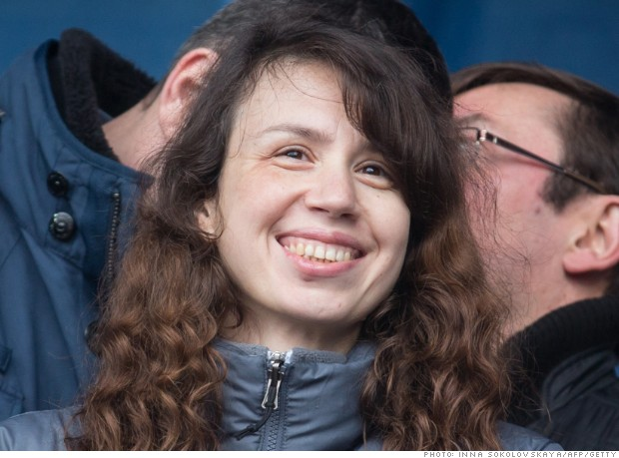
44. Tetiana Chornovol

Slide 90
Age: 34
Reporter, anticorruption policy, Ukraine
One of the first reporters to document the rich estate of then-Ukrainian President Viktor Yanukovych, Chornovol faced continual threats and was beaten to within an inch of her life on Christmas Day. The attack added fuel to the Euromaidan protests, which forced Yanukovych's ouster in February. Chornovol has now been asked to ferret out corruption from inside Ukraine's interim government.

Slide 91
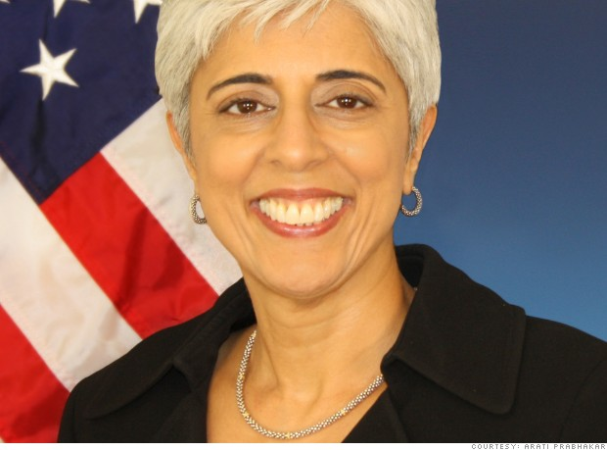
45. Arati Prabhakar

Slide 92
Age: 55
Director, DARPA
Running the military's technology innovation lab in the middle of the austerity era is no easy task. But Prabhakar, who first led a major federal office when she was only 34 and later spent time as a venture capitalist, is meeting the challenge with an outsider's enthusiasm. Key Beltway stakeholders are taking notice. Says Thomas Mahnken, a defense expert at Johns Hopkins University: "She's very charismatic."

Slide 93
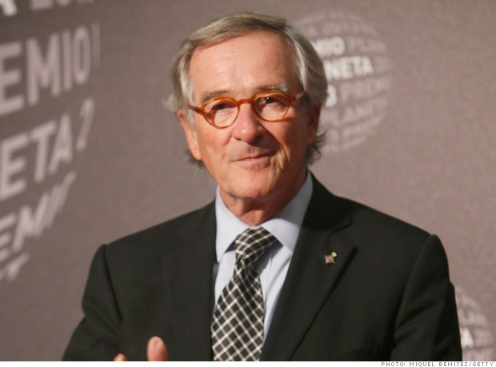
46. Xavier Trias

Slide 94
Age: 67
Mayor, Barcelona
Barcelona has its Mediterranean port, its Gaudí treasures, and since 2011, a mayor who is busy transforming the cultural gem of Spain's Catalonia region into the smartest "smart city" on the planet. Partnerships with companies like Cisco and Microsoft are fueling development, a new tech-campus hub is in the works, and he's connecting citizens to government services through mobile technology.

Slide 95
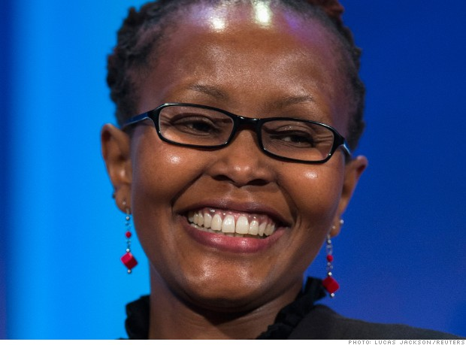
47. Juliana Rotich

Slide 96
Age: 36
Co-founder, executive director, Ushahidi
Nonprofit Ushahidi has helped seed the fast-growing East African tech industry and reimagined what technology can do. Witness its crowdsourced mapping platform, which helps communities track everything from violence to floods.

Slide 97
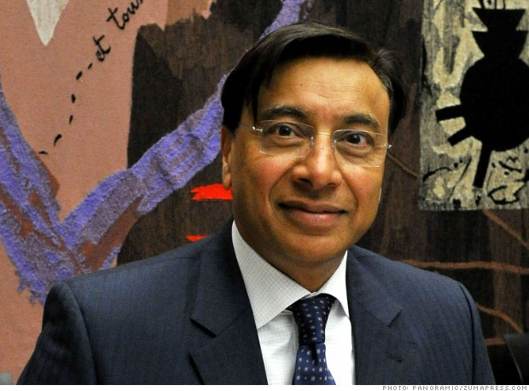
48. Lakshmi Mittal

Slide 98
Age: 63
CEO, ArcelorMittal
Mittal created the world's largest steelmaker (MT) by pursuing a decades-long, impossibly audacious plan of consolidation -- working with governments, powerful labor unions, and other constituencies to rewrite the rules of the old steel industry in tough times.

Slide 99
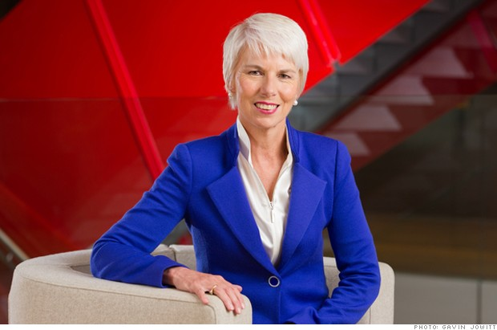
49. Gail Kelly

Slide 100
Age: 57
CEO, Westpac
Her six-year tenure as CEO has brought a 70% return to WestPac (WBK) shareholders -- a remarkable feat given the challenges. Kelly engineered a huge merger with a rival bank, and then had to deal with fallout from the global financial crisis. Australia's most powerful woman in business has gotten high marks all around.

Slide 101
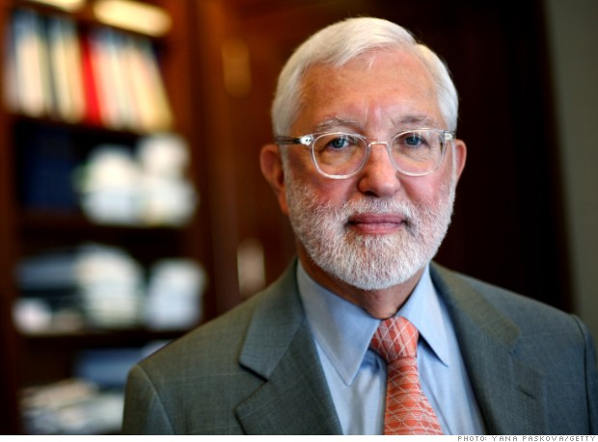
50. Jed Rakoff

Slide 102
Age: 70
U.S. District Court Judge
Breaking with tradition, Judge Rakoff rebuffed the SEC's bid to let Citigroup settle securities violation charges without admitting wrongdoing. The case went to the heart of the financial crisis, he said, and the public deserved to know more. An appeals court still deliberates, but the bold stand, in our view, is an act of leadership.

