Slide 1
Nature can be tough
Nature can be beautiful, and it can be dangerous, sometimes at the same time!

Slide 2
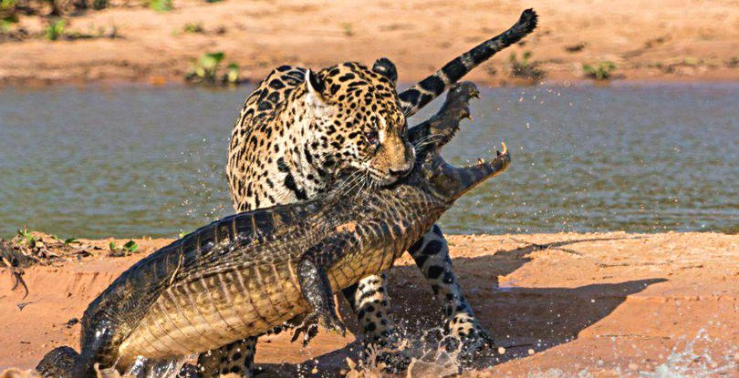

Slide 3
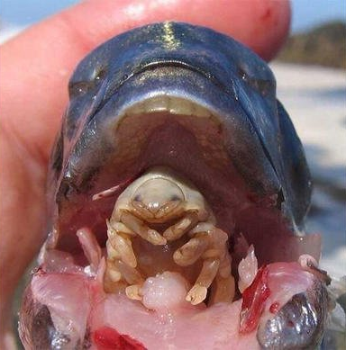
In this fish's mouth is a parasite called Cymothoa Exigua. The parasite enters through the gills, eats the fish's tongue, and then replaces the tongue.

Slide 4
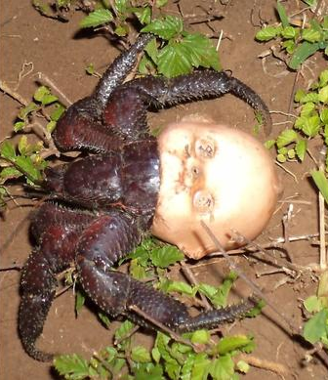
On your left, you'll see a hermit crab using a doll's head as a shell.

Slide 5
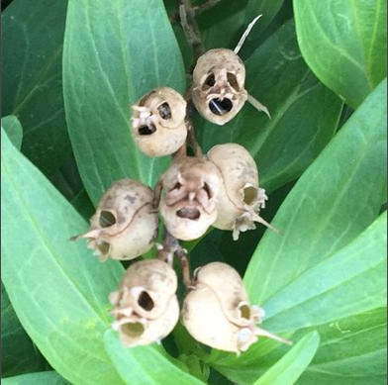
If you look closely in the grass, you'll see the remnants of calcified flowers.

Slide 6
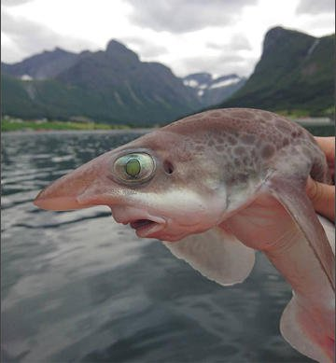
A great variety of shapes.

Slide 7
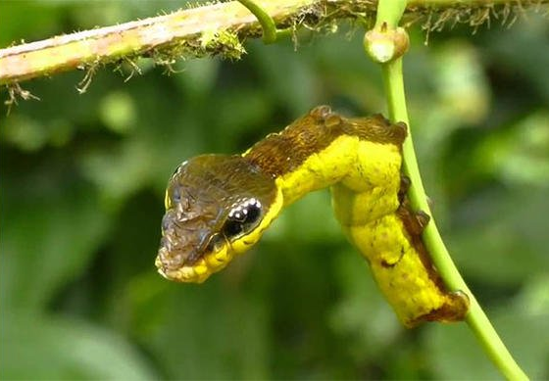
That's just a snake's head caterpillar

Slide 8
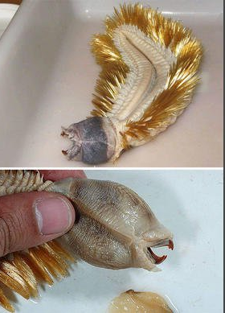
Have you ever seen a worm from Antarctica? Well, here you go! It's called Eulagisca Gigantean, and it has TEETH.

Slide 9
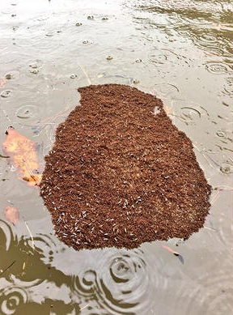
In the waters, you'll see an entire floating island made out of fire ants. Do not touch it. This is real. It happened in Houston after the Hurricane Harvey flooding. NEVER touch these islands.

Slide 10
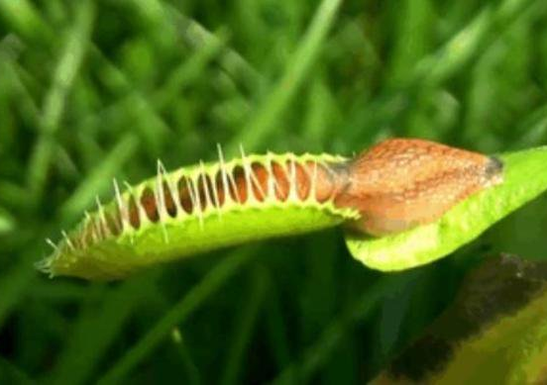
In the grass, you might notice a PLANT eating a SLUG.
That's a Venus Fly Trap, and it eats meat.

Slide 11
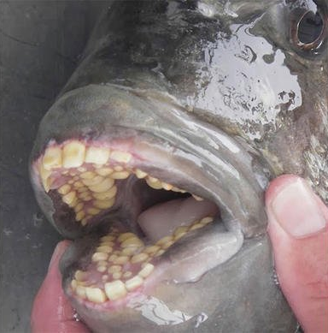
Ever seen the inside of a sheepshead fish's mouth? Well, here ya go.

Slide 12
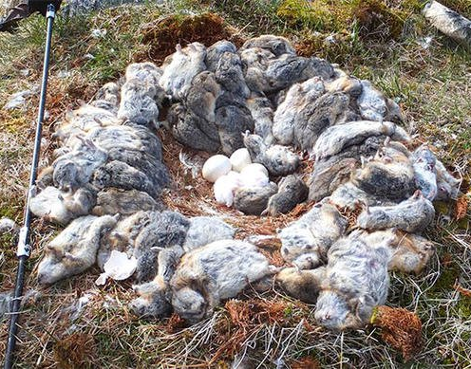
And there's an owl's nest that has been built with the bodies of lemmings she attacked.

Slide 13
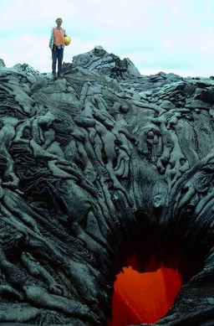
If you're starting to feel the heat, it's from this lava pit of dying souls. If you're starting to feel the heat, it's from this lava pit of dying souls.

Slide 14
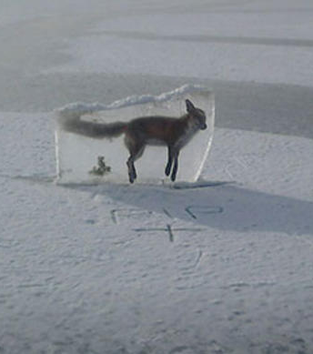
On the arctic lake, you'll notice a grey fox that has been drowned, frozen, and then extracted from the ice.

Slide 15
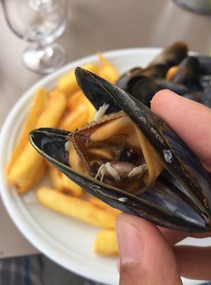
Inside this mussel you'll see a tiny, half-eaten crab.

Slide 16
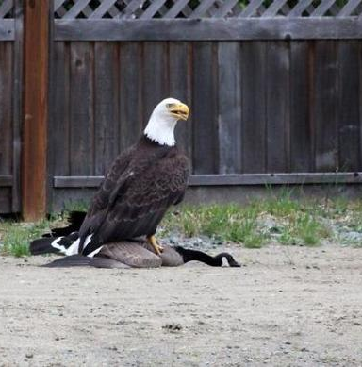
If you notice a bald eagle taking down a Canadian goose, leave it alone.

Slide 17
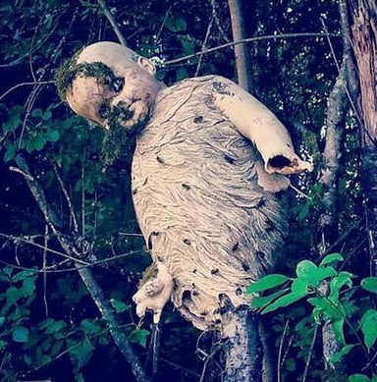
Up ahead in the trees, you'll see a doll with an entire wasp nest in it.

Slide 18
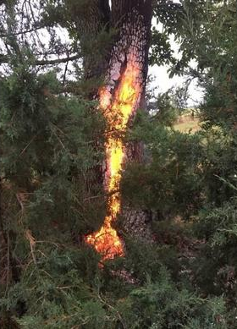
Notice this tree burning with fire inside of it? That's because it got hit by lightning... two days ago.

Slide 19
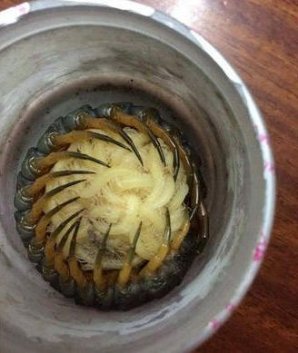
Oh, and here in my coffee cup is a giant centipede protecting her babies.

Slide 20
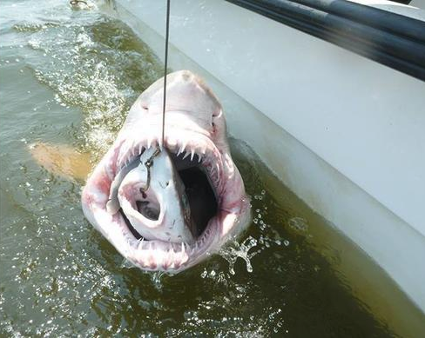
Want to go fishing? You might catch a shark... inside of another shark.

Slide 21
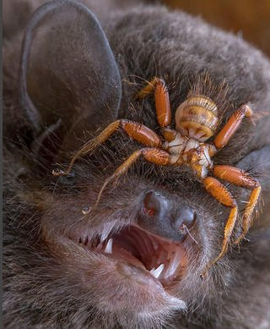
Up close on this bat's face, you'll see a wingless fly called a penicillidia. It attaches itself to the bat's face (and our nightmares) and never leaves.

Slide 22
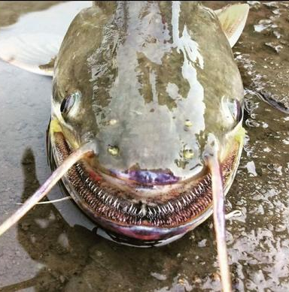
Look at this strange looking fish on the shores of the river. This is the Wallagu Attu catfish.

Slide 23
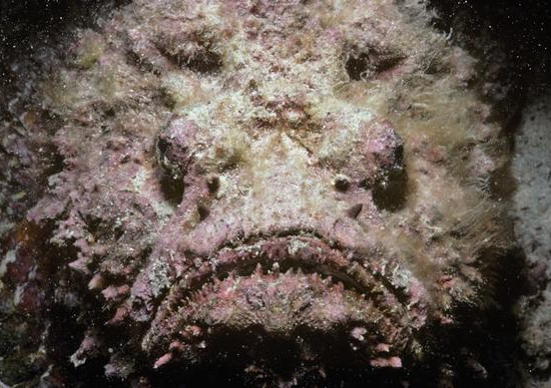
Elsewhere in the water, you'll see a giant stonefish. He dares you to step on him so he can sting you. The sting is said to be so painful that people have begged to have their leg cut off.

Slide 24
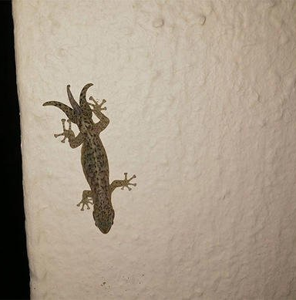
And over here, you'll see a gecko with three tails.

Slide 25
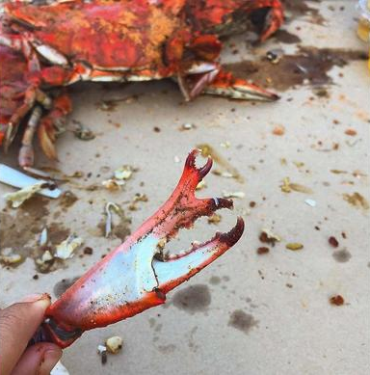
At the beach, you'll see a crab claw growing out of another crab claw.

Slide 26
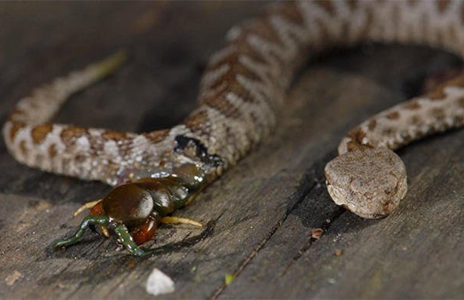
If you look on this porch, you might notice a centipede coming out of a snake's side. That's because the snake devoured the centipede, and then the centipede dug its way out of the snake's insides. A win for the prey!

Slide 27
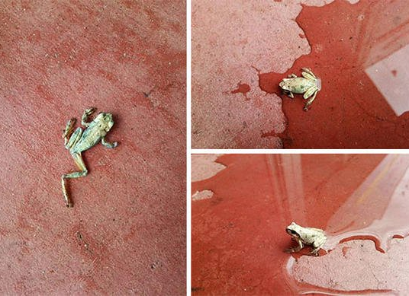
And here inside this house, here's a frog that came back to life. Just add water.

Slide 28
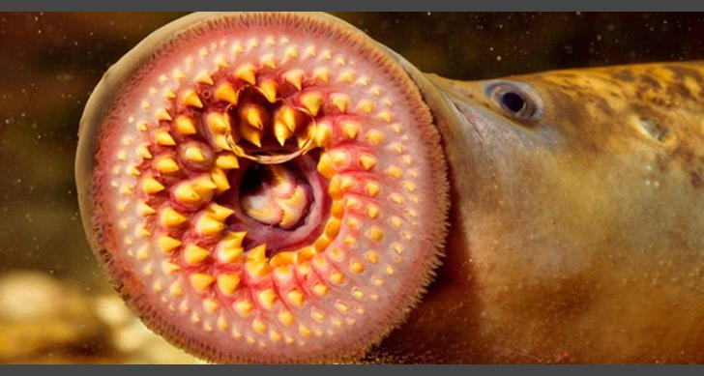
And in the water, you'll see the inside of a lamprey's mouth.

Slide 29
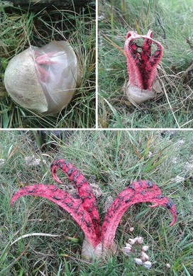
In the grass, you'll notice devil's fingers fungus.

Slide 30
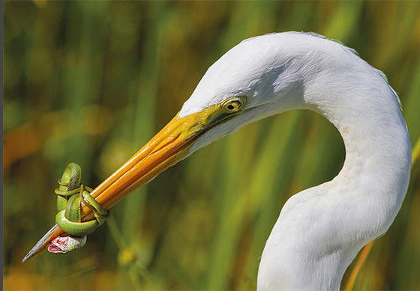
Have you ever seen an epic battle between prey and predator?

Slide 31
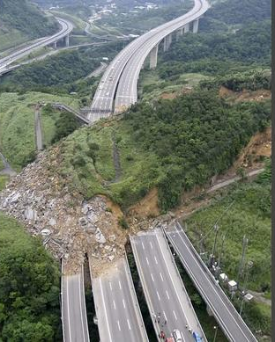
Oh, and in case you thought only animals were terrifying? Look at this Taiwanese landslide on a major highway.

Slide 32
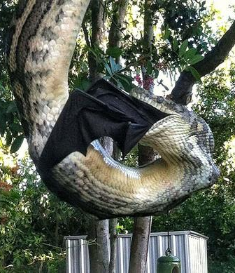
Check out this python eating a flying fox. The world's largest bat is no match for this horrific creature, clearly.

Slide 33
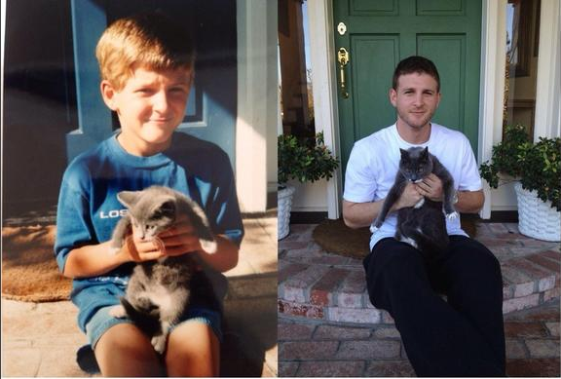
Seventeen years later: Furrever friends!

