Slide 1
Most Dangerous Countries In The World For Tourists

Slide 2
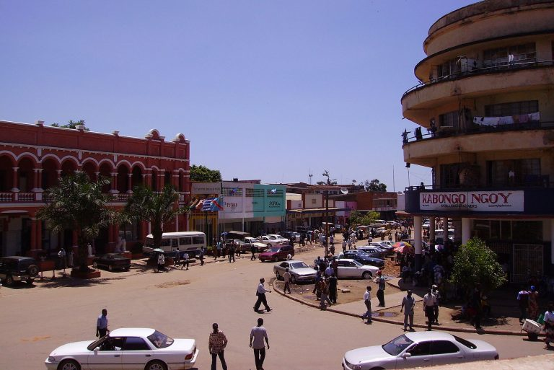
1. Democratic Republic of the Congo:
A number of different armed groups, including bandits and the Congolese Armed Forces themselves, populate the country and are known for being quite violent.

Slide 3
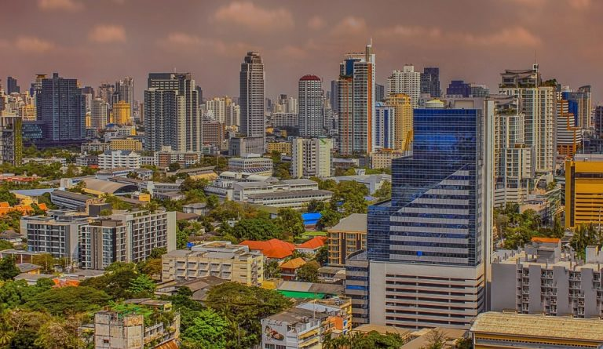
2. Thailand:
There are four provinces in southern Thailand that are considered the most dangerous and where there have been roughly 6,500 violent deaths in the past 13 years: Pattani, Yala, Songkhla, and Narathiwat. Martial law is even imposed on the area.

Slide 4
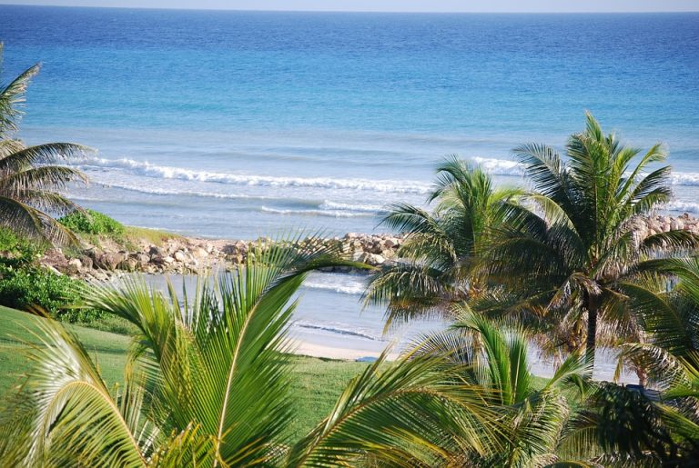
3. Jamaica:
Montego Bay and Kingston in particular have had problems with violent crime, including shootings, in recent years. Even those staying in resorts are not invulnerable. Jamaica is beautiful, but the dangers are something to watch out for.

Slide 5
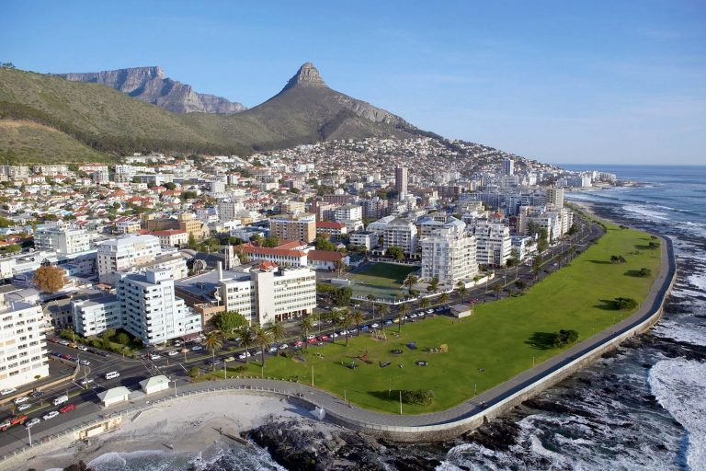
4. South Africa:
There are such high crime rates in South Africa that some citizens have taken to hiring their own private security guards. Murder and rape are especially prevalent in the more remote regions. Still, destinations like Cape Town are known for being some of the most beautiful travel spots on the planet.

Slide 6
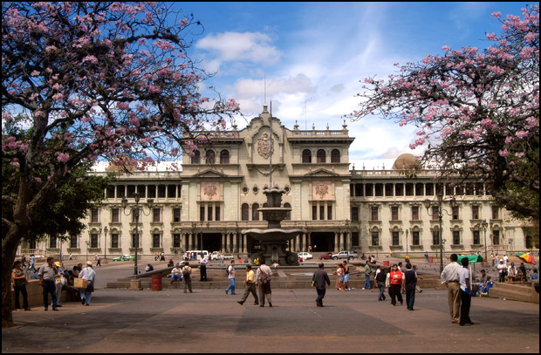
5. Guatemala:
The Guatemalan border with Mexico is among the most unsafe parts of the nation, as the area has been plagued with drug-related crimes and human trafficking. Throughout Latin America and the Caribbean, Guatemala has the fifth highest homicide rate. Armed robberies and carjackings are common as well.

Slide 7
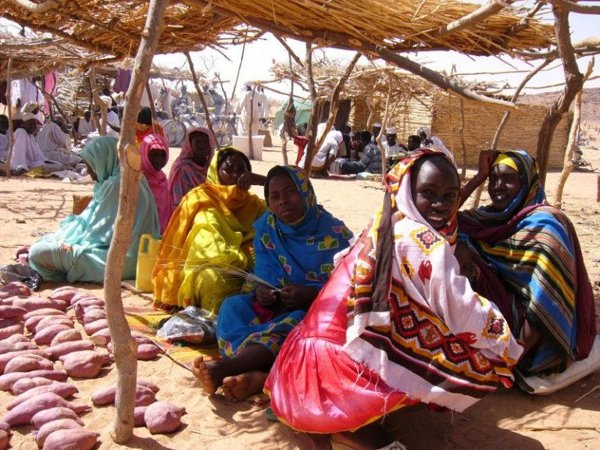
6. Chad:
Al-Qaeda, Boko Haram, and even ISIS have an active presence in this central African country. Foreigners have been just as vulnerable to these terrorist groups as the country’s citizens and security. They also have a problem with the minefields around the borders with Libya and Sudan.

Slide 8
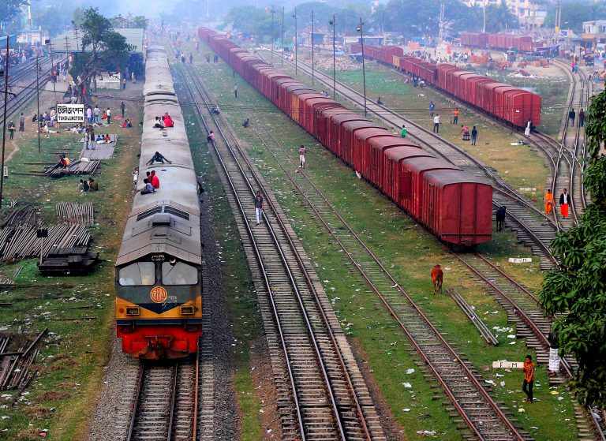
7. Bangladesh:
This South Asian country is not only vulnerable to terrorist attacks, but to extreme weather conditions, including natural disasters like cyclones, floods, and even earthquakes.

Slide 9
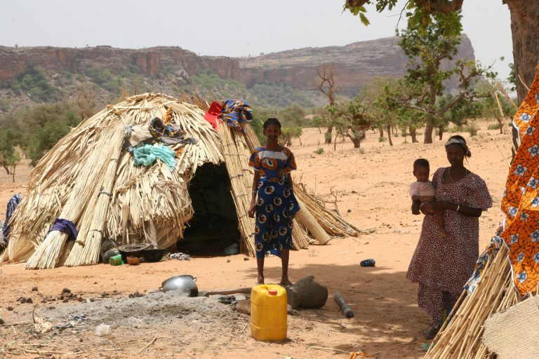
8. Mali:
Bamako, the capital of this West African country, has a high risk of terrorist attacks, as do other parts of central and northern Mali. Restaurants and hotels have been targeted in particular frequency.

Slide 10
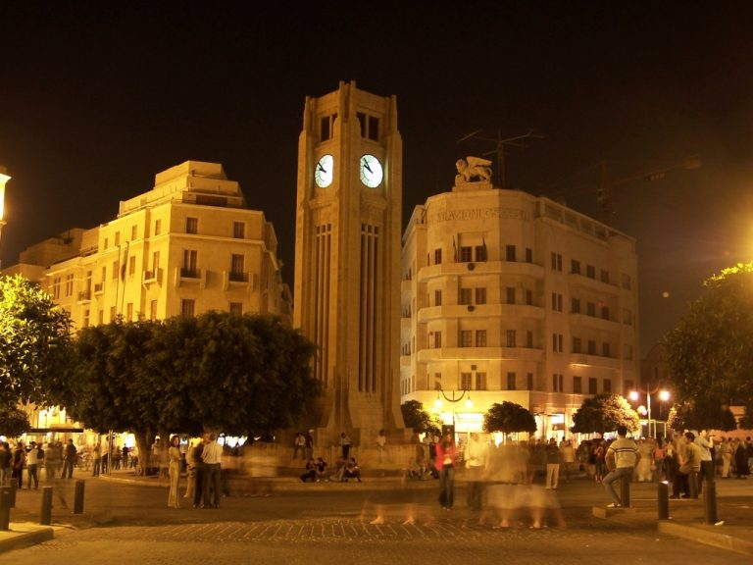
9. Lebanon:
The number of controversial groups that populate Lebanon have made violence a threat to residents and tourists alike. It has also had problems with innocent lives being caught in the crossfire of more relatively minor disputes.

Slide 11
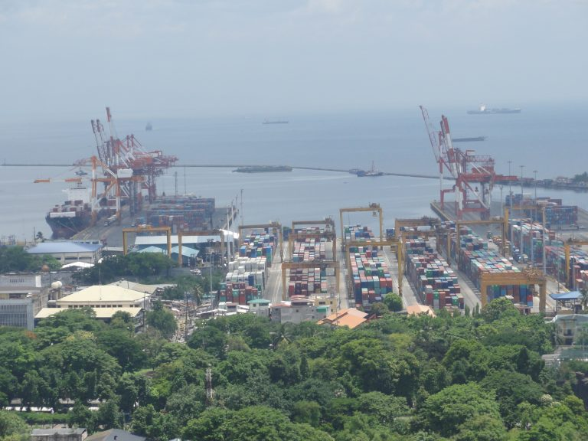
10. The Philippines:
Not only did a Manila casino suffer a fire after a shooting in 2017, but there have been an alarming number of kidnappings with foreigners frequently being targeted, especially around the southern Sulu Sea and the Sulu Archipelago.

Slide 12
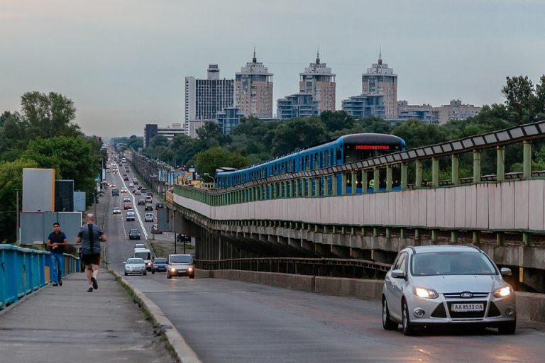
11. Ukraine:
Russian-supported separatists have frequently clashed with the armed forces of Ukraine in the country’s eastern and southeastern regions, with civilians often finding themselves in the crossfire.

Slide 13
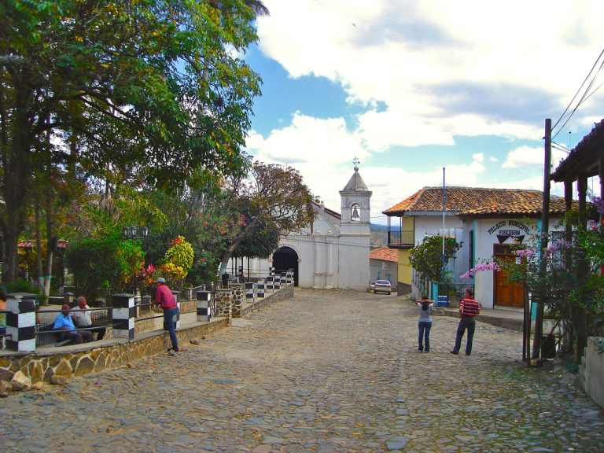
12. Honduras:
Honduras has one of the highest murder rates on the planet. The country struggles so much with drugs and crime that the police are overwhelmed. Seventy percent of American citizen homicides in Honduras have occurred in the areas of San Pedro Sula, La Ceiba, and Tegucigalpa.

Slide 14
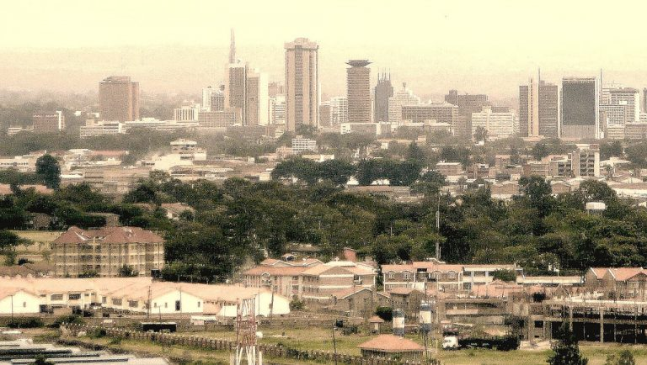
13. Kenya:
There have been a number of terror attacks both within and outside of the capital city of Nairobi (the biggest city in the country), including stabbings, shootings, and even bombings from grenades.

Slide 15
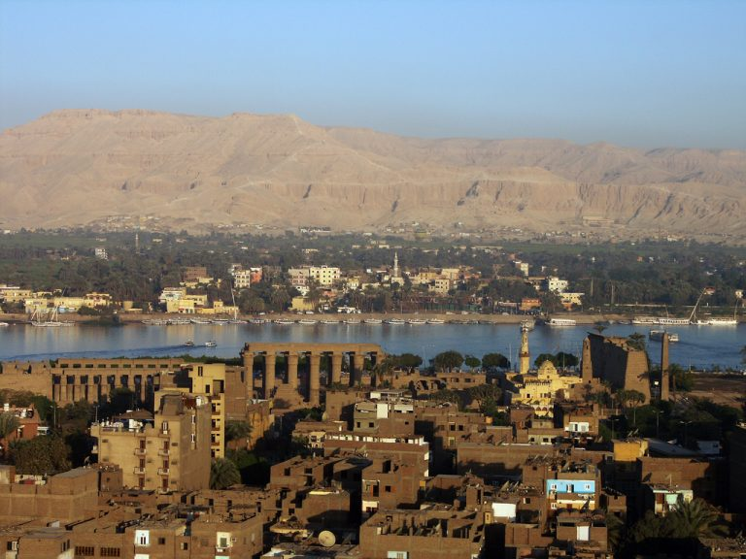
14. Egypt:
Egyptian sites frequently visited by tourists have not been safe from attacks by extremist terrorist groups like ISIS, nor have a number of different modes of transportation. It’s recommended that tourists avoid this area if they can.

Slide 16
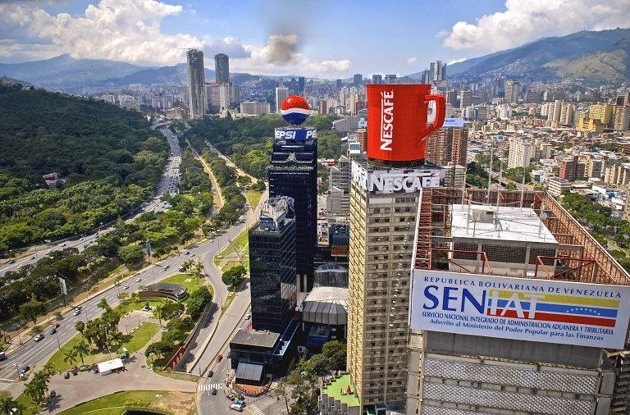
15. Venezuela:
There have been a great deal of challenges in Venezuela due to the political upheaval in the South American nation, all of which has been credited with leading to a rise in crime. These days, it boasts one of the highest crime rates on Earth.

Slide 17
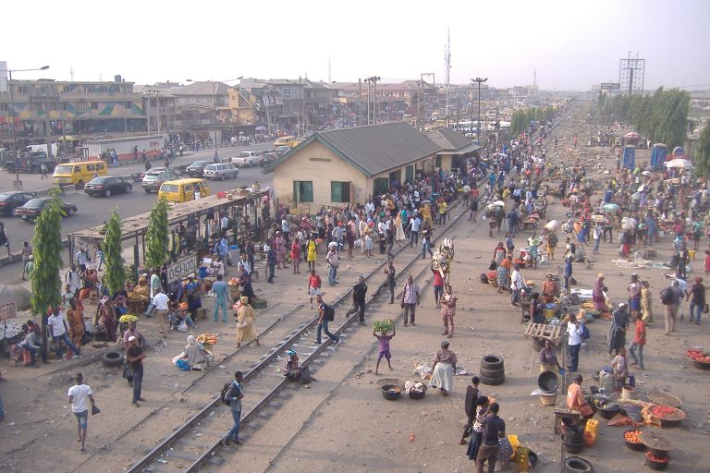
16. Nigeria:
Crowded public places like hotels, restaurants, entertainment venues, churches, and even schools have been targeted by Boko Haram and the Islamic State of West Africa. The U.S. State Department has even issued a travel warning.

Slide 18
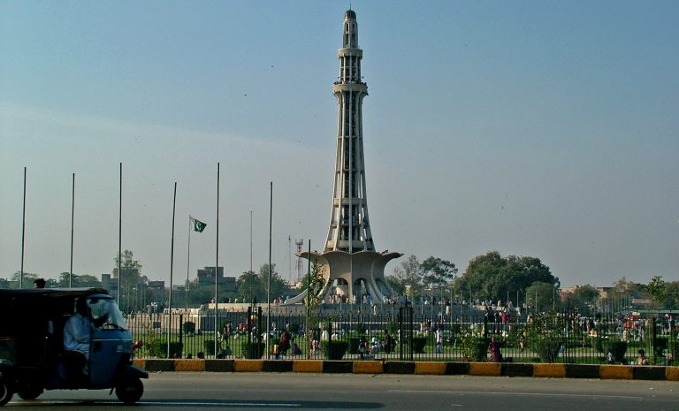
17. Pakistan:
Sadly, Pakistan has had a problem with religious strife for many years. The fact that there are severe limits upon the freedom of speech, and that some places are forbidden to foreigners, certainly doesn’t help.

Slide 19
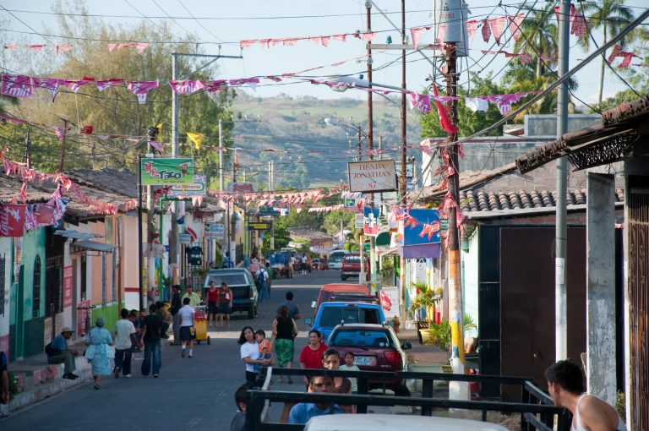
18. El Salvador:
Not only does this Central American nation have one of the highest homicide rates on the planet, but the country is plagued by violent gangs known as maras who have been known to traffic drugs and weapons.

Slide 20
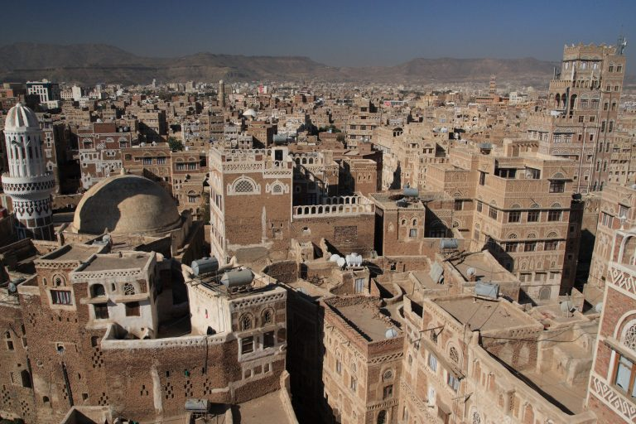
19. Yemen:
U.S. citizens in particular have been targeted and detained in the capital city of Sanaa by rebel groups. Plus, the war there has led to a massive outbreak of cholera and violence.

Slide 21
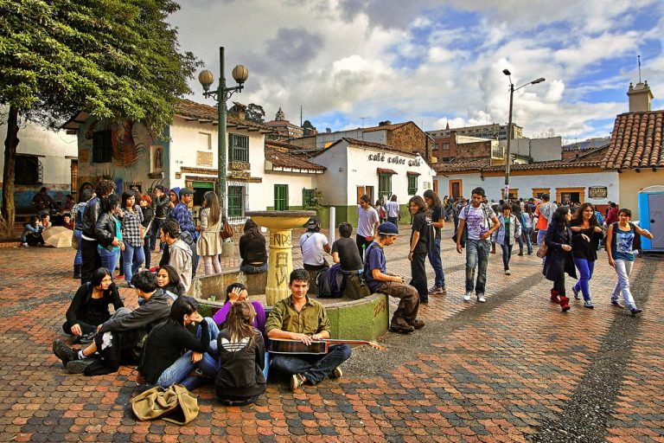
20. Columbia:
It should be noted that this country is not necessarily as dangerous as it once was, but that doesn’t necessarily make it safe, either. It’s still struggling with armed gangs known as Bacrim, as well as terrorist attacks.

