Slide 1
Disturbing before-and-after images show what major US cities could look like in the year 2100

Slide 2
What may lie ahead
The world's oceans levels are rising at faster and faster rates as waters warm and ice sheets melt. Researchers, led by University of Colorado-Boulder professor Steve Nerem, looked at satellite data dating back to 1993 to track the rise of sea levels. Their findings, published in the journal Proceedings of the National Academy of Sciences, show that sea levels aren't just rising — that rise has been accelerating over the last 25 years. Even small increases can have devastating consequences, according to climate experts. If the worst climate-change predictions come true, coastal cities in the US will be devastated by flooding and greater exposure to storm surges by the year 2100

Slide 3
Today 2100

Slide 4
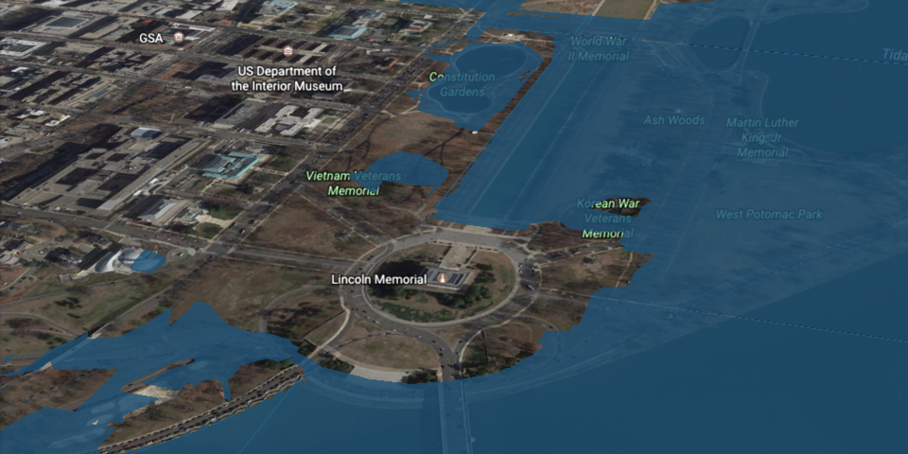
Washington, D.C.

Slide 5
Washington, D.C. today

Slide 6
Washington, D.C. 2100

Slide 7
National Mall today

Slide 8
National Mall 2100

Slide 9
New York today

Slide 10
New York 2100

Slide 11
N.Y. Financial District today

Slide 12
N.Y. Financial District 2100

Slide 13
San Francisco

Slide 14
S.F. 2100

Slide 15
S.F. Airport

Slide 16
S.F. Airport 2100

Slide 17
New Orleans

Slide 18
New Orleans 2100 – 500,000 displaced persons

Slide 19
Charleston, S.C.

Slide 20
Charleston, S.C. 2100

