Slide 1
To My Friend

Slide 2
Your friend is your needs answered.
http://maryt.files.wordpress.com/2008/06/boy-s-best-friend-posters.jpg

Slide 3
He is your field which you sow with love and reap with thanksgiving.
http://www.funtoosh.com/f_images/friend_8.jpg

Slide 4
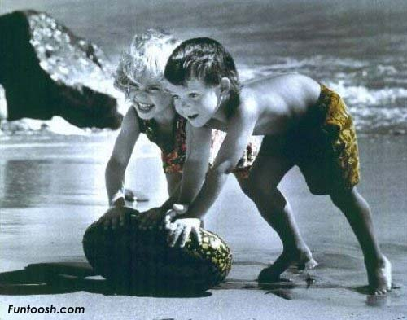
And he is your board and your fireside.
http://www.funtoosh.com/f_images/friend_7.jpg

Slide 5
For you come to him with your hunger, and you seek him for peace.
http://www.trulylovable.com/media/786-between-two-people.jpg

Slide 6
When your friend speaks his mind you fear not the "nay" in your own mind, nor do you withhold the "ay."
http://stealthispicture.com/images/beach-people-shadows-12-19-06/2-people-beach-shadows-002.jpg

Slide 7
And when he is silent your heart ceases not to listen to his heart; For without words, in friendship, all thoughts, all desires, all expectations are born and shared, with joy that is unacclaimed.
http://4.bp.blogspot.com/_FEqCaeQ5Yik/TCry4R2uhHI/AAAAAAAAB9c/1RqwDHiWSLo/s1600/image001.jpg

Slide 8
When you part from your friend, you grieve not; For that which you love most in him may be clearer in his absence, as the mountain to the climber is clearer from the plain.
http://www.abdek.com/stock/art-portrait/stock/happening_somewhere_else_by_girltripped_by-www.abdek.com.jpg

Slide 9
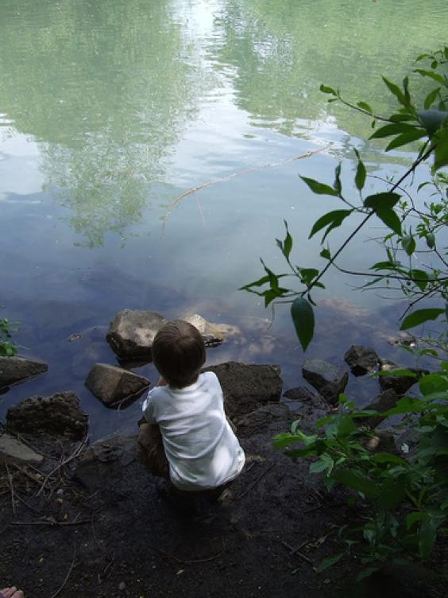
And let there be no purpose in friendship save the deepening of the spirit.
http://s.chakpak.com/se_images/619919_-1_564_none/i-m-alone-wallpaper.jpg

Slide 10
For love that seeks aught but the disclosure of its own mystery is not love but a net cast forth: and only the unprofitable is caught.
http://www.city-data.com/forum/attachments/photography-contests/36188d1234645309-february-theme-love-contest-holding-hands-b-w.jpg

Slide 11
And let your best be for your friend.
http://3.bp.blogspot.com/_asc5ezMrasQ/SyqYWoJgd2I/AAAAAAAAAgI/RivPU_Nod70/s320/small0004.jpg

Slide 12
If he must know the ebb of your tide, let him know its flood also.
http://images.paraorkut.com/img/pics/images/c/crying_and_alone-13002.bmp

Slide 13
For what is your friend that you should seek him with hours to kill?
http://www.sevenof.com/wp-content/uploads/2009/06/kids_in_sprinkler_8693008_std1.jpg

Slide 14
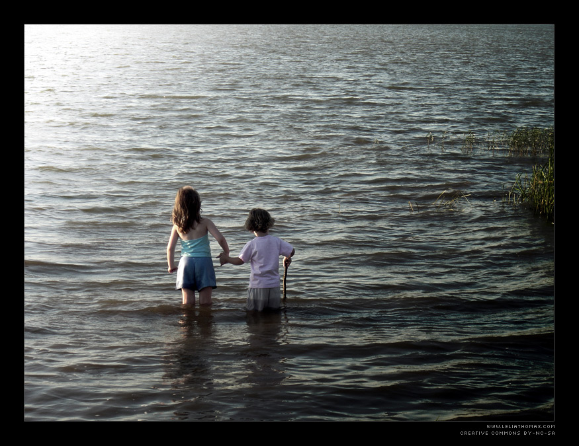
Seek him always with hours to live.
http://www.leliathomas.com/images/uploads/portfolio-uploads/large_well-walk-together.jpg

Slide 15
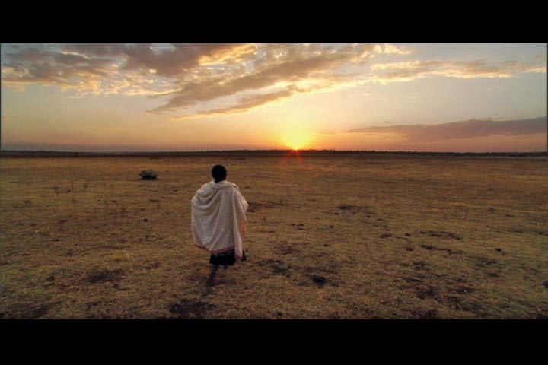
For it is his to fill your need, but not your emptiness.
http://www.womeninworldcinema.com/uploaded_images/Walk_to_Beautiful_06-743674.jpg

Slide 16
And in the sweetness of friendship let there be laughter, and sharing of pleasures.
http://www.more4kids.info/uploads/Image/two-friends-walking.jpg

Slide 17
For in the dew of little things the heart finds its morning and is refreshed.
http://farm1.static.flickr.com/56/126661740_09fc5a03ab.jpg

Slide 18
By - Kahlil Gibran
http://fineartamerica.com/images-medium/somewhere-in-black-sea-amalia-toivonen.jpg

