Slide 1
This is Attitude
How is yours?

Slide 2
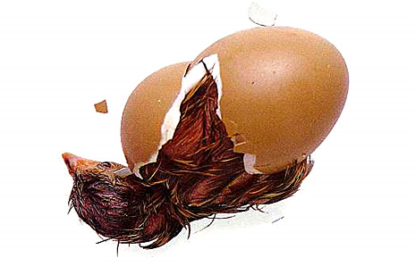
This is attitude
IF AN EGG IS BROKEN BY AN OUTSIDE FORCE..A LIFE ENDS.
IF AN EGG BREAKS FROM WITHIN...... .LIFE BEGINS.
GREAT THINGS ALWAYS BEGIN FROM WITHIN .

Slide 3
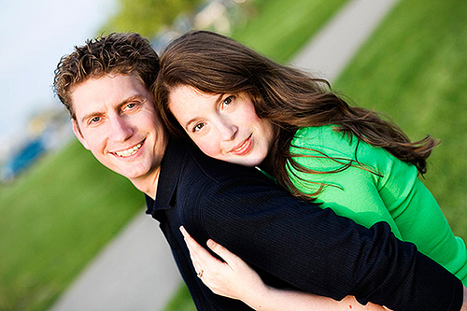
This is attitude
IT'S BETTER TO LOSE YOUR EGO TO THE ONE YOU LOVE.
THAN TO LOSE THE ONE YOU LOVE ....... BECAUSE OF EGO

Slide 4
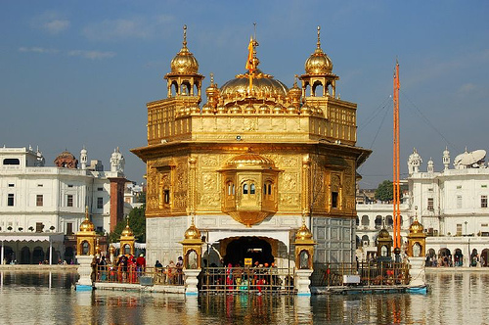
This is attitude
WHY DO WE HAVE SO MANY TEMPLES, IF GOD IS EVERYWHERE ?
A WISE MAN SAID:
AIR IS EVERYWHERE,
BUT WE STILL NEED A FAN TO FEEL IT .

Slide 5
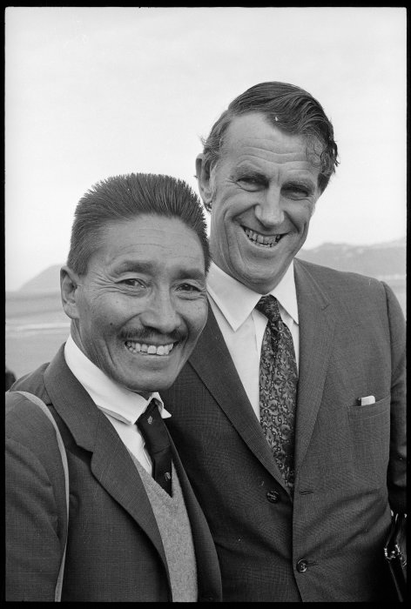
This is attitude
WHEN YOU TRUST SOMEONE TRUST HIM COMPLETELY WITHOUT
ANY DOUBT....... AT THE END YOU WOULD GET ONE OF THE TWO :
EITHER A LESSON FOR YOUR LIFE OR A VERY GOOD PERSON

Slide 6
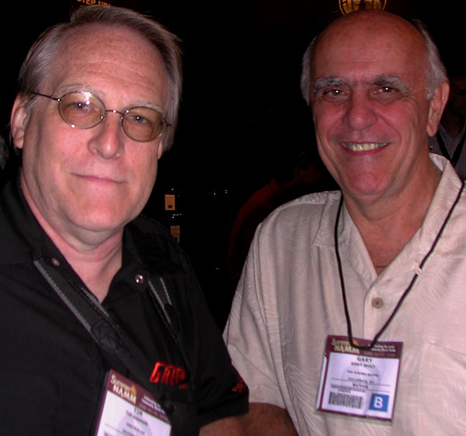
This is attitude
LIFE IS NOT ABOUT THE PEOPLE WHO ACT TRUE TO YOUR FACE ........
IT'S ABOUT THE PEOPLE WHO REMAIN TRUE BEHIND YOUR BACK

Slide 7

This is attitude
SOLDIER : SIR WE ARE SURROUNDED FROM ALL SIDES BY ENEMIES ,
MAJOR : EXCELLENT ! WE CAN ATTACK IN ANY DIRECTION.

Slide 8
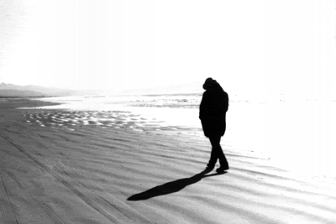
This is attitude
THE WORST IN LIFE IS "ATTACHMENT " IT HURTS WHEN YOU LOSE IT. THE BEST THING IN LIFE IS " LONELINESS "
BECAUSE IT TEACHES YOU EVERYTHING AND, WHEN YOU LOSE IT, YOU GET EVERYTHING.

Slide 9
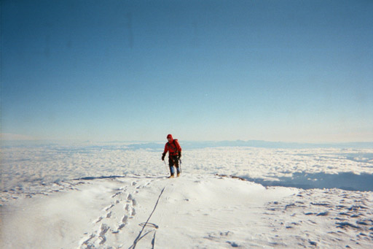
This is attitude
"You never conquer a mountain. You stand on the summit a few moments; then the wind blows your footprints away."
-Arlene Blum

Slide 10
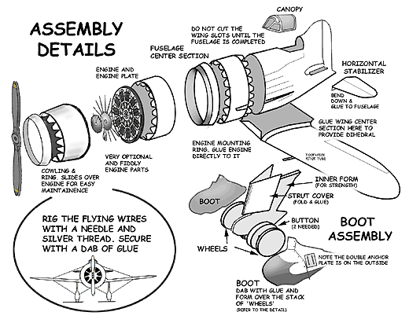
This is attitude
“I hear and I forget.
I see and I remember.
I do and I understand.”
Chinese proverb

Slide 11
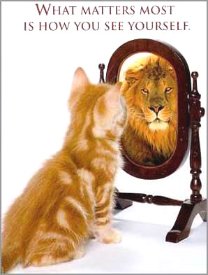
This is attitude
“The greatest waste in the world is the difference between what we are and what we could become.”
Ben Herbste

