Slide 1
Punctuation is Powerful
Yes, it is important to learn grammar and punctuation If one really want to communicate effectively in writing.

Slide 2
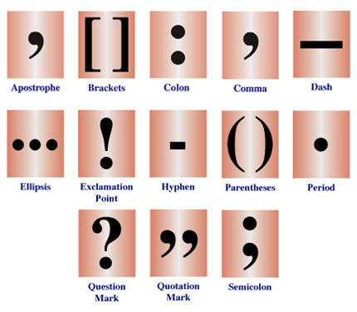

Slide 3
Stimulus
An English professor wrote the words:
"A woman without her man is nothing“
on the chalkboard and asked his students to punctuate it correctly.

Slide 4
Response
All of the males in the class wrote:
"A woman, without her man, is nothing.“
A “put-down” on women.

Slide 5
Response
All the females in the class wrote:
"A woman: without her, man is nothing.“
A “Put-down” on men!

Slide 6
The Moral Is . . . . .
Punctuation is powerful :-)

Slide 7
Sad truths!

Slide 8
Today, many college students cannot express themselves correctly and effectively . . . and they graduate with college degrees.

Slide 9
In most universities the colleges of Arts and Sciences require fewer courses in English composition and communication than they did 50 years ago.
1960 – 2 composition classes (6 credit hrs.)
2 literature (with extensive writing) classes (6 credit hrs.)
1 speech course (2 credit hrs.)
Today – 2 composition classes (6 credit hrs.)

Slide 10
1960 at St. Louis University
After passing the first, Freshman composition, and at the end of the second composition class students took an “Exit Exam.” Everyone had to write an essay in two hours on a topic that was presented to them at the beginning of the two hours. Unless a student got a solid C on that essay, he/she had to take and pass a remedial writing course before he/she was allowed to register for the two Sophomore literature courses.

Slide 11
Why so much writing?
Most third and fourth year courses required two major exams (largely are all essay) and two major research papers (5 – 10 pages).
The university wanted to be certain that every student who made it to the third year was capable of writing acceptable essays and research papers.

Slide 12
A student needed more than the correct number of credits to get his/her degree.
Once a student achieved the required number and selection of courses for graduation, there were two more hurdles to overcome before the degree would be conferred.
A written, comprehensive exam in the student’s major which covered all aspects of that discipline.
An oral comprehensive examination before a committee of 3 to 5 professors from the student’s major subject.

Slide 13
What prepared students for these last two hurdles?
Writing 100 or more exams in their junior and senior years
Writing 100 or more research papers in their junior and senior years.
WHAT IF A STUDENT FAILED THE WRITTEN AND/OR ORAL EXAMS?
Take another semester of courses (minimum 12 credit hours) and then try to pass them at the end of that semester.

Slide 14
What about St. Louis University in 2011
Only 6 credit hours of composition is required.
No “Exit Exam” at the end of the Freshman year.
No comprehensive written and oral exams required before a degree would be conferred.

Slide 15
What about you?
Is your main interest collecting the necessary credits while doing as little as possible to pass?
You may get a degree, but you probably won’t really be educated. After 4 years of university, if you cannot write a clear, well-organized essay, you are not educated.
Do you want to get a solid education so you can compete in the real world of work?
Consider taking more than the required writing courses so you won’t be intimated by essay questions or essay assignments. Then you can graduate with a degree and an education.

