Slide 1
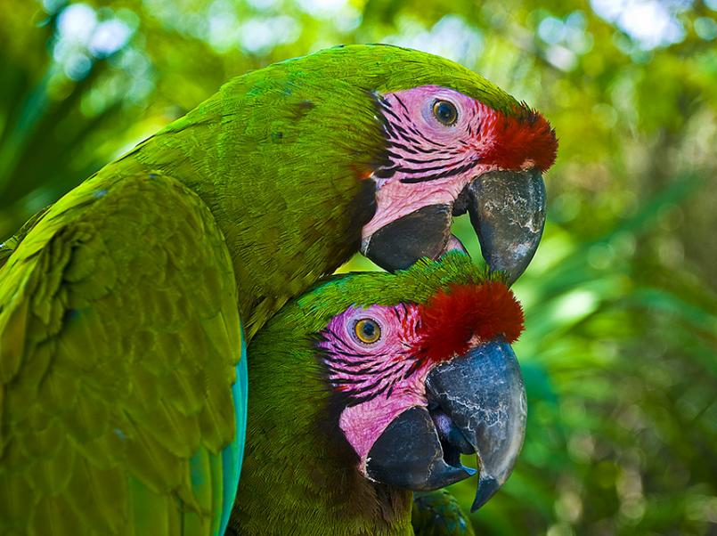
FRIENDSHIP

