Slide 1
A BEAUTIFUL LESSON IN LIFE AND LONGEVITY
Joe Naumann

Slide 2
Be nice to others because: Time WILL make a difference!

Slide 3
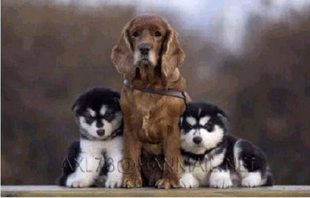

Slide 4
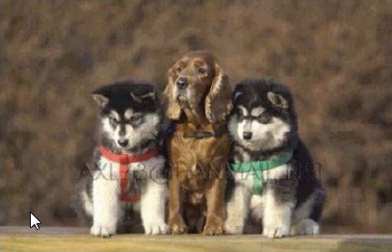

Slide 5
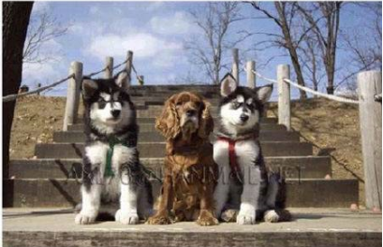

Slide 6
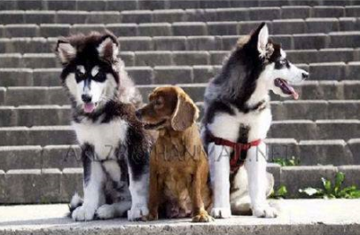

Slide 7
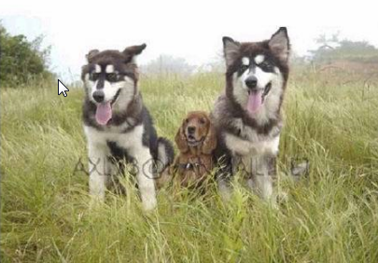

Slide 8
One day you will no longer be the big dog... just the old dog...

Slide 9
And my friend we are now becoming the old dogs!

Slide 10
We can’t avoid this journey . . .
SO . . .
Learn to enjoy the trip!

