Slide 1
21 Ways to Be Inspired
Take Time Out
By Laurie Sue Brockway and Victor Fuhrman

Slide 2
There are so many ways to find inspiration in daily life. It does not require a lot of money or time. The only requirement is to open your spiritual eyes and choose to see life, and life’s natural wonders, in a new light.
Take a few minutes just for you to click through this gallery for easy ways to observe nature, meditate, pray, clear your head, have a good laugh or simply relax.

Slide 3
Watch the Sun Rise
Watch the sunrise and sunset from the best vantage point possible.

Slide 4
Observe Birds in Flight
Look up into the sky on a bright day and observe birds in flight.

Slide 5
Words Can Make You Happy
Read a book or inspirational quotes that help you to believe in the magic of life.

Slide 6
Express Gratitude
Acknowledge at least five experiences or people in your life that you are grateful for. Express gratitude to anyone on your list.

Slide 7
Connect to Nature
Take a walk to a special place that makes you feel connected to nature. Enjoy the sights and smells of a beach, garden or greenery.

Slide 8
Let the Children Play
Watch children at play. Take a moment to appreciate the spirit and joy they express, and the way they live in the present.

Slide 9
Let Music Move You
Put on your favorite music and dance, or just listen.

Slide 10
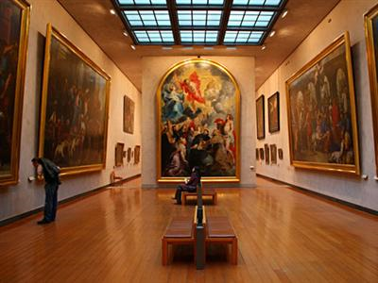
Enjoy Hopeful Art
Gaze at a piece of art or a photo that makes you feel hopeful and happy. Let the colors and images lift your spirits.

Slide 11
Pet a Furry Friend
Pet an animal you love and feel its heart beat against your skin.

Slide 12
Let Water Clear Your Mind
Sit by a waterfall or on a beach, and feel the pure and positive feelings that emanate from water.

Slide 13
Have a Good Laugh
Watch a movie or have a fun moment with a loved one that makes you laugh, and laugh some more.

Slide 14
Smile Often
Smile, as often as possible, even when you do not feel like it. Just the act of smiling will change your day.

Slide 15
Soak Your Cares Away
Take a warm bath in scents or bubble bath you love, and relax your mind.

Slide 16
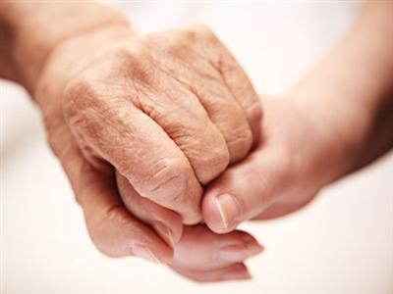
Acts of Kindness
Do something nice for someone in need and allow others to do for you.

Slide 17
Light a Candle
Light a candle and enjoy the warmth of the light. Watch the fire dance, as it casts a light in your life.

Slide 18
Say I Love You
Tell someone you love them, and mean it. Allow someone to express love to you.

Slide 19
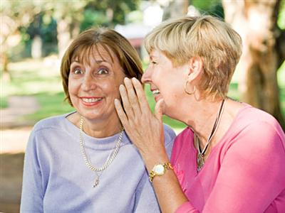
Remember Good Times
Call or get together with an old friend and reminisce about a truly happy time and generate feel-good memories.

Slide 20
Open Your Heart
Treat yourself to an uplifting movie, a poetry reading, an event, or an experience with others that opens your heart.

Slide 21
Let Good People and Places Abound
Turn your world into a happy and loving place by surrounding yourself with people and things you love.

Slide 22
Dream About the Life You Desire
Make a list of things you would love to do if you had the time, money, and energy. Every day, allow yourself to daydream that they all come true!

Slide 23
Make a Wish for World Peace
Make a wish or say a prayer for world peace, and in that moment, believe it can be so.

