Slide 1
the Worlds Most Fascinating International Borders

Slide 2
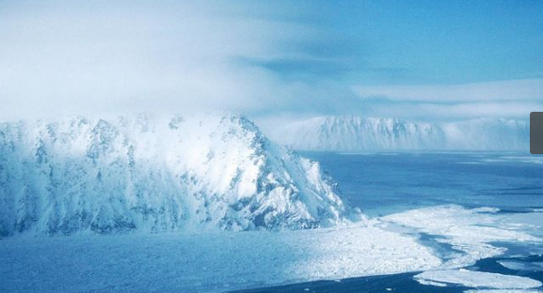
Little Diomede and Big Diomede.
Two and a half miles separate the islands of Little Diomede and Big Diomede. The latter is Russian, and entirely uninhabited, while the former belongs to the United States and has approximately 150 very hardy residents. The space between the two Diomedes doubles as an unusual international border and the International Date Line. According to Mental Floss, locals on Little Diomede can spend their Fridays expectantly watching the weekend wash over Big Diomede.

Slide 3
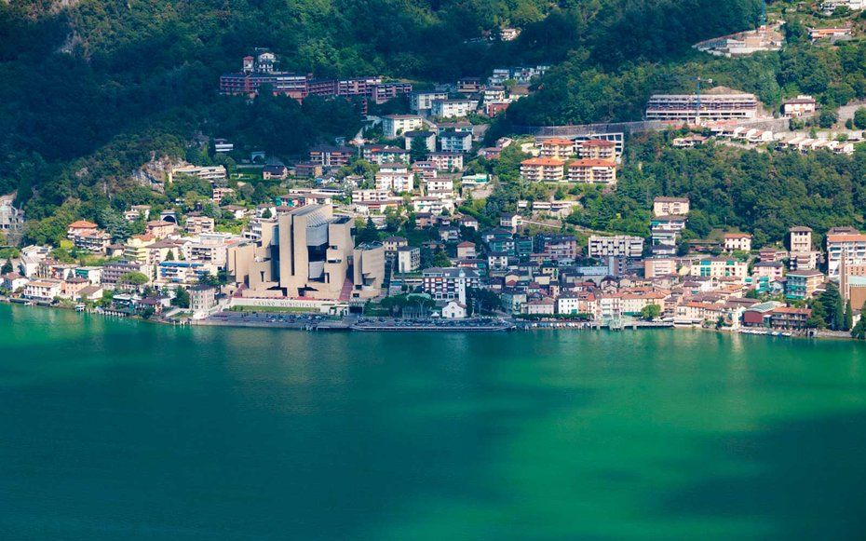
Campione dItalia
An Italian enclave thats mostly Swiss
At first glance, you might think you’re in Switzerland: Campione dItalia has a Swiss dialing code, Swiss emergency responders, and uses the Swiss Franc. But this is an Italian enclave, surrounded by Switzerland and the Lugano Prealps.

Slide 4
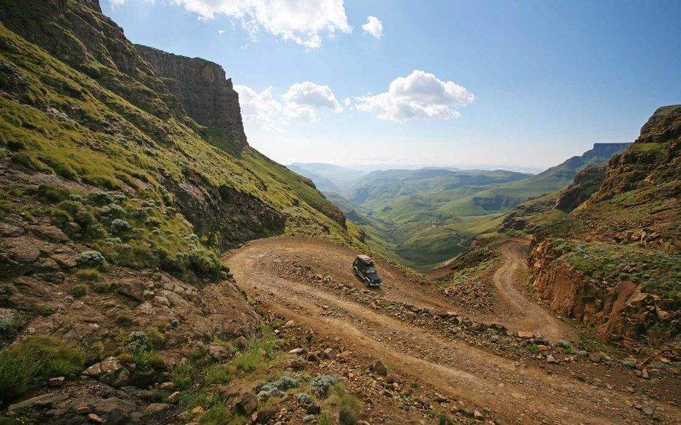
Lesotho
The worlds largest enclave
A kingdom entirely surrounded by South Africa, Lesotho is considered the largest enclave on Earth. It spans 11,720-square-miles and has a population of approximately two million.

Slide 5
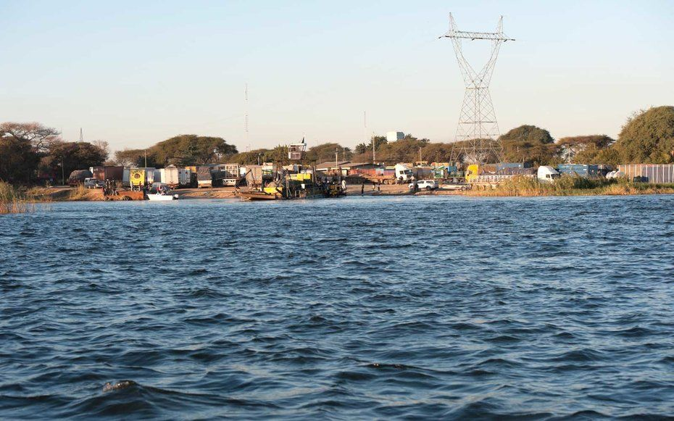
A possible quadripoint
Reportedly, only one place on earth exists where four countries meet at a single point. This so-called quadripoint (which many argue is only two tripoints) can be found at the intersection of Zambia, Namibia, Zimbabwe, and Botswana.

Slide 6
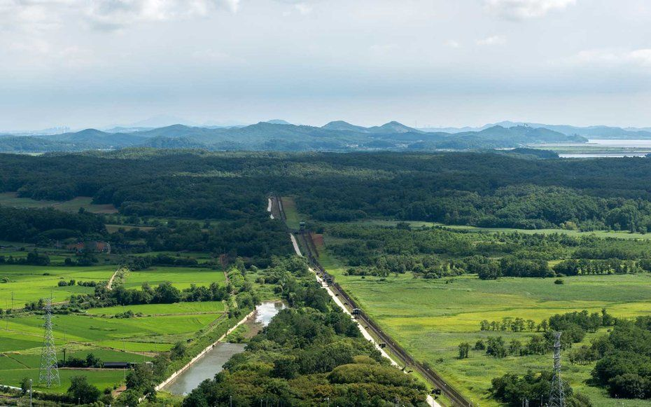
A wildlife reserve
Between North Korea and South Korea is a buffer, known as the Korean Demilitarized Zone. More than half a century after its creation in 1953, this 2.5 mile-wide and 155-mile-long stretch has become something of a nature reserve. Both countries have cooperated to

Slide 7
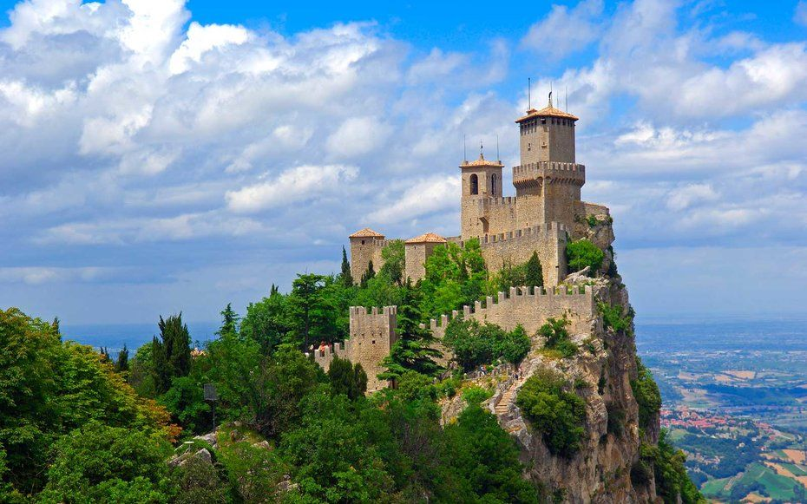
The worlds smallest republic
If you’re visiting the worlds oldest, smallest republic, you’ll find it entirely engulfed in Italy. The Republic of San Marino is an enclave, as is Vatican City. After crossing the quirky border, you can score one of the worlds coolest passport stamps.

Slide 8
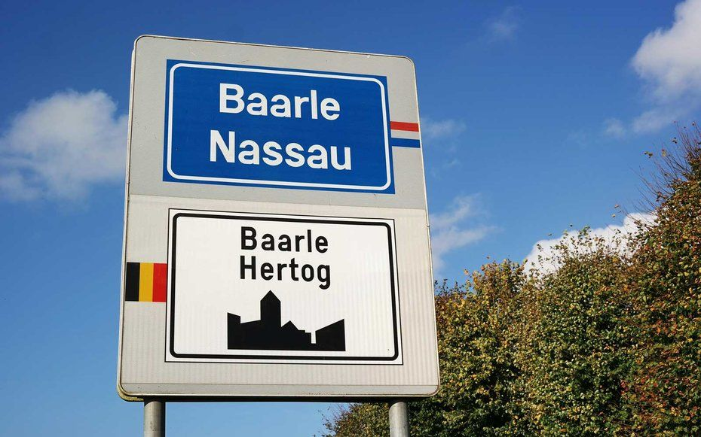
A very confusing village
More like a patchwork quilt than a village, the territory of Baarle is shared by Belgium and the Netherlands, with seven Dutch exclaves inside some 22 Belgian exclaves (Baarle-Hertog) scattered across Dutch territory (Baarle-Nassau). Here, the border is quite literal, with white crosses and country indicators running through cafes and homes with seeming abandon. A buildings nationality is determined by the location of the front door. As NPR hilariously pointed out, you can cross five international borders here in just 60 seconds without breaking a sweat.

Slide 9
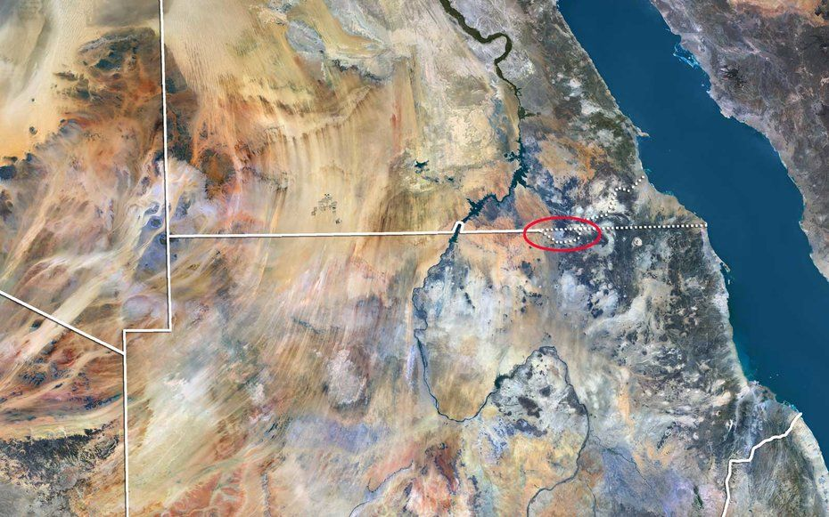
Land owned by no one
While most countries clash over land claims, there’s one 800-square-mile piece of land in Africa that is owned by no one. Bir Tawilis wedged between Egypt and Sudan, and neither country wants to claim the small, lawless, uninhabited bit of desert. To do so would be to officially renounce ownership of the fertile Halaib Triangle. Each country’s maps depict the border differently.

Slide 10
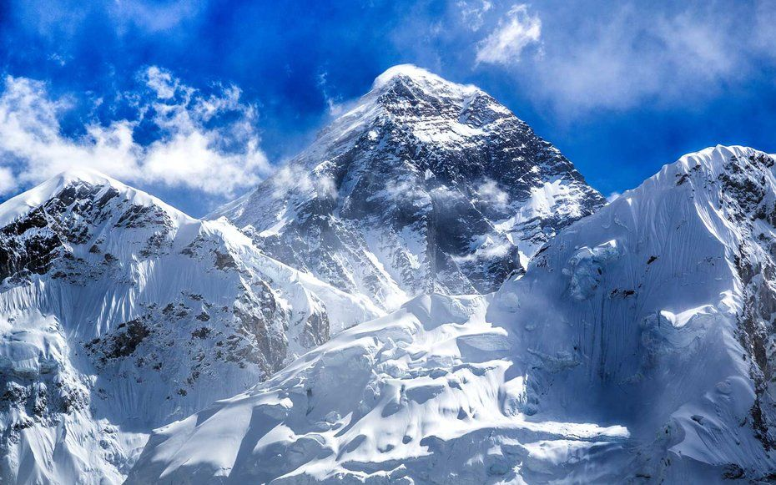
The worlds tallest international border
To trace the international border separating Nepal and the Tibet Autonomous Region’s part of China you’ll have to climb the worlds tallest mountain. This border splits Mount Everest at its summit: more than 29,000 feet above sea level.

Slide 11
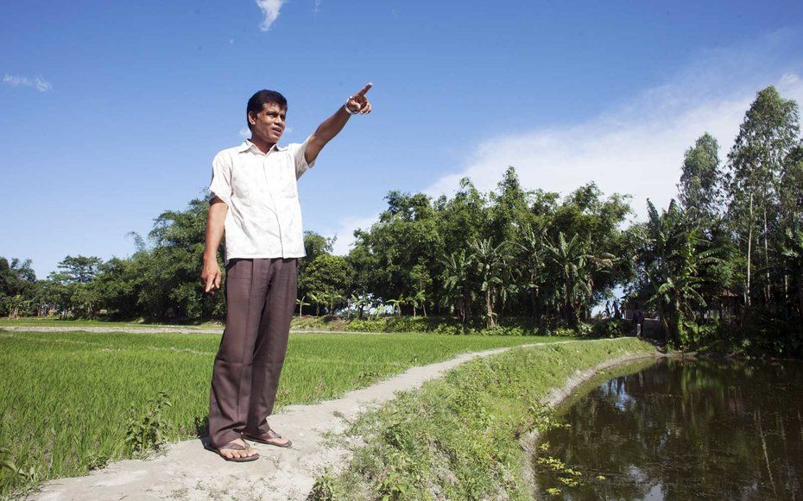
An extinct, third-order enclave
Until August 2015, the Indian enclave of Dahala Khagrabi was surrounded by a Bangladeshi enclave, which was surrounded by an Indian enclave inside Bangladesh. As interesting as these cartographic oddities are, they can be a nightmare for those living inside of them. After all, you may need to enter a foreign country just to visit the market. A land swap in 2015, reported by the Washington Post, ended the worlds only third-order enclave by allowing citizens to accept new citizenship or keep their original citizenship and relocate.

Slide 12
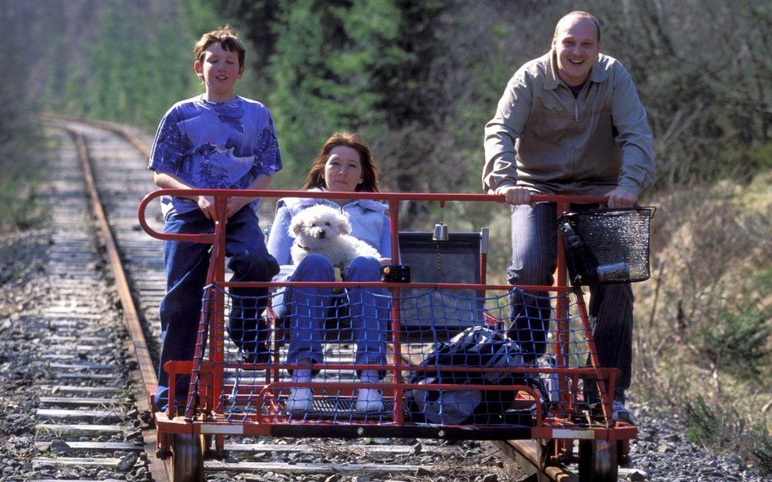
This disused railway
The Venbahn, a former German railway line, ended up in Belgium after the Treaty of Versailles. At the same time, six German exclaves were created, as well as one Belgian enclave inside a three-way intersection of German roads.

Slide 13
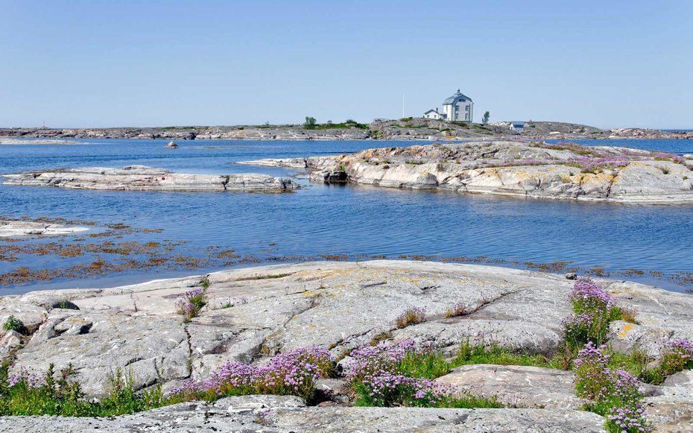
A misplaced lighthouse
Suspended between Finland and Sweden, at the point where the Baltic Sea gives way to the Gulf of Bothnia, is a peculiar island. Mrket Island (Swedish for border marker) was meant to be split clean down the middle. But a Finnish lighthouse, erected on the Swedish side of Mrket (when Finland was controlled by Russia) violated the border. To correct the mistake, the border across Market now zigs and zags wildly.

Slide 14
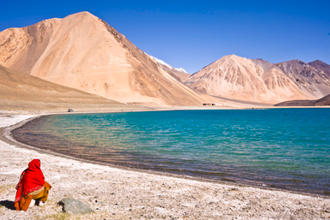
Angle Inlet
In far southeastern Manitoba, Canada lies an inlet of the Lake of the Woods that is part of the United States. Also known as the Northwest Angle, this exclave of the United States, considered part of Minnesota, can only be reached from Minnesota by traveling over the Lake of Woods or by traveling through Manitoba or Ontario.

Slide 15
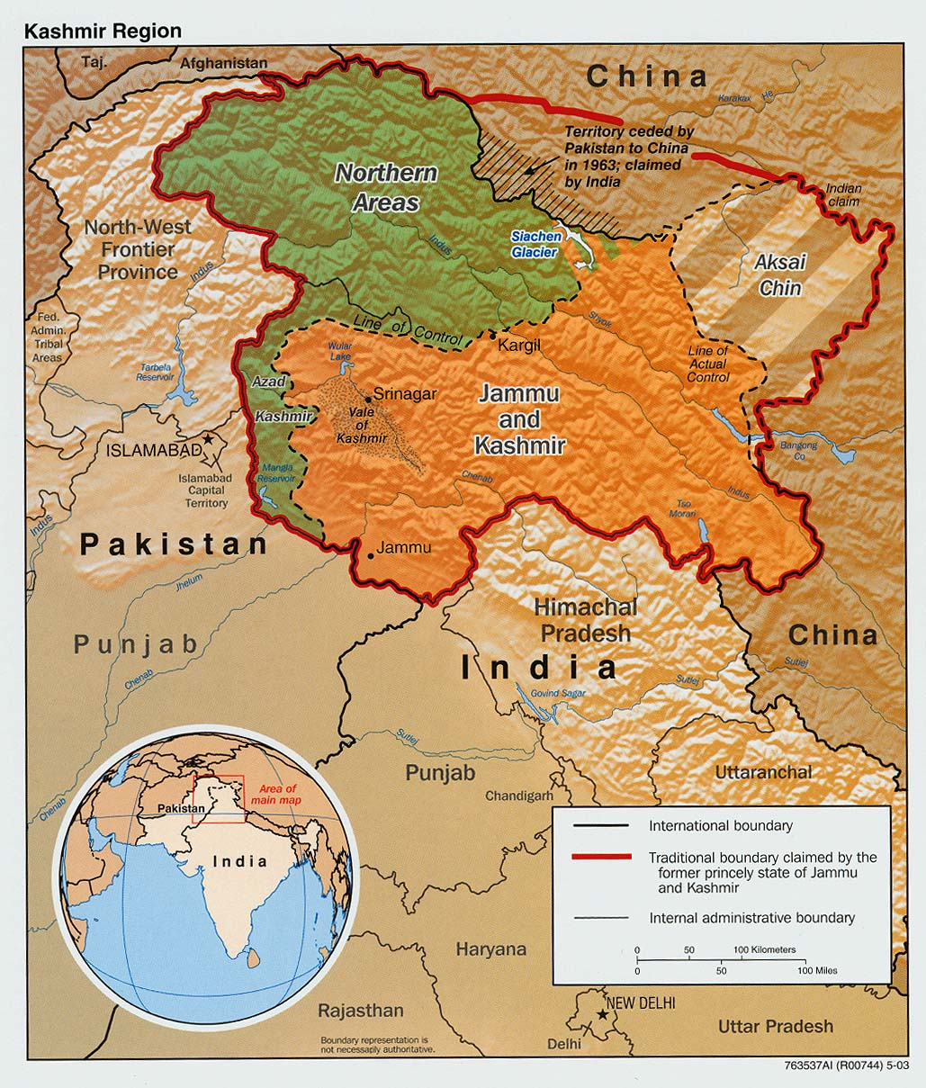
China-Pakistan-India (Kashmir)
The Kashmir region where India, Pakistan, and China meet in the Karakoram Range is incredibly complex. This map illuminates some of the confusion.

Slide 16
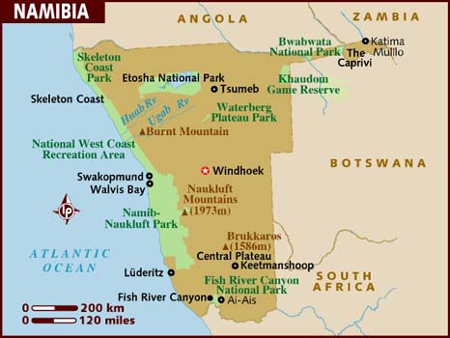
Namibia's Caprivi Strip
Northeastern Namibia has a panhandle that extends far east several hundred miles and separating Botswana from Zambia. The Caprivi Strip provides Namibia access to the Zambezi River near the Victoria Falls. The Caprivi Strip is named for German Chancellor Leo von Caprivi, who made the panhandle part of German South-West Africa to provide Germany access to Africa's eastern coast.

Slide 17
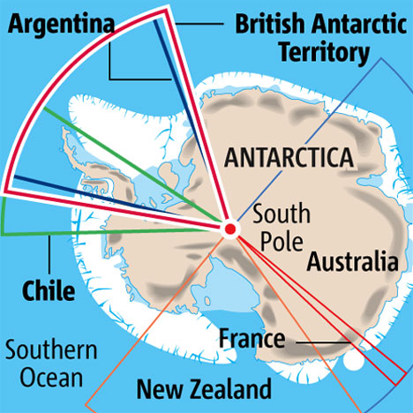
Antarctica
Seven countries claim pie-shaped wedges of Antarctica. While no nation can modify their territorial clam nor can any nation act upon their claim, these straight boundaries that typically lead from 60 degrees south to the South Pole divide up the continent, overlapping in some instances but also leaving significant segments of the continent unclaimed (and unclaimable, according to the principles of the Antarctic Treaty of 1959). This map shows the boundaries of the competing claims.

