Slide 1
Before Amazon, We Had Bookmobiles
One visited my high school once a month – 1956-1960

Slide 2
The Bookmobile
Long before Amazon, Audible, and other digital book distributors, bookmobiles were bringing literature to peoples' doorsteps. Their mission was to provide the written word to remote villages and city suburbs that had no libraries. We invite you to remember these almost forgotten four-wheelers of the past.
The first bookmobile is believed to have appeared in Warrington, England in the late 1850s. It was a horse-drawn cart, and lent about 12,000 books during its first year of service. Later, mobile libraries were installed inside vehicles and reached the height of their popularity in the mid-20th century when they had become a part of Americal life.
Although bookmobiles are still operated in some parts of the world by libraries, schools, activists, and other organizations, they are widely thought to be an outdated service due to high costs, advanced technology and impracticality.

Slide 3
National Bookmobile Day has been observed on the Wednesday of National Library Week since 2010. The first bookmobile in the U.S. was the 1905 horse-drawn “Library Wagon” in Washington County, Maryland.
According to the American Library Association there are 33 bookmobiles in Florida today, but we’re not sure when the first bookmobile hit the streets in Palm Beach County.

Slide 4
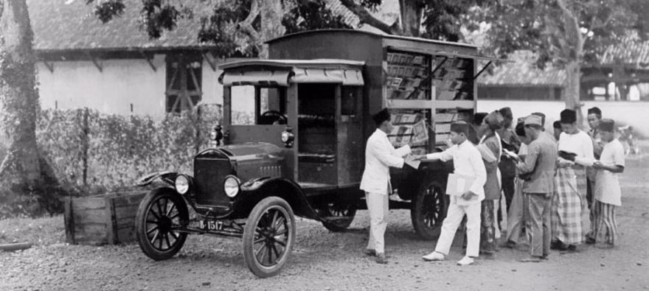
A Bookmobile In Indonesia, Early 20th Century.

Slide 5
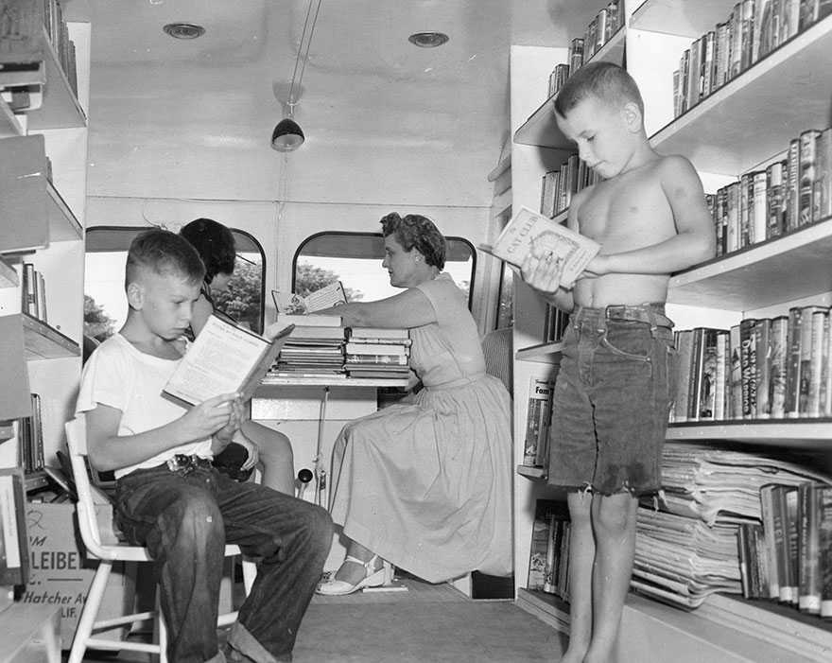
Craig Medvigny (left) And David Sutton Enjoying A Book; Eleanor Mann Substitute Traveling Branch Librarian, C. 1920s

Slide 6
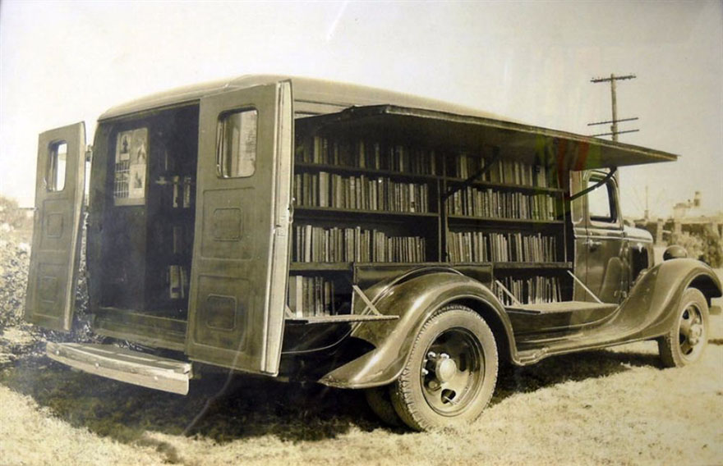
An Opened Bookmobile, 1925

Slide 7
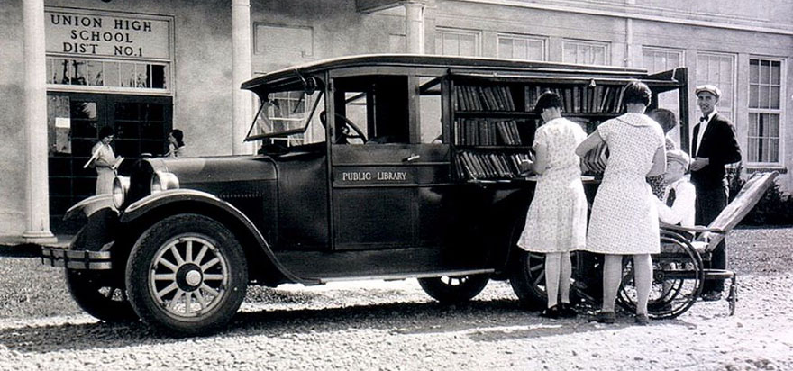
Multnomah County Library, 1926

Slide 8
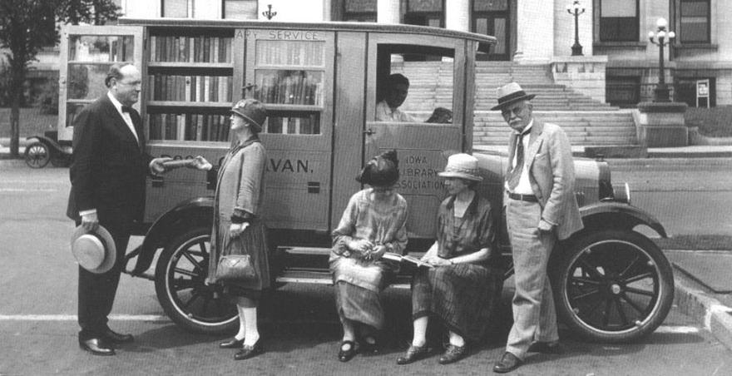
Book Caravan In Iowa, C.1927

Slide 9
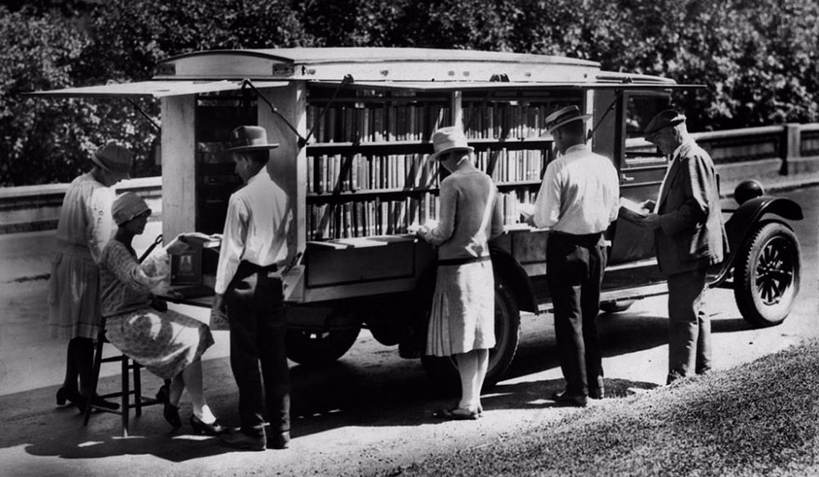
The First Bookmobile Of The Public Library Of Cincinnati, 1927

Slide 10
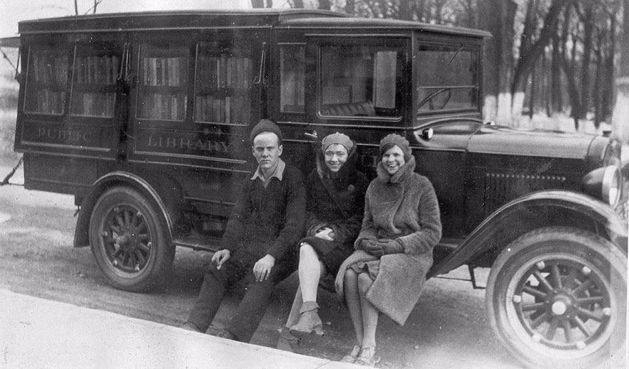
Three Of The Bookmobile Staff, C.1930

Slide 11
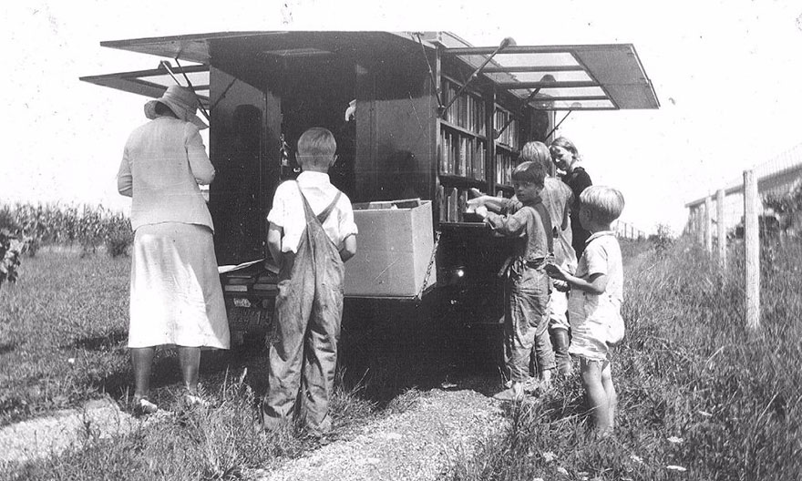

Slide 12
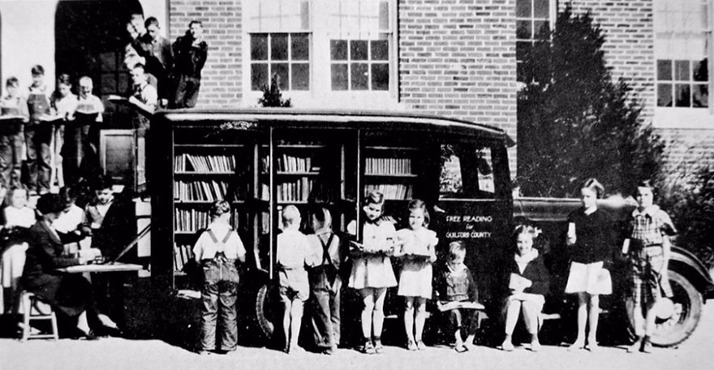
Greensboro, North Carolina, 1936

Slide 13
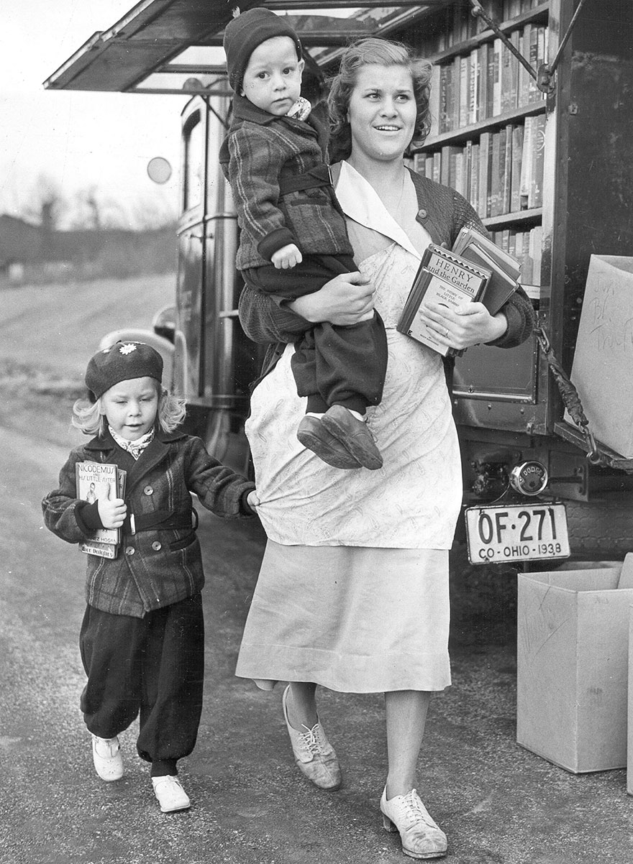
The Bookmobile In Columbia Park, C. 1940

Slide 14
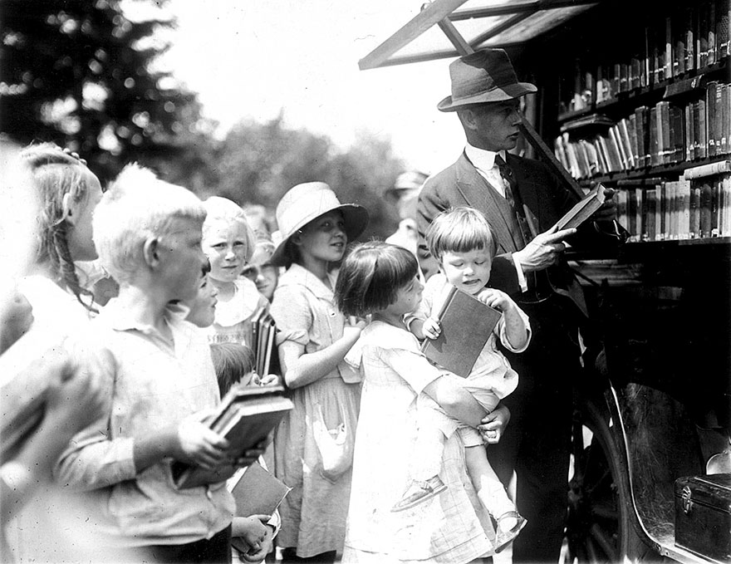

Slide 15
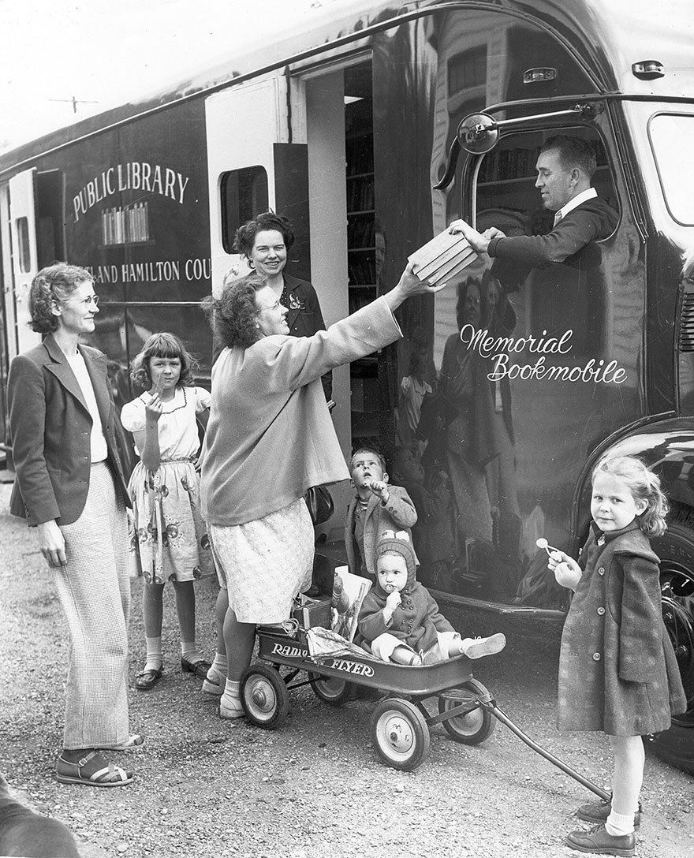
One Of The Library Bookmobiles, C. 1948.

Slide 16
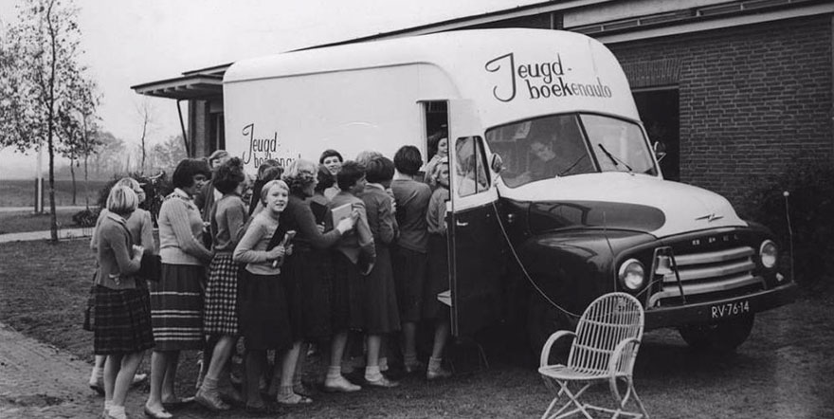
An Impatient Queue For A Dutch Bookmobile

Slide 17
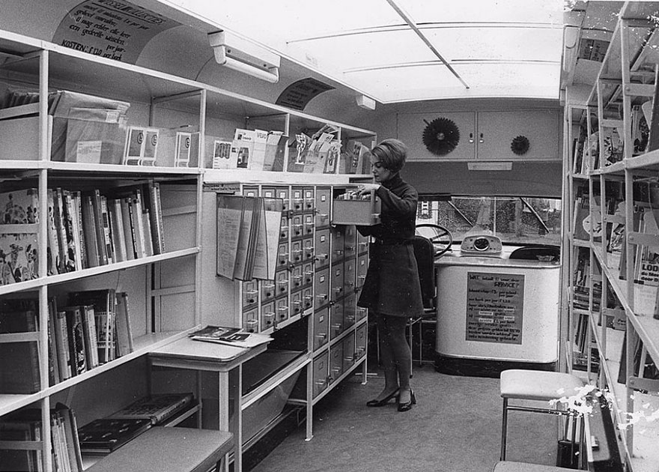
Inside A Bookmobile, 1960s
Very much like the one that visited my high school.

Slide 18
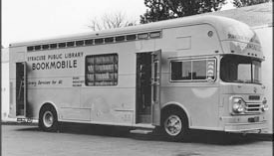
1960s bookmobile

Slide 19
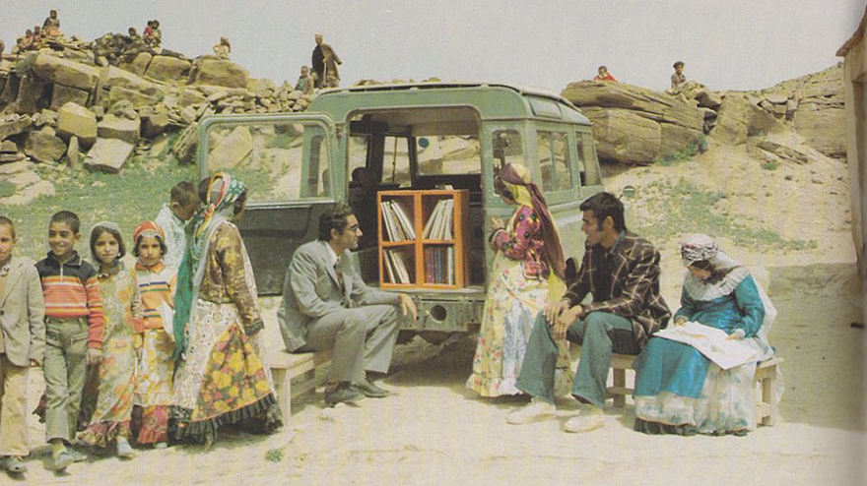
A Mobile Library In Kurdistan, Iran, 1970

Slide 20
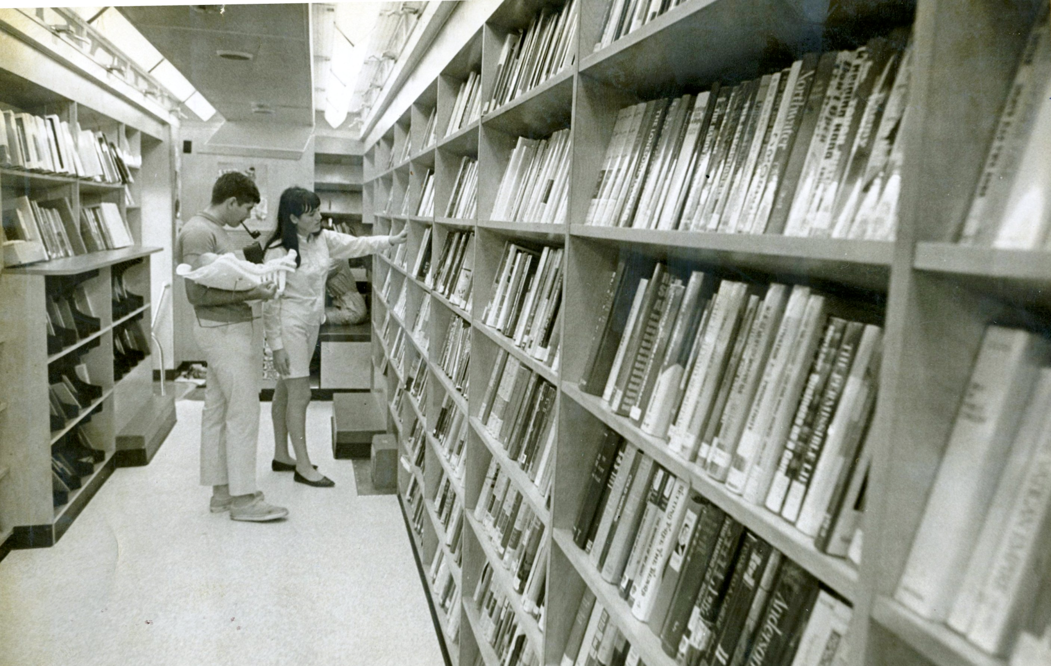
1970s Interior

Slide 21
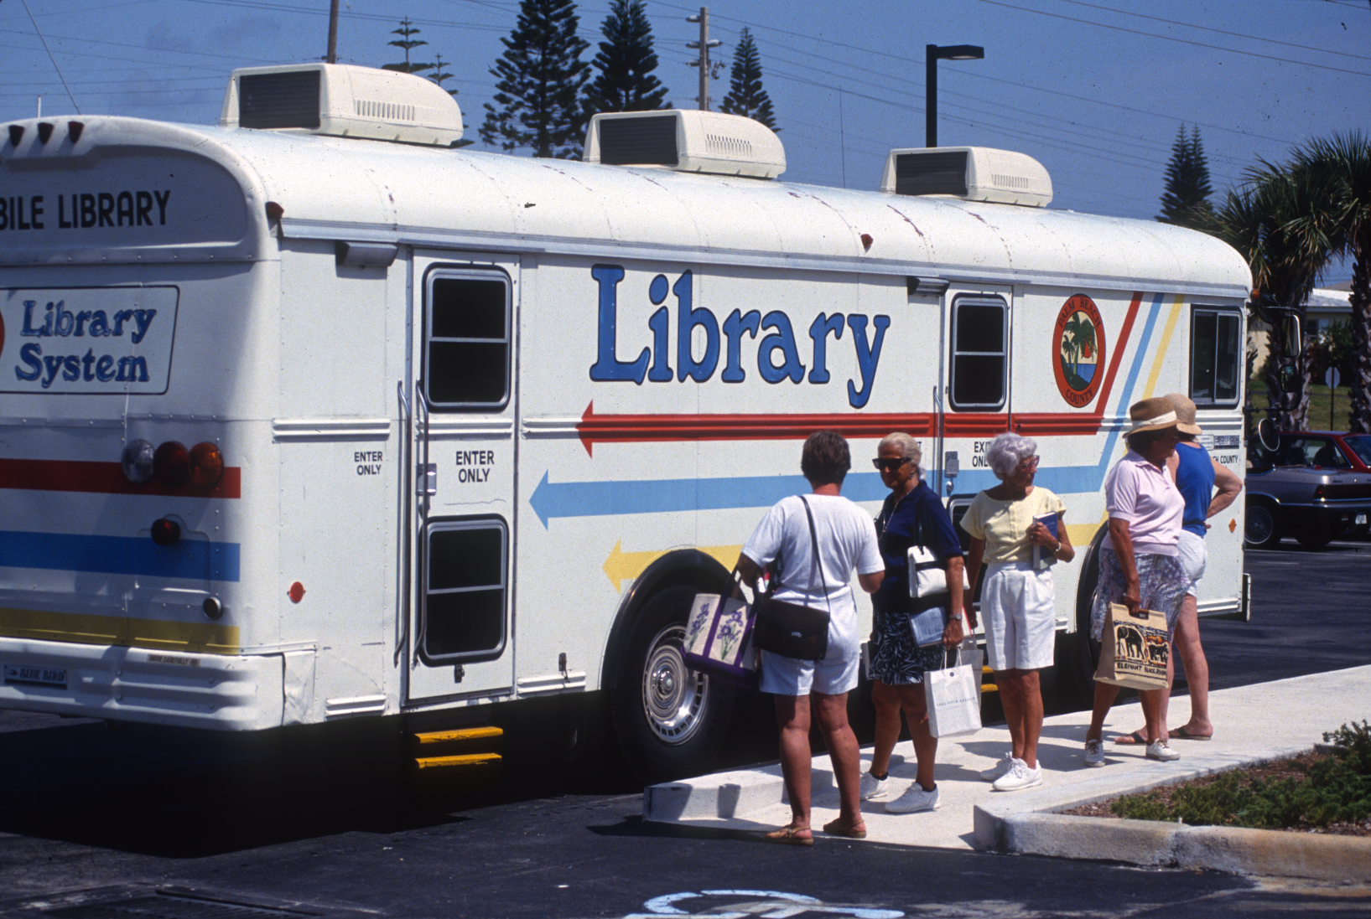
The Palm Beach County Library Bookmobile in 1993.

