Slide 1
Becoming Human
In Pictures

Slide 2
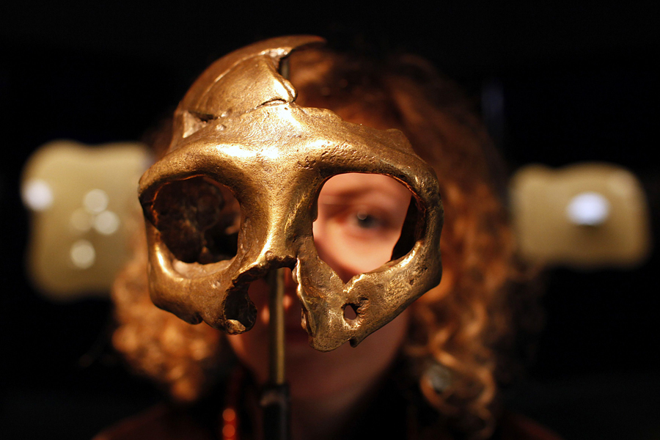
A girl looks through the replica of a neanderthal skull displayed in the new Neanderthal Museum in the northern town of Krapina, February 25, 2010. The high-tech, multimedia museum, with exhibitions depicting the evolution from 'Big Bang' to present day.

Slide 3
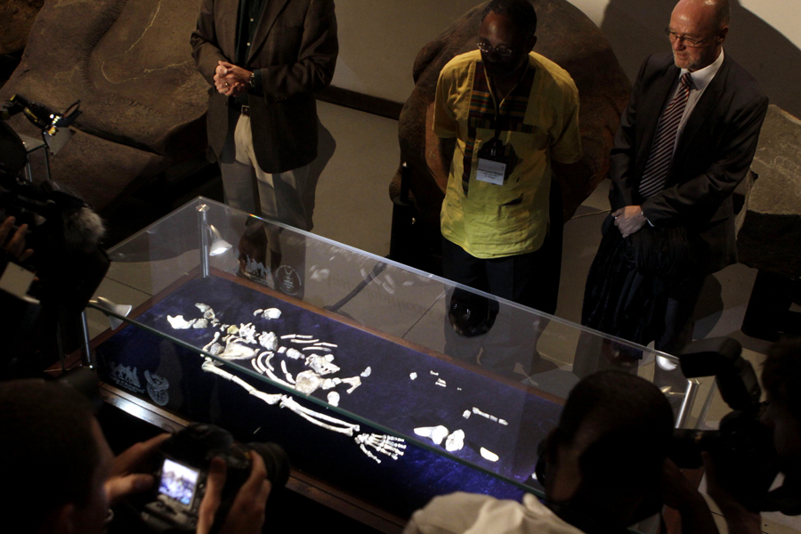
One of two sets of bones from Australopithecus sediba, found in South Africa are unveiled at the University of the Witwatersrand in Johannesburg, September 8, 2011. The bones offer the most powerful case so far in identifying the transitional figure that came before modern humans, finding some are calling a potential game-changer in understanding evolution.

Slide 4
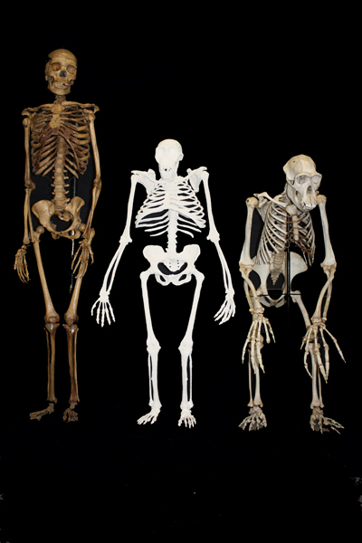
This undated image shows a reconstruction of the skeleton of Australopithecus sediba (c.) next to a small-bodied modern human female (l.) and a male chimpanzee. The newly-studied species lived some 2 million years ago, and it both climbed in trees and walked upright. Scientists are getting a more comprehensive look at the extinct South African creature with an intriguing mix of human-like and primitive traits, but scientists say they still haven't pinned down where it fits on our evolutionary family tree.

Slide 5
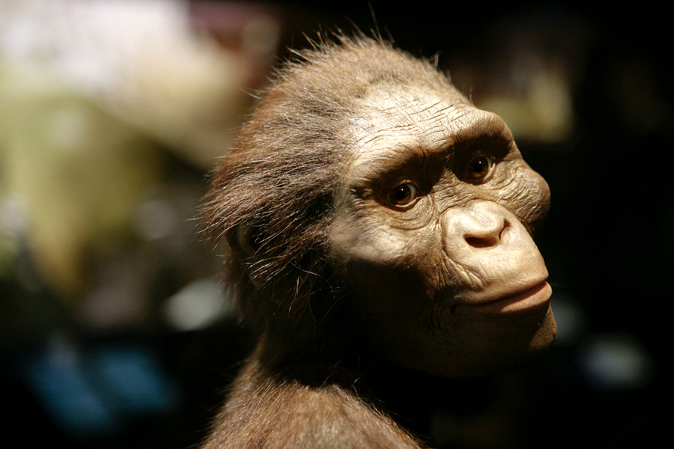
An artist's life-sized model of Lucy, based on the 3.2-million-year-old Australopithecus afarensis skeleton called Lucy, is part of a new exhibit shown during a press preview at the Houston Museum of Natural Science in Houston on August 28, 2007.

Slide 6
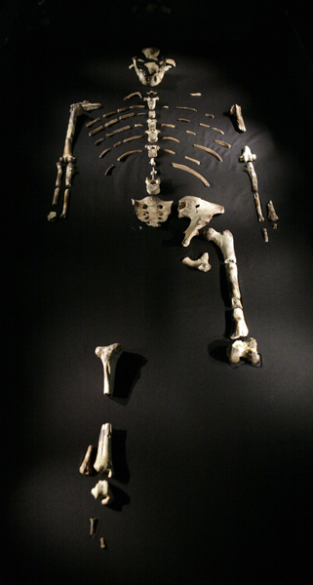
The 3.2-million-year-old Australopithecus afarensis skeleton called Lucy, part of a new exhibit displayed during a press preview at the Houston Museum of Natural Science in Houston, August 28, 2007. Lucy, it turns out, had company — another prehuman that also walked but spent more of its time in trees. A fossil discovery reveals there was another creature around 3 million years ago and it gives new insight into the evolution of a key human trait — walking on two legs.

Slide 7
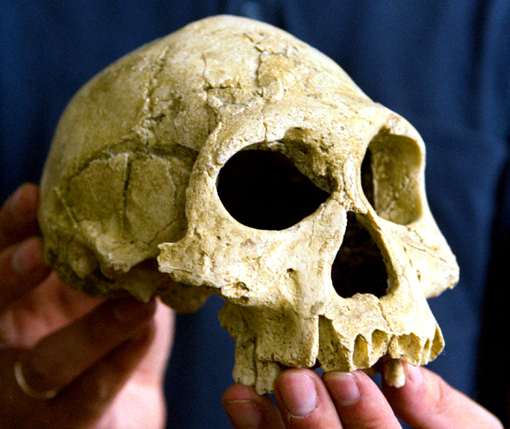
David Lordkipanidze, of the Georgian Academy of Sciences, shows the 1.75-million-year-old skull and jawbone excavated near the town of Dmanisi, some 85 kms south west of Tbilisi, on August 12, 2001. Bones of a slightly-built early human with a small head suggest the large brains that characterize modern humans did not necessarily evolve before our ancestors began migrating all over the world, the researchers reported in Friday's issue of the journal Science. Lordkipanidze's team believe it is an example of Homo erectus, thought to have been the first hominid species to leave Africa.

Slide 8
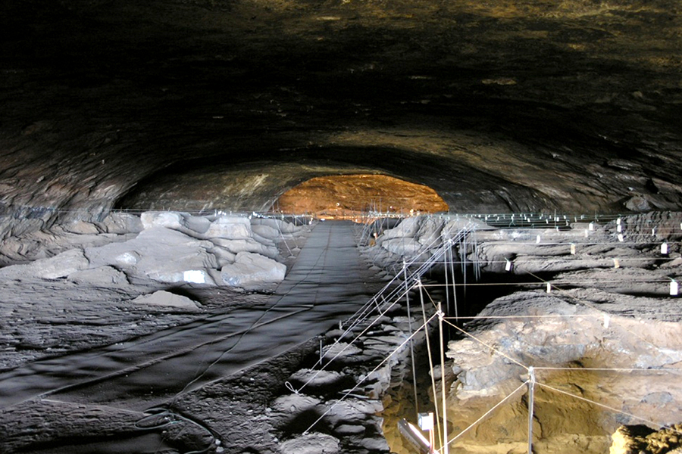
An undated photo shows the inside of Wonderwerk cave in South Africa. Scientists said, April 2, 2012, that they've found the earliest firm evidence of human ancestors using fire: material about 1 million years old in Wonderwerk cave. Burned bones and microscopic ash in the dirt suggests fire frequently burned there, apparently under the control of our ancestor Homo erectus, researchers said.

Slide 9
A cave where the astonishing discovery of a dwarf like hobbit that could rewrite the history of human evolution is shown in this undated photo. During a news conference in Sydney Australia, October 28, 2004, scientists said they have found the skeleton of a new human species, a dwarf, marooned for eons in a tropical Lost World while modern man rapidly colonized the rest of the planet. A 3-foot-tall adult female skeleton found in the cave on a remote Indonesian island is believed 18,000 years old and smashes the long-cherished scientific belief that our species, Homo sapiens, systematically crowded out other upright-walking human cousins beginning 160,000 years ago.
The picture is on the next slide

Slide 11
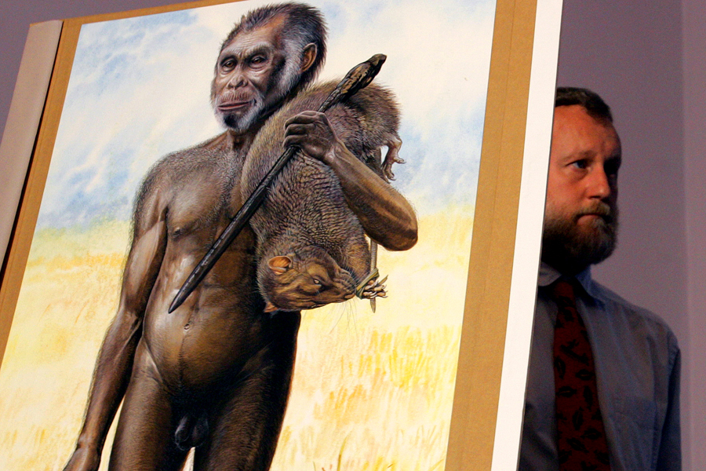
Australian Museum scientist Paul Tacon stands next to a life-size drawing of a newly discovered species of hobbit-sized humans in Sydney. Australian Museum scientist Paul Tacon stands next to a life-size artist's drawing in Sydney October 28, 2004, of a newly discovered species of hobbit-sized humans that adds another piece to the complex puzzle of human evolution. The partial skeleton of Homo floresiensis, found in a cave on the Indonesian island of Flores, is of an adult female that was three-feet-tall, and had a chimpanzee-sized brain that was substantially different from modern humans.

Slide 12
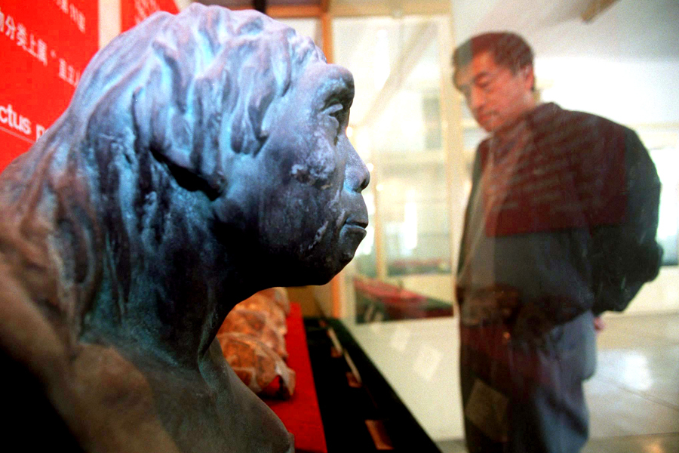
A man looks at a model of Homo erectus pekinensis, also known as Peking Man, on display in Zhoukoudian south of Beijing, November 10, 1998. Peking man is considered the evolutionary ancestor of modern Chinese and lived between 700,000 to 200,000 years ago.

Slide 13
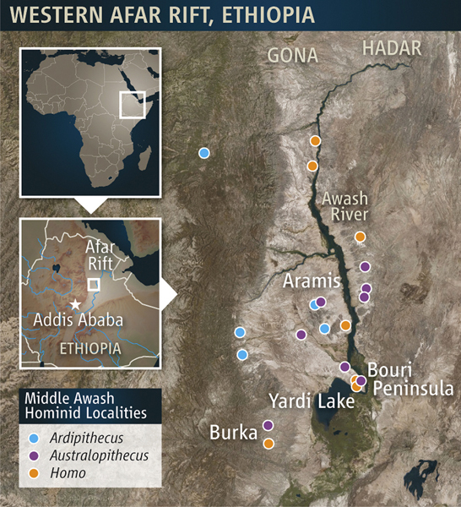
The area where 'Ardi' was found is rich in hominin fossil sites, including these worked by the Middle Awash research team released to Reuters on October 1, 2009. This female stood about 1.2 meters high. The skeleton of an early human who lived 4.4 million years ago shows that humans did not evolve from chimpanzee-like ancestors, researchers reported.

Slide 14
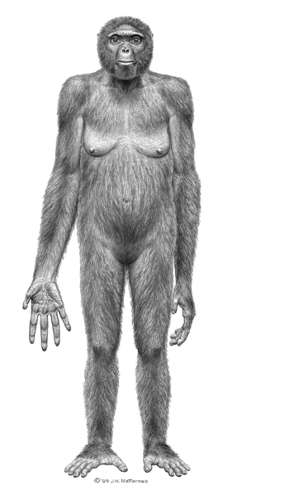
This undated artist's rendering provided by the journal Science shows the probable life appearance in anterior view of Ardipithecus ramidus also known as 'Ardi.' Last year, the fossil skeleton shook up the field of human evolution. Now, some scientists are raising doubts about what exactly the creature from Ethiopia was and what kind of landscape it inhabited.

Slide 15
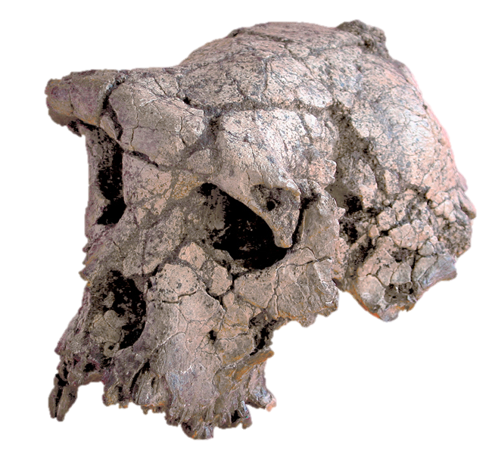
Scientists unveiled on July 10, 2002, the skull of what they called the earliest member of the human family so far discovered, dating back six or seven million years to a period in evolution about which virtually nothing is known. The skull, featured in the journal Nature, was discovered last year by an international team of paleoanthropologists working in Chad, Central Africa.

Slide 16
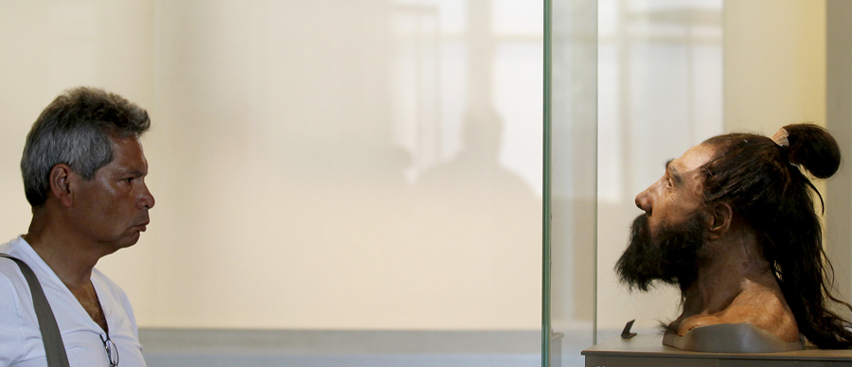
A man looks at a model of a head of Homo neanderthalensis during a visit to the Smithsonian Institution's National History Museum in Washington, June 19, 2012. Based on decades of cutting-edge research by Smithsonian scientists, the exhibits in the David H. Koch Hall of Human Origins tells the epic story of human evolution and how humans evolved over six million years in response to a changing world.

Slide 17
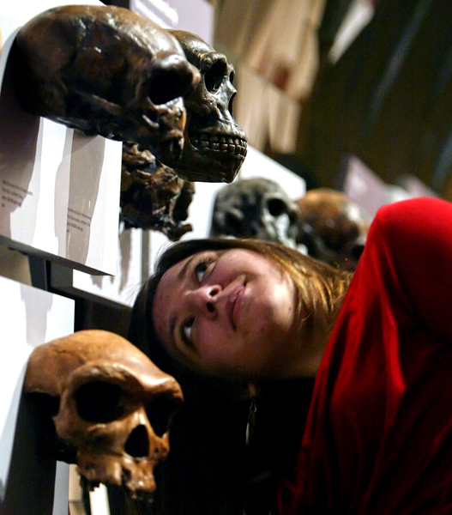
Valerie Eppolito looks inside the cast of a human skull, April 16, 2008, which is on display at the exhibit 'Surviving: The Body of Evidence' at the University of Pennsylvania in Philadelphia. The exhibit, five years in the making, uses ancient fossils and interactive multimedia displays to tell the story about how the human race adapted, thrived, and continues to evolve.

Slide 18
Keep in Mind . . . . .
None of these findings (theories) is absolute.
If the human story were a jigsaw puzzle of 5000 pieces, we might be working with only 15 pieces – each new piece that is found may cause us to alter our picture

