Slide 1
Rare photos show life inside North Korea's top-secret military and burdened civilians
Nina Godlewski, Tech Insider

Slide 2
Little is known about North Korea, and maybe even less is known about the country's military.
And while photos can be instrumental in learning about everyday life in the hermit kingdom, they can be extremely difficult to get past the border and out of the country.
But a recent Reuters package has a set of rare photos of North Korea's military, ranging from 2006 to 2015, which reveal a snapshot of life as a soldier in North Korea.

Slide 3
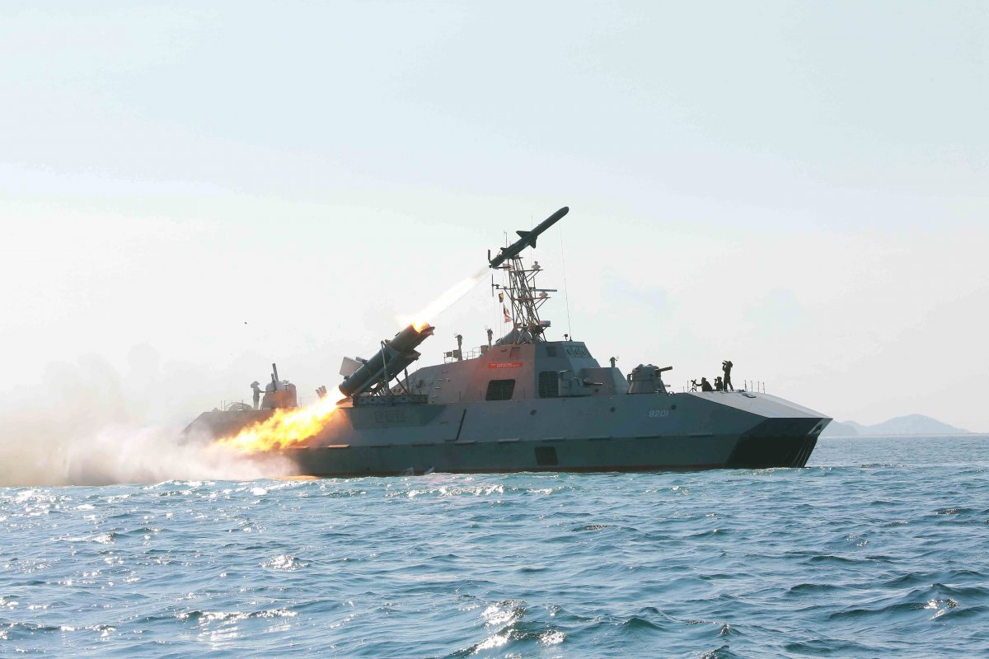
The Korean War began in 1950 when 75,000 soldiers from the North crossed the border and invaded the South.

Slide 4
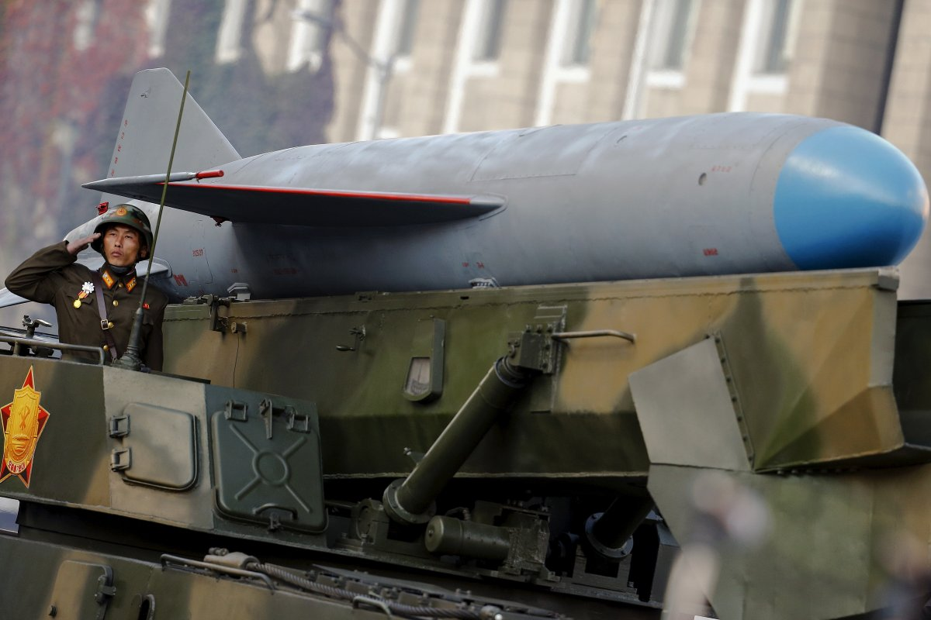
After the Korean War, North and South Korea were split. The Soviet Union had control of the North and the United Nations was controlling the South.

Slide 5
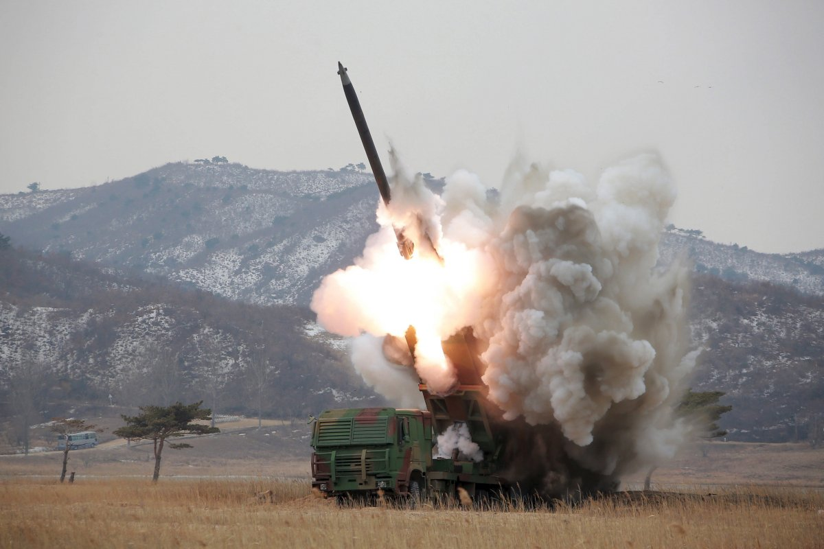
The Soviet Union put Kim Il-sung in charge of North Korea, which became known as the Democratic People’s Republic of Korea. His son, Kim Jong-il, took over after his death in 1994.

Slide 6
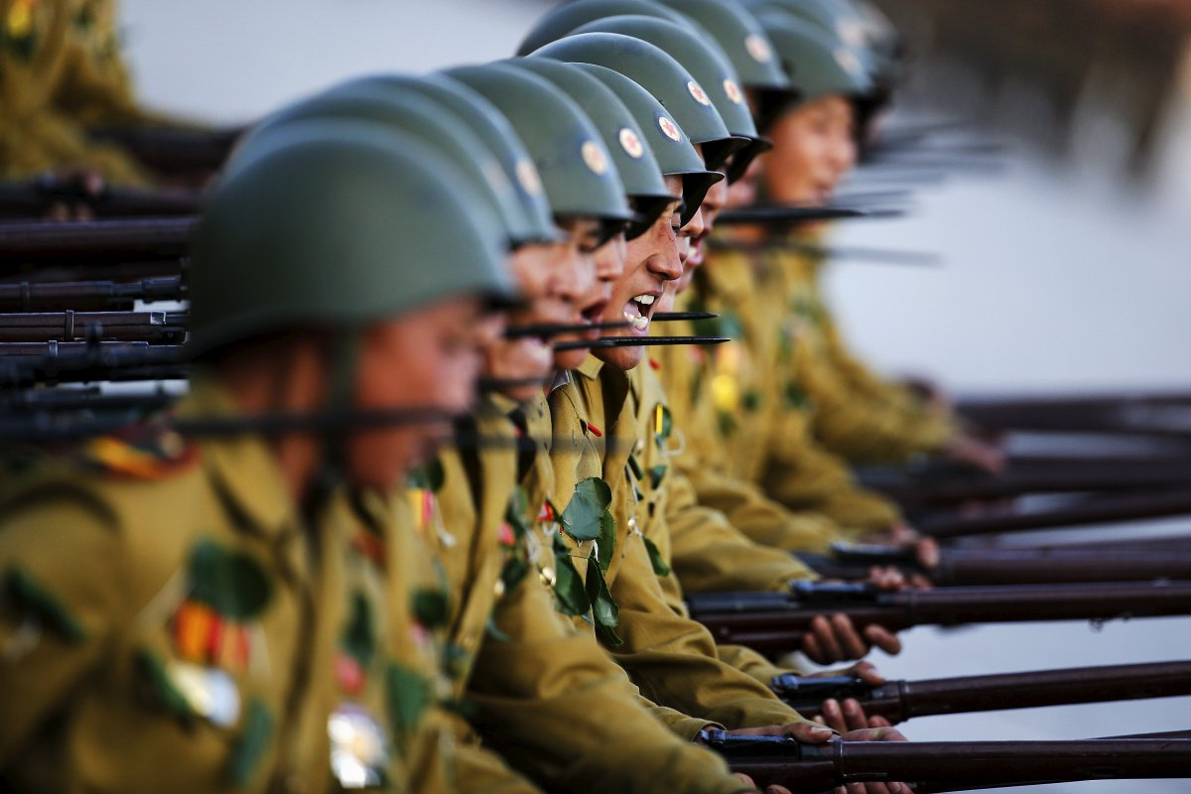
Kim Jong-un then took over as the ruler of the country in December of 2011 when his father and the former leader, Kim Jong-il, died of a heart attack.

Slide 7
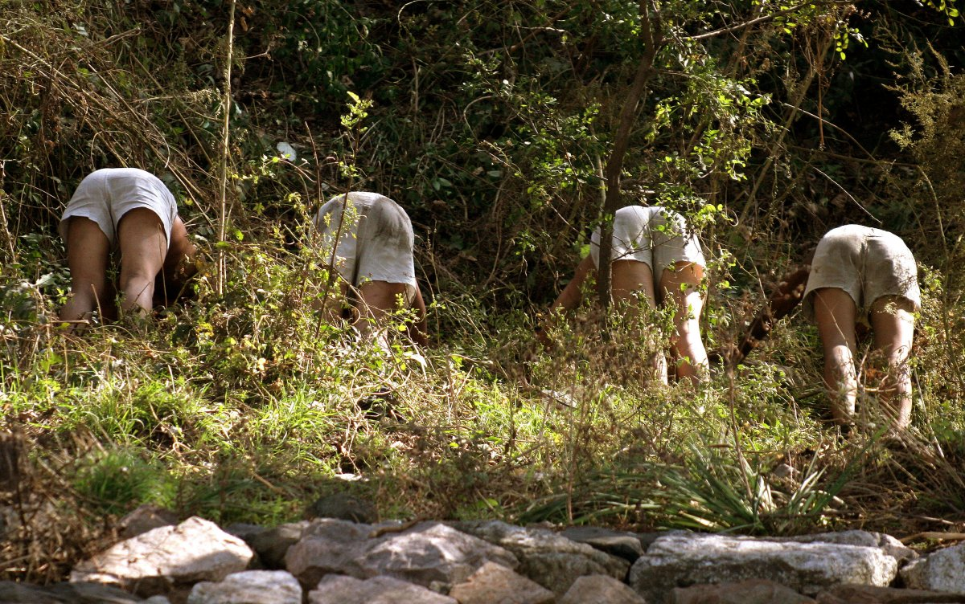
Despite the fact that he is in charge of the fourth largest military in the world, Kim Jong-un has no formal military training.

Slide 8
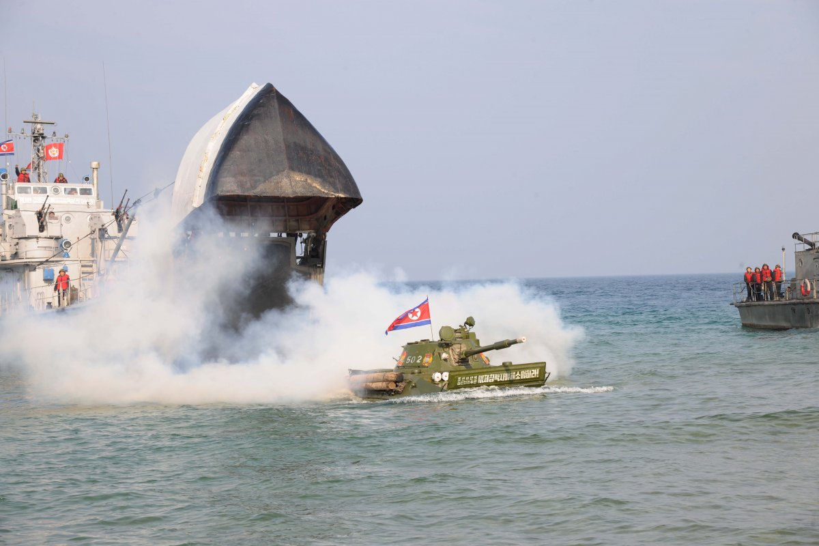
70% of ground forces and 50% of air and naval forces are deployed within around 62 miles of the demilitarized no man's land between North and South Korea as of 2014.

Slide 9
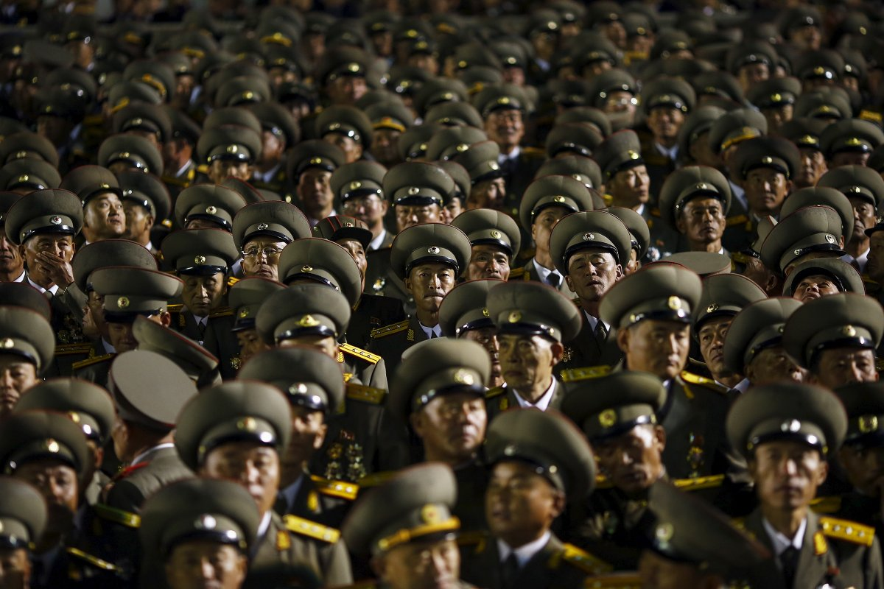
North Korea's military is called the "Korean people's army" or the KPA.

Slide 10
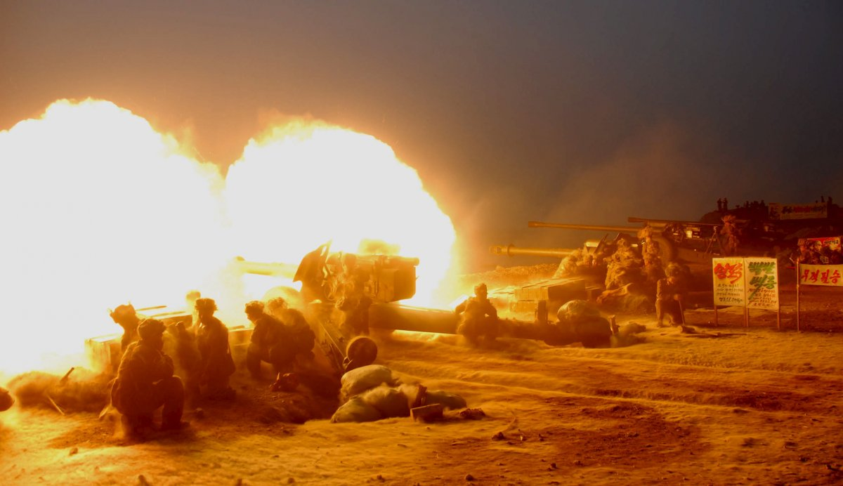
Today the North Korean military is comprised of over 1.2 million active soldiers.

Slide 11
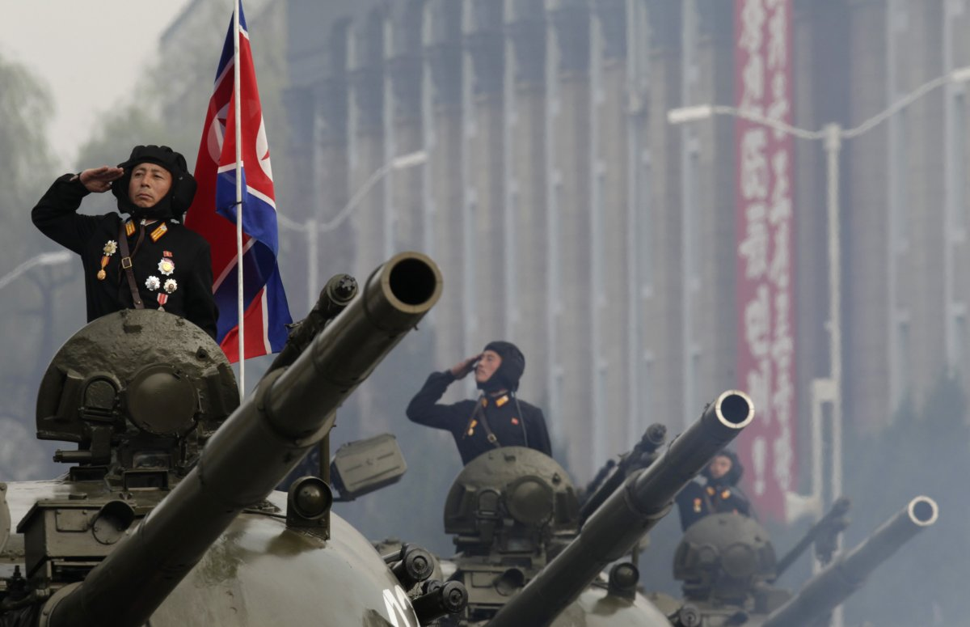
And there are another 7.7 million on reserve.

Slide 12
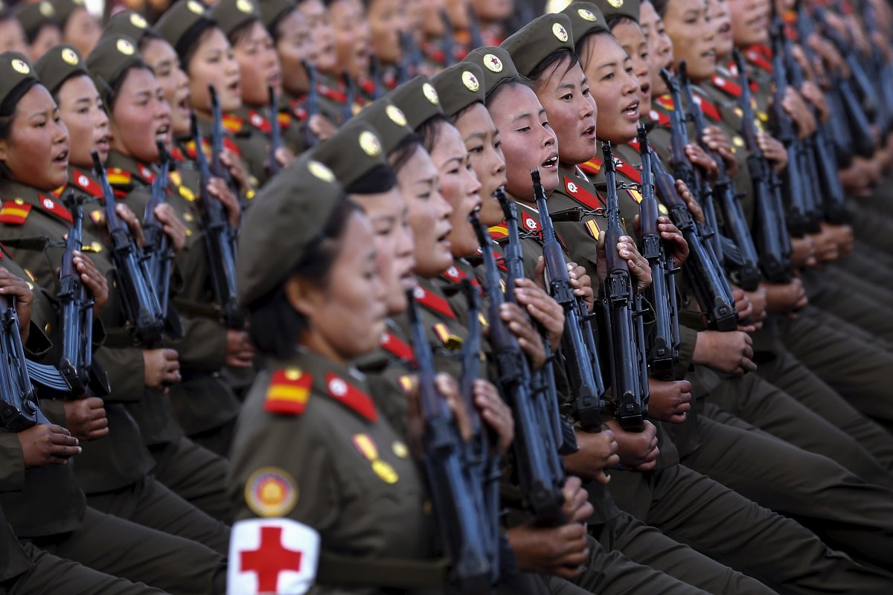
Most people serve in the military after completing high school. Men serve for 10 years and women serve for seven years.

Slide 13
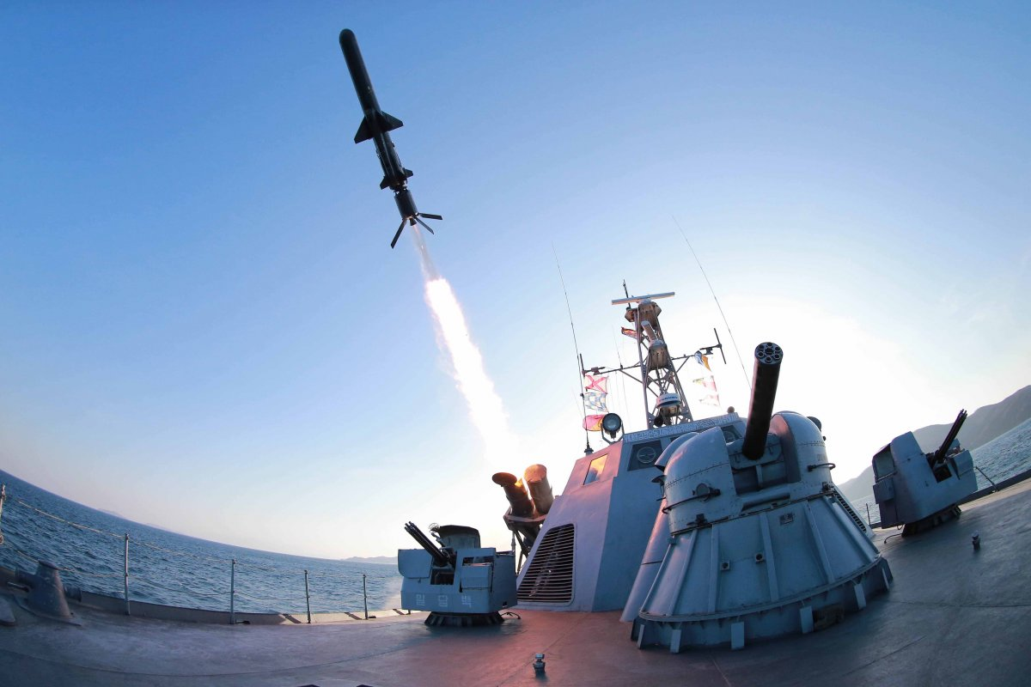
Those who go to college serve for five years after completing their degree.

Slide 14
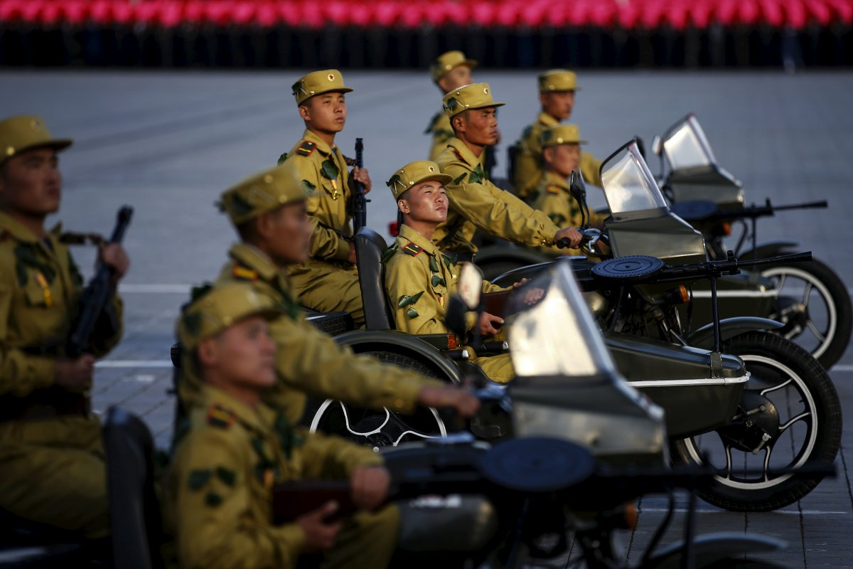
But those who study science only serve for three years. This was decided by Kim Jong-il in 2015 to encourage people to study science.

Slide 15
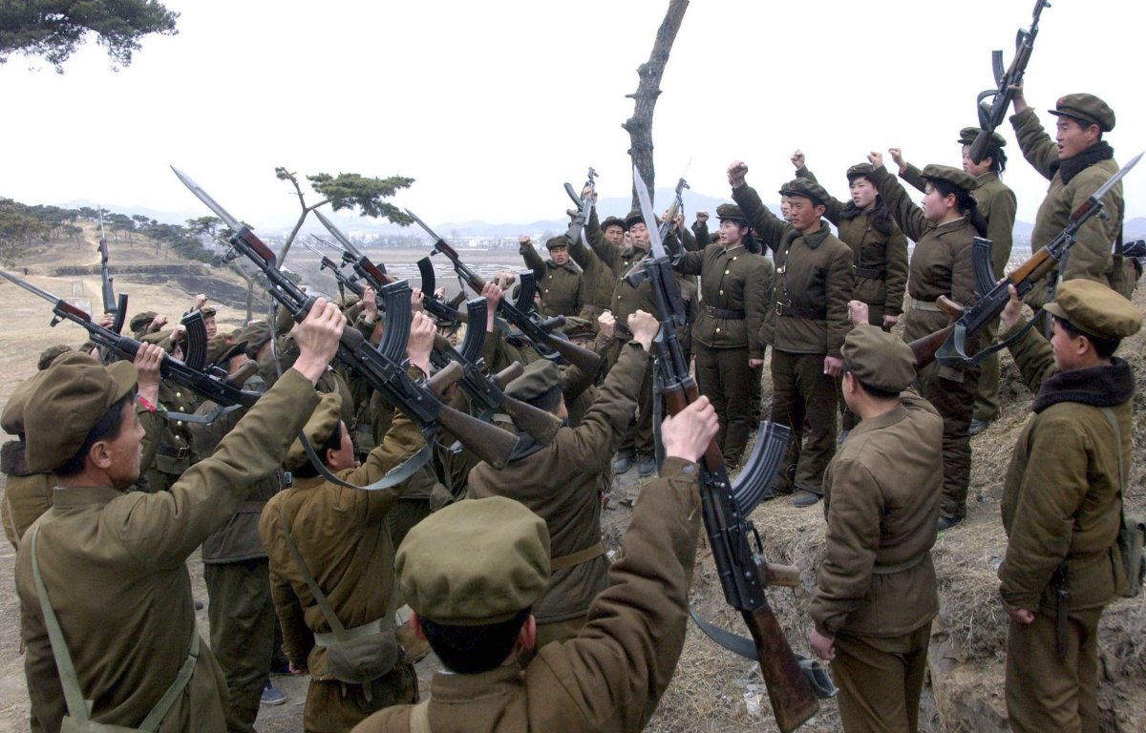
The military is the country's largest employer.

Slide 16
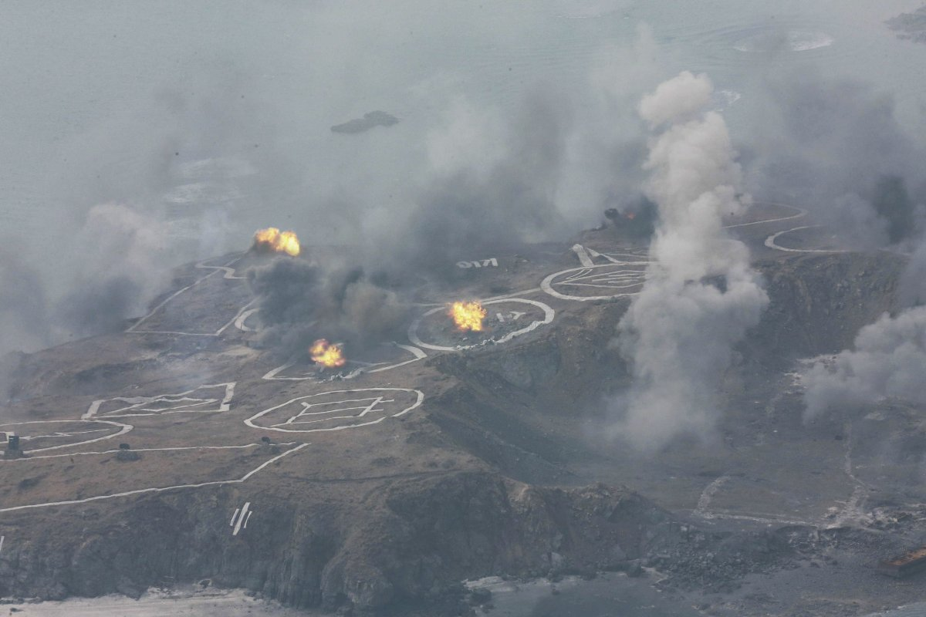
The North Korean air force is made up of over 1,300 aircrafts. The newest plane was obtained in 1999.

Slide 17
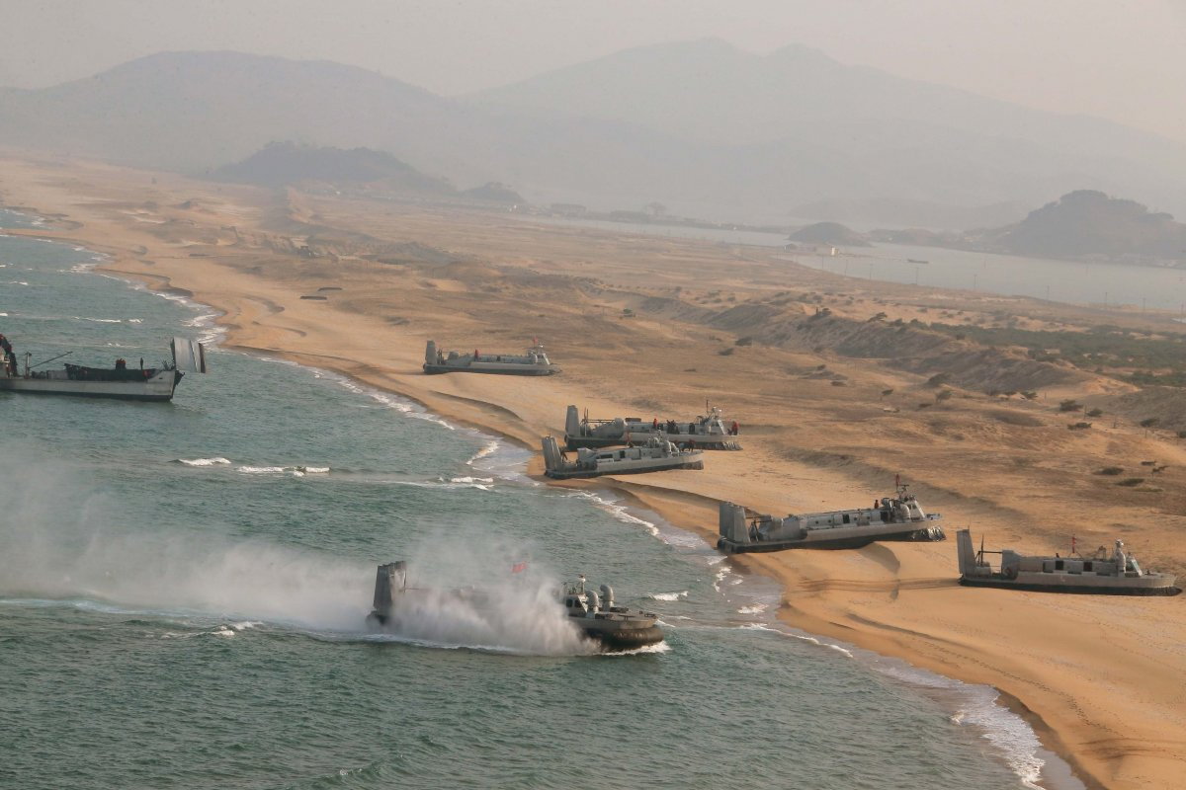
It is believed that the North Korean military has 260 amphibious landing crafts in its Naval force.

Slide 18
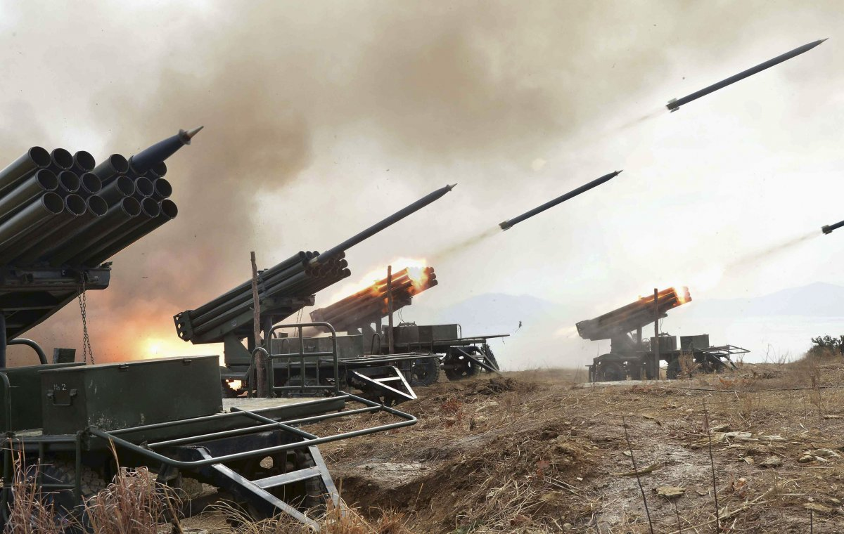
The North Korean missile program began development in the late 1960s, but really began to flourish in the 1970s.

Slide 19
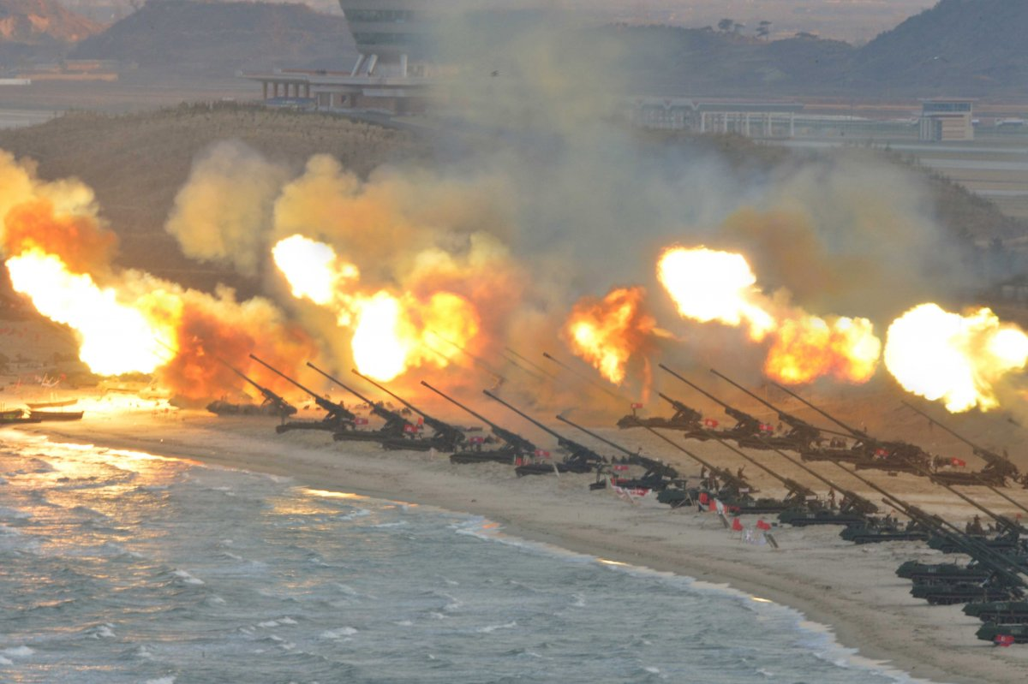
Today, North Korea is thought to be in possession of over 1,000 long, medium, and short-range missiles.

Slide 20
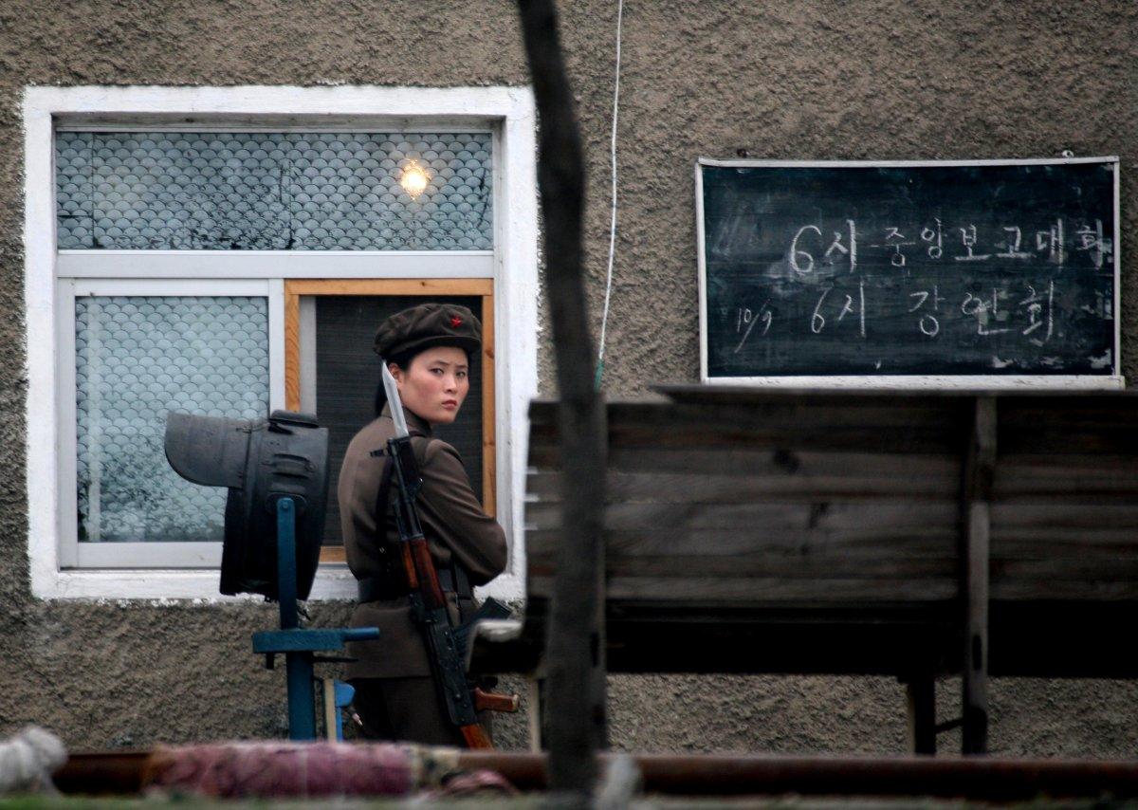
In 2015 it became mandatory for all women to serve in the military.

Slide 21
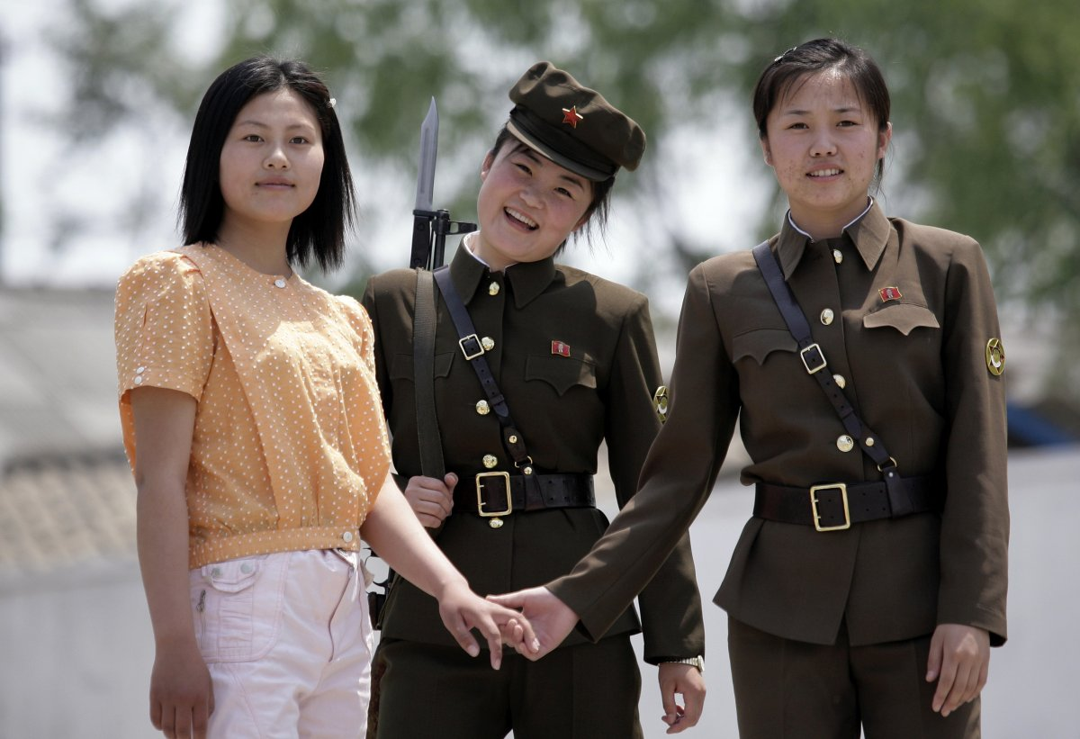
Before 2015 women served purely on a voluntary basis.

Slide 22
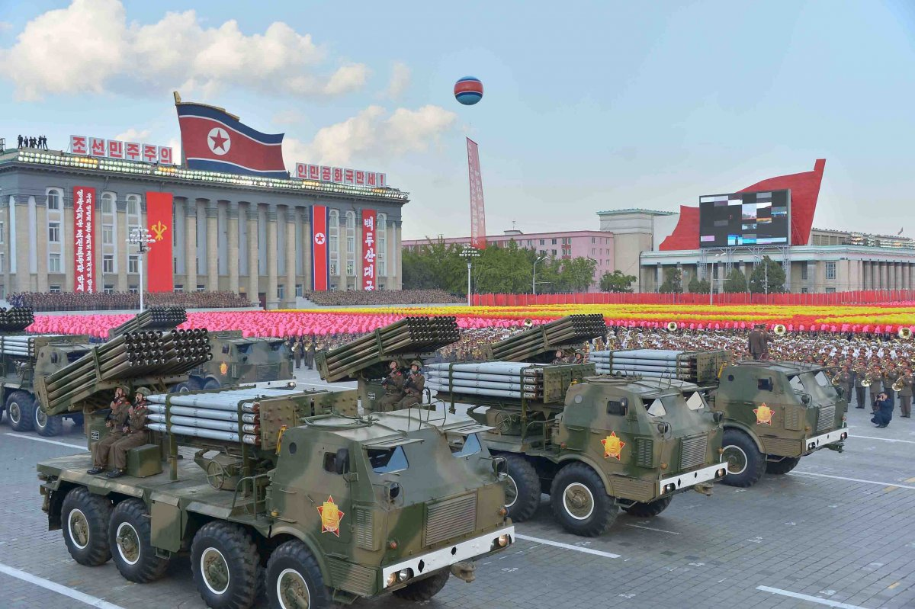
Citizens of North Korea may only own a motor vehicle if they are a military or government official.

Slide 23
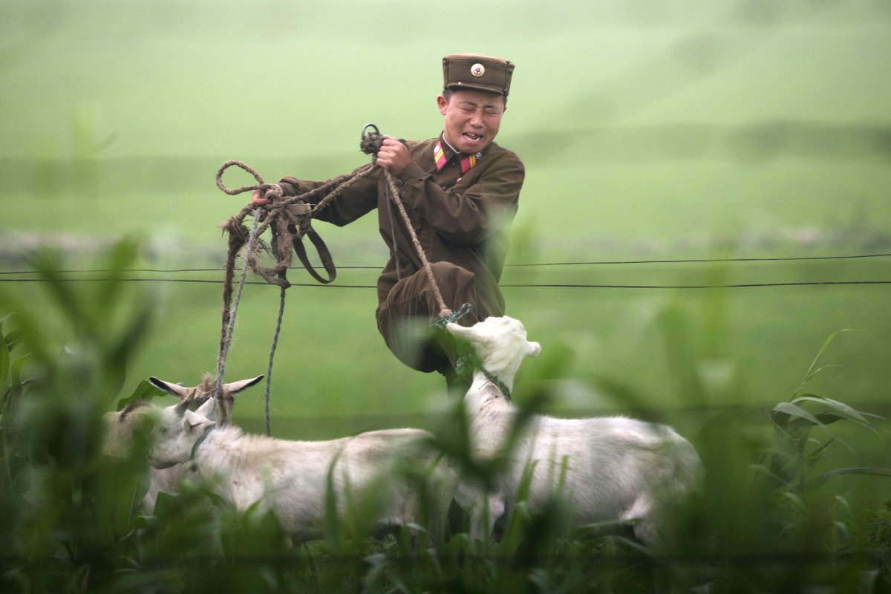
Soldiers in the military face malnourishment and hunger due to a lack of food availability and rigorous training.

Slide 24
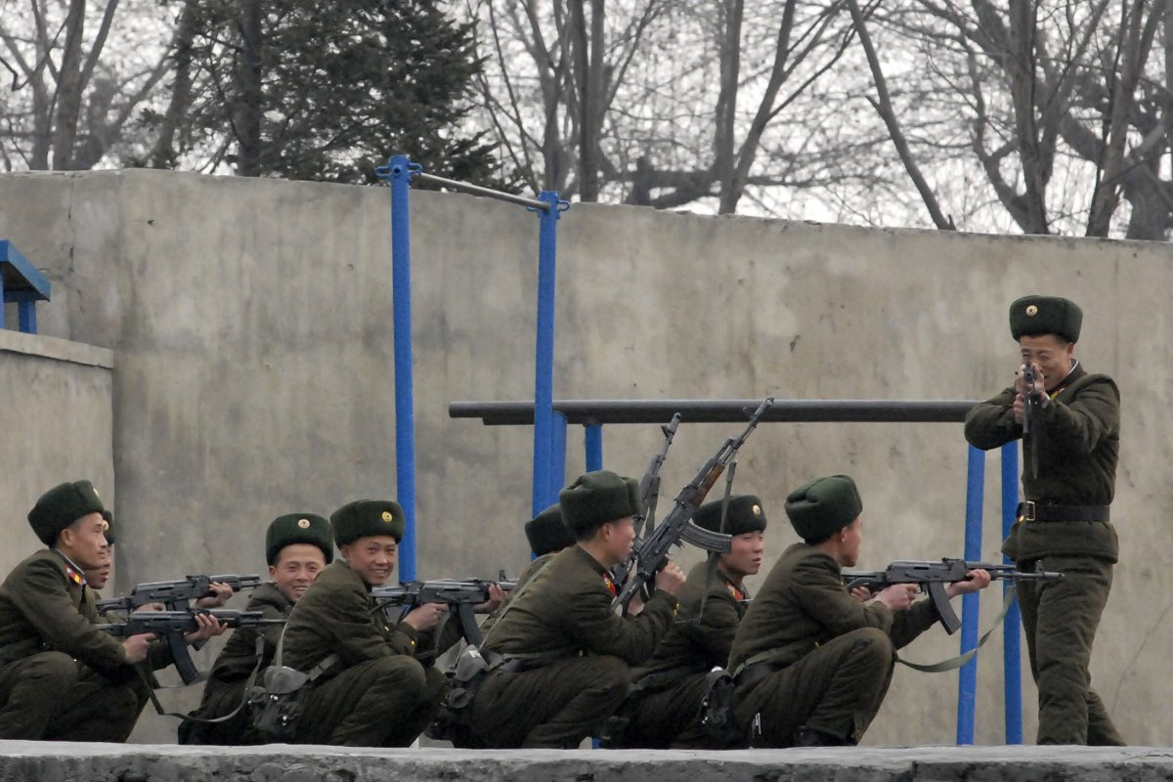
Nuclear tests were conducted within the country in 2006, 2009, and 2013.

Slide 25
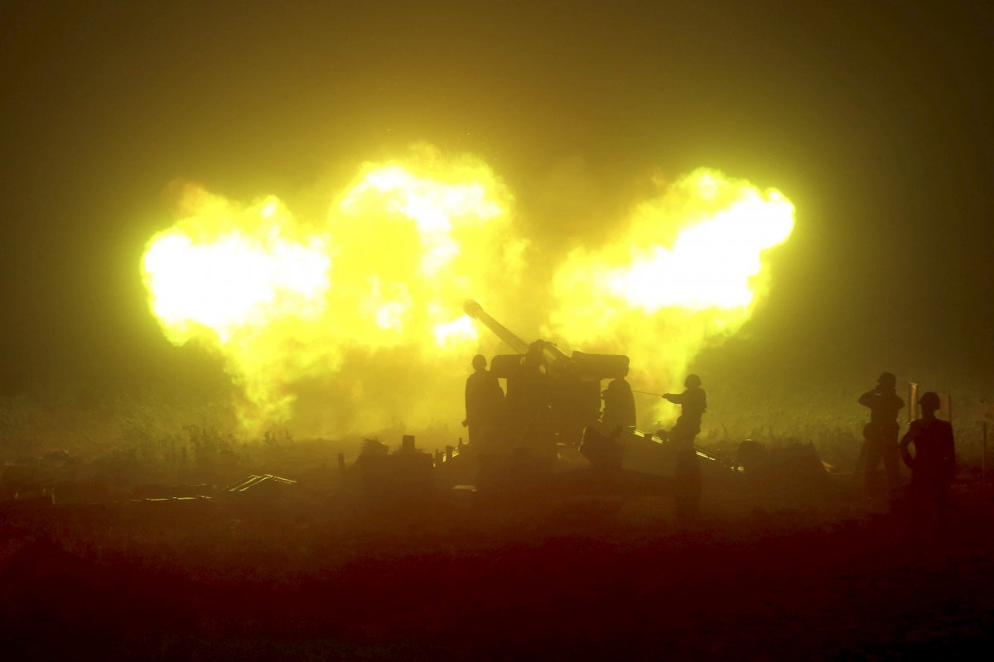
North Korea's military is now one of the largest in the world and the exact details of conditions for soldiers stay under tight wraps. There is likely so much we don't know about the world's fourth largest military.

Slide 26
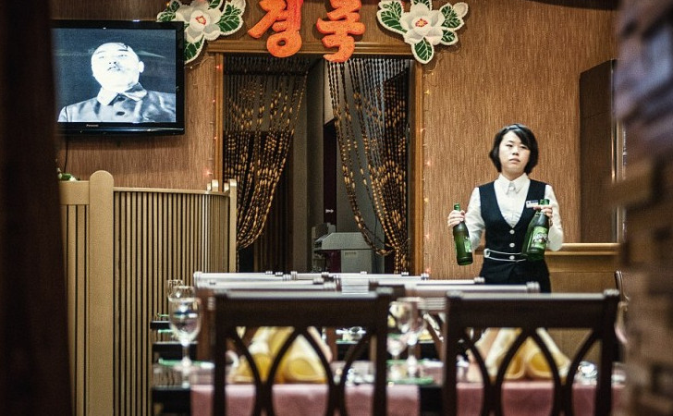
Lunch With A Side of Propaganda - As this waitress goes about her work routine, there is endless propaganda playing on the television in the background of the restaurant.

Slide 27
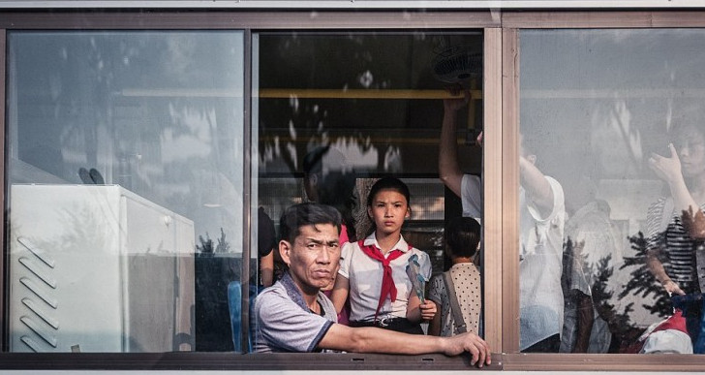
These commuters look beyond just unhappy. They look as though they are devoid of any capability of caring or having hope anymore.

Slide 28
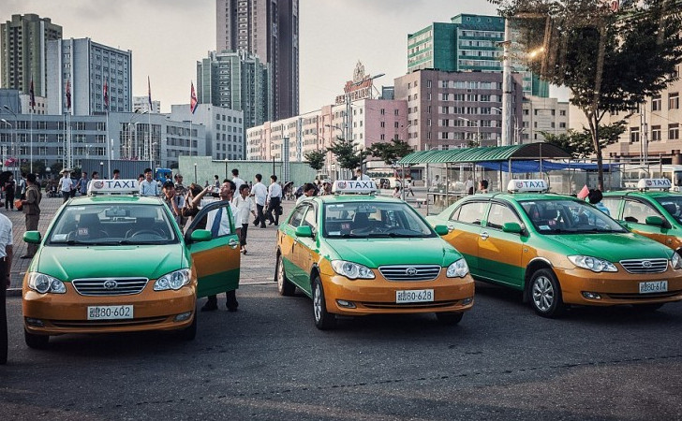
Interestingly, the taxi cabs are strictly for locals. Tourists are strictly prohibited from using the taxis for transportation.

Slide 29
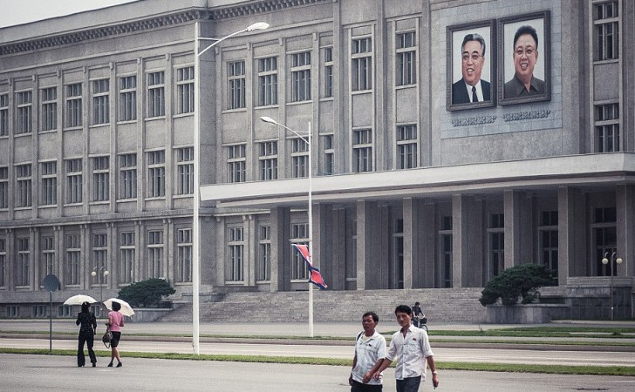
Interestingly, even though outside cameras are prohibited, the people in the photograph do not seem to have any qualms about being photographed, particularly in front of a government building.

Slide 30
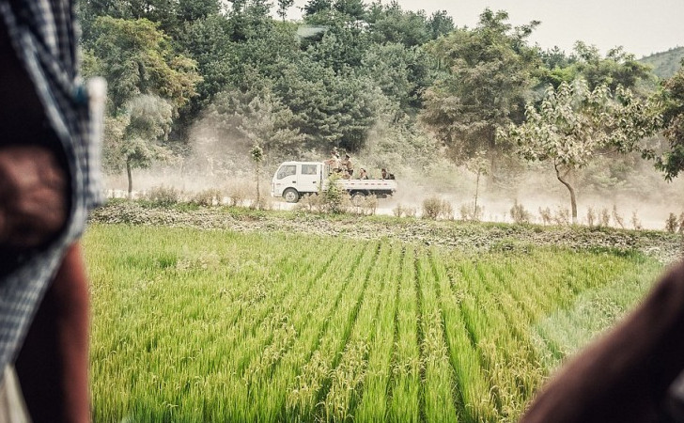
In the distance, we can see a group of soldiers sitting in the bed of a truck, which is not commonly how soldiers travel around.

Slide 31
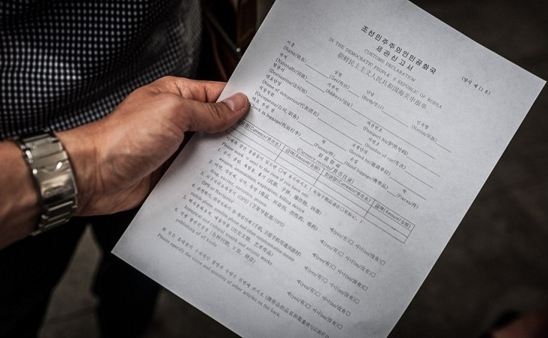
Along with many other restrictions, some of the items that are banned from entering the country include cameras, cell phones, and adult literature. Michal Huniewicz had to smuggle his camera in to capture some of these images.

Slide 32
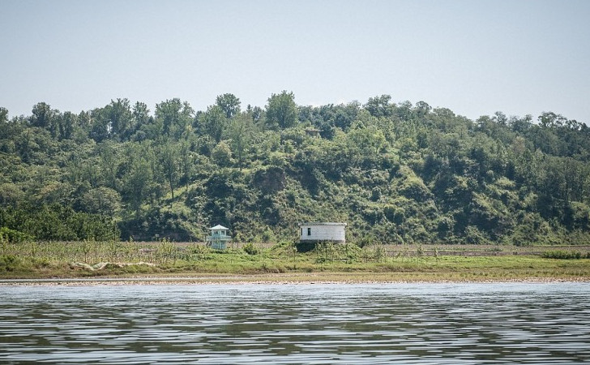
Even in the most obscure places, there are the eyes of the government watching and monitoring every person’s move.

Slide 33
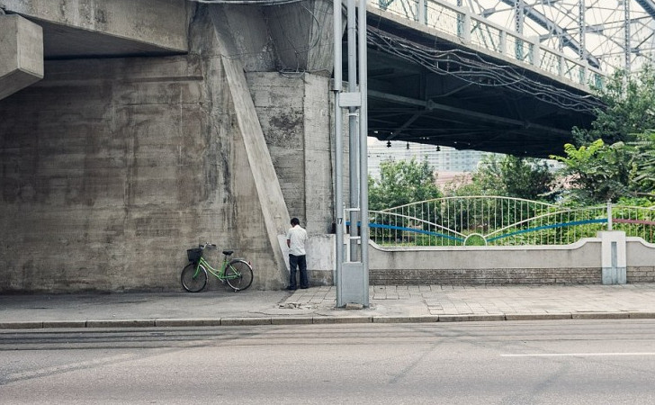
We’re not sure if this kind of activity is prohibited in North Korea as well, but nothing is stopping this man from answering nature’s call.

Slide 34
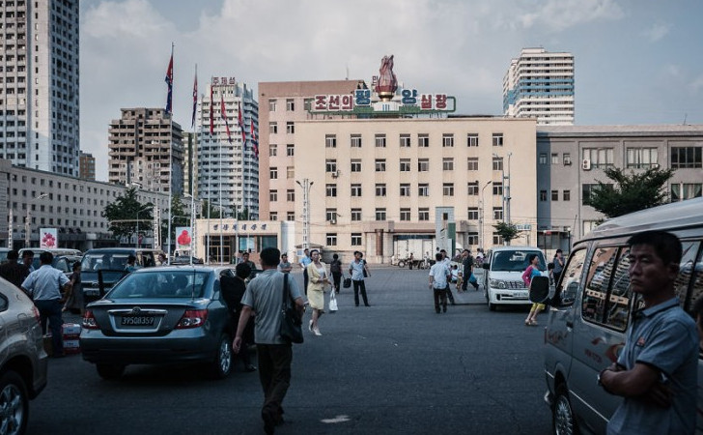
As a tourist in North Korea, you must be accompanied by a guide at all times, and the guide instructs you on when to sleep and eat. No freedom of choice, even for visitors.

Slide 35
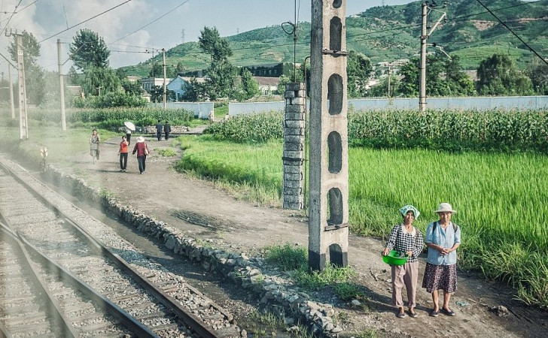
Since it is not common to own and drive a car in North Korea, most people walk or get around by bicycle, if they can afford it. Despite this, many roads in North Korea are paved.

Slide 36
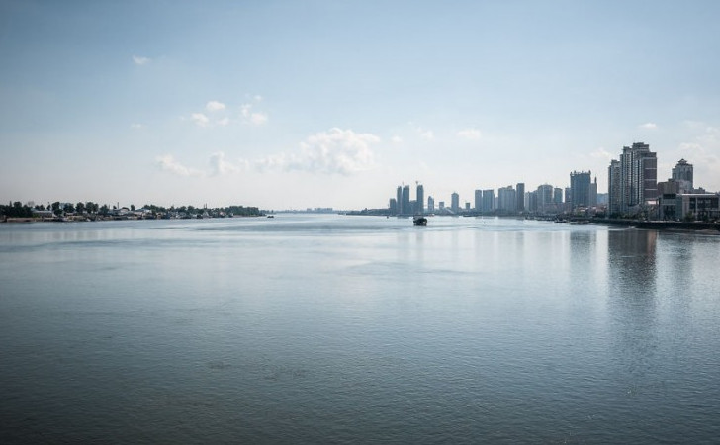
With China being separated by only a small body of water, we can see the stark differences between the two countries. One depleted and held back by its government, and the other standing tall with its skyscrapers and accomplishments.

Slide 37
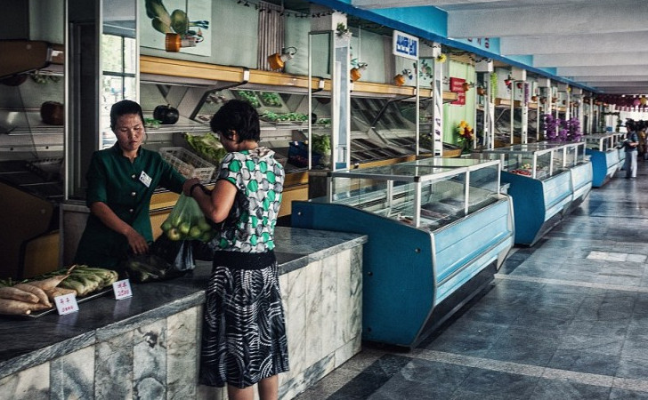
There is only enough produce to provide exactly what is needed, with no excess. For that reason, only locals are allowed to shop for food.

Slide 38
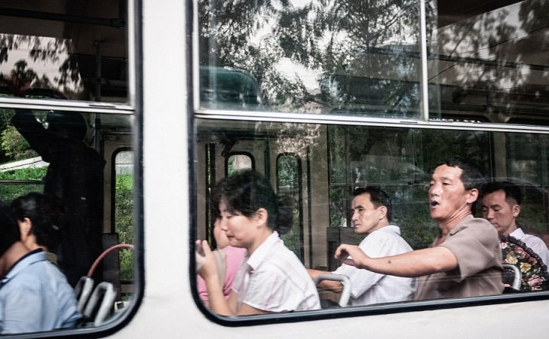
In order to take the bus and other public transportation, citizens of North Korea must obtain a valid permit.

Slide 39
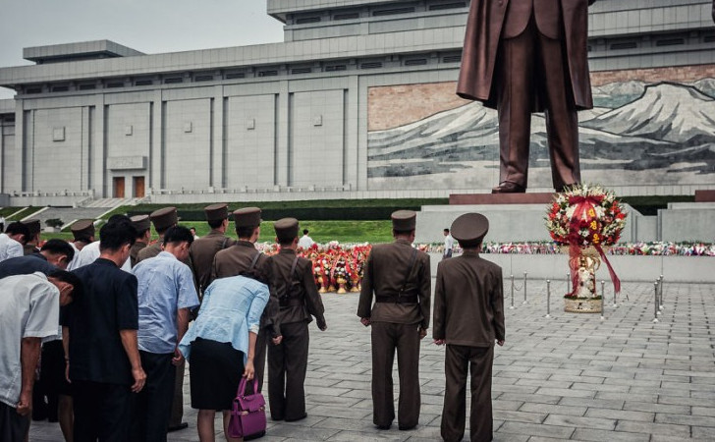
It is said that all photographs of statues must include the entire figure. In addition to smuggling in a camera, the photographer also broke this rule of the strict country.

Slide 40
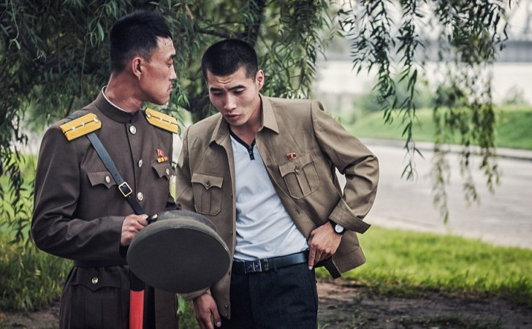
Though a risky photo to take, the photographer captured a real moment in which the soldiers are caught a little off-guard, looking a little less stern than usual.

Slide 41
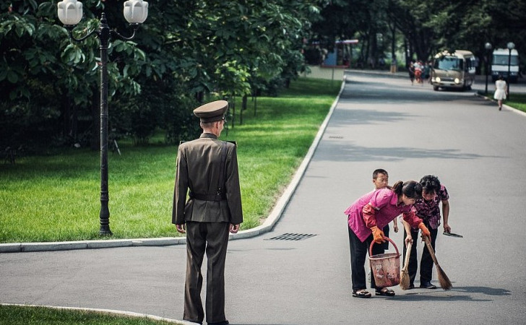
It is clear in this photo that law and order come first, as these two women and a child rush to clean the street in front of a guard, who is observing their every move.

Slide 42
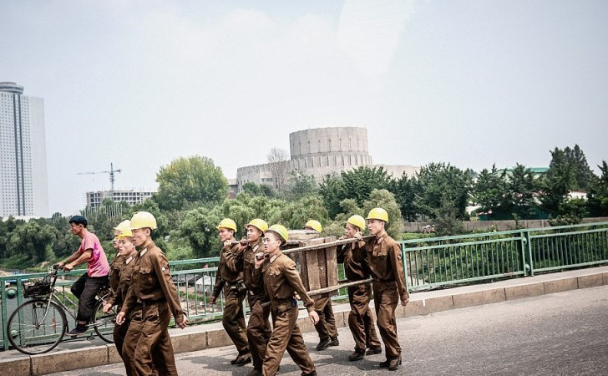
Engineers must carry their equipment from one side of the city to the other due to lack of funds that would allow easier and more convenient transportation.

Slide 43
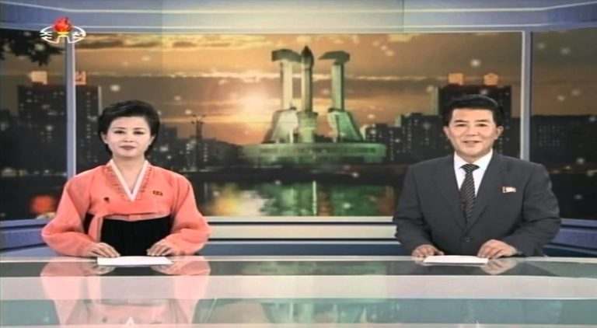
Television programming in North Korea is highly controlled and monitored, and there is only state provided programming. Additionally, apart from a controlled domestic network, there is no internet access in the country.

Slide 44
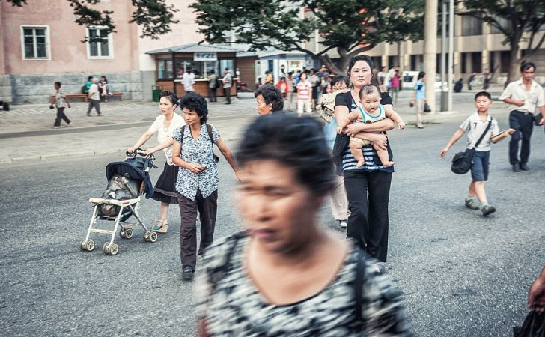
Dressed in similarly simple clothing, this is a glimpse of the daily lives of residents of North Korea.

Slide 45
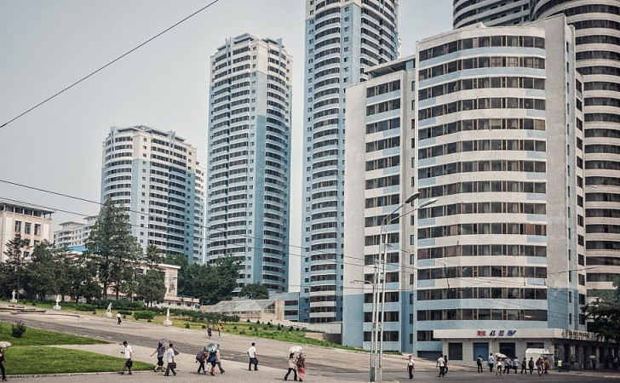
In contrast to the poverty that is commonly found in the rest of the country, capital city Pyongyang is gleaming and well developed.

Slide 46
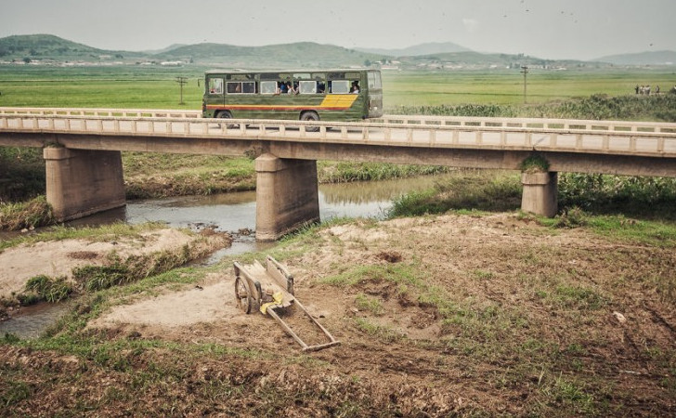
In addition to having to obtain a permit for public transportation, people must obtain a permit in order to travel to and from different places. This is yet another way for the government to monitor every person.

Slide 47
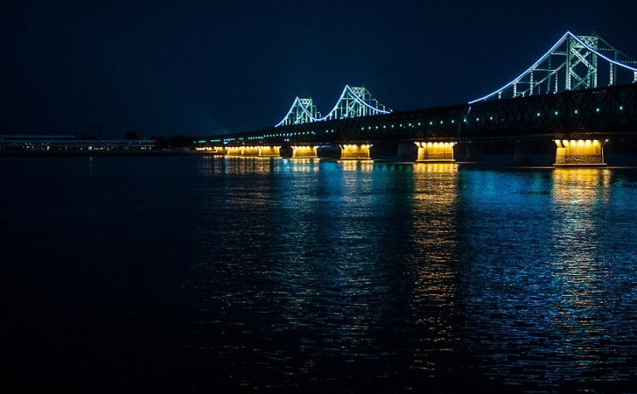
The Sino-Korean Friendship Bridge was built over the Yalu River, connecting the cities of Sinuiju, North Korea with Dandong, China. It was renamed to “Yalu River Bridge” in 1990. Pedestrians are not allowed to cross the bridge and it is one of the only ways to enter or leave the country.

Slide 48
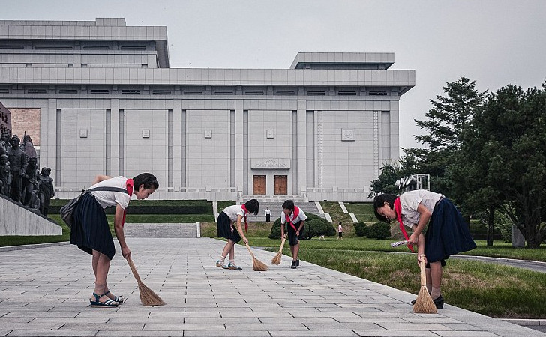
The streets of the city are to be kept clean at all times, and women in uniform attend to this rule.

Slide 49
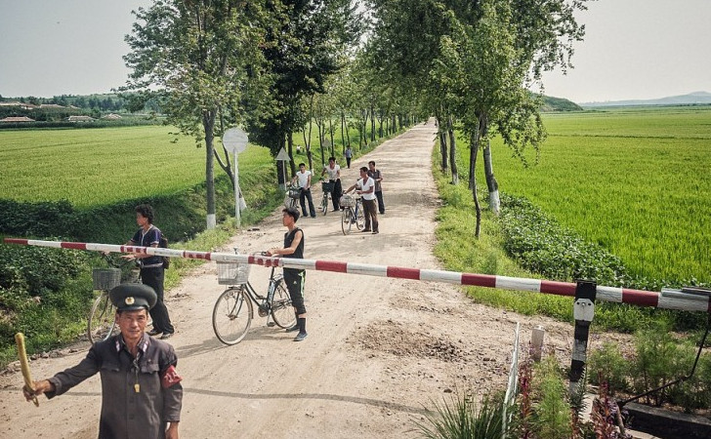
As a guard stands by to maintain order, people on bicycles wait for a train to pass before they can cross the path they are on.

Slide 50
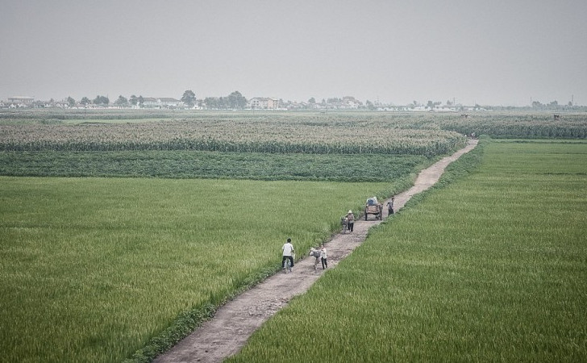
North Korea does not receive imports from other countries, therefore the crops that they cultivate are crucial for their sustenance and survival.

Slide 51
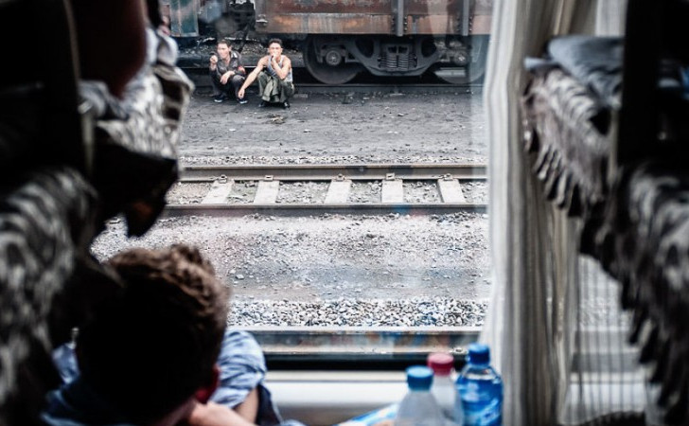
Human waste is converted into fertilizer, which is crucial for farming and cultivating the crops that are distributed all over the country.

Slide 52
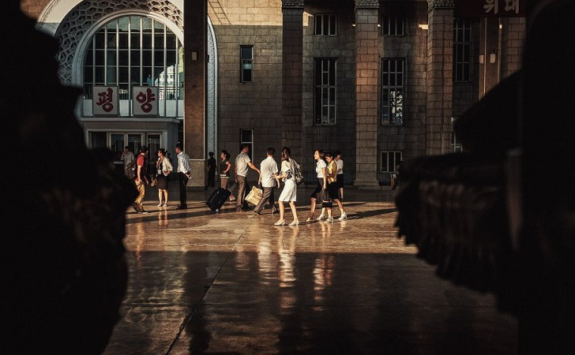
Even though there were no trains leaving that evening, there were people planted in the train station to make it seem as though there is free mobility available in the country. The government employs this tactic to try to portray an image of normalcy to the rest of the world.

Slide 53

The photographer who captured this photo was undertaking a very big risk by doing so, as he could have been arrested and his guide would have been tortured for participating in “espionage.”

Slide 54

Up to 200,000 civilians are imprisoned in North Korea. They are held in prison camps that are enclosed by electric fences. Some of the prisoners have been accused of political crimes, and many even have had their extended family imprisoned along with them.

Slide 55

Military and government officials are the only citizens allowed to own motor vehicles in this dictatorship.

Slide 56

There are 28 different approved haircut styles that North Korean women must follow. Unmarried women are only allowed to have short hair, while married women are presented with more options.

Slide 57

The missile program in North Korea was developed in the 1970’s along with help from the Soviet Union. This is still a huge hot button topic in international news today.

Slide 58

The vibrant greenery is juxtaposed against what looks like a deserted community. Meanwhile, young children play along the crops.

Slide 59

Here we see just how limited the mobility is of the North Korean people, as evidenced by this nearly deserted train station.

Slide 60

The common architecture style of buildings in North Korea is very simplistic and linear. You won’t easily find many varying or creative details in buildings.

Slide 61

Despite the strict rules normally associated with a dictatorship such as North Korea, did you know that marijuana is actually legal there?

Slide 62

North Korea actually has the largest stadium in the world. Rungnado May Day stadium can seat 150,000 people and regularly hosts extravagant sporting and national events.

Slide 63

The most popular attraction in North Korea is that of Kim Jong-il’s body, which is displayed in a glass case and is preserved for anyone, including foreign tourists, to see. You can find it at Kumsusan Memorial Palace.

Slide 64

Half of the country’s 24 million population live in extreme poverty. Most do have access to basic human needs. In this picture, taken in North Hamgyong province, school children are helping to fix a pot hole on one of the only roads in the area.

Slide 65

The image of a seamstress at work was captured in a factory in Sonbong, North Korea. The textile factory is what is called ‘an economic zone’, which the country has introduced in order improve the lives and economic situations outside of the capital of Pyongyang.

Slide 66

This North Korean soldier is walking past a ski slope that was being constructed in 2013 at Masik Pass. The country’s authorities have gone to great lengths to encourage participation in sports across the nation in recent years.

