Slide 1
Palm Sunday

Slide 2
Christians around the world celebrate Palm Sunday to remember the triumphant entry of Jesus Christ into Jerusalem on the Sunday before Easter.​ The occasion marks the beginning of the Holy Week, the most sacred days of the Christian calendar, leading up to the resurrection of Christ.

Slide 3
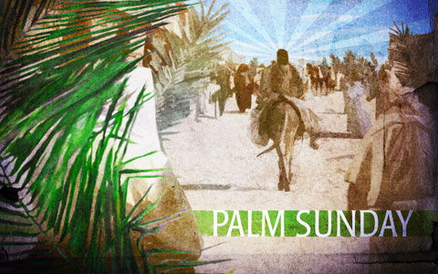

Slide 4
In the Bible, Saint John describes the happenings on Palm Sunday: "The next day the great crowd that had come for the Feast heard that Jesus was on his way to Jerusalem, they took palm branches and went out to meet him, shouting, 'Hosanna! Blessed is he who comes in the name of the Lord! Blessed is the King of Israel!"

Slide 5
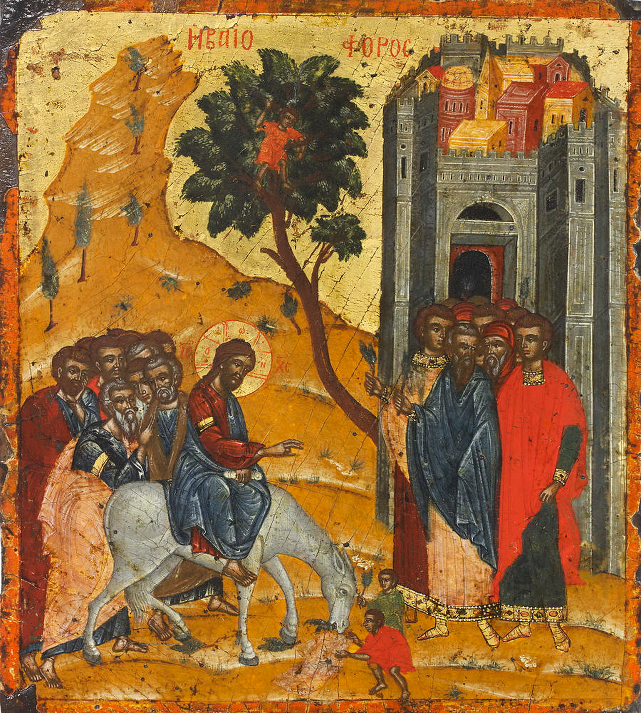
During Palm Sunday services, large palm branches are carried in procession to represent the palm branches the crowd scattered in front of Jesus as he rode into Jerusalem.

Slide 6
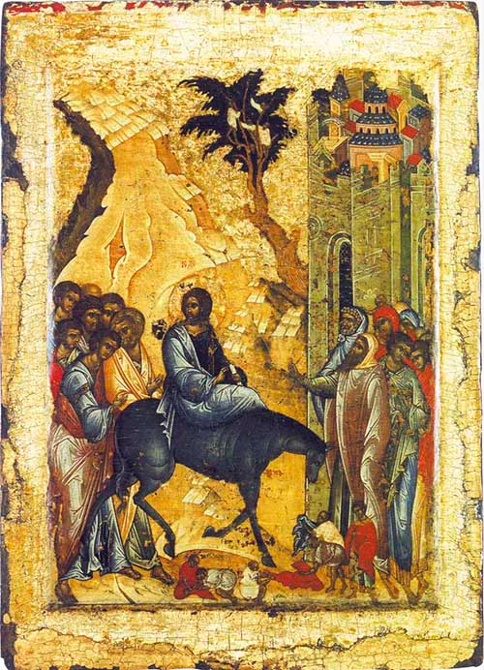
"Jesus found a donkey and sat upon it, as Scripture says: Do not fear, city of Zion! See, your king is coming, sitting on the colt of a donkey!"
- John 12:14

Slide 7
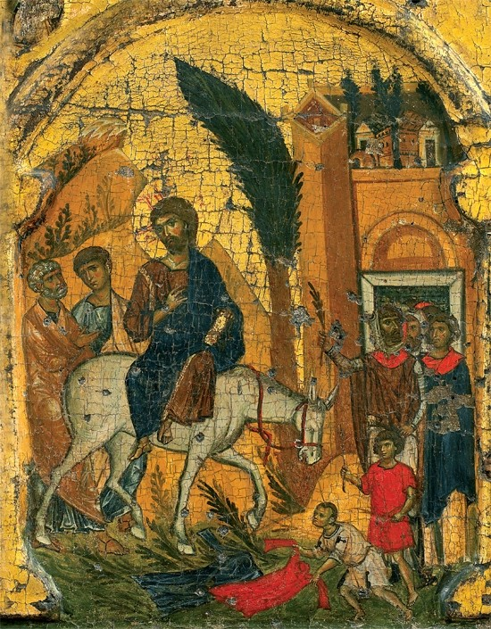
"Palm Sunday's thought; Life is full of ups and downs. Glorify God during the ups and fully trust in Him during the downs." - Unknown

Slide 8
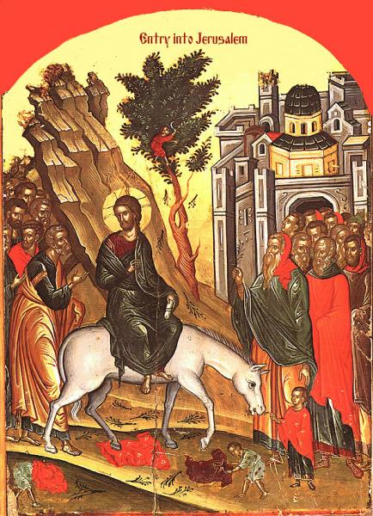
"Rejoice greatly, O daughter of Zion! Shout, daughter of Jerusalem! See, your king comes to you; righteous and having salvation, gentle and riding on a donkey, on a colt, the foal of a donkey." - Zechariah 9:9

Slide 9
