Slide 1
Looking Back on Change
“Time is a measure of change – either you change, or you die!”
Mary Jane Stephenson Naumann

Slide 2
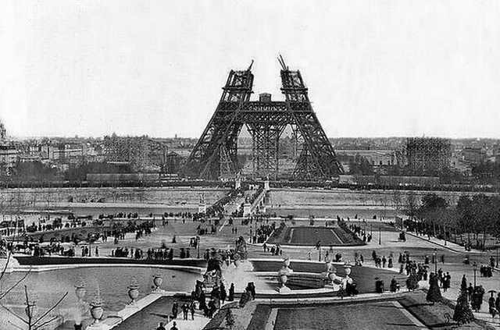
This was the tallest building in Paris, the Eiffel Tower under construction in the 1880's.

Slide 3
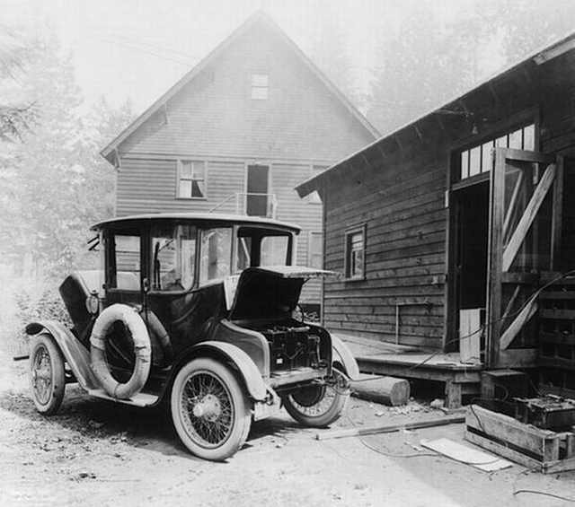
Charging your electric car looked like this, 1905.

Slide 4
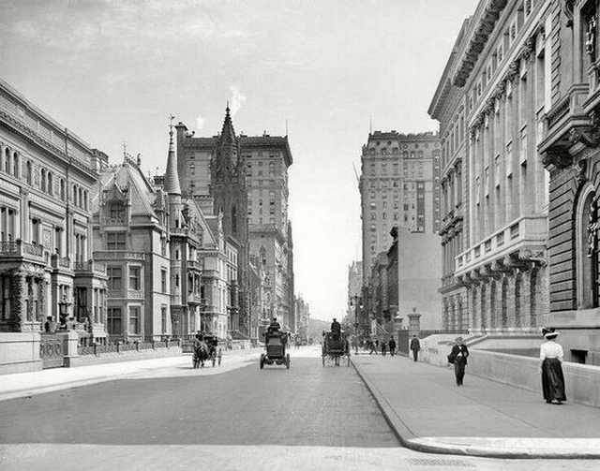
NYC was a much less busy city, 1908.

Slide 5
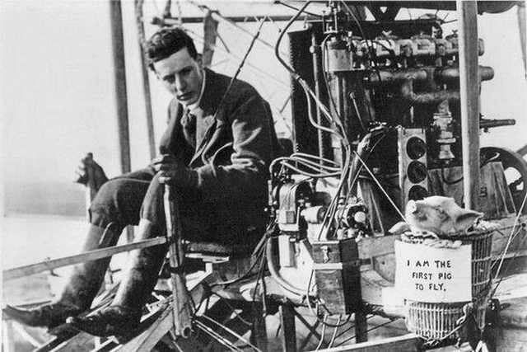
"I am the first pig to fly," 1909 (see pig in lower right of picture).

Slide 6
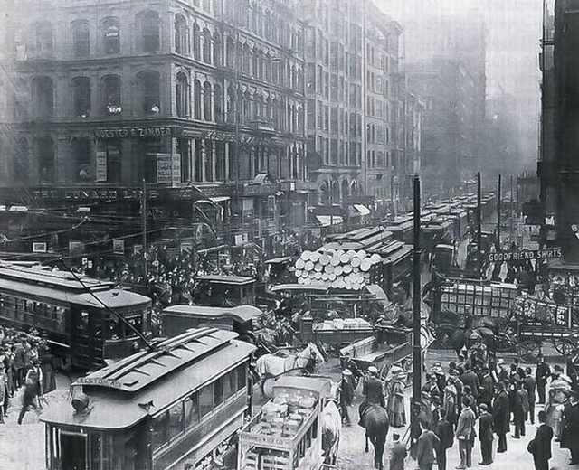
Rush hour in Chicago, 1909.

Slide 7
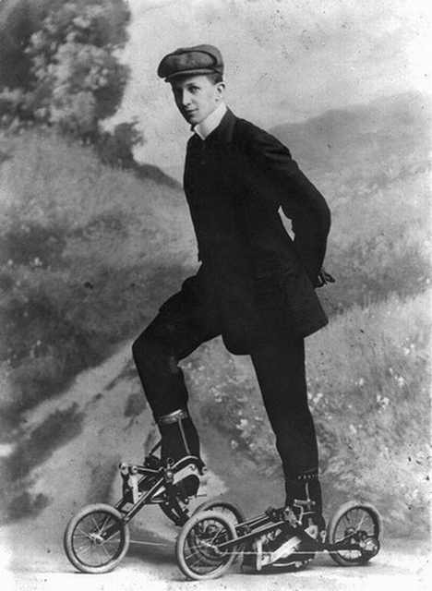
Roller skates were the hot new thing but still needed a bit of work, 1910.

Slide 8
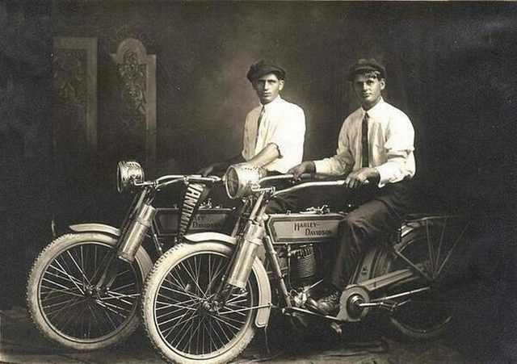
William Harley and Arthur Davidson unveiled their motorbikes for the first time, 1914

Slide 9
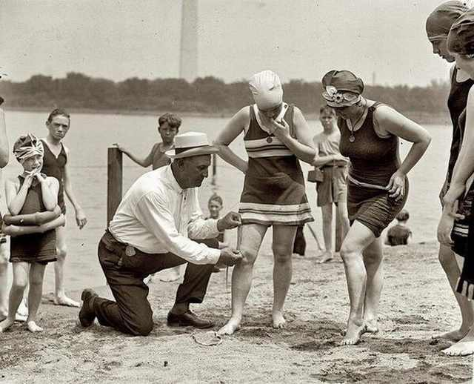
Beach Police Officers made sure no swimsuit was higher than 6 inches above the knee, 1922.

Slide 10
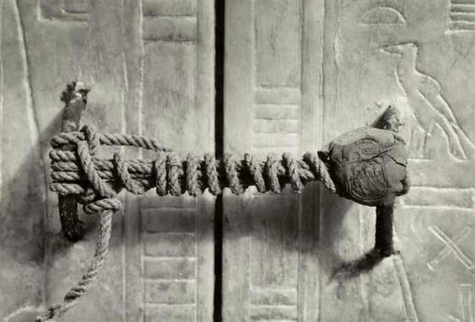
King Tut's slumber was undisturbed and the seal to his tomb was unbroken,1922

Slide 11
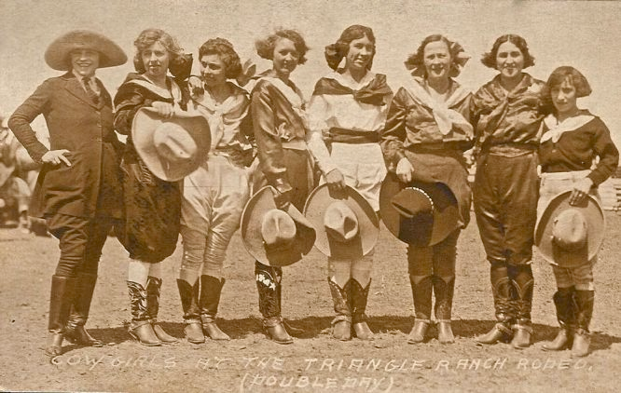
Cowgirls at the Triangle Ranch Rodeo in Cedar City, Utah, circa 1924.

Slide 12
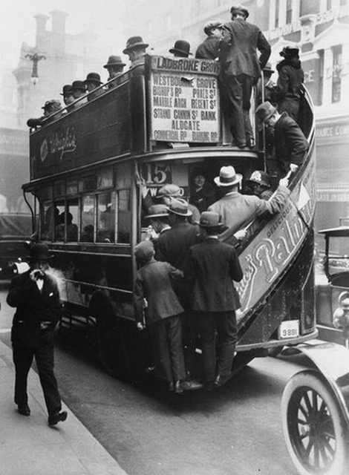
The iconic London buses looked like this, 1928.

Slide 13
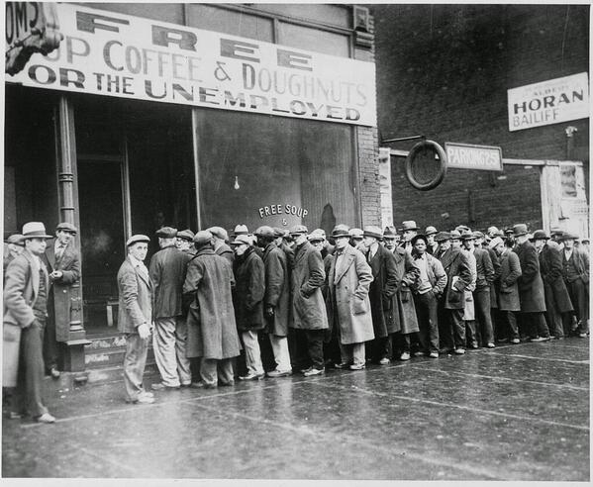
People queued for Al Capone’s free coffee in Chicago, 1931.

Slide 14
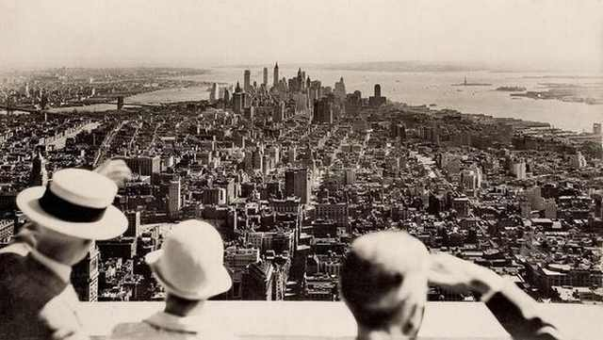
A new vantage point was introduced to New York on the opening day of the Empire State Building, 1931.

Slide 15
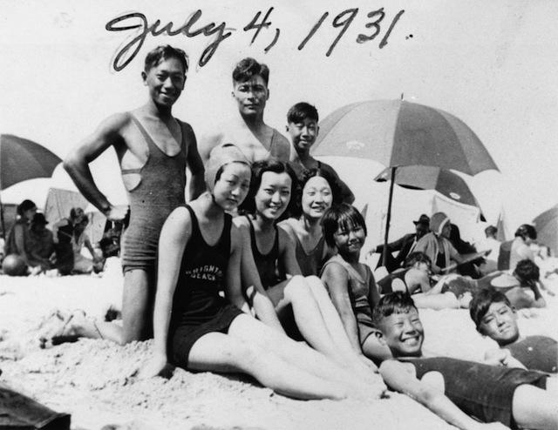

Slide 16
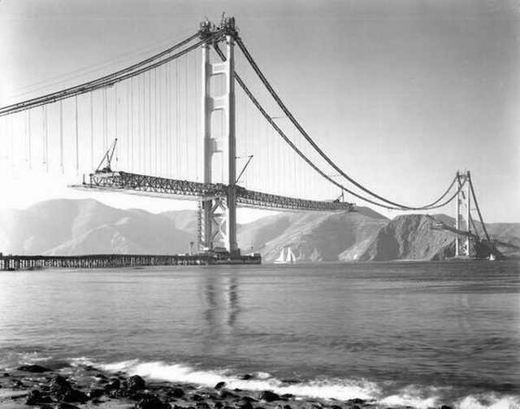
The Golden Gate Bridge was still under construction and looked like this, 1937.

Slide 17
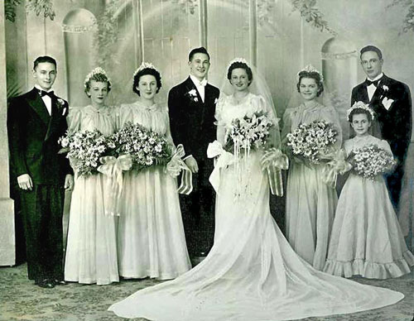
Wedding C. 1938

Slide 18
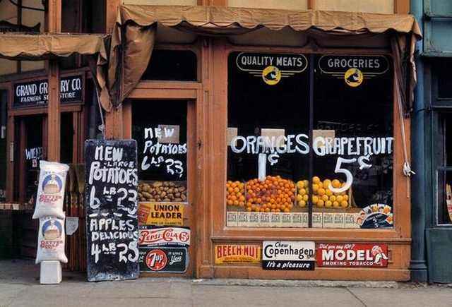
Oranges were sold for just one cent, 1942.

Slide 19
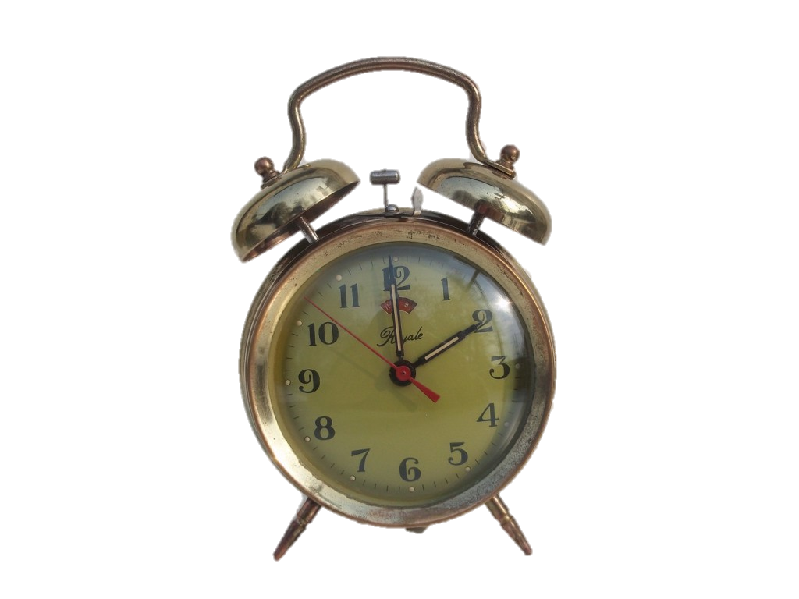
Alarm Clock 1940s

Slide 20
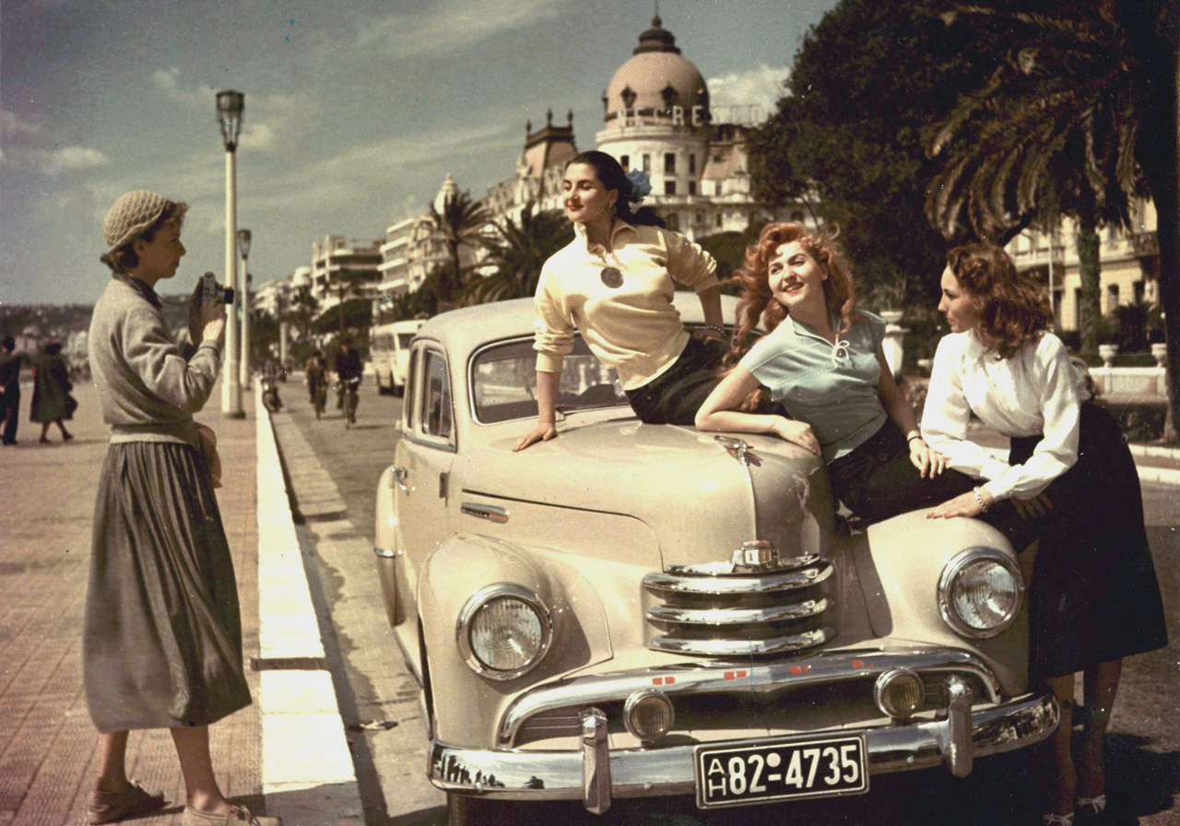
C. 1948

Slide 21
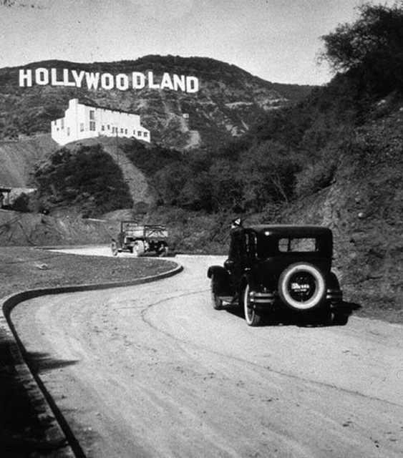
The Hollywood sign was still the 'Hollywoodland' sign. The last four letters were removed in 1949.

Slide 22
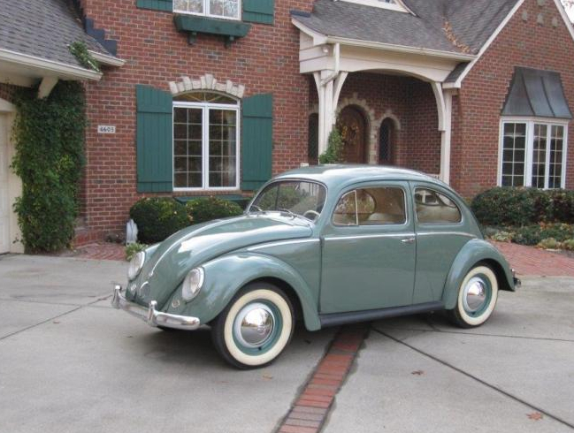
1952 VW

Slide 23
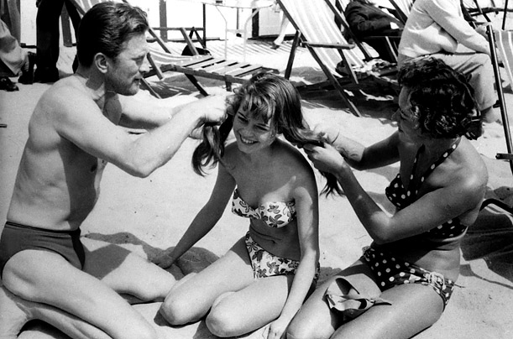
Brigitte Bardot gets her locks braided by Kirk Douglas in 1953

Slide 24
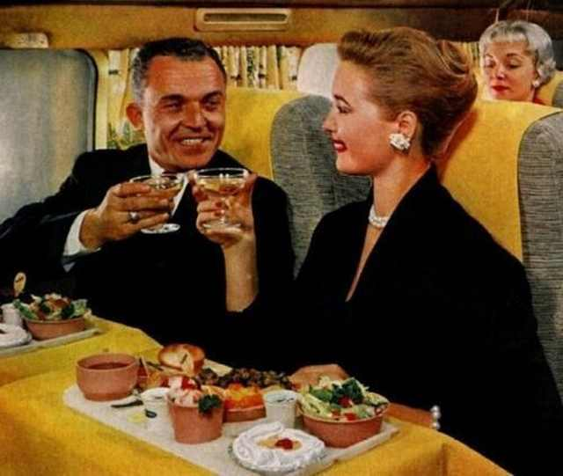
You got normal food and a full meal on flights, 1958.

Slide 25
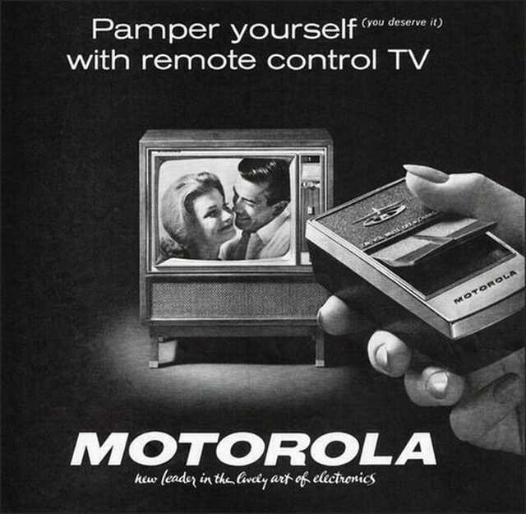
Remote controls were cutting-edge technology, 1962.

Slide 26
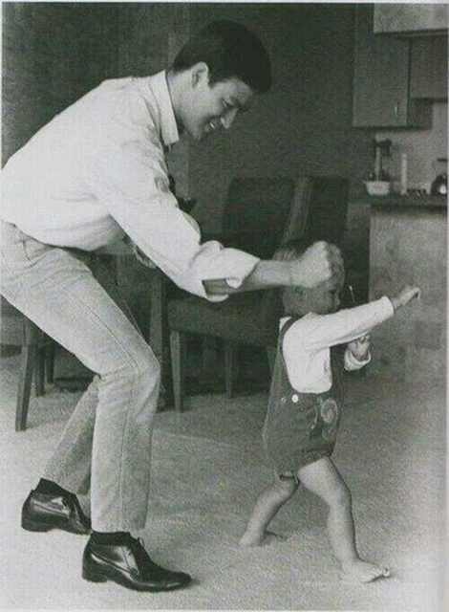
Legends passed on their legacies, Bruce Lee playing with his son Brandon, 1966.

Slide 27
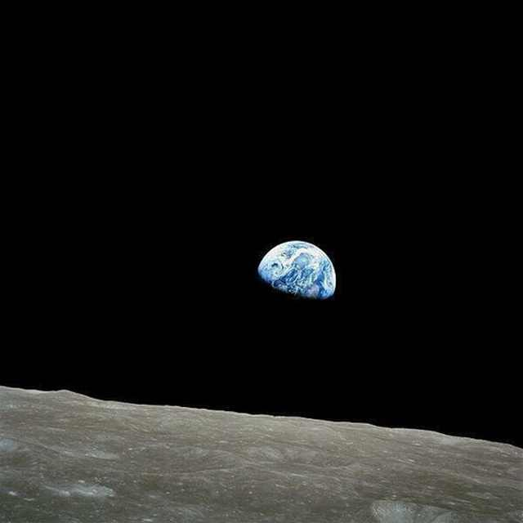
Gorgeous picture of the Earth, 1968.

Slide 28
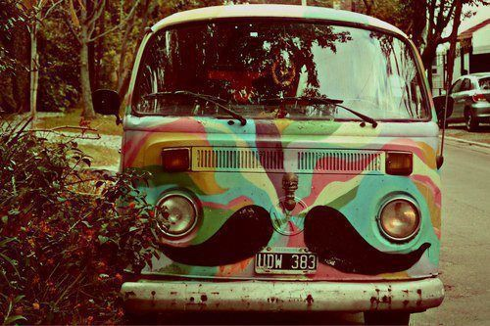
C. 1968

Slide 29
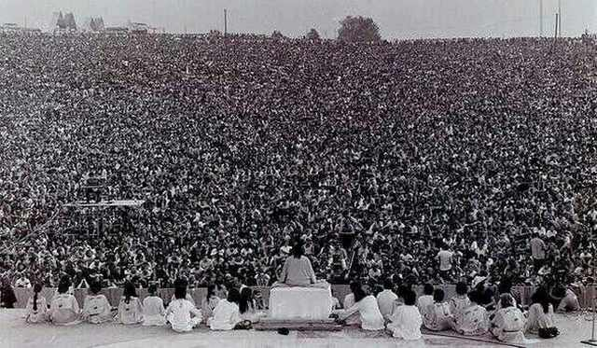
People at Woodstock, 1969.

Slide 30
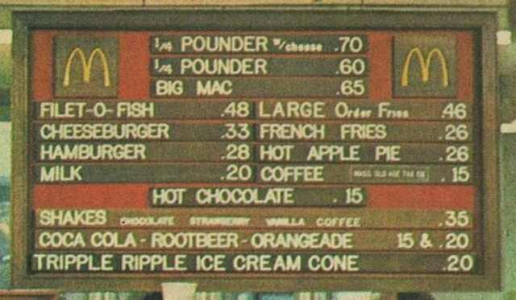
You could get a Big Mac for 65 cents, 1970's.

Slide 31
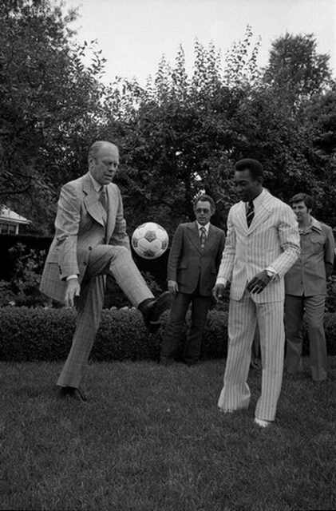
The President shows Pele his skills with a ball, Gerald R. Ford and Pele, 1975

Slide 32
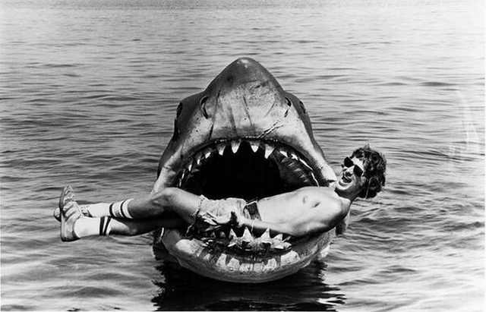
Steven Spielberg gave the world "Bruce", the prop that was used to make "Jaws" in 1975.

Slide 33
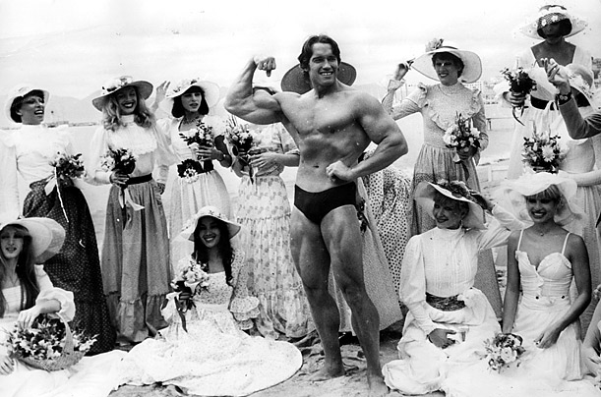
Arnold 1977 – Mr. Universe

