Slide 1
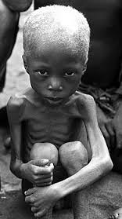
Life for More than Half of the People in the World
Out of sight, out of mind for most Americans

Slide 19
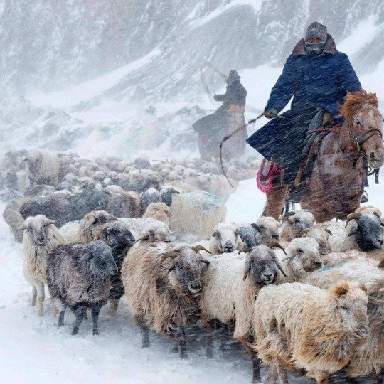

Slide 22
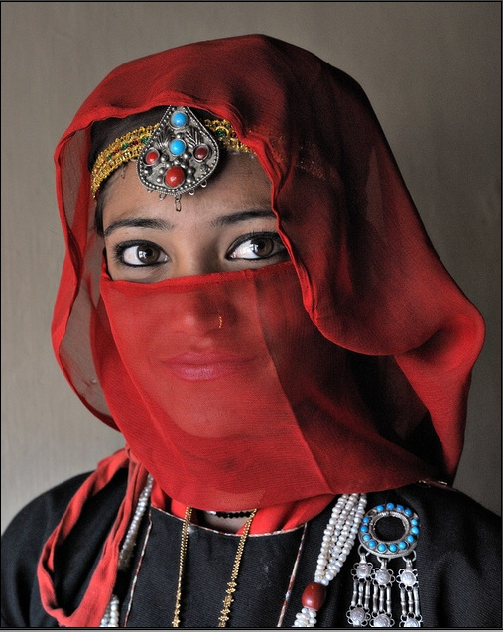

Slide 27
