Slide 1
Impressive Tiny Houses

Slide 2
The Crib
Located in West Virginia and designed by Broadhurst Architects, The Crib is 250 square feet of everything you need. Taken from the basic form of a traditional American corn crib, a common farm building used to store and dry corn, this tiny house combines functionality and sustainability with the use of recycled materials.
Its walls are made from polycarbonate panels to allow light to shine through, while the floor and roof are both made from structural insulated panels.
A custom-made piece of furniture in the interior is designed as a television wall that opens up into an office with plenty of built-in cabinetry and a ladder that provides access to a loft and sleeping area. But perhaps one of the coolest features in The Crib is the large glass wall that can be lifted up or pulled down to add outside access.

Slide 3
Paradise Of Relaxation
Always wanted to leave the hustle and bustle of the city? Live life on the water in the Floatwing by Portuguese firm Friday. This environmentally-friendly home relies on solar energy, a wastewater treatment plant with advanced tertiary treatment, and stored fuel for self-sufficiency. It can produce up to 100 percent of its annual energy needs in just over six months!
There are two levels to this eco-home: a floating deck and upper deck that doubles as a roof. Featuring a fully equipped kitchen, heat pump and AC generator, barbecue on the upper terrace, and pellet stove, this tiny house screams comfort and bliss. There’s even a wine cellar! The Floatwing comes in a variety of models, allowing you to opt for a studio up to a three-bedroom home for the whole family.

Slide 4
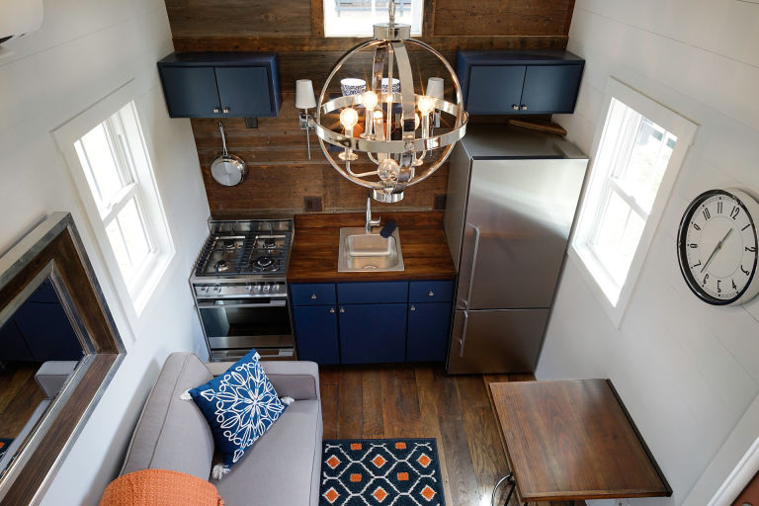
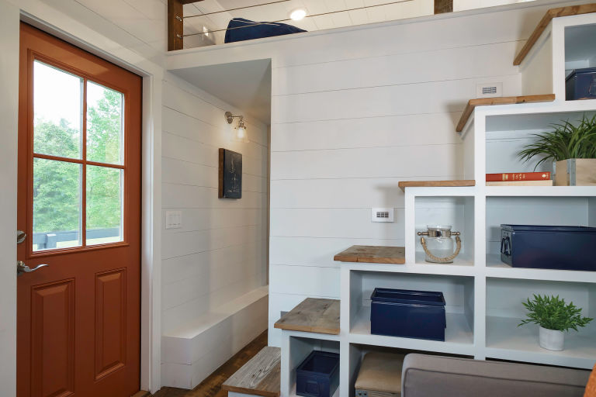
Bold And Blue
This 280-square-foot beauty breaks the rule of thumb that dark colors can’t be used in small spaces. The Indigo Tiny Home by Driftwood Homes USA pairs bold colors with white accents and rustic wood, a design choice we certainly can’t argue with.
As if the decor doesn’t already have you convinced, the layout is equally stunning. The kitchen comes fully-equipped with gourmet appliances and custom cabinets, while the living room boasts a ceiling high enough for a chandelier. There’s even enough space for you and a guest! The first floor master has a queen-sized, murphy bed in addition to an oversized loft. Bathroom and shower? It’s got that too. This incredible home can be all yours for $74,500, decor included.

Slide 5
Lucky Penny Cottage
Tiny home builders can pull inspiration from just about anywhere, even pennies. This 100-square-foot copper cottage built by Lina Menard is the perfect amount of space for her and her cat.
The copper-themed home features circular cedar shingles, an adorably curved-shaped door, and even a copper spray-painted freezer! And you can’t look past the space-maximizing tricks she used: her Japanese tansu dresser provides plenty of storage space, as do the overhead cubbies that double as a jungle gym and obstacle course for her cat. She also cut a hole into the bottom of a dresser drawer to fit the cat’s litter box. Even her mattress, which fits perfectly along the back wall, can fold open for more space.
And just in case she wants to escape her Portland community filled with other tiny home owners, Lina’s front porch can flip into a trailer hitch.

Slide 6
The Matchbox
The Matchbox, pictured on the right, looks just like its name suggests. This 140-square-foot tiny house is located in Boneyard Studios, founded in 2012 in the District of Columbia, and was designed by Jay Austin.
It’s rain catchment system, greywater management, composting toilet, fledgling garden, and state-of-the-art solar kit make this little abode fully off-grid, self-sustaining, and carbon-zero. Natural methods, like using earthen plaster clay instead of paint for humidity control and wide windows for passive cooling, scream sustainability at its finest.

Slide 7
Rooftop Balcony
Tiny house builders have big ideas, and for Tiny Heirloom, this one involves a genius rooftop deck.
On the first level of this cozy abode, you’ll find a kitchen complete with a full sink, stovetop, oven, and fridge. There’s also white cabinets paired with wooden countertops and an ample amount of windows to let the natural light shine through. Don’t forget about the washing machine hidden underneath the stairs! Because you’re going to want clean clothes after a day-long adventure. A ladder leads to the second level, a bedroom with a skylight and a separate space for storage that can double as a second sleeping spot.
Custom packages start at $79,000 and homes can be delivered anywhere in the continental U.S. free of charge within 90 to 120 days.

Slide 8
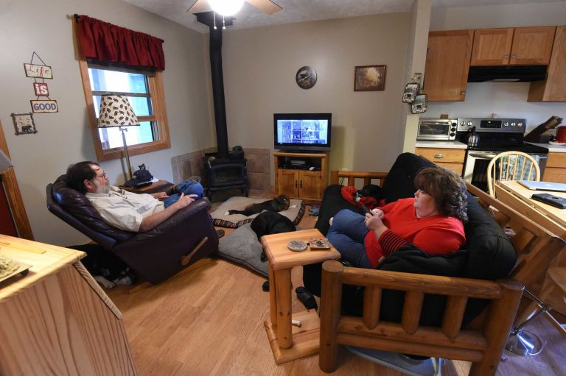
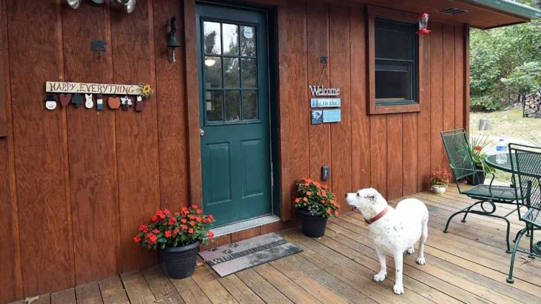
Kerri Fivecoat-Campbell, the author of the new book Living Large in Our Little House, ​ shares her first-hand perspective of living in a 480-square-foot house with her husband, six dogs, and one TV remote.​

Slide 9
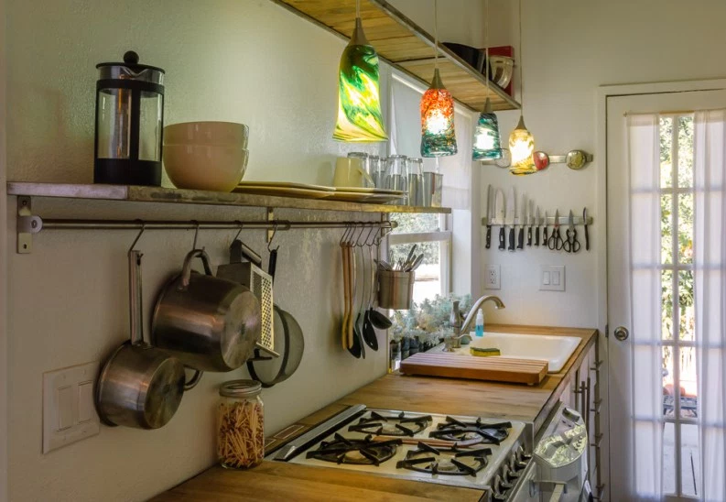
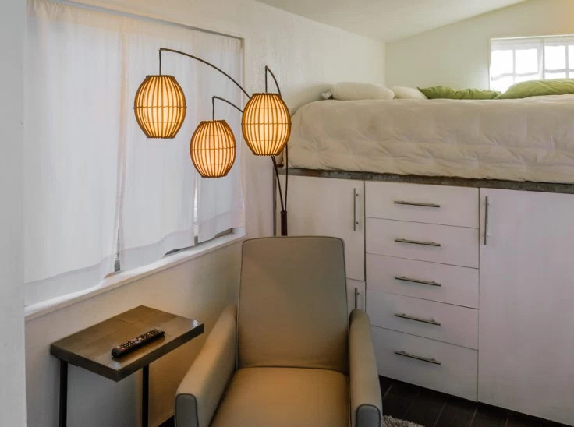
Minimalist
196 square feet and built at a cost of $11,000. Built on a 24 foot flatbed

Slide 10
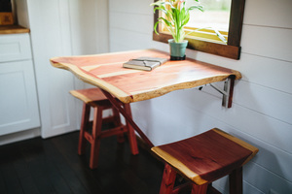
Dream Bungalow
204 square feet. Custom built.

Slide 11
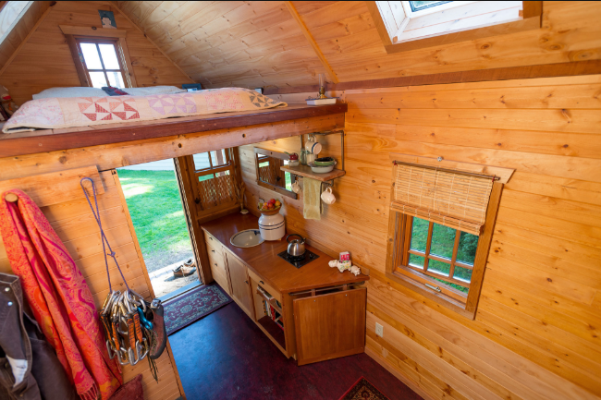
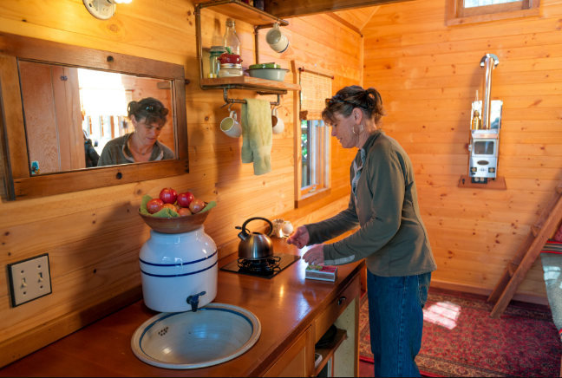
84 square foot – built on the bed of a truck trailer

